Slide 1


Slide 2
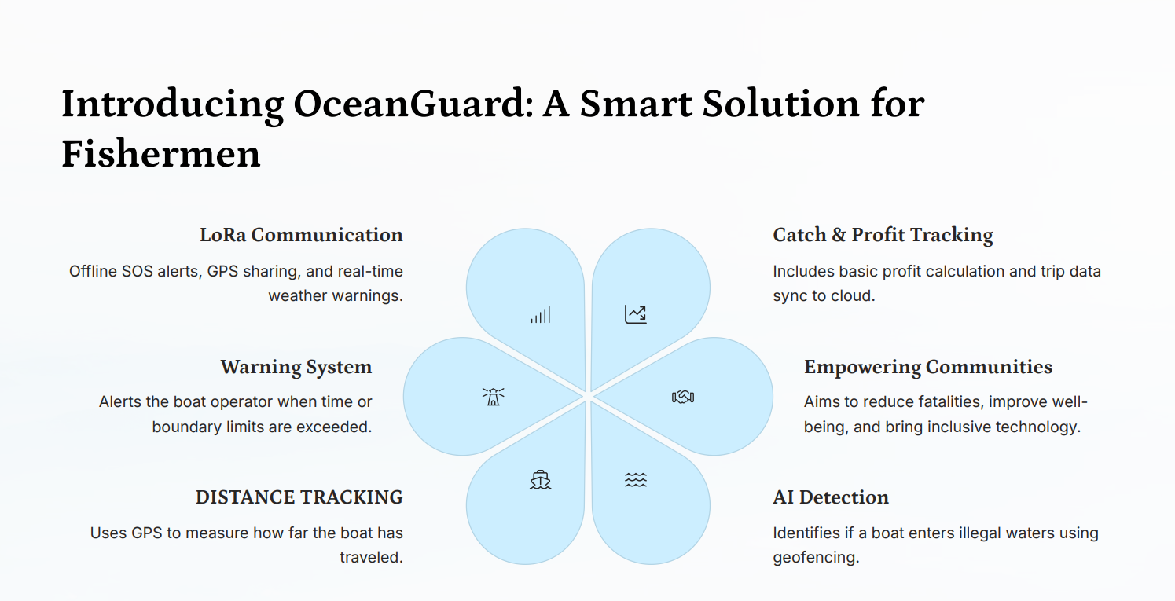

Slide 3
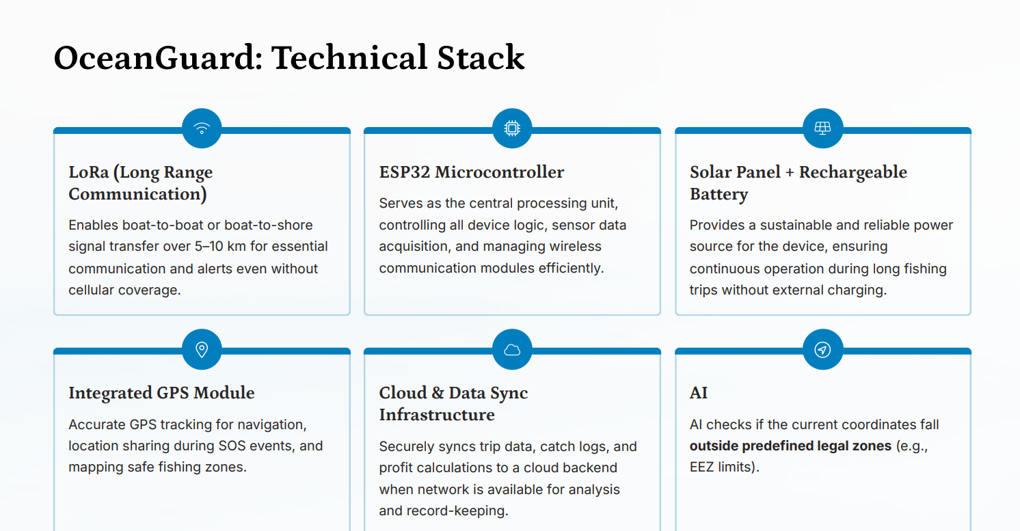

Slide 4
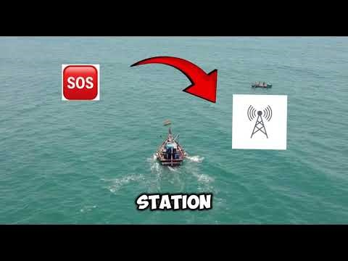
YOUTUBE DEMO VIDEO

Slide 5
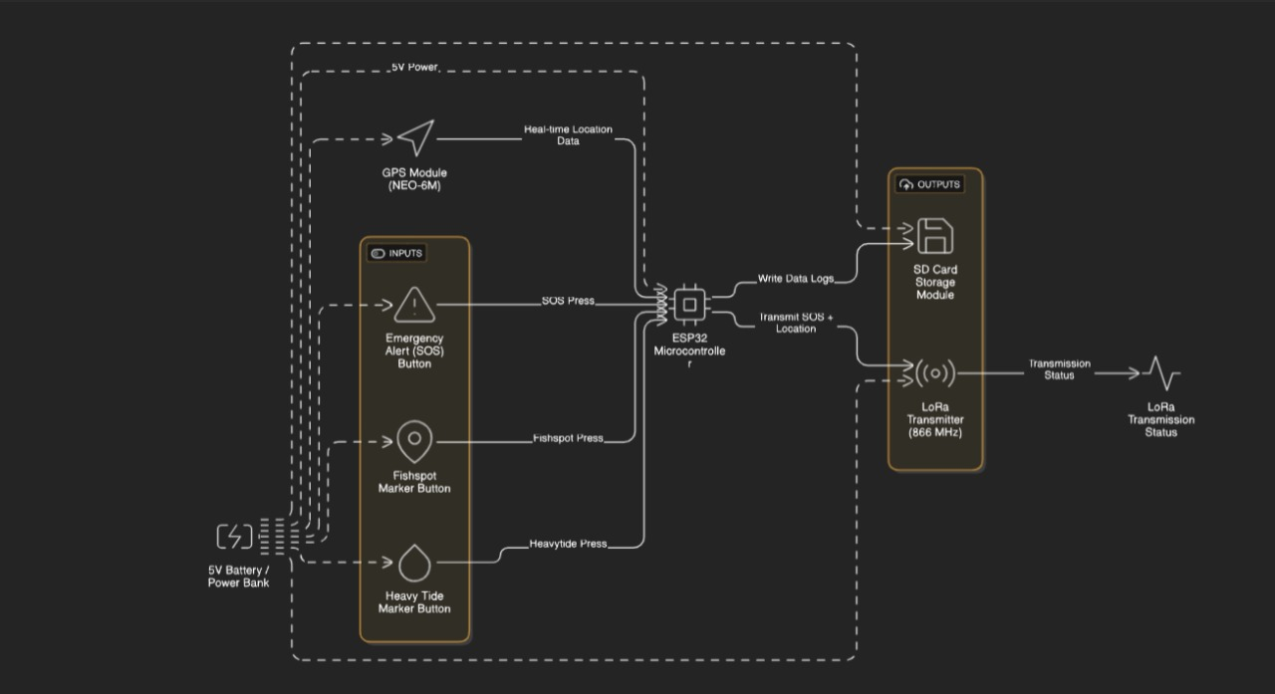
SYSTEM ARCHITECTURE

Slide 6
