Slide 1
Opioid Crisis Analysis
Data Semantics Presentation
CSE6242 Course Project

Slide 2
ARCOS Reference
ARCOS Field Reference
https://www.deadiversion.usdoj.gov/arcos/handbook/full.pdf
ARCOS Drug Data Dictionary Schema
https://www.deadiversion.usdoj.gov/arcos/ndc/readme.txt
ARCOS Drug Data Dictionary
https://www.deadiversion.usdoj.gov/arcos/ndc/ndcfile.txt

Slide 3
Sample Opioid Data from DEA
product_name | ingredient_name | ndc_no | quantity | unit | strength | dosage_unit | calc_base_wt_in_gm | dos_str | measure
OXYCODONE HCL 30MG TABLETS, USP | OXYCODONE HYDROCHLORIDE | 57664022488 | 1 | null | null | 100 | 2.6895 | 30 | TAB
OXYCODONE HYDROCHLORIDE 15MG TABLETS | OXYCODONE HYDROCHLORIDE | 00406851501 | 2 | null | null | 200 | 2.6895 | 15 | TAB
OXYCONTIN - 10MG OXYCODONE.HCL CONTR | OXYCODONE HYDROCHLORIDE | 59011010010 | 1 | null | null | 100 | 0.8965 | 10 | TAB
OXYCODONE.HCL ER 10MG TABS | OXYCODONE HYDROCHLORIDE | 68774016101 | 3 | null | null | 300 | 2.6895 | 10 | TAB
OXYCODONE HYDROCHLORIDE TABLETS 5MG | OXYCODONE HYDROCHLORIDE | 00406055201 | 5 | null | null | 500 | 2.24125 | 5 | TAB
COMBUNOX - 5MG / 400MG OXYCODONE.HCL | OXYCODONE HYDROCHLORIDE | 00456520001 | 1 | null | null | 100 | 0.44825 | 5 | TAB
OXYCODONE HCL/ACETAMINOPHEN 10MG/325 | OXYCODONE HYDROCHLORIDE | 00406052301 | 4 | null | null | 400 | 3.586 | 10 | TAB

Slide 4
Consider 1 Row
product_name | ingredient_name | ndc_no | quantity | unit | strength | dosage_unit | calc_base_wt_in_gm | dos_str | measure
OXYCODONE HCL 30MG TABLETS, USP | OXYCODONE HYDROCHLORIDE | 57664022488 | 1 | null | null | 100 | 2.6895 | 30 | TAB
Quantity
Unit
Strength
Dosage Unit
Calc_base_wt_in_gm
Dos_Str
Measure
What should we use?
Why are some NULL? How to interpret?

Slide 5
ARCOS Data – Major Fields Transaction Code
ARCOS Transaction Code:
4 Major Categories of Code
Inventory Transaction Code (Plain Report of Inventory) – 5 Codes
Acquisition Transaction Code (Addition to Inventory) – 8 Codes
Disposition Transaction Code (Reduction of Inventory) – 8 Codes
Miscellaneous – 3 Codes
NOTE: NOT ALL ROWS ARE EQUAL
Need to interpret correctly
WASH POST:
Has only Transaction code of ‘S’
‘S’ Stands for Selling – comes under ‘Reduction of Inventory’
One of the 8 codes for Reduction of Inventory!

Slide 6
ARCOS Data – Major Fields Action Indicator
ARCOS Action Indicator:
Related to Error Processing
Valid value can indicate (mostly this is null but still we may need to account)
D -> Deletion of a Record
A -> Revision (Adjustment) of a Record
I -> Insertion of a LATE Transaction Record
WASH POST:
Mostly Null
There are considerable records with non-null entries
We will need to account for this in our Analysis

Slide 7
ARCOS Data – Major Fields NDC Number
ARCOS NDC Number:
11-Character Code
5 + 4 + 2
( 5 ) Labeller Code -> Identifies Manufacturer or Distributor (FDA Allots this number)
( 4 ) Product Code -> Decided by the Labeler to indicate particular dosage/form/strength of a product
( 2 ) Package Code -> Developed by the Labeller. Can be different for different labellers
When ** -> Bulk product and this is where ‘Strength’, ‘Unit’ come into picture
National Drug Dictionary
For every NDC number, it captures full information about the product
Drug Dictionary
https://www.deadiversion.usdoj.gov/arcos/ndc/ndcfile.txt
Drug Dictionary Schema
https://www.deadiversion.usdoj.gov/arcos/ndc/readme.txt
WASH POST:
NDC number is there for all rows just like the original full table

Slide 8
ARCOS Data – Major Fields NDC Number
NDC Code : 00406851501
Labeller Code: 00406 (FDA Assigned)
Product Code: 8515 (Labeller Assigned)
Package Code: 01 (Labeller Assigned but documented in Drug Dictionary)
Look up the Drug Dictionary for this NDC Code
Know more about this NDC!
NOTE: This dictionary is NOT field separated.
It is CHARACTER INDEX based.
Go by the SCHEMA

Slide 9
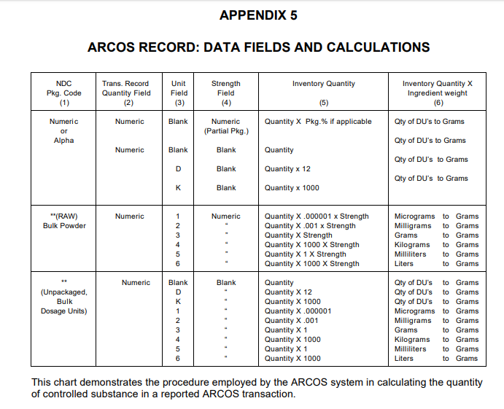
ARCOS Data – calc_base_wt_in_gm
All these Calculations are ALREADY DONE and reported in “calc_base_wt_in_gm” field!
This Table is ONLY FOR OUR CLARITY!
We don’t need to use QTY, UNIT, STRENGTH and DOSAGE fields at all.
Just use “calc_base_wt_in_gm” – This tells how much opioid substance was transferred by that Transaction!

Slide 10
DEA Calculations Explained
Report (A Row) can be in terms of PACKAGES
Quantity of Package
UNIT Modifier D or K (Dozen or Thousand Multiplier) (or) STRENGTH Modifier acting as Package %
Weight in Grams of sensitive substance from Drug Dictionary per Package
Report can be for Bulk
No Pre-Defined Dictionary Information (last 2 chars in NDC is **)
Information needs to be inferred from Quantity, Unit and Strength

Slide 11
DEA Calculation Illustrated For Non-Bulk QTY Based Reporting
ARCOS Entry (A Row)
NDC_NO last 2 digits is 88 and hence QTY based Reporting
product_name | ingredient_name | ndc_no | quantity | unit | strength | dosage_unit | calc_base_wt_in_gm | dos_str | measure
OXYCODONE HCL 30MG TABLETS, USP | OXYCODONE HYDROCHLORIDE | 57664022488 | 1 | null | null | 100 | 2.6895 | 30 | TAB
Drug Dictionary Entry for NDC
576640224881 12 1 OXYCODONE HCL 30MG TABLETS; 100 TABL000100000TAB 9143.005 OXYCODONE HYDROCHLORIDE 0000026895000
From Dictionary Schema:
Package Quantity Code = 000100000
Package Quantity = Qty Code with a decimal before the last 3 digits = 000100.000 = 100
Total Package Quantity = 100 * 1 = 100
Ingredient Base Weight Code = 0000026895000
Ingredient Base Weight = Decimal before the last 7 digits = 000002.6895000 = 2.6895 Grams
Total Ingredient Base Weight = 2.6895 * 1 = 2.6895
CONCLUSION: 1 PACKAGE QUANTITY CONSISTS OF 100 UNITS (tablets) and the amount of sensitive substance is 2.6895 GRAMS

Slide 12
DEA Calculation Illustrated For Non-Bulk QTY Based Reporting
ARCOS Entry (A Row)
NDC_NO last 2 digits is 01 and hence QTY based Reporting
product_name | ingredient_name | ndc_no | quantity | unit | strength | dosage_unit | calc_base_wt_in_gm | dos_str | measure
OXYCODONE HYDROCHLORIDE TABLETS 5MG | OXYCODONE HYDROCHLORIDE | 00406055201 | 5 | null | null | 500 | 2.24125 | 5 | TAB
Drug Dictionary Entry for NDC
004060552011 12 1 OXYCODONE HYDROCHLORIDE TABLETS 5MG 000100000TAB 9143.005 OXYCODONE HYDROCHLORIDE 0000004482500
From Dictionary Schema:
Package Quantity Code = 000100000
Package Quantity = Qty Code with a decimal before the last 3 digits = 000100.000 = 100
Total Packages = 5
Total Package Quantity = 100 * 5 = 500
Ingredient Base Weight Code = 0000004482500
Ingredient Base Weight = Decimal before the last 7 digits = 000000.4482500 = 0.44825 Grams
Total Ingredient Base Weight = 0.44825 * 5 = 2.24125 Grams
CONCLUSION: 5 PACKAGE QUANTITY CONSISTS OF 500 UNITS (tab) and the amount of sensitive substance is 2.24125 GRAMS

Slide 13
DEA Calculation Illustrated Bulk Reporting
NDC Number ends with **
Bulk Entry
ARCOS Entry
product_name | ingredient_name | ndc_no | quantity | unit | strength | dosage_unit | calc_base_wt_in_gm | dos_str | measure
HYDROCODONE BIT/ACETA 5MG/325MG USP | HYDROCODONE BITARTRATE HEMIPENTAHYDRATE | 004060365** | 5820 | null | null | 5820 | 17.61714 | 5 | TAB
Drug Dictionary Entry for NDC
004060365**1N12 1 HYDROCODONE BIT/ACETA 5MG/325MG USP 000001000TAB 9193.068 HYDROCODONE BITARTRATE HEMIPENTAHYDRATE 0000000030270
Since this is BULK and no UNIT and STRENGTH are given, we can simply multiply the Quantity with Ingredient weight
Ingredient weight = 000000.0030270 * 5820
= 0.003027 * 5820
= 17.61714
Explains the DEA calculation for ‘calc_base_wt_in_gm’

Slide 14
calc_base_wt_in_gm
We can use this field to know the “Sensitive Substance” amount in each and every DEA ARCOS entry
For all Summations and Metrics to know how much Opioid reached a county, we can SUM this field

Slide 15
dos_str Field – Where does this come from?
product_name | ingredient_name | ndc_no | quantity | unit | strength | dosage_unit | calc_base_wt_in_gm | dos_str | measure
OXYCODONE HCL 30MG TABLETS, USP | OXYCODONE HYDROCHLORIDE | 57664022488 | 1 | null | null | 100 | 2.6895 | 30 | TAB
This is REALLY of no consequence in the Calculations….
Just Recording the Observation!

Slide 16
Washington Post Data
How is it different from Full Data?
It turns out that the following SQL on Full Data matches the Number of Rows in Washington Post Data
select count(*) from dea_arcos_full_string where transaction_code = 'S' and ((drug_code = '9193') or (drug_code = '9143')) and measure = 'TAB' and buyer_bus_act in ('PRACTITIONER-DW/30', 'CHAIN PHARMACY', 'PRACTITIONER', 'RETAIL PHARMACY', 'PRACTITIONER-DW/275', 'PRACTITIONER-DW/100' )
It eliminates DISTRIBUTOR <-> DISTRIBUTOR chain sales
It only looks for “Sale” based disposition of Sensitive Substances
Filters out Additions to Inventory, Inventory Reports, Miscellaneous Reports and Reduction Entries apart from Sales
Only 2 Drugs of Interest and TABLET prescriptions
RECEIVER is one of the Types listed in SQL. There are several other types which are not considered.
Not clear what is the specialty of this group. We may have to find this out.

