Slide 1
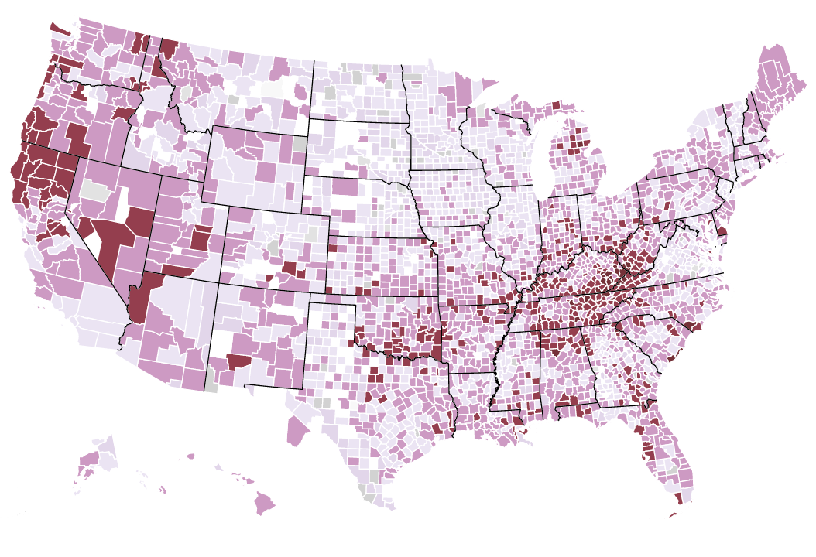
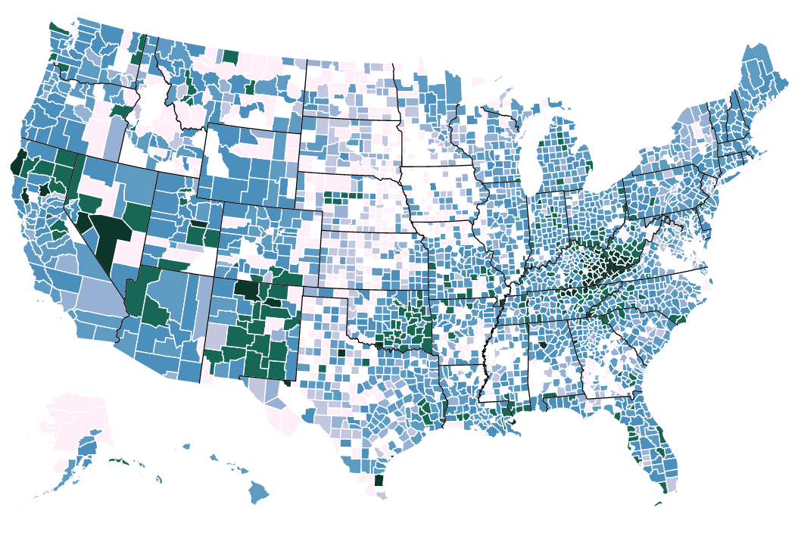
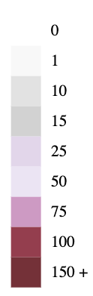
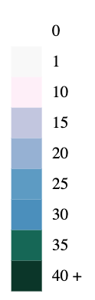
Number of Pills Per Person Per Year
Opioid Deaths
Average County yearly total 2006 - 2012
Cumulative Opioid death rate 2006 - 2012

Slide 2
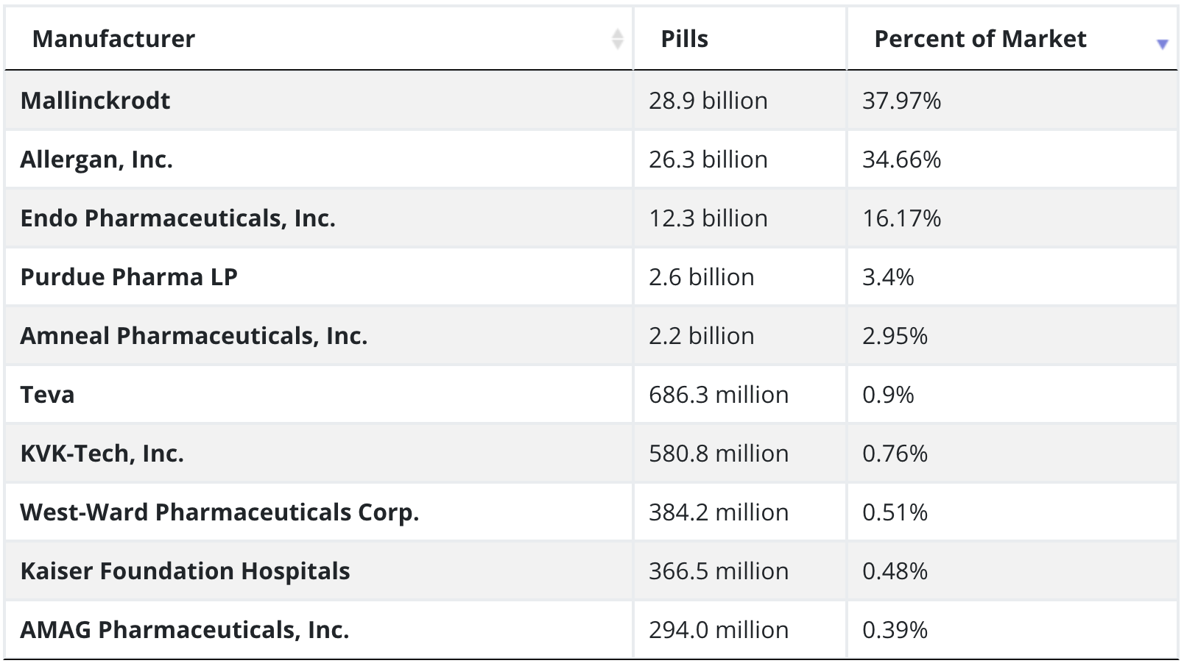
Top pill manufacturers, 2006 through 2012

Slide 3
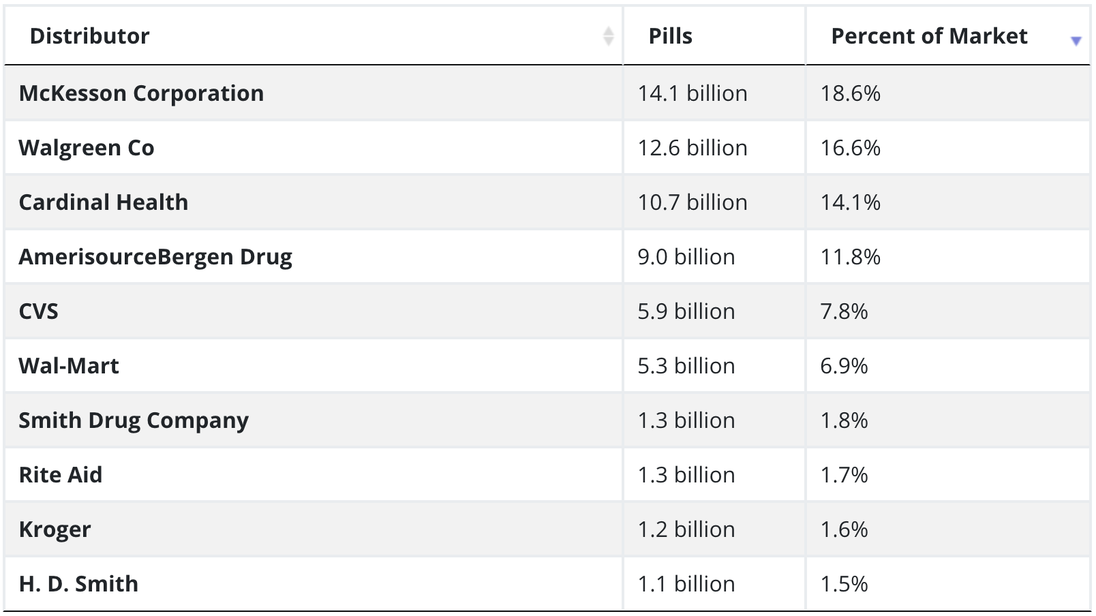
Top pill distributors, 2006 through 2012

