Slide 1
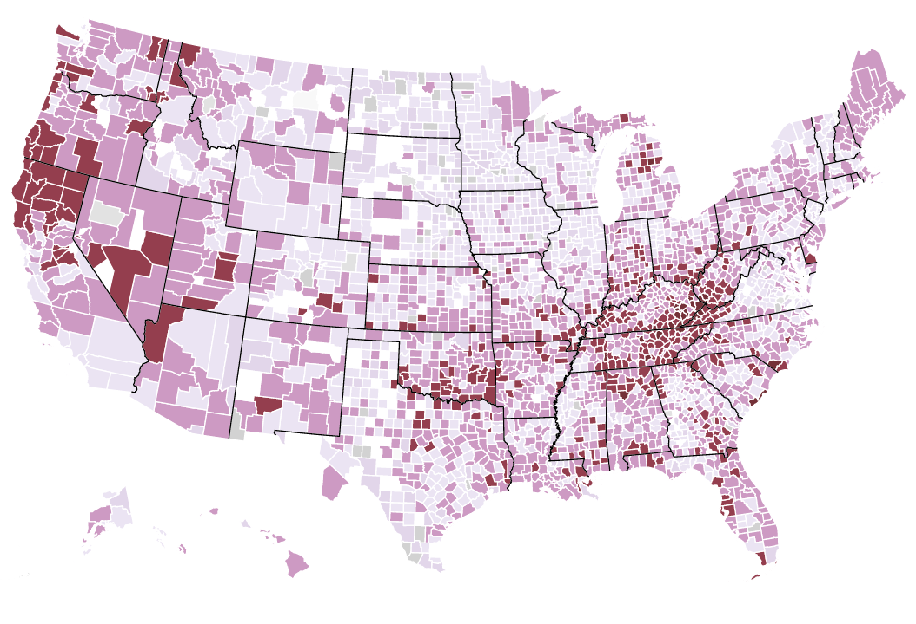
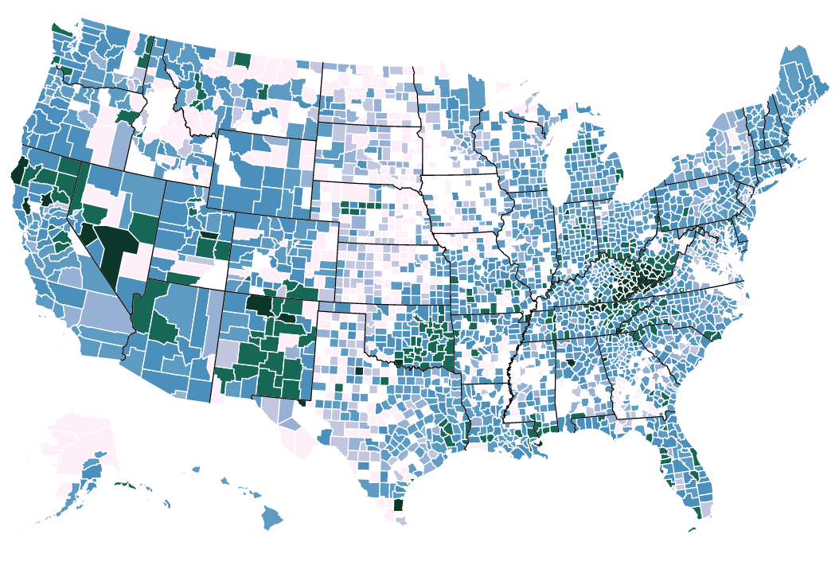
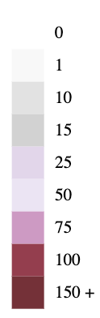
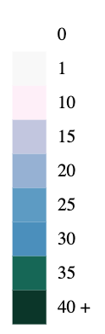
Number of Pills Per Person Per Year
Opioid Deaths
Average County yearly total 2006 - 2012
Cumulative Opioid death rate 2006 - 2012

