Slide 1
Wikispeedia Network Analysis
Elijah DiFuria, Kian Jadbabaei, Harrison Funk, Jayden Gould

Slide 2
What is Wikispeedia?
Wikispeedia is an online game where users attempt to navigate from one Wikipedia article to another using only hyperlinks embedded in the articles.
The goal is to start from Article A and finish at Article B in as fewest clicks as possible.
We model it as a directed network articles are nodes and hyperlinks are edges
This particular dataset uses a smaller version of Wikipedia with only 4,592 nodes (articles) and 119,000+ edges (hyperlinks)

Slide 3
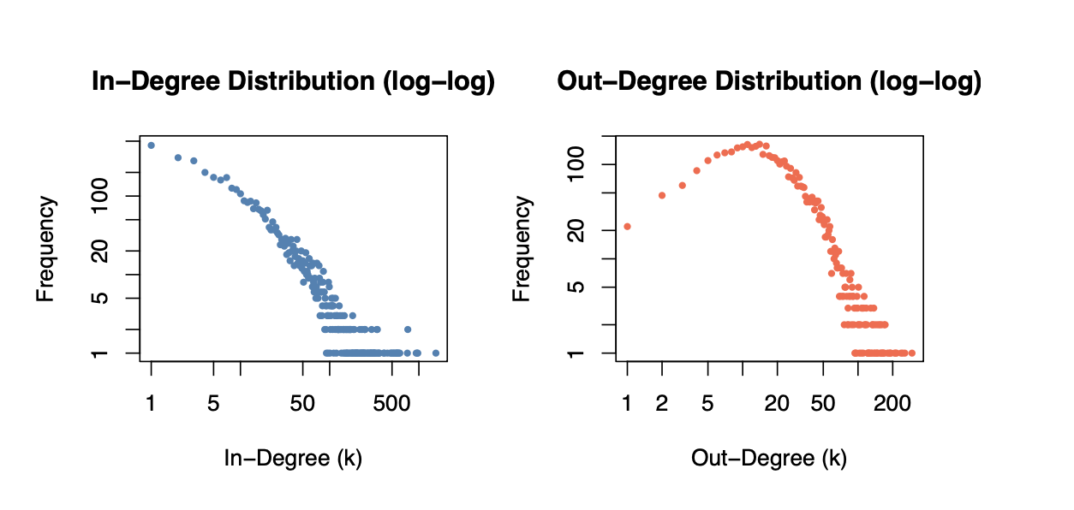
Network Structure
Diameter = 9, average path length = 3.18 → small-world network
Reciprocity = 0.221 → 22% of links are mutual
Clustering coefficient = 0.103
In-degree is heavy-tailed: a few mega-hubs, most articles barely linked
The out-degree distribution is somewhat less skewed, since the number of outgoing links depends more on how detailed an article is.

Slide 4
Network Visualizations
We sampled 4 random subgraphs of 200 nodes each from the full network
Nodes are colored by Wikipedia category and sized proportionally to their degree
Three layout algorithms used for each subgraph:
Fruchterman-Reingold: force-directed, pulls high-degree hubs to the center
Kamada-Kawai: positions nodes so graph distances match geometric distances (# of clicks)
Circular: arranges all nodes in a ring, making edge density easy to see
Across all layouts: well-connected hub nodes cluster at the center, low-degree nodes pushed to the periphery
Circular layout makes it clear edges are not evenly distributed, some regions are far more densely connected

Slide 5
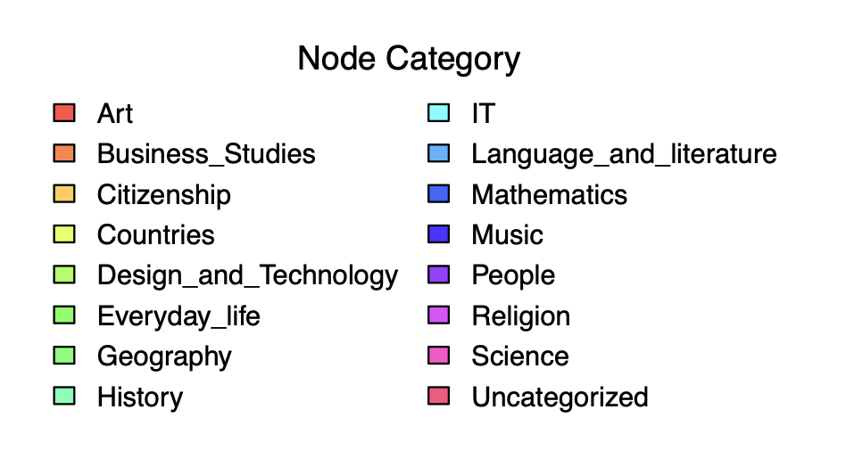
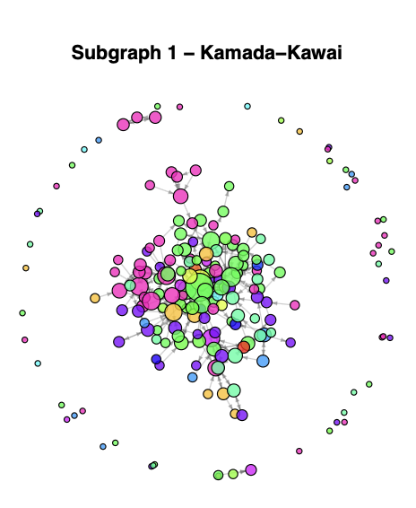
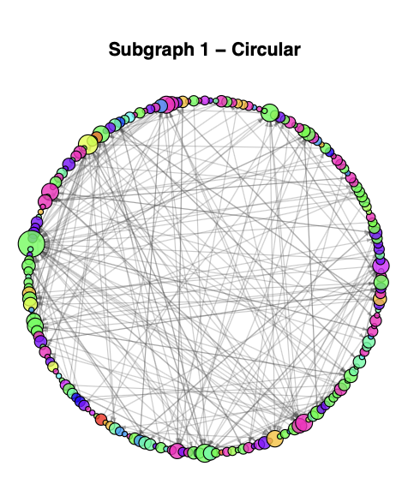
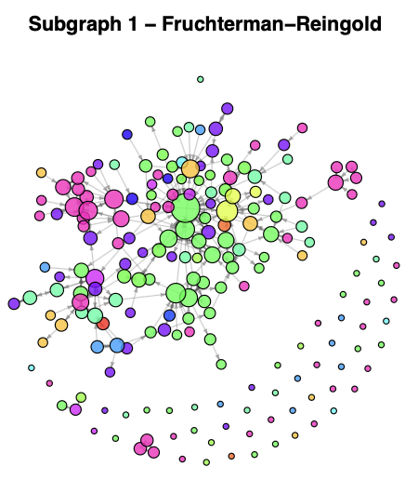
Network Visualizations

Slide 6
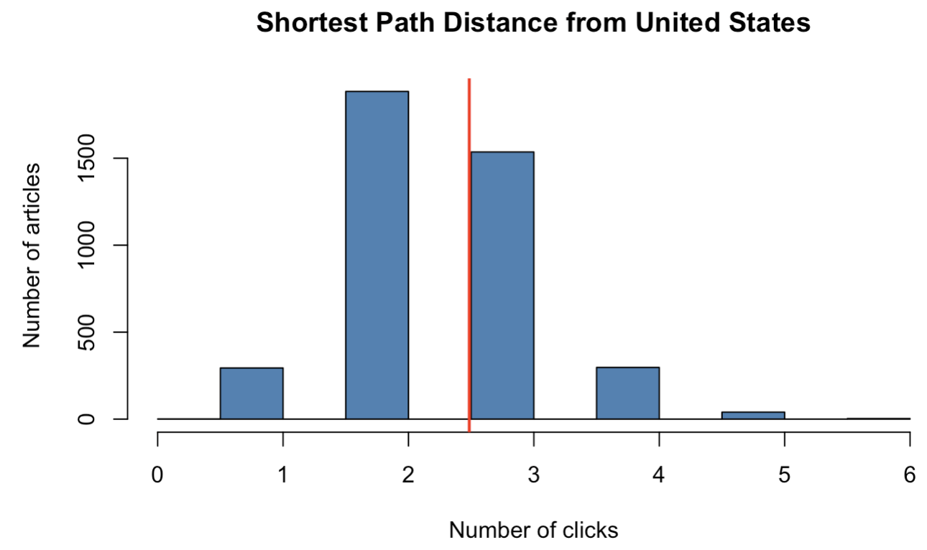
Most Influential article:
The “United_States” article is the most central article in the Network
In Degree (popularity):
1,551 incoming links
Most linked-to article
Betweenness (Bridge role):
Appears on the largest number of shortest paths
Connects many different topics
Eigenvector Centrality (influence)
Score = 1.000 (highest possible)
Linked by other important articles
Most articles are only 2-3 clicks away from the United States
Average distance is 2.48

Slide 7
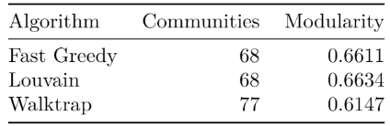
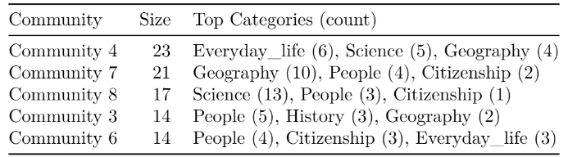
Community Detection
Used three different community detection algorithms
Louvain has the highest modularity, making it our best algorithm
Strong evidence because algorithms have similar communities
Pre-made Categories tend to be in the same Communities.

Slide 8
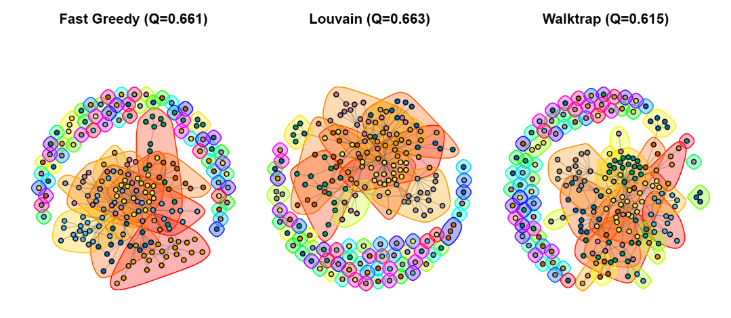
Community Detection Visualization

Slide 9
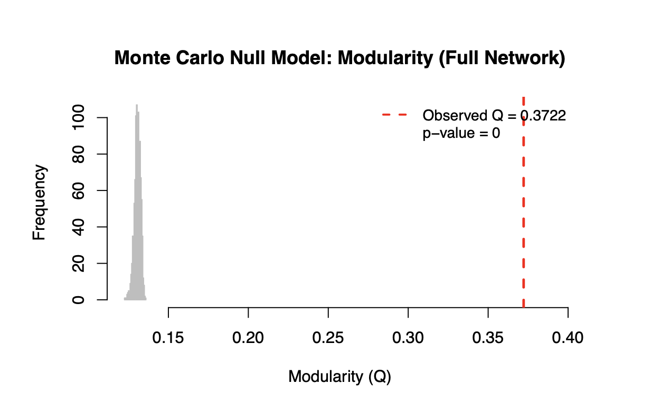
Statistical Validation: Is the community structure real or just random wiring?
Methodology: Compared our Louvain communities against 1,000 randomly wired networks.
Results: Our network's modularity (Q=0.3722) vastly outperformed the random distribution (p≈0).
Conclusion: The network’s community structure have real underlying organization with Wikipedia's categories and are not just random chance.

Slide 10
Results & Conclusion
Key Findings: Network Structure and Centrality
The network has a short diameter of 9 and an average path length of 3.18 which explains why Wikispeedia is easily played.
About 22.1% of hyperlinks are mutual which shows a lot of cross-referencing between related articles.
Degree and centrality metrics show that a small core of broad topics act as major hubs while a few high betweenness edges act as bridges between different categories.
Community Detection & Significance
Our three algorithms consistently found communities that aligned with the actual Wikipedia subject categories.
Our Monte Carlo null model test of 1,000 random graphs confirmed that the observed community structure is highly significant and not just by chance (Q = 0.3722, p = 0).
Future Direction
Next step would be to incorporate actual player data to build a weighted network and shift the focus from static hyperlinks to actual human navigation behavior.

Slide 11

wikispeedia game link

