Slide 1
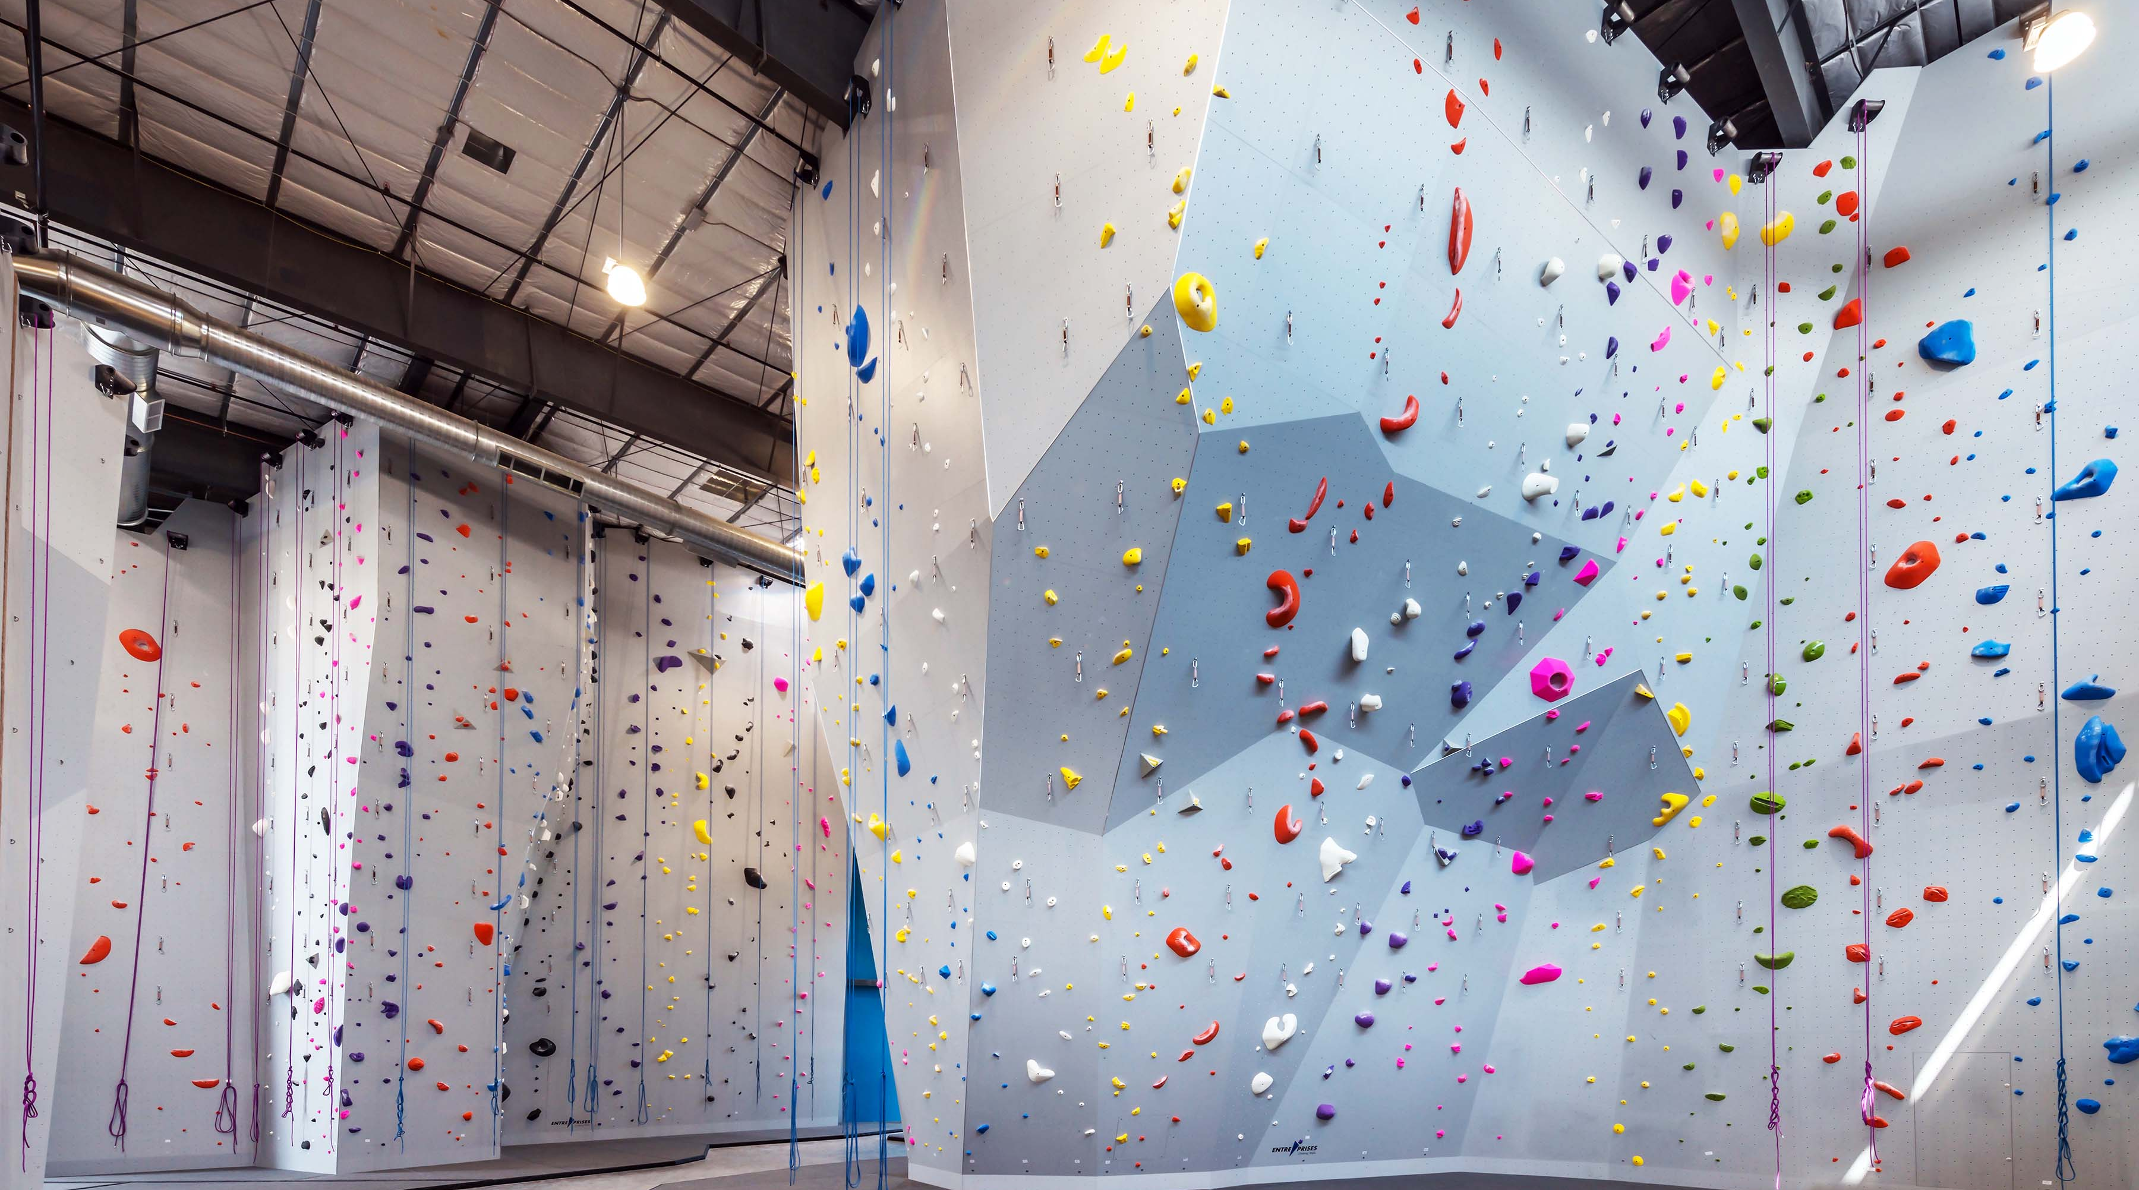






Deriving Business Insights from Customer Reviews
By Harrison Wang, Data Scientist @Metis

Slide 2
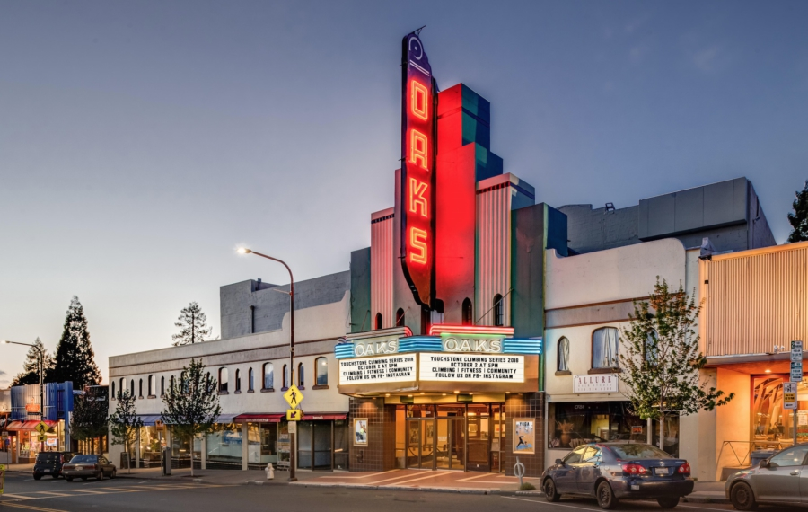
Size: 21,578 ft²
Cost: $4.25m

Slide 3

Size: 21,578 ft²
Cost: $4.25m

Slide 4
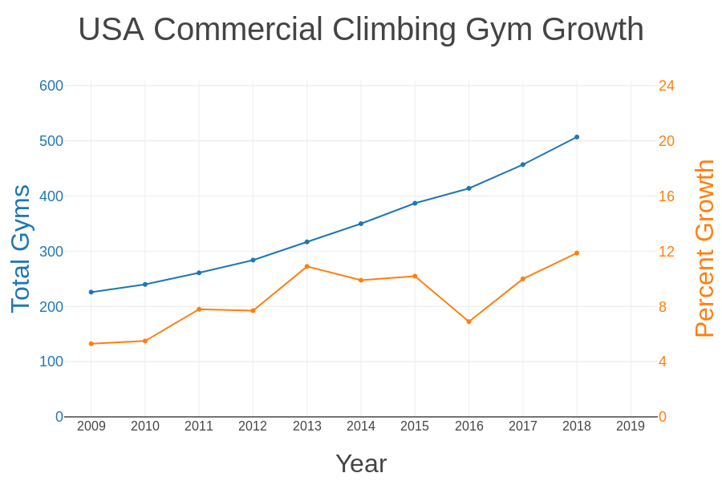



Slide 5
Data Science Work Flow
1
2
3
Scrape
Yelp
Exploratory
Data Analysis
Compare
Models
6
4
5
Topic
Modeling
Optimize Best Model
Make Predictions

Slide 6
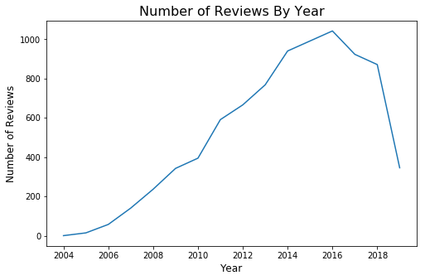
The Data
Locations: CA
No. of Gyms: 71
No. Of Reviews: 8328

Slide 7
Compare Models
Logistic
Regression
Gaussian NB
Random Forest
Count
Vectorizer
TF-IDF

Slide 8
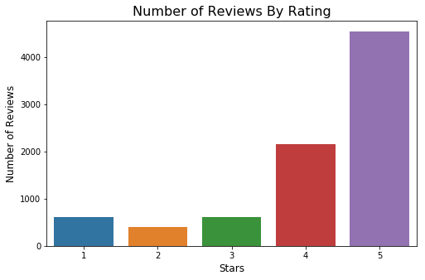
Exploratory Data Analysis

Slide 9
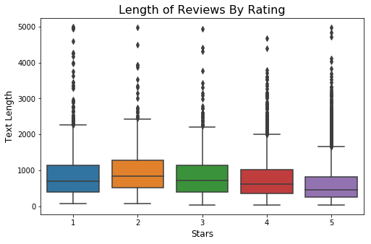
Exploratory Data Analysis

Slide 10
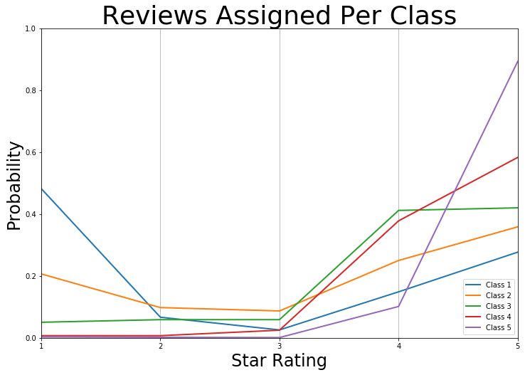
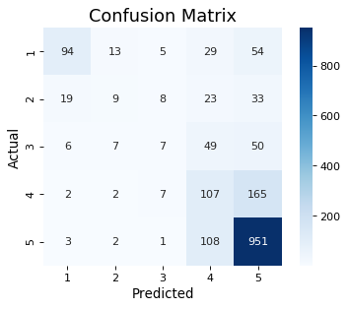
Optimize Best Model
Total Accuracy: 0.666
Weighted Acc.: 0.693

Slide 11
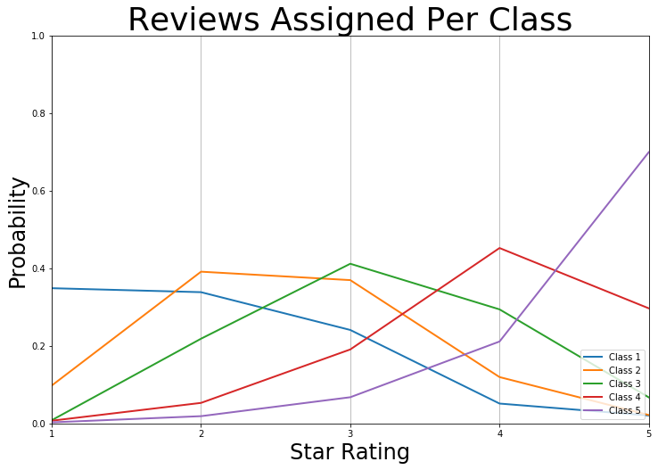
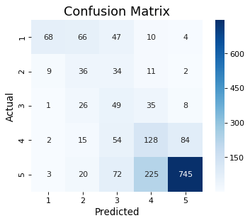
Make Predictions
Total Accuracy: 0.585
Weighted Acc.: 0.864

Slide 12
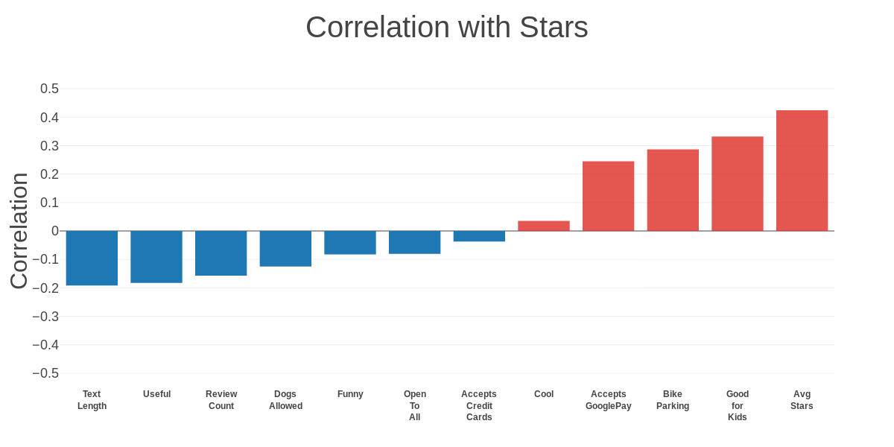
Exploratory Data Analysis

Slide 13

Optimize Best Model
Pipeline
Count
Vectorizer
Clean
Data
Logistic
Regression
Numerical Features
Clean Text
FeatureUnion
Clean Text
TF-IDF
StandardScaler

Slide 14
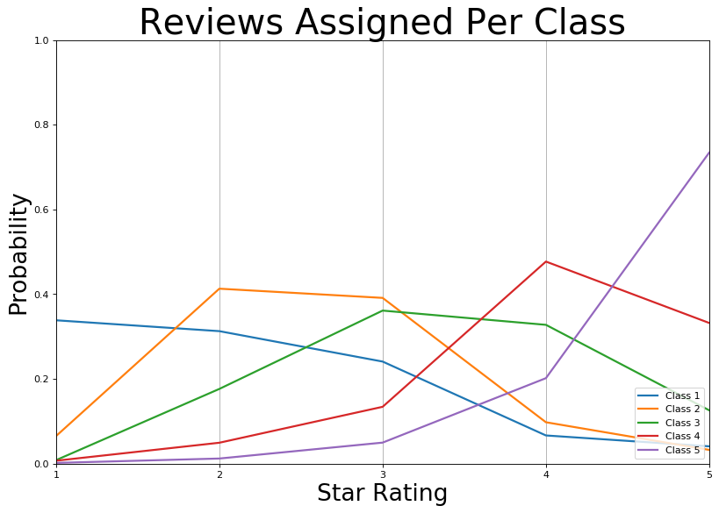

Make Predictions
Total Accuracy: 0.607
Weighted Acc.: 0.853

Slide 15
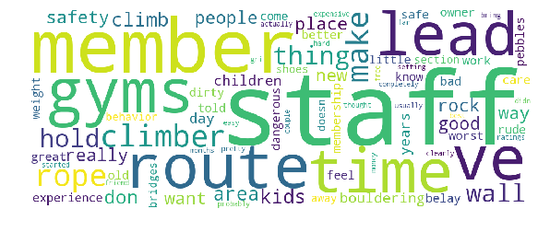
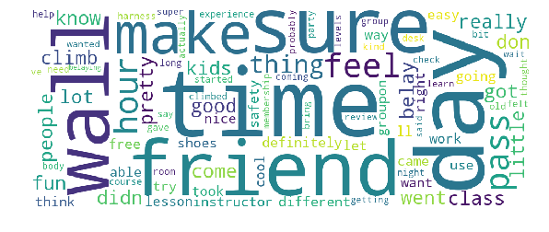
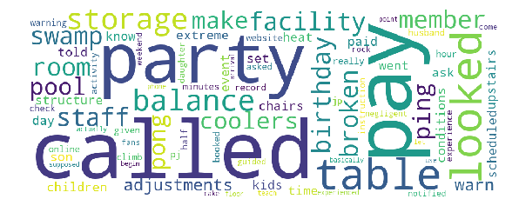
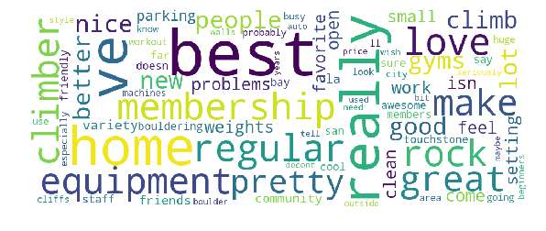
Topic Modeling: NMF
Topic
1 Star Reviews
5 Star Reviews
1
2

Slide 16
Topic Modeling: NMF
Topic
1 Star Reviews
5 Star Reviews
1
2

Slide 17
Thank You for Listening!
To Keep In Touch, please contact: harrison.c.wang@gmail.com https://www.linkedin.com/in/harrisonized https://harrisonized.github.io/about
By Harrison Wang, Data Scientist @Metis

