Slide 1
MTA Data Analysis for Targeted Outreach Harrison Wang, Adi Gaur & Genevieve McGuire

Slide 2
WTWY Fundraising Gala: Project Objectives
Gather most amount of signatures from people most likely to donate
Optimize street team targeting
Highest average daily ridership
Day / Time of day
Nearby tech hubs
<number>

Slide 3

What did we do to find the best hubs?
Download data: one year of turnstile data from MTA website
Obtain counts of total entries and exits for each station
Rank stations by entries and exits
Select stations close to tech hubs
Map it!
Notes:
(data, models, metrics, tools) use PICTURES (maybe logos of tools you used)

Slide 4
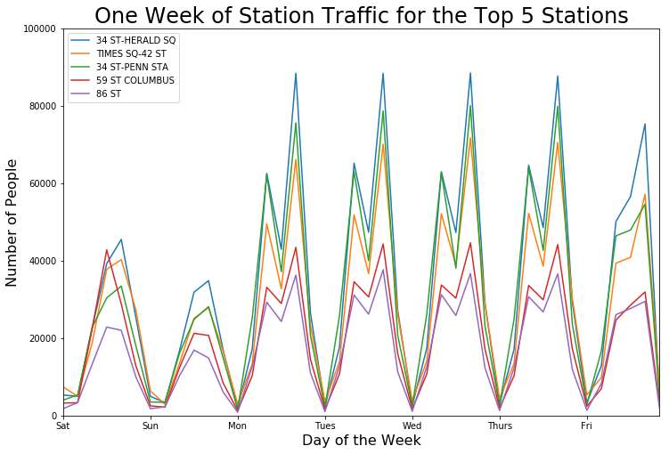
What does the data look like?
Notes:
****Morning and afternoon peaks correspond to morning and evening commutes ---> highest ridership in afternoons

Slide 5
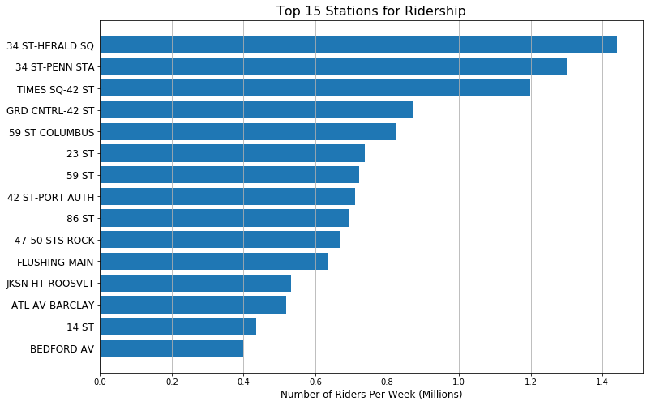
Which stations have the top ridership?
Notes:
(data, models, metrics, tools) use PICTURES (maybe logos of tools you used)

Slide 6
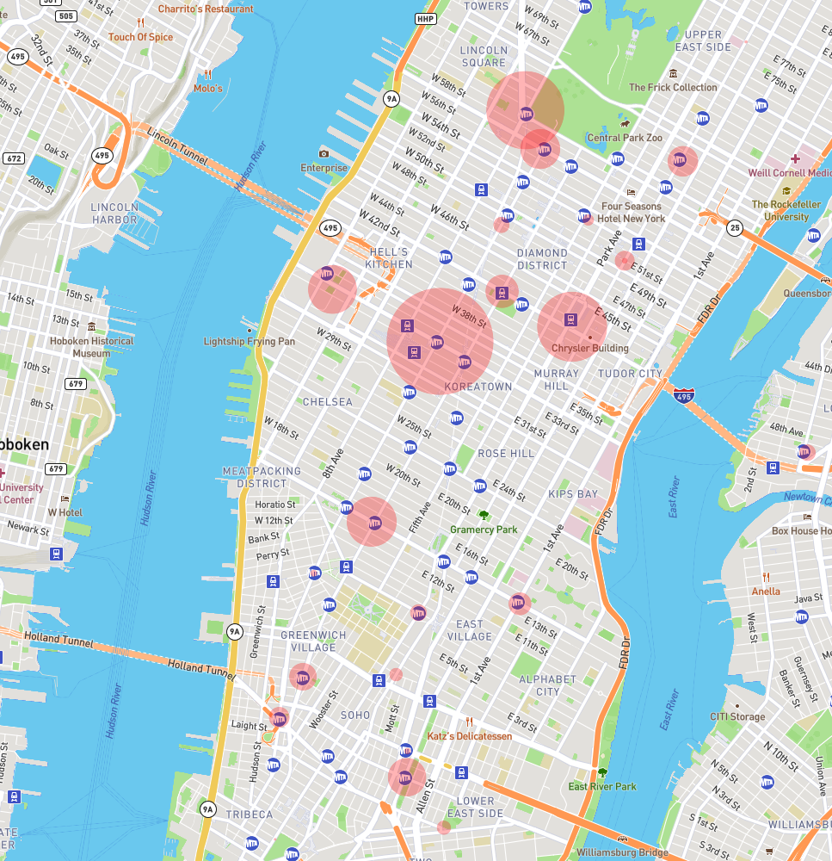
Which stations have the top ridership?
Notes:
(data, models, metrics, tools) use PICTURES (maybe logos of tools you used)

Slide 7
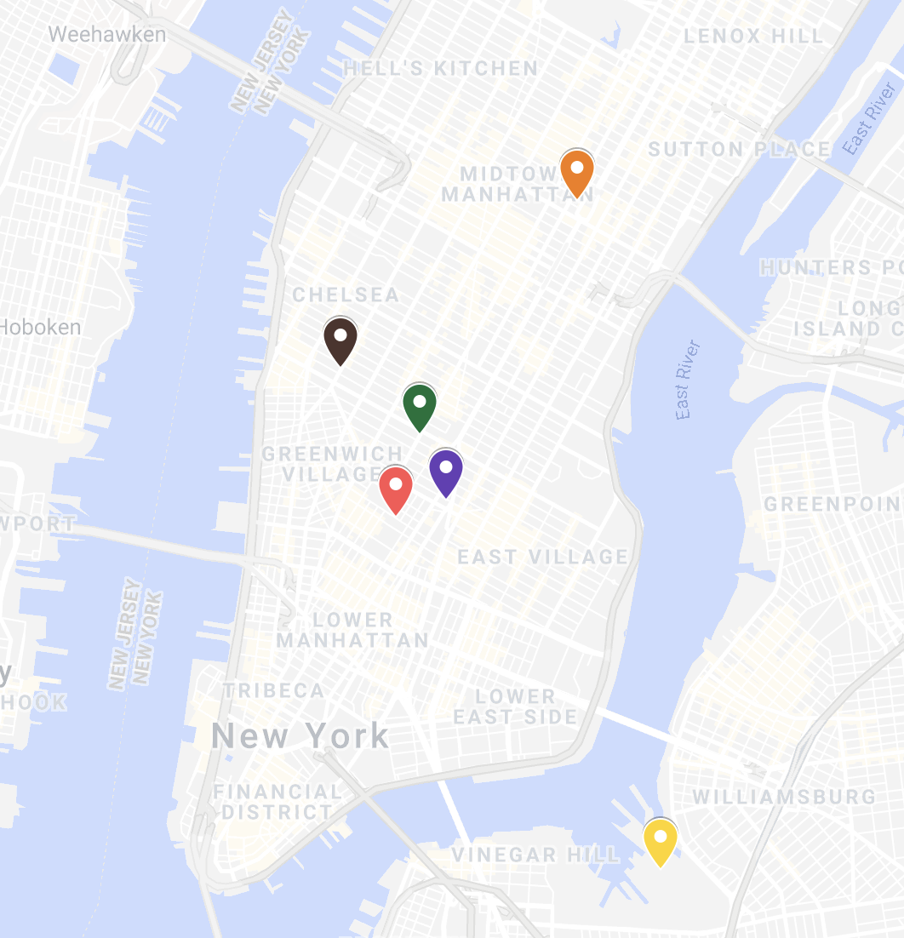
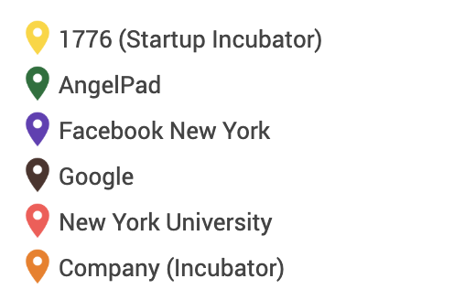
Top Tech Hubs in the NYC Area
Notes:
Interactive

Slide 8
Recommendations
How to most effectively utilize limited number of street teams
<number>

Slide 9
Top 5
34th St-Herald Square, Times Sq-42nd St, 34th St-Penn Station, 59 St Columbus, 86th Street
Weekdays
Tuesday - Thursday
Afternoon
Peak ridership between 2 - 6 PM
<number>

Slide 10
Areas for future collaboration
<number>
Notes:
We look forward to working with you every year for your gala. Here are some ideas that we came up with and would be able to implement given more time.

Slide 11
Future Work: Follow the $$$
Station | Median Income
Park Place | $200,000+
Chambers Street | $200,000+
World Trade Center | $200,000+
5th Avenue-59th Street | $171,000
Source: https://www.businessinsider.com/the-wealthiest-subway-stops-in-manhattan-2013-4
<number>
Notes:
we could incorporate neighborhood-level
keep in mind: no guarantee that these individuals will be progressive or tech-savvy

Slide 12
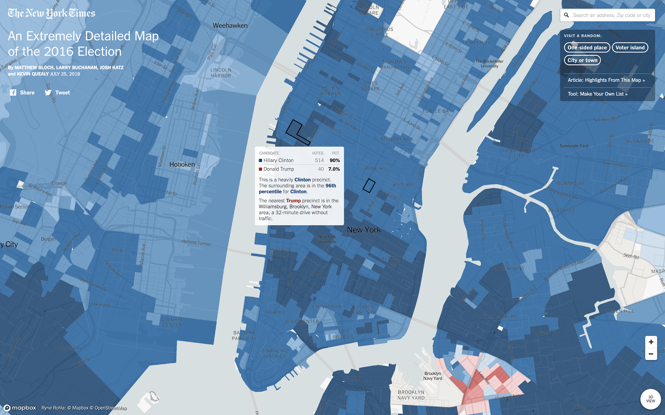
Notes:
if two stations have a similar profile, how do you decide which one to prioritize?
using public datasets, we can incorporate neighborhood-level 2016 & 2018 election data to help decide which stations to prioritize
technical lesson: how to utilize geocoder, a Python library for geocoding, to interact with the Google Maps API

Slide 13

THANKS!
Any questions?
You can find our repo at:
https://github.com/metis-sf-spring-2019-project-1/MTA_Data_Analysis
Interactive map available at:
https://api.mapbox.com/styles/v1/ag892/cju2x2ddx00ye1fnt8nwekdc2.html?fresh=true&title=true&access_token=pk.eyJ1IjoiYWc4OTIiLCJhIjoiY2p1Mnc5NTQ2MGd5YzQ0cjFubmJ5a3h0aSJ9.6rbTJn3aF6xVEXiqlK8ejg#13.16/40.71757/-73.99982/1.5
<number>
Notes:
https://api.mapbox.com/styles/v1/ag892/cju2x2ddx00ye1fnt8nwekdc2.html?fresh=true&title=true&access_token=pk.eyJ1IjoiYWc4OTIiLCJhIjoiY2p1Mnc5NTQ2MGd5YzQ0cjFubmJ5a3h0aSJ9.6rbTJn3aF6xVEXiqlK8ejg#13.16/40.71757/-73.99982/1.5

