Slide 1





Predicting Physics PhD Admissions
Harrison Wang, Data Scientist

Slide 2

Suppose You are an Aspiring Physicist...

Slide 3
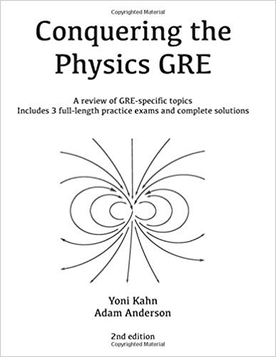
Suppose You are an Aspiring Physicist...
…or you work for a Test Prep Company...

Slide 4
Suppose You are an Aspiring Physicist...
…or you work for a Test Prep Company...
GPA
Research
Publications
GRE Verbal
GRE Quant
GRE Writing
GRE Subject
Playing Video Games
…which items are the most important?

Slide 5
Data Science Approach
1
2
3
Obtain and Clean Data
EDA & Feature Engineering
Compare
Models
4
5
Optimize Best Model
Make Predictions

Slide 6
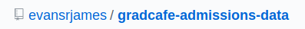

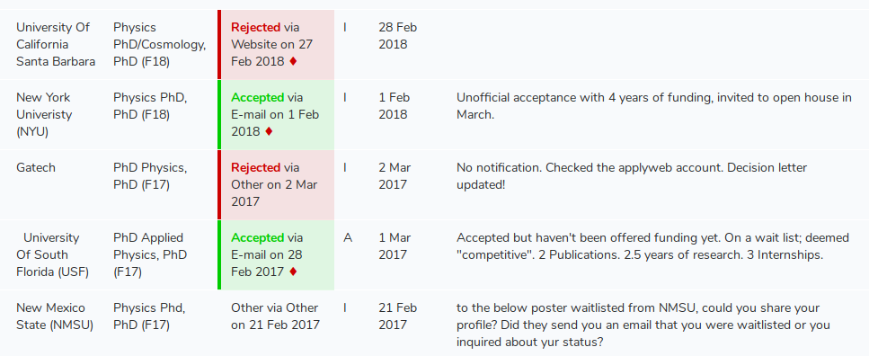
1. Obtain and Clean Data

Slide 7
2. EDA and Feature Engineering
2
GPA
GPA_sq
GRE Writing percentile
GRE Writing
sqrt(
GRE Verbal
x
GRE Subject
)
GREVxGRES
Research
Comments
Papers

Slide 8
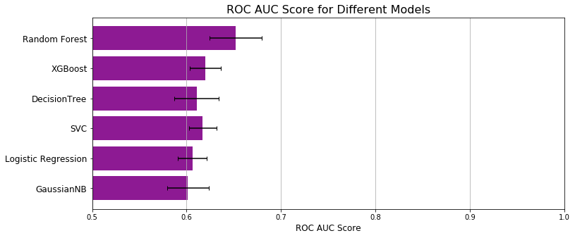
3. Compare Models Using Cross Validation
5-Fold Cross Val:
1
2
3
4
5
No Touch

Slide 9
3. Compare Models Using Cross Validation
5-Fold Cross Val:
1
2
3
4
5
No Touch

Slide 10
3. Compare Models Using Cross Validation
5-Fold Cross Val:
1
2
3
4
5
No Touch

Slide 11
3. Compare Models Using Cross Validation
5-Fold Cross Val:
1
2
3
4
5
No Touch

Slide 12
3. Compare Models Using Cross Validation
5-Fold Cross Val:
1
2
3
4
5
No Touch

Slide 13
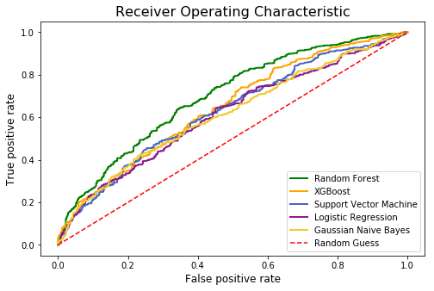
3. Compare Models Using Cross Validation
Final Train Test
Train
Test

Slide 14
3. Compare Models Using Cross Validation
Final Train Test
Train
Test
Winner

Slide 15
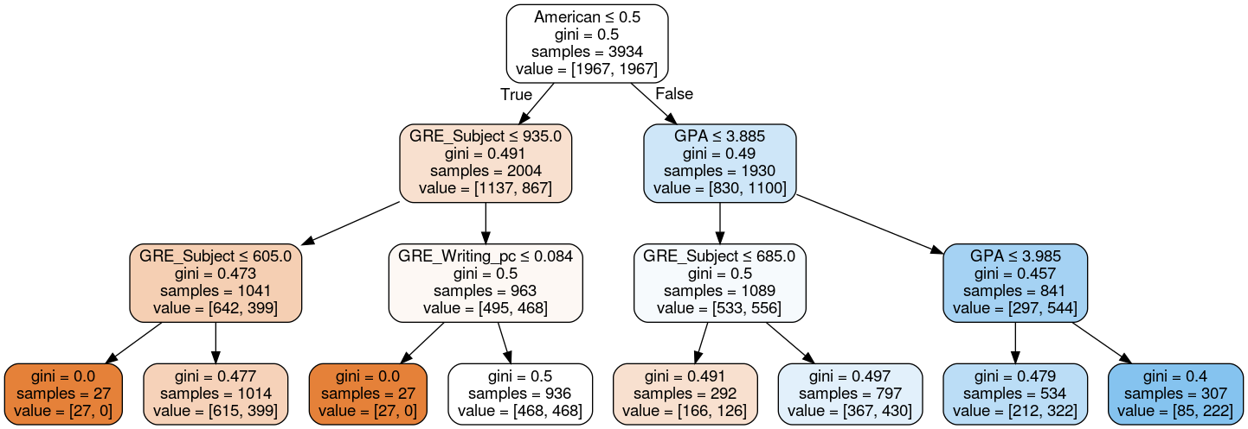

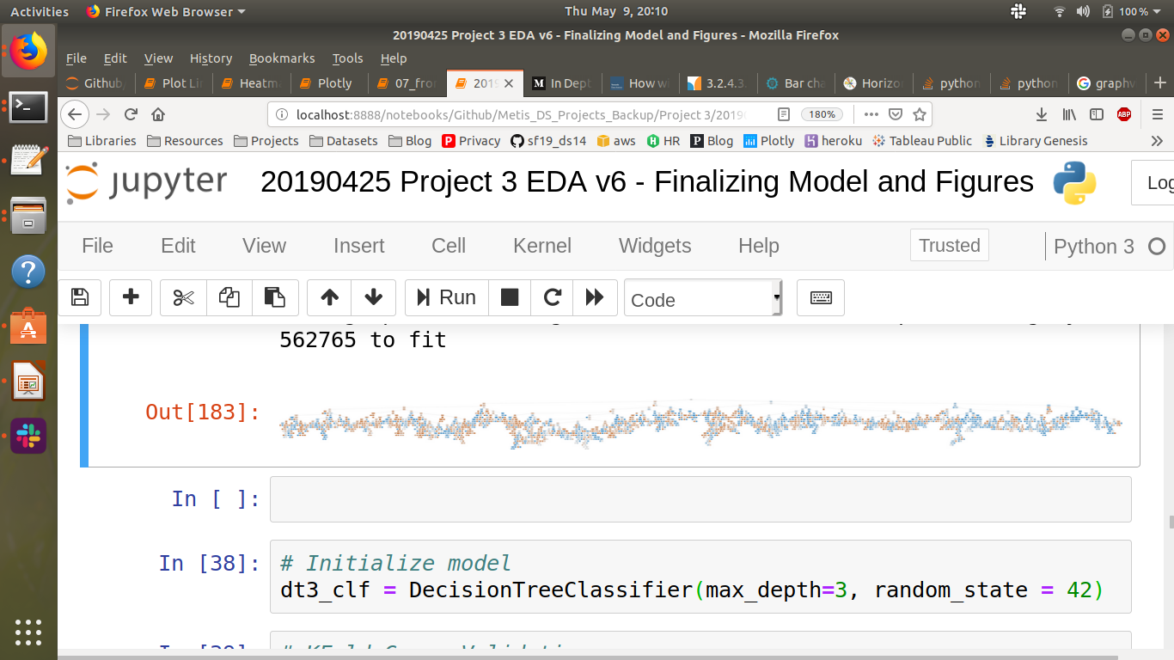
Interlude: What is Random Forest?
Example Tree
Real Decision Tree Output:

Slide 16
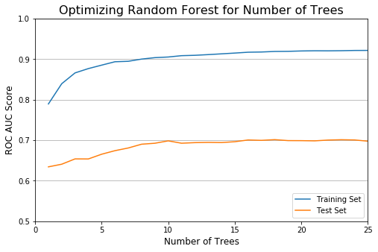
4. Model Optimization
Number of Trees = 10

Slide 17
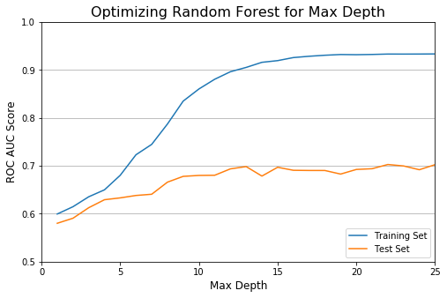
4. Model Optimization
Max Depth = 13

Slide 18
5. Make Predictions
ROC AUC
0.651
0.698

Slide 19
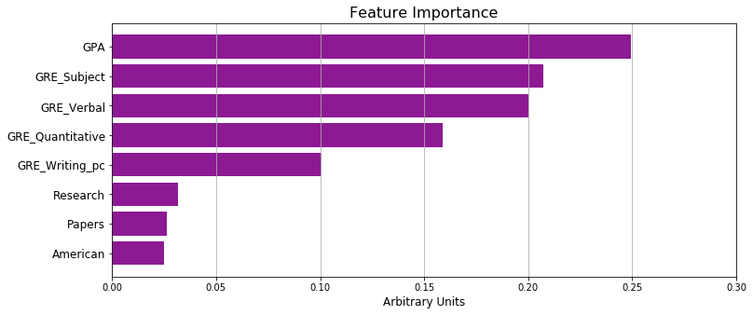
Suppose You are an Aspiring Physicist...

Slide 20
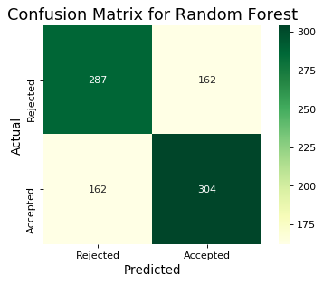
…or you work for a Test Prep Company...
Threshold = 0.477
f1 = 0.634
Precision = Recall = 0.652

Slide 21
… please keep in touch.
Thank you for listening!
Harrison Wang, Data Scientist

