Slide 1






Forecasting Rent Petitions in SF
By Harrison Wang, Data Scientist @Metis

Slide 2
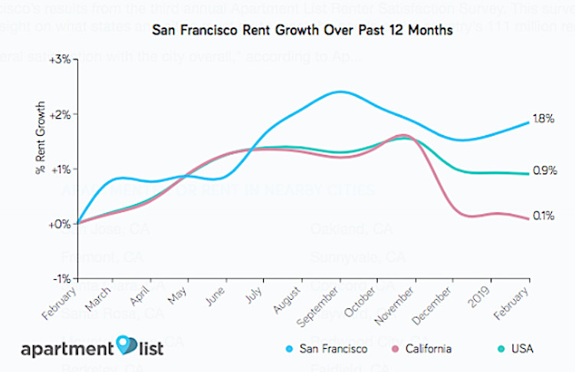
Why Rent Petitions?

Slide 3
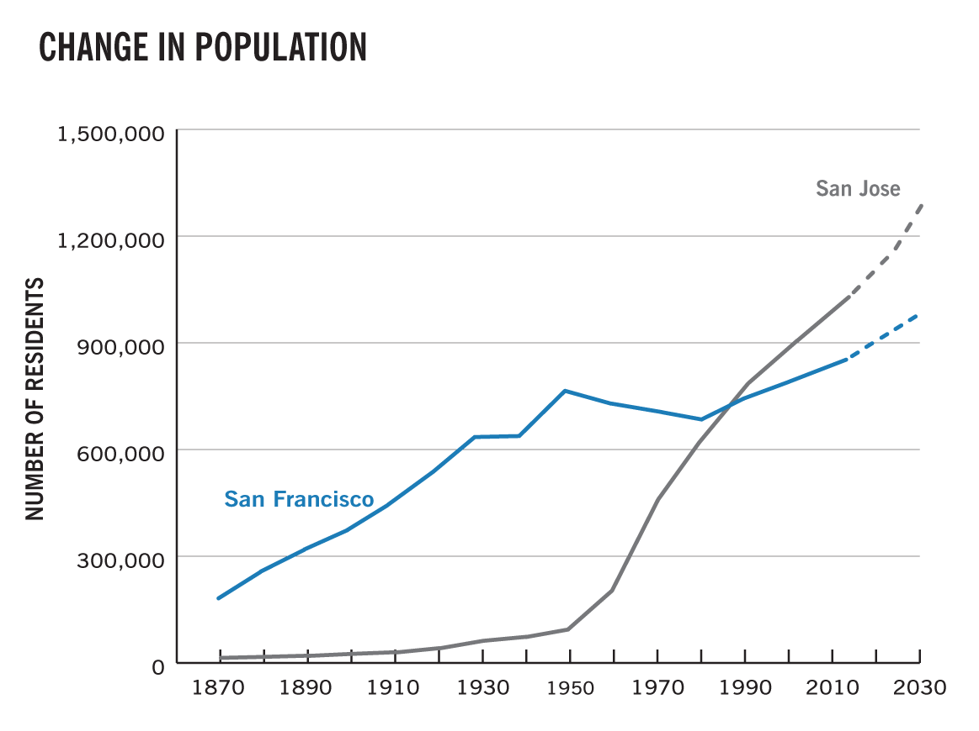
Why Rent Petitions?

Slide 4
Reasons to File Rent Petitions
Landlords (13k) | Tenants (28.5k)
Capital Improvement Passthrough (6k) | Wrongful Eviction Report (11k)
Intent to Leave Rental Housing Business (1.8k) | Decrease in Housing Services (9k)
Rent Increase where no Tenant is in Occupancy (1.2k) | Unlawful Rent Increase (4k)
Operating & Maintenance Rent Increase (1k) | Petition to Sublease (1k)
Utility Passthrough (<1k) | Capital Improvement Passthrough Hardship Petition (<1k)

Slide 5
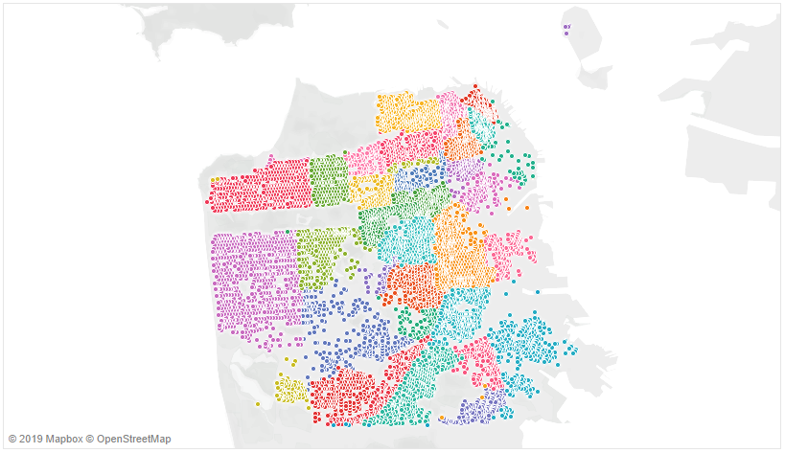
Neighborhoods in San Francisco

Slide 6
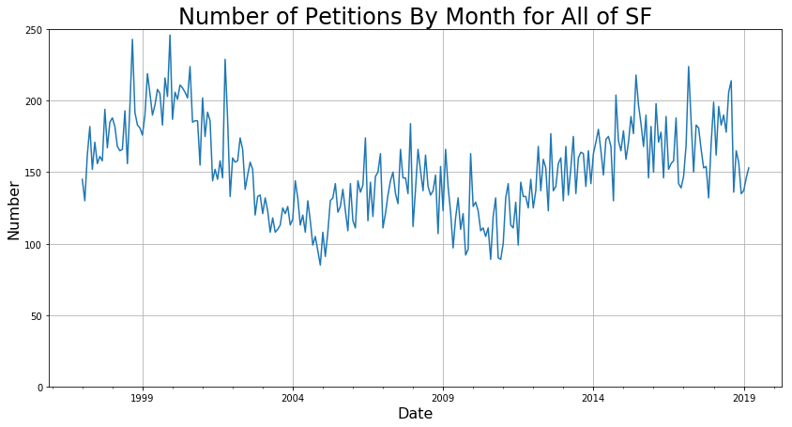

Slide 7
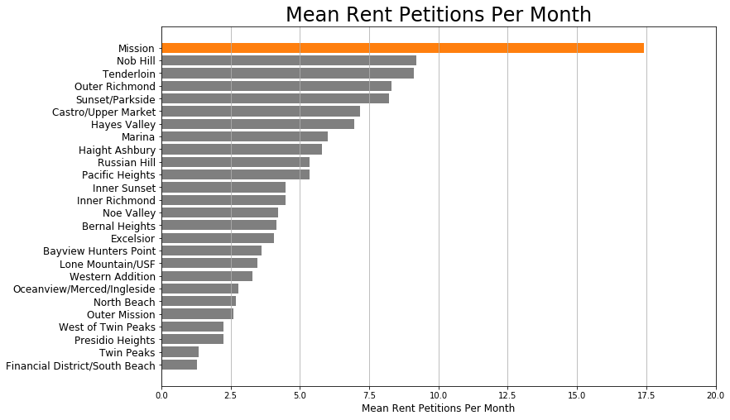
Which Neighborhoods Matter Most?

Slide 8
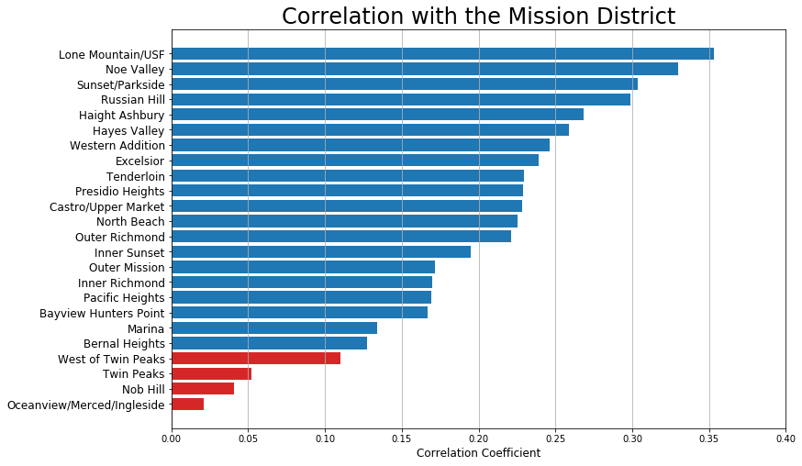
Which Neighborhoods Matter Most?

Slide 9
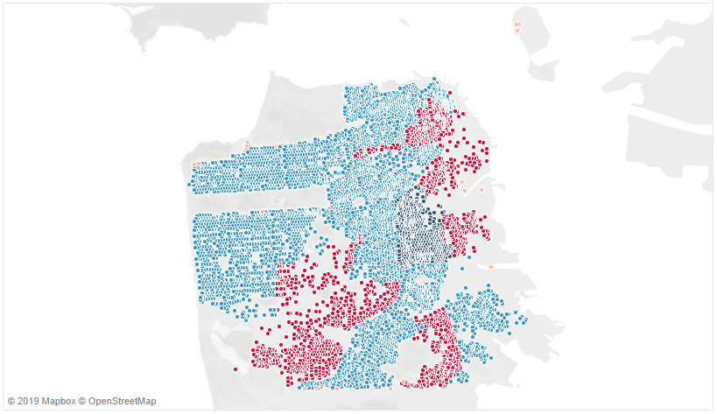
Which Neighborhoods Are Time-Varying?
Blue = Time-varying
Red = Stationary

Slide 10
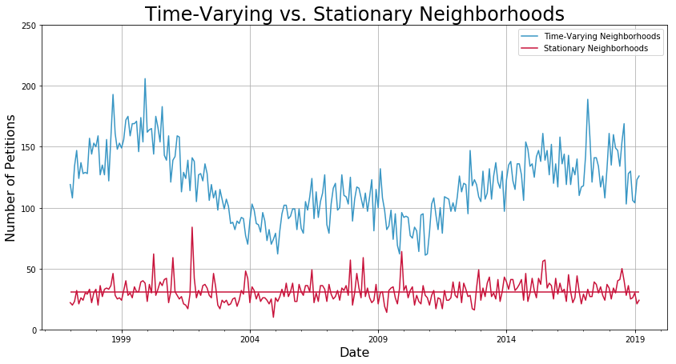
Haight Ashbury
Mission
Russian Hill
Sunset/Parkside
Financial District
Nob Hill

Slide 11
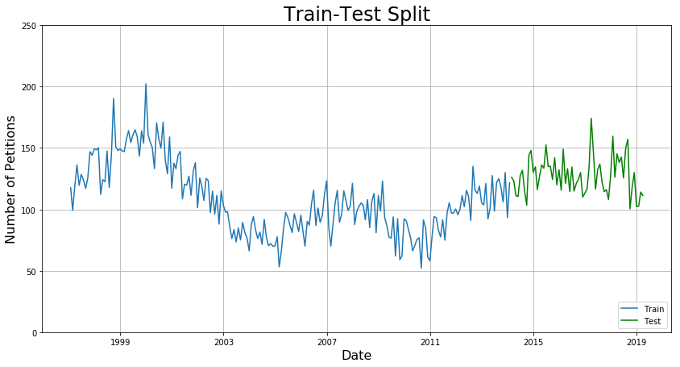

Slide 12
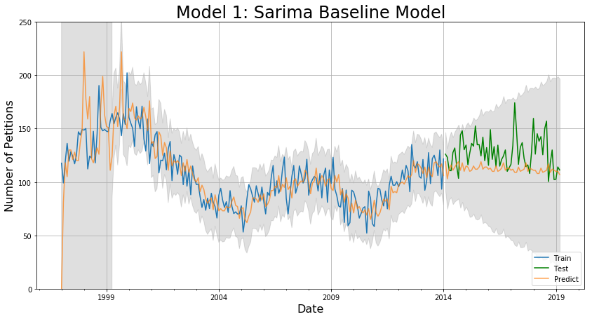
SARIMA(2, 1, 2)(0, 1, 2)[12]
MAE: 8.4 for 3 months, 17.6 for 5 years

Slide 13
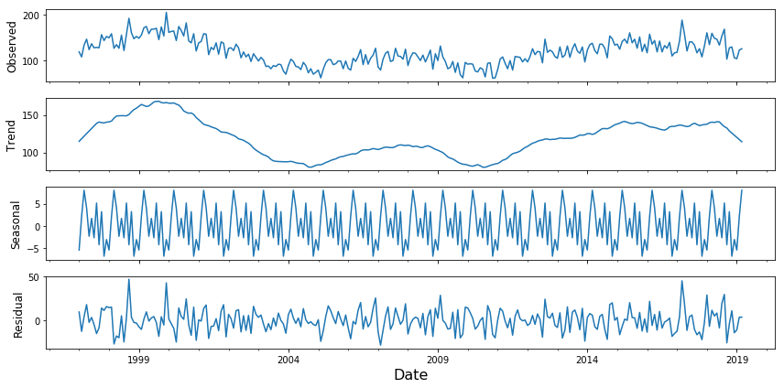
Use Seasonal Decomposition To Isolate Trend

Slide 14
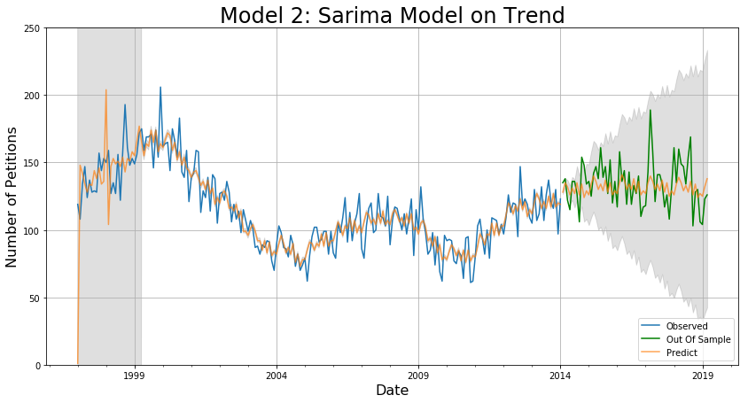
SARIMA(2, 1, 2)(0, 1, 2)[12]
MAE: 7.8 for 3 months, 12.3 for 5 years

Slide 15
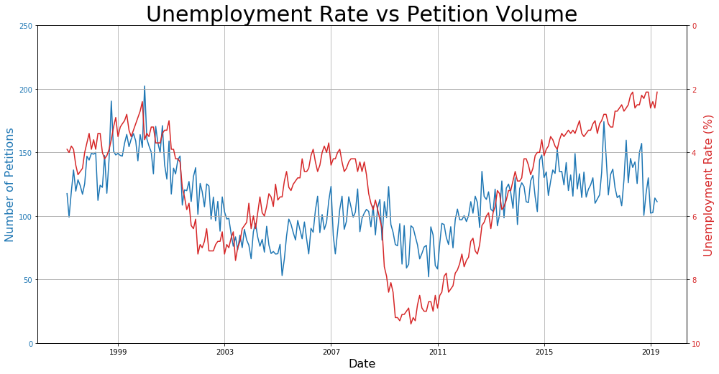
Unemployment Rate Is a Good Predictor of Petition Volume

Slide 16
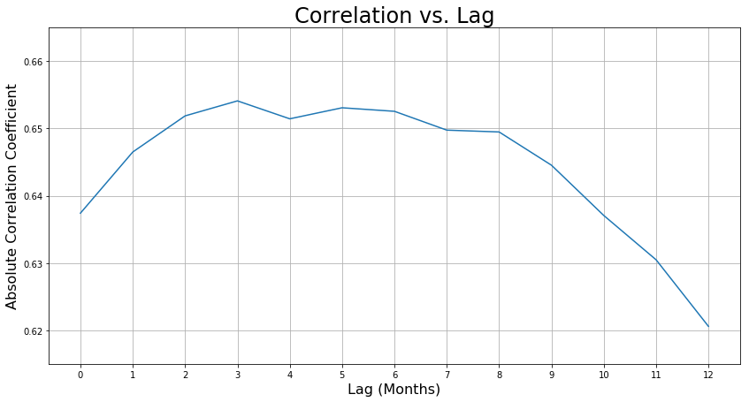
Unemployment Rate Leads Petition Volume by 3 Months
Ideal Lag = 3

Slide 17
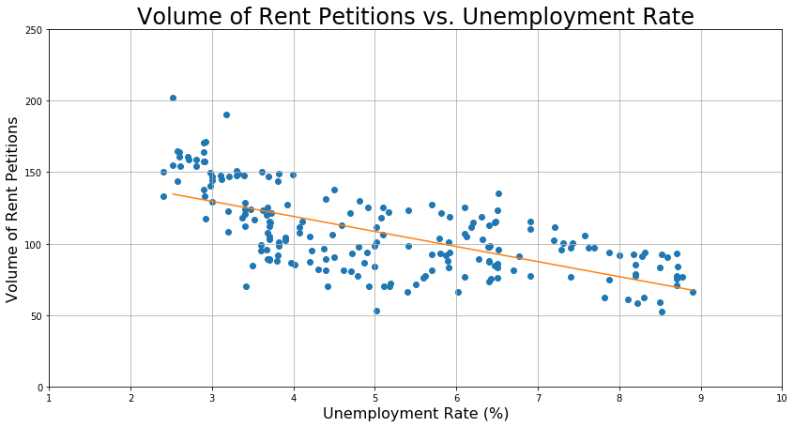
Rent Petitions has Linear Relationship with Unemployment Rate

Slide 18
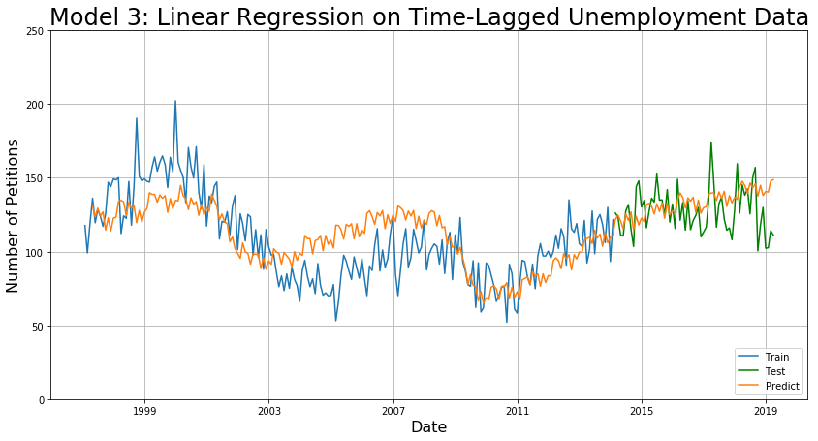
MAE: 5.1 for 3 months, 13.6 for 5 years

Slide 19
Summary Of Models
Model | Benefits | MAE(3 Months) | MAE(5 Years)
Naive Sarima | Easy to Implement | 8.4 | 17.6
Sarima on Trend | More Accurate | 7.8 | 12.3
LinReg on Unemployment | Fastest Most Interpretable | 5.1 | 13.6

Slide 20




Thank You for Your Time
harrison.c.wang@gmail.com
Harrisonized
Harrisonized

