Slide 1
USER-DOCUMENTATION FOR ASCII SPACEGAME
Team members:
SulAxya lama
kAYLA harrison
Ayça Küçükdurmaz
May 4th, 2016

Slide 2
Table of Contents
Introduction to the game
Examples of ASCII Games
Screenshot of the game
Command Summary
Brief Information about the program
References

Slide 3
Introduction to our game
Hello User. We welcome you to try out our fun and simple arcade style game and this manual is going to help you generally understand better about what the game is about, what we used and how to play it.

Slide 4
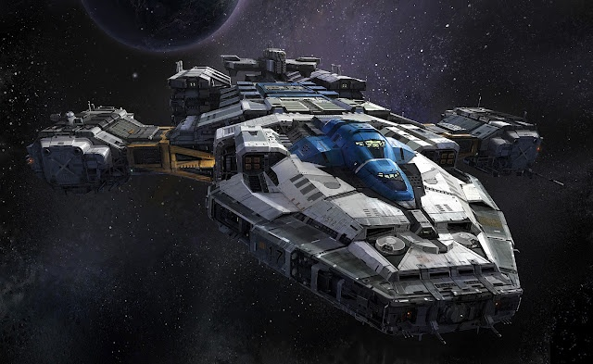
So, to begin with, the game has a window that is the “space”. The player (in this case the user) has to move, manage and shoot as a spaceship. Basically, the player has a “hero” spaceship and fights. The player is able to move up and down because it is already being accelerated forward in a uniform speed. Player has the abilities to shoot at things like meteors, spaceships of different shapes and lives. Player also has a number of lives in one round. There will be a chart on the bottom of the window with all the information regarding the progression of the player’s performance such as HP.

Slide 5
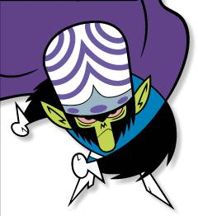
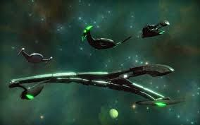
The opponent side has a lot of things going on. It is very diverse. We have space rocks, meteors of various shapes and sizes. And, drumroll, we have the enemy spaceships. And, as expected, they can also shoot and hurt the player’s lives. They have the ability to move up and down as well. Also, these bad guys have varied lives. For example: a small enemy spaceship might be destroyed with three shoots whereas a bigger one might need about five shoots.

Slide 6
Abstract introduction
This is an arcade style space game with simple ASCII visuals. It is written in C++ Programming Language and we used SDL graphics library to handle visuals. We have also used a bit actual simple graphics with Adobe Photoshop for the game. The code was made to reach a goal to be object oriented for a clean and manageable program design.

Slide 7
Not sure what an ASCII Game looks like? Fret not. The internet has blessed us with hundreds of examples that include so many of our early childhood games.

Slide 8
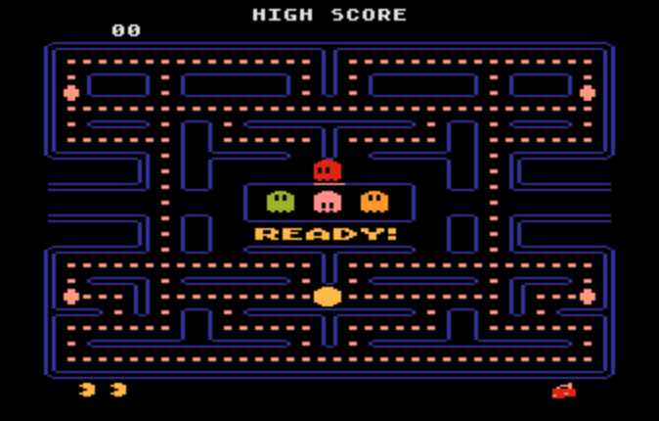
REMEMBER PACMAN?

Slide 9
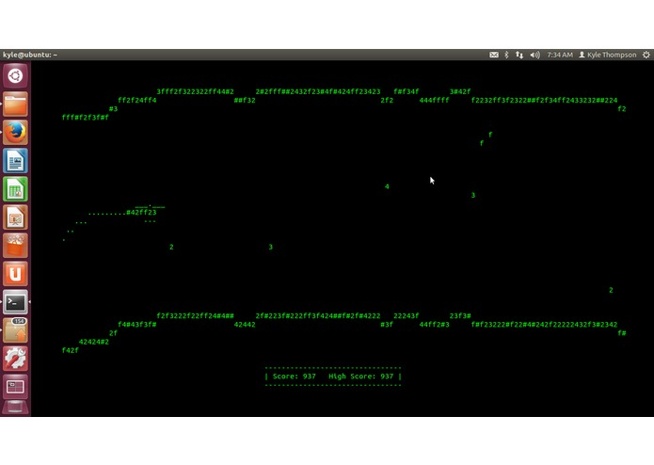
Or the simple Helicoptor game that you might have been madly addicted to?

Slide 10
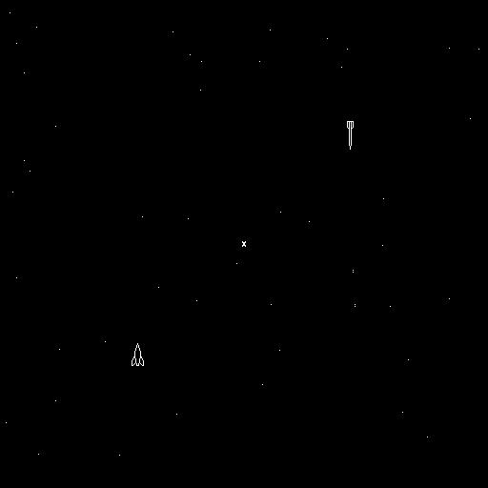
Or the extravagant spaceship game where you, as a spaceship, wander around shooting stuff until you get to fight the monstrous robot octopus spaceship that could shoot nine ways?

Slide 11
Well, our game does not look exactly as perfect as these games but we have a head start and you can definitely play and have fun. Here is a little screenshot of what the game looks like

Slide 13
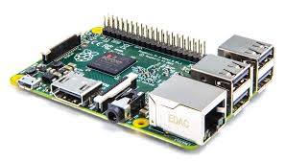


Materials used
Raspberry Pi Computing device(It fits in the palm of your hands)
Raspberry Linux – Development Environment
A distribution of Debian developed for the Raspberry Pi

Slide 14



SDL – Graphic Library
Abode Photoshop
Github
GitHub is a web-based Git repository hosting service where our team collaborated to update each other with the most recent code that we work on.

Slide 15
Command Summary
The player has several commands that he or she can use in order to play.
To move up, simply press the “Up” keyboard key. Similarly, to move down, press the “Down” keyboard key.
To shoot, press “---” key.
To pause the game, press “---“ key.
To resume a paused game, press “----“key.
To exit, press “----“key.

Slide 16
Thank you. We hope you enjoy the new product. For further more information on how the program works, check out our technical documentation, which is more thorough and detailed. ☺

Slide 17
References
http://www.magnavox-odyssey.com/1962.htm
http://devpost.com/software/42ff23-copter
http://benhem.com/idontexist/

