Slide 1

Python Workshop #2

Slide 2
Recap
launching the python interpretter
  use the interactive interpreter to help you!
datatypes:
  int: 1234
  float: 1.23e6
  string: "Hello World!"
string formatting:
  'Your score is: {}'.format(123)

Slide 3
Today: Scripting!
Two steps:
  write the script in a suitable editor
  run the script from command line
Text Editor / Development Environment:
  not a word processor!
  syntax highlighting, code indentation
  Windows: NotePad++
  Mac: gedit
  Linux: geany, gedit, kate, nano, vim, emacs
  Eclipse + PyDev
indentation: 4 spaces per tab!
line endings!

Slide 4
Installing Software
CAUTION: it's easy to install malware
  sourceforge Filezilla example
Linux: managed repositories
Mac: Homebrew

Slide 5
Scripting Hello World
Step one:
  print "Hello World!"
Step two:
  python hello_world.py
Linux/Mac alternative:
  #!/usr/bin/python
  chmod u+x hello_world_alternative.py

Slide 6
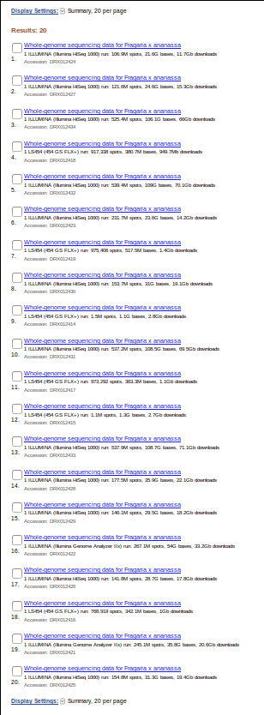
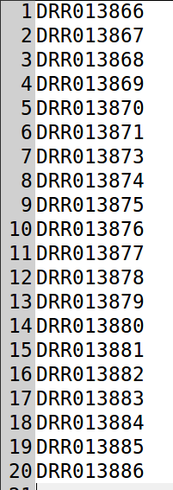
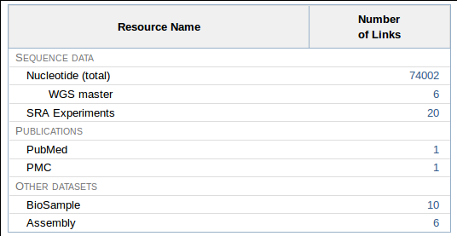
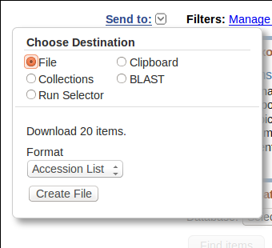
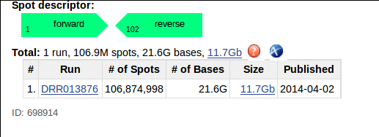
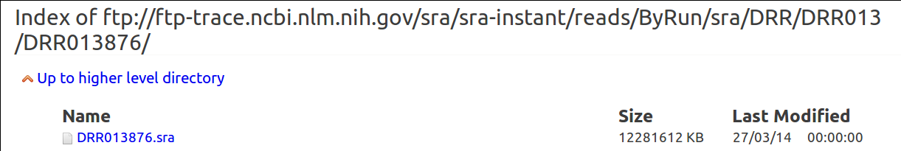
Example Problem: Reikou
wget http://ftp-trace.ncbi.nlm.nih.gov/sra/sra-instant/reads/ByRun/sra/DRR/DRR013/DRR013876/DRR013876.sra

Slide 7
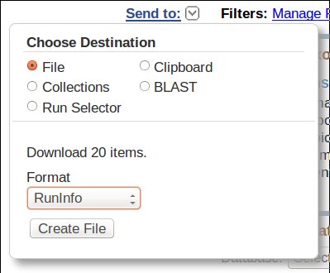
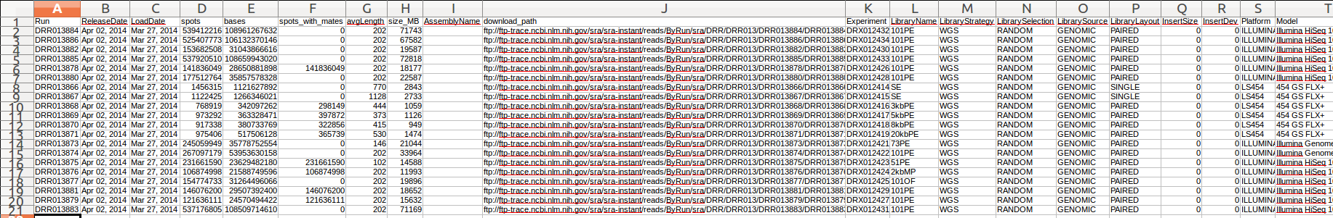
Example Problem: Reikou

Slide 8
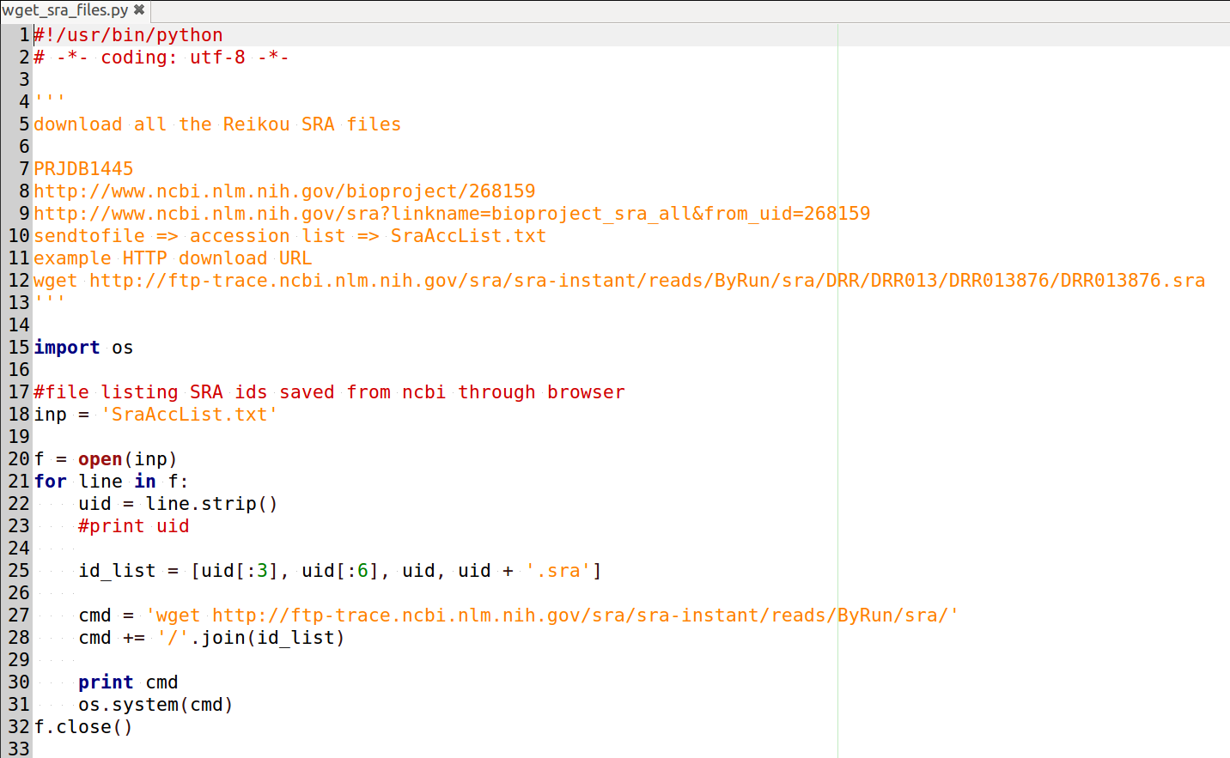
Our First Script

Slide 9
Line by Line
triple quote string / comment
module import
inp = 'filename' assignment
f = open(inp) open file / f.close() close file
for line in f:
indentation
uid = line.strip()
id_list = [...]
cmd += '/'.join(...)
os.system()

Slide 10
For loop
f = open('SraAccList.txt')
for line in f:
print line
f.close()

