Slide 1

Python Workshop #2

Slide 2
Recap
launching the python interpretter
use the interactive interpreter to help you!
datatypes:
int: 1234
float: 1.23e6
string: "Hello World!"
string formatting:
'Your score is: {}'.format(123)

Slide 3
Today: Scripting!
Two steps:
write the script in a suitable editor
run the script from command line
Text Editor / Development Environment:
not a word processor!
syntax highlighting, code indentation
Windows: NotePad++
Mac: gedit
Linux: geany, gedit, kate, nano, vim, emacs
Eclipse + PyDev
indentation: 4 spaces per tab!
line endings!

Slide 4
Installing Software
CAUTION: it's easy to install malware
sourceforge Filezilla example
Linux: managed repositories
Mac: Homebrew

Slide 5
Scripting Hello World
Step one:
print "Hello World!"
Step two:
python hello_world.py
Linux/Mac alternative:
#!/usr/bin/python
chmod u+x hello_world_alternative.py

Slide 6
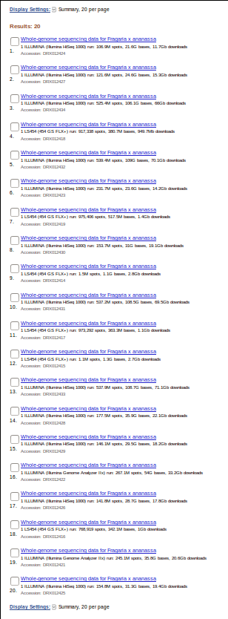
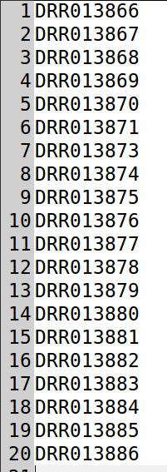
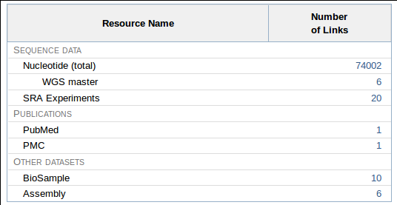
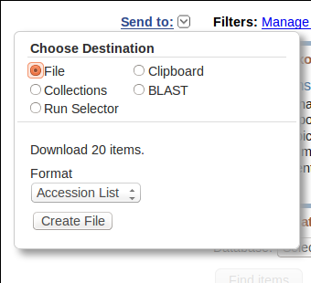
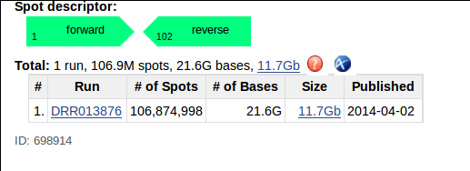
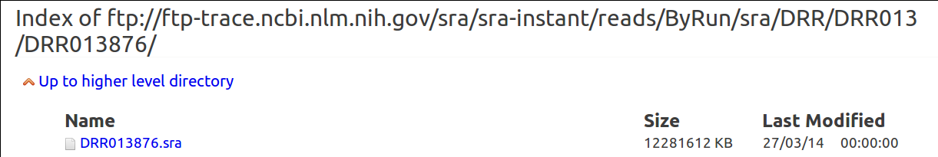
Example Problem: Reikou
wget http://ftp-trace.ncbi.nlm.nih.gov/sra/sra-instant/reads/ByRun/sra/DRR/DRR013/DRR013876/DRR013876.sra

Slide 7
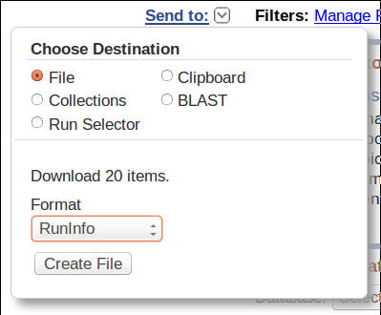
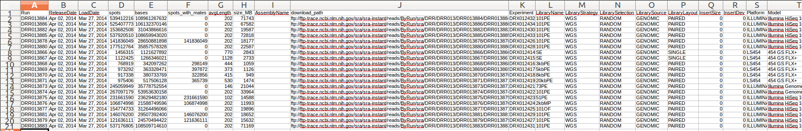
Example Problem: Reikou

Slide 8
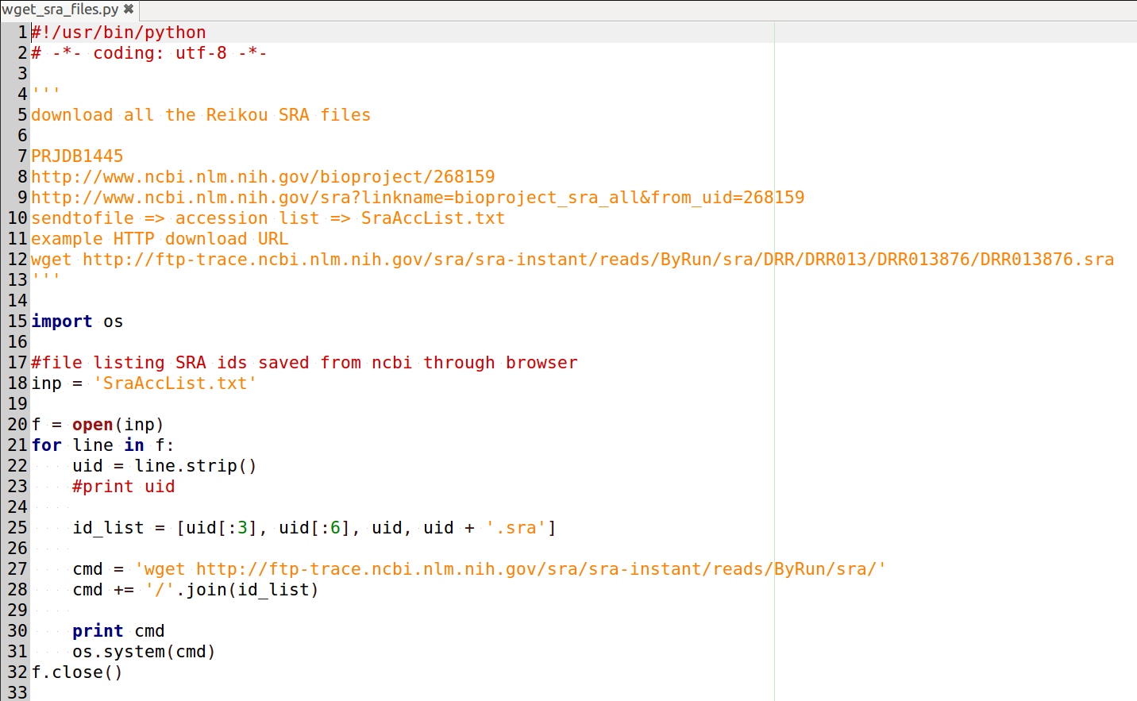
Our First Script

Slide 9
Line by Line
triple quote string / comment
module import
inp = 'filename' assignment
f = open(inp) open file / f.close() close file
for line in f:
indentation
uid = line.strip()
id_list = [...]
cmd += '/'.join(...)
os.system()

Slide 10
For loop
f = open('SraAccList.txt')
for line in f:
print line
f.close()

