Slide 1
Technical Presentation – Paintball Turret
Harrison Lanfrank – Mechanical Design Engineering
Notes:
Hi everyone, I’ll be presenting a personal project that I’ve been on working on for the last few weeks.

Slide 2
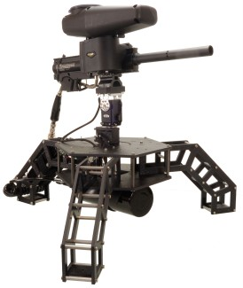
Project Overview
Paintball turret system
Example
Environmental Inputs
Camera
Yaw
Stepper motor driven gearbox to function as base of the unit and provide 360 deg rotation
Firing mechanism
Use gutted paintball marker to as firing mechanism
Pitch
Stepper motor direct drive for 45 degrees of pitch control
Notes:
The project I want to discuss today is a personal project I’ve been working on for the past few weeks. The goal is to design a paintball turret system, that uses object tracking to fix on a target. To break it down I’ll have a camera to feed into a raspberry pi to run the object tracking model. From there the controller will output position commands to the yaw and pitch mechanism to aim at the target. The use case I am designing for is more of a Back yard defense system. This project is currently in progress and for the purpose of this presentation, I will be focusing on the Yaw mechanism.

Slide 3
Design Targets
Accuracy @ 5m
Metric | Target Value | Notes
Angular Accuracy | ±1.0° | Ensures reliable torso-sized hits
Positional Error @ 5m | ≤8.7 cm | Equivalent to ±1.0° at 5 meters
Repeatability | Consistent return to set angles | Essential for calibration
Yaw Mechanism Constraints
Constraints | Target Value | Notes
Cost | <100$ | Prototyping costs for hardware
Packaging Dimensions | 100mm Dia x 70mm | Compact packaging
Fabrication | FDM 3D-printing + Amazon | Prioritize for speed of iterations
Output | Rotate 4kg | Weight of pitch mechanism and firing mechanism
Motion Speed
Axis | Target Speed | Use Case
Yaw (Pan) | ≥35°/s | Lateral movement of targets @ Jog speed (3 m/s)
Pitch (Tilt) | ≥35°/s | Vertical adjustments for elevation
Notes:
First step was to specify some design targets. To determine accuracy, I looked at the average human torso size which is about 32cm wide, based on this I selected an angular accuracy of plus minus 1 degree. This equates to about 8.7cm accuracy @ 5m, which will be sufficient to hit a human torso at 5m.
To determine speed, I looked at the average jog speed of a person which is about 3m/s. This is equivalent to about 35 deg per sec at 5m. The pitch speed, I chose as 35 deg/s which will likely be too quick due to unlikeliness of the target moving in Z very quickly.
Some general constraints were to keep the yaw mechanism prototype cost to below $100, I wanted to keep the packaging relatively small as well but large enough to hold some mass. And fabrication I am limited to my 3D printer and off-the shelf parts from amazon. I wanted to make sure I could fail fast and improve quickly, so being able to 3D-print immediately and have hardware shipped next day, would help iterate quick

Slide 4
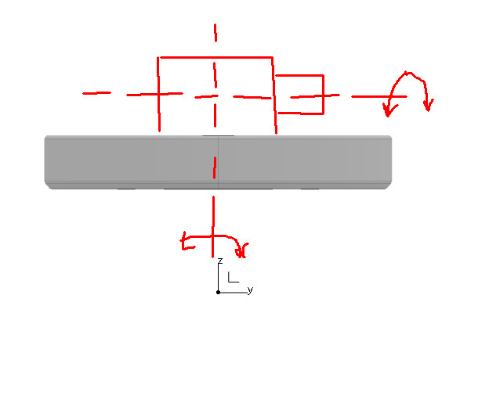
Turret Base Design (Yaw)
Concept
360 deg rotating platform to mount pitch and firing mechanisms
Must reliably rotate 4kg of mass
Notes:
The basic concept was to have a rotating platform with mounting features that I could easily swap out different pitch and firing mechanisms. This would help with quick prototyping and testing later down the line. Also this would let me use this design for future projects.

Slide 5
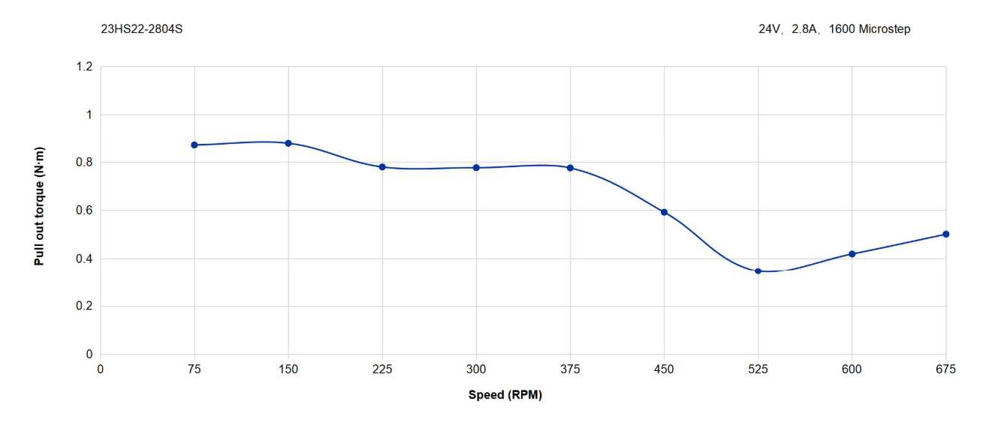
Turret Base Design (Yaw Function)
Gear Reduction | 15:1 | 10:1
Required Torque @ Gearbox Output shaft | 0.2Nm | 0.2Nm
Required Speed @ Output shaft | 34.5 deg/s (6 RPM) | 34.5 deg/s (6 RPM)
Input Torque | 0.013Nm | 0.02Nm
Input Speed (RPM) | 90 | 60
Required Torque Output
4kg @ 0.05m =0.2Nm
Output Plate
*To utilize Nema 23 Stepper I had on hand
4kg
12V supply @ 200-800 microstep
Incorrect
Notes:
The first step was calculating the required torque to rotate the turret. I roughly expect a mass of 4kg which includes some safety margin. However, I only realized when I was prototyping iteration 4 that I had calculated torque incorrectly. I’ll go through the correction in later slides. Secondly, I had a nema 23 stepper motor from a past project which I wanted to utilize. To do so, I knew I would need some sort of reduction to get the motor within it’s functional range.
The torque curve I had for the motor was for 24v @ 1600 microsteps. I only have a 12V power supply rated for 4A. Based on this I dropped the pull-out torque by roughly half (Pull out torque, max torque a motor can produce at a given speed. Without stalling or losing sync) (holding torque – amount of external torque required to turn the shaft when it’s at rest but full power)
To use this motor I had and achieve 6 rpm, I needed to drop the input speed. I also wanted to keep the motor speed low to maximize available torque. So the motor satisfies the 0.2Nm torque with no issue, but to get 6 rpm, and be within the motor operating speed, I decided to go with a 15:1 reduction which lands me at 90 Rpm input speed. I could go higher to 20 or 30 and still be at a low input speed. But I was on the fence about going higher since that meant smaller teeth and other features, or even more parts in the assembly.

Slide 6
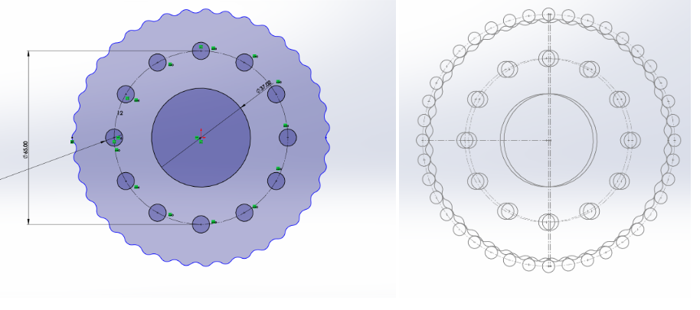
Cycloidal Gear
Cycloidal Gear Profile Parametric Equation
X = (Rcos(t))-(Rrcos(t+arctan(sin((1-N)t)/((R/EN)-cos((1-N)t)))))-(Ecos(Nt))
Y = (-Rsin(t))+(Rrsin(t+arctan(sin((1-N)t)/((R/EN)-cos((1-N)t)))))+(Esin(Nt))
R = Outer lobe Position Radius
Rr= Outer lobe Radius
N = # of lobes (Akin to Reduction Ratio)
E= Eccentricity
*-1mm offset to account for assembly, and tolerances.
Benefits
Low backlash
Minimized friction and wear due to rolling contact
Compact packaging
Good for load transfer when using 3D-printed parts
Common in robotics
Haven’t come across it before
Design Parameters | Value
R | 45mm
Rr | 6.5mm
N | 16
E | 1.5mm
3d-printed spur gears often fail due to concentrated load on small features
Greater contact area between gear and ring pins to distribute load
References
https://uwaterloo.atlassian.net/wiki/spaces/UWRT/pages/33962263427/Cycloidal+Drive+-+Rev+1+Prototype+Journal
Notes:
Next stop was to choose how I was going to provide the gear reduction. I had heard about cycloidal gears being used in humanoid robotics. I didn’t know what they were or how they worked but I assumed they had to be quite accurate and compact. As I did more research I found that the main advantage of using a cycloidal gearbox was the compact packaging, good load distribution due to number of lobes in contact at all times, and inherently has low back lash. Another big reason for choosing this type of gear was that I had never used it before and I thought it would be interesting to learn about.
Also from past experience I’ve had 3D-printed spur gears get chewed up or crack at the root (due to concentration of load on a small amount of teeth and also due to plastic simply not being stiff enough.)
To get this prototyped I found an equation online that would let me generate the curve in CAD. Since my packaging dimension was 100mm dia, I chose the radius to be 45mm. The output lobe radius was 6.5mm and N was based on the desired reduction ratio and eccentricity was based on a rule of thumb that E<R/N.

Slide 7
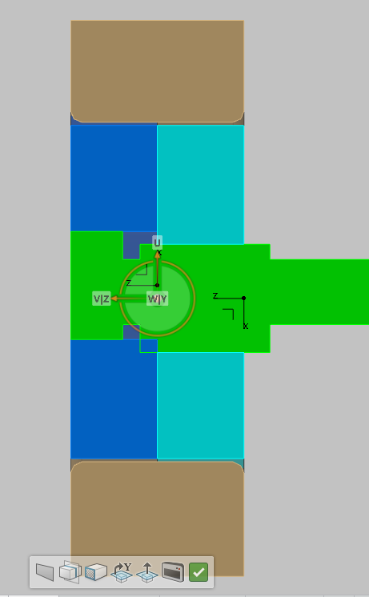
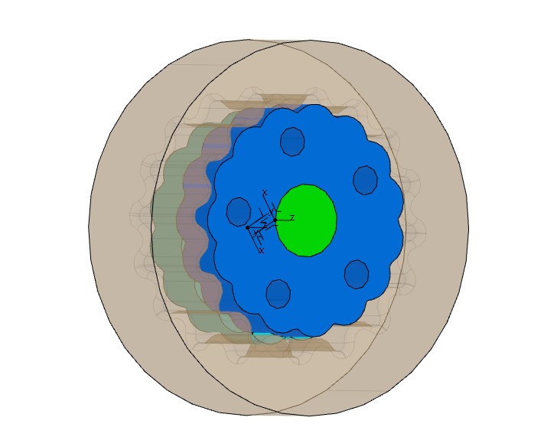
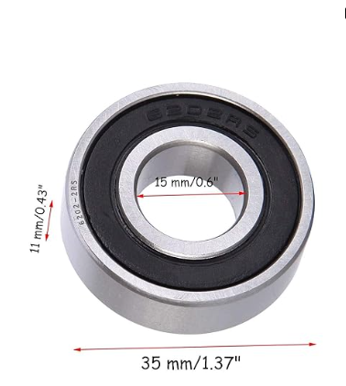
Cycloidal Gear Proof of Concept
DFM Considerations
FDM printing tolerances +_ 0.2mm
Design to be compatible with standard hardware
Limited to PLA
Limit features that require internal supports
Print orientation
Notes:
Next I’ll go through the prototyping process and what I tuned. These next slides were made as I was prototyping just to keep track of learnings and note down next steps.
First I just made a quick proof of concept to get a feel for the motion of the gear. As I was modeling and playing around with this proof of concept I determined some DFM considerations. I’d have to account for the printer tolerances, I needed to design around standard hardware sizes, like bearings, fasteners and etc. I was currently limited to PLA, and I needed to design with print orientation in mind, as that would help me save material on supports, and print quality. Another big one was limiting print supports on mating features between components. Print supports always leave heavy surface imperfections and could

Slide 8
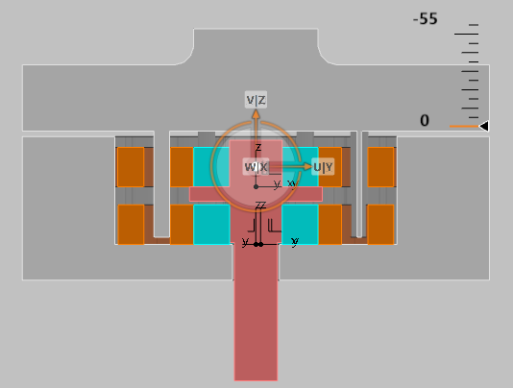
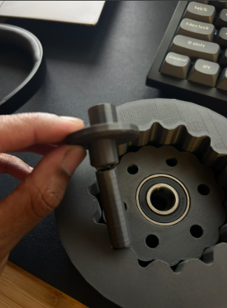
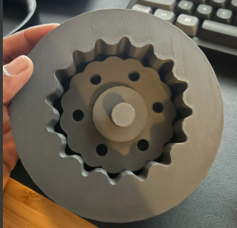
1st Iteration
Output Plate
Observations
Shaft
Lobe 1&2 diameter out of spec (nominal = 14.85, Actual = 14.3-14.5)
Input shaft broke at shoulder
High torque to overcome at certain points due to gear getting stuck at some points.
Layer lines are in plane with radial forces, so they’re loaded in shear and split
Gear
Eccentric Shaft
Hub/outer ring
Bearings
Next Iteration
Print shaft sideways to prevent layer line aligning with radial load
Oversize shaft nominal (15.2mm dia)
Understand printer tolerances in (X,Y,Z, and features)
Print and test with output shaft
Summary
-works overall to show feasibility
-needs tuning and design improvement
-Holes are 0.2mm undersized
Notes:
My first real prototype, had all 3d printed parts except for the bearings between the eccentric shaft cams and the gears. I had an extended input side of the eccentric shaft so I could spin the gears. However, this prototype only lasted about 5 min due to the shaft breaking right at the shoulder. I believe this failure happened from the gear getting jammed up and either the radial force from the gear caused it to fail from bending or from torsion.
Another observation was that this shaft was printed vertically so the layer lines from printing were parallel to the force. This makes the shaft much weaker to radial forces.
For the next iteration, the shaft needed to be printed sideways to make the layer lines perpendicular to the force. I also had a few fitment issues, which I planned to dial for the next iteration.

Slide 9
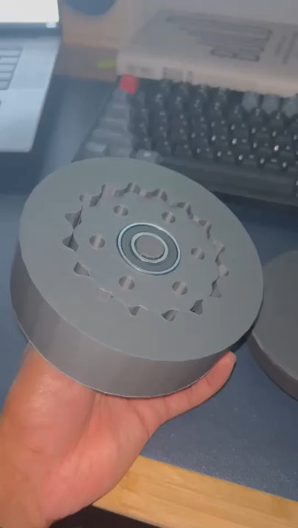
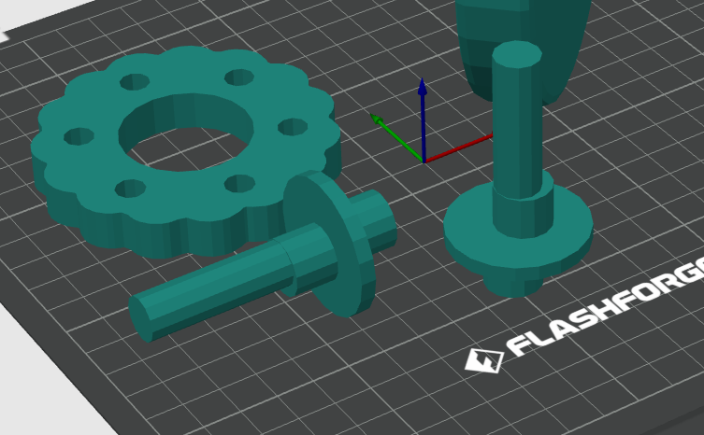
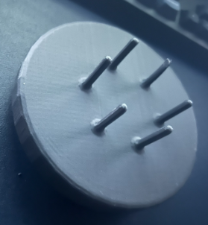
2nd Iteration
Observations
Oversized lobe diameter to compensate for 3D-print undersizing (14.8 -> 15.2)
Measured 14.9mm
Side print had tighter fit due to support layer breakaway on radius of lobe
Summary
-better lobe fitment
-print vertical but oversized diameters to prevent profile distortion due to support layers
-output shaft/plate needs to be print flat
-need to design a feature to add thrust bearing and distribute load effectively
-brainstorm some radial bearing addition to center output plate
Next Steps
Need a way to measure backlash
Fix output shaft
Integrate thrust bearing to transfer axial load
Integrate radial bearing for output shaft for alignment
add a feature to make sure output shaft and input shaft are concentric
Fix pins
-Print flat
-Press fit for dowel pins?
Notes:
My second iteration had less jamming, better fitment between parts, and the shaft did not break this time due to printing horizontally.
The main issue I found was that the output pins were undersized, were not perpendicular and would bend with very little force. This would be an issue since the pins transfer all the force and if they are not dimensionally accurate they would jam the gear.
The rest of the observations were fitment issues, and tweaks to the printing parameters.

Slide 10
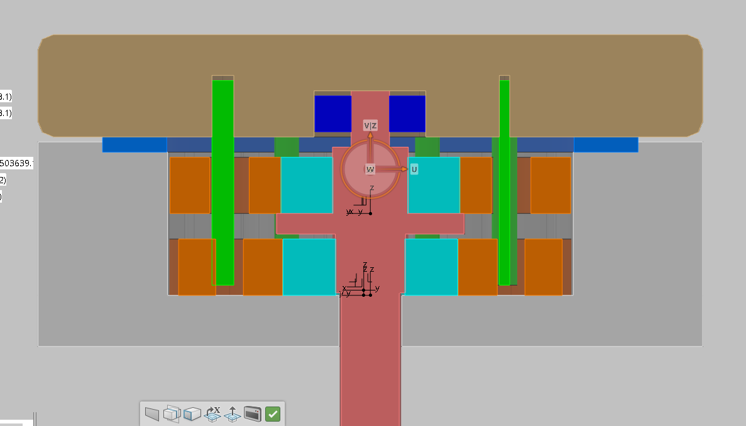
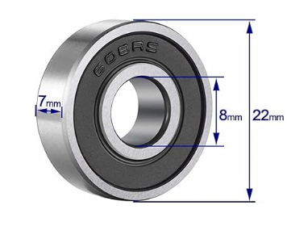
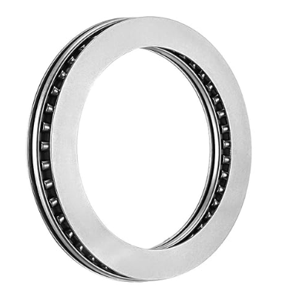
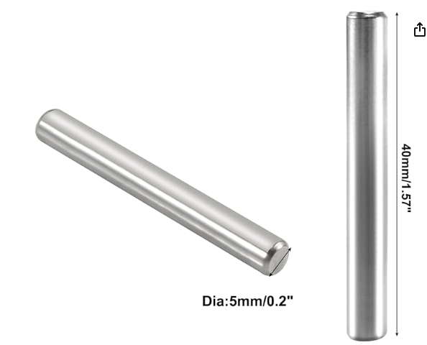
3rd Iteration
Added bearing and feature on shaft to align output plate
Added Dowel Pins
Added thrust bearing to reduce friction
Notes:
For the 3rd iteration, to improve the weak output pins. I decided to add press fit steel dowel pins. The dowel pins would resist bending a lot better and be dimensionally accurate. The dowel pins have a size tolerance of plus minus 0.01mm which would be more than enough to solve the perpendicularity issue. T
To minimize friction on the output plate I added a thrust bearing and I also wanted to center the output plate with the shaft so I modified the shaft to have a mating feature that rotates on the same axis as the input. There is a bearing in between the feature and the output plate so that it can spin freely.

Slide 11
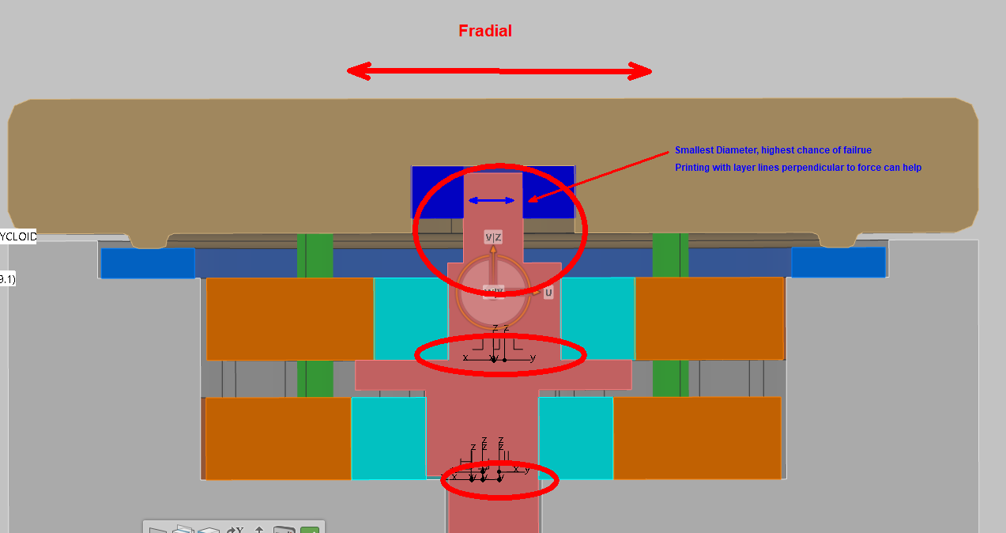
Observations
Integrated thrust bearing into assembly to handle axial loads from downstream systems
Integrated additional radial bearing that connects output plate and input shaft concentrically (Still on different axes and can rotate independently)
Eccentric shaft is taking all radial load.
Sharp shoulders with no stress relief. High chance of failure
Thrust Bearing Capability
Static Loading = 278.5kN
Dynamic Loading = 55.6kN
Speed = 2600rpm Max
Thrust bearing will not be failure point. Much higher capacity than needed for the system.

Slide 12
Debugging Assembly Issues
 |  | Nominal Dia | Measured | Variation | Fit
Eccentric Shaft | Input shaft | 12 | 11.8 | -0.2 | Good Fit
 | output shaft | 8 | 7.7 | -0.3 | Tighter
 | lobe 1 | 15 | 14.8 | -0.2 | Good(loose)
 | lobe 2 | 15 | 14.8 | -0.2 | Good (loose)
Cycloidal Gear | Bearing Hole | 35.2 | 34.9 | -0.3 | Perfect
 | Pin Holes | 8.1 | 7.8 | -0.3 | Needs to meet design spec
Hub | Shaft Hole | 13 | 12.7 | -0.3 | Good
 | Thrust Bearing Seat | 106 | 105.4 | -0.6 | Maybe 0.5mm tighter later
Output Plate | Bearing Hole | 22.4 | 22.2 | -0.2 | Too tight for prototyping
 | Dowel Pin Hole | 5.5 | 5.6 | 0.1 | Needs to be slightly smaller
Notes:
For the 3rd iteration, I still had some issues with assembly and every time I added a new mating feature or part I would have to print it several times until I got the right fit.
To investigate this issue,I took measurements of critical features just to see how far off I was and tune the nominal dimensions in CAD. I was more or less finding that both holes and circular features were off by 0.2-0.3mm on average. With the except being the thrust bearing diameter being undersized by -0.6mm which I suspect is due to the size of the feature. I suspect that I should lower my print speed to get better dimensional accuracy
Based on this info, I know I need to adjust my CAD nominal by roughly 0.2mm on assembly features.

Slide 13
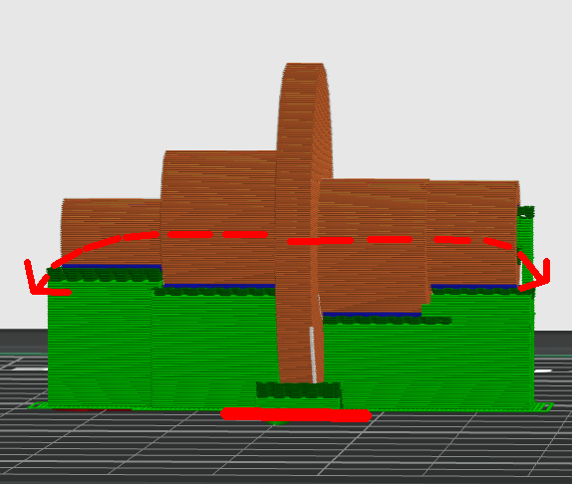
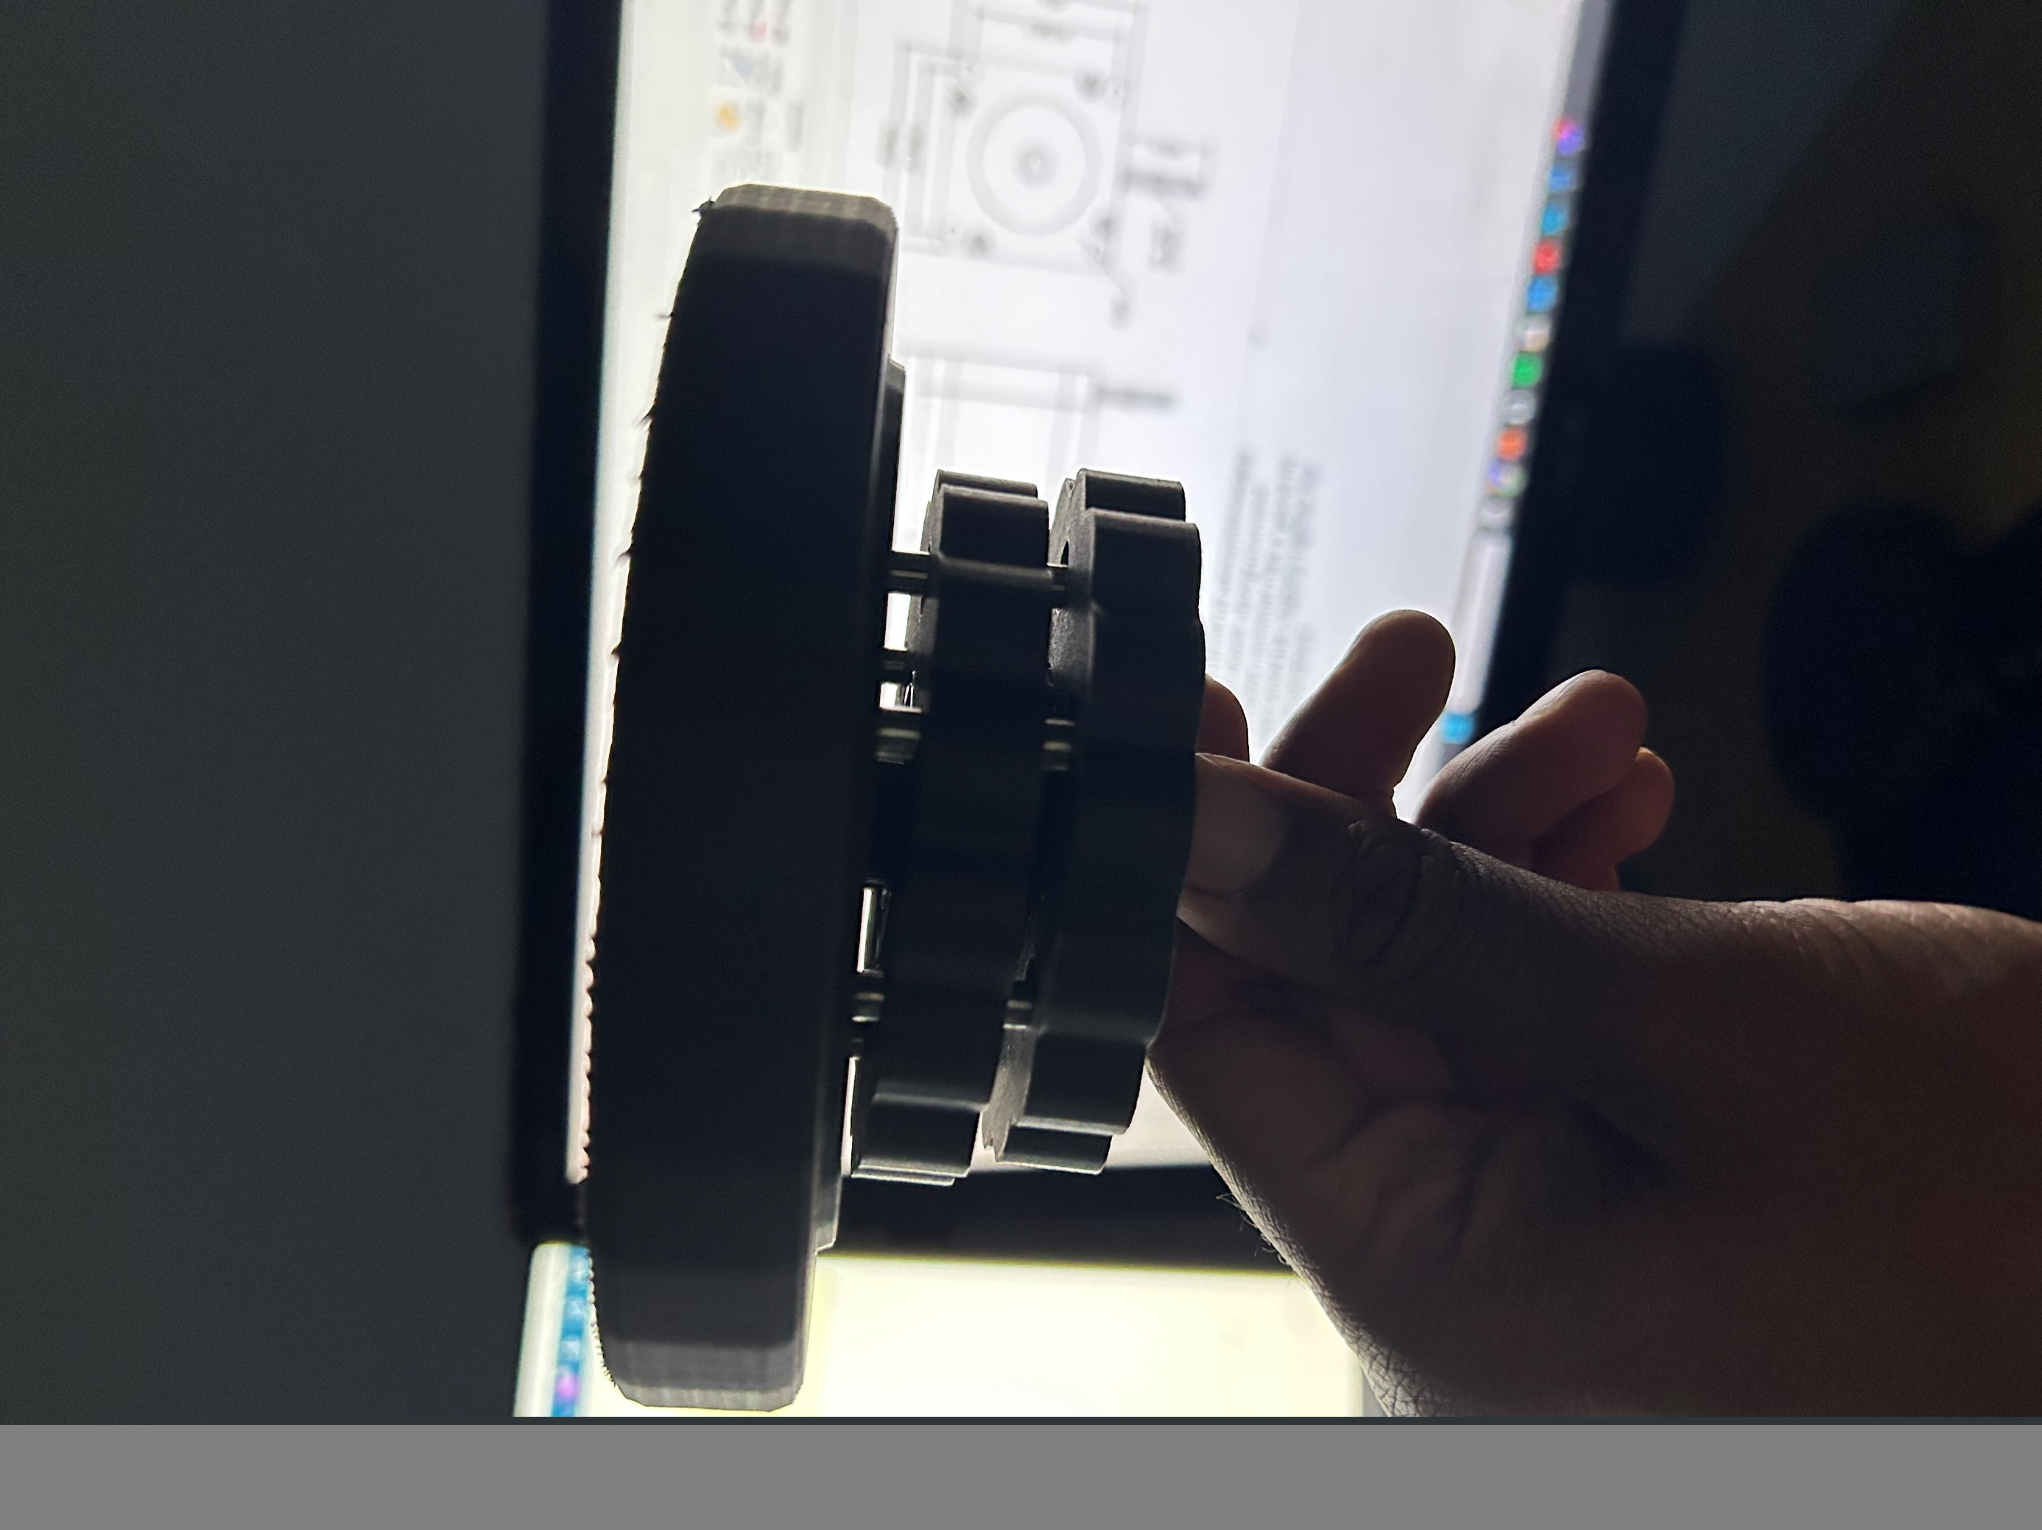
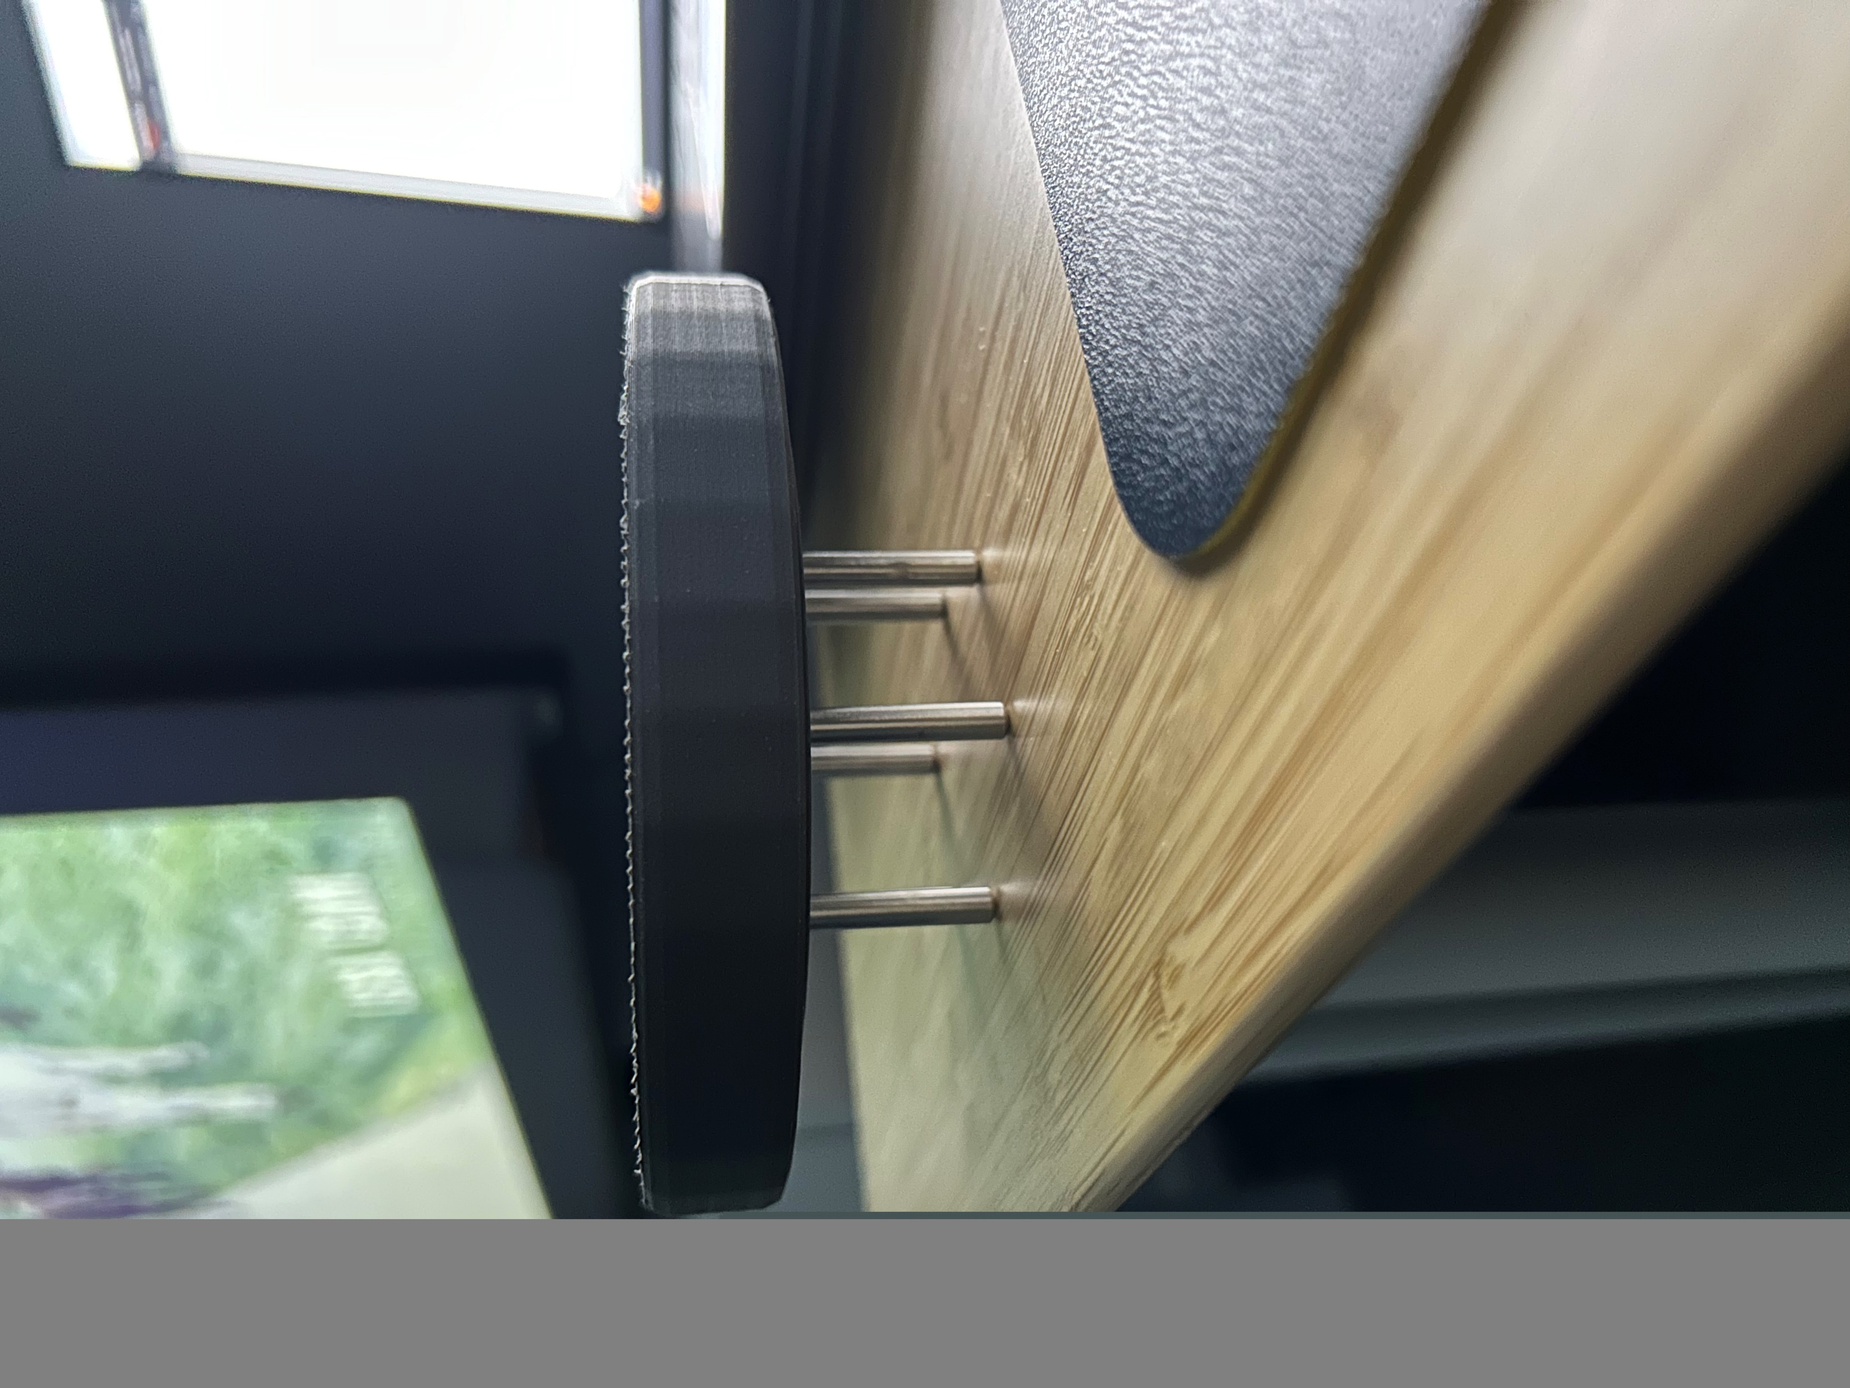
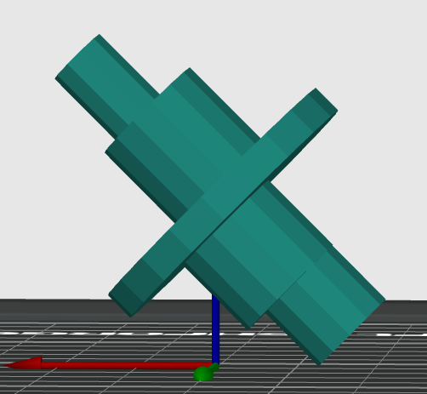
Debugging Assembly Issues
Shaft and Output plate not perpendicular – wobble and jamming
Eccentric shaft was bowed. Out of perpendicularity along axis. Caused fitment, alignment and uneven loading issues. Occurs during horizontal print orientation
Notes:
One thing I was not able to measure directly was the perpendicularity of the eccentric shaft. From the first picture you can see that the gear and plate are not parallel. I also noticed when spinning the gearbox, there is a ton of wobble and I have to apply an uneven force. Also when looking at the shaft, I could visibly see some bowing.
Previously when I was printing vertically, the shaft did not display any noticeable bowing, but since I need to print horizontally due to the alignment of layer lines, I need to solve for printing horizontally.
As for why this is happening, I suspect that the low density infill support layers were cooling much faster and pulling down the ends of the shaft which are a lot thinner than the main body of the shaft.
To find a balance between strength, my next iteration was printed at 45 deg. This proved to work much better and did not have alignment issues or portions of the shaft breaking.

Slide 14
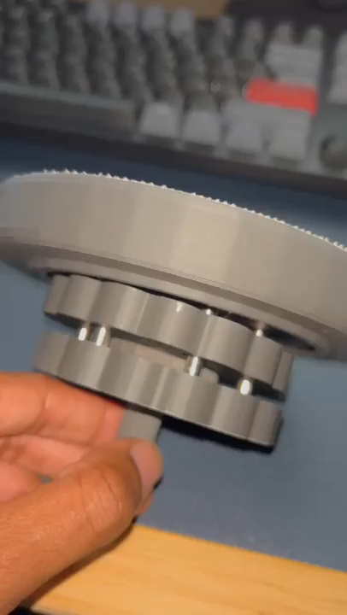
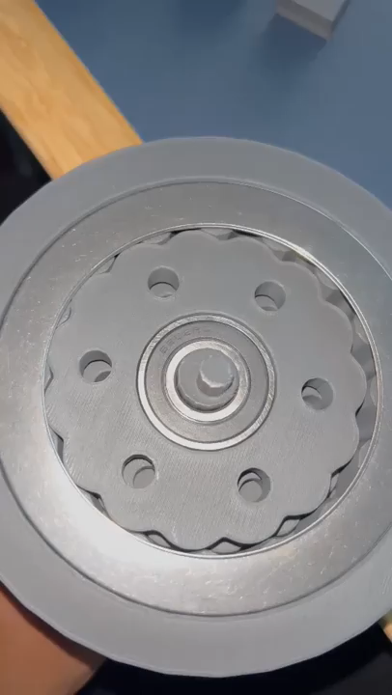
4th Iteration
New Features
5mm dowel pins
22mm bearing + eccentric shaft aligns concentrically with output plate such that output plate is radially aligned but on a different axis than input
Thrust Bearing + Output plate touch off ring. Axial loading only through thrust bearing
Tuned Eccentric shaft (lobe/shaft diameters)
Observations
Eccentric shaft need tight tolerance.
Still gets jammed up
Friction marks on bottom surface of gear due to rubbing with gearbox face
Notes:
So my 4th iteration had the 5mm dowel pins and the output plate thrust bearing + alignment feature. I don’t have the video but I did test the shaft printed at 45 deg, which solved the wobble issue.

Slide 15
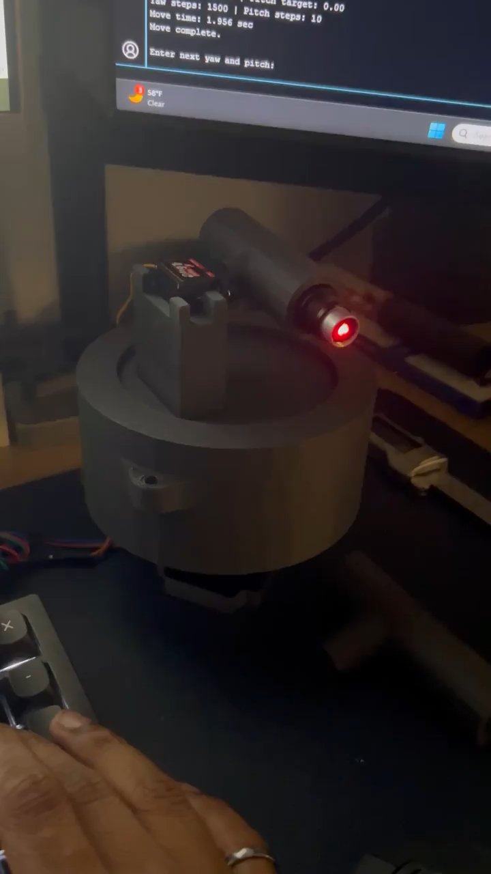
1st Hardware Trial
Observations
Rattly gearbox and vibration
Feels like motor is skipping steps (motor only trial)
Loud gritty sounds from motor
Electronics
learned that speed is quite limited
Very jerky and loud at 200 microsteps
Frequency of missed steps Is proportional to increase speed and increase microsteps
Next steps
Create a test code which takes position and speed as input
Need to redesign gearbox for smoother operation and reduce points of friction
Implement Acceleration function
Measure stepper motor accuracy
Measure gearbox accuracy
Kinda getting close @200steps/rev and 400microsecond delay
Notes:
At this point I was just curious to see how everything would perform with hardware. I did a quick pitch mechanism design which was just a servo, and a part to attach a laser pointer.
From the hardware side, it took a bit of trial and error to get the programming correct and also learn the limitations of my hardware. Specifically, things like speed and microstepping and controller data transfer limits.
This stage mostly involved just adjusting parameters such as motor speed, microstepping and current. Mostly I was just observing how the system reacted to these parameters.
Main thing I noticed was that the rotation was very jerky, and the motor would make loud gritty noises. I also noticed that the motor would missteps even when driven by itself. For example, If I would command 90 degrees, it would only make it about 60 degs and there would be some shuttering motion inbetween.
Here’s a quick video. Play video

Slide 16
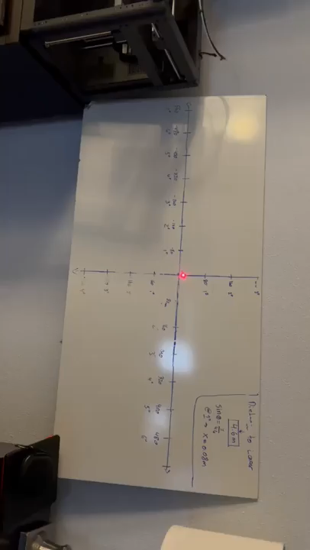
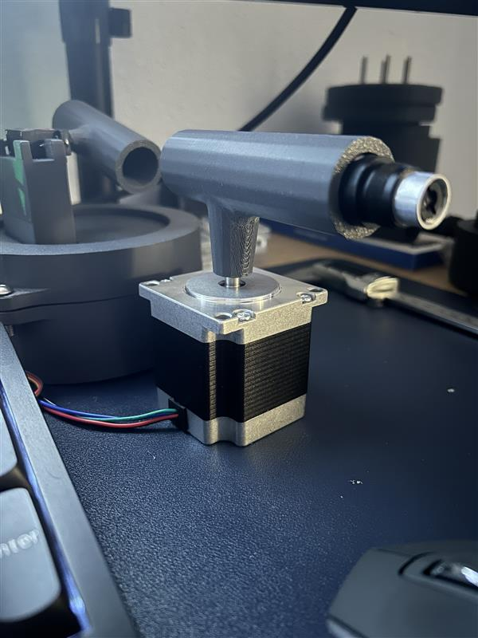
Positional Accuracy Testing
Test Parameters
Materials | PLA to PLA Interface
Microsteps | 800
Power | 12V, 2.8A
Speed | 400 microseconds
Accel | 0.3*Speed
1 deg = 80mm @ 4.3M
Test #1 – Incremental Accuracy at 1 deg steps
Measure distance between system and whiteboard.
Determine correlation between change in angle and change in position (1 deg = 0.08m)
Set system at position (0,0)
Provide terminal command to rotate -1 deg in X
Measure distance between laser and point
Repeat steps 4-5 till -7
Manually reset to (0,0)
Repeat steps 4 -5 till +7
Test #2 – Absolute Accuracy
Start at (0,0)
Command to -7
Measure distance and then manually reset to (0,0)
Command to -6
Repeat for -7 to +7 (reset in between each position command)
Notes:
To actually quantitatively track the accuracy of the system I performed two tests.
First test is to track how accurate the position is at 1 deg increment at 4.3m and the second was to just check absolute accuracy. At 4.3m, 1 deg is equivalent to 80mm.
Based on my time playing around with the motor parameters, I set them at the parameters that I qualitatively felt were best, just through observing smoothness and missteps. Also since I had a laser pointed at the wall I could kinda see the points when the motor went out of sync. This is a quick video showing my test set up in my room. It’s just a whiteboard with marks at 80mm increments to represent 1 deg steps. Due to the size of the white board I was only able to go from -7to +7 deg.
As for the actual tests. I ran both tests with the gearbox and then I ran both tests again without the gearbox. As you can see I am well off my 1 deg = 80 tolerance.
However the silver lining is that both incremental and absolute testing showed the same amount of variation which indicates to me that the lack of accuracy lies in the system and not in the delta between position commands/
Secondly, the direct to stepper test also shows the same relationship but at an even higher offset position.
I was expecting the direct to stepper to produce better results so I was surprised when it was actually much worse. I did some research and I learned that stepper motors do not like to operate under no load. When the rotor is pulled by magnetic forces to the next step it actually goes past the target step and then kind of osicillates until it reaches equilibrium. But typically the next pulse will arrive before equilibrium and that means for the next step the rotor will be off. This is then propagated due to the hundreds of steps. To my understanding, adding load reduce the resonance and help the motor be a bit more accurate. This is something I need to look into a bit deeper and find the ideal load
Based on these tests, I need to first adjust the parameters and find the combination that gives me the best accuracy under a semi loaded motor condition. I need to add an acceleration function to gradually allow the motor to get up to speed. Once the motor is accurate under limited load, I can then independently determine how much variation the gearbox adds.

Slide 17
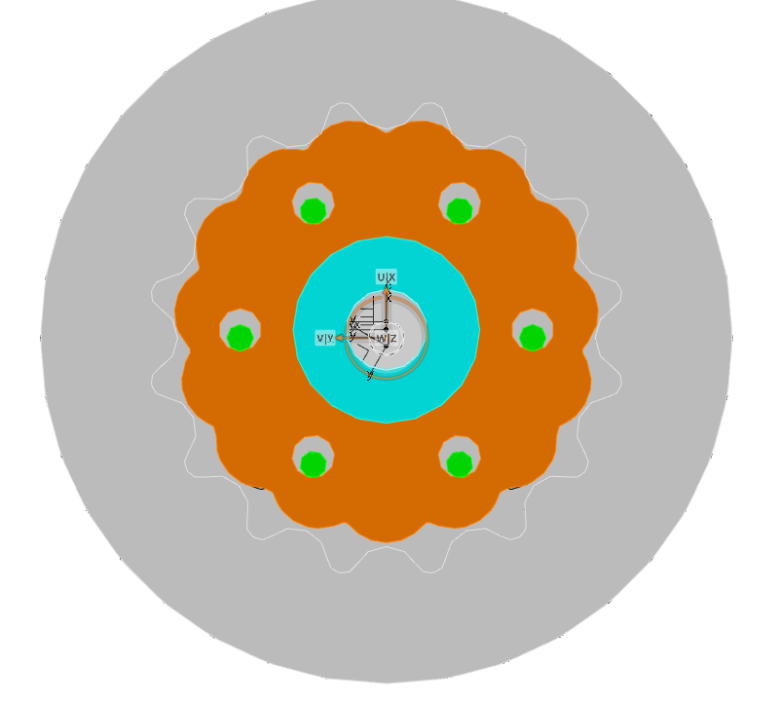
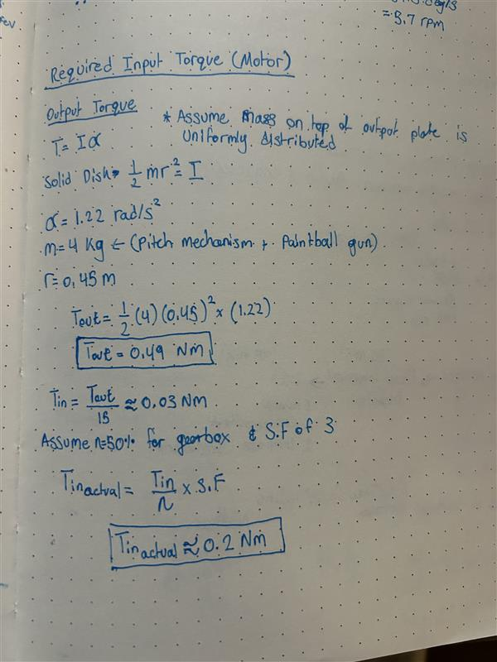
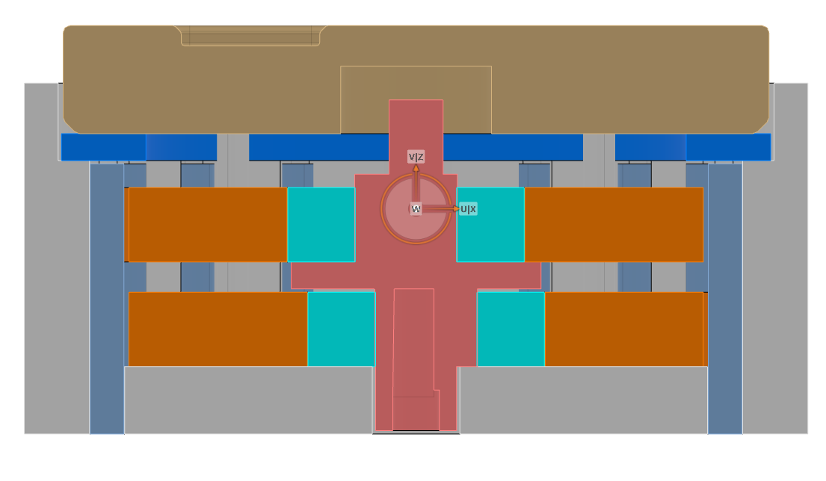
V2 Design Improvements
V1
Corrected Torque Calc
Mechanical Losses
Sliding friction between eccentric shaft and gearbox (not shown)
Bearing friction between cam and gear
Rolling + sliding friction between disk gear and ring gear
Sliding friction between output pins and output holes on disk gear
3
2
4
V2
Hardware Improvements
Reducing friction in gearbox will minimize missteps from motor
Tune micro step & amperage setting (Driver)
Tune speed and accel parameters (Software)
Notes:
During the positional accuracy test and actually running the motor for a bunch of cycles, I realized that I determined my output torque incorrectly. On the left you’ll see the correct calculation based on torque for a spinning disk. This takes into account the moment of inertia and acceleration.
My actual required input torque was 0.2Nm as opposed to the 0.013Nm. Luckily since my motor is much more powerful than necessary, I was still well within the torque curve for the desired rpm.
Also at this point I started looking into how real cycloidal gearboxes are designed and started reading some papers.
The key takeaways were that I needed to reduce my friction losses. The losses I looked at was the sliding friction between the eccentric shaft and gearbox hole, the bearing friction between the cam and gear, rolling + sliding friction between the gear and the ring gear, and the sliding friction between the output pins and output holes on the gear.
Theoretically, the cycloidal gear is only supposed to have a rolling contact with the ring gear profile. However this does not account for tolerances, or assembly. In reality, the gear needs to have some clearance, which I learned the hard way when the first gears I printed would not assembly. I do not fully understand the dynamics but due to this offset the gear will experience rolling and sliding friction.
Also due to contact stress, there will be small deformations in the plastic that deform the surface and contribute to sliding instead of rolling. In the future I could use a plastic with higher hardness and lower coefficient of friction to reduce some of friction loss.
Now the sliding friction between output pins and output holes and disk gear can be limited by adding a bearing to let the dowel spin. Ideally there will be no relative movement between the contact points and there will be pure rolling.
Based on these learnings I decided to redesign and create a v2
Rolling friction is the slight deformation at the point of contact, this eats some of the energy. Converts to heat?

Slide 18
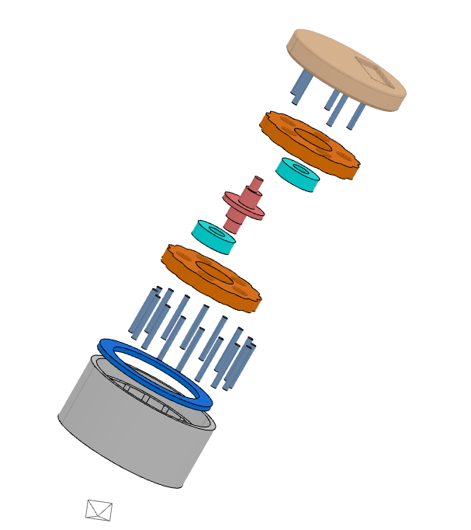
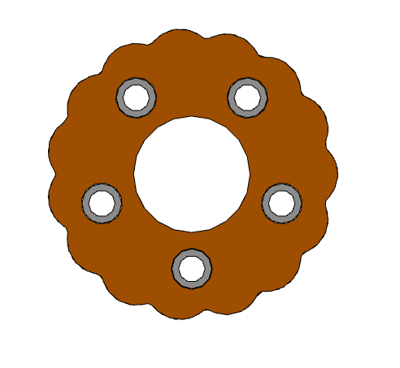
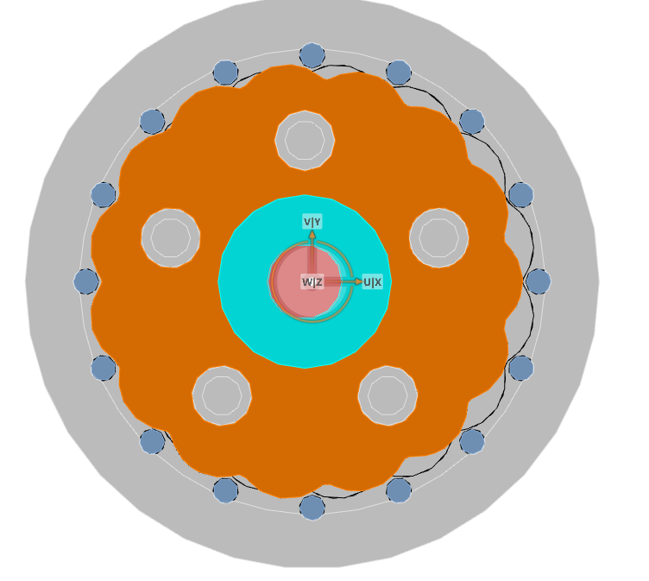
Steel dowel pins to plastic - rolling + sliding interface
Bearing for output pins
Notes:
The main changes were adding bearings for the output pins, and adding steel dowel pins to the ring gear side. Although I don’t have an exact number for coefficient of friction for PLA to steel, or PLA to PLA, I am sure the steel to the 3d-printed pla will have a much lower coefficient of friction. Also the steel being much harder, will definitely improve the rolling friction.
Other than that, for V2 I had to resize a bunch of things to fit the new bearings and pins, and I attempted to make the packaging smaller.

Slide 19
Learnings
Motor needs to be loaded for optimal performance. (Reduce resonance)
Motor struggles for accuracy and speed at small increments of rotation. (Increase gear ratio to allow for speed ramp up to optimal speed thus more accurate positioning)
Need to offset gear surface since the “theoretical profile” does not account for real world conditions (tolerances, friction, contact stress, and etc.)
Print orientation matters for managing failure under load
Helped to prototype and iterate quickly. Was able to have constant improvement.
Underestimated impact of tolerances on this design, from assembly to actual gear motion
Motors have many parameters that need to be optimized per application. Not plug and play
Next Steps
Assemble V2 design and repeat position accuracy test
Add feature to hub design to stabilize the gearbox radially. (more mass or clamp to table)
Replace PLA
Design test rig to accurately determine torque
Torque test – use torque wrench to measure torque at gearbox output and motor input
Continue optimizing software and driver to minimize missteps
Add lubrication (Vaseline)
Investigate operating temp of gearbox
Notes:
I have both v2 and v1 sitting in front of you, and although I haven’t had a chance to test it yet, the v2 feels much smoother when backdriven, which indicates to me that there are some improvements.
I have a quick summary of my learnings on the left.
As for next steps I need to run the accuracy tests for the v2,
I also need to add a feature to clamp the geabox to the table or just add some mass. At the moment I have nothing to absorb the radial force from the gearbox.
I’d like to replace the PLA at some point to a more suitable material
I think a huge step would be to have some sort of test rig to benchmark input and output torque. Currently I have no real way of knowing if my improvements work or what the actual torque output is.
I need to optimize the software and motor parameters to reduce the missteps, this will require some more research into stepper motors and a lot of trial and error.
Something I’d be interesting in learning as well is how much heat is produce in a gearbox. Especially since I’m using plastic for the gearbox, creep and fatigue would be a lot more sensitive as the gearbox heats up.
In summary, I’ve been able to design the gearbox and determine how far I am from my high level design targets. There are more tests I need to do to fully understand the gearbox output, but overall I’m learning what levers I can pull to tune my results and it’s been quite interesting to learn about this style of gear. As well as learning the electronics side a bit more in depth. If I had attempted this before interning here, I would have a much tougher time on this project.
Thermal
Material warpage due to HDT
Reduced yield stress

Slide 20
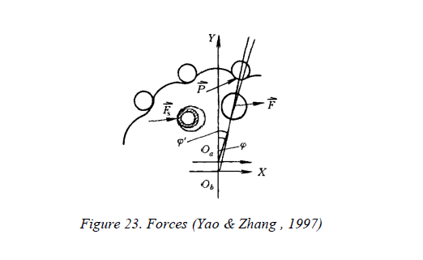
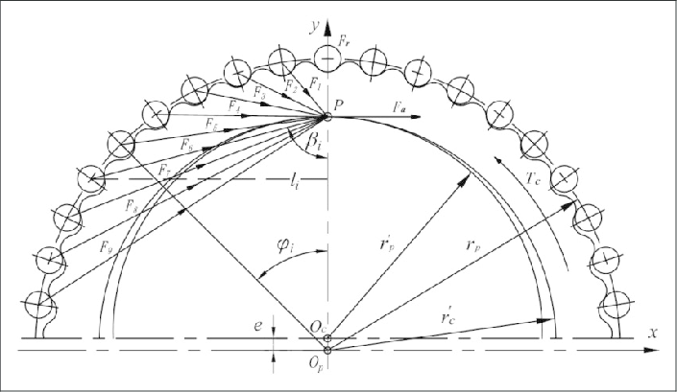

Slide 21
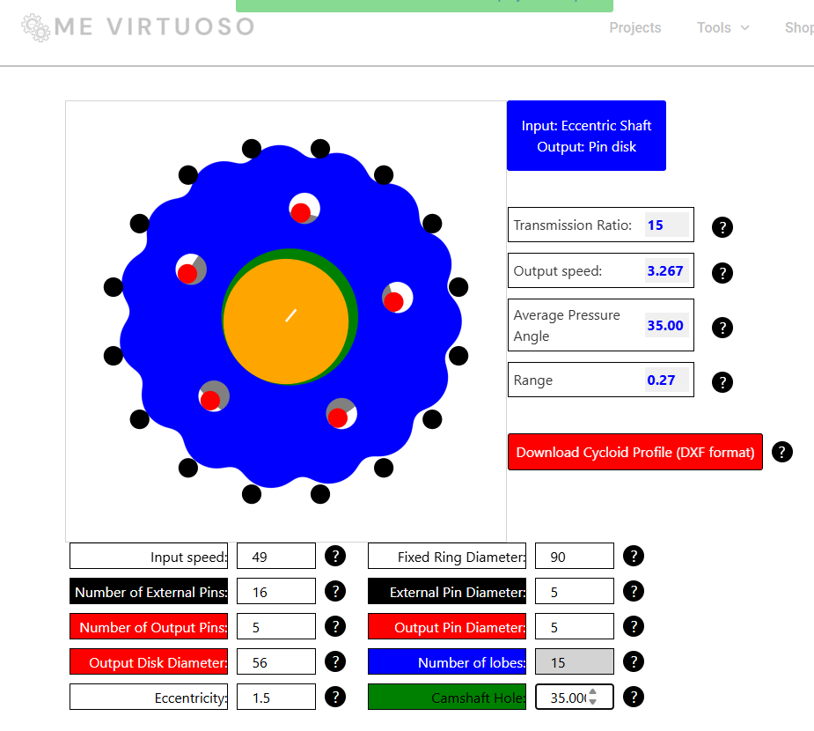
Pressure Angle
Average pressure angle = 35 deg
*Not an accurate characterization
Pressure angle is proportional to power transmission.
Levers for Pressure Angle
# of external pins a.k.a GR (+)
Eccentricity (-)
Pitch circle diameter (+)
Ring pin diameter (-)
Notes:
Due to the variable nature of pressure angle for cycloidal gears, I am overly simplifying this to the average pressure angle seen through a full rotation. Also due to the complexity, I am characterizing pressure angle similar to a spur gear. Relative to the standard 20 deg pressure angle for spur gears, this pressure angle has a much larger radial force. To transfer more useful tangential force, I could adjust an independent parameter like eccentricity. This would also provide smoother and quieter operation. This is not something I have optimized for currently but for future iterations this is something I will adjust.

Slide 22
PLA vs Nylon
Material Properties | PLA | Nylon
Yield Stress (MPa) | 38 | 77
Youngs Modulus (GPa) | 3.5 | 2.6
Elongation @ yield (%) | 6 | 46
Coefficient of Friction | 0.42 | 0.26
Hardness (Shore D) | 66 | 81
 | PLA | Nylon
Cost | $ | $$$
Difficulty to print | Easy | Moderate (need heated enclosure for optimal results)

Slide 23
“Zero Backlash”
Traditional Involute Gear Profile
Gap between teeth are part of the design to prevent jamming due to manufacturing tolerances
Load concentrated on a few teeth and has sliding and rolling contact
Cycloidal Gear Profile
Supposed to have constant contact (no design gap). Will be in preload
Multi-tooth contact – up to 50% of pins
When reversed the load transfers onto the pins already in contact

Slide 24
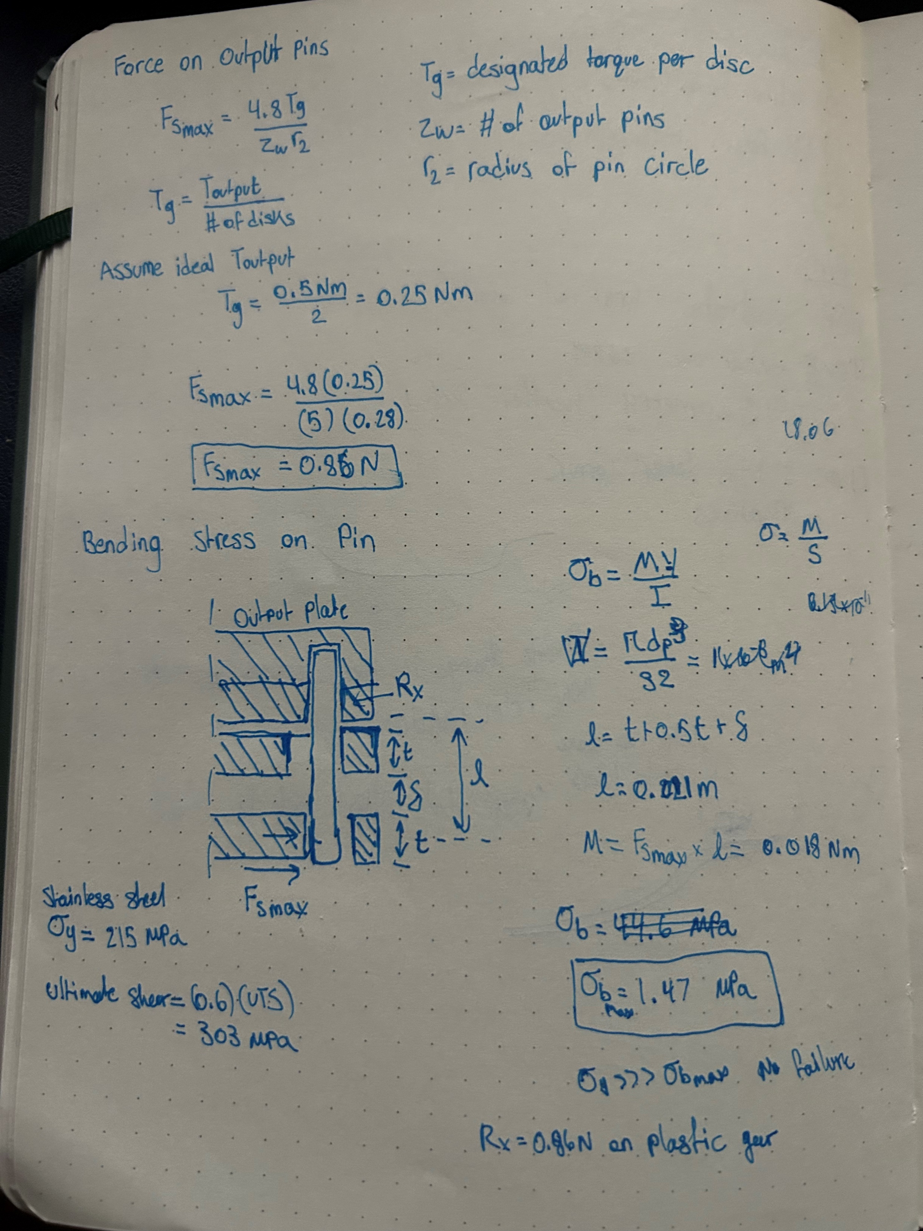

Slide 25
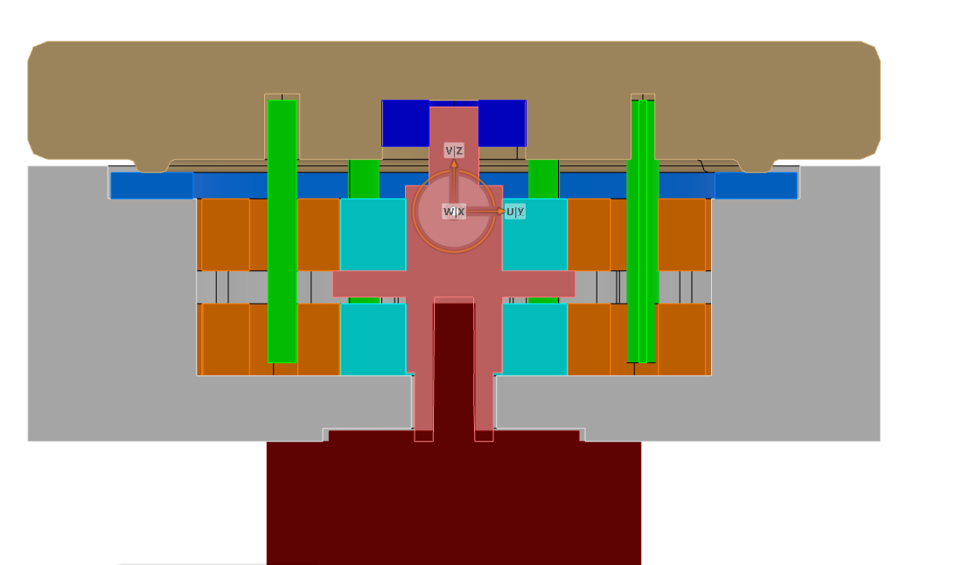
Faxial

