Slide 1
REMOVE THIS SLIDE BEFORE SENDING TO STUDENTS
Currently Complete:
Intro Slide
Gameplay Instructions
How the game mechanics work
How agents interact with the game (read/write of txt files)
Illegal Movements
GUI instructions
OS and Language Requirements
TBD:
Course instructions
How grading will occur
How the final competition will be conducted (What game settings we will use, soccer tournament style?, etc)
How code and presentation will be submitted
Recommended dev environment (I suggest they work in VSCode but we should recommend a few options)
Bug testing the Game
Bug testing the GUI
This presentation is a work-in-progress.

Slide 2
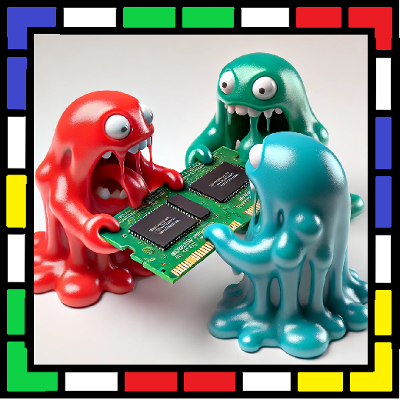
RINGwars — A Code-able Game
Course Name & Number
Our names and credits
etc

Slide 3
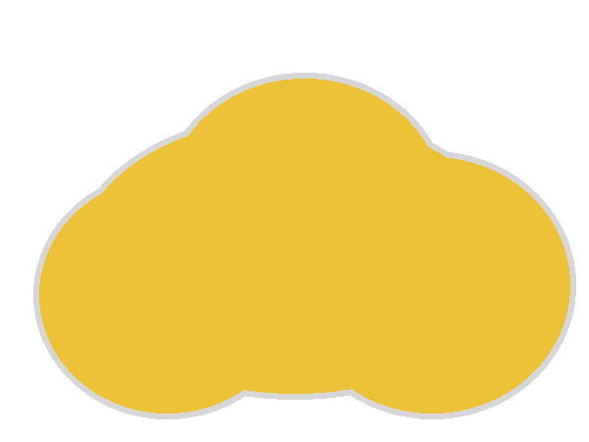





What we’ll cover in this presentation
Introduction to RINGwars
The Rules of the Game
How the game is played
How agents interact with the game
Illegal moves
The Class and Competition
Student Teams
Submission Requirements
Group Phase
Knockout Phase
OS Requirements and GUI Details
Required OS and Programming Language
How-to Guide for the GUI

Slide 4
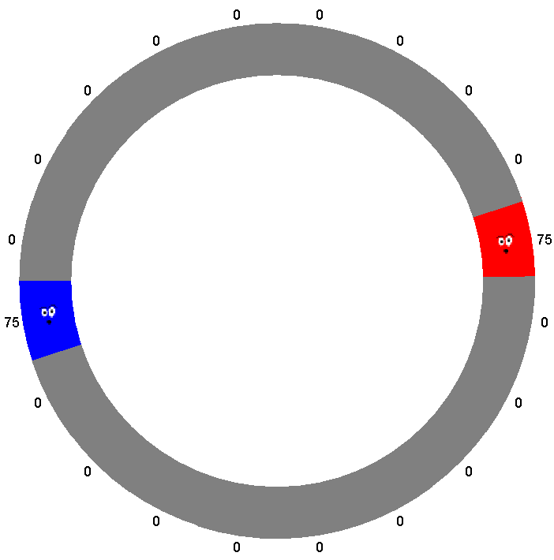
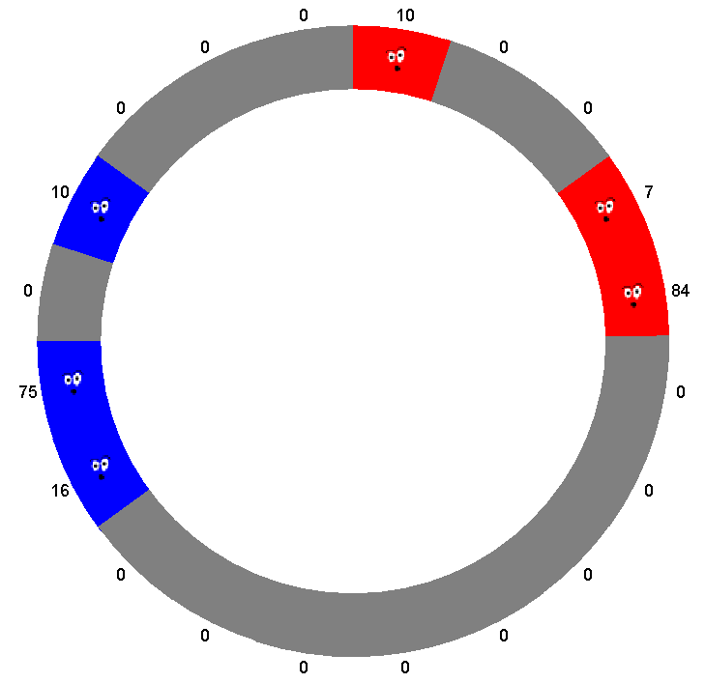
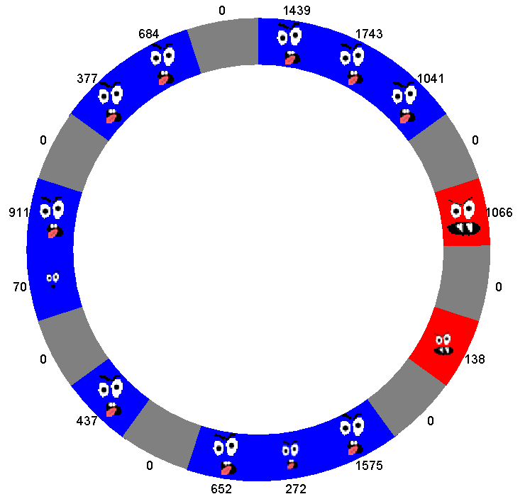
What is RINGwars?
Two players create agents that compete on a ring of nodes.
Win by conquering all nodes or eliminating your opponent.
Agents interact with the ring world by reading and writing simple txt files
Turns resolve simultaneously; after moves, resolution phases handle battles and control changes.

Slide 5

Game Rules
The following slides describe the rules of RINGwars. These rules fall into 3 categories:
Basic Gameplay
How the game starts
What happens each turn
How battles work
Agent-RING Interactions
How agents interact with the RING world
What constitutes an “illegal” move
Misc
Strategies for winning
What counts as cheating

Slide 6
Starting State & Control
Agents initially control a single node each on opposite sides of the ring
Each agent has an equal number of starting fernies on their initial node
All other nodes are uncontrolled
Nodes become controlled by placing Fernies on them
Agents only have knowledge about nodes within a fixed range of nodes they control
If you remove all fernies from a node, it returns to being uncontrolled
Starting state of the game.

Slide 7
Taking a turn
At the start of each turn agents receive new Fernies
The number of new Fernies is determined by Fernie count and the number of nodes controlled at the start of the turn
New Fernies = Current Fernies × Growth Percentage × Node Ownership Bonus
Once new Fernies are received agents can place these Fernies on the ring
Pre existing Fernies can also be moved
Only nodes within a fixed range of currently controlled nodes can have Fernies placed on them
Nodes outside of this range are invisible to the agent.
?
?
0
0
50
0
0
?
?
Legal Placement Zone & Visibility Zone
(If legal range = 2 nodes)

Slide 8
Two Action Types
Agents perform only two primary actions: Place and Remove
Place: Put fernies on any node within the visibility range of a node you control.
Remove: Take fernies off any node you control; you can then place them on any legal node the same turn.
Removed Fernies which are not placed in the same turn will be permanently lost.
Each node has a maximum Fernie capacity. Any excess Fernies placed on a node will be lost.

Slide 9
Resolution Phase: Local Battles
Once both agents have made their moves / actions a resolution phase occurs
First local battles occur when both agents attempt to claim the same node in the ring
The agent with more Fernies on a given node wins control of that node
This Fernie count includes Fernies placed during this turn
The Fernie count of the loser is subtracted from the winner
SO if Agent A places 75 Fernies on the same node where Agent B has 50 Fernies, Agent A will win control of that node and hold 25 remaining Fernies on it.
If both agents have equal numbers of Fernies then they cancel each other out and the node is left with no controller / owner
Remaining Fernies = |Total A Fernies − Total B Fernies|

Slide 10
Resolution Phase: Local Battles
Local Battles are calculated immediately after both agents move.txt files have been read and accepted.
75
Red Agent places 75 Fernies on a node controlled by blue with 50 Fernies
0
0
50
0
Red takes control of that node but only has 25 surviving Fernies
0
0
25
0

Slide 11
Resolution Phase: Local Battles
Local Battles are calculated immediately after both agents move.txt files have been read and accepted.
50
Red Agent places 50 Fernies on a node controlled by blue with 50 Fernies
0
0
50
0
Fernies cancel each other out and no agent controls the node
0
0
0
0

Slide 12
Resolution Phase: Local Battles
Local Battles are calculated immediately after both agents move.txt files have been read and accepted.
25
50
Red Agent places 50 Fernies on a node controlled by blue with 50 Fernies. Blue also places 25 new Fernies on that node.
0
0
50
0
Blue wins and retains control of the node with 25 Fernies
0
0
25
0

Slide 13
Resolution Phase: Edge Battles
Once all local battles have been resolved the ring is searched and Edge Battles and Triple Battles occur.
This search occurs in alternating directions: clockwise and counterclockwise
The starting location of this search is randomized**
If two neighboring nodes are controlled by different agents then an edge battle occurs between these nodes
If three neighboring nodes have alternating ownership then a triple battle occurs
**No battles occur on the edge between the starting node of the search and the final node of the search. In effect this creates a pseudo safe-zone at that edge. It is randomly selected to avoid giving a pre-determinable advantage to either player.

Slide 14
Edge Battles
Edge battles are fought on the edge between two nodes controlled by opposing players
The player with more fernies absorbs the other
winner keeps their node and gains fernies equal to the loser's count
the loser's node becomes uncontrolled with zero fernies.
If absorption results in a Fernie count higher than the maximum node capacity then any excess Fernies are lost.
If equal, both nodes become uncontrolled (all fernies removed).
Red has 75 Fernies bordering a blue node with 50 Fernies
0
75
50
0
Red absorbs the 50 blue Fernies. Blue loses control of its node.
0
125
0
0

Slide 15

Edge Battles
Edge battles are fought on the edge between two nodes controlled by opposing players
The player with more fernies absorbs the other
winner keeps their node and gains fernies equal to the loser's count
the loser's node becomes uncontrolled with zero fernies.
If absorption results in a Fernie count higher than the maximum node capacity then any excess Fernies are lost.
If equal, both nodes become uncontrolled (all fernies removed).
Red has 50 Fernies bordering a blue node with 50 Fernies
0
50
50
0
Both sides cancel each other out and lose control of their nodes
0
0
0
0

Slide 16

Resolution Phase: Triple Battles
The Ring search may also result in a third type of battle: a triple battle
If ownership alternates across three consecutive nodes (A-B-A), then all Fernies present in these nodes are involved in the battle
Again the player with the highest total of Fernies wins
Similarly a tie results in a loss of ownership for both players
The winner gains control of his opponents node(s) and Fernies but no Fernies are moved in this process
50
75
50
0
50
75
50
0

Slide 17
Resolution Phase: Triple Battles
The Ring search may also result in a third type of battle: a triple battle
If ownership alternates across three consecutive nodes (A-B-A), then all Fernies present in these nodes are involved in the battle
Again the player with the highest total of Fernies wins
Similarly a tie results in a loss of ownership for both players
The winner gains control of his opponents node(s) and Fernies but no Fernies are moved in this process
50
100
50
0
0
0
0
0

Slide 18
Agent Interaction & Files
Agent programs are run independently by the RINGwars GUI.
They read a state file containing information about the current state of the ring, generate a move file containing their instructions for that turn, and then terminate.
Any language which you can run on your computer can be handled by the GUI
However this lab requires you work in Java
You may still prototype your agents in a scripting language such as Python
…

Slide 19
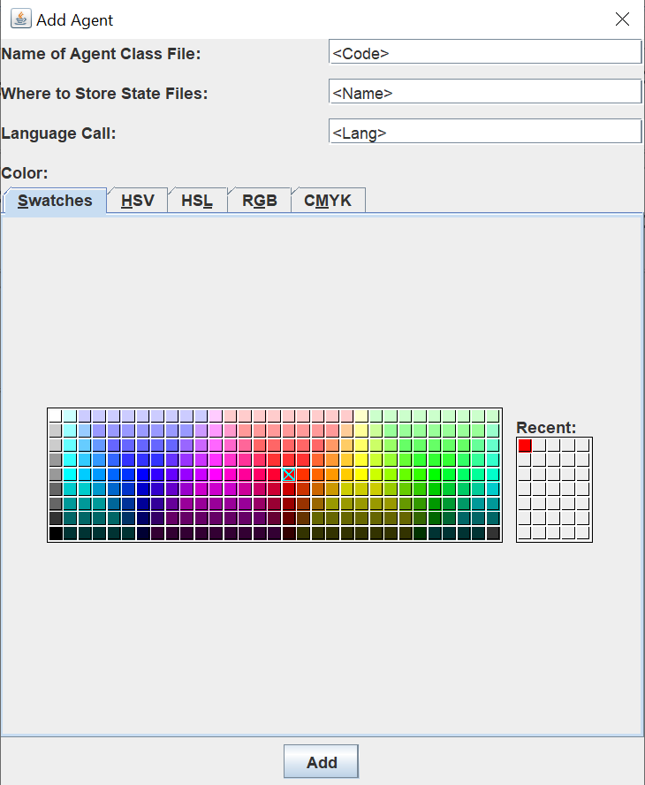
Agent Interaction & Files
Your agent will be a program named <Code> and have an in game name <Name> as well as a language call <Lang>
<Name> must be unique for each agent, but multiple agents can reference the same <Code> file.
Since this lab requires Java <Lang> should always be “java”
Agent code must be stored in the same folder as the RINGwars GUI
State files and move files will be stored in /<Name>
This folder is created by the GUI you do not need to create it yourself
Each turn, the game writes a <step#>.txt in /<Name>
Your agent reads <step#>.txt and creates move.txt with its actions for that step.
You may read earlier step files or create separate memory files, however these files must be in a plain text format.
The game then reads move.txt and, if legal, applies your agent’s actions.

Slide 20
Agent Interaction & Files
What the GUI calls:
<Lang> <Code> <step#> <Name>
For example:
C:\RINGwarGUI\>java myAgent 11 redagent
Runs a java agent program called myAgent which must read /redagent/11.txt and create /redagent/move.txt

Slide 21
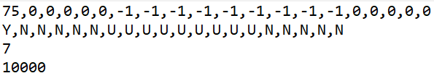
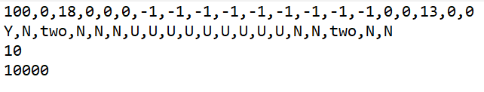
Agent Interaction & Files
<step#>.txt stores a representation of the current state of the ring along with the number of new Fernies your agent can add and the maximum Fernies per node.
The first line of <step#>.txt contains a comma separated list of Fernie counts.
A -1 count indicates that the node is currently invisible to the agent
The next line indicates node ownership
Y = Yours - a node controlled by the agent
N = No control - a node with no controller
U = Unknown
Any other text = a node controlled by your opponent (represented with their name)
The first two lines always start with the node your agent began on and list the remaining nodes in a counterclockwise order.
The third line tells you how many new Fernies you can place this turn
The final line tells you the maximum Fernie capacity for all nodes
1.txt the state file for the first step of the game.
Note: the opposing player is not yet visible at this step.
5.txt the state file for the 5th step of the same game.
Now the opposing player “two” is visible.

Slide 22

Agent Interaction & Files
Your agent reads <step#>.txt and creates a corresponding move.txt file with its instructions for the game step.
Each line of move.txt contains a different action / instruction
Each instruction consists of a node location and a number of Fernies to either add or remove at that location
Where location 0 is always your agents starting position
Nodes iterate counterclockwise, so node 1 is the next node beside your starting node in a counterclockwise direction
Negative numbers indicate REMOVE actions while positive numbers are PLACE actions
A set of 4 actions / instructions / moves.
PLACE 36 Fernies on node 1 (the first node in a counterclockwise direction from the agent’s starting node)
PLACE 1 Fernie on node 17
REMOVE 50 Fernies from node 0 (the agent’s initial node)
PLACE 50 Fernies on node 5
This move.txt implies that the agent received (at least) 37 new Fernies and had at least 50 Fernies on its starting node (node 0).

Slide 23
Illegal Moves Invalidate Your Turn!!!
If you make any illegal moves during your turn all moves made during your turn will be ignored. However you will still be able to make new moves at the next turn.
Illegal Moves:
Removing Fernies from a node you do not control
Removing more Fernies than you possess from a node you do control
Placing more Fernies than the sum of your new Fernies + any Removed Fernies
Placing Fernies on nodes outside of your visibility range
Other moves such as not placing all your new Fernies during your turn are legal but will result in the loss of the left-over Fernies

Slide 24

Learning to play RINGwars
Ultimately the best way to understand the mechanics of RINGwars is to play it for yourself. To help with this we provide HumanAgent.exe an executable which allows you to input moves.
HumanAgent.exe is added like any other agent. However its language call field must be left blank.

Slide 25
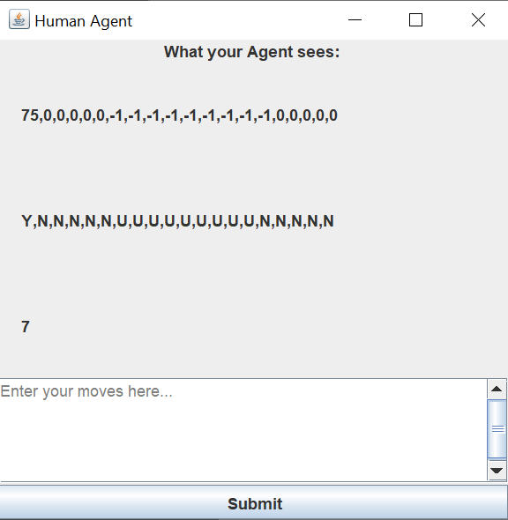
Learning to play RINGwars
We recommend first playing the game with a couple instances of HumanAgent to understand how RINGwars works.
HumanAgent creates a pop-up window which displays the first 3 lines of <step#>.txt and allows you to input lines of move.txt
This lets you interact with the game exactly as your programmed agents do.

Slide 26
Understanding the Game
Fundamentally RINGwars is a game about exponential growth. If you can “snowball” faster than your opponent you will win the game.
Your growth rate depends both on the total number of Fernies you possess and on the number of nodes you control. This leads to a balancing act. You can rapidly spread out to boost your node ownership bonus, however this will leave your nodes weakly defended. Or you can slowly expand, and miss out on the ownership bonus.

Slide 27
CHEATING
Your agent is only allowed to read and write its own files. Reading your opponents state files or creating a fake move.txt for your opponent is CHEATING. This will not be tolerated and if you caught you will be treated with the same severity as if you had cheated on an exam. DO NOT CHEAT. Your agent should only interact with files in its own state directory (/<Name>).

Slide 28
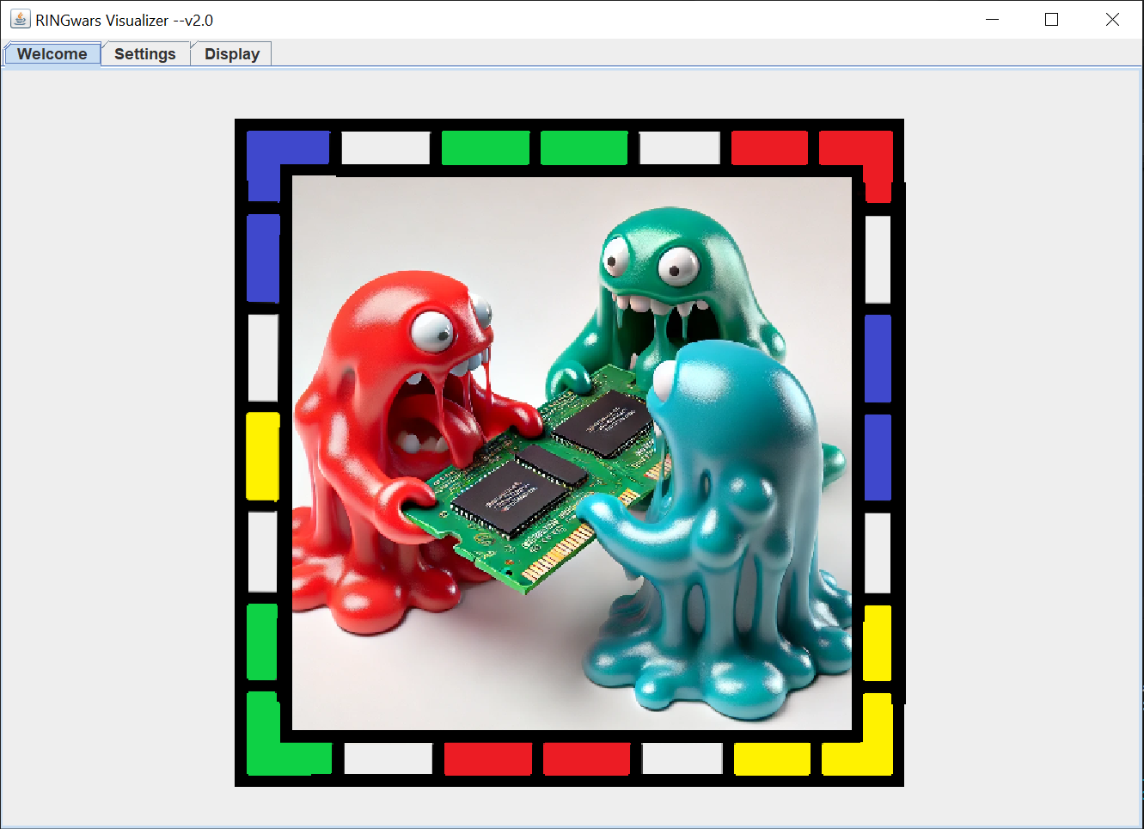
Using the RINGwars GUI
The following slides describe how to use the RINGwars app to test your agents.
The launch screen of the RINGwars GUI. Note the three tabs: welcome, settings, and display.
Settings allows you to load agent files and adjust the game settings.
Display gives you a visualization of the RINGwars game with the agents you have loaded in.

Slide 29
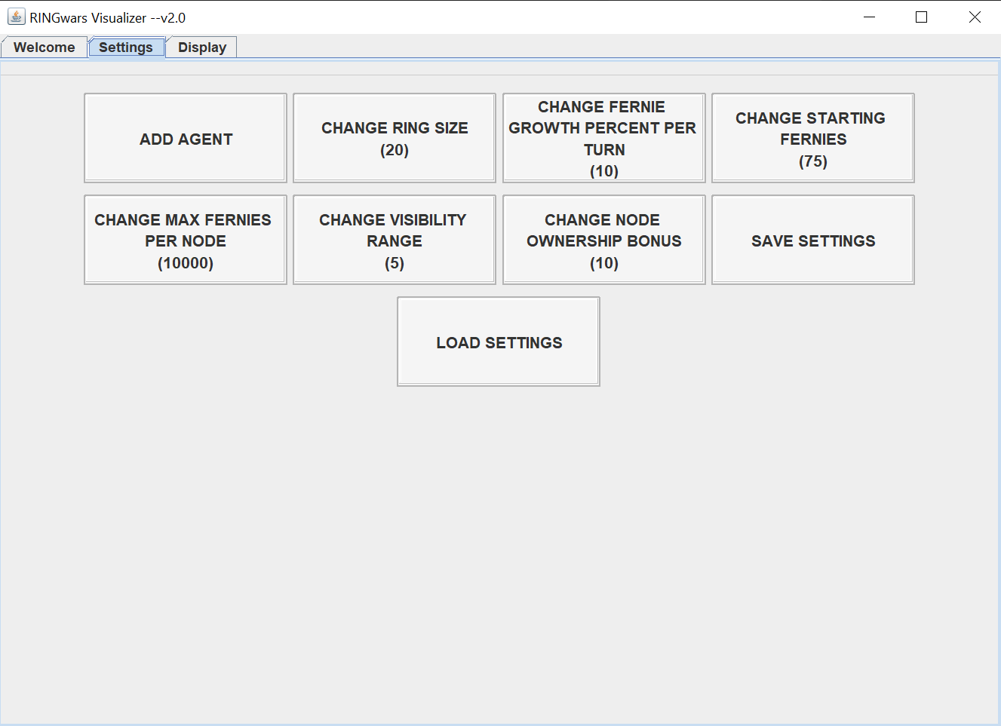
Settings
The settings tab allows you to adjust game settings.
Change Ring Size: Adjusts the number of nodes of the game world.
Change Fernie Growth Percent Per Turn: Controls the raw growth rate of Fernies.
In this case you automatically receive 10% of your total Fernies as new Fernies at the start of each turn
Change Starting Fernies: Sets the number of Fernies you start with
Change Max Fernies Per Node: Sets the Maximum Fernie Count per node
Change Visibility Range: Sets the range of nodes around nodes you control which your agent can observe and place Fernies on
Change Node Ownership Bonus: Controls the ownership growth bonus you receive for each additional node you control
In this case you receive a growth bonus of 10%
The settings tab

Slide 30
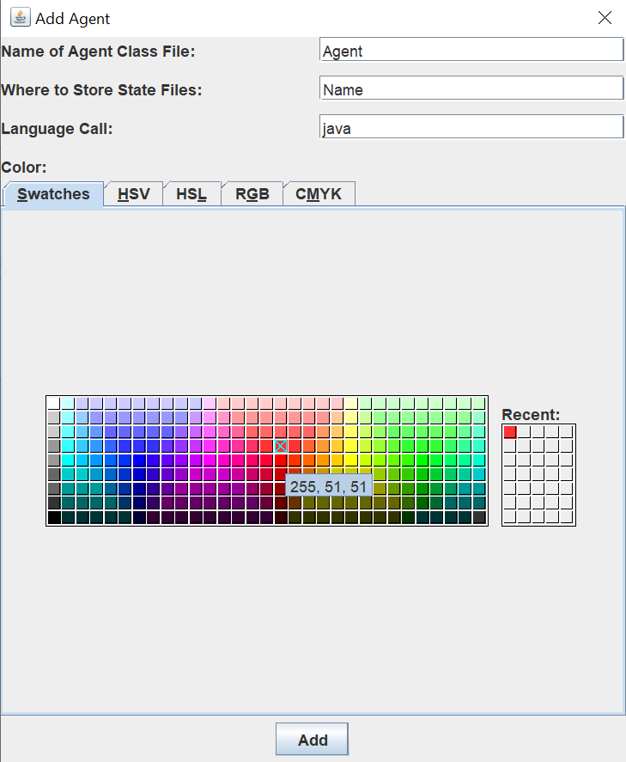
Settings
This popup was already explained in previous slides.
Remember the Name field must be unique for each added agent but multiple agents can reference the same class file.
Names must be at least 2 characters long.
Names such as “src” and “saves” should be avoided as they may interfere with app functions.
Clicking the Add Agent button causes the add agent popup to appear.

Slide 31
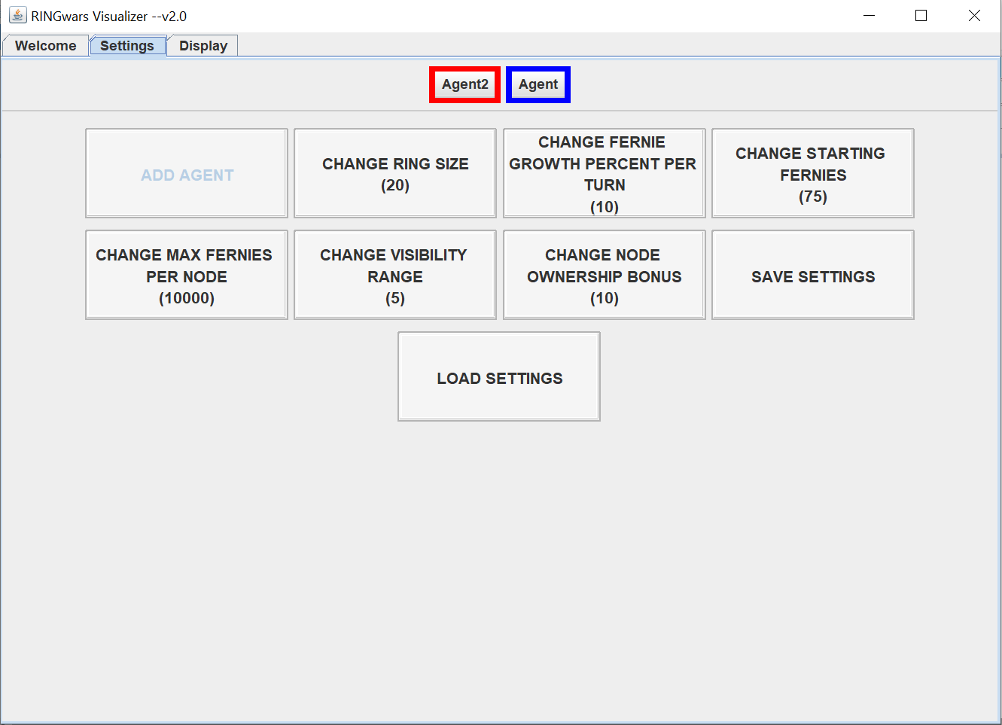
Settings
Once Agents are added they will appear at the top of the screen.
DO NOT add more than 2 agents at a single time.
The settings tab

Slide 32
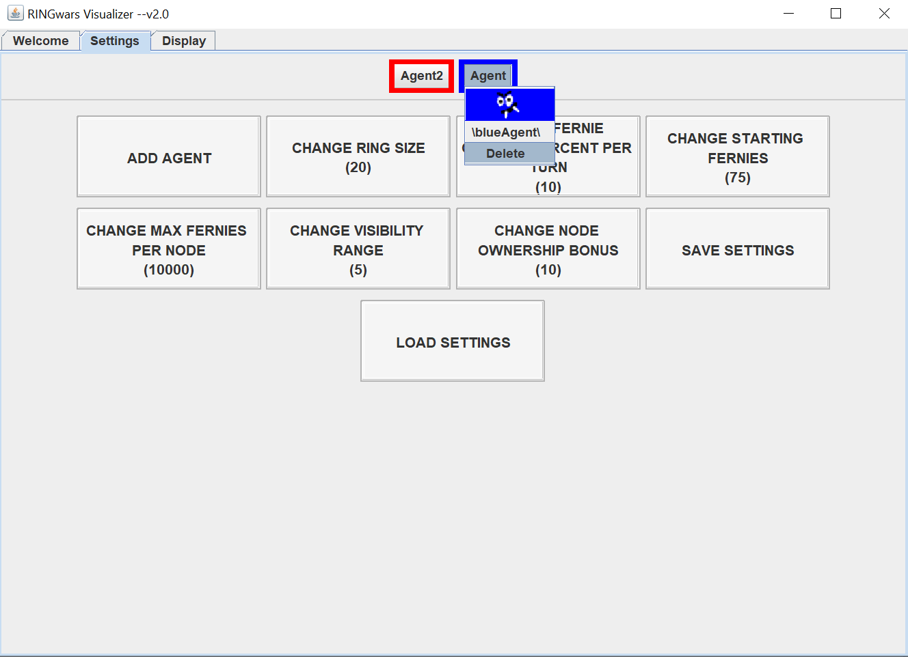
Settings
If you click on an agent you will see details about that agent such as it’s name (the folder location where its state files are stored) and have the option to delete that agent.
The settings tab

Slide 33
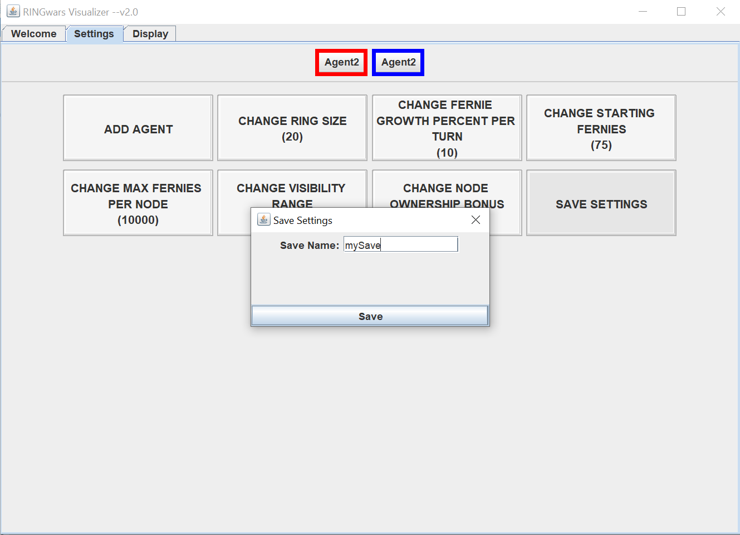
Settings
The Save Settings button allows you to save your game settings including the agents you have added.
This means you will not need to readd agents everytime you launch the app.
The settings tab

Slide 34
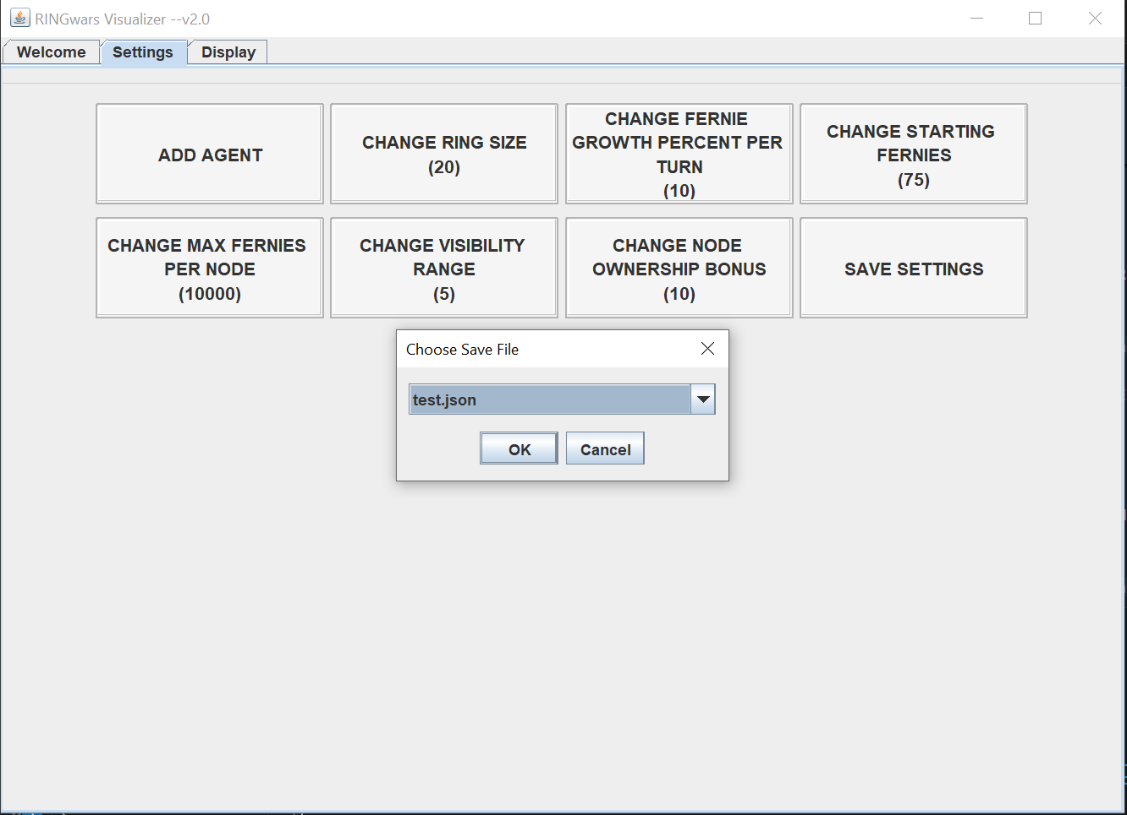
Settings
The Load Settings button loads any previously saved game settings.
Saved settings as stored as json files in the /saves/ folder.
If you find you have too many saves simply delete them from this folder.
The settings tab

Slide 35
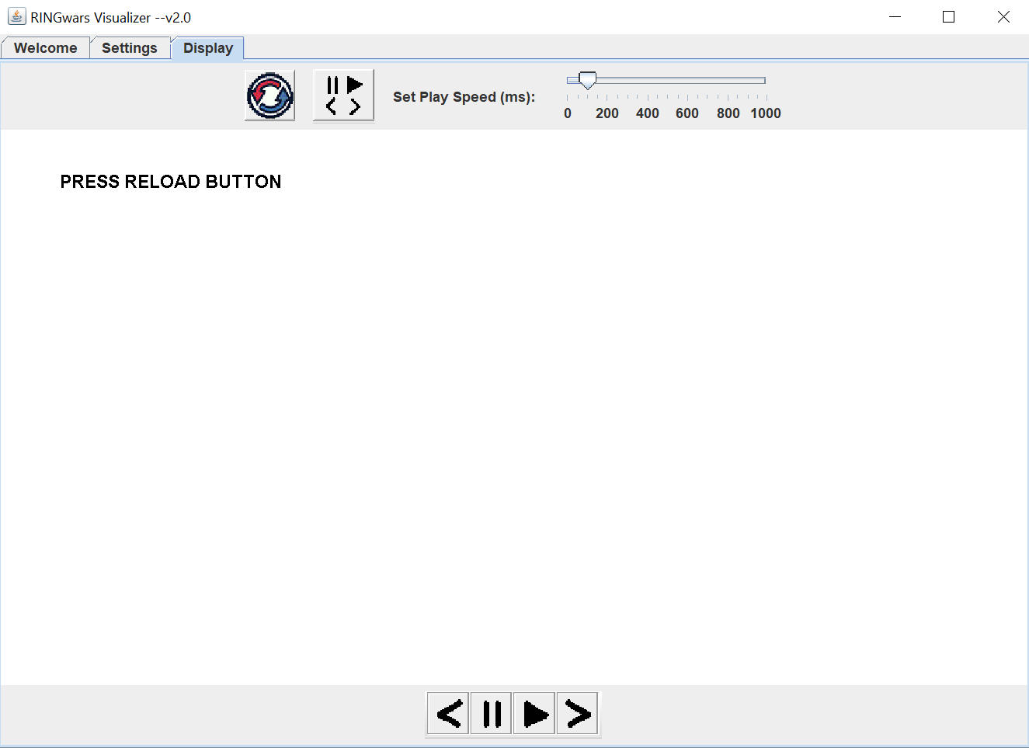
The Game Simulation
Clicking the display tab brings you to the game interface.
Press the Reload button to load your game settings.
You can press this button at any time to reset the simulation.
RELOAD BUTTON
The display tab

Slide 36
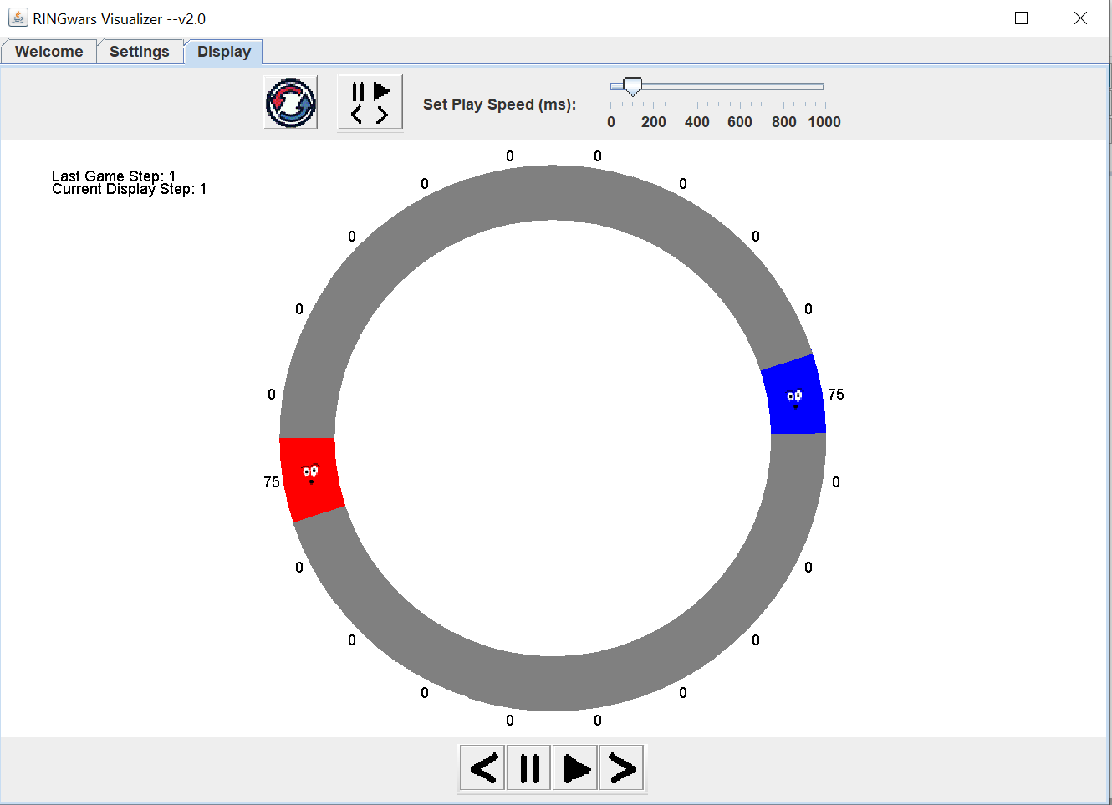
The Game Simulation
Once the simulation is loaded you will see the game in its initial starting state. Colored nodes are controlled by their respective agents and the numbers on the outside of the ring indicate the number of Fernies on that node.
You can press either the play button or the forward button to start the simulation.
Play Button
Forward Button
Pause Button
Back Button
Set Sim Speed
The display tab once the reload button has been pressed

Slide 37
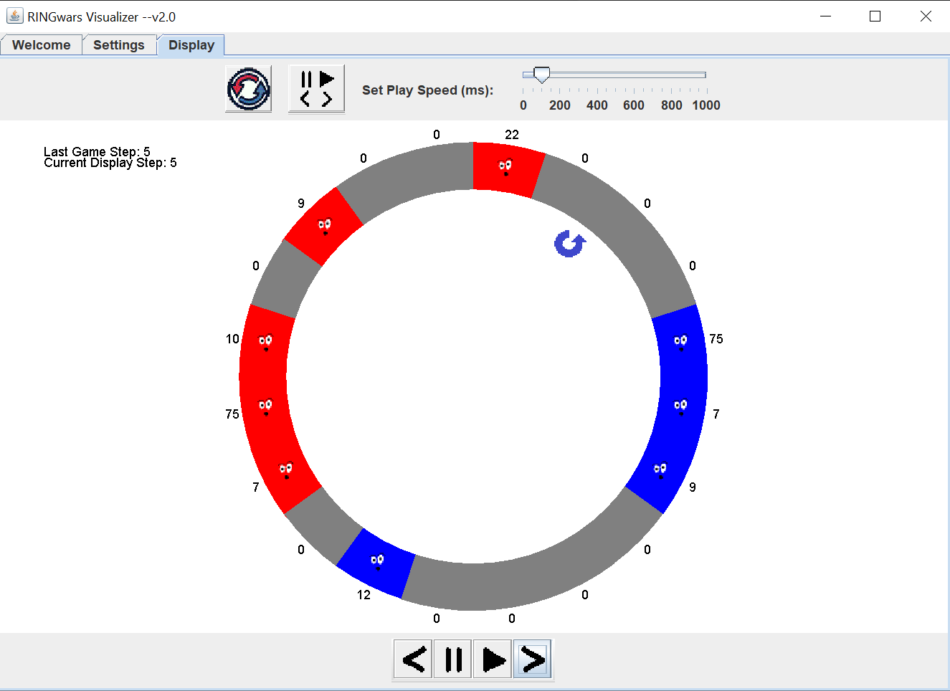


The Game Simulation
Once you begin the game simulation you will note a small blue or red arrow on the inside of the ring. This indicates the direction of the resolution search and its starting edge.
In the image on the left the ring search starts on node 3 and moves counterclockwise. (This means the edge between nodes 2 and 3 forms a pseudo safe-zone)
Clockwise Search:
Counterclockwise Search:
Please note that the display only shows the state of the Ring after the resolution phase.
The display tab once the game has begun

Slide 38
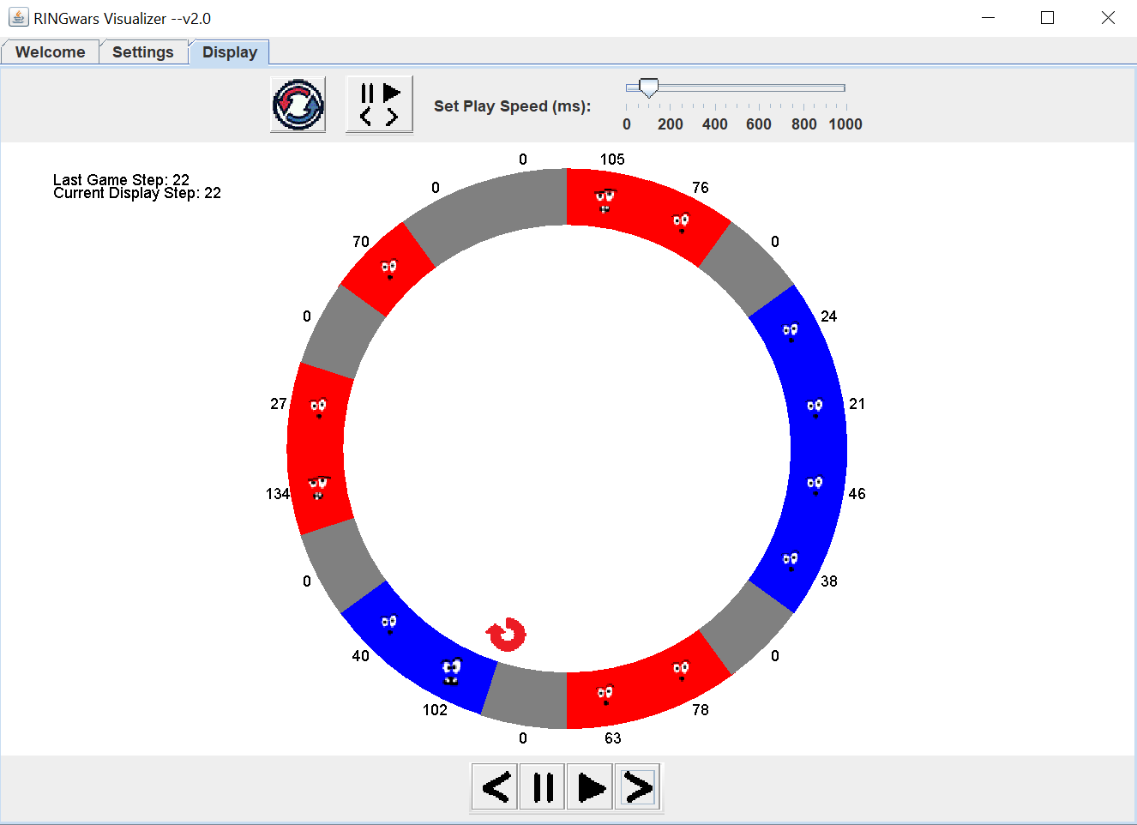

The Game Simulation
Clicking the Gameplay Setting Button gives you options to return to previous steps or enter Debug Mode.
Gameplay Settings Button:
If you are in Debug Mode you will find the option to return to normal mode in the same menu.
The display tab once the game has begun

Slide 39
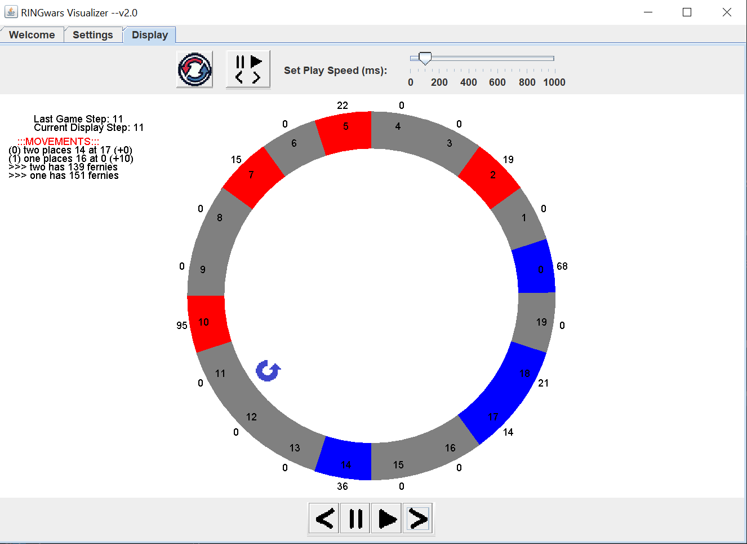
The Game Simulation
In debug mode you will find useful information about the state of the ring and agents movements. The outer numbers on the ring still indicate the number of Fernies on each node. The inner numbers indicate the global location of each ring node.
On the left you will see a list of movements / actions made by each agent next to their name. Note the locations are global ring locations with the agents offset in parentheses.
So “(1) one places 16 at 0 (+10)” indicates that agent “one” has placed 16 Fernies on global node 10 (which from his perspective is node 0)
Below these movements you will see the total number of Fernies owned by each agent.
Debug Mode

Slide 40
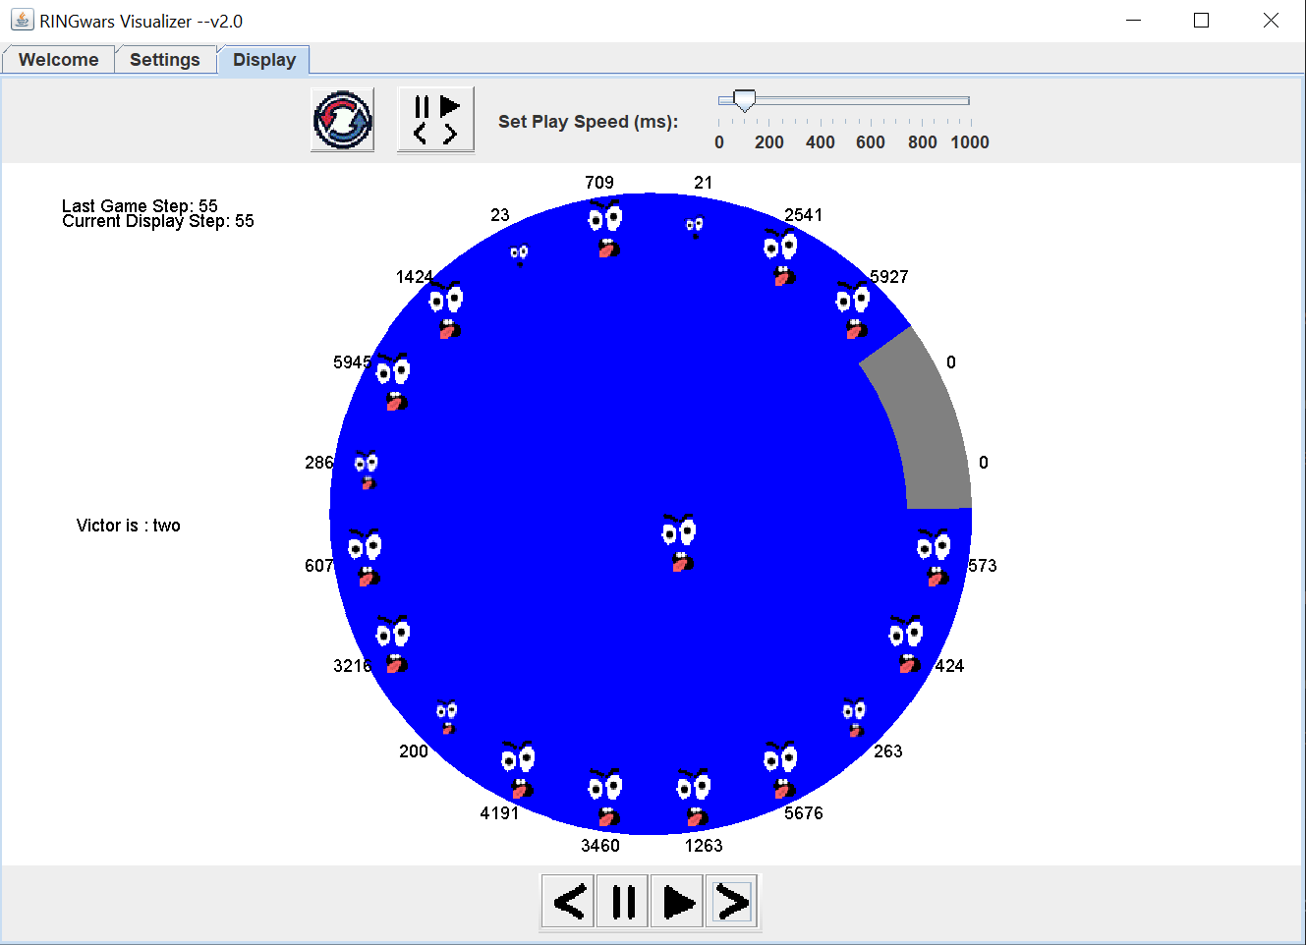
The Game Simulation
Victory occurs when your agent eliminates his opponent.
Victory for Blue

Slide 41
OS and Language Requirements
As previously noted your agents must be programmed in Java 24. However you may prototype your agents in another more easily scriptable language such as Python.
The RINGwars app may function in MacOS and Linux however you are required to submit a Windows compatible Agent. It is your responsibility to confirm this.
The RINGwars.exe executable is a simple executable wrapper around a java Jar file. If you do not understand how to extract the underlying Jar file you should work in Windows.

Slide 42
Class Instructions
Forming groups
What to submit and how grades will be calculated
How the end of semester competition will be run
Etc
etc

