Slide 1
B-Trees
Harrison Tran

Slide 2
What’s a B-Tree? (Bayer and McCreight 1972)
Self-balancing search tree
The standard file organization (databases, filesystems, applications)
PURPOSE: Reduce number of disk accesses
All leaves are at the same level
Update/search affects only a few disk blocks, minimizing disk I/O
Records with similar key values are consolidated to the same block
Every node is kept to a certain size (certain amount of data)

Slide 3
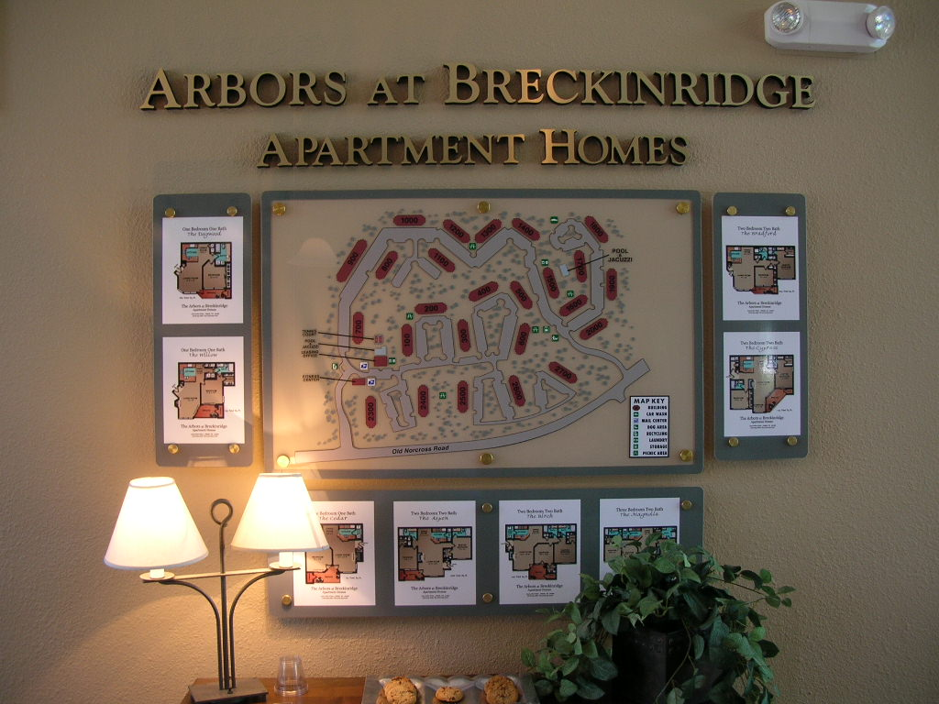

Slide 4
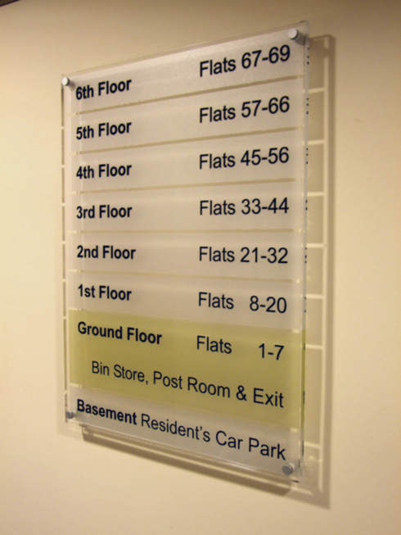

Slide 5


Slide 6
B-Tree of order 4 (m=4)
Root Node
24
Child Node
15
20
33
45
48
10
12
18
21
23
30
31
38
47
50
52
60
Leaves →
All internal nodes (nodes with children) have between ceil(m/2) and m children, inclusive; leaves have between floor(m/2) and m-1 keys
All internal nodes with k keys have k+1 children
All leaves are at the same level

Slide 7
B-Tree Operations
Searching
Perform a binary search for the search key on the current node
Return record if found
Else indicate unsuccessful search (if on a leaf)
If successful, navigate to the matching node
Insertion
Insert key into available location
If node is full, split the node into two, and promote the middle key value (see next slide)
Deletion
Do the reverse

Slide 8
B-Tree Insertion (m=4)
65
24
33
45
48
30
31
38
47
50
52
60
65

Slide 9
B-Tree Insertion (m=4)
24
33
45
48
60
30
31
38
47
50
52
65

Slide 10
B-Tree Insertion (m=4)
24
48
33
45
60
30
31
38
47
50
52
65

Slide 11
B+ Trees
ALL DATA is in the leaf nodes
Again, all leaves are at the same level
All leaf nodes have links to other leaf nodes
Used by a number of database management systems:
IBM DB2
Microsoft SQL
Oracle 8
SQLite
ADVANTAGES:
Since information is only in leaves, tree can be shorter, less need for disk I/O
Sequential access sped up

Slide 12
B+ Tree Insertion (m=3)
100
50
75
n
Indicators, No Data
n
Pointers to Data

Slide 13
B+ Tree Insertion (m=3)
50
75
100
n
Indicators, No Data
n
Pointers to Data

Slide 14
B+ Tree Insertion (m=3)
75
≤75
≥75
50
75
100
n
Indicators, No Data
n
Pointers to Data

Slide 15
Further Reading
Symmetric binary B-Trees: Data structure and maintenance algorithms (Bayer and McCreight 1972)
Data Structures and Algorithm Analysis, ed. 3.2 (Shaffer 2013) Chapter 10.5
B-Trees, Shadowing, and Clones (Rodeh 2007)

