Slide 1
Compilers I
Loop Optimizations
Dr William Harrison

Slide 2
Loop Optimizations
Empirical studies show that much of program execution occurs within loops
  So, it makes sense to identify loops & concentrate optimization efforts on that code
  But what is a loop?
    Within source code, it's obvious
    Within IR/CFG, however,…
      Loops aren't precisely what your first guess would be

Slide 3
Simple loop optimization
within the source code, that is…
for (i = 1; i++ ; i = 10) { c }
➔
c ; … ; c
10 times
Caveat:
seems reasonable (removes branches)
not terribly general: would like to use on while loops
but how do you identify the induction variable “i”?
also, how does this apply at the IR/CFG level?

Slide 4
Ex: Loop invariant code hoisting
Say the assignment “a⬅b+c” occurs within a loop
  But “b” and “c” aren't assigned in the loop
  Would like to move “a⬅b+c” somewhere “right in front of” the loop
    Thereby avoiding redundant reassignments to “a”
Problem IR/CFG is a directed graph of basic blocks
  Where, for example, is the “front of” a loop?

Slide 5
A flow graph
_x0003__x0016__x0003__x0016__x0003__x0016_
1
_x0003__x0016__x0003__x0016__x0003__x0016_
Say “a⬅b+c” occurs in 9,
To where might we hoist it?
2
_x0003__x0016__x0003__x0016__x0003__x0016_
4
3
_x0003__x0016__x0003__x0016__x0003__x0016_
5
6
_x0003__x0016__x0003__x0016__x0003__x0016_
_x0003__x0016__x0003__x0016__x0003__x0016_
8
7
_x0003__x0016__x0003__x0016__x0003__x0016_
_x0003__x0016__x0003__x0016__x0003__x0016_
9
11
_x0003__x0016__x0003__x0016__x0003__x0016_
_x0003__x0016__x0003__x0016__x0003__x0016_
10
12
_x0003__x0016__x0003__x0016__x0003__x0016_

Slide 6
A flow graph
_x0003__x0016__x0003__x0016__x0003__x0016_
1
Say “a⬅b+c” occurs in 9,
To where might we hoist it?
_x0003__x0016__x0003__x0016__x0003__x0016_
2
_x0003__x0016__x0003__x0016__x0003__x0016_
4
3
_x0003__x0016__x0003__x0016__x0003__x0016_
5
6
_x0003__x0016__x0003__x0016__x0003__x0016_
_x0003__x0016__x0003__x0016__x0003__x0016_
Nodes 5,4,2,1 seem likely
  how would I determine that automatically?
  Impact on other optimizations?
  Identifying loops with “dominator tree"
8
7
_x0003__x0016__x0003__x0016__x0003__x0016_
_x0003__x0016__x0003__x0016__x0003__x0016_
9
11
_x0003__x0016__x0003__x0016__x0003__x0016_
_x0003__x0016__x0003__x0016__x0003__x0016_
10
12
_x0003__x0016__x0003__x0016__x0003__x0016_

Slide 7
Dominators
Assume we have a flow graph with entry node s₀ with no predecessors
  I.e., no edge into s₀
Node d dominates n means that
  d occurs in every path from s₀ to n
Note that every node dominates itself

Slide 8
A flow graph
_x0003__x0016__x0003__x0016__x0003__x0016_
1
for each pair of nodes d,n
  does d dominate n?
  can think of “d dominates n” as a new kind of directed arc in a new graph
Question: is it possible that for d≠n that:
  d dominates n, and
  n dominates d?
_x0003__x0016__x0003__x0016__x0003__x0016_
2
_x0003__x0016__x0003__x0016__x0003__x0016_
4
3
_x0003__x0016__x0003__x0016__x0003__x0016_
5
6
_x0003__x0016__x0003__x0016__x0003__x0016_
_x0003__x0016__x0003__x0016__x0003__x0016_
8
7
_x0003__x0016__x0003__x0016__x0003__x0016_
_x0003__x0016__x0003__x0016__x0003__x0016_
9
11
_x0003__x0016__x0003__x0016__x0003__x0016_
_x0003__x0016__x0003__x0016__x0003__x0016_
10
12
_x0003__x0016__x0003__x0016__x0003__x0016_

Slide 9
Theorem
Let d ≠ e both dominate n. Then, either
d dominates e or e dominates d (but not both)
Proof sketch. Assume neither d dominates e nor vice versa.
s₀
Path to e not containing d exists since d doesn’t dominate e
d
e
n

Slide 10
Theorem
Let d ≠ e both dominate n. Then, either
d dominates e or e dominates d (but not both)
Proof sketch. Assume neither d dominates e nor vice versa.
Path to e not containing d exists since d doesn’t dominate e
s₀
d
e
Path from s₀ to n not through d exists. ∴ d doesn’t dominate n ➔⬅
n

Slide 11
flow graph & its dominator tree
_x0003__x0016__x0003__x0016__x0003__x0016_
1
1
_x0003__x0016__x0003__x0016__x0003__x0016_
_x0003__x0016__x0003__x0016__x0003__x0016_
2
2
_x0003__x0016__x0003__x0016__x0003__x0016_
_x0003__x0016__x0003__x0016__x0003__x0016_
4
3
4
3
_x0003__x0016__x0003__x0016__x0003__x0016_
_x0003__x0016__x0003__x0016__x0003__x0016_
5
6
5
6
7
_x0003__x0016__x0003__x0016__x0003__x0016_
_x0003__x0016__x0003__x0016__x0003__x0016_
_x0003__x0016__x0003__x0016__x0003__x0016_
_x0003__x0016__x0003__x0016__x0003__x0016_
_x0003__x0016__x0003__x0016__x0003__x0016_
12
_x0003__x0016__x0003__x0016__x0003__x0016_
8
7
8
11
_x0003__x0016__x0003__x0016__x0003__x0016_
_x0003__x0016__x0003__x0016__x0003__x0016_
_x0003__x0016__x0003__x0016__x0003__x0016_
_x0003__x0016__x0003__x0016__x0003__x0016_
9
11
_x0003__x0016__x0003__x0016__x0003__x0016_
_x0003__x0016__x0003__x0016__x0003__x0016_
9
_x0003__x0016__x0003__x0016__x0003__x0016_
10
12
_x0003__x0016__x0003__x0016__x0003__x0016_
_x0003__x0016__x0003__x0016__x0003__x0016_
10

Slide 12
flow graph & its dominator tree
Not necessarily predecessor in flow graph
_x0003__x0016__x0003__x0016__x0003__x0016_
1
1
_x0003__x0016__x0003__x0016__x0003__x0016_
_x0003__x0016__x0003__x0016__x0003__x0016_
2
2
_x0003__x0016__x0003__x0016__x0003__x0016_
_x0003__x0016__x0003__x0016__x0003__x0016_
4
3
3
_x0003__x0016__x0003__x0016__x0003__x0016_
4
_x0003__x0016__x0003__x0016__x0003__x0016_
5
6
5
_x0003__x0016__x0003__x0016__x0003__x0016_
_x0003__x0016__x0003__x0016__x0003__x0016_
_x0003__x0016__x0003__x0016__x0003__x0016_
6
7
_x0003__x0016__x0003__x0016__x0003__x0016_
_x0003__x0016__x0003__x0016__x0003__x0016_
12
_x0003__x0016__x0003__x0016__x0003__x0016_
8
7
_x0003__x0016__x0003__x0016__x0003__x0016_
_x0003__x0016__x0003__x0016__x0003__x0016_
8
11
_x0003__x0016__x0003__x0016__x0003__x0016_
_x0003__x0016__x0003__x0016__x0003__x0016_
9
11
_x0003__x0016__x0003__x0016__x0003__x0016_
_x0003__x0016__x0003__x0016__x0003__x0016_
9
_x0003__x0016__x0003__x0016__x0003__x0016_
10
12
_x0003__x0016__x0003__x0016__x0003__x0016_
_x0003__x0016__x0003__x0016__x0003__x0016_
10

Slide 13
Immediate Dominators
An immediate dominator of node n is a node idom(n) such that
  idom(n) ≠n
  idom(n) dominates n
  idom(n) does not dominate any other dominator of n
Every node has (at most) one immediate dominator
  How do we know this?

Slide 14
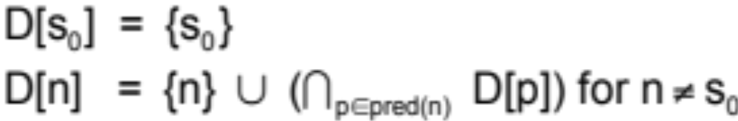
Calculating Dominators
Let D[n] be the set of nodes that dominate n
in a particular flow graph G, we get the following
two simultaneous equations*
*I wonder how we’d solve equations like this?

Slide 15
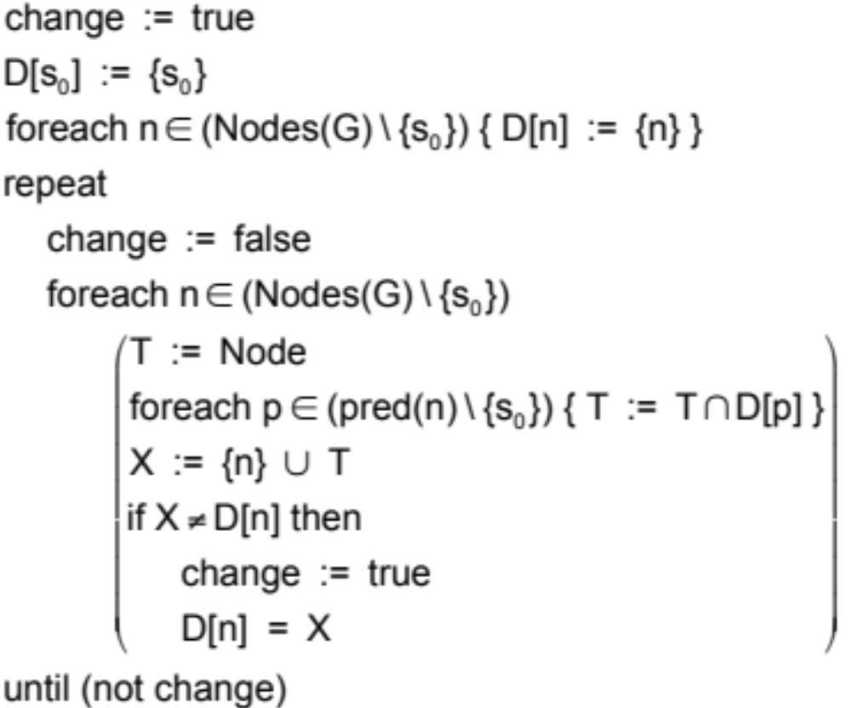
Iterative solution

Slide 16
Backedges are edges n➔h where h dominates n
1
1
2_x0016_
2
3
_x0003__x0016_4_x0016__x0003__x0016_
3
4
5_x0016_
6
5
6
7
12
8
7
8
11
9
11
9
10
12
10

Slide 17
“Natural” Loops
The natural loop of a backedge n➔h is
  The set of x such that
    h dominates x
    there is a path from x to n not containing h
h is called the header of this loop

Slide 18
Backedges induce natural loops
1
2
3
4
The four natural loops are:
{2,3}
{2,4}
{5,8,9,10}
{8,9}
5
6
8
7
9
11
10
12

Slide 19
Identifying loops
1
2
3
4
By merging natural loops
with identical headers, one
identifies all loops
note that a natural loop is
what you think of as a loop
while a loop inside a compiler
is a slightly different animal
5
6
8
7
9
11
10
12

Slide 20
Identifying nested loops
Defn: Let A,B be loops with
headers a,b s.t. a≠b.
B is nested within A iff B⊂A
1
2
3
4
5
6
generally start optimizing inside
the innermost loop
Ex: {8,9} nested within {5,8,9,10}
Reminder: “⊂” means proper subset
  i.e., A≠B
8
7
9
11
10
12

Slide 21
Loop pre-header
Many loop optimizations require moving code from inside a loop to just before its header
To guarantee that we uniformly have such a place available, we may insert a loop pre-header
  initially empty basic block with a single edge into the header
  potentially reduces code duplication, among other things
  the pre-header block dominates the loop (that's important)

Slide 22
Inserting a loop pre-header
preheader
header
header
B1
B2
B1
B2
B3
B3

Slide 23
Loop invariant computations
Let L be a loop and d be “t⬅a⊗b”
  d is loop invariant for L iff
    “a” and “b” are constant, or
    definitions reaching “a” and “b” occur outside L, or
    only one definition reaches “a” and one reaches “ b” and they are loop invariant for L
This is a conservative estimate of loop invariance
  i.e., it may report d is not loop invariant when it is
    but it will never say it is loop invariant when it is not

Slide 24
To hoist or not to hoist…
Q: when is it safe to hoist t⬅a⊗b?
L0
t⬅0
L1
i⬅i+1
t⬅a⊗b
M[i]⬅t
if i<N
goto L1
L2
x⬅t
L0
t⬅0
L1
i⬅i+1
t⬅a⊗b
M[i]⬅t
t⬅0
M[j]⬅t
if i<N
goto L1
L2
x⬅t
L0
t⬅0
L1
M[j]⬅t
i⬅i+1
t⬅a⊗b
M[i]⬅t
t⬅0
if i<N
goto L1
L2
x⬅t
?
?
?

Slide 25
To hoist or not to hoist…
Before
After
L0
t⬅0
L1
i⬅i+1
t⬅a⊗b
M[i]⬅t
if i<N
goto L1
L2
x⬅t
L0
t⬅0
t⬅a⊗b
L1
i⬅i+1
M[i]⬅t
if i<N
goto L1
L2
x⬅t
* We must determine the criteria for hoisting

Slide 26
Determining the criteria for safe hoisting
Before
irrelevant definition:
t not live-out
After
L0
t⬅0
L1
i⬅i+1
t⬅a⊗b
M[i]⬅t
if i<N
goto L1
L2
x⬅t
L0
t⬅0
t⬅a⊗b
L1
i⬅i+1
M[i]⬅t
if i<N
goto L1
L2
x⬅t
single definition of t
a⊗b is loop invariant
(t⬅a⊗b) dominates L2

Slide 27
To hoist or not to hoist…
Before
After
L0
t⬅0
L1
branch (i≥N) L2
i⬅i+1
t⬅a⊗b
M[i]⬅t
goto L1
L2
x⬅t
L0
t⬅0
t⬅a⊗b
L1
branch (i≥N) L2
i⬅i+1
M[i]⬅t
goto L1
L2
x⬅t

Slide 28
To hoist or not to hoist…
Before
After
L0
t⬅0
L1
branch (i≥N) L2
i⬅i+1
t⬅a⊗b
M[i]⬅t
goto L1
L2
x⬅t
L0
t⬅0
t⬅a⊗b
L1
branch (i≥N) L2
i⬅i+1
M[i]⬅t
goto L1
L2
x⬅t
always executes
only executes when branch fails
can be a⊗b or 0
always a⊗b

Slide 29
To hoist or not to hoist…
Before
After
L0
t⬅0
L1
i⬅i+1
t⬅a⊗b
M[i]⬅t
t⬅0
if i<N
goto L1
L2
L0
t⬅0
t⬅a⊗b
L1
i⬅i+1
M[i]⬅t
t⬅0
if i<N
goto L1
L2

Slide 30
To hoist or not to hoist…
Before
After
L0
t⬅0
L1
i⬅i+1
t⬅a⊗b
M[i]⬅t
t⬅0
if i<N
goto L1
L2
L0
t⬅0
t⬅a⊗b
L1
i⬅i+1
M[i]⬅t
t⬅0
if i<N
goto L1
L2
always a⊗b
sometimes a⊗b
Observe: multiple definitions of t inside L1 complicate matters

Slide 31
To hoist or not to hoist…
Before
After
L0
t⬅0
L1
M[j]⬅t
i⬅i+1
t⬅a⊗b
M[i]⬅t
if i<N
goto L1
L2
x⬅t
L0
t⬅0
t⬅a⊗b
L1
M[j]⬅t
i⬅i+1
M[i]⬅t
if i<N
goto L1
L2
x⬅t
sometimes a⊗b
always a⊗b

Slide 32
Safe hoisting of d: t⬅a⊗b
d dominates all loop exits where t is live, and
only one definition of t in the loop, and
t is not live-out in the preheader
assumes d is loop invariant
This is only a conservative approximation!
- will say some hoistings are unsafe when they are safe
- will not say a hoisting is safe when it isn't

Slide 33
To hoist or not to hoist…
Before
t not live-out
After
L0
t⬅0
L1
i⬅i+1
t⬅a⊗b
M[i]⬅t
if i<N
goto L1
L2
x⬅t
L0
t⬅0
t⬅a⊗b
L1
i⬅i+1
M[i]⬅t
if i<N
goto L1
L2
x⬅t
one definition of t
a⊗b is loop invariant
(t⬅a⊗b) dominates L2
*Therefore, hoist!

Slide 34
Induction Variable Analysis
Some loops have an induction variable
  a variable “i” that is incremented by a constant or loop invariant amount each iteration
    for loop-inv. “c”, only definitions of the form:
      “i ⬅ i + c” or “i ⬅ i - c”
Other variables may depend entirely on “i”
  these are called derived induction variables
Identifying induction variables within a loop enables a variety of loop optimizations
  strength reduction: replacing an expensive operation by a less expensive one
  induction variable elimination: removing the variable, thereby (perhaps) shortening the code and reducing register pressure

Slide 35
An Example
s⬅0
i⬅0
L1
branch (i>n) L2
j⬅i*4
k⬅j+a
x⬅M[k]
s⬅s+x
i⬅i+1
goto L1
L2
i is an induction variable
i*4 has values 0,4,8,12,…
can perform strength reduction
s⬅0
i⬅0
j⬅0
L1
branch (i>n) L2
j⬅j+4
k⬅j+a
x⬅M[k]
s⬅s+x
i⬅i+1
goto L1
L2
Before
After

Slide 36
Basic Induction Variables
Given a loop L with header h
  “i” is a basic induction variable within L iff
    the only definitions of “i” have the form:
      “i ⬅ i + c” or “i ⬅ i - c”
      for loop-invariant “c”
Detection of basic induction variables is done by inspecting their form

Slide 37
Derived Induction Variables in the family of “i”
If “i” is an induction variable (basic or otherwise) for loop L, then
  “j” is a derived induction variable in the family of “i” means
    all definitions of “j” in L are of the form
      j ⬅ c*i + d
        where c,d are loop invariant
        may be more than one instruction
        Lingo: j is determined by (i,c,d)

Slide 38
Derived induction variables in the family of “i”
definitions of such a “j” may be rewritten without reference to “i”
  That is, replace definition(s) with the effect of “j ⬅ c*i + d” with “j ⬅ j + c*a”
    where “i” is incremented by “a”
    c,d --- loop invariant for L
    N.b., “c*a” is either
      constant: in which case, calculate it
      loop-inv, but not constant
        in which case compute in the pre-header

Slide 39
Example: i ← i+4, j ← 2*i+5
Initialize j ← 5
iteration j ← j+2*4
i 2*i + 5
0
4
8
12
…
5
13
21
29
…
0th
1st
2nd
3rd
…
5
13
21
29
…
after each
iteration
a=4,c=2

Slide 40
Detecting derived induction variables
Let “j” be an induction variable for L in the family of “i”
“k” is a derived induction variable for “j” in loop L when:
  (Case 1) there is only one definition of “k” in L
    and that definition is of the form:
      “k ⬅ c * j”
      “k ⬅ j + d”
        where c,d are loop invariant

Slide 41
Detecting derived induction variables
Let “j” be an induction variable for L in the family of “i”
“k” is a derived induction variable for “j” in loop L when:
  (Case 2) same as Case 1 AND:
    the only definition of “j” that reaches “k” is in the loop
      i.e., “k” depends entirely on a single definition of “j”
    and, no definition of “i” occurs on any path between the definitions of “j” and “k”
      i.e., the dependence of “k” on “i” via “j” maintained

Slide 42
Array bounds checking
“Safe” programming languages
insert dynamic checks to array references
to avoid “out of bounds” references
array m[1..100] of int;
…
m[i] := 77;
…
r1 ⬅fp + offset_{i}
branch (r1>100) L_{error}
branch (r1<1) L_{error}
<code for assignment>
…

Slide 43
Array bounds checking
Under certain circumstances, may be able to
determine that the array reference is safe and
eliminate the check
- relies on induction variable analysis
array m[1..100] of int;
…
m[i] := 77;
…
r1 ⬅fp + offset_{i}
branch (r1>100) L_{error}
branch (r1<1) L_{error}
<code for assignment>
…

Slide 44
Loop Unrolling Overview
If the body of a loop L is small, it may be that it spends most of its execution “looping” rather than “computing”; i.e.,
  incrementing induction variables
  branching
Simple example at source level; replace
  “for (i=0; i++; i<2) { c }” with
  “i=0; c; i=1; c
    avoids branching, etc.
The Problem: how do you do this at the machine code/IR level?
AKA Software Pipelining

Slide 45
Unrolling a loop (brute force)
Let L be the loop:
h
…
…
…
where h is the header and are backedges

Slide 46
Unrolling a loop (brute force)
Make a copy of L
h
h’
…
…
…
…
…
…

Slide 47
Unrolling a loop (brute force)
Reroute the backedges
h
h’
…
…
…
…
…
…

Slide 48
Effects of “brute force” unrolling
Before_x0003__x0016_
After_x0003__x0016_
L1: x⬅M[i]
s⬅s+x
i⬅i+4
branch (i<n) L1
L2:
L1: x⬅M[i]
s⬅s+x
i⬅i+4
branch (i≥n) L2
L1’: x⬅M[i]
s⬅s+x
i⬅i+4
branch (i<n) L1
L2:
Q: Does this constitute an improvement?

Slide 49
Empirical Studies show: loops with the following are good candidates for unrolling
Single Basic Blocks
  i.e., straight line code
  with a limited number of floating point & memory operations
    why? Limits unrolling to loops that are most likely to benefit from instruction scheduling (i.e., ordering code w.r.t. architectural features such as data caches)
Small in Length
  otherwise unrolling may have negative impact on instruction cache performance
Simple Loop Control
  simplifies the unrolling transformation

Slide 50
Typical unrolling candidate
Note that half of the work is in “looping”
It’s a loop within a single basic block
few instructions
has a “repeat-until” structure
L1: x⬅M[i]
s⬅s+x
i⬅i+4
branch (i<n) L1
L2:

Slide 51
Fragile* unrolling (K=2)
Before_x0003__x0016_
After_x0003__x0016_
L1: x⬅M[i]
s⬅s+x
i⬅i+4
branch (i<n) L1
L2:
L1: x⬅M[i]
s⬅s+x
i⬅i+4
x⬅M[i]
s⬅s+x
i⬅i+4
branch (i<n) L1
L2:
*Fragile: must establish that middle branch may be removed and that
loop iterates an even number of times

Slide 52
“Fragile” unrolling (K=2)
Before_x0003__x0016_
After_x0003__x0016_
L1: x⬅M[i]
s⬅s+x
i⬅i+4
branch (i<n) L1
L2:
L1: x⬅M[i]
s⬅s+x
i⬅i+4
x⬅M[i+4]
s⬅s+x
i⬅i+8
branch (i<n) L1
L2:
…can do better with induction variable analysis

Slide 53
Robust* unrolling (K=2)
After_x0003__x0016_
Before_x0003__x0016_
if (i<n-8) L1 else L2
L1: x⬅M[i]
s⬅s+x
x⬅M[i+4]
s⬅s+x
i⬅i+8
if (i<n-8) L1 else L2
L2: x⬅M[i]
s⬅s+x
i⬅i+4
if (i<n) L2 else L3
L3:
L1: x⬅M[i]
s⬅s+x
i⬅i+4
if (i<n) L1 else L2
L2:
*Robust: i.e., works for any number of iterations.

Slide 54
Robust* unrolling (K=2)
After_x0003__x0016_
Before_x0003__x0016_
if (i<n-8) L1 else L2
L1: x⬅M[i]
s⬅s+x
x⬅M[i+4]
s⬅s+x
i⬅i+8
if (i<n-8) L1 else L2
L2: x⬅M[i]
s⬅s+x
i⬅i+4
if (i<n) L2 else L3
L3:
L1: x⬅M[i]
s⬅s+x
i⬅i+4
if (i<n) L1 else L2
L2:
“twice”
block
“once”
block
*Robust: i.e., works for any number of iterations.

Slide 55
That's all, folks!

