Slide 1
Certification of Programs for Secure Information Flow
Dorothy & Peter Denning
Communications of the ACM (CACM) 1977

Slide 2
Language-based Security (LBS)
Many security models are based on abstract formalisms
  Typically, state machines [Bell-LaPadula73, Goguen-Meseguer82,84,Rushby81] or traces [Goldschmidt88, McCullough88]
  Challenge: faithfully relating formal security specification to concrete implementations
Denning & Denning proceed from a new (at the time) starting point: language-based security
  Define security certification of programs at the language level
  Compile-time, completely automated process
    based on well-known “attribute grammar” compiler concept
  Goal: If program p is certified by the compiler, then it is secure

Slide 3
Example
begin
i,n : integer security class L;
flag : boolean security class L;
f1,f2 : file security class L;
x,sum : integer security class H;
f3, f4 : file security class H;
begin
i := 1; n := 0; sum := 0;
…
if flag then
begin
n := n + 1;
sum := sum + x;
end;
…
end
end
storage objects
labeled statically with
security level
Basic Idea: Certify at
compile-time that insecure flows
don’t occur within program

Slide 4
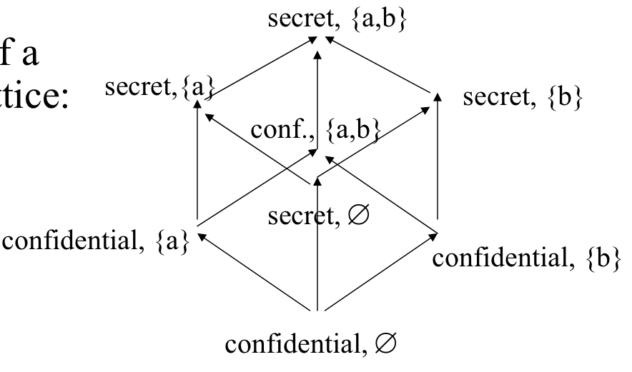
Information Flow Policy as Lattice
least upper
bound x⊕y
x
y
security level of
storage object “x”
“x→y” means that information
flow is permitted by policy from
object x to object y
greatest lower
bound x⊗y

Slide 5
“Information Flows” Attribute
“x⇒y” means that information flows from x to y
  this is the attribute calculated during certification
Explicit flow: e.g., “y := x” implies “x⇒y”
Implicit flow: “y := 1; if x=0 then y:=0”
  Assuming x is 0 or 1, then x=y after completion
  ∴ x⇒y
  Generally, control structures in language cause such indirect/implicit flows
Transitive: x⇒y and y⇒z implies x⇒z
Defn. Program statement specifies a flow if its execution could result in flow
    N.b., this is weaker than “does result in flow”

Slide 6
Security Requirements
Program p is secure iff flow x⇒y results from executing p only when x→y
  Security Definition (1st shot): flow x⇒y results from executing p only when x→y
    Undecidable: is there a flow from x to y in “if f(x) halts then y:=0”?
Security Definition: flow x⇒y is specified by p only when x→y
  note that “is specified by” is weaker than “results from executing”
Living with imprecision:
  “if x=0 then if x≠0 then y:=z” is disallowed if z→y

Slide 7
Certification Mechanism
a⊕b→c ???
Stmt
Stmt
c
a⊕b
Var
:=
Exp
Var
:=
Exp
+
a⊕b
+
c
c
c
*
b
b
a⊕L=a
*
b
a
2
a
a
L
2
Calculate flows “upwards”

Slide 8
Certification Mechanism (cont’d)
s⊕sl
Statement-list
Not shown: control
mechanisms, exceptions,
IO, etc. (see paper for details)
s
sl
Statement
;
Statement-list
e→s₁⊗s₂???
if this doesn’t hold,
then certification fails
Statement
if
Exp
then
Statement
else
Statement
e
s₁
s₂

Slide 9
Example, redux
begin
i,n : integer security class L;
flag : boolean security class L;
f1,f2 : file security class L;
x,sum : integer security class H;
f3, f4 : file security class H;
begin
i := 1; n := 0; sum := 0;
…
if flag then
begin
n := n + 1;
sum := sum + x;
end;
…
end
end
Use certification across
entire program structure
at compile-time; process
is automatic
Theorem: a program is certified
only if it is secure (recall the
converse may not hold).

Slide 10
Denning Descendents:
Security as Type-checking
From λ_{sec} (Li & Zdancewic, POPL2005):
Γ ➔ e₁ : int_{l}
Γ ➔ e₂ : int_{l}
“Reading up is permitted”
(l ∈ {L,H})
Γ ➔ e₁ + e₂ : int_{H}
“Low computations
considered low”
Γ ➔ e₁ : int_{L}
Γ ➔ e₂ : int_{L}
Γ ➔ e₁ + e₂ : int_{L}
➔
usually written as turnstile |-

Slide 11
Summary
Compile-time security certification is big plus
  check the program once and no run-time checks necessary
    assuming faithful language implementation, of course
  Dynamic security checks (e.g., access control) are relatively expensive: repeated over and over
Weaknesses:
    Most “systems” are not single programs
    Security definition is, of necessity, an approximation
Denning and Denning started a new branch within computer security research: language-based security
  very active area, typically based in type theory
    see “Language-based Information Flow Security” (2003) by Sabelfeld and Myers for an excellent survey

Slide 12
Tips for Presentations
You have 20 minutes
  good rule of thumb is two minutes per slide
    i.e., about 10 slides
  practice at home and see how close you get
Introduce the problem
  “How do you relate security spec. to implementation?”
Say why it’s interesting
Give an overview of the solution
  “compile-time security certification via attributes”
Nice to refer to others work: if you cite someone in the audience, they will consider you a pal
Have small examples illustrating the technique

Slide 13
More tips
Avoid presenting all details
  Important: your goal is to give the audience a taste of the paper to motivate them to read it
  You do not have time to explain all of the results!
  Even if you did, all of your listeners would be asleep after 20 minutes of it
This is why examples are crucial --- they convey the essence of the work without overwhelming the audience
You want to leave the listener with a “bottom line” message
  “Hmmm, neat, here’s how my compiler can help make things secure”
  Rather than: “Oh God, when will it end…”

