Slide 1
Noninterference and the Composability of Security Properties
Daryl McCullough
1988

Slide 2
Today
Start talking about composition & security properties
McCullough 1990, “A Hookup Theorem for Multilevel Security” is also relevant
Monday: midterm in class.

Slide 3
Composable Security Properties
1
2
1
2
+
=
Want to say: if
1 obeys policy P and
2 obeys policy P,
then
12 obeys policy P

Slide 4
Why care about composability?
Extensibility: few systems are standalone
Divide and Conquer design.
just as with structured programming, want to decompose whole systems into modules
Ubiquity of Parallelism/Concurrency.

Slide 5
G&M Noninterference
Assumed: Output function of input
Means deterministic (else not function)
Means uninterruptability (differences in timings can cause differences in states, hence in outputs)
This result for deterministic, noninterference-secure systems

Slide 6
Non-determinism can arise from deterministic machines

Slide 7
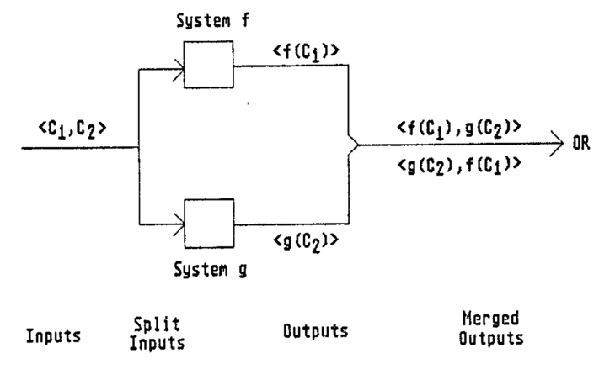
Non-determinism can arise from deterministic machines

Slide 8
Making Systems Deterministic
Add FIFO buffers to system inputs and outputs
Unbounded buffer?
nice theoretical model, unfortunately it doesn’t exist
Finite Buffer with Blocking?
Sender to a full buffer blocks/suspends until space available
Receiver from an empty buffer blocks until input available
Finite buffers with Dropping?
Sender to full buffer continues
Message would be dropped
Or, respond with “Busy” signal

Slide 9
Compose Systems
Louie, Dewey LOW
Hughie HIGH
b_{L} output buffer
Anyone can read it
b_{H} input buffer
From HIGH source
Hughie reads from:
b_{LH} (Louie writes)
b_{LDH} (Louie, Dewey write)
b_{DH} (Dewey writes)

Slide 10
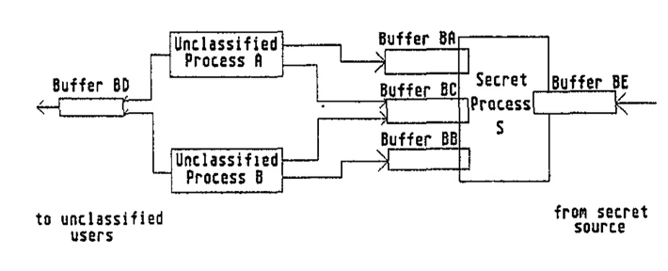
In the paper

Slide 11
Systems Secure
All noninterference-secure
Hughie has no output
So inputs don’t interfere with it
Louie, Dewey have no input
So (nonexistent) inputs don’t interfere with outputs

Slide 12
Security of Composition
Buffers finite, sends/receives blocking: composition not secure!
Example: assume b_{DH}, b_{LH} have capacity 1
Algorithm:
Louie (Dewey) sends message to b_{LH} (b_{DH})
Fills buffer
Louie (Dewey) sends second message to b_{LH} (b_{DH})
Louie (Dewey) sends a 0 (1) to b_{L}
Louie (Dewey) sends message to b_{LDH}
Signals Hughie that Louie (Dewey) completed a cycle

Slide 13
Hughie
Reads bit from b_{H}
If 0, receive message from b_{LH}
If 1, receive message from b_{DH}
Receive on b_{LDH}
To wait for buffer to be filled

Slide 14
Example
Hughie reads 0 from b_{H}
Reads message from b_{LH}
Now Louie’s second message goes into b_{LH}
Louie completes step 2 and writes 0 into b_{L}
Dewey blocked at step 1
Dewey cannot write to b_{L}
Symmetric argument shows that Hughie reading 1 produces a 1 in b_{L}
So, input from b_{H} copied to output b_{L}

Slide 15
Nondeducibility
Noninterference: do state transitions caused by high level commands interfere with sequences of state transitions caused by low level commands?
Really case about inputs and outputs:
Can low level subject deduce anything about high level outputs from a set of low level outputs?
Sutherland, D., “A Model of Information”, 1986.

Slide 16
Example: 2-Bit System
High operations change only High bit
Similar for Low
s0 = (0, 0)
Commands (Heidi, xor1), (Lara, xor0), (Lara, xor1), (Lara, xor0), (Heidi, xor1), (Lara, xor0)
Both bits output after each command
Output is: 00,10,10,11,11,01,01

Slide 17
Security
Not noninterference-secure w.r.t. Lara
Lara sees output as 0,0,0,1,1,1,1
Delete High and she sees 0,0,1,1,1
But Lara still cannot deduce the commands deleted
Doesn’t affect values; only lengths
So it is deducibly secure
Lara can’t deduce the commands Heidi gave

Slide 18
Event System
4-tuple (E, I, O, T)
E set of events
I ⊆ E set of input events
O ⊆ E set of output events
T set of all finite sequences of events legal within system
E partitioned into H, L
H set of High events
L set of Low events

Slide 19
More Events …
H∩I set of High inputs
H∩O set of High outputs
L∩I set of Low inputs
L∩O set of Low outputs
T_{Low} set of all possible sequences of Low events that are legal within system
π_{L}:T→T_{Low} projection function deleting all High inputs from trace
Low observer should not be able to deduce anything about High inputs from trace t_{Low} ∈ T_{low}

Slide 20
Deducibly Secure
System deducibly secure if,
for every trace t_{Low} ∈ T_{Low}, the corresponding set of high level traces contains every possible trace t ∈ T for which π_{L}(t) = t_{Low}
Given any t_{Low}, the trace t ∈ T producing that t_{Low} is equally likely to be any trace with π_{L}(t) = t_{Low}

Slide 21
Example
Back to our 2-bit machine
Let xor0, xor1 apply to both bits
Both bits output after each command
Initial state: (0, 1)
Inputs: 1_{H} 0_{L} 1_{L} 0_{H} 1_{L} 0_{L}
short for xor1 or xor0
Outputs: 10 10 01 01 10 10
Lara (at Low) sees: 001100
Does not know initial state, so does not know first input; but can deduce fourth input is 0_{H}
Not deducibly secure

Slide 22
Example
Now xor0, xor1 apply only to state bit with same level as user
Inputs: 1_{H}0_{L}1_{L}0_{H}1_{L}0_{L}
Outputs: 1011111011
Lara sees: 01101
She cannot deduce anything about input
Could be 0_{H}0_{L}1_{L}0_{H}1_{L}0_{L} or 0_{L}1_{H}1_{L}0_{H}1_{L}0_{L} for example
Deducibly secure

Slide 23
Security of Composition
In general: deducibly secure systems not composable
Strong noninterference: deducible security + requirement that no High output occurs unless caused by a High input
Systems meeting this property are composable

Slide 24
Example
2-bit machine done earlier does not exhibit strong noninterference
Because it puts out High bit even when there is no High input
Modify machine to output only state bit at level of latest input
Now it exhibits strong noninterference

Slide 25
Problem
Too restrictive; it bans some systems that are obviously secure
Example: System upgrade reads Low inputs, outputs those bits at High
Clearly deducibly secure: low level user sees no outputs
Clearly does not exhibit strong noninterference, as no high level inputs!

Slide 26
Remove Determinism
Previous assumption
Input, output synchronous
Output depends only on commands triggered by input
Sometimes absorbed into commands …
Input processed one datum at a time
Not realistic
In real systems, lots of asynchronous events

Slide 27
Generalized Noninterference
Nondeterministic systems meeting noninterference property meet generalized noninterference-secure property
More robust than nondeducible security because minor changes in assumptions affect whether system is nondeducibly secure

Slide 28
Example
System with High Holly, Low lucy, text file at High
File fixed size, symbol b marks empty space
Holly can edit file, Lucy can run this program:
while true do begin
n := read_integer_from_user;
if n > file_length or char_in_file[n] = b then
print random_character;
else
print char_in_file[n];
end;

Slide 29
Security of System
Not noninterference-secure
High level inputs—Holly’s changes—affect low level outputs
May be deducibly secure
Can Lucy deduce contents of file from program?
If output meaningful (“This is right”) or close (“Thes is riqht”), yes
Otherwise, no
So deducibly secure depends on which inferences are allowed

Slide 30
Composition of Systems
Does composing systems meeting generalized noninterference-secure property give you a system that also meets this property?
Define two systems (cat, dog)
Compose them

Slide 31
First System: cat
Inputs, outputs can go left or right
After some number of inputs, cat sends two outputs
First stop_count
Second parity of High inputs, outputs

Slide 32
Noninterference-Secure?
If even number of High inputs, output could be:
0 (even number of outputs)
1 (odd number of outputs)
If odd number of High inputs, output could be:
0 (odd number of outputs)
1 (even number of outputs)
Therefore, High level inputs do not affect output
So noninterference-secure

Slide 33
Second System: dog
High outputs to left
Low outputs of 0 or 1 to right
stop_count input from the left
When it arrives, dog emits 0 or 1

Slide 34
Noninterference-Secure?
When stop_count arrives:
May or may not be inputs for which there are no corresponding outputs
Parity of High inputs, outputs can be odd or even
Hence dog emits 0 or 1
High level inputs do not affect low level outputs
So noninterference-secure

Slide 35
Compose Them
Once sent, message arrives
But stop_count may arrive before all inputs have generated corresponding outputs
If so, even number of High inputs and outputs on cat, but odd number on dog
Four cases arise

Slide 36
The Cases
cat, odd number of inputs, outputs; dog, even number of inputs, odd number of outputs
Input message from cat not arrived at dog, contradicting assumption
cat, even number of inputs, outputs; dog, odd number of inputs, even number of outputs
Input message from dog not arrived at cat, contradicting assumption

Slide 37
The Cases
cat, odd number of inputs, outputs; dog, odd number of inputs, even number of outputs
dog sent even number of outputs to cat, so cat has had at least one input from left
cat, even number of inputs, outputs; dog, even number of inputs, odd number of outputs
dog sent odd number of outputs to cat, so cat has had at least one input from left

Slide 38
The Conclusion
Composite system catdog emits 0 to left, 1 to right (or 1 to left, 0 to right)
Must have received at least one input from left
Composite system catdog emits 0 to left, 0 to right (or 1 to left, 1 to right)
Could not have received any from left
So, High inputs affect Low outputs
Not noninterference-secure

Slide 39
Feedback-Free Systems
System has n distinct components
Components c_{i}, c_{j} connected if any output of c_{i} is input to c_{j}
System is feedback-free if for all c_{i} connected to c_{j}, c_{j} not connected to any c_{i}
Intuition: once information flows from one component to another, no information flows back from the second to the first

Slide 40
Feedback-Free Security
Theorem: A feedback-free system composed of noninterference-secure systems is itself noninterference-secure

Slide 41
Some Feedback
Lemma: A noninterference-secure system can feed a high level output o to a high level input i if the arrival of o at the input of the next component is delayed until after the next low level input or output
Theorem: A system with feedback as described in the above lemma and composed of noninterference-secure systems is itself noninterference-secure

Slide 42
Why Didn’t They Work?
For compositions to work, machine must act same way regardless of what precedes low level input (high, low, nothing)
dog does not meet this criterion
If first input is stop_count, dog emits 0
If high level input precedes stop_count, dog emits 0 or 1

Slide 43
State Machine Model
2-bit machine, levels High, Low, meeting 4 properties:
For every input i_{k}, state σ_{j}, there is an element c_{m} ∈ C* such that T*(c_{m}, σ_{j}) = σ_{n}, where σ_{n} ≠ σ_{j}
T* is total function, inputs and commands always move system to a different state

Slide 44
Property 2
There is an equivalence relation ≡ such that:
If system in state σ_{i} and high level sequence of inputs causes transition from σ_{i} to σ_{j}, then σ_{i} ≡ σ_{j}
If σ_{i} ≡ σ_{j} and low level sequence of inputs i₁, …, i_{n} causes system in state σ_{i} to transition to σ_{i}′, then there is a state σ_{j}′ such that σ_{i}′ ≡ σ_{j}′ and the inputs i₁, …, i_{n} cause system in state σ_{j} to transition to σ_{j}′
≡ holds if low level projections of both states are same

Slide 45
Property 3
Let σ_{i} ≡ σ_{j}. If high level sequence of outputs o₁, …, o_{n} indicate system in state σ_{i} transitioned to state σ_{i}′, then for some state σ_{j}′ with σ_{j}′ ≡ σ_{i}′, high level sequence of outputs o₁′, …, o_{m}′ indicates system in σ_{j} transitioned to σ_{j}′
High level outputs do not indicate changes in low level projection of states

Slide 46
Property 4
Let σ_{i} ≡ σ_{j}, let c, d be high level output sequences, e a low level output. If ced indicates system in state σ_{i} transitions to σ_{i}′, then there are high level output sequences c’ and d’ and state σ_{j}′ such that c′ed′ indicates system in state σ_{j} transitions to state σ_{j}′
Intermingled low level, high level outputs cause changes in low level state reflecting low level outputs only

Slide 47
Restrictiveness
System is restrictive if it meets the preceding 4 properties

Slide 48
Composition
Intuition: by 3 and 4, high level output followed by low level output has same effect as low level input, so composition of restrictive systems should be restrictive

Slide 49
Composite System
System M₁’s outputs are M₂’s inputs
μ_{1i}, μ_{2i} states of M₁, M₂
States of composite system pairs of M₁, M₂ states (μ_{1i}, μ_{2i})
e event causing transition
e causes transition from state (μ_{1a}, μ_{2a}) to state (μ_{1b}, μ_{2b}) if any of 3 conditions hold

Slide 50
Conditions
M₁ in state μ_{1a} and e occurs, M₁ transitions to μ_{1b}; e not an event for M₂; and μ_{2a} = μ_{2b}
M₂ in state μ_{2a} and e occurs, M₂ transitions to μ_{2b}; e not an event for M₁; and μ_{1a} = μ_{1b}
M₁ in state μ_{1a} and e occurs, M₁ transitions to μ_{1b}; M₂ in state μ_{2a} and e occurs, M₂ transitions to μ_{2b}; e is input to one machine, and output from other

Slide 51
Intuition
Event causing transition in composite system causes transition in at least 1 of the components
If transition occurs in exactly one component, event must not cause transition in other component when not connected to the composite system

Slide 52
Equivalence for Composite
Equivalence relation for composite system
(σ_{a}, σ_{b}) ≡_{C} (σ_{c}, σ_{d}) iff σ_{a} ≡ σ_{c} and σ_{b} ≡ σ_{d}
Corresponds to equivalence relation in property 2 for component system

Slide 53
Key Points
Composing secure policies does not always produce a secure policy
The policies must be restrictive
Noninterference policies prevent HIGH inputs from affecting LOW outputs
Prevents “writes down” in broadest sense
Nondeducibility policies prevent the inference of HIGH inputs from LOW outputs
Prevents “reads up” in broadest sense

