Slide 1
Covert Channels, Analysis and Mitigation
CS8440
Fall 2016

Slide 2
Introduction
Covert channels are a means of communication between two processes
Processes may be:
Authorized to communicate, but not in the way they actually are
Prohibited from communicating
One process is a Trojan
Transmits data covertly
The other is a Spy
Receives data

Slide 3
Outline
Definitions
Covert channel examples
Local channels
Remote (network) channels
Channel discovery and analysis
Channel mitigation

Slide 4
Covert Channels
Covert channels arise because subjects share resources.
The shared resources allow one subject (the transmitter) to modulate some aspect of how another subject (the receiver) perceives the system.
Covert channels are generally grouped for working purposes into:
storage channels (where the values returned to the receiver by operations are affected).
timing channels (where the times at which events are perceived by the receiver are modulated).

Slide 5
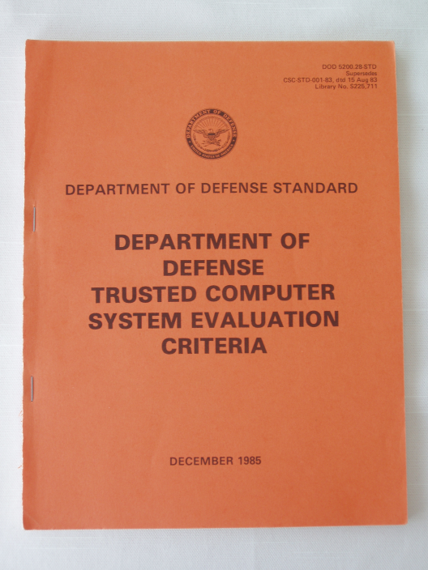
Covert Channels
“Parasitic” communications channel
hidden within the medium of a legitimate communications channel
Storage channel: Communicate by modifying a stored object
Examples:
a storage location is written with confidential data; then a public process reads that location
a shared buffer is first written with confidential information, then, assuming the buffer is not “zeroed out”, a public process retrieves that information
Storage & Timing channels are defined in the “Orange Book”
Originally in Butler Lampson’s “A Note on the Con-
finement Problem”, 1973.
On the website

Slide 6
Covert Channels (cont’d)
Timing channel: Transmit information by affecting the relative timing of events
Example: the execution of processes at one level affects when processes at another level execute or which resources are available
E.g., a Hi process and Lo process conspire to circumvent system security. The Hi process will attempt to acquire the disk drive at midnight
The Lo process knows that, if the disk is unavailable at midnight, then “we attack at dawn”; otherwise, not.
Timing channels are very difficult to avoid on time-shared systems

Slide 7
Where and What?
For a covert channel to exist, it must be the case that:
A multi-level system is in use
A resource (or one of its attributes) is shared by high (Trojan) and low (spy) processes

Slide 8
Definitions of Channels
Covert channel: Intentionally used to communicate
Side channel: Unintentionally reveals information
Steganography: Techniques for hiding the very presence of communication
Subliminal channel: Covert channel with mathematically proven steganographic properties
Ex: human speech.
Even # words = 0
Odd # words = 1
“how do you do?” → 0

Slide 9
Why Are They Important?
Difficult to detect
Can operate for a long time and leak a substantial amount of classified data to uncleared processes
Can compromise an otherwise secure system, including one that has been formally verified!
Must be considered to achieve high government certification levels

Slide 10
Local Channels

Slide 11
Resource Manipulation
Trojan fills kernels process table to transmit 1, leaves it partially empty to transmit 0. Spy tries to create process.
Trojan allocates 0MB of memory to transmit 00, 64MB to transmit 01, 128MB to transmit 10, 192MB to transmit 11.
Easily distinguishable by any spy with resource monitoring capabilities
Trojan induces bus contention, spy measures bus latency (multiprocessors)
Will multicores cause resurgence?

Slide 12
Resource Exhaustion Countermeasures
Preallocate resources and prevent dynamic modification
Only used when covert channels pose a serious enough risk to justify the inefficiency

Slide 13
Disk Arm Optimizations
To send a bit:
Starting at 2
To send a 0: High: 1
To send a 1: High: 3
Low: 0, 4
(assumes elevator algorithm)
Spy process observes which request finishes first to receive bit:
- 0 first = 0 transmitted
- 4 first = 1 transmitted
Bandwidth = 23-56b/s in 1970
0
1
2
3
4
Karger, Wray, “Storage Channels in Disk Arm Optimization”, 1991

Slide 14
Disk Arm Countermeasures
Return disk arm to fixed position after each seek
Awful performance, not portable
Only issue requests from one class of processes at a time, and restore disk arm direction when returning to low process
Not portable, hard to implement
Return disk blocks to software in the order they were requested
Batch requests in pseudorandom time quanta
No proofs for these approaches

Slide 15
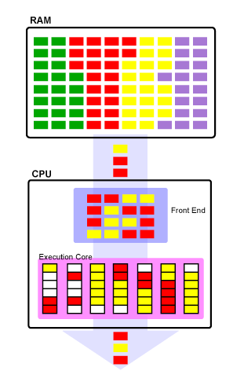
Cache Missing for Fun and Profit
Hyper-Threading permits two threads to execute on a single Pentium 4 core
Cache is shared between threads (Trojan and spy)
Arstechnica.com
Percival 2005, “Cache Missing for Fun and Profit”

Slide 16

Cache Missing (cont.)
Trojan horse (in high process) runs one thread, spy runs another
Trojan allocates 2KB array (in L1 cache)
Spy allocates 8KB array (in L1 cache)
Trojan (in OpenSSL)
2KB
8KB
Spy
Nuwen.net

Slide 17
Cache Missing (cont.)
To transmit a 1 bit, Trojan accesses corresponding location in array, evicting one spy cache line
When spy reloads cache line from L2 cache, additional 30 cycle latency
32 bits per 5000 cycles, < 25% error rate
400KB/s on 2.8GHz processor
Size of RSA/DSA private key usually < 256B

Slide 18
Cache Missing Countermeasures
Architecture-level:
Don’t share caches between threads
More expensive, slower
Change cache eviction strategy to enforce fair sharing between threads
Performance penalty
OS-level:
Make sure low- and high-level processes never share the processor simultaneously

Slide 19
Channel detection and analysis

Slide 20
Analysis Techniques
Information flow
Operates at high-level language level
Often overestimates flows, flags non-existent flows
Noninterference
Analysis performed on abstract model, not real system
Shared Resource Matrix
Very popular with systems folks
Sabelfeld, Myers 2003, “Language-Based Information-Flow Security”

Slide 21
Shared Resource Matrix
If row has both R and M, attribute may permit covert channel to exist
R,M are permissions
R = read
M = modify
Kemmerer 1983, “Shared Resource Matrix Methodology: An Approach to Identifying Storage and Timing Channels”

Slide 22
Advanced channel mitigation

Slide 23
Fuzzy Time
All covert timing channels rely on accurate clock
You can either attempt to disrupt the timing of the channel (add noise or slow it down), or reduce the accuracy of the clock
VAX security kernel slows down timer interrupt periods to be uniformly distributed with a mean of 20 ms.
Randomly modifies the completion time of I/O requests, so they can’t be used as a clock
Hu 1991, “Reducing Timing Channels with Fuzzy Time”

Slide 24
Lattice Scheduling
Many local covert channels require simultaneous operation of spy and Trojan
Process scheduler can be modified to prevent this situation
Recall cache missing attack…
This is actually the same sort of attack presented in this VAX security kernel paper!
Demonstrates that covert channels haven’t been taken seriously
Hu 1992, “Lattice Scheduling and Covert Channels”

Slide 25
References
Wray; “An Analysis of Covert Timing Channels,” Research in Security and Privacy, 1991. Proceedings., 1991 IEEE Computer Society Symposium on
Hu; “Reducing Timing Channels with Fuzzy Time,” Research in Security and Privacy, 1991. Proceedings., 1991 IEEE Computer Society Symposium on
Kemmerer; “Shared resource matrix methodology: an approach to identifying storage and timing channels,” CM Transactions on Computer Systems (TOCS) 1983

Slide 26
References
Sohn, Noh, Moon; “Support Vector Machine Based ICMP Covert Channel Attack Detection,” Computer Network Security: Second International Workshop on Mathematical Methods, Models, and Architectures for Computer Network Security, MMM-ACNS 2003
Buchanan, Llamas; “Covert Channel Analysis and Detection with a Reverse Proxy Servers using Microsoft Windows”

Slide 27
References
Moskowitz, Newman, Crepeau, Miller; “A detailed mathematical analysis of a class of covert channels arising in certain anonymizing networks”, Naval Research Laboratory
Sabelfeld, Myers; “Language-Based Information-Flow Security,” Selected Areas in Communications, IEEE Journal on, 2003

Slide 28
References
Kelem, Feiertag; “A Separation Model for Virtual Machine Monitors,” Proc. IEEE Symposium on Security and Privacy, 1991
Giffin, Greenstadt, Litwack, Tibbetts; “Covert Messaging through TCP Timestamps,” Proceedings of the Privacy Enhancing Technologies Workshop, 2002
Kuhn, Anderson; “Soft Tempest: Hidden Data Transmission Using Electromagnetic Emanations,” Information Hiding, Second International Workshop, IH, 1998

Slide 29
References
Hu; “Lattice Scheduling and Covert Channels,” Research in Security and Privacy, 1992
LeMay, Tan; “Acoustic Surveillance of Physically Unmodified PCs,” Security and Management 2006

