Slide 1
A Summary of John Rushby’s
‘Proof of Separability: A Verification Technique for a Class of Security Kernels
CS8440, Information Security

Slide 2
Separation Kernel Approach [Rushby82,81,…]
Lo “domain”
Kernel
Hi “domain”
mediating
services
mediating
services
Lo state
“system resources”
Hi state
Enforces separation of “domains” via state partitioning
AND controlling interactions through trusted kernel
services
Separation is virtual not physical: I.e., the kernel and domains
execute on the same hardware

Slide 3
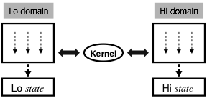
How do we define separation?
Implementing a separation kernel in C on a Pentium?
    Defn: if your kernel acts like my kernel, it has separation
In English: separation means that
  entities at lower levels can’t update higher level data &
  higher level entities can’t “write down”

Slide 4
Have we defined separation?
Lack of abstraction
  previous definition makes it difficult to relate to other implementations/settings
Imprecise
  how can you be sure that this other system is enough like your standard?
Not Amenable to Proof
  what’s an “entity” and what does “update” or “write” mean?

Slide 5
What’s this paper about?
Rushby gives a high-level standard that defines “domain separation”
To accomplish this, he uses transition semantics to describe a “system”
  then, in terms of this system abstraction, he makes a precise definition of “separation”
  needs a precise way to describe “this entity affects that entity”
    for this, he introduces input and output

Slide 6
Defining a System or Machine
M = (S, I, O, NEXTSTATE, INPUT, OUTPUT)
S is a finite, non-empty set of states
I is a finite, non-empty set of inputs
O is a finite, non-empty set of outputs
NEXTSTATE : S→S
INPUT : I→S
OUTPUT: S→O
  these three functions are assumed to be total

Slide 7
Q: How good is this system model?
M = (S, I, O, NEXTSTATE, INPUT, OUTPUT)
S is a finite, non-empty set of states
I is a finite, non-empty set of inputs
O is a finite, non-empty set of outputs
NEXTSTATE : S→S
INPUT : I→S
OUTPUT: S→O
  these three functions are assumed to be total
Why?

Slide 8
How do we run these systems?
The computation from initial input i∈I is:
COMPUTATION(i) = ⟨s₀,s₁,s₂,…,s_{n},…⟩
where s₀ = input(i) and s_{j+1} = NEXTSTATE(s_{j})
The result of a computation from i∈I is:
RESULT(i) = ⟨output(s₀),output(s₁),output(s₂),…,output(s_{n}),…⟩

Slide 9
What runs on these systems?
We have to assume that these systems are shared (or else,
what’s the point of security?)
Rushby introduces “colours” standing for the separate states
of various domains:
Colours C = {1,…m}
For each domain/colour, there is assumed to be a part of the
inputs and outputs private to that colour:
I = I¹ × I² × … × I^{m}
O = O¹ × O² × … × O^{m}
In other words, inputs and outputs are partitioned by colour to
represent the fact that domains are separate

Slide 10
What is “visible” to each domain?
The things that are visible to each domain/colour
are its own inputs and outputs:
EXTRACT(c, ⟨i¹,…,i^{c},…,i^{m}⟩) = i^{c}
EXTRACT(c, ⟨o¹,…,o^{c},…,o^{m}⟩) = o^{c}
Rushby overloads EXTRACT on sequences of
outputs:
EXTRACT(c, RESULT(i)) = ?

Slide 11
Defining Separation
Using EXTRACT, we can characterize what secure isolation means
The idea is to write a statement that requires individual colours to depend only on their own input
c∈C. ∀ i,j∈I.
EXTRACT(c,i) = EXTRACT(c,j) ⇒
EXTRACT(c,RESULT(i)) = EXTRACT(c,RESULT(j))

Slide 12
What does this mean?
How does this work?
Think: how good a definition is this? Strengths? Weaknesses?
c∈C. ∀ i,j∈I.
EXTRACT(c,i) = EXTRACT(c,j) ⇒
EXTRACT(c,RESULT(i)) = EXTRACT(c,RESULT(j))

Slide 13
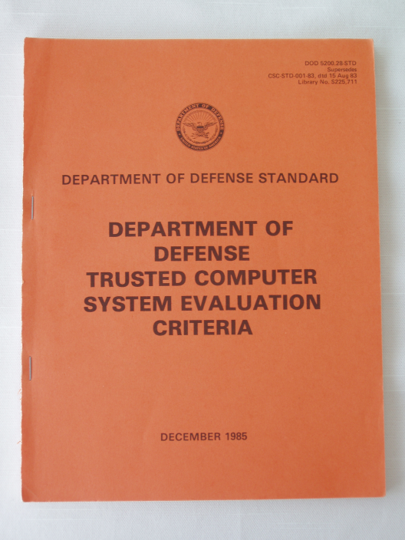
Covert Channels
“Parasitic” communications channel
  hidden within the medium of a legitimate communications channel
Storage channel: Communicate by modifying a stored object
  Examples:
    a storage location is written with confidential data; then a public process reads that location
    a shared buffer is first written with confidential information, then, assuming the buffer is not “zeroed out”, a public process retrieves that information
Storage & Timing channels are defined in
the “Orange Book”
  Originally in Butler Lampson’s “A Note on the Con-
  finement Problem”, 1973.
  On the website

Slide 14
Covert Channels (cont’d)
Timing channel: Transmit information by affecting the relative timing of events
Example: the execution of processes at one level affects when processes at another level execute or which resources are available
  E.g., a Hi process and Lo process conspire to circumvent system security. The Hi process will attempt to acquire the disk drive at midnight
    The Lo process knows that, if the disk is unavailable at midnight, then “we attack at dawn”; otherwise, not.
Timing channels are very difficult to avoid on time-shared systems

Slide 15
Rushby doesn’t consider timing channels; only storage channels
Time-sharing can result in “stuttering” of outputs:
Colour c produces: <1,1,2,2,2,3,4,4,3,3,6,6,6>
Rushby introduces CONDENSE to eliminate stuttering:
CONDENSE <1,1,2,2,2,3,4,4,3,3,6,6,6> = <1,2,3,4,3,6>
c∈C. ∀ i,j∈I.
EXTRACT(c,i) = EXTRACT(c,j) ⇒
CONDENSE(EXTRACT(c,RESULT(i)))
= CONDENSE(EXTRACT(c,RESULT(j)))

Slide 16
Rushby says this definition is still too strong
Handles storage channels, but…
…requires the absence of “Denial of Service” attacks
  e.g., Lo crashes system or looping infinitely cannot occur with either of the two definitions
“…beyond the scope of the security mechanisms here.”
Q: How would one describe a “system crash” or infinite loop within this framework?

Slide 17
Too Strong: the culprit
c∈C. ∀ i,j∈I.
EXTRACT(c,i) = EXTRACT(c,j) ⇒
CONDENSE(EXTRACT(c,RESULT(i)))
= CONDENSE(EXTRACT(c,RESULT(j)))
The equality of the l.h.s. and r.h.s. disallows exceptions
like crashing/infinite looping, etc.
But, it’s our job to capture just separation security

Slide 18
Weaker Form of Equivalence
c∈C. ∀ i,j∈I.
EXTRACT(c,i) = EXTRACT(c,j) ⇒
CONDENSE(EXTRACT(c,RESULT(i)))
≈ CONDENSE(EXTRACT(c,RESULT(j)))
X ≈ Y iff either X=Y or the shorter sequence is an initial
subsequence of the other.
Q: Define a machine for two colors which is not isolated by
the “too strong” definition but is isolated by the
weaker definition

Slide 19
Class Discussion
Evaluate Rushby’s model --- what do you think its strengths and weaknesses are?
Read Rushby’s paper

