Slide 1
CS 8440
Type Systems for Security

Slide 2
Type Checking
What type has every (sub-)expression?
Is it consistent?
How do you specify a language’s typing semantics?
  Sometimes called “static semantics”.
What else might you wish to check?
  In C: break only valid inside while & for loops.

Slide 3
Type systems and Languages
Many modern programming languages are strongly-typed
  Java, ML, Haskell,…
  “strongly” meaning that each “subprogram” must be typed
Some aren’t (or barely are):
  C, LISP, C++,PERL
Why types?
  allow static checking for common programming errors
  data objects of a particular type can be reasoned about without thinking of their representations
  E.g., consider a situation where that is not true
    type-casting a pointer in C
How do we specify type checking for languages like Java, ML, and Haskell?
  type derivation systems = type judgments + inference rules

Slide 4
Typing judgments
Typical typing judgement:
A ⇒ e : T
Can be read as:
in symbol table A, expression e has type T
“:” = “has type”
“⇒” = “implies”
usually written “|-”, but
powerpoint doesn’t seem to
have that font ;>
N.b., later in this talk, “⇒” will mean “evaluates to”. I.e., “⇒” is overloaded.

Slide 5
Type Inference Systems
A ⇒ e1 : Bool A ⇒ e2 :T A ⇒ e3 : T
A ⇒ IF e1 THEN e2 ELSE e3 :T
IF e1 can be shown to have type Bool
e2 can be shown to have type T
e3 can be shown to have (the same) type T
THEN
“if e1 then e2 else e3” can be shown to have the type T.

Slide 6
Inference rules for small language
Small Grammar
Exp → Exp + Exp
Exp → Exp = = Exp
Exp → IF Exp THEN Exp ELSE Exp
Exp → ID
Exp → INT
Exp → LET ID := Exp IN Exp
A ⇒ e1 :Int A ⇒ e2 : Int
A ⇒ e1 + e2 :Int
A ⇒ e1 :T A ⇒ e2 : T
A ⇒ e1 == e2 :Bool
Grammar for Types
T → Bool
T → Int
A ⇒ e1 : Bool A ⇒ e2 :T A ⇒ e3 : T
A ⇒ IF e1 THEN e2 ELSE e3 :T

Slide 7
Inference rules for small language
A ⇒ e1 :Int A ⇒ e2 : Int
A ⇒ e1 + e2 :Int
Observe the type
variables here: stand
for any type in the
language
A ⇒ e1 :T A ⇒ e2 : T
A ⇒ e1 == e2 :Bool
A ⇒ e1 : Bool A ⇒ e2 :T A ⇒ e3 : T
A ⇒ IF e1 THEN e2 ELSE e3 :T

Slide 8
Inference rules for small language
A + { ID → T} ⇒ ID : T
Small Grammar
Exp → Exp + Exp
Exp → Exp = = Exp
Exp → IF Exp THEN Exp ELSE Exp
Exp → ID
Exp → INT
Exp → LET ID := Exp IN Exp
A ⇒ INT : Int
A ⇒ e1 : T1 A + { v → T1 } ⇒ e2 : T2
A ⇒ LET v := e1 IN e2 :T2

Slide 9
Uses of a type system
Type checking problem:
  Given a claim that program “e” and a type “T”
  determine if “e” has type “T”
    i.e., if “{} ⇒ e : T” is derivable using the rules
    Tends to be straightforward
Type inference problem:
  Given a program “e”
  determine which type(s) “e” has
  This is the problem a compiler confronts
    I.e., compile(e) isn’t given the type of “e” and must calculate it itself

Slide 10
Type Systems are typically conservative
“Nonsense” programs
“Sensible” programs
Well-typed
Programs
For practical reasons (e.g., decidability), type systems typically
sacrifice some sensible programs when eliminating nonsense.

Slide 11
A Type-based Approach to Program Security
Dennis Volpano & Geoffrey Smith
TAPSOFT 1997

Slide 12
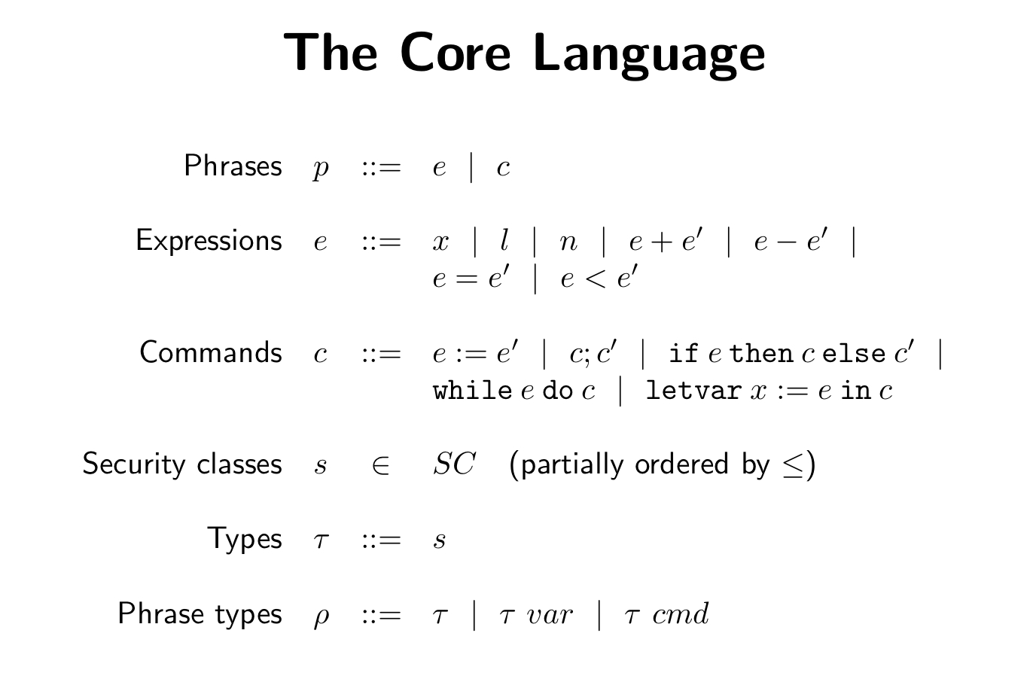

Slide 13
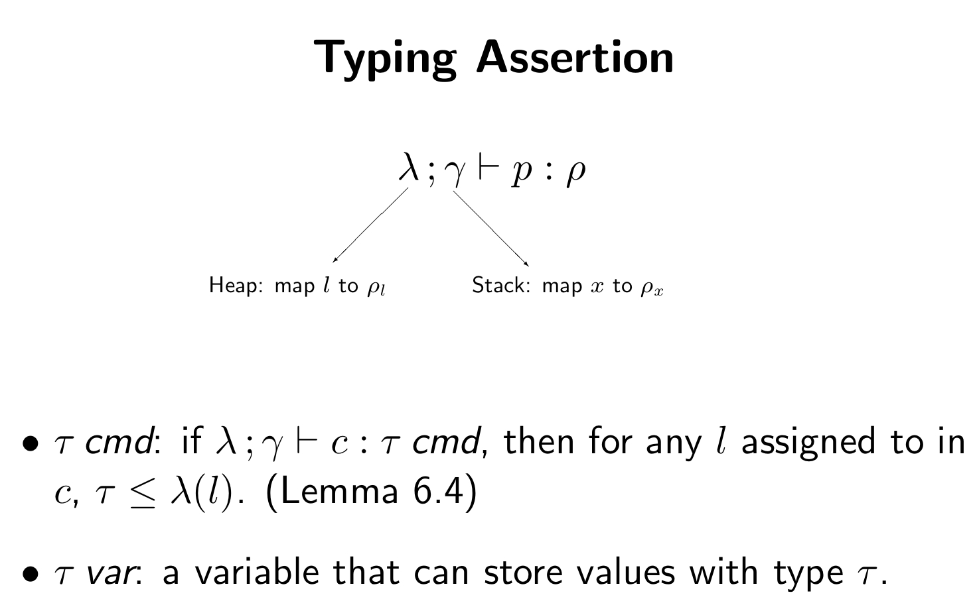
security level

Slide 14
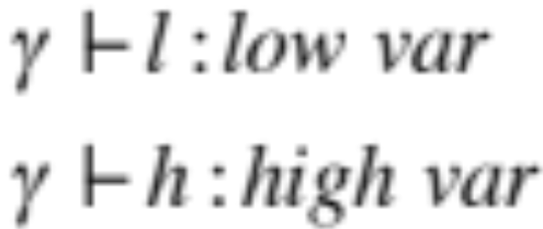
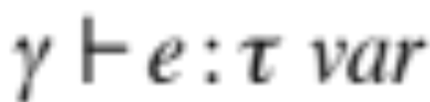
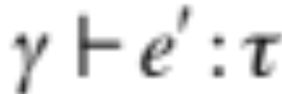
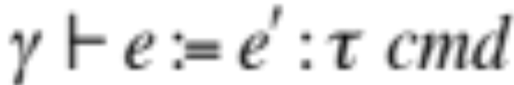
Example: Typing Commands
Say l : low var and h : high var. To be more formal:
Clearly, the explicit flowing command, l := h, must be rejected
Allow type coercions “upwards” in security: e.g., consider l : high var

Slide 15
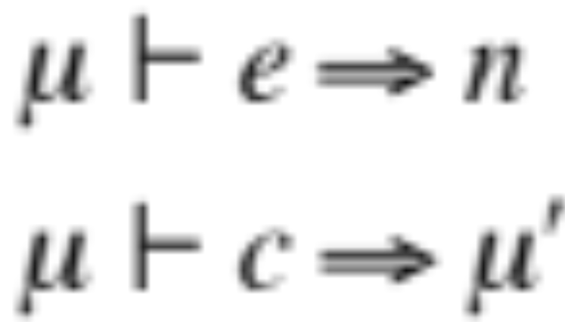
Natural Semantics
A program is evaluated w.r.t. a memory (finite map from locations to integers)
expression
value
input
memory
output memory
command
⇒ is the “evaluates to” relation; “|-” is overloaded

Slide 16
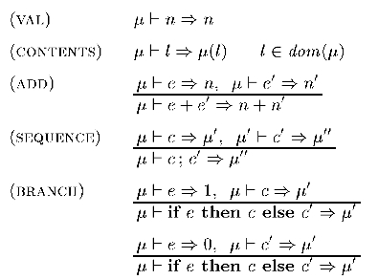
Natural Semantics

Slide 17
