Slide 1
Distributed K Nearest Neighbors
Harrison Zhao
David Katz
Eli Friedman

Slide 2
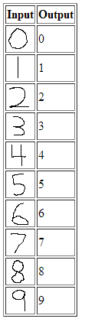
Converting Images -> Numbers:

Slide 3
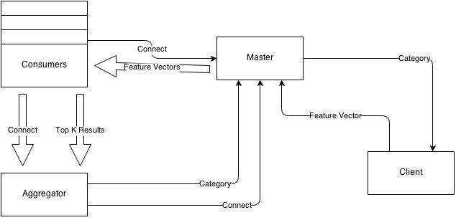
Flow structure

Slide 4
Results
# Consumers | Avg. Time (s)
1 | 29.615
2 | 20.624
3 | 14.364
4 | 11.539
5 | 9.534
6 | 8.221
7 | 7.255
8 | 6.489
9 | 5.771
10 | 5.327
11 | 4.805
12 | 5.719

Slide 5
Changing K Value

