Slide 1
Venture Capital A study of robust features that influence change in industry specific deals
Harrison Zhao and Andrew Koe

Slide 2
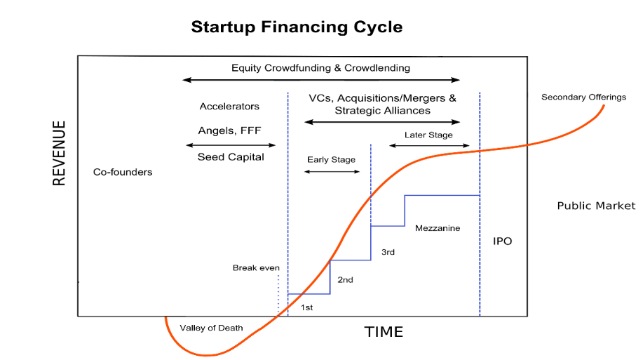

Slide 3
Data
Venture capital data obtained from PriceWaterhouseCoopers (PWC)
NASDAQ data obtained from Yahoo finance.
Data starts at Q1 1997 and ends Q3 2015

Slide 4
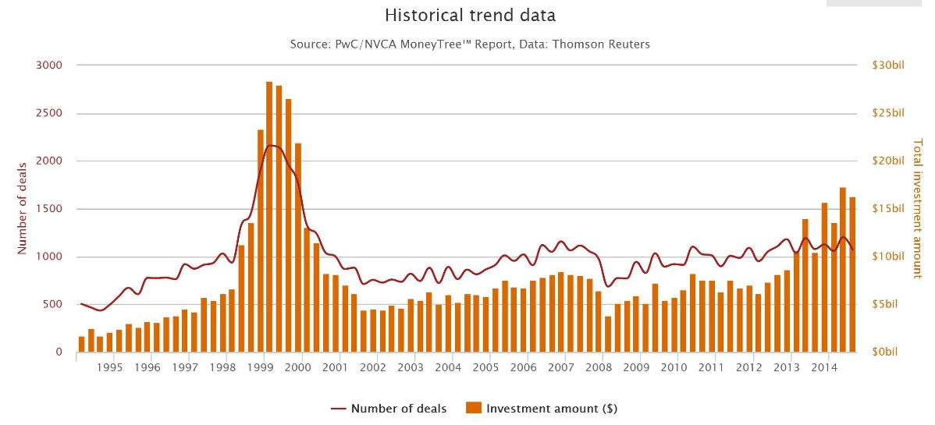
PWC Historical Venture Capital Data

Slide 5
PWC Sector Indices
9 indices which include
Biotechnology
Energy
Financial
Healthcare
Industrial
IT
Software
Telecommunication
Semiconductors

Slide 6
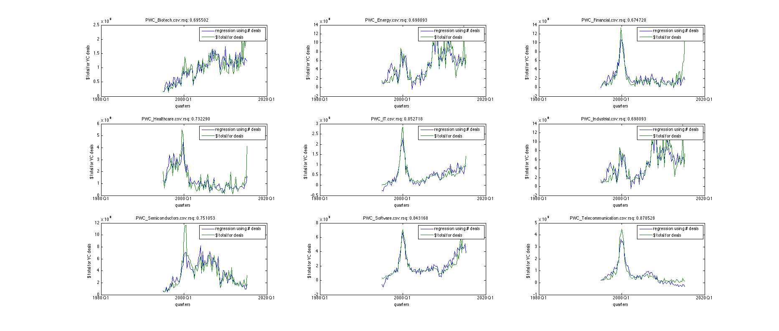
Regression of VC investment

Slide 7
NASDAQ Sector Indices
7 indices which include
Bank
Biotechnology
Computer
Industrial
Insurance
Other finance
Telecommunication

Slide 8
Preprocessing Data
PWC data
Formatted as quarterly data
Raw data features are:
Number of deals and total amount of dollars invested
Number of deals is highly correlated with total dollar amount invested
Features used are:
Number of deals
De-mean and standardized

Slide 9
Preprocessing Data
NASDAQ data
Monthly data converted to quarterly data
Raw data features are:
Opening, high, low, and close indices
Features extracted are:
Opening, high, low, close indices, momentum, and swing
De-mean and standardized
All features other than momentum are converted to units of % change since last quarter

Slide 10
Preliminary Analysis
Perform regression analysis on atypical periods of time
Dotcom bubble (Q1 1998 – Q1 2004)
Subprime Mortgage Crisis (Q1 2006 – Q1 2013)
Use related NASDAQ industries as independent variables
Use F-test to identify relevant variables

Slide 11
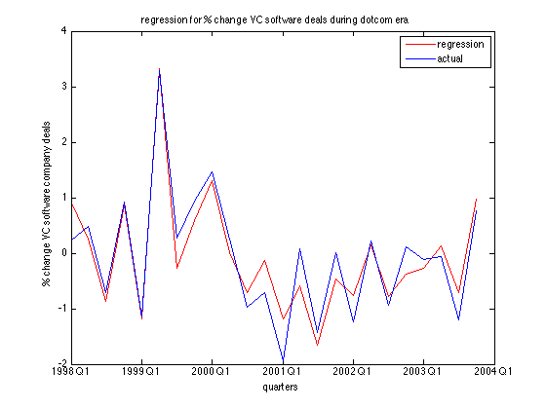
Dotcom Bubble Analysis

Slide 12
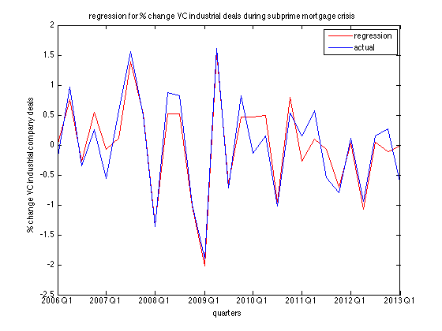
Subprime Mortgage Crisis Analysis

Slide 13
Rolling Window Analysis
Perform regressions on 3, 4, and 5 year windows on the PWC data
Roll the window forward one quarter and iteratively perform regressions
Identify NASDAQ features that are valuable independent variables
Choose independent variables that yield stable regression coefficients throughout the analysis

Slide 14
Data in Rolling Window Analysis
All the features extracted from the NASDAQ data are candidate independent variables
7 NASDAQ indices
6 features per index
42 total features
Regression is performed for each of the 9 PWC sector indices
NASDAQ features are filtered down using the F-test

Slide 15
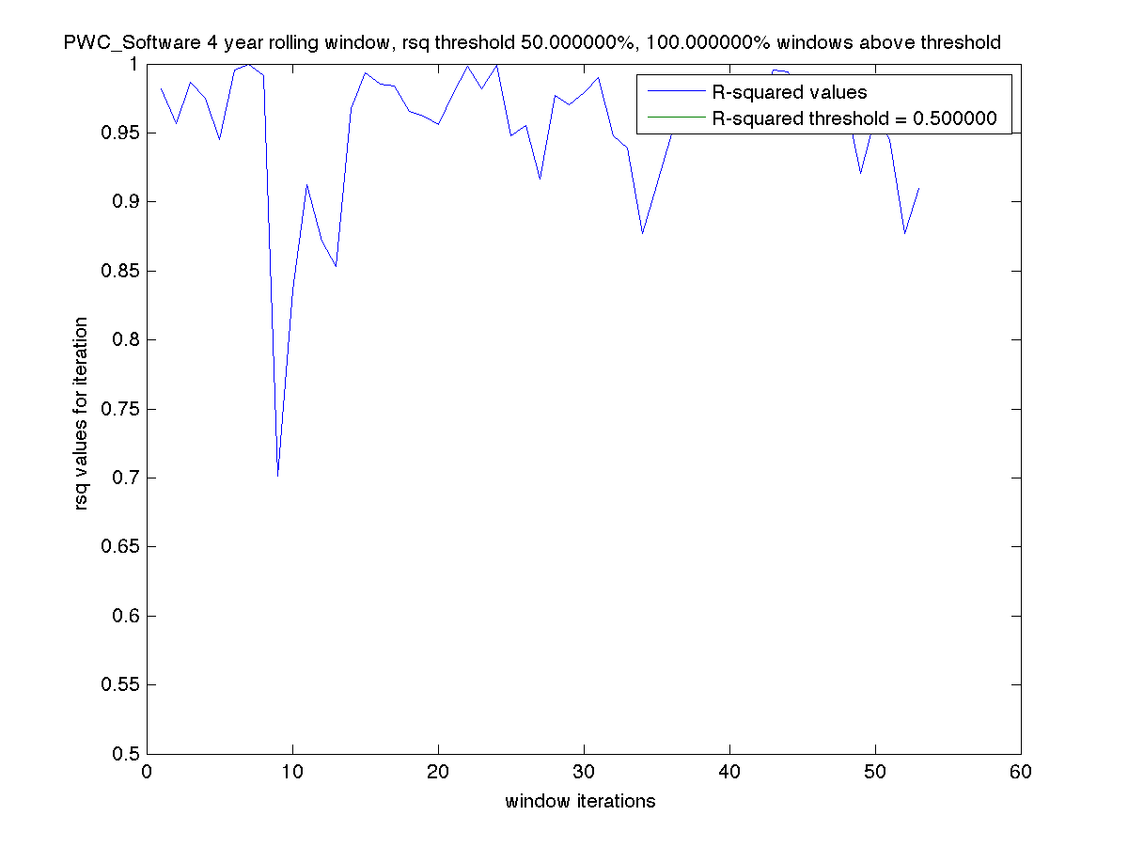
Rolling Window Analysis

Slide 16
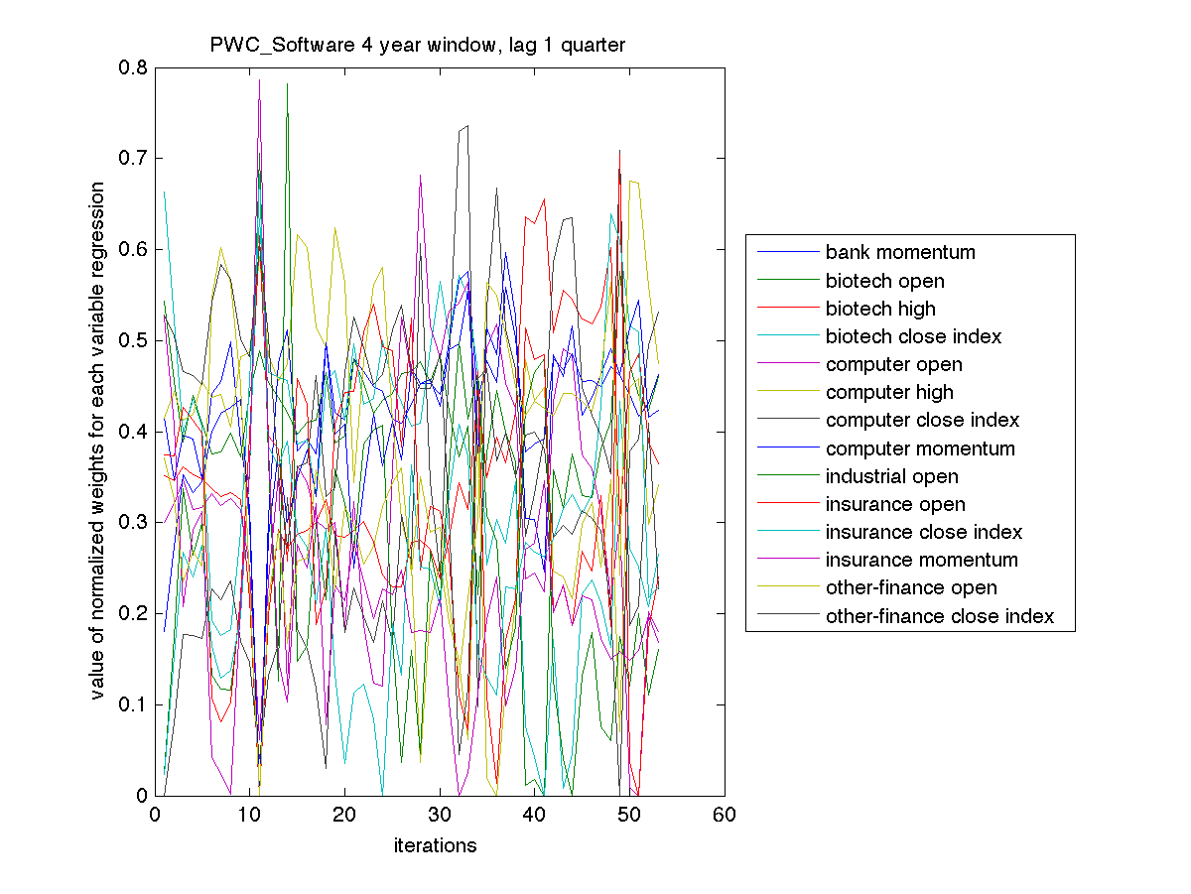
Relevant Variables and Weights

Slide 17
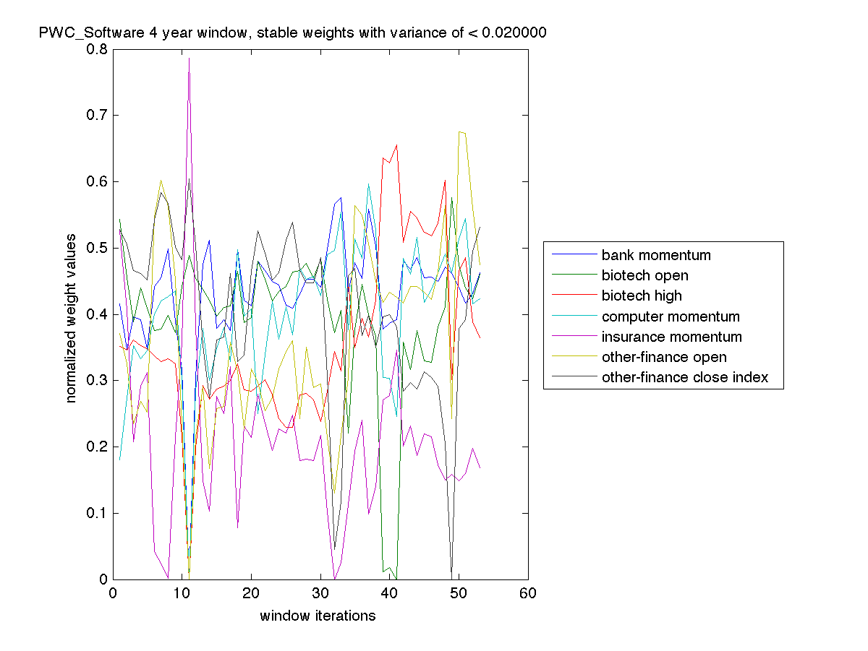
Stable Weights for Analysis

Slide 18
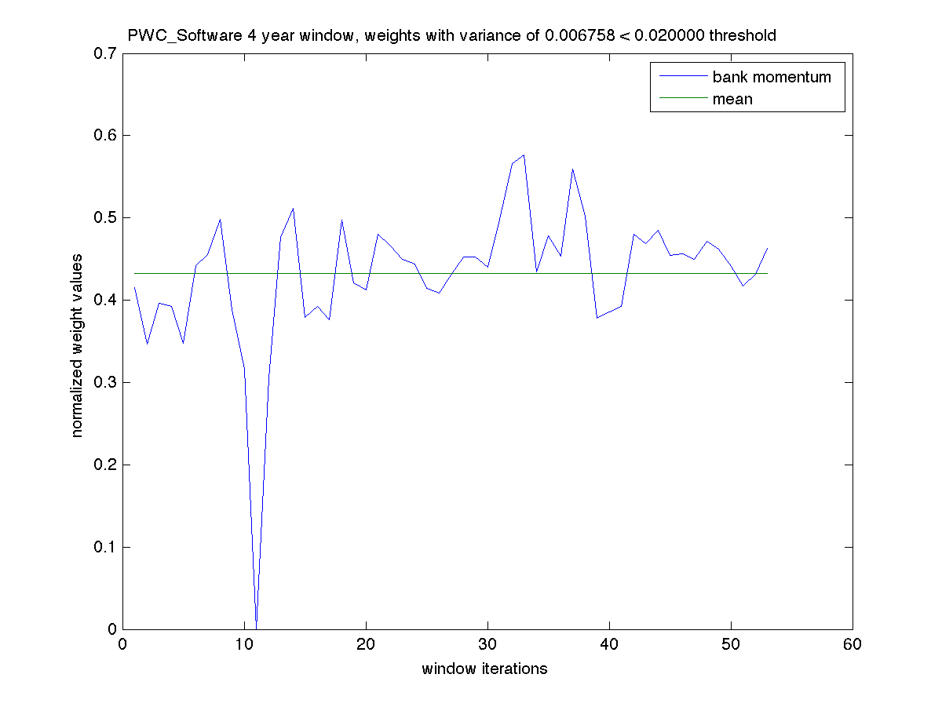
Examining Stable Weights

Slide 19
Conclusions
During atypical periods for the public market, market volatility and investor uncertainty was also reflected in private investments
Performance of related sectors are also strong indicators of investors’ willingness to invest in startups

Slide 20
Questions?

