Slide 1

Two Bit Circus
Summer 2013 Overview
By: Harrison Bryant

Slide 2
Game Table
Lightcycles, Offroad racer, Team Pong, Marble Maze
Unity3d - C#
2 minute play experience
Minimize latency & suite problems

Slide 3

Game Table demo
Creating a fun experience for all ages
was the biggest challenge
Intro project success as stepping stone

Slide 4
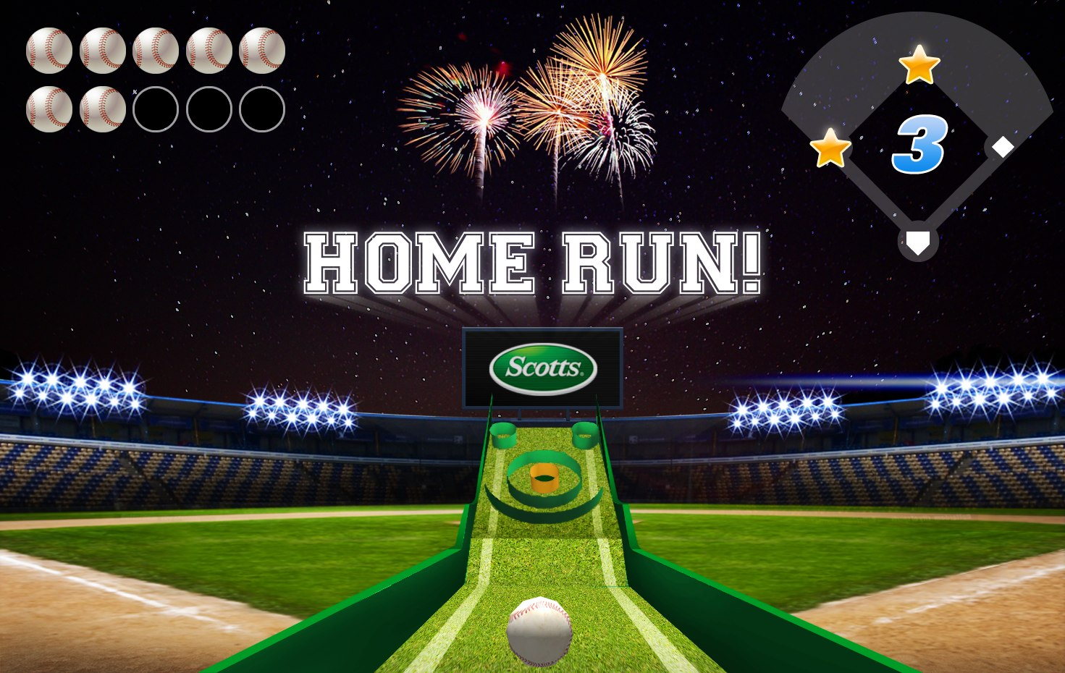
Skeeball Baseball
Unity skills put to test
Real client - Scotts
Co-operation and teamwork
Realistic deadline
Concept art. Day 1.

Slide 5
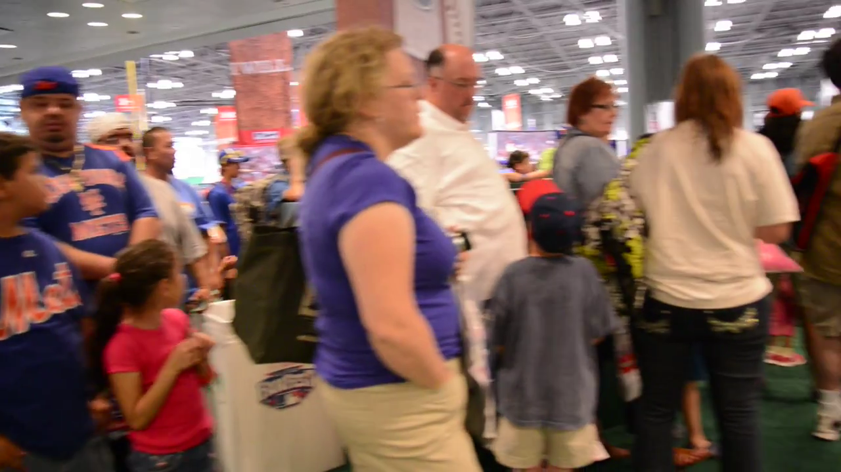
Product Demo
Dressing up scene: Lights, Camera, Scotts!
utilizing 3d models & physics
HUD most challenging: syncing animation
wonky physics & lag tolerance

Slide 6
Two Bit Circus Experience
CS skills put to test other than class projects
Confidence
Great team with good goals as motivation

