Slide 1
Harris Sainulabdeen BU MET CS699 Spring 2017
MET CS699
Classification Project
Classification of Cancer Data using Weka
Lung Cancer and Leukemia

Slide 2
Introduction
Objective
To present the analysis of publicly available WHO mortality data set with focus on two types of widely prevalent cancers; Lung Cancer and Leukemia .
Outcome
The data was pre-processed using R and Weka, and classified using Weka. Four different classification algorithms were compared to each other in terms of performance. The models were found to classify Lung Cancer vs. Leukemia with varying degrees of accuracy. Overall, these two cancer types can be classified based on age of individuals at death.

Slide 3
Agenda
Project Goal
Dataset Background
Data Import and Cleaning in R
Classification
Performance Comparison
Conclusion
Q&A

Slide 4
1. Project - Goal
WHO Classification Data
The International Classification of Diseases is the standard diagnostic tool for epidemiology, health management, and clinical purposes. This includes the analysis of the general health situation of population groups.
Lung Cancer and Tobacco
The Tobacco industry still does not publicly accept that smoking causes lung cancer.
If Lung cancer is similar to other types of cancers then it will difficult to classify Lung cancer as different from other types of cancers.
This project aims to classify and quantify the accuracy of such classification

Slide 5
2. Dataset Background
The WHO Mortality database comprises deaths registered in national vital registration systems.
The database contains number of deaths by country, year, sex, age group and cause of death as far back from 1950.
There are 4 sets of mortality data:-
1950 to 1972 – 281,749 records
1968 to 2008 – 380,627 records
Mortality from 227 countries are included, divided into 26 age buckets.
Hundreds of causes, with 57 different types of cancer listed out. Out of these two types of cancer are selected.

Slide 6
3. Data Import and Cleaning in R
The two data files were imported into R, converted into data frames.
These data frames were then filtered to include only Leukemia and Lung Cancer as the causes of death.
Columns were re-arranged to place the ‘Cause of Death’ column at the end for ease of classification in Weka.
The cleaned data frames were then were written into CSV files, replacing all missing numeric values with zero.
The CSV files were in turn loaded into Weka, and saved as .arff files.
All subsequent pre-processing was done in Weka

Slide 7
4. Classification
Training Data – Selected 1950-1972 Dataset for training each classification algorithms owing to two reasons:
Primarily this dataset had a manageable number of records (3281) .
Selection based on chronological order, since the test data was
newer (1968 to 2008) while the training data was from 1955 to 1972
Algorithms
Naïve Bayes
AdaBoostM1
DecisionTable
RandomForest
Attribute Selection
Correlation
GainRatio
InfoGain
Wrapper - GreedyStepWise
ReliefAttributeEval

Slide 8
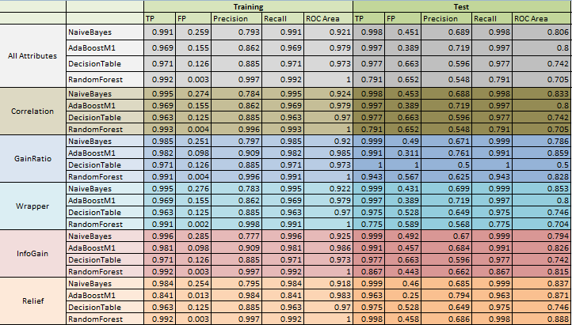
5. Performance Comparison

Slide 9
6. Conclusion
AdaBoostM1, with Relief and InfoGain attribute Selectors give the best FP and ROC.
The models can classify Lung Cancer and Leukemia with a reasonable level of accuracy.
This is because the data set provides age at death. There are 26 age groups and usually Lung Cancer affects mostly people who are old enough to start smoking and be susceptible to other carcinogenic substances.
The objective was to see if these classification algorithms could detect the patterns which are understood when looking at cause of death and age at death. The algorithms clearly could predict with a reasonable degree of accuracy.

Slide 10

7. Questions and Answers

