Slide 1
Harris Sainulabdeen BU MET CS544 Summer 2016
544
Final Project
Analysis of Primary Election Candidate Spending

Slide 2
Introduction
Objective
To present the analysis of publicly available data set containing information about the money spend by each of the 24 candidates in the primary election campaign . The cleaned data set contains 159625 records spanning from August 2015 to February 2016.
Outcome
The data is analyzed using R programming language, and found to confirm with Central Limit Theorem. Also, the analysis shows comparison of spending pattern of Clinton and Sanders campaigns.

Slide 3
Agenda
Dataset Background
Data Import and Cleaning in R
Analysis of Categorical and Numerical Data
Normal Distribution
Central Limit Theorem
Confidence Intervals

Slide 4
1. Dataset Background
Presidential Candidate Spending data is available at Federal Election Commission.
There are 159925 records in the original dataset. However, the data after cleaning shows 159625 records for 24 candidates.
Some of the graphs derived out of this dataset is available at the Tableau website.
This fairly good sized dataset is selected due to the large number of records that is required to show conformity with the Central Limit Theorem.

Slide 5
2. Data Import and Cleaning in R
Presidential Candidate Spending dataset is a CSV file. Used readcsv function to import the dataset. read.csv(file='2016_presidential_candidate_expenditures.csv', header=TRUE)
The headers of the data frame were then changed to add meaningful column headers, using colnames
The original dataset did not have information about candidate’s political affiliation. This was corrected first using subset to split the data frame and adding political affiliation, and then using rbind to combine the split data frames back to the original size.

Slide 6
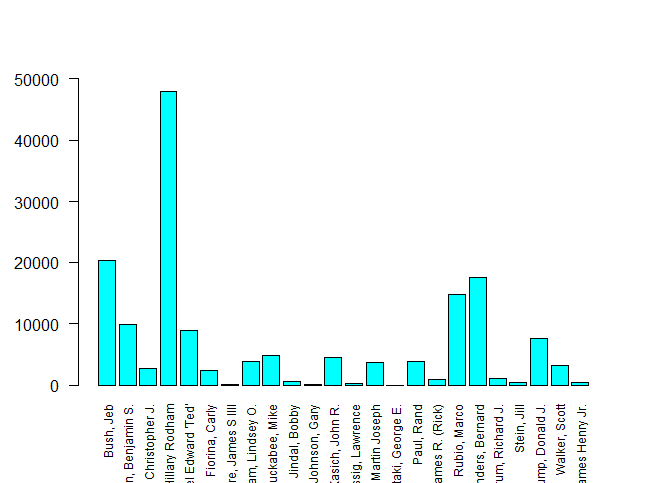
3. Analysis of Categorical and Numerical Data-1
The total number of transactions for each candidate. The notable thing here is that Fmr. Secretary Clinton has significant number of transactions compared to others.

Slide 7
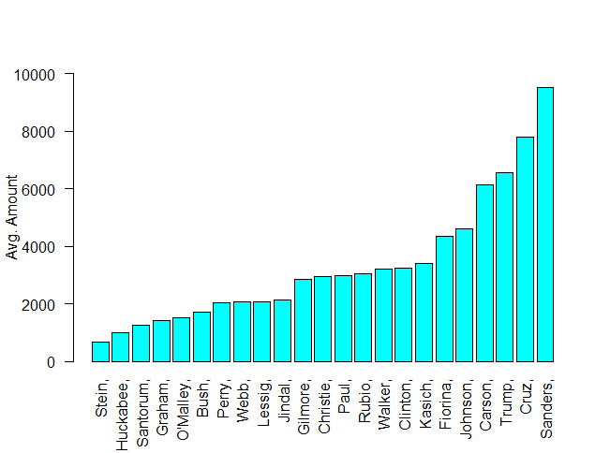
3. Analysis of Categorical and Numerical Data -2
The average size of transactions for each candidate. Clinton here is 8th ranked in the list, despite having twice as many transactions as the next in the list in the previous plot.

Slide 8
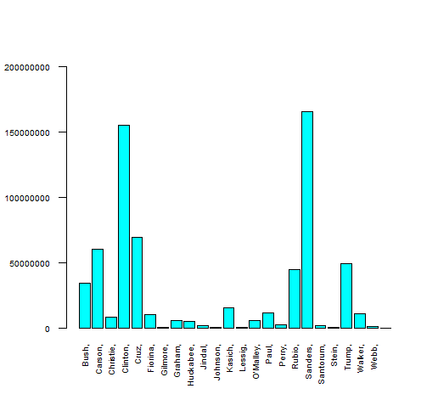
3. Analysis of Categorical and Numerical Data -3
The total amount spent by each candidate shows Clinton at the second place, behind Sen. Sanders, although the number of transactions for Clinton is far higher compared to Sanders.

Slide 9
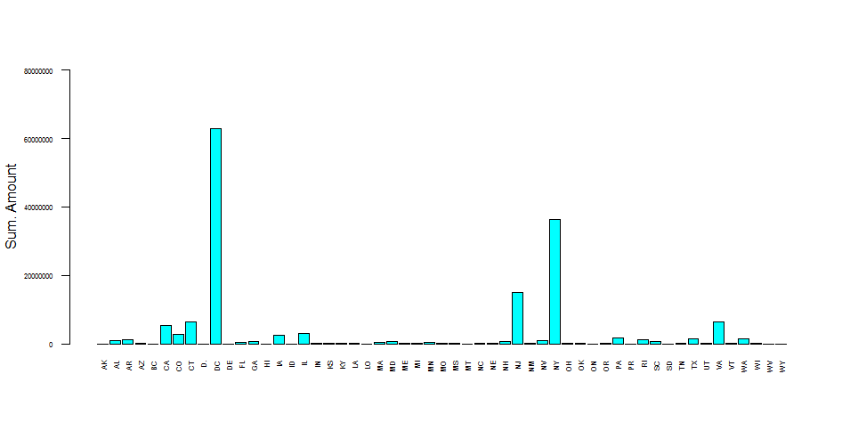
3. Analysis of Categorical and Numerical Data -4
Here is the break up of spending by State. DC, NJ and New York are notable
because the biggest category of spending is Media, which increased the size of spending in these three states.

Slide 10
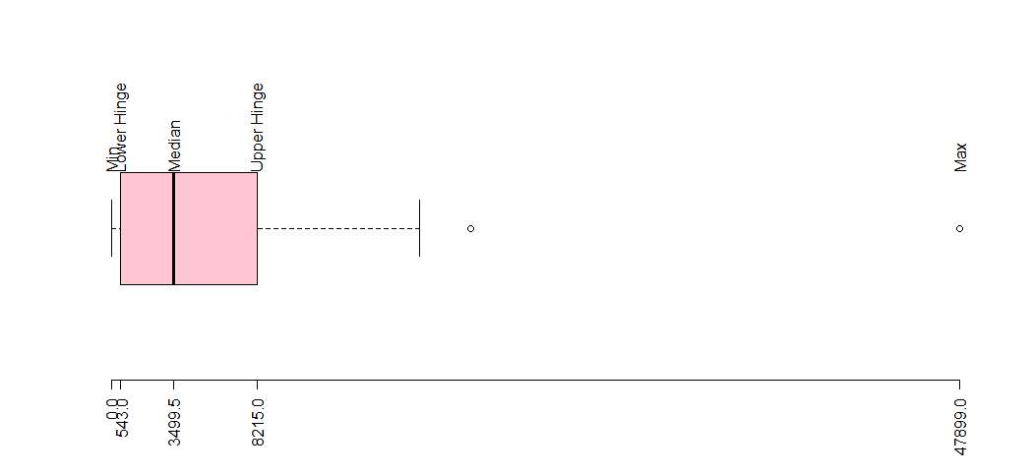
3. Analysis of Categorical and Numerical Data -5
Boxplot for the number of transactions. While the mean of number of transactions is 3499.5, Clinton’s number of transaction is truly an outlier at 47899.

Slide 11
4. Normal Distribution -1
The Presidential Candidate Spending dataset has a normal distribution. Here, let us compare the normal distribution for Sanders, Clinton and all candidates.
While Clinton’s average transaction amount as well as Standard Deviation
follows the general trend, Sanders’ numbers show bigger variance.
Top 5 transactions – by transaction amount
Measure - Spending | Sanders | Clinton | All
Mean | 9512.281 | 3245.984 | 4123.382
Standard Deviation | 115104.5 | 47176.9 | 54125.72
Candidate | Distribution Amount
Sanders, Bernard | 6119501
Sanders, Bernard | 6000000
Cruz, Rafael Edward 'Ted' | 5116968
Sanders, Bernard | 4424744
Sanders, Bernard | 4096202

Slide 12
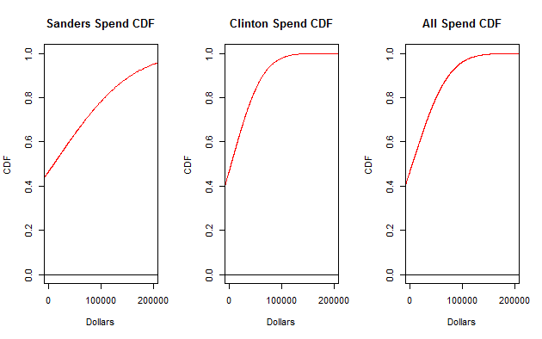
4. Normal Distribution -2
To expand further, comparing Clinton CDF and Sanders CDF with the entire CDF across all candidates, Clinton’s spend is more towards smaller transactions.

Slide 13
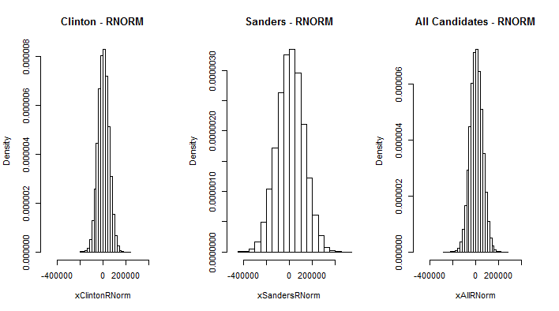
5. Central Limit Theorem - 1

Slide 14
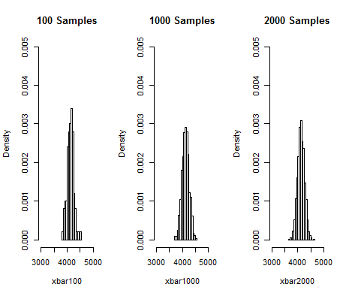
5. Central Limit Theorem - 2

Slide 15
6. Confidence Intervals
The Confidence Intervals of the entire population mean is compared against various samples
Measure | All Candidates | Clinton | Sanders
Mean | 4123.382 | 3245.984 | 9512.281
SD | 54125.72 | 47176.9 | 115104.5
80% Confidence | -65241.53 - 73488.29 | -57213.65 - 63705.62 | -138000.09 - 157024.65
90% Confidence | -84905.51 - 93152.28 | -74353.12 - 80845.09 | -179817.80 - 198842.36

Slide 16

8. Questions and Answers

