Slide 1
Harris Sainulabdeen BU MET CS688 Fall 2016
CS688
Term Project
Soccer Leagues
&
Prediction

Slide 2
Introduction
Objective
To present web scraping soccer data using API calls and ShinyR.
To show how goals scored in EPL is a Poisson Distribution
Outcome
8 season worth of English Premier League data was analyzed using R programming language, and goals distribution is found to be a Poisson Distribution.

Slide 3
Agenda
Dataset Background
Data Import and Cleaning in R
Analysis of Data / ShinyR
Poisson Distribution
Q&A

Slide 4
Dataset Background
Two Data Sources
Football-data API provides football data of all major european leagues in a machine-readable way. Data includes fixtures, teams, players, results and more via a RESTful API in JSON (only) representation.
Kaggle European Soccer Database - Since the API data is available only for 2015/2016 and 2016/2017, collected more soccer data for previous years from a database for analysis

Slide 5
Data Import and Cleaning in R
Football-data API
First task was to register for a free access API key. Using the API access key, a generic function in ‘R’ was built to get data from the website.
Subsequently, function calls were built to collect data for:
Competitions – All major soccer leagues in Europe
Teams – Teams participating in each competition
League Table – For each of the competition, standings of teams
Kaggle European Soccer Database
Downloaded ‘database.sqlite’ file and used SQLite to get a list of:
Matches
Leagues
Teams
Results
Used filter to collect data for only English Premier League (8 Seasons - 2008 to 2014)

Slide 6
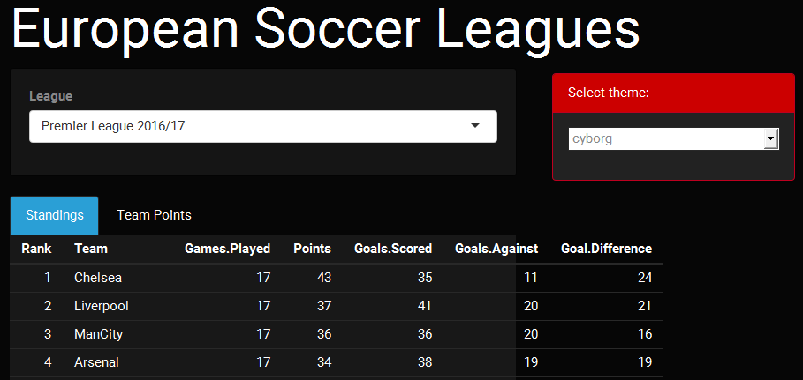
Analysis of Data / ShinyR - 1
The league standings, selected from a list, shows all major European Soccer League data for the past two seasons. 17 Matches have been played in the English Premier League.

Slide 7
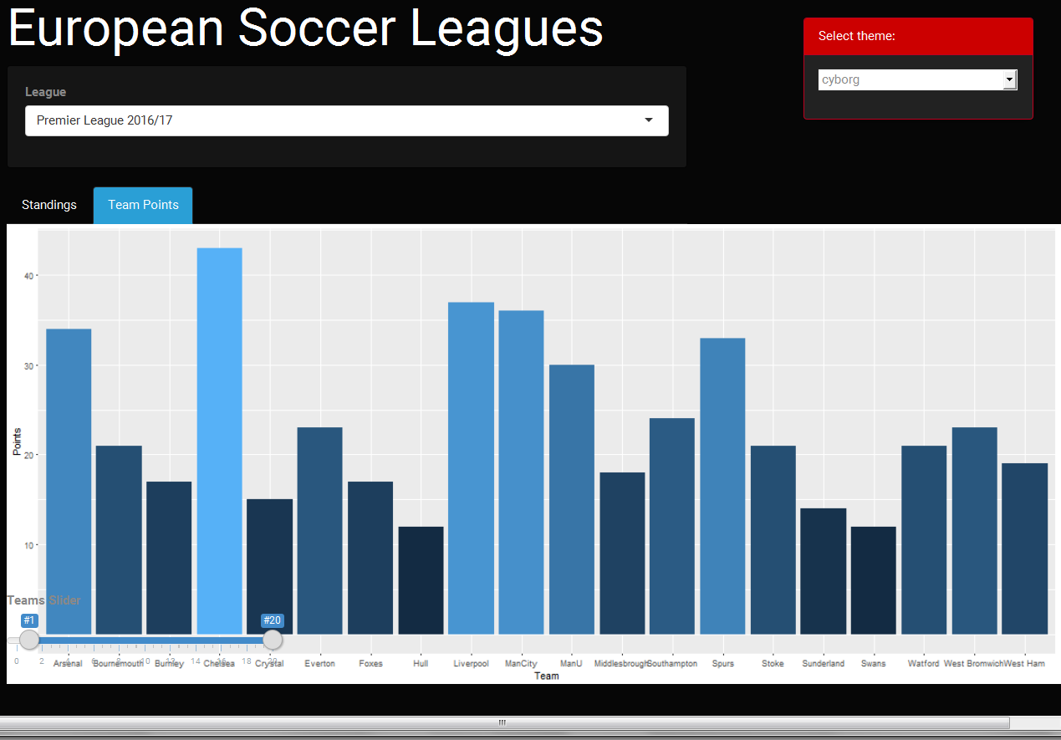
Analysis of Data / ShinyR - 2
The points table, can be expanded using a slider.

Slide 8
Analysis – Historical Data
The data available at Football-data API is only for 2 years.
Not a sufficient time frame to create any meaningful analysis
Not enough to build any models either.
The lack of depth in available data created a need to access more detailed, historical data. Kaggle European Soccer Database is a good source for Soccer game analysis.
The data set includes 25K+ matches, players, teams etc… across major leagues of Europe.
English Premier League data is available for 8 seasons (compared to 1.5 seasons in the API)

Slide 9
6. Poisson Distribution
A discrete probability distribution that expresses the probability of a given number of events occurring in a fixed interval of time and/or space if these events occur with a known average rate and independently of the time since the last event.
Distribution often used to model the number of incidences of some
Characteristic in time or space:
Arrivals of customers in a queue
Numbers of flaws in a roll of fabric
Number of typos per page of text.
e.g English Premier League
Total Goals Per Game (Both Teams)
Mean=1.4
Goals by Team
Home Team: Mean=1.6 Variance=1.7
Away Team: Mean=1.2 Variance=1.3

Slide 10
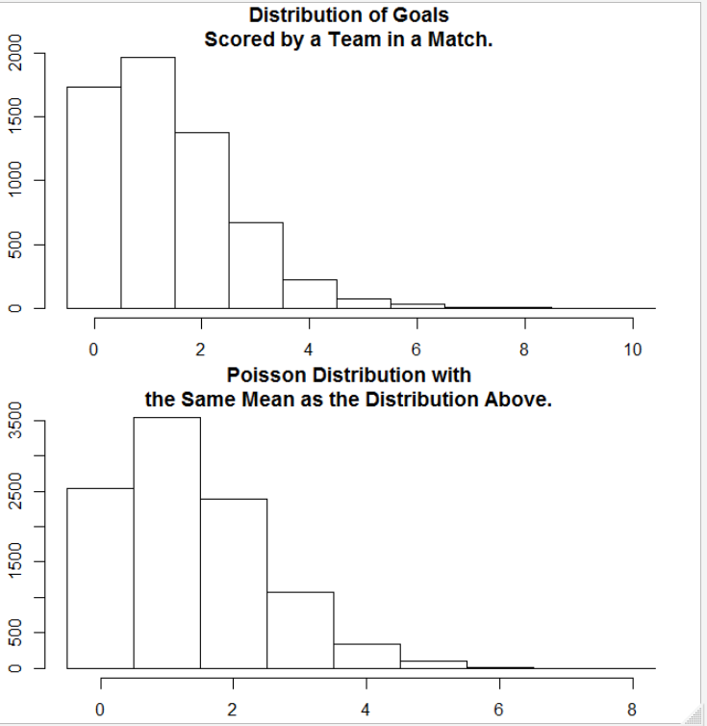
6. Poisson Distribution - EPL

Slide 11
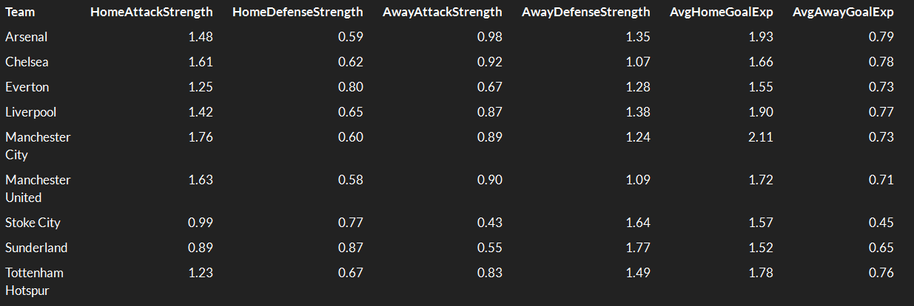
7. Team Comparative Strength- EPL

Slide 12

8. Questions and Answers

