Slide 1





Project
Cataschevastica
TEAM 2
19/06/2024

Slide 2


OUR TEAM
Georgios Valavanis
Michael Voutyritsas
Elisavet Kavoura
Evaggelos Stergiou
Charisis Skordas

Slide 3





GOALS AND OBJECTIVES
Develop a robust Data Warehouse for Cataschevastica
Provide advanced analytical capabilities for Sales decision making
Support historical data analysis
Enhance business insights
Creation of datalake and deployment

Slide 4

Project Timeline
1
2
3
4
5
Update of the OLTP Database
Creation of the Data Warehouse
Creation of Datalake
Databricks ML
Visualization of results
New tables for:
Quality Control
Warehouse
Shifts
Roles
Locations
Orders for raw materials
Staging
Fact tables for Sales, Production, Inventory and Raw materials orders
View for Products and Raw materials
SCD Type 2 (Row Versioning)
Deployment of local datawarehouse to azure data lake
Sales prediction with KMeans using databricks and scikit learn library
Using Power BI

Slide 5


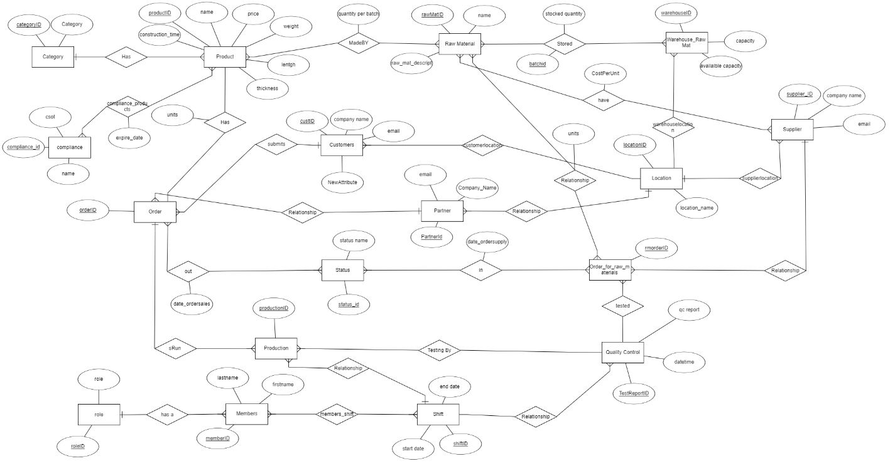
ENTITY-RELATIONSHIP DIAGRAM (ERD) -VERSION 2

Slide 6
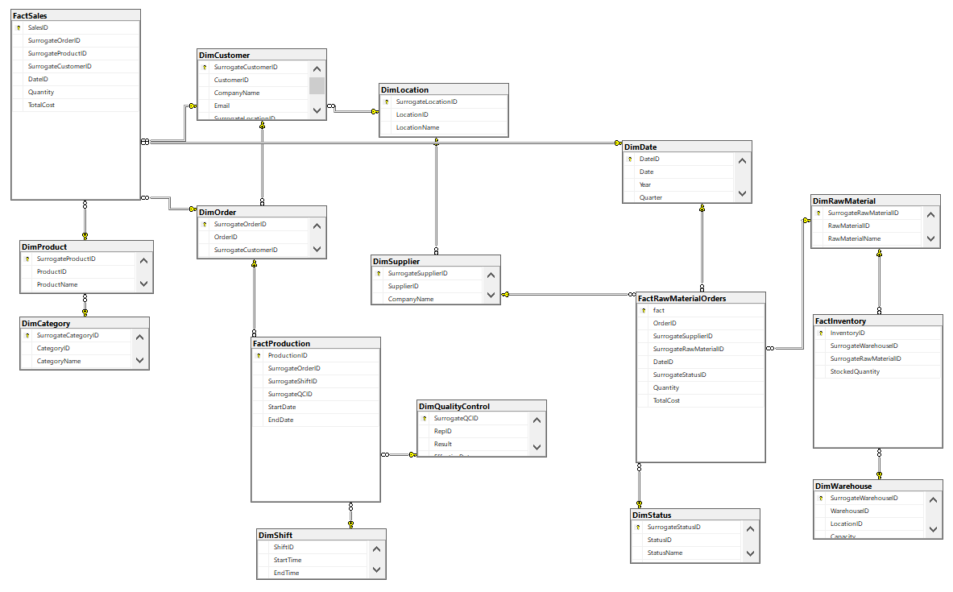
GALAXY SCHEMA

Slide 7

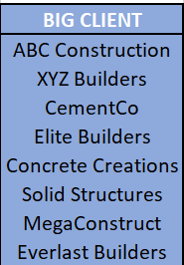
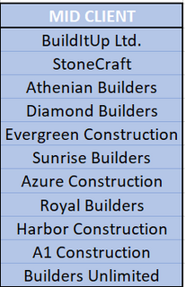


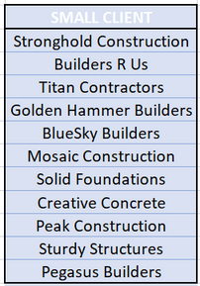


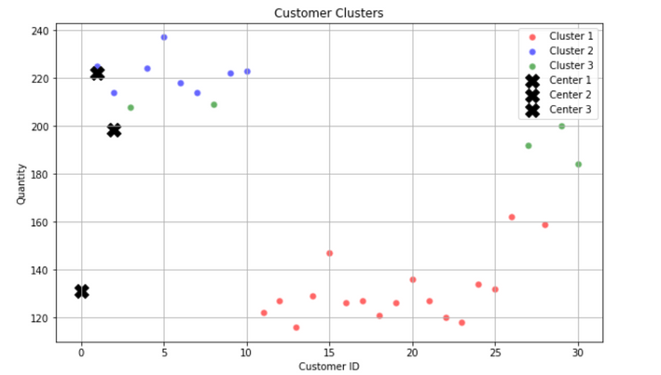
DATABRICKS & ML
GOAL: Costumer classification based on number of products per order.
Clustering Results
Import data from Azure storage account
Machine learning using KMeans for customer clustering

Slide 8

REPORT
Live reporting in Power BI

Slide 9





CHALLENGES & FURTHER IMPLEMENTATIONS
Creating sufficient data entries in the OLTP database required considerable time to ensure accuracy
The Azure implementation required several steps, which slowed down our efficiency, since we were new to the solution.
Further implementation of additional raw material orders to cover a wider period of time.
Evaluate additional predictions for better insight into the demand of our products.
CHALLENGE N°1
CHALLENGE N°2
FURTHER IMPLEMENTATIONS

Slide 10
THANK YOU FOR WATCHING
Are there any questions?

