Slide 1
APS1052 FINAL PROJECT
Indicator Project
With Timothy Indicator and Model Explanation
By Yunkun Yang

Slide 2
Introduction
This project is a indicator analysis.
The indicators are created through Timothy Master program.
Timothy Master: http://www.timothymasters.info/
Machine learning is trained on the data with different indicators to determine whether the indicators boost the metrics. Also, a comparison between Timothy indicators and Talib indicators will be conducted (RSI).
Model explanation is applied on the model with selected indicators to see how the extra information affect the model.
Side: An entropy analysis is applied on the indicators to check the indicator data quality.

Slide 3
Data and Indicators

Slide 4
Setup
For this project, multiple resources are used, such as C++, Python, Azure
Data generation is through Python and C++ for the indicators.
Python are used for modelling and evaluation.
For the tuning Azure Machine Learning Studio is also used for a better performance.
Related files:
./src/data_prep.py ## for generating data and timothy indicators (note: I used python to run CLI command)
./req_pkg.txt ## for the related packages
./vs.txt for indicators
./exe/* for all timothy executables

Slide 5
Data Used
The data used is from scraped from yahoo finance using yfiance API
The stocks used with their tickers are the following:
"^OEX","^NDX","^RUT","^DJI", ## index
"TSLA","NKE","AMZN","WMT","JPM","GS","BA","CAT","IBM","MSFT","TLT", ## popular ones
"BAC","KO","AAPL","DIS","SBUX” ## some stable stocks noted from the page
https://www.fool.com/investing/stock-market/types-of-stocks/safe-stocks
The signals used in the programs are from
Timothy Master program single program for 16 different indicators
Talib package in python for 2 RSI indicators

Slide 6
Data Used
The historical data received from yahoo finance are daily from Jan 2010 to Jan 2022.
The target in the model is a simple percentage return.
The independent data are past 30 day percentage return.
The reason we used such simple model is because we hope to focus on the effect of the indicators.
All the data are stored in ./data/*
All files are named as <ticker>.txt for raw data, <ticker>_signal.txt for indicators and <ticker>_full.txt for a joined version of previous 2 files

Slide 7
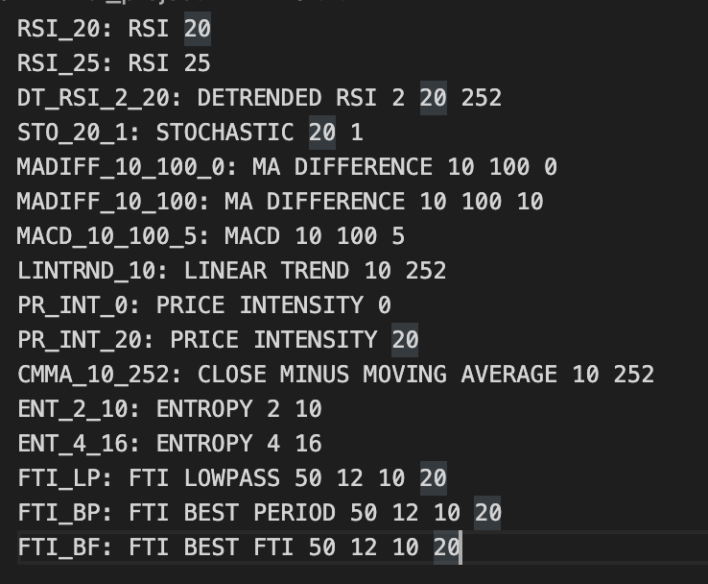
Indicators
As stated in the VS.txt file, we include the following indicators:
Detailed in the following sides
Including the 2 extra talib RSI indicators
RSI_20_ta
RSI_25_ta
Those 2 extra indicators are used to compare with
Timothy RSI indicators

Slide 8

Exponential Smooth
Function:
$S_{t}=αX_{t}+\left(1−α\right)S_{\left\{t−1\right\}}$
Where
$α=\frac{2}{k+1}$
And k is lookback window

Slide 9
RSI
Relative Strength Indicator is used to compare average magnitude of recent close-to-close price increases versus decreases. It uses two series, upsum and dnsum to store prices increase and price decrease.
With a lookback windows n, the algo examines the nth bar starting at the first bar in market history.
The program sums all upward moves but dividing by the total number of moves, and the downward moves are similarly averaged.
RSI = 100 * Upsum/(Upsum + Dnsum)
Instead of a traditional ordinary MA for smoothing, Timothy uses an exponential smoothing
Input parameter: lookback window.

Slide 10
DT_RSI
Detrend RSI is a special RSI with a detrended.
Mean reversion is the scenarios that a stocks suddenly jump out of line and then recovers to normal trend.
The program will compare the market with its expectation, and it can better capture those stocks’ sudden jump. However, dt_rsi is normally negatively correlated with the market behavior in short term.
Input parameter: lookback being detrended, lookback for detrended, number of bars for linear model

Slide 11
STO
STO stands for stochastic.
It is an indicator lookback n bars, find the lowest price and highest price in that period and decide whether the close of the current bar lies relative to the price range. If the price lies closes to lowest price, then the stochastic is 0, otherwise 100.
Sto = 100 * (Close – Low)/(High – Low)
Input parameter: lookback, smoothing options

Slide 12
MADIFF
MADIFF is an abbreviation of Moving Average DIFFerence.
It calculates difference between two Moving average with different lookback windows
Input parameter: short-term lookback, long-term lookback, lag for long-term lookback

Slide 13
MACD
Moving Average Convergence Divergence
It is used similarly with MADiff. Instead of being computed using simple moving average, exponential smoothing is used to compute short-term and long-term moving averages.
Exponential smoothing perform better when goes all the way back to the start of the process, and it can sometimes decrease the impact of oldest price when window moves.
Input parameter: short-term lookback, long-term lookback, lookback for final exp. smoothing

Slide 14
LINTRND
Linear trend algorithm apply a linear regression to the data and use the linear model to decide the expectation of the price.
It works similar to moving average, but using a regression model instead of a mean, this indicator is more responsive than MA
Input parameter: lookback for trend, lookback for ATR normalization

Slide 15
PR_INT
Price Intensity as one of the most successful indicator in our project, it examines the intraday price movement and the volume that accompanies that price movement.
It depends on the intraday intensity.
It is an indicator for a bar is the open-to-close price change relative to the range of prices for this bar and close of the prior bar.
Raw Price Intensity = (Close – Open)/ max[High – Low, High - Last Close, Last Close - Low]
Price Intensity = 100 * Φ(0.8 * k^(0.5) * Smoothed) – 50 where smoothed is the exponential smoothed function and Φ(Z) is a standard normal cumulative distribution function.
Input parameter: bars for exponential smoothing

Slide 16
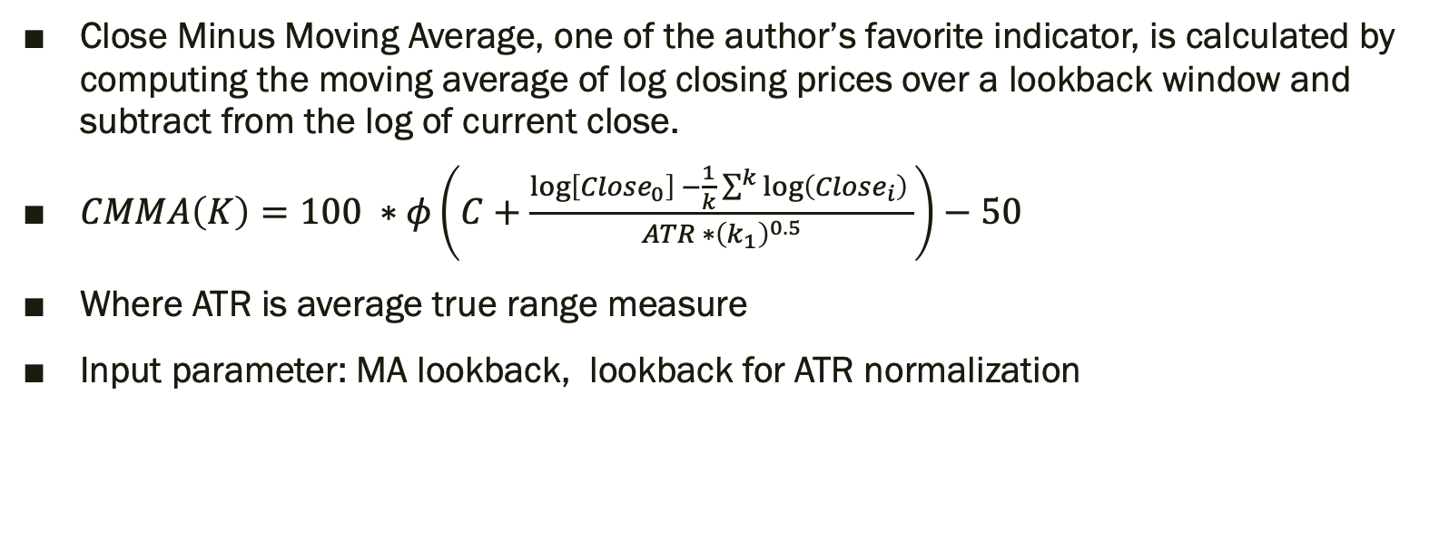
CMMA
Close Minus Moving Average, one of the author’s favorite indicator, is calculated by computing the moving average of log closing prices over a lookback window and subtract from the log of current close.
$CMMA\left(K\right)=100 ∗φ\left(C+\frac{\log\left[Close_{0}\right] −\frac{1}{k}\sum^{k}{\log\left(Close_{i}\right)} }{ATR ∗{\left(k_{1}\right)}^{0.5}}\right)−50$
Where ATR is average true range measure
Input parameter: MA lookback, lookback for ATR normalization

Slide 17
ENT
Entropy Measure.
Skipped because we will have one entire section for entropy analysis.
This ENT construction is same as the permutation entropy in slides 43
Input parameter: word_length/permutation_order, bin count

Slide 18
FTI
Khalsa’s Follow Through Index
It is not a traditional indicator, not a direction, also not a rate of the trend.
It is an indicator that when the market shows a trend and did that trend continue for a long time?
When a trend stay for a long time, it will present a high FTI value.
It has a few subcategory, Lowpass Filtering,, best period, best width, and best FTI.
For the complexity, I will not explain more about this.
Input parameter: lookback window, half-length, min period search for max FTI, max period search for max FTI

Slide 19
Model and Evaluation

Slide 20
Model and Evaluation
As we introduced before, we are going to apply model on the stock return data with and without indicators to see whether we would benefit from including indicators.
We also going to compare Timothy and Ta-lib indicators.
Due to the large amount of indicators selected and stock we use, we are not going to evaluate in details how much each indicators can bring. Rather, we focus on Yes or No that indicators can bring us.
A selection of tickers would be retrained over a model explanation model to compare whether the result align with our model evaluation. (This will be in next section.)

Slide 21
Models
As mentioned in the Data section, we use past 30-day percentage returns + different indicators. For the target variable, we used a future 1 day percentage change. We applied the imputing and standard scaler along with Scikit-learn regression models to train the dataset.
Out of concern of the time and computational power, I only trained 3 regression models with limited parameter space.
Ridge
Random Forest
GBM
The evaluation metrics we use are most used in our course, spearmanr and RMSE, CAGR, Sharpe ratio and Calmar are also calculated for an analysis. Due to the data issue, some Calmar results contain inf or –inf. We mostly focus on CGAR in the following slides.

Slide 22
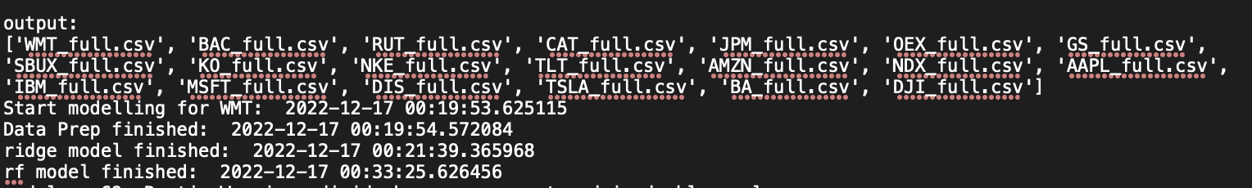
Model Runtime and Scripts
The model tuning part took ~ 19 hours to run in Azure, the output log is stored under ./output/tuning_out.txt file
The related files:
./src/model.py ## for actual script used for tuning model
./src/model_eval.ipynb ## for evaluating model, and store most of our result
./src/model.ipynb ## an template/experiment with one file

Slide 23
Tuning Part
Refer to ./src/model.py
I trained one base model(without any indicators) as the baseline model.
I trained multiple models with each of 19 indicators with spearmanr and negative rmse and produce the CAGR and sharpe ratio.
Due to some issues, I was not able to re-run multiple times of with training-testing split. Rather, I used timeseries split for the cross validation, and directly analyze over the training dataset metrics. This is not optimal, but it would satisfy our need because comparing metrics over training data for all indicators can still illustrate whether indicators help or not.
More modification plans in Future Work section.

Slide 24
Model results
We have 19 indicators per model, including one base model
We have 3 models categories per stock.
We have 20 stocks.
So, we would have in total 19 * 3 * 20 = 1140 models.
It’s hard to analyze model over model, so we will mostly compare indicator with baseline model, and another interesting thing to analyze is the Timothy RSI VS Talib RSI.

Slide 25
Metrics Evaluation
We trained the model over Spearmanr, sharpe and negative-rmse.
By comparison those metrics, we are able to find which model is better fitted and the higher those metrics are, it means the data are more sufficient.
If our model with indicators produces a higher spearmanr, or negative-rmse, then it means the indicators helped boost the model accuracy.
Due to we calculate sharpe_ratio in training dataset, we will focus on Spearmanr and rmse here to determine whether models are well trained, and whether including indicators brings benefit to our model.

Slide 26
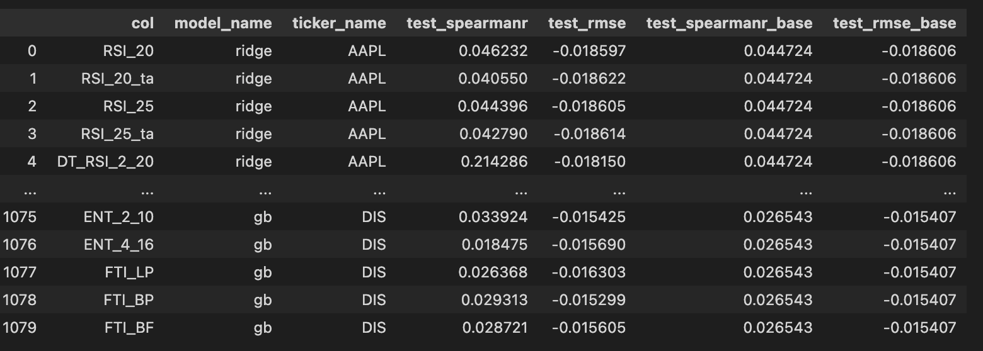
VS Baseline Model
For all the indicators, models category and stocks, we find that 70% trained models a higher test spearmanr than our baseline model, and ~50% of trained models have better rmse than baseline model.
The number show that some of our indicators provides some extra information and it actually helped the model to better calculate the result.
However, for the 50% of worse RMSE models, I would think that not all indicators take the great effect and we will look them in details.
We count how many models outperform baseline model and do the following analysis

Slide 27
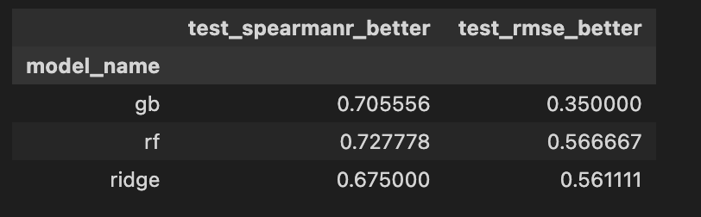
Comparison Between Model Category
We firstly look at the comparison between 3 model category. Ridge, gradient boosting and random forest. We noticed that all three models have similar numbers of observations that outperform baseline model in spearmanr. However, the random forest and ridge regression works much better than gradient boosting regressor, but still not good enough.
From the next slides, we can see that the low rmse is because of some bad indicators and that dragged a lot of evaluation metrics down.
Still, a more complete parameter grid could be defined and more training should be done.

Slide 28
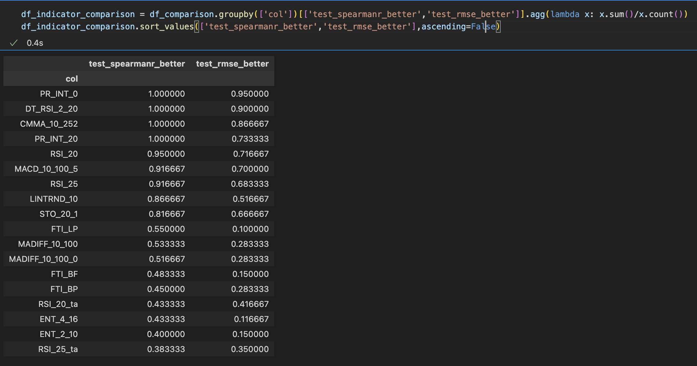

Comparison between Indicators
From the chart, we can see for a few indicators, all model trained with those indicators reach a better spearmanr than baseline model, like PR_INT, DT_RSI and CMMA.
Those indicators also provide a great rmse than our baseline model.
However, for a few ones as circled in green, only a few models trained using that indicator outperforms baseline model, those are the models dragged down the overall performance.
Also, we can see from this chart, highlighted in blue,
Timothy RSI performs better than Talib RSI (which is named _ta). We will see a more detailed comparison between Timothy and Talib RSI in next slides.
Another fun thing: good performed indicators stack together like PR_INT and bad indicators they also stack together like FTI, ENT. That indicates that those bad behaving indicators are not informative or this indicator set is not suitable for those dataset.

Slide 29
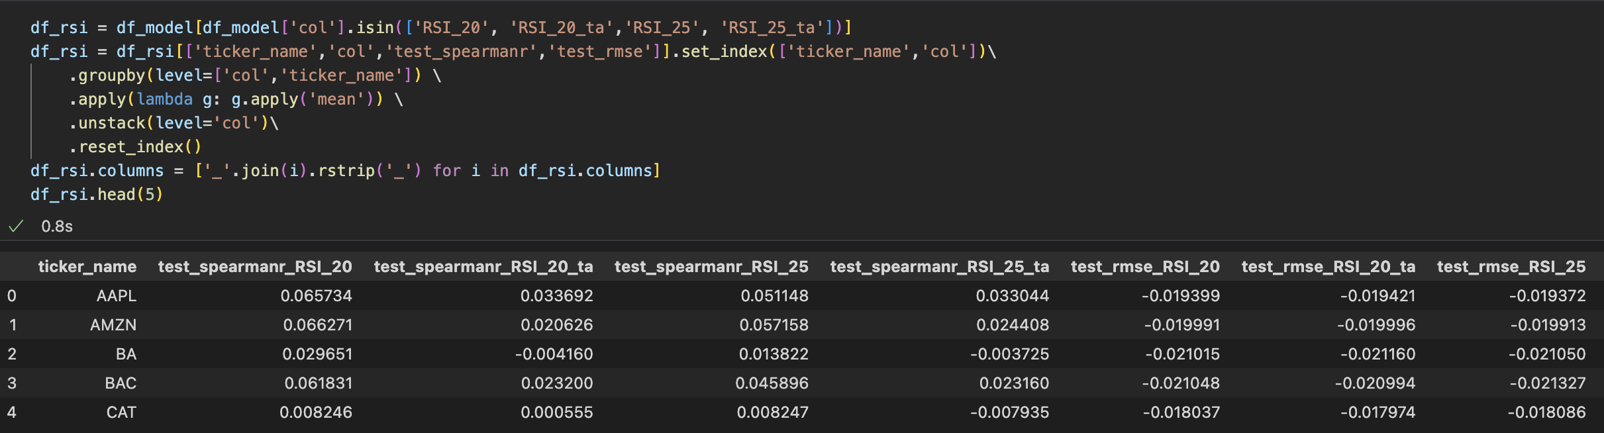
Timothy VS Talib regarding RSI
RSI is one of the frequent used indicator.
We make a comparison of Timothy VS Talib RSI.
From the previous slides, we would anticipate that Timothy_RSI works better than Talib RSI. With some aggregation, we have the following table.
Generally, timothy’s RSI shows better result than RSI_ta.

Slide 30
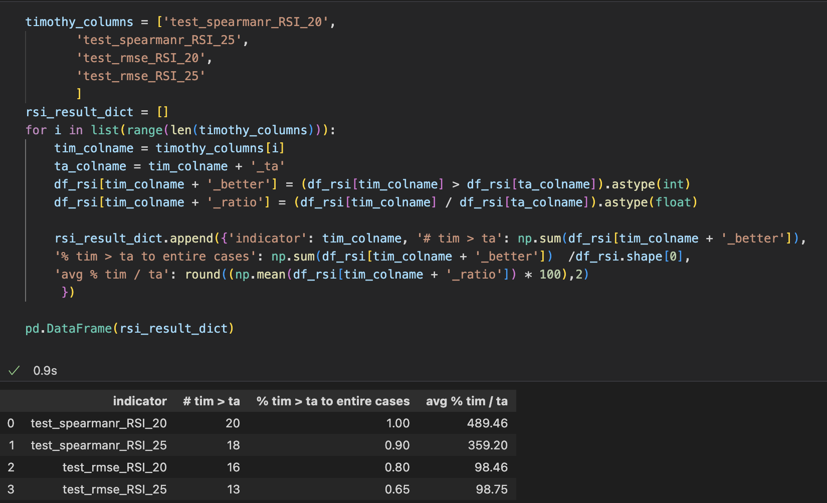
Timothy VS Talib
The code show the comparison between Timothy indicators and Talib indicators. We noticed that for both Spearmanr and rmse, timothy produces better result than Talib almost for all stocks.
Note that RMSE is negative in this case, so a % < 0 means that timothy result is better than Talib
That is a good indication that Timothy program produces a better indicator than Talib does.

Slide 31
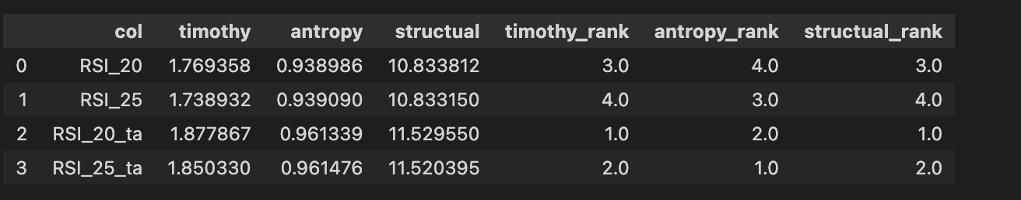
Entropy for Timothy VS Talib RSI
Entropy is a concept brought from Science, which is a measure to see the movement of particles in a space. It is used to determine whether data contains information in Statistics. (More detailed introduction will be in next section)
Ideally, from the previous few slides, we would think timothy RSI indicators provide more information than Talib RSI indicator because it has higher spearmanr and better rmse. However, according to what I calculated, it is not the case.
Most of the data follows such trend, that Talib’s RSI has a higher entropy than Timothy RSI for three entropy calculation method (Timothy’s , AntroPy, and structural)
The reason? I do not know…

Slide 32
CAGR Analysis
CAGR is the compounded annual growth rate.
We can use this to see whether model with indicators would tend to produce a higher growth rate or not.
Also, we will analyze the sharpe ratio here because it is calculated on the dataset, and it could be used to analyze the prediction VS actual data.
We run the same calculation by comparing whether each model brings a higher CAGR and sharpe ratio than threshold(baseline model), and counts all those outperforming models.

Slide 33
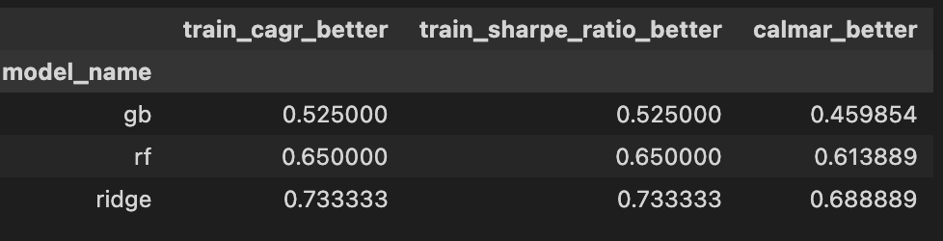
VS baseline model
Regardless of indicators, model and stocks, there’s 64% models produces a higher CAGR and sharpe ratio for indicator model than baseline model.
For three model category, sharpe ratio is highest for ridge regression. My guess would be that ridge regression works best with numerical data. Also, it confirms the conclusion we reached from previous section that gradient boosting machine and random forest should be trained with a more complete parameter grid using more powerful computation.

Slide 34
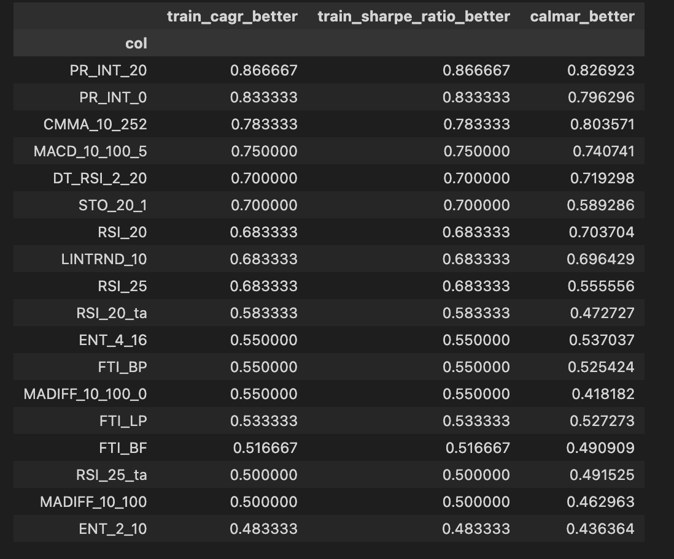
Comparison between indicators
We can see that a handful indicators produce higher CAGR and higher sharpe ratio.
PR_INT, CMMA and MACD all have results over 75%(top few rows in the chart) as their sharpe ratio
However, for a few indicators like ENT or MADIFF, FTI, they do not perform so well. That observation is similar to what we saw in previous slides when we analyzed the models.
Side: We see that cagr and sharpe_ratio have same value, it’s not that they are same, instead, it’s just the count of models that outperforming the baseline model. It’s not like evaluation metrics, it’s a calculation using the trained model and the entire input data.

Slide 35
Model Explanation

Slide 36
Model Explanation
SHAP (Shapley Additive exPlanations) is an approach to explain output of models. Unlike LIME(Local Interpretable Model-agnostic Explanations), which explains observations by observations, SHAP gives us a better picture of the feature importance in models.
SHAP is like iterating over all observations, and give us an aggregated level result on each variables we use.
From previous section, we already have some knowledge about our model and indicators. We know some of the indicators are more significant while some of them does not behave well for our training. We can use the SHAP to check out ideas.
The related files:
./src/model_eval.ipynb ## for ticker selections
./src/model_explanation.py ## for plotting SHAP charts
./output/*.png ## for SHAP output plots

Slide 37
Stock Selection
Due to the time consumption to run SHAP model, we selected a few stocks to run SHAP and plot.
We selected TSLA, TLT, RUT and BA, 4 stocks and run the SHAP model because they have highest and lowest CAGR and highest and lowest sharpe ratio respectively.
We selected those stocks was to see the feature importance calculated through SHAP from the stocks with high and low growth rate.
We will choose 3 models with interesting plots comparison and do a quick analysis.

Slide 38
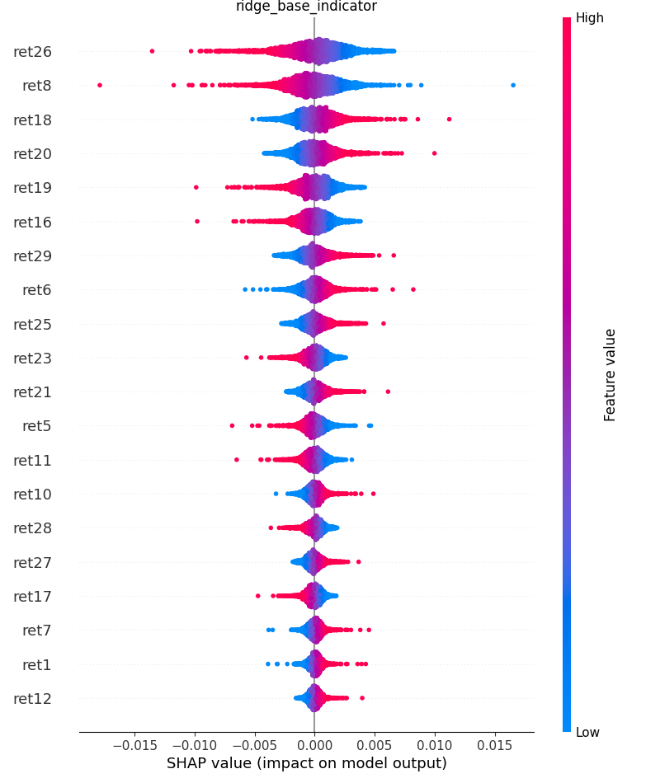

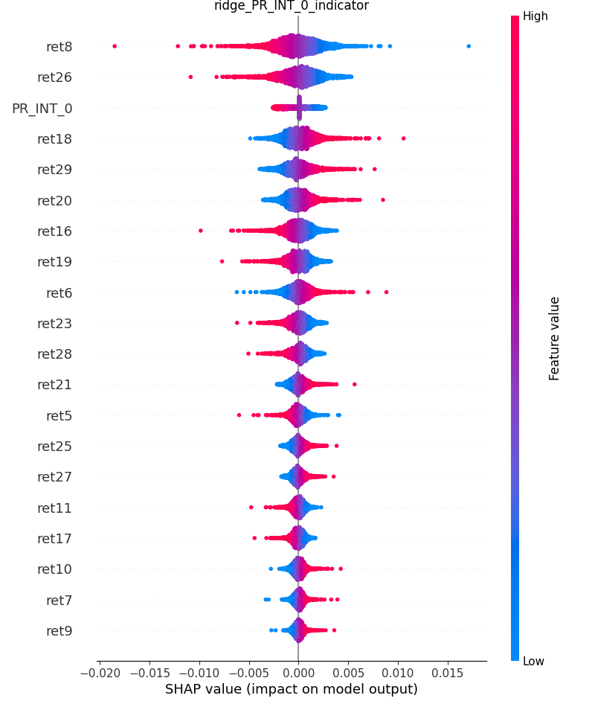
TLT Ridge Regression
From previous slides, we know that FTI_BF is one of the not significant indicators and PR_INT produces some good results. This is a good example. For TLT ridge model, base model and FTI_BF shows the same feature impact, which means that FTI_BF is very insignificant for the model. However, PR_INT_0 takes a great impact on the model output. Ret8 and ret26 are still dominating.

Slide 39
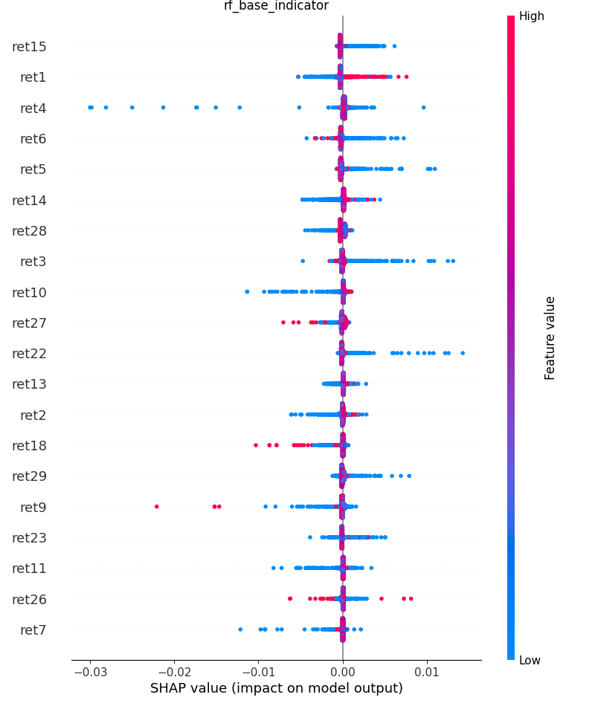
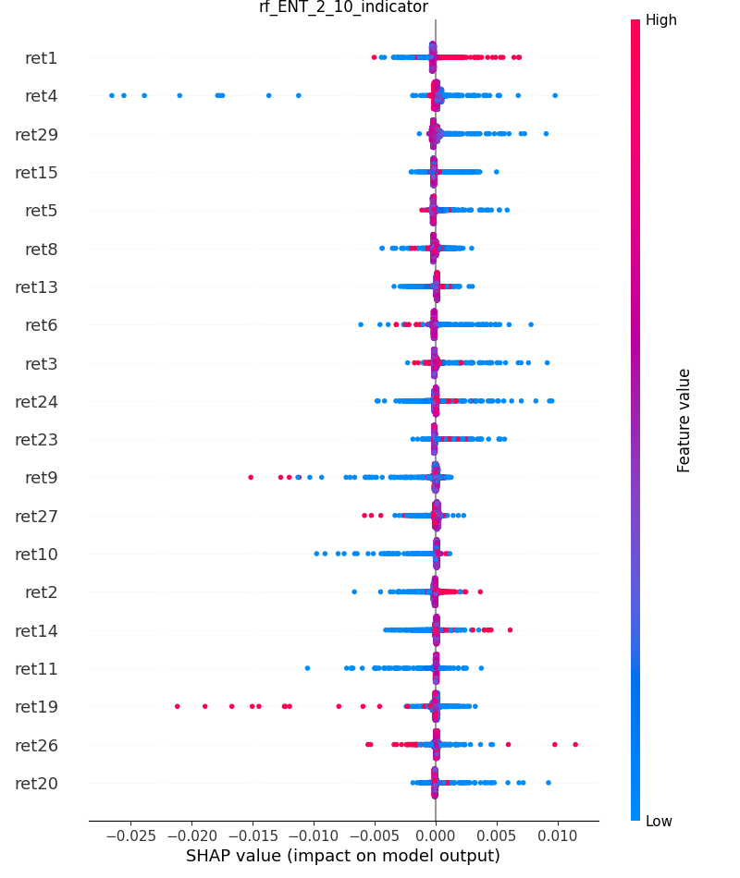
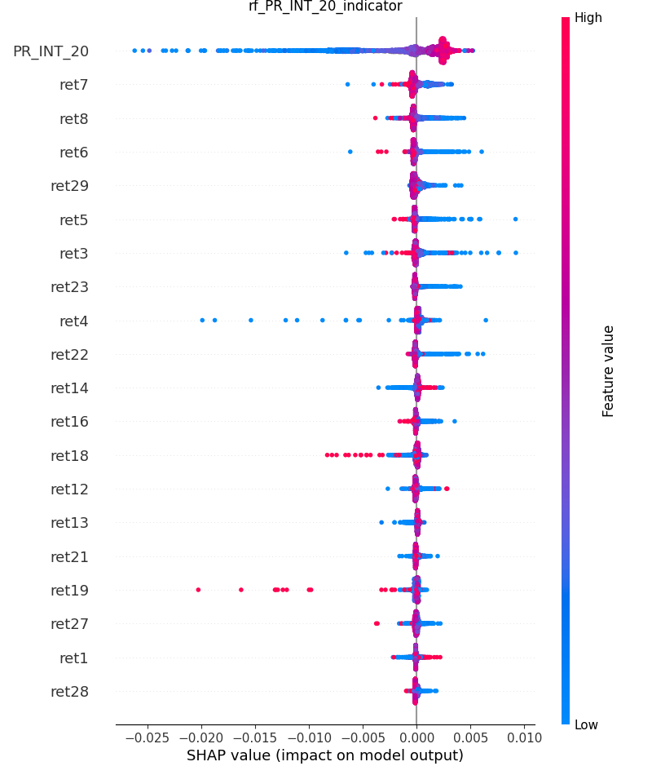
RUT RF Regression
RUT RF model. Unlike TLT ridge regression, the introduction of ENT_2_10 has some impact on the features. Despite of the reordering of ret15, ret1, ret4, They are still quite important. ENT_2_10 still not appear on the list. For the PR_INT_20, we can see that PR_INT_20 dominates all indicators, and have a great SHAP value.

Slide 40
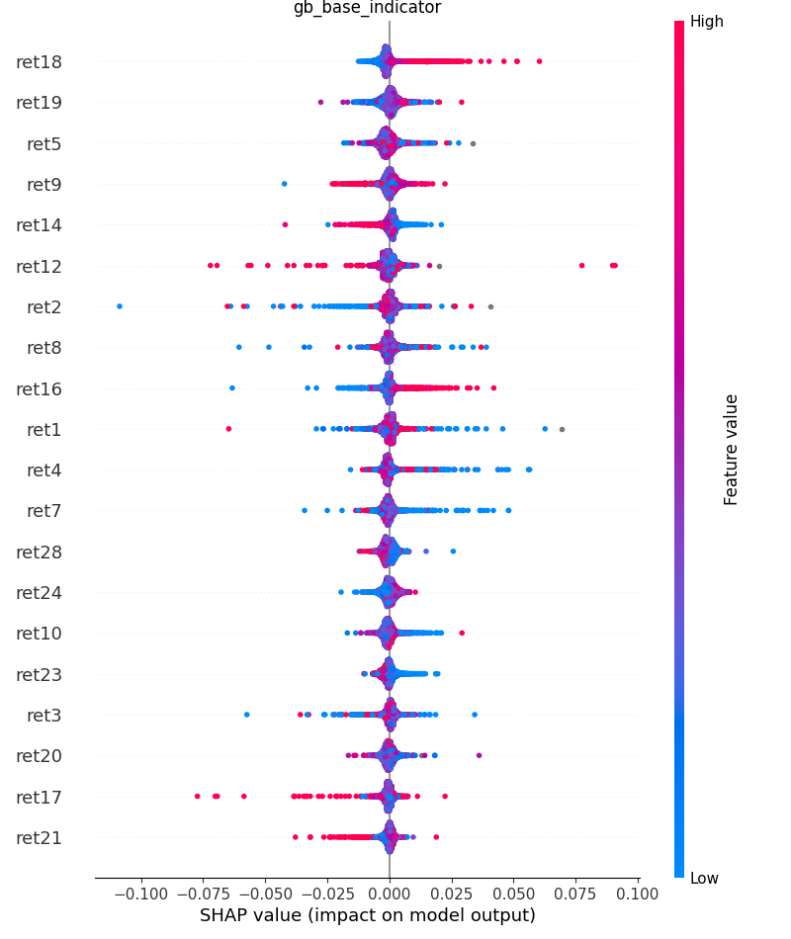
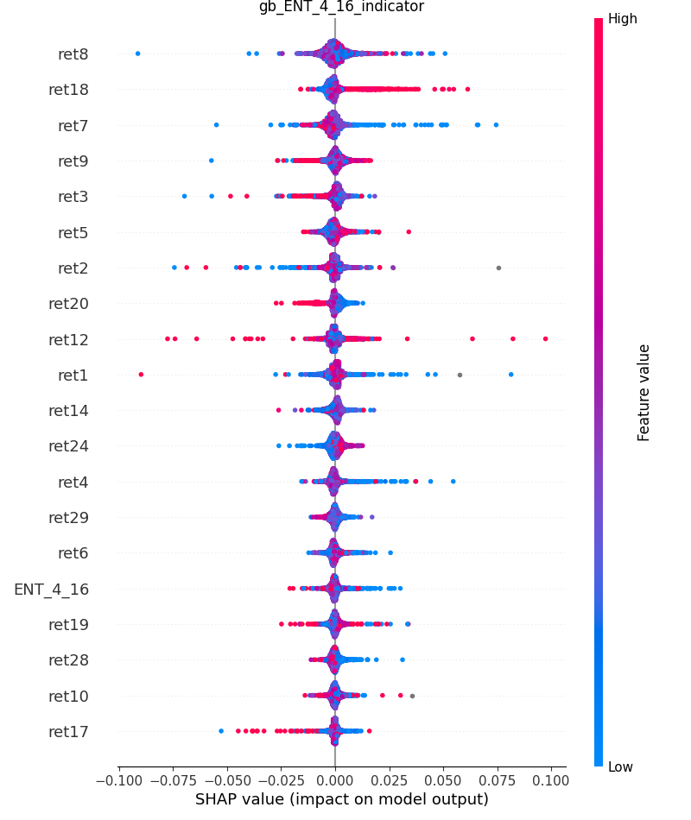
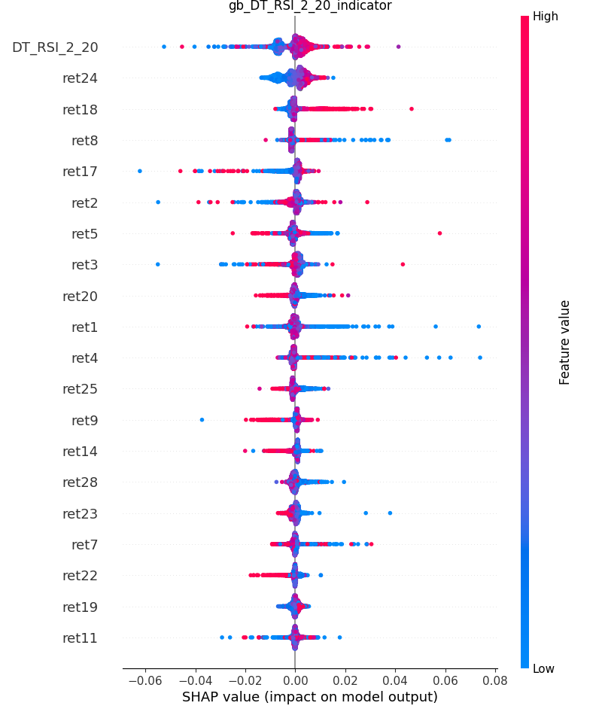
TSLA GB Regression
TSLA as most aggressive (highest CAGR) stock, we see that for either best and worst indicators (ENT_4_16) and (DT_RSI_2_20) have some impact on the final output. DT_RSI_2_20 is clearly have more impact on the output, and ENT_4_16 has 16th impact in the model performance. Ret18, ret19 and ret5 still appear on all charts.

Slide 41
ENTROpy

Slide 42
Entropy Analysis
Just like we mentioned before about entropy, it can be used as a supplementary metrics to see whether values bring any information.
The entropy measures the “amount of information” present in a variable. It is estimated not only based on the number of different values in a list, but also by the amount of outliers or uncertainty the variable holds.
Entropy Calculation: H(X) = – Σ (p_{i} * log₂ p_{i})
However, the way of defining binning can really matter and result completely different result.
The usage of entropy should be carefully considered.
The related files:
./src/model_entropy_analysis.ipynb

Slide 43
Permutation Entropy
Permutation Entropy is one entropy calculation method.
It is used to look at a certain length of window(order) and see which permutation combination it locates, and use the probability for the entropy calculation.
The order of the calculation takes a great effect on the final result.
For more mathematic understanding, follow the reference:
https://www.aptech.com/blog/permutation-entropy/#:~:text=Permutation%20Entropy%20(PE)%20is%20a,Henry%20and%20Judge%2C%202019).
We use a python package AntroPy to do the calculation.

Slide 44
Timothy Master’s Entropy
This is a entropy calculation stated in Timothy’s book.
He defined the entropy by the following steps:
If length > 10000, bins = 20
If length > 1000, bins = 20
If length > 100, bins =5
Else bins = 3
Dividing all values into # of bins, count the occurrence in each bin / length
Sum( - p * log(p))
Return value

Slide 45
Structural Entropy
This entropy calculation is more rigid and computation exhausting.
It takes the unique value and its counts and calculate the sum(-p*log(p)) where p = count/sum(count)

Slide 46
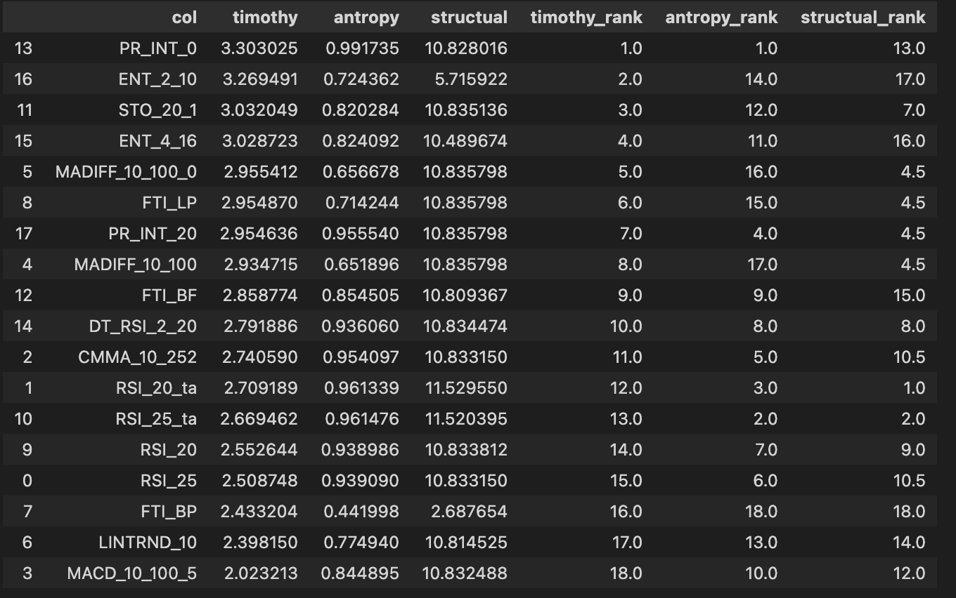
Entropy Result
I run the entropy calculation for all indicators on the RUT stock. The result is the following:
All three entropies give us different results and they do not necessarily align with what we saw in model part.
PR_INT_0 was a significant feature in our modelling, which has a high timothy and Antropy value, which is good.
However, for the second and third place, ENT2_10(Timothy), RSI_25_ta(Antropy), they did not perform well in modelling part.
For the structural calculation, RSI_25/20_ta was also quite insignificant in our modelling part.
FT_RSI, CMMA and MACD were quite significant in our modelling part, but the does not produce a high entropy value in this case.

Slide 47
Entropy Analysis
Some of the indicators with high entropy value does not perform well in the modelling part. It does not mean that the entropy is incorrect or the indicators are useless. It means we need to find a better model for those indicators so they can be better utilized.
For those high entropy valued indicators, they may have more outliers/ wider distribution( larger variance), then a more tail-highlighted model could be used to emphasize the indicators.

Slide 48
Entropy Limitation
Given that there’s a lot of ways of entropy calculation, it’s hard to find the best way.
Even for one method, using different binning method, the result may differ.
More time are required to dig into the data and select the optimal entropy calculation for each dataset.

Slide 49
Future Work

Slide 50
Future Work
Due to my sickness in the December, I did not have enough time to run and re-run the model multiple times given that each training takes almost a day to finish.
There are a few modifications that we can use to improve the project.
Better separate training-validation-testing dataset. It was quite unfortunate that I did not have chance to figure out a good way of splitting training-testing dataset. If a sharpe ratio can be calculated on testing data, it would be a better measure than what we currently have.
A more complete region of parameter space should be defined for tuning the models, especially for gradient boosting machine and random forest.
More powerful models should be considered, like light GBM, extreme GBM or Neural Network.

Slide 51
Future Work Data and Indicators
The project only focus on the single indicator, but there are more indicators in Timothy Project that we can use, such as paired signals or mult-signals(namely signal for the market). We can use such signals to enrich our dataset and compare the effect of each indicators.
The other way of generating mode indicators, is by adding, subtracting stocks, and apply the single indicator on those sum/diff data. The result of that can be used for a paired trading algorithm.
The indicators used in the project are limited, and we can try more different parameters for indicators with different lookback windows and different options.

Slide 52
Future Work Preprocessing and Modelling
Other than applying more high-end models, we can include more preprocessing techniques, like trying to apply PCA on the data to shrink the size and reduce the training time.
A longer / shorter periods can be used to increase data/ reduce training time.
Multiple single indicators can be considered at the same time. By analyzing the correlation, we can properly train the models with more data.

Slide 53
Future Work Post-processing
Entropy analysis should be considered more carefully. Given that we see different calculation of entropy outputs different results, and the binning of entropy largely impact the result of entropy value for indicators. How to use those entropy values should be better considered. A different model can be selected to cater for those insignificant indicators with high entropy values.
Rather than training lots models and calculate the counts over the comparison, a better method can be developed to compare two models side by side and calculate the difference of evaluation metrics. That is the better way to find the best model so we can apply for the actual finance data.
LIME can be used to detect single observation, and that can help us better explain the impact our indicators bring.

Slide 54
Reference

Slide 55
Reference
Timothy Master: http://www.timothymasters.info/
Talib: https://mrjbq7.github.io/ta-lib/index.html
SHAP: https://shap.readthedocs.io/en/latest/
Entropy Paper: https://www.mdpi.com/1099-4300/23/5/568/htm
Entropy Blog: https://www.analyticsvidhya.com/blog/2020/11/entropy-a-key-concept-for-all-data-science-beginners/#:~:text=The%20entropy%20measures%20the%20%E2%80%9Camount,value%20of%20the%20variable%20holds.
AntroPy: https://raphaelvallat.com/antropy/build/html/index.html
Structural Entropy: https://github.com/cerlymarco/MEDIUM_NoteBook/blob/master/Structural_Entropy/Structural_Entropy.ipynb
Stock Selection: https://www.fool.com/investing/stock-market/types-of-stocks/safe-stocks

