Slide 1
Entropy Analysis
Just like we mentioned before about entropy, it can be used as a supplementary metrics to see whether values bring any information.
The entropy measures the “amount of information” present in a variable. It is estimated not only based on the number of different values in a list, but also by the amount of outliers or uncertainty the variable holds.
Entropy Calculation: H(X) = – Σ (p_{i} * log₂ p_{i})
However, the way of defining binning can really matter and result completely different result.
The usage of entropy should be carefully considered.
The related files:
./src/model_entropy_analysis.ipynb

Slide 2
Permutation Entropy
Permutation Entropy is one entropy calculation method.
It is used to look at a certain length of window(order) and see which permutation combination it locates, and use the probability for the entropy calculation.
The order of the calculation takes a great effect on the final result.
For more mathematic understanding, follow the reference:
https://www.aptech.com/blog/permutation-entropy/#:~:text=Permutation%20Entropy%20(PE)%20is%20a,Henry%20and%20Judge%2C%202019).
We use a python package AntroPy to do the calculation.

Slide 3
Timothy Master’s Entropy
This is a entropy calculation stated in Timothy’s book.
He defined the entropy by the following steps:
If length > 10000, bins = 20
If length > 1000, bins = 20
If length > 100, bins =5
Else bins = 3
Dividing all values into # of bins, count the occurrence in each bin / length
Sum( - p * log(p))
Return value

Slide 4
Structural Entropy
This entropy calculation is more rigid and computation exhausting.
It takes the unique value and its counts and calculate the sum(-p*log(p)) where p = count/sum(count)

Slide 5
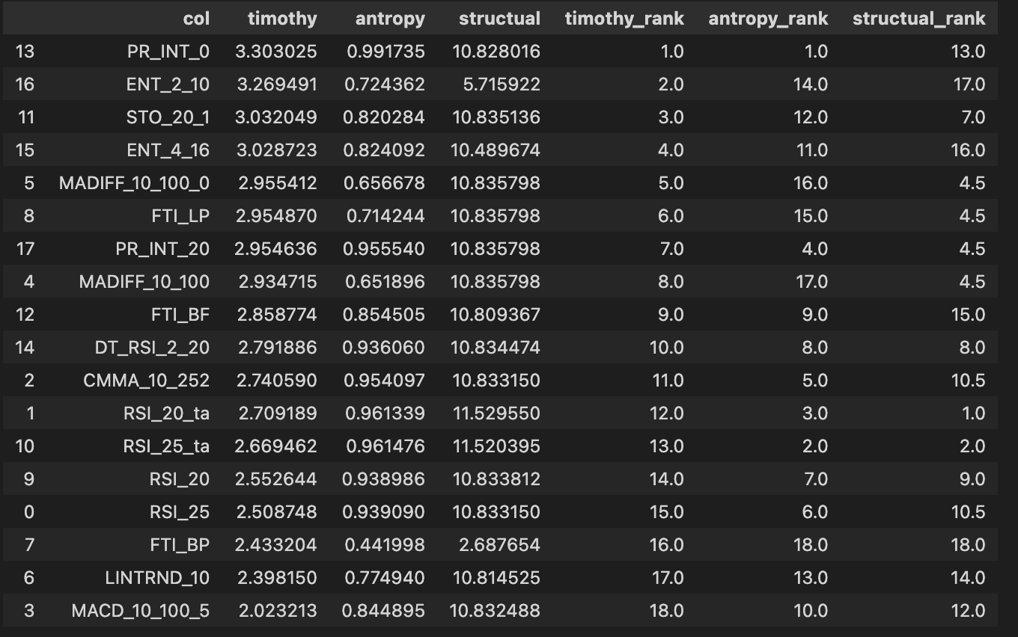
Entropy Result
I run the entropy calculation for all indicators on the RUT stock. The result is the following:
All three entropies give us different results and they do not necessarily align with what we saw in model part.
PR_INT_0 was a significant feature in our modelling, which has a high timothy and Antropy value, which is good.
However, for the second and third place, ENT2_10(Timothy), RSI_25_ta(Antropy), they did not perform well in modelling part.
For the structural calculation, RSI_25/20_ta was also quite insignificant in our modelling part.
FT_RSI, CMMA and MACD were quite significant in our modelling part, but the does not produce a high entropy value in this case.

Slide 6
Entropy Analysis
Some of the indicators with high entropy value does not perform well in the modelling part. It does not mean that the entropy is incorrect or the indicators are useless. It means we need to find a better model for those indicators so they can be better utilized.
For those high entropy valued indicators, they may have more outliers/ wider distribution( larger variance), then a more tail-highlighted model could be used to emphasize the indicators.

Slide 7
Entropy Limitation
Given that there’s a lot of ways of entropy calculation, it’s hard to find the best way.
Even for one method, using different binning method, the result may differ.
More time are required to dig into the data and select the optimal entropy calculation for each dataset.

Slide 8
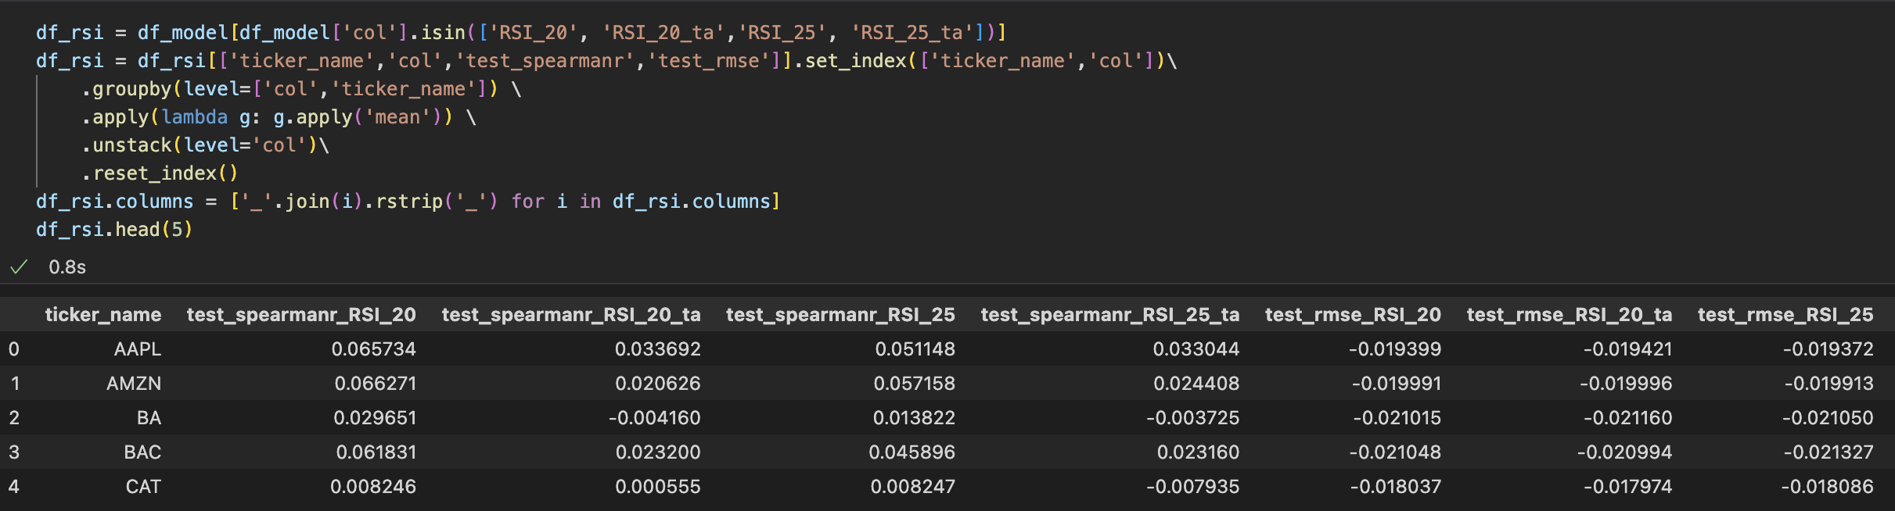
Timothy VS Talib regarding RSI
RSI is one of the frequent used indicator.
We make a comparison of Timothy VS Talib RSI.
From the previous slides, we would anticipate that Timothy_RSI works better than Talib RSI. With some aggregation, we have the following table.
Generally, timothy’s RSI shows better result than RSI_ta.

Slide 9
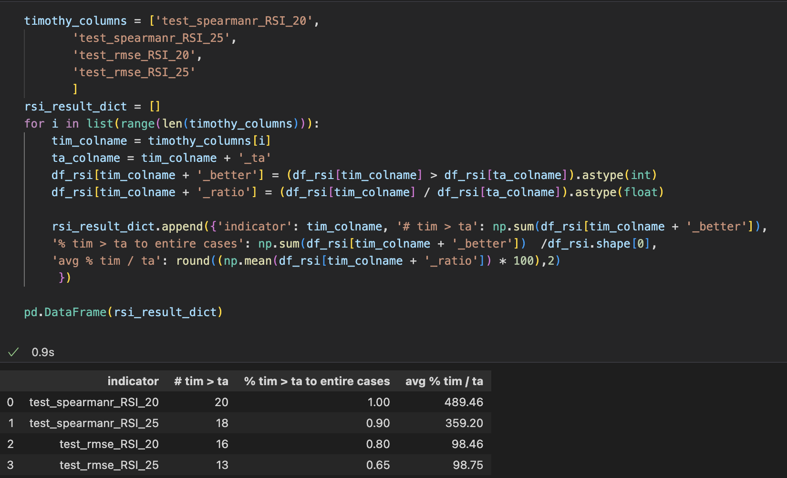
Timothy VS Talib
The code show the comparison between Timothy indicators and Talib indicators. We noticed that for both Spearmanr and rmse, timothy produces better result than Talib almost for all stocks.
Note that RMSE is negative in this case, so a % < 0 means that timothy result is better than Talib
That is a good indication that Timothy program produces a better indicator than Talib does.

Slide 10
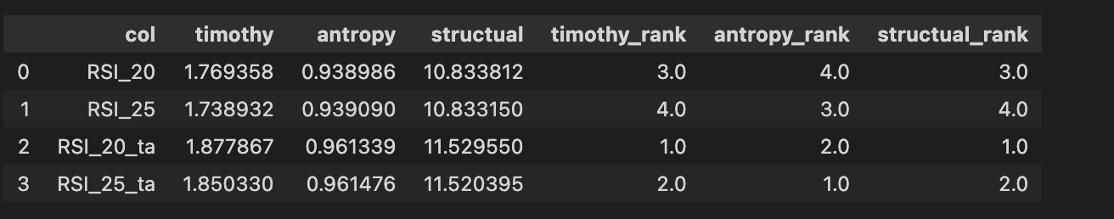
Entropy for Timothy VS Talib RSI
Entropy is a concept brought from Science, which is a measure to see the movement of particles in a space. It is used to determine whether data contains information in Statistics. (More detailed introduction will be in next section)
Ideally, from the previous few slides, we would think timothy RSI indicators provide more information than Talib RSI indicator because it has higher spearmanr and better rmse. However, according to what I calculated, it is not the case.
Most of the data follows such trend, that Talib’s RSI has a higher entropy than Timothy RSI for three entropy calculation method (Timothy’s , AntroPy, and structural)
The reason? I do not know…

