Slide 1
Hellenic Mediterranean University, Department of informatics Engineering
Advanced Topics in Antennas, Propagation of EMF fields, and Wireless Networks
Prof. Dimitris Stratakis, Markakis Evangelos
Spring Semester 2024 – 1st Project
Students:
Charilaos Koutsourelakis (MTP323),
Vardis Daskalakis (MTH295)

Slide 2
Introduction
This application aims to provide a platform that calculates propagation loss using well-known propagation models such as Okumura, Hata, Free Space, and CCIR.
Such calculations are achieved by inputting appropriate parameters such as frequency, distance, transmitter height and receiver height.
Users can swiftly generate insights into signal propagation characteristics in different environments.

Slide 3
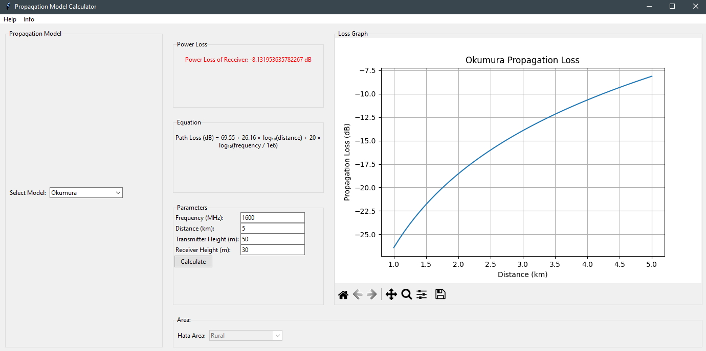
Graphical User Interface (GUI)

Slide 4
Model Selection
Choose from a range of propagation models including Okumura, Hata, Free Space, and CCIR. Each model offers unique insights into signal propagation characteristics, allowing users to tailor their analysis to specific scenarios and environments.
Area Selection for Hata Model:
For Hata model calculations, users can select from different areas including Urban, Suburban, and Rural. This feature enables precise estimation of propagation loss based on the urbanization level of the environment, facilitating accurate planning and deployment of wireless networks.

Slide 5
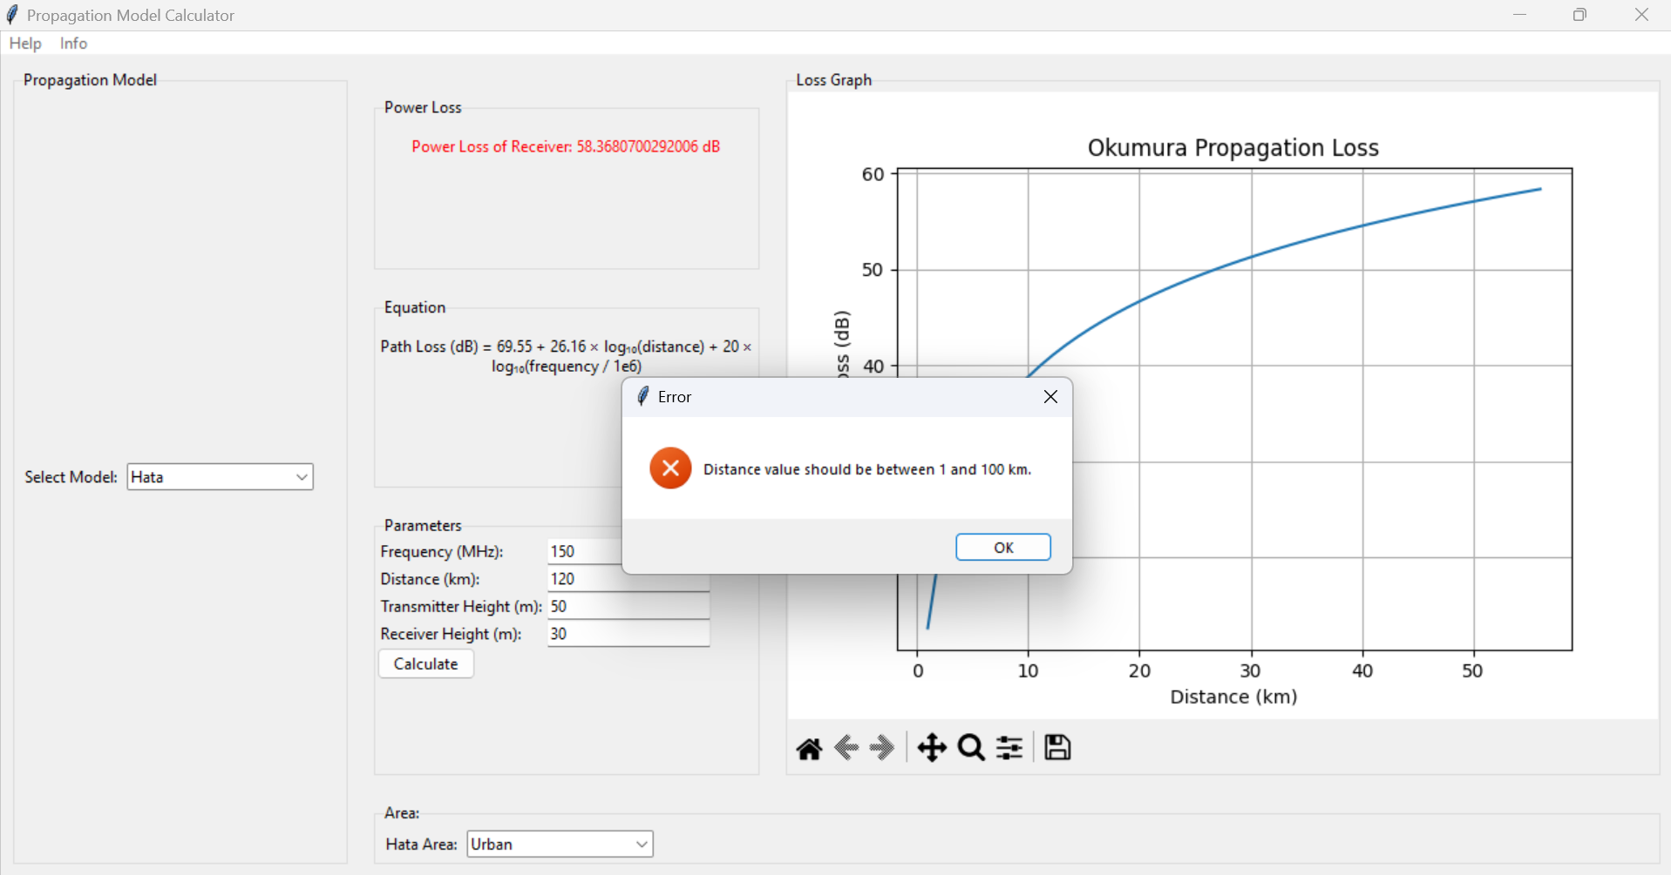
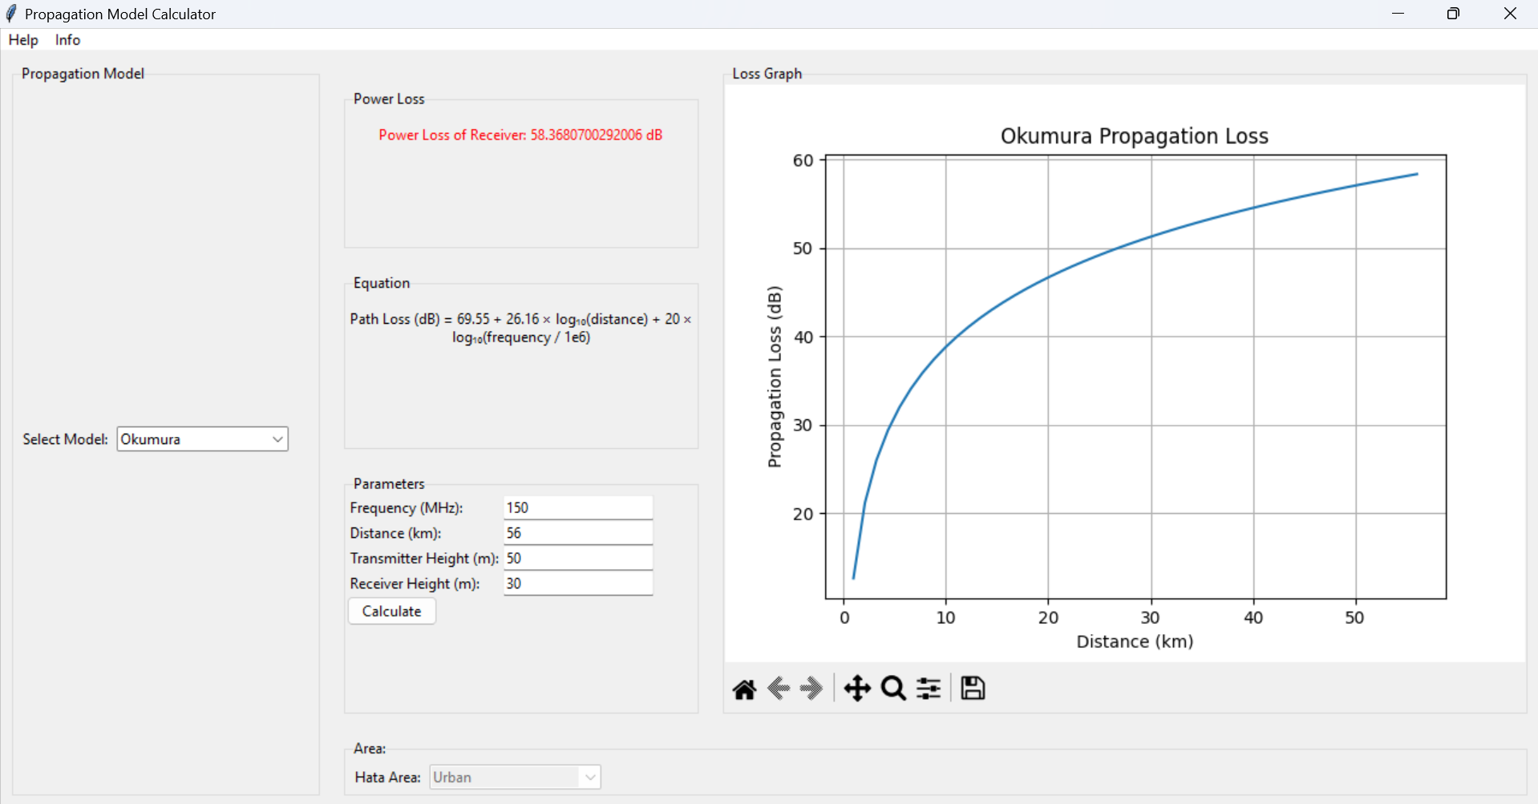
Features
Input parameters error handling
Power/Path Loss Formulas for each propagation model

Slide 6
Thank You

