Slide 1


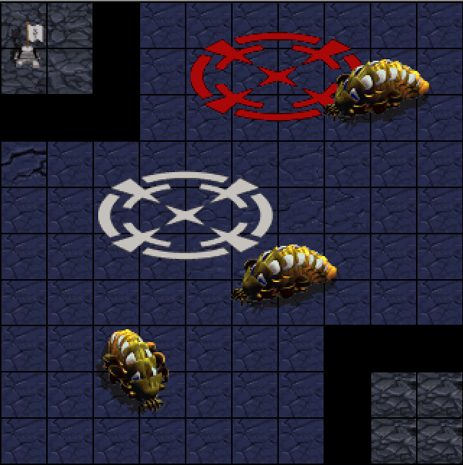
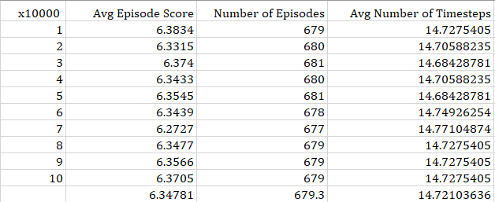
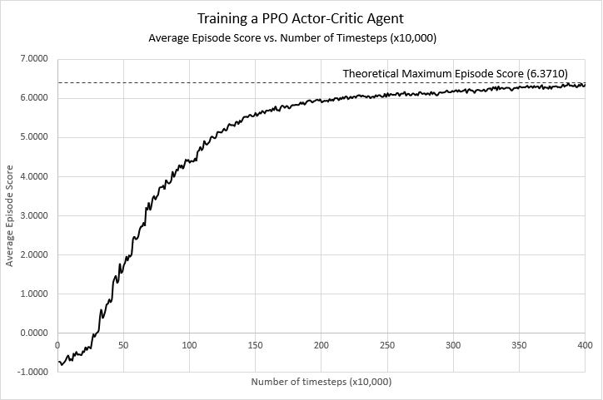
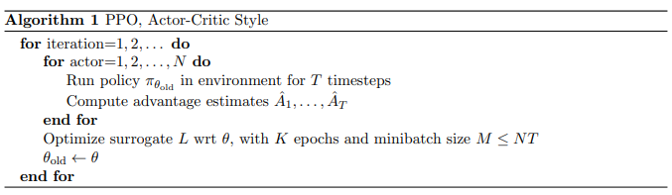
Exercise in Reinforcement Learning Using StarCraft: Brood War
Researcher: Benjamin Harruff
Advisor: Dr. Hongli Luo
Purdue University - Fort Wayne
Problem Statement
Conclusion
The goal of this research is to expand my knowledge, as well as others’ knowledge, of reinforcement learning. This was motivated primarily with a passion for both machine learning and video games. Thusly creating an agent to interact with StarCraft: Brood War seemed appropriate as there is already a wealth of research regarding AIs in this environment from hobbyists, post-graduate students, and dedicated research teams alike. The great interest in this variety of reinforcement learning exemplifies the range of tech industries that it could potentially impact.
Because the agent achieved behavior that only deviated by 0.364%, this is much less than the maximum tolerance of 5% that was required. Thusly, the project was a success. Continued research and additional applications are planned for the future.
Results
Acknowledgement
After 28 hours of training the finalized agent, it was able to achieve very impressive, near-optimal behavior. The following graph shows the average episode reward for every 10,000 timesteps over the course of 4.0 million timesteps. For reference, each timestep took an average of 25ms.
I would like to thank the Student StarCraft Artificial Intelligence Tournament (SSCAIT) organized by the Department of Computer Science, Czech Technical University in Prague for the inspiration. Had I not been participating for over 2 years at this point, this research would not have been done. I’d additionally like to thank Prof. Alasti and Prof. Luo for their advice and consultation.
References:
Approach
To create the reinforcement learning environment, several tools were needed. The agent was developed in Python using Visual Studio Code. The framework was modeled with a suite of tools from the Samsung Research and Development Team (SAIDA), which was made specifically for agents in StarCraft: Brood War. Tensorflow and Keras libraries, necessary for implementing neural networks, layers, models, etc.
The agent was placed into a custom scenario, where it was tasked with moving from point A to B while avoiding several randomly moving obstacles, thereby creating the complex, stochastic environment pictured in the next column. Ultimately, a PPO Actor-Critic agent was decided upon due to its robust and quick training capabilities
[1] | M. Čertický and D. Churchill, "The Current State of StarCraft AI Competitions and Bots," In Proceedings of the AIIDE 2017 Workshop on Artificial Intelligence for Strategy Games, 2017.
[2] | M. Čertický, D. Churchill, K.-J. Kim, M. Čertický and R. Kelly, "StarCraft AI Competitions, Bots and Tournament Manager Software," IEEE Transactions on Games (ToG), vol. 1, no. 13, p. 1, 2018.
[3] | D. Churchill, M. Preuss, F. Richoux, G. Synnaeve, A. Uriarte, S. Ontanón and M. Čertický, "Starcraft Bots and Competitions," in Encyclopedia of Computer Graphics and Games (ECGG), Springer International Publishing, 2016.
[4] | TeamSAIDA, "SAIDA_RL," GitHub repository, 2019.
[5] | V. Mnih et al., "Playing Atari with Deep Reinforcement Learning," DeepMind Technologies.
[6] | J. Schulman, F. Wolski, P. Dhariwal, A. Radford and O. Klimov, "Proximal Policy Optimization Algorithms," CoRR, vol. abs/1707.06347, 2017.
[7] | L. Hardesty, "Explained: Neural Networks," MIT News Office, 2017.
[8] | AurelianTactics, "PPO Hyperparameters and Ranges," 25 July 2018. [Online]. Available: https://medium.com/aureliantactics/ppo-hyperparameters-and-ranges-6fc2d29bccbe. [Accessed 6 April 2020].
[9] | S. John et al., "Trust Region Policy Optimization," University of California, Berkeley, Department of Electrical Engineering and Computer Sciences, no. https://arxiv.org/pdf/1502.05477.pdf, 2017.
[10] | Keras Team, "Keras: The Python Deep Learning Library," GitHub repository, 2019.
[11] | N. S. Keskar and R. Socher, "Improving Generalization Performance by Switching from Adam to SGD," Salesforce Research, no. https://arxiv.org/pdf/1712.07628.pdf, 2017.
In a trial of 100,000 timesteps, the trained agent averaged an episode score of 6.3478. Compared to the theoretical calculated maximum episode score of 6.3710, the agent deviated by about 0.364%, thus being as close as 99.636% to optimal behavior. At the top is a table of results from the trial.

