Slide 1
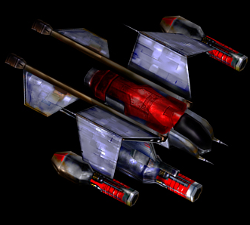
Exercise in Reinforcement Learning Using StarCraft: Brood War
Ben Harruff
B.S. Computer Engineering Technology
Purdue University – Fort Wayne
School of Polytechnic
May 8th, 2020

Slide 2
Problem Statement
Produce an effective agent
Use Reinforcement Learning
Apply as case study to CPET disciplines

Slide 3
Motivation
Personal hobby
SSCAIT
Potential Industry impact
Notes:
Thusly creating an agent to interact with StarCraft: Brood War seemed appropriate as there is already a wealth of research regarding AIs in this environment from hobbyists, post-graduate students, and dedicated research teams alike. The great interest in this variety of reinforcement learning exemplifies the range of tech industries that it could potentially impact.

Slide 4
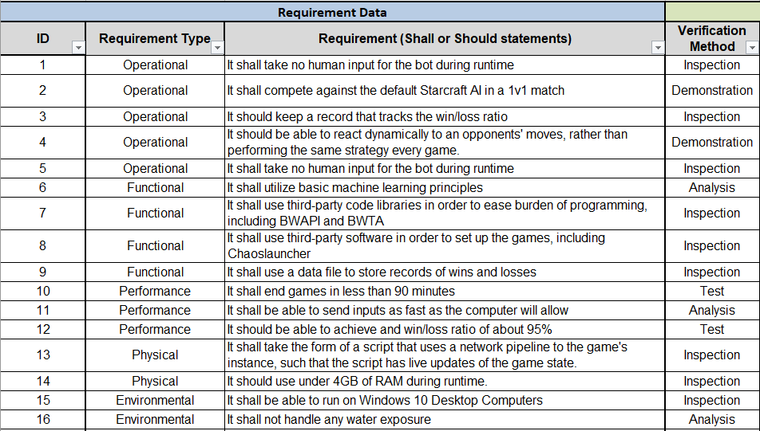
Project Requirements Table
Notes:
Requirement 2 – The original requirement was to defeat the in-game default AI in a normal 1v1 match, now it is to complete the scenario.
Requirement 12 – The original requirement was to achieve 95% win rate, but now it is to achieve a successful agent that is within 95% episode score as compared to near-perfect agent.

Slide 5
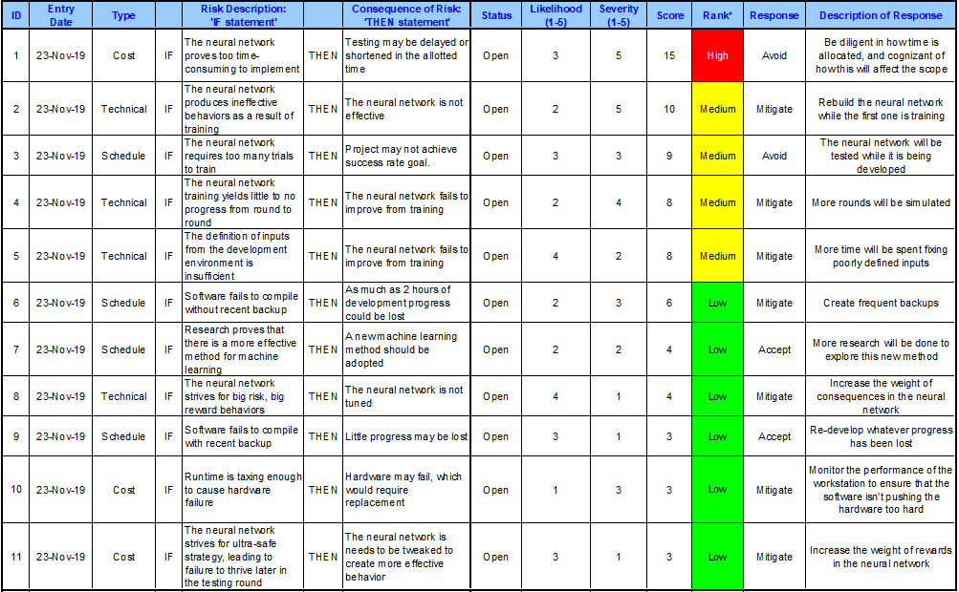
Risk Analysis
Notes:
Id’s 1, 2, 7

Slide 6
Related Courses
ECET470 – Tech. Proj. Mgmt
ECET264 – C Progrm Language Appl
All CS courses

Slide 7
Solution Statement & Design Approach
PPO Actor-Critic Style Agent
SAIDA tools
Tensorflow tools, neural networks
Notes:
The agent was developed in Python 3.6.8 using Visual Studio Code. The framework for the agent was developed by the Samsung Research and Development Team (SAIDA), which uses a specialized API (Application Programming Interface) library called BWAPI (Brood War API) that acts as an input/output (I/O) bridge between the agent and the game environment. Additionally, there are several libraries that were necessary to implement reinforcement learning for the agent, such as Tensorflow and Keras (with Tensorflow as a backend). This allows the agent to slowly improve between episodes. This means that the agent starts with no information regarding actions to take, but it understands actions it could take and the result of the action when it has been performed. After every episode, a new and improved iteration of the agent is generated in a process referred to as training.

Slide 8
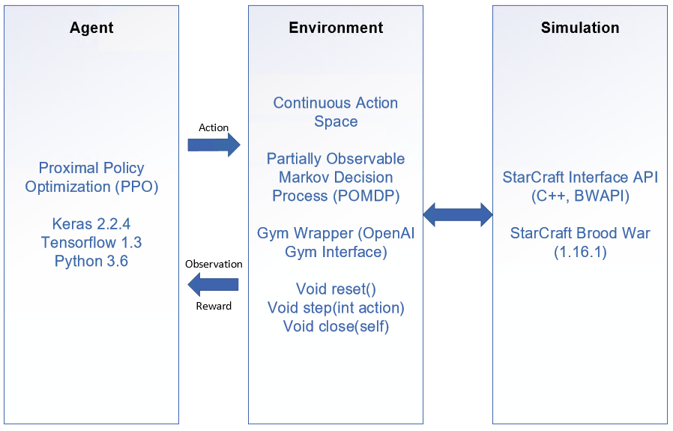
Diagram
5/8/2020

Slide 9
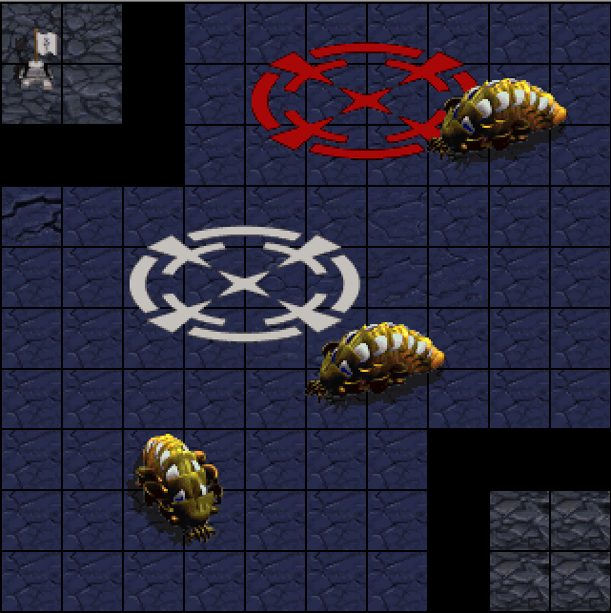
Game Environment
3 Reavers (yellow guys)
10x10 tiles
Start at Top-Left
Goal at Bottom-Right
The Dropship played by the agent must make it to the Goal from the Start while avoiding the 3 Reavers.
Notes:
The environment that the agent interacts with is a custom-made StarCraft BW scenario, one of many provided by the suite of tools made by SAIDA. It is a simple scenario with a complicating twist: the agent must move from point A to point B while avoiding 3 randomly moving obstacles. This creates an interesting decision-making process in a stochastic environment for the agent to converge on an optimal solution for.
The scenario consists of a board of tiles, 10 high and 10 wide. The top-left flag represents the beginning episode position, the bottom-right square represents the goal, and the 3 yellow guys (Reavers, as they are called in the game) are the obstacles. The Reavers are programmed to move to a random location in the blue area repeatedly, thus creating a stochastic environment. At the beginning of the episode, the dropship spawns on top of the flag, then the agent takes over and controls the dropship from there. The episode ends when the dropship reaches the bottom-left. The following graphic displays the scenario as it was created in the StarCraft Map editor software (ignore the red and white circles).

Slide 10

Technical
Reinforcement Learning
Agent -> Script
Environment -> Game
States, Actions, and Rewards

Slide 11
Technical
Software Function
BWAPI
Brood War Application Programming Interface
Allows for I/O between agent and game
Team SAIDA
Using as a framework for agent
TensorFlow, Keras, GYM libraries

Slide 12
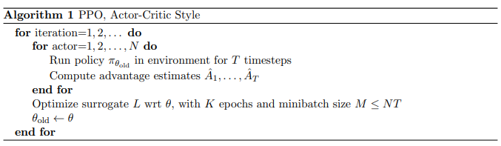
Technical - Model
Notes:
The model is defined as a function with dynamic parameters that deciphers the input and determines the desired output. This model will use an algorithm referred to as Advantage Actor-Critic (A2C). This algorithm is known for combining the best parts of both value-based and policy-based learning with less of the drawbacks. A2C, as it pertains to my agent, will split the model into two parts: the actor (policy-based) and the critic (value-based). The actor takes input state and maps the best action to take. It attempts to learn the optimal policy. The critic criticizes the action taken by the actor by computing the value function. These two parts of the model both learn at the same time, the actor by optimizing the policy, and the critic by training its values. The critic will use Deep Q Networks (DQN) while the actor will use a policy gradient, most likely the Adam optimizer.

Slide 13
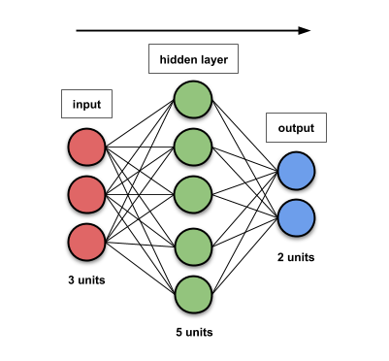
Technical – Neural Networks
Notes:
A neural network, named for its similarity to how the brain functions, is a system of layers of web made up of many simple computation nodes tightly woven together [7]. In this exercise, the neural network flows in one direction, from input to output. This means that a layer has nodes that are tied to every node in the previous layer and the following layer, but not its own layer. These nodes represent weights of values of input data, where, as data flows through the neural network, they are multiplied by the weights of the nodes it passes through. Before data continues from one node to the next, it must meet a threshold in order to pass. Training a neural network, where every weight and threshold starts at random values, means that these values are tweaked until all inputs reach a similar output (preferably a good output). The figure is an example of a simple Feed-Forward Neural Network (FFNN) that consists of an input layer of size 3 units, a hidden layer of size 5, and an output layer of size 2.

Slide 14
Test Results
Agent met requirements.
Achieved success rate of 99.636%
Deviated by about 0.364%
Notes:
After 28 hours of training the finalized agent, it was able to achieve very impressive, near-optimal behavior.

Slide 15
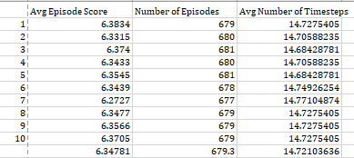
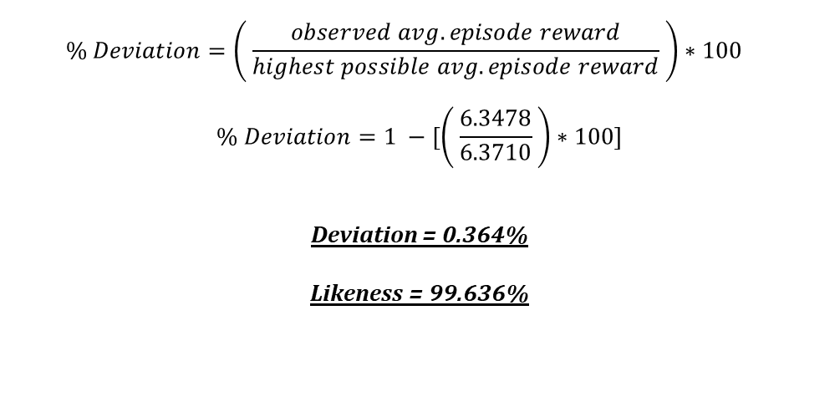
$$\% Deviation=\left( \frac{observed avg. episode reward}{highest possible avg. episode reward} \right)∗100$$
$$\% Deviation=1 −[\left( \frac{6.3478}{6.3710} \right)∗100]$$
Deviation = 0.364%
Likeness = 99.636%

Slide 16
Challenges & Troubleshooting
Underestimated burden of research
Original scope too large
Switched frameworks
Requirement changes:
Requirement 2 and 12
Notes:
Underestimated burden of research – I ended up spending much more time on research than I originally anticipated. Rather than researching just for the sake of the project, I quickly found that I had much to learn regarding several different reinforcement learning techniques, which was not something that I learned from any classes at PFW.
Original scope too large – As a result of the original scope being too obtuse, ambitious, and off-topic for most CPET students and professionals, I decided it was in my best interest to downsize the scope of my project to make it more understandable and applicable.
Switched frameworks – As a result of both of the previous problems, my original body of work that I planned to use for the project became irrelevant. Thusly, after weeks of digging, I was able to stumble across a body of work done by the Samsung Artificial Intelligence Research Team (SAIDA) that was tailor-made for use with reinforcement learning. I am now using that framework in the project.
Additionally, I lacked a strong knowledge in Python, as my background is primarily with C++, C, and Java.
Here are two requirements that were changed or cannot be met:
Requirement 2 – The original requirement was to defeat the in-game default AI in a normal 1v1 match, now it is to complete the scenario.
Requirement 12 – The original requirement was to achieve 95% win rate, but now it is to achieve a successful agent that is within 95% episode score as compared to near-perfect agent.

Slide 17
Conclusion and Lessons Learned
Success!
Future Work
Continued training
Hyperparameter tweaking
Complete agent reconstruction
Change optimizers
Notes:
My very first initial goal was to create an entire AI that would play the game as a player would through means of reinforcement learning techniques. It was not soon after beginning research that I realized that this was a little too ambitious, specifically after learning that both Facebook and Google had to dedicate a research team of (presumably) very intelligent individuals to make one. However, after my experience with this exercise, I’ve learned a great amount about how agents are constructed, and I may very well continue my efforts to create better agents for StarCraft in the future.

Slide 18
Video Example – different stages of training
https://youtu.be/eCL6Wbpo0is

Slide 19

Thanks!
Questions/comments?
Visit sscaitournament.com!
[SSCAIT] Student StarCraft AI Tournament
Organized by Games and Simulations Research Group
Czech Technical University in Prague
5/8/2020

Slide 20
References
[1] | M. Čertický and D. Churchill, "The Current State of StarCraft AI Competitions and Bots," In Proceedings of the AIIDE 2017 Workshop on Artificial Intelligence for Strategy Games, 2017.
[2] | M. Čertický, D. Churchill, K.-J. Kim, M. Čertický and R. Kelly, "StarCraft AI Competitions, Bots and Tournament Manager Software," IEEE Transactions on Games (ToG), vol. 1, no. 13, p. 1, 2018.
[3] | D. Churchill, M. Preuss, F. Richoux, G. Synnaeve, A. Uriarte, S. Ontanón and M. Čertický, "Starcraft Bots and Competitions," in Encyclopedia of Computer Graphics and Games (ECGG), Springer International Publishing, 2016.
[4] | TeamSAIDA, "SAIDA_RL," GitHub repository, 2019.
[5] | V. Mnih et al., "Playing Atari with Deep Reinforcement Learning," DeepMind Technologies.
[6] | J. Schulman, F. Wolski, P. Dhariwal, A. Radford and O. Klimov, "Proximal Policy Optimization Algorithms," CoRR, vol. abs/1707.06347, 2017.
[7] | L. Hardesty, "Explained: Neural Networks," MIT News Office, 2017.
[8] | AurelianTactics, "PPO Hyperparameters and Ranges," 25 July 2018. [Online]. Available: https://medium.com/aureliantactics/ppo-hyperparameters-and-ranges-6fc2d29bccbe. [Accessed 6 April 2020].
[9] | S. John et al., "Trust Region Policy Optimization," University of California, Berkeley, Department of Electrical Engineering and Computer Sciences, no. https://arxiv.org/pdf/1502.05477.pdf, 2017.
[10] | Keras Team, "Keras: The Python Deep Learning Library," GitHub repository, 2019.
[11] | N. S. Keskar and R. Socher, "Improving Generalization Performance by Switching from Adam to SGD," Salesforce Research, no. https://arxiv.org/pdf/1712.07628.pdf, 2017.
Bibliography
P. Dhariwal, C. Hesse, O. Klimov, A. Nichol, M. R. A. Plappert, J. Schulman, S. Sidor, Y. Wu and P. Zhokhov, "OpenAI Baselines," GitHub repository, 2017.
U. Jo, Writer, SAIDA RL: An Open-source Reinforcement Learning Platform. [Performance]. Samsung Developers, 2019.
A. Juliani, "Simple Reinforcement Learning with Tensorflow Part 0: Q-Learning with Tables and Neural Networks," 25 August 2016. [Online]. Available: https://medium.com/emergent-future/simple-reinforcement-learning-with-tensorflow-part-0-q-learning-with-tables-and-neural-networks-d195264329d0. [Accessed 3 April 2020].
A. Juliani, "Simple Reinforcement Learning with Tensorflow Part 4: Deep Q-Networks and Beyond," 2 September 2016. [Online]. Available: https://medium.com/@awjuliani/simple-reinforcement-learning-with-tensorflow-part-4-deep-q-networks-and-beyond-8438a3e2b8df. [Accessed 6 April 2020].
T. Matiisen, "Demystifying Deep Reinforcement Learning," 19 December 2015. [Online]. Available: https://neuro.cs.ut.ee/demystifying-deep-reinforcement-learning/. [Accessed 06 April 2020].
V. Mnih, B. Adria Puigdomenech, M. Mirza, A. Graves, T. P. Lillicrap, T. Harley, D. Silver and K. Kavukcuoglu, "Asynchronous Methods for Deep Reinforcement Learning," CoRR, vol. abs/1602.01783, 2016.
D. Seita, "Actor-Critic Methods: A3C and A2C," 28 June 2018. [Online]. Available: https://danieltakeshi.github.io/2018/06/28/a2c-a3c/. [Accessed 06 April 2020].
O. Vinyals et al., "Grandmaster level in StarCraft II using multi-agent reinforcement learning," Nature, vol. 575, pp. 350-354, 2019.
C. Yoon, "Understanding Actor Critic Methods and A2C," 5 February 2019. [Online]. Available: https://towardsdatascience.com/understanding-actor-critic-methods-931b97b6df3f. [Accessed 6 April 2020].

Slide 21
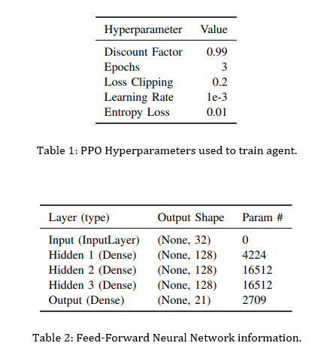
Other Information

