Slide 1

INSTAGRAM COMPARE
Instagram Compare Report
BRAND
PERIOD
COMPARISON PERIOD
CHANNEL
@padmavathi_jewellery_mart • @caratlane
02 Jul 2026 - 31 Jul 2026
2 Jun 2026 - 1 Jul 2026
Instagram

Slide 2

Padmavathi Jewellery mart
EXECUTIVE SUMMARY
2/8
Between 02 Jul 2026 and 31 Jul 2026, Padmavathi Jewellery mart maintained a follower base of 563, experiencing a slight decline of 0.18%, whereas CaratLane Jewellery saw follower growth, increasing by 1.12% to 1.7 million. In terms of posting activity, Padmavathi Jewellery mart published 16 posts, down 11.11%, while CaratLane Jewellery posted more frequently at 26 times, with a smaller decline of 3.7%.Engagement metrics show a stark contrast: Padmavathi Jewellery mart's total engagement dropped significantly by 73.83% to 56 interactions, averaging 3.5 engagements per post. Conversely, CaratLane Jewellery increased engagement by 59.14% to 28.8K, averaging 1.1K engagements per post.Although Padmavathi Jewellery mart has a higher engagement rate relative to reach (1.59%) and impressions (1.25%), its small audience size results in much lower absolute engagement. Regarding content distribution, CaratLane Jewellery's average post reach and impressions remain vastly higher at 775.6K and 1.2M respectively, despite minor decreases, compared to Padmavathi Jewellery mart's 247.56 reach and 281.56 impressions.This comparison indicates CaratLane Jewellery's stronger audience scale and interaction despite slightly reduced posting frequency, while Padmavathi Jewellery mart struggles with declining reach and engagement.
Source: Socialinsider
Date range: 02 Jul 2026 - 31 Jul 2026

Slide 3
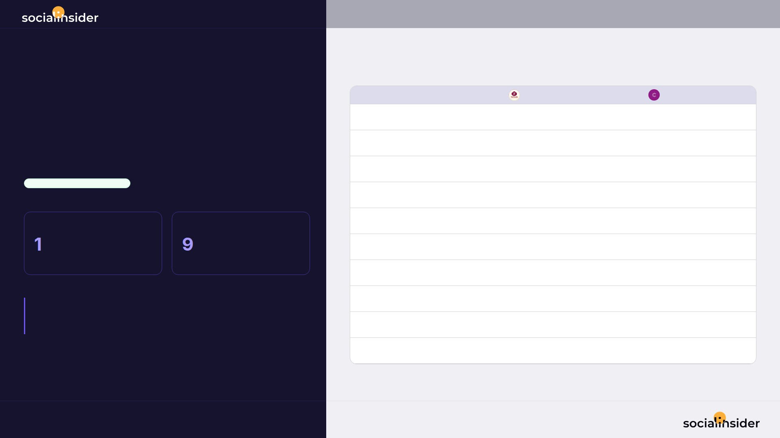
3/8
INSTAGRAM HEAD-TO-HEAD
• 10 metrics compared
02 Jul 2026 - 31 Jul 2026
CaratLane Jewellery leads on 9 of 10 metrics
Metric
Padmavathi Jewellery mart
CaratLane Jewellery
Followers
563
1.7M
Followers growth
-5
18.4K
PERFORMANCE COMPARISON
Total posts
16
26
CaratLane Jewellery • OVERALL LEADER
Avg. posts / day
0.53
0.87
PADMAVATHI JEWELLERY MART
CARATLANE JEWELLERY
Total engagement
56
28.8K
/10
/10
Avg. eng. rate by followers
0.62%
0.07%
metrics won
metrics won
Avg. engagement / post
3.5
1.1K
Avg. reach / post
247.56
775.6K
KEY TAKEAWAY:
CaratLane Jewellery is ahead on avg. views / post (4352.8x), but Padmavathi Jewellery mart still takes avg. eng. rate by followers.
Avg. views / post
281.56
1.2M
Avg. reel length
3s
29s
Source: Socialinsider
Date range: 02 Jul 2026 - 31 Jul 2026

Slide 4
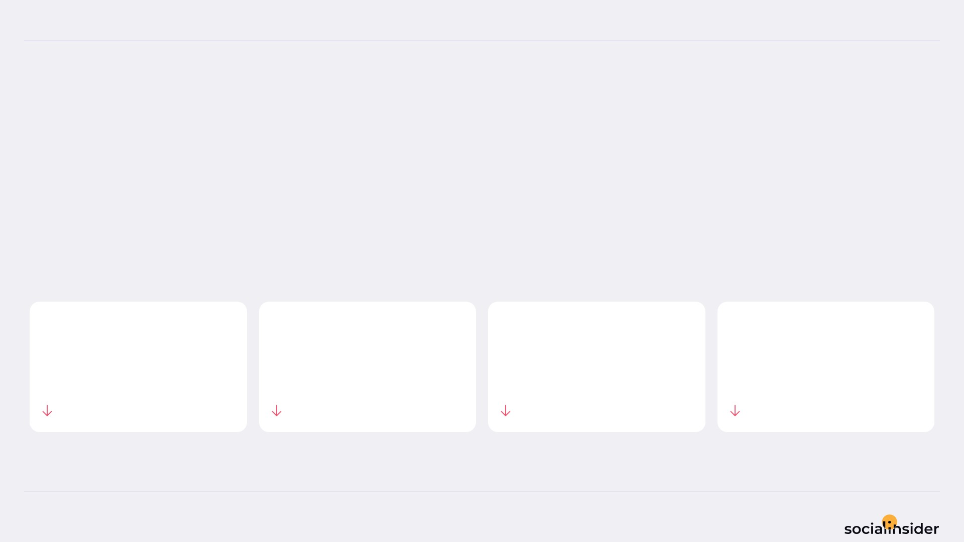
Padmavathi Jewellery mart
POSTS PERFORMANCE
4/8
POSTS TO ENGAGEMENT
Padmavathi Jewellery mart posted 11.11% less, and engagement followed.
TOTAL POSTS
TOTAL ENGAGEMENT
AVG ENGAGEMENT / POST
AVG ENGAGEMENT / DAY
16
56
3.5
1.9
11.11%
73.83%
70.56%
73.83%
Source: Socialinsider
Date range: 02 Jul 2026 - 31 Jul 2026

Slide 5
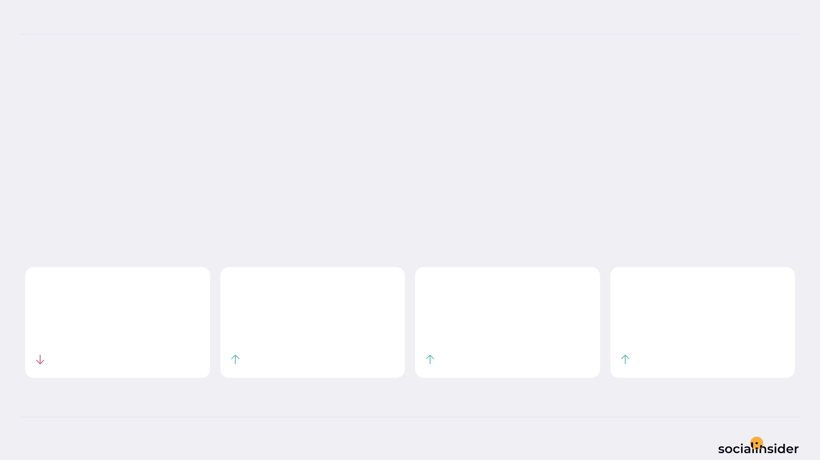
CaratLane Jewellery
POSTS PERFORMANCE
5/8
POSTS TO ENGAGEMENT
CaratLane Jewellery posted 3.70% less, and earned 59.14% more engagement.
Fewer posts, more engagement — quality over quantity is working.
TOTAL POSTS
TOTAL ENGAGEMENT
AVG ENGAGEMENT / POST
AVG ENGAGEMENT / DAY
26
28.8K
1,109
961.2
3.7%
59.14%
65.27%
59.14%
Source: Socialinsider
Date range: 02 Jul 2026 - 31 Jul 2026

Slide 6
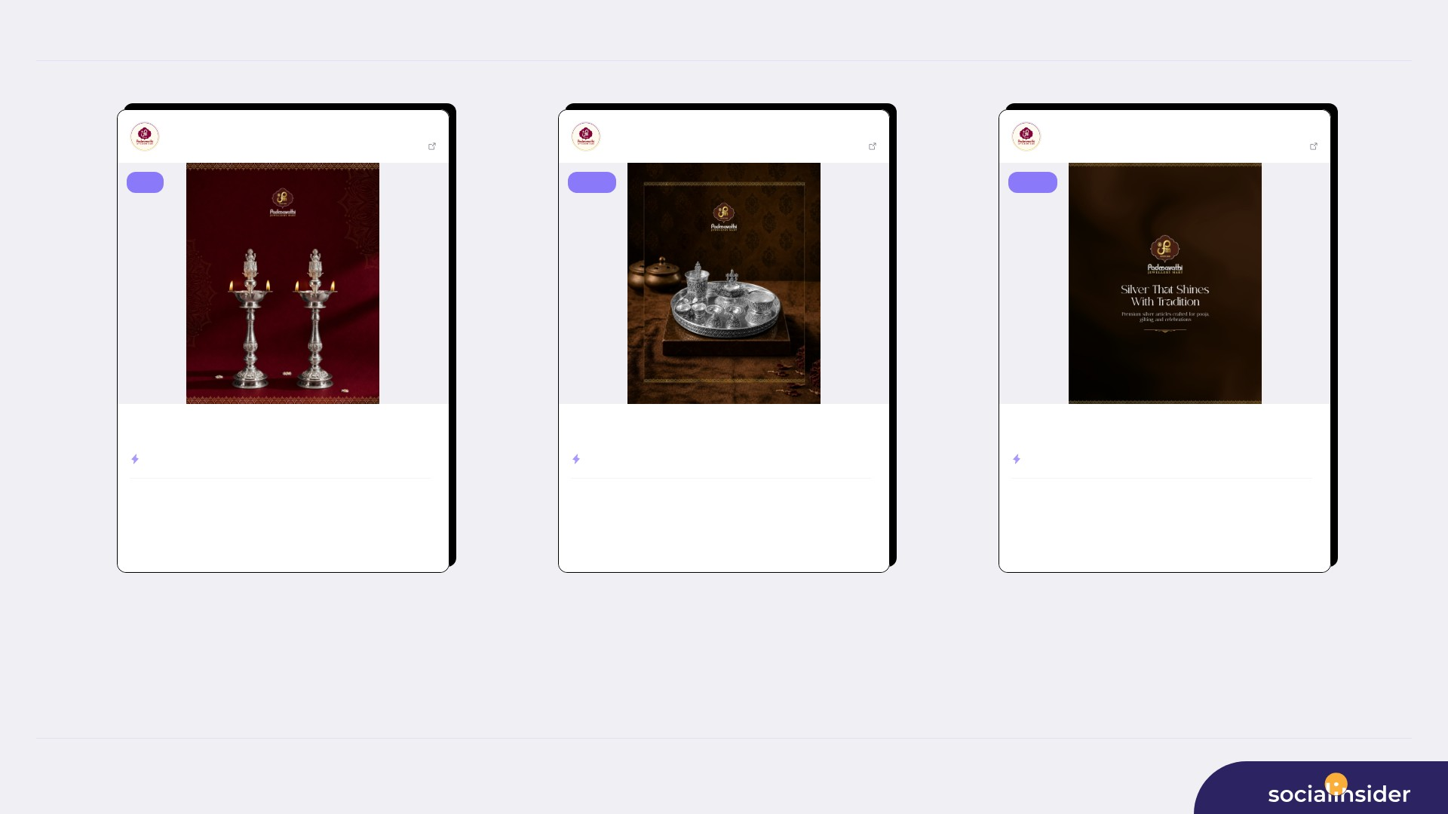
Padmavathi Jewellery mart
TOP CONTENT
6/8
Padmavathi Jewe...
Jul 20, 2026
Padmavathi Jewe...
Jul 13, 2026
Padmavathi Jewe...
Jul 02, 2026
563 followers
View post
563 followers
View post
563 followers
View post
reel
image
image
Light up your sacred moments with the elegance of silver. ✨ Discover ...
Add a touch of tradition and elegance to every ritual. ✨ Padmavathi J...
Silver that shines with tradition. ✨🤍 Explore premium silver article...
ENGAGEMENT RATE
2.31%
ENGAGEMENT RATE
1.07%
ENGAGEMENT RATE
0.89%
246
13
605
6
504
5
VIEWS
LIKES
VIEWS
LIKES
VIEWS
LIKES
0
153
0
550
0
458
COMMENTS
REACH
COMMENTS
REACH
COMMENTS
REACH
Source: Socialinsider
Date range: 02 Jul 2026 - 31 Jul 2026

Slide 7
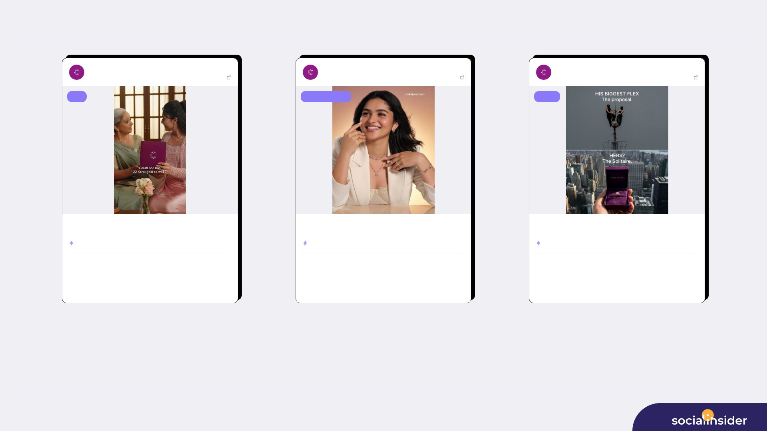
CaratLane Jewellery
TOP CONTENT
7/8
CaratLane - A T...
Jul 21, 2026
CaratLane - A T...
Jul 06, 2026
CaratLane - A T...
Jul 03, 2026
1656527 followers
View post
1656527 followers
View post
1656527 followers
View post
reel
carousel album
image
This Aadi month , celebrate new beginnings with the glow of 22KT gold ...
Celebrate every little victory with designs made to shine with you.💜✨
He went all the way to the top, but honestly? The real showstopper is ...
ENGAGEMENT RATE
0.52%
ENGAGEMENT RATE
0.14%
ENGAGEMENT RATE
0.12%
2.6M
8,501
169.1K
2,346
118.7K
2,018
VIEWS
LIKES
VIEWS
LIKES
VIEWS
LIKES
62
1.6M
52
153.7K
22
107.9K
COMMENTS
REACH
COMMENTS
REACH
COMMENTS
REACH
Source: Socialinsider
Date range: 02 Jul 2026 - 31 Jul 2026

Slide 8

REFERENCE
8/8
Definitions and reference materials for this report
Glossary & Resources
Scope
Definitions
Resources
Period
Engagement
Socialinsider Blog
02 Jul 2026 - 31 Jul 2026
The sum of interactions on the organic posts
socialinsider.io/blog
Comparison Period
Engagement Rate
Socialinsider Help Center
2 Jun 2026 - 1 Jul 2026
Engagement divided by the audience size, expressed as a percentage
https://howto.socialinsider.io/en/
Social Channel
Reach
Socialinsider Studies
Instagram
Number of unique accounts that saw the content
https://www.socialinsider.io/reports
Profiles Compared
Views
Total number of times the content was displayed
Source: Socialinsider
Date range: 02 Jul 2026 - 31 Jul 2026

