Slide 1

INSTAGRAM COMPARE
Instagram Compare Report
BRAND
PERIOD
COMPARISON PERIOD
CHANNEL
@padmavathi_jewellery_mart • @psggold916
02 Jul 2026 - 31 Jul 2026
2 Jun 2026 - 1 Jul 2026
Instagram

Slide 2

Padmavathi Jewellery mart
EXECUTIVE SUMMARY
2/8
This comparison between Padmavathi Jewellery Mart and Psg Gold on Instagram from 02 Jul 2026 to 31 Jul 2026 reveals pronounced differences in audience size and engagement. Psg Gold leads substantially in followers with 1.2 million, dwarfing Padmavathi Jewellery Mart's 563 followers.Despite a slight decline in followers for both, Psg Gold's scale remains overwhelmingly larger, providing it with greater organic reach potential. Regarding publishing volume, Psg Gold posted 237 times, 14.49% more than in the previous period, whereas Padmavathi Jewellery Mart posted only 16 times, an 11.11% decrease.Although Psg Gold posts far more frequently, it achieves a higher average engagement per post at 280.85 compared to Padmavathi Jewellery Mart's 3.5, indicating stronger audience interaction per post despite the frequency. Engagement rates by followers are higher for Padmavathi Jewellery Mart at 0.62% but still much below Psg Gold's massive engagement in absolute terms.In terms of reach and impressions, Psg Gold's average post reach of 23,000 and impressions of 36,400 far exceed Padmavathi Jewellery Mart's figures below 300, signifying Psg Gold's superior content visibility. Both brands experienced declines in total reach and impressions, with Padmavathi Jewellery Mart's decreases being more severe.Overall, Psg Gold sustains a dominant position in follower base, post frequency, engagement, and content reach over this analyzed period.
Source: Socialinsider
Date range: 02 Jul 2026 - 31 Jul 2026

Slide 3
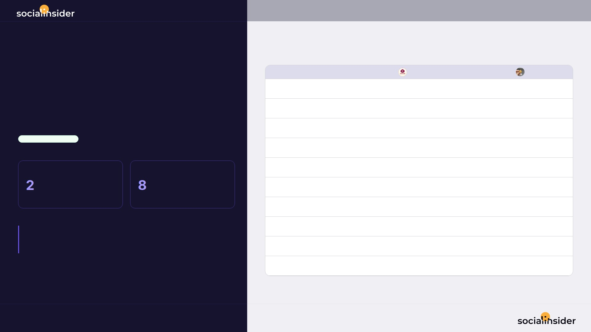
3/8
INSTAGRAM HEAD-TO-HEAD
• 10 metrics compared
02 Jul 2026 - 31 Jul 2026
Psg Gold leads on 8 of 10 metrics
Metric
Padmavathi Jewellery mart
Psg Gold
Followers
563
1.2M
Followers growth
-5
-865
PERFORMANCE COMPARISON
Total posts
16
237
Psg Gold • OVERALL LEADER
Avg. posts / day
0.53
7.9
PADMAVATHI JEWELLERY MART
PSG GOLD
Total engagement
56
66.6K
/10
/10
Avg. eng. rate by followers
0.62%
0.02%
metrics won
metrics won
Avg. engagement / post
3.5
280.85
Avg. reach / post
247.56
23.0K
KEY TAKEAWAY:
Psg Gold is ahead on followers (2090.3x), but Padmavathi Jewellery mart still takes followers growth.
Avg. views / post
281.56
36.4K
Avg. reel length
3s
7s
Source: Socialinsider
Date range: 02 Jul 2026 - 31 Jul 2026

Slide 4
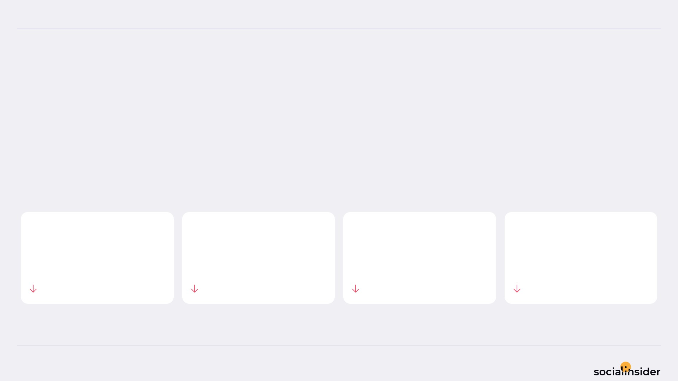
Padmavathi Jewellery mart
POSTS PERFORMANCE
4/8
POSTS TO ENGAGEMENT
Padmavathi Jewellery mart posted 11.11% less, and engagement followed.
TOTAL POSTS
TOTAL ENGAGEMENT
AVG ENGAGEMENT / POST
AVG ENGAGEMENT / DAY
16
56
3.5
1.9
11.11%
73.83%
70.56%
73.83%
Source: Socialinsider
Date range: 02 Jul 2026 - 31 Jul 2026

Slide 5
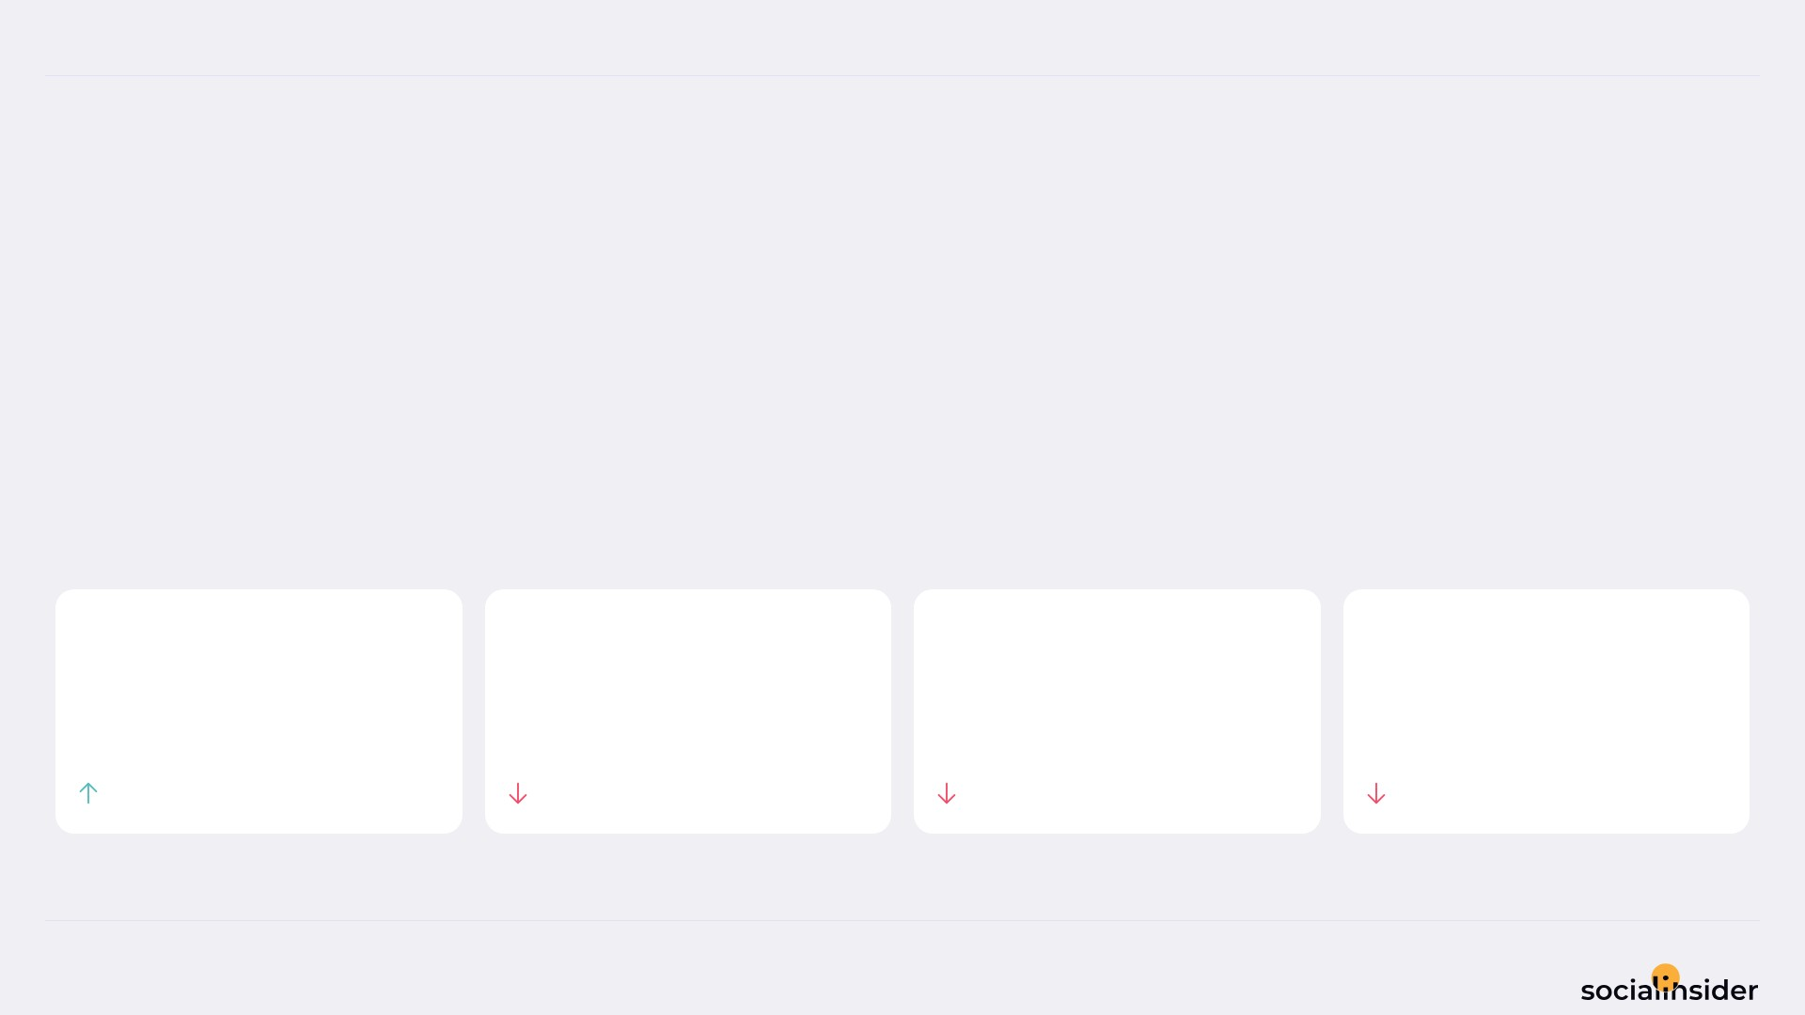
Psg Gold
POSTS PERFORMANCE
5/8
POSTS TO ENGAGEMENT
Psg Gold posted 14.49% more, but engagement dropped 10.40%.
More posts produced less engagement — review content quality or frequency.
TOTAL POSTS
TOTAL ENGAGEMENT
AVG ENGAGEMENT / POST
AVG ENGAGEMENT / DAY
237
66.6K
280.9
2,219
14.49%
10.4%
21.75%
10.4%
Source: Socialinsider
Date range: 02 Jul 2026 - 31 Jul 2026

Slide 6
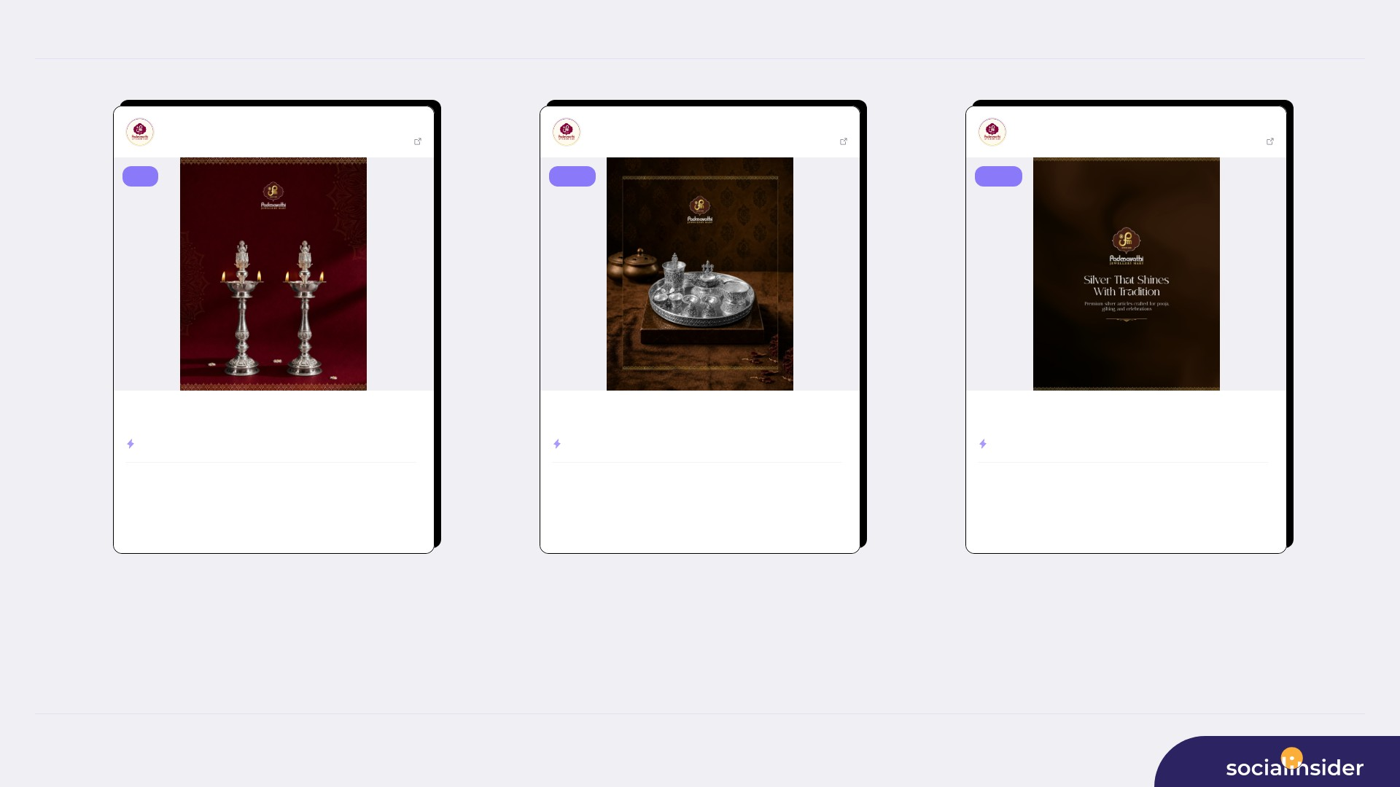
Padmavathi Jewellery mart
TOP CONTENT
6/8
Padmavathi Jewe...
Jul 20, 2026
Padmavathi Jewe...
Jul 13, 2026
Padmavathi Jewe...
Jul 02, 2026
563 followers
View post
563 followers
View post
563 followers
View post
reel
image
image
Light up your sacred moments with the elegance of silver. ✨ Discover ...
Add a touch of tradition and elegance to every ritual. ✨ Padmavathi J...
Silver that shines with tradition. ✨🤍 Explore premium silver article...
ENGAGEMENT RATE
2.31%
ENGAGEMENT RATE
1.07%
ENGAGEMENT RATE
0.89%
246
13
605
6
504
5
VIEWS
LIKES
VIEWS
LIKES
VIEWS
LIKES
0
153
0
550
0
458
COMMENTS
REACH
COMMENTS
REACH
COMMENTS
REACH
Source: Socialinsider
Date range: 02 Jul 2026 - 31 Jul 2026

Slide 7
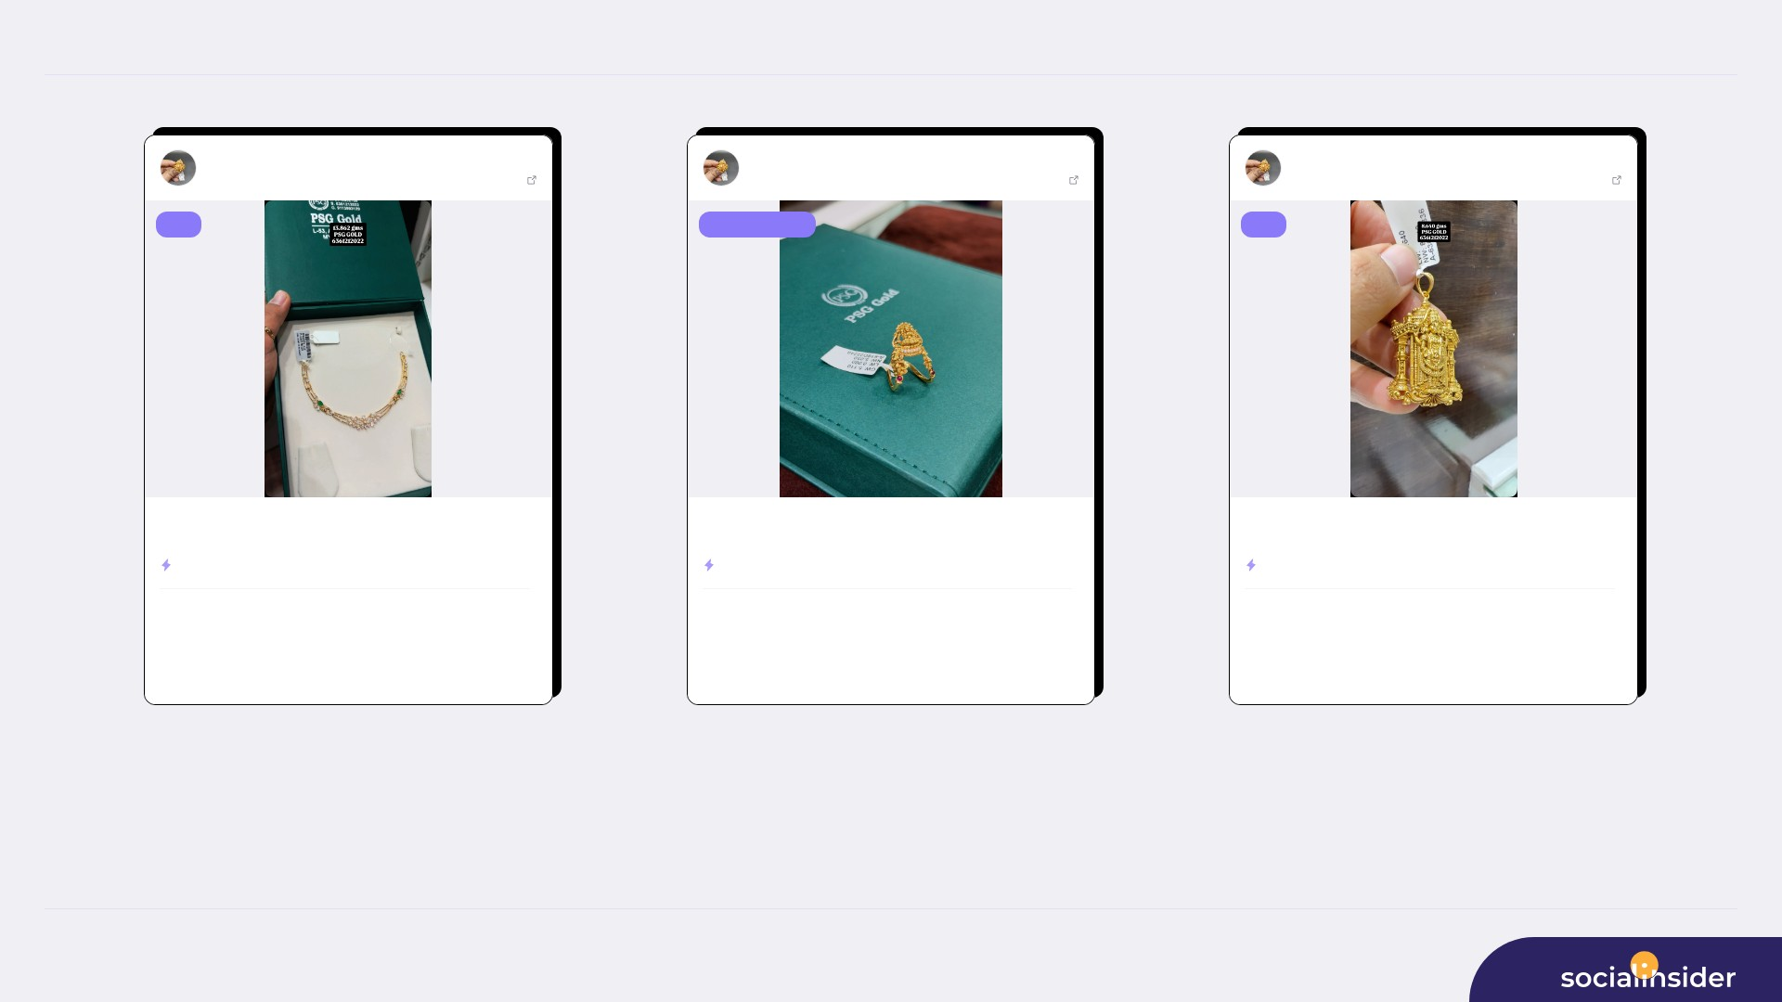
Psg Gold
TOP CONTENT
7/8
Psg Gold
Jul 03, 2026
Psg Gold
Jul 06, 2026
Psg Gold
Jul 17, 2026
1176850 followers
View post
1176850 followers
View post
1176850 followers
View post
reel
carousel album
reel
22 CT gold / BIS 916 Hall mark Necklace 13.862 gms Contact No. For ...
22 CT gold / BIS 916 Hall mark Ring Contact No. For more details 63...
22 CT gold / BIS 916 Hall mark Pendant 8.640 gms Contact No. For m...
ENGAGEMENT RATE
0.45%
ENGAGEMENT RATE
0.18%
ENGAGEMENT RATE
0.12%
668.8K
5,061
9,323
2,171
99.7K
1,436
VIEWS
LIKES
VIEWS
LIKES
VIEWS
LIKES
220
416.7K
3
8,476
5
62.1K
COMMENTS
REACH
COMMENTS
REACH
COMMENTS
REACH
Source: Socialinsider
Date range: 02 Jul 2026 - 31 Jul 2026

Slide 8

REFERENCE
8/8
Definitions and reference materials for this report
Glossary & Resources
Scope
Definitions
Resources
Period
Engagement
Socialinsider Blog
02 Jul 2026 - 31 Jul 2026
The sum of interactions on the organic posts
socialinsider.io/blog
Comparison Period
Engagement Rate
Socialinsider Help Center
2 Jun 2026 - 1 Jul 2026
Engagement divided by the audience size, expressed as a percentage
https://howto.socialinsider.io/en/
Social Channel
Reach
Socialinsider Studies
Instagram
Number of unique accounts that saw the content
https://www.socialinsider.io/reports
Profiles Compared
Views
Total number of times the content was displayed
Source: Socialinsider
Date range: 02 Jul 2026 - 31 Jul 2026

