Slide 1
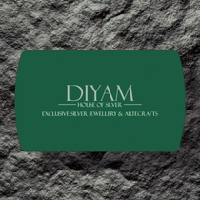
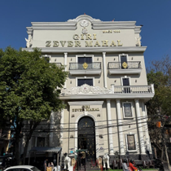
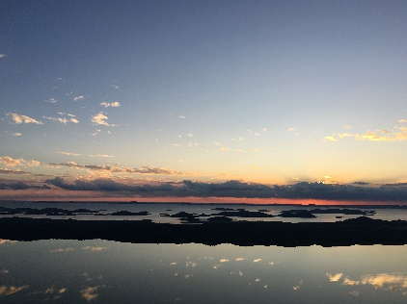
Instagram Social Report
DIYAM HOUSE OF SILVER vs Giri Zever Mahal
20 Jun 2026 - 19 Jul 2026

Slide 2


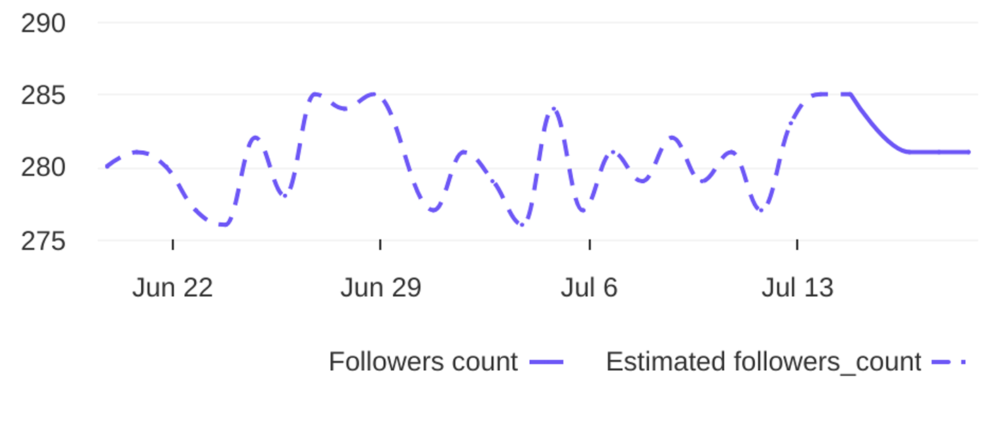
Social Report
20 Jun 2026 - 19 Jul 2026
Profile summary • DIYAM HOUSE OF SILVER
Key metrics of the profile
135
39
Followers' evolution
3.5
posts
engagement
1.2%
avg. engagement
avg. engagement
/ post
rate / post
1
Followers
0.4%
Avg. Eng. Rate/Post
281
engagement
Eng. Rate/Profile
profile growth
Followers
rate / profile

Slide 3
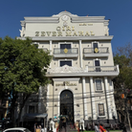
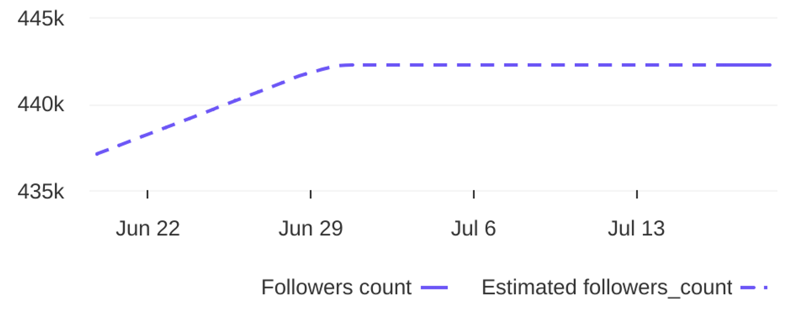
Social Report
20 Jun 2026 - 19 Jul 2026
Profile summary • Giri Zever Mahal
Key metrics of the profile
270.2K
40
Followers' evolution
6756
posts
engagement
1.5%
avg. engagement
avg. engagement
/ post
rate / post
5155
Followers
1.2%
Avg. Eng. Rate/Post
442235
engagement
Eng. Rate/Profile
profile growth
Followers
rate / profile

Slide 4


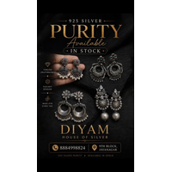
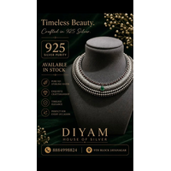
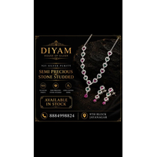
Social Report
20 Jun 2026 - 19 Jul 2026
Top posts • DIYAM HOUSE OF SILVER
The most engaging posts
Date
Image
Text
Type
Engagement
Comments
Likes
925 Silver Adjustable Rakhi. Available in stock. Get yours before its over. For more details Dm o...
reel
reel
reel
reel
reel
8
7
7
5
5
1
0
0
0
0
7
7
7
5
5
02 Jul
21 Jun
27 Jun
26 Jun
17 Jul
925 Silver Earings Oxidise Finish. Available in Stock. For more details DM or visit store. diyamh...
925 silver oxadise Necklace. Available in stock. For more details Dm or Visit store. diyamhouseof...
925 Silver Necklace. Available in Stock. For more details Dm or Visit Store. diyamhouseofsilver 9...
925 silver antique finish necklace. Available in stock. For more details Dm or visit store. diyam...

Slide 5
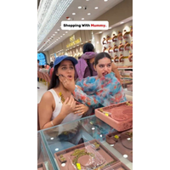
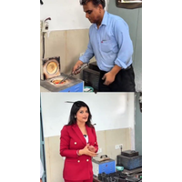
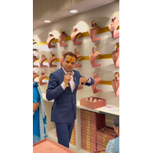

Social Report
20 Jun 2026 - 19 Jul 2026
Top posts • Giri Zever Mahal
The most engaging posts
Date
Image
Text
Type
Engagement
Comments
Likes
Shopping with Mother😍👉Get 2% Making Charges on OLD GOLD EXCHANGE, Offer for Next 15Days🏦 In Ou...
reel
reel
reel
reel
reel
197231
10879
8373
7104
6624
504
27
419
64
104
196727
10852
7954
7040
6520
03 Jul
14 Jul
09 Jul
01 Jul
09 Jul
Get 2% Making Charges on OLD GOLD EXCHANGE, Offer for Next 15Days🏦 In Our All Branches✨Share the...
Get 2% Making Charges on OLD GOLD EXCHANGE, Offer for Next 15Days🏦 In Our All Branches✨Share the...
🤩Kartik Giri - The Jewellery King👑#girizevermahal . . . Get 2% Making Charges on OLD GOLD EXCHA...
Get 2% Making Charges on OLD GOLD EXCHANGE, Offer for Next 15Days🏦 In Our All Branches✨Share the...

Slide 6
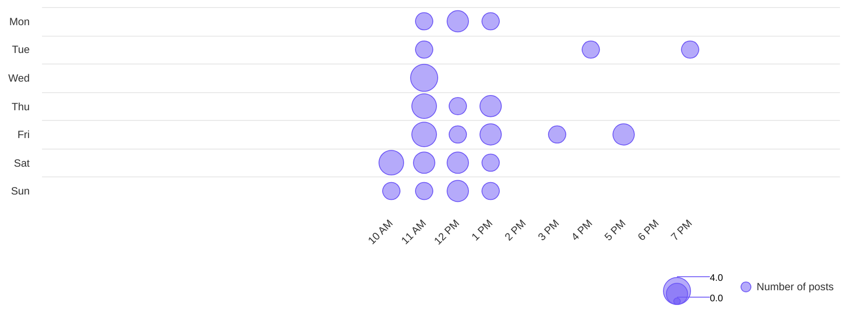
Social Report
20 Jun 2026 - 19 Jul 2026
Publishing behaviour • DIYAM HOUSE OF SILVER
See the posting patterns of the page
Posting times
11 AM
wed
Day with most posts
Hour with most posts

Slide 7
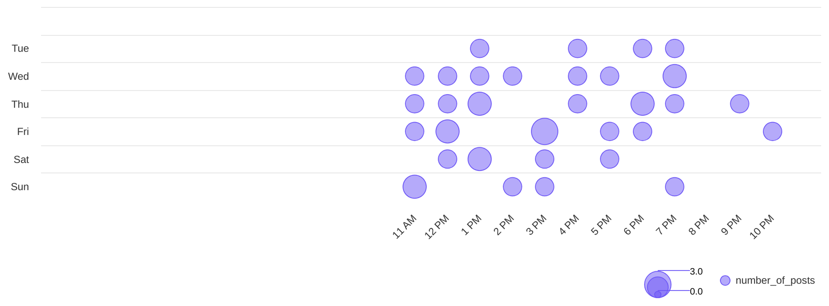
Social Report
20 Jun 2026 - 19 Jul 2026
Publishing behaviour • Giri Zever Mahal
See the posting patterns of the page
Posting times
3 PM
fri
Day with most posts
Hour with most posts

Slide 8
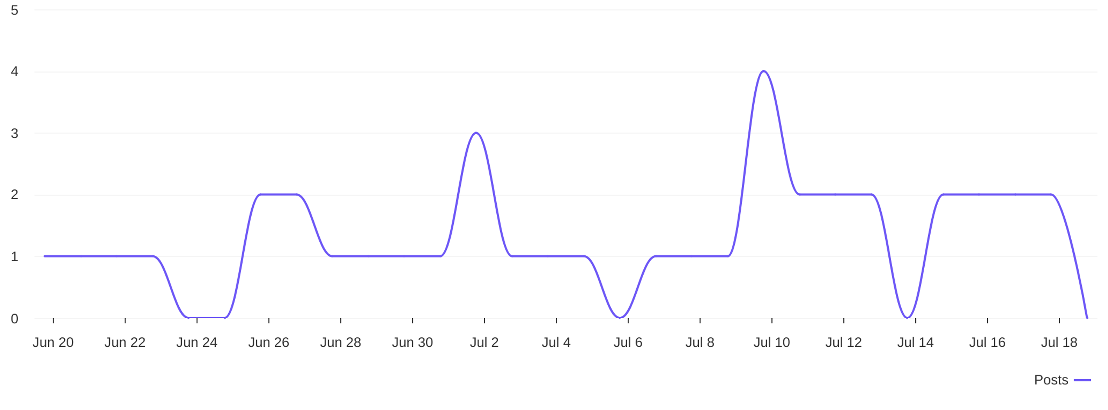
Social Report
20 Jun 2026 - 19 Jul 2026
Publishing behaviour • DIYAM HOUSE OF SILVER
See the posting patterns of the page
Distribution of posts
1.3
avg posts / day

Slide 9
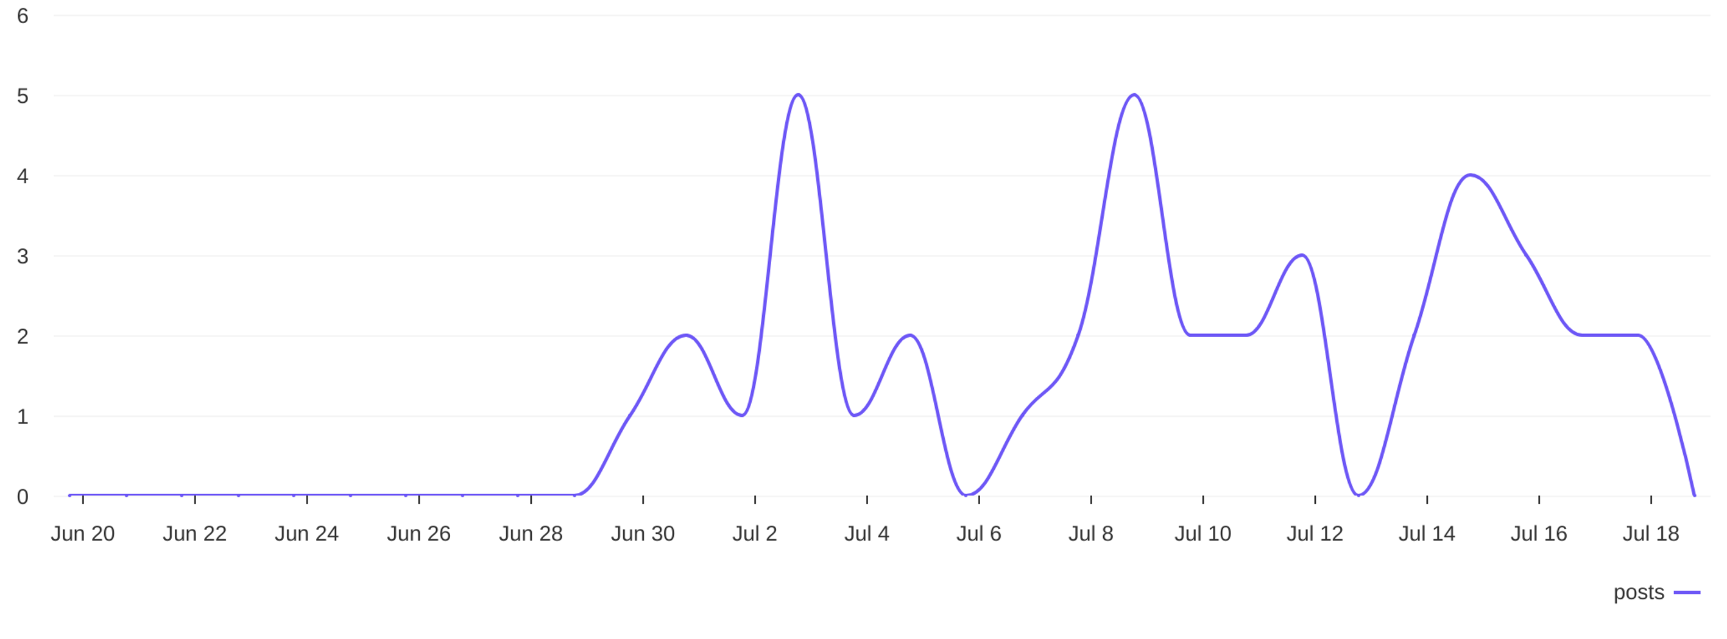
Social Report
20 Jun 2026 - 19 Jul 2026
Publishing behaviour • Giri Zever Mahal
See the posting patterns of the page
Distribution of posts
1.3
avg posts / day

Slide 10
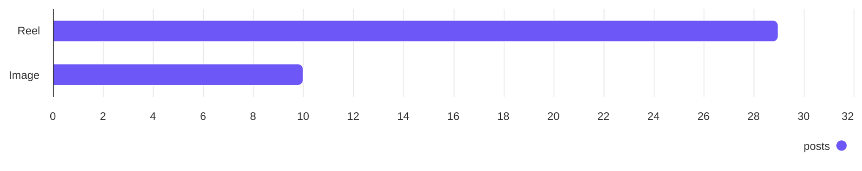
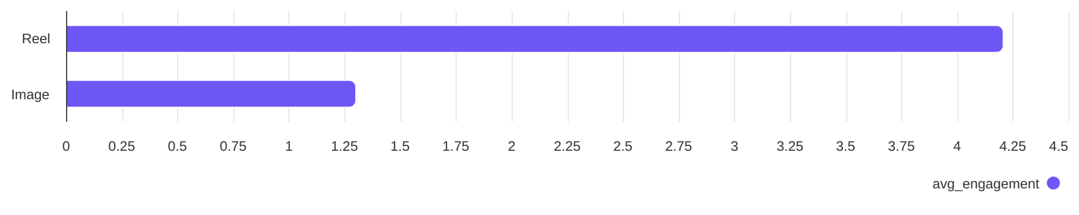
Social Report
20 Jun 2026 - 19 Jul 2026
Content performance • DIYAM HOUSE OF SILVER
See what types of post the profile published and understand the success of different post types
Post types
Reel count
Image count
29
10
Post types ranked by avg. engagement
Reel
Image
4.21
1.30

Slide 11
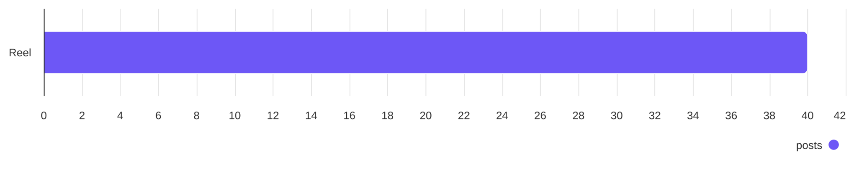
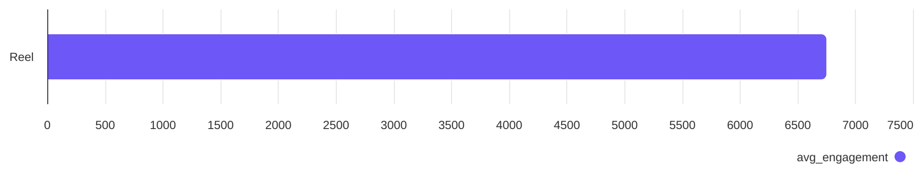
Social Report
20 Jun 2026 - 19 Jul 2026
Content performance • Giri Zever Mahal
See what types of post the profile published and understand the success of different post types
Post types
Reel count
40
Post types ranked by avg. engagement
Reel
6756

Slide 12
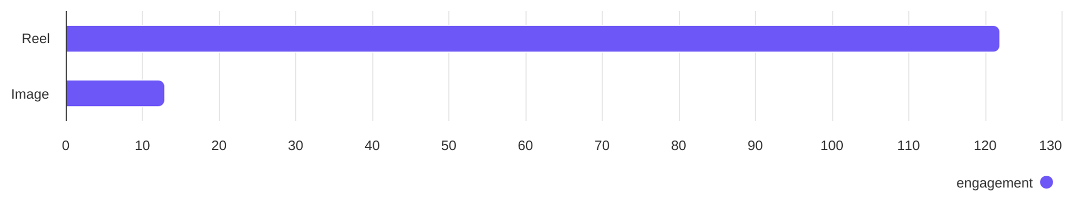
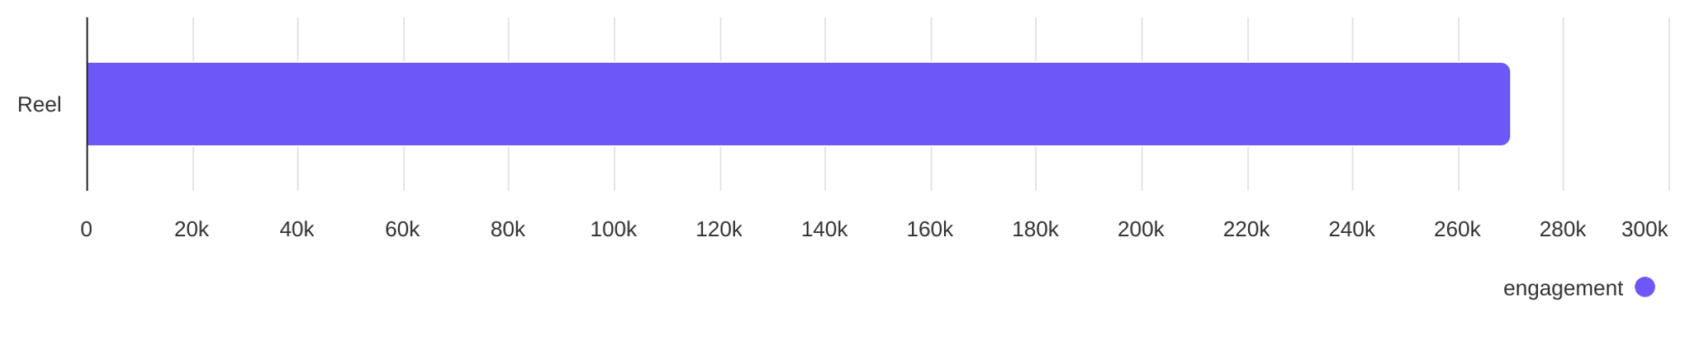
Social Report
20 Jun 2026 - 19 Jul 2026
Engagement overview
See the distribution of engagement (likes + comments)
Post types ranked by engagement - DIYAM HOUSE OF SILVER
Reel
Image
122
13
Post types ranked by engagement - Giri Zever Mahal
Reel
270.24K

Slide 13
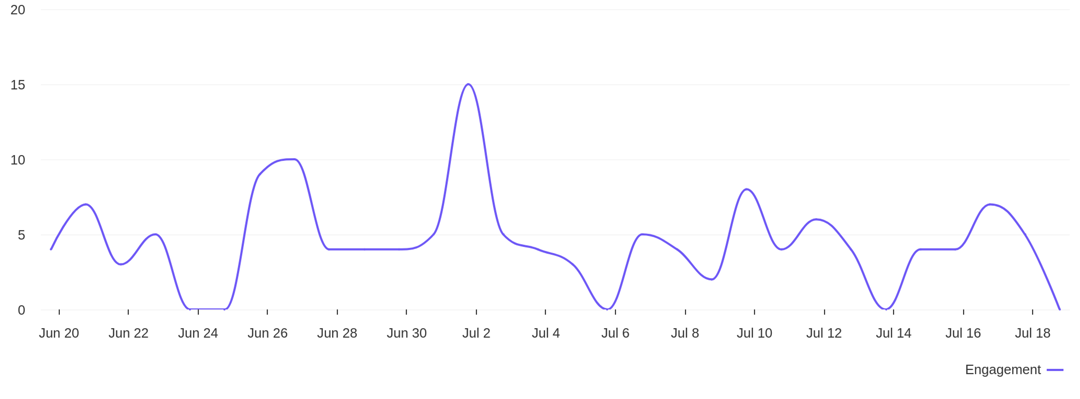
Social Report
20 Jun 2026 - 19 Jul 2026
Engagement overview • DIYAM HOUSE OF SILVER
See the distribution of engagement (likes + comments)
Engagement distribution / day
4.5
avg eng / day

Slide 14
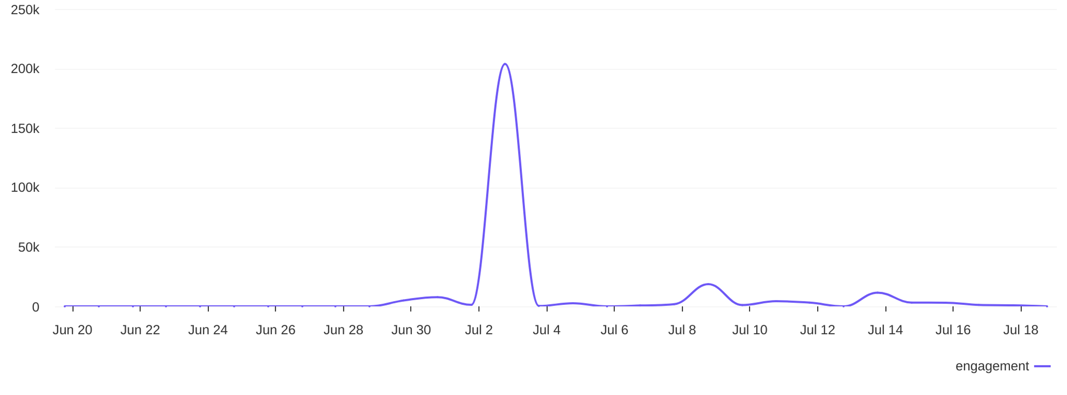
Social Report
20 Jun 2026 - 19 Jul 2026
Engagement overview • Giri Zever Mahal
See the distribution of engagement (likes + comments)
Engagement distribution / day
9008
avg eng / day

Slide 15
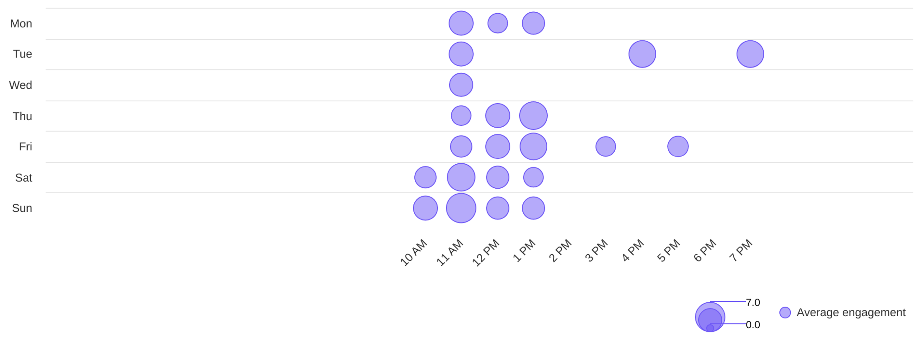
Social Report
20 Jun 2026 - 19 Jul 2026
Engagement overview • DIYAM HOUSE OF SILVER
See the distribution of engagement (likes + comments)
Best time to post by engagement
sun
11 AM
Day with most engagement
Hour with most engagement

Slide 16
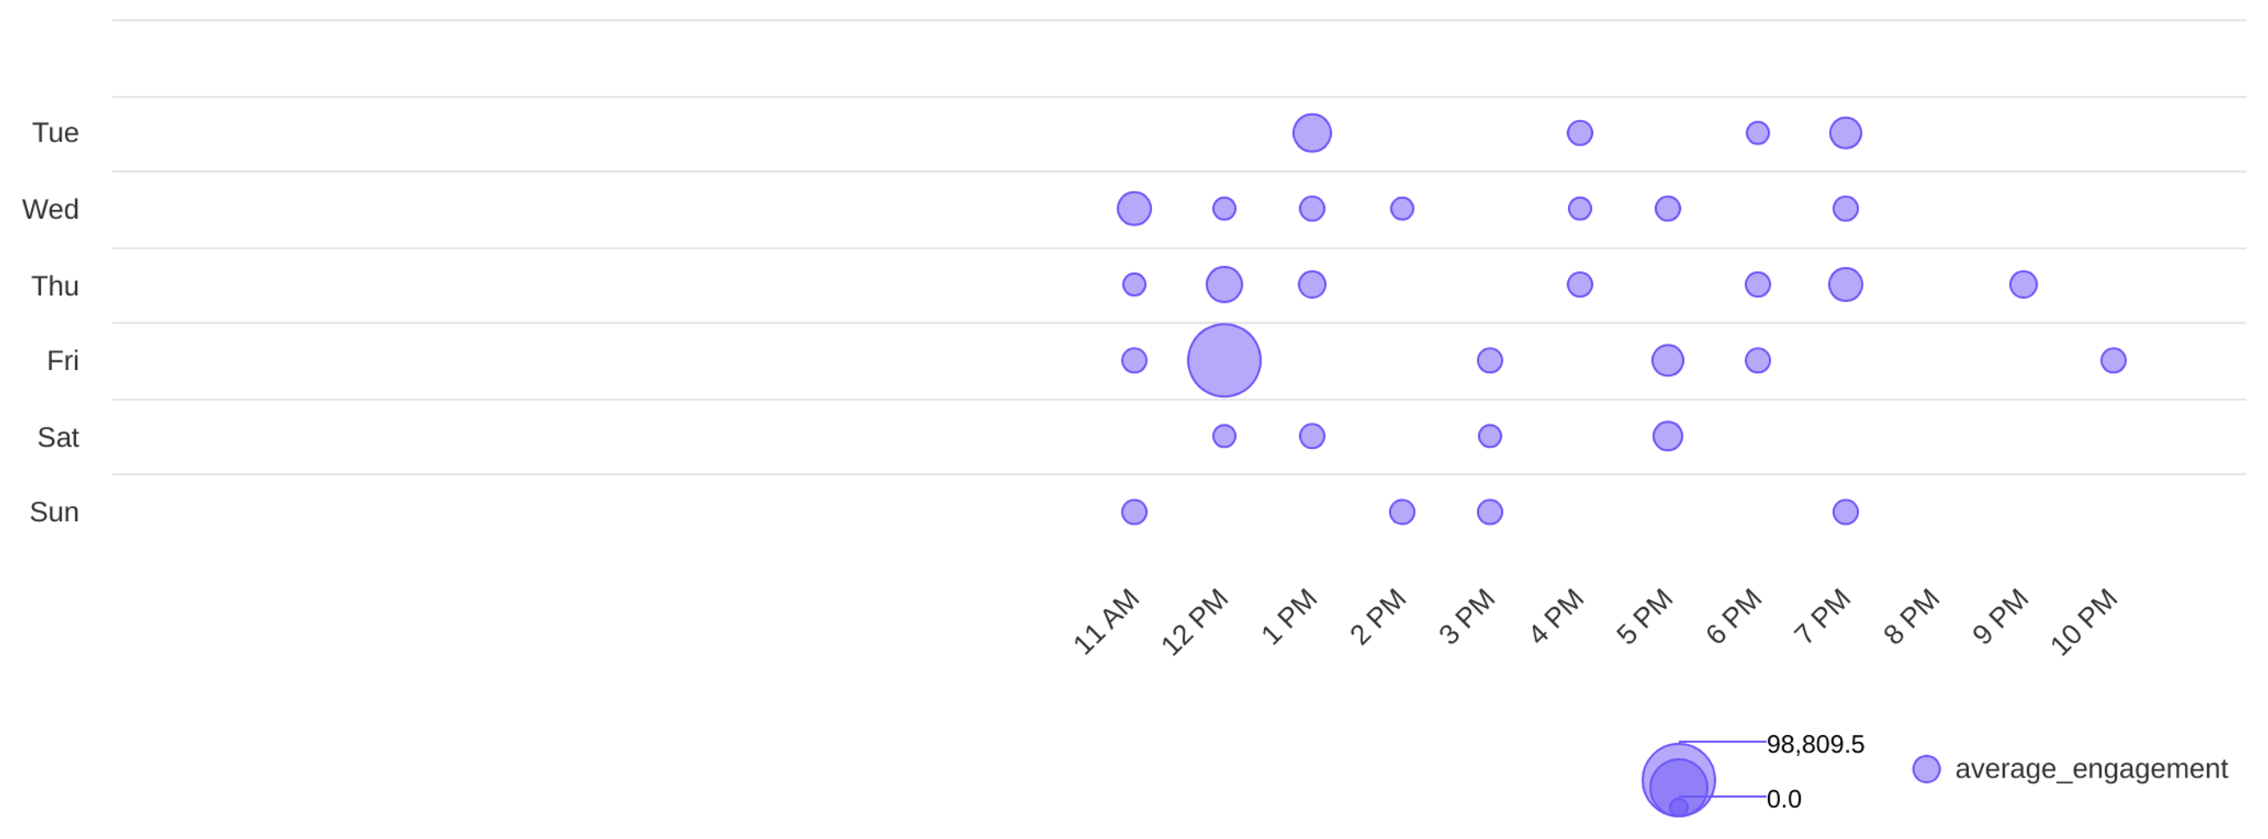
Social Report
20 Jun 2026 - 19 Jul 2026
Engagement overview • Giri Zever Mahal
See the distribution of engagement (likes + comments)
Best time to post by engagement
fri
12 PM
Day with most engagement
Hour with most engagement

Slide 17
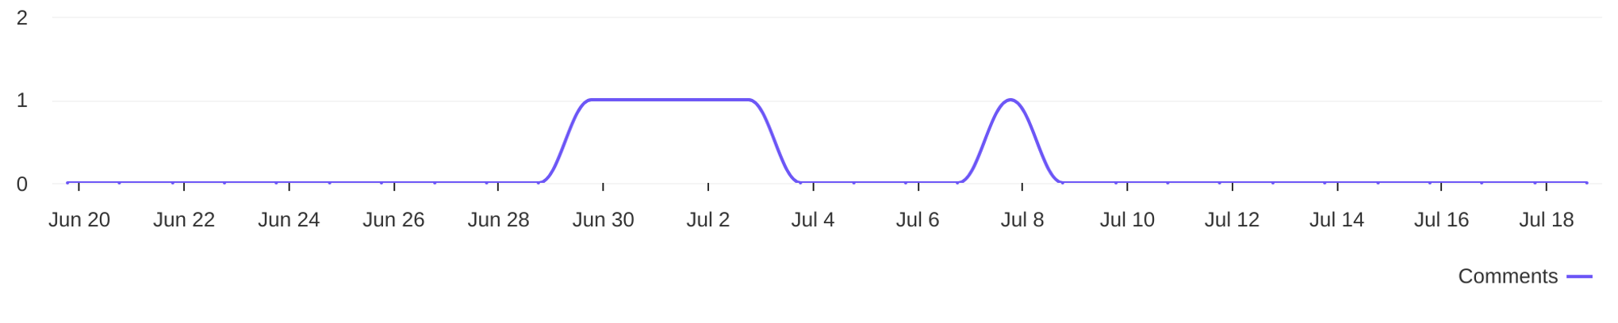
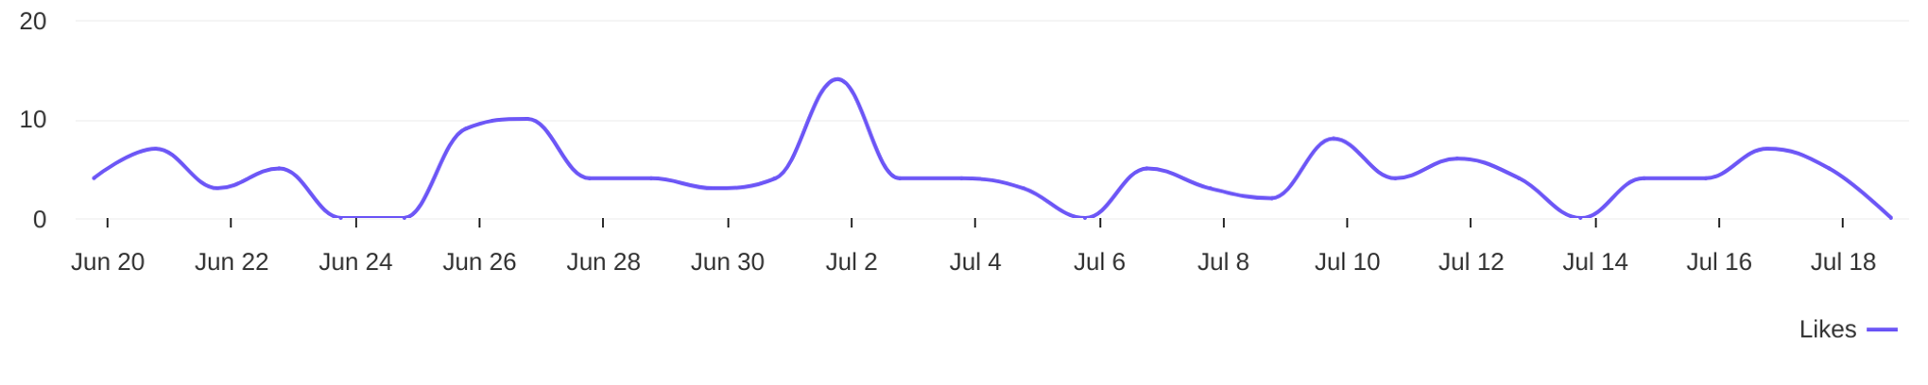
Social Report
20 Jun 2026 - 19 Jul 2026
Engagement metrics • DIYAM HOUSE OF SILVER
Breakdown of engagement for the profile
Distribution of comments / day
5
comments
Distribution of likes / day
130
likes

Slide 18
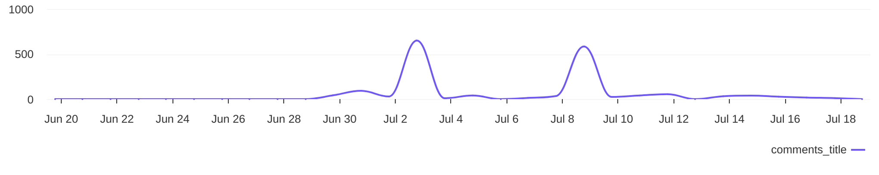
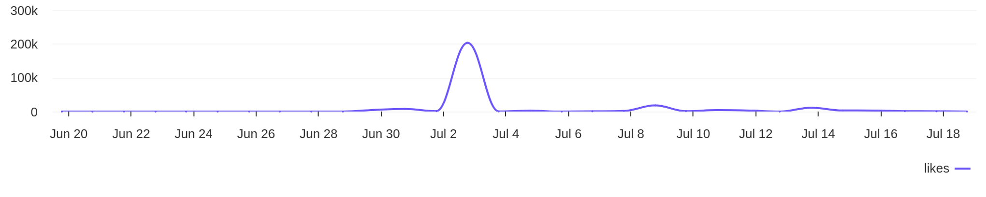
Social Report
20 Jun 2026 - 19 Jul 2026
Engagement metrics • Giri Zever Mahal
Breakdown of engagement for the profile
Distribution of comments / day
1738
comments
Distribution of likes / day
268.5K
likes

Slide 19
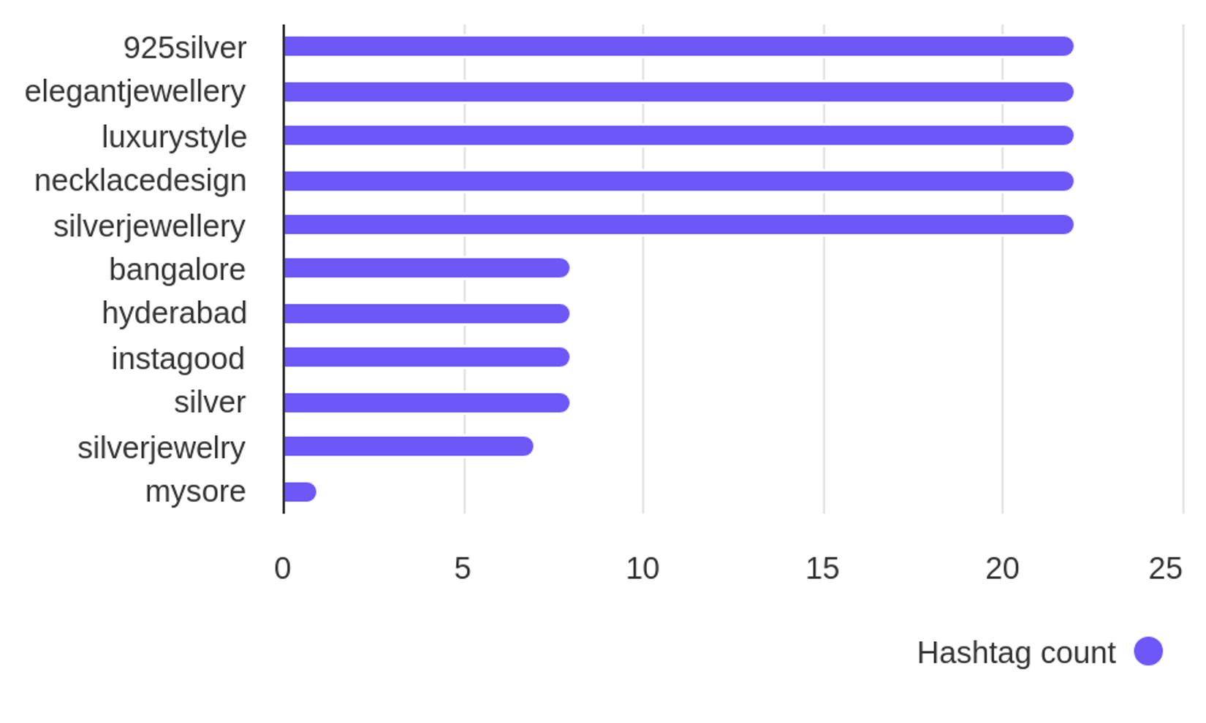

Social Report
20 Jun 2026 - 19 Jul 2026
Hashtag analysis • DIYAM HOUSE OF SILVER
See what hashtags are used the most
3.8
Most used hashtags
avg. hashtags
/ post
Hashtags
Occurrences
925silver
elegantjewellery
luxurystyle
necklacedesign
silverjewellery
bangalore
hyderabad
22
22
22
22
22
8
8

Slide 20
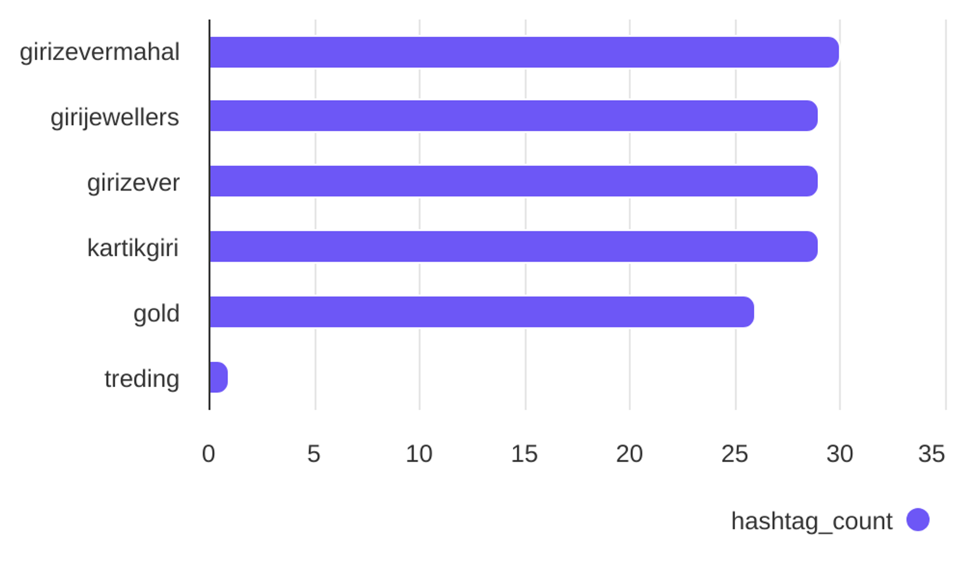
Social Report
20 Jun 2026 - 19 Jul 2026
Hashtag analysis • Giri Zever Mahal
See what hashtags are used the most
3.6
Most used hashtags
avg. hashtags
/ post
Hashtags
Occurrences
girizevermahal
girijewellers
girizever
kartikgiri
gold
treding
30
29
29
29
26
1

