Slide 1
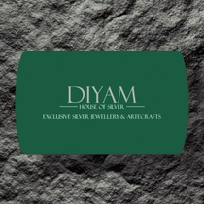


Instagram Social Report
DIYAM HOUSE OF SILVER vs SILVANA
20 Jun 2026 - 19 Jul 2026

Slide 2
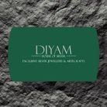

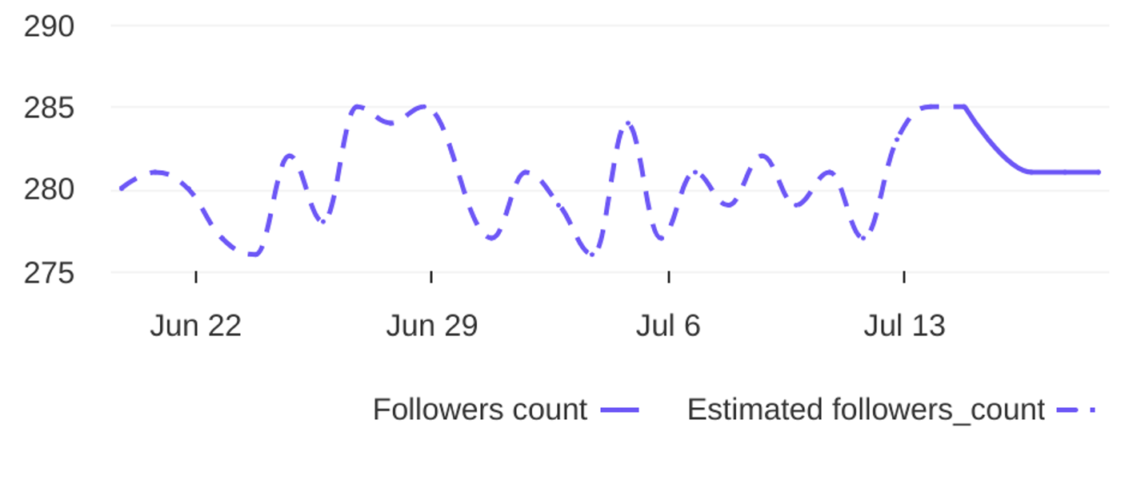
Social Report
20 Jun 2026 - 19 Jul 2026
Profile summary • DIYAM HOUSE OF SILVER
Key metrics of the profile
135
39
Followers' evolution
3.5
posts
engagement
1.2%
avg. engagement
avg. engagement
/ post
rate / post
1
Followers
0.4%
Avg. Eng. Rate/Post
281
engagement
Eng. Rate/Profile
profile growth
Followers
rate / profile

Slide 3

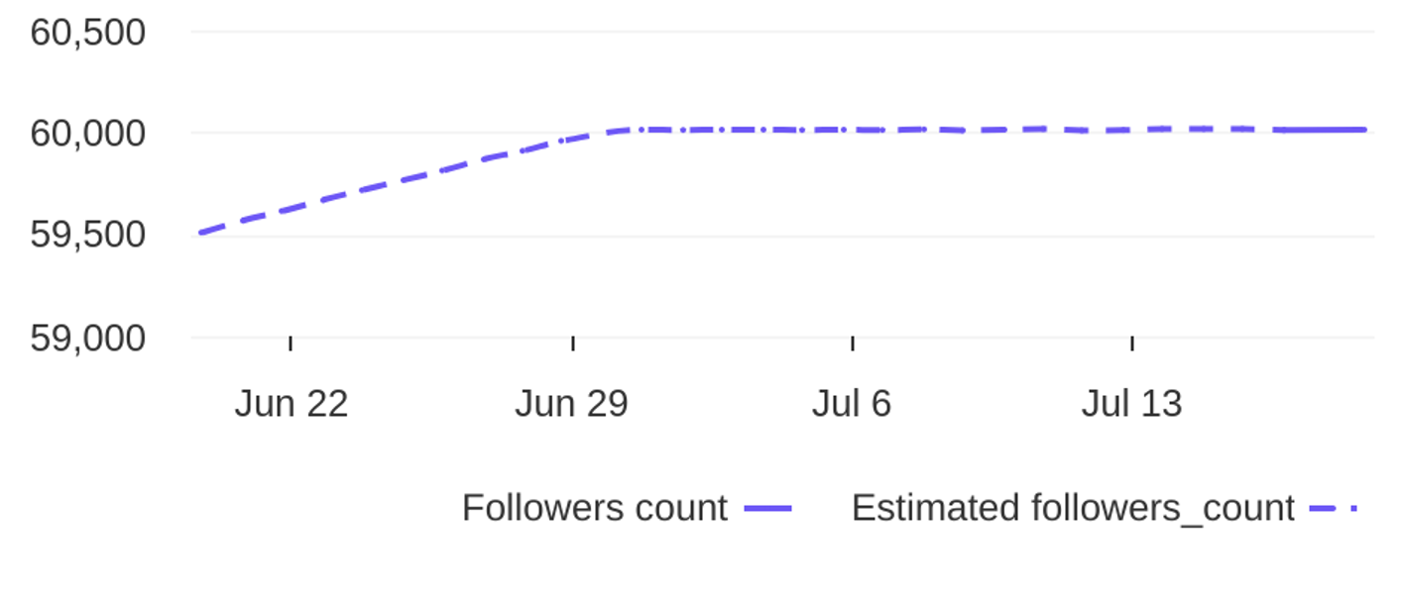
Social Report
20 Jun 2026 - 19 Jul 2026
Profile summary • SILVANA
Key metrics of the profile
178.7K
55
Followers' evolution
3249
posts
engagement
5.4%
avg. engagement
avg. engagement
/ post
rate / post
504
Followers
0.8%
Avg. Eng. Rate/Post
60012
engagement
Eng. Rate/Profile
profile growth
Followers
rate / profile

Slide 4

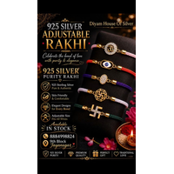
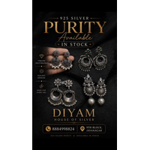
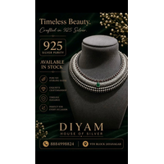
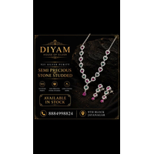
Social Report
20 Jun 2026 - 19 Jul 2026
Top posts • DIYAM HOUSE OF SILVER
The most engaging posts
Date
Image
Text
Type
Engagement
Comments
Likes
925 Silver Adjustable Rakhi. Available in stock. Get yours before its over. For more details Dm o...
reel
reel
reel
reel
reel
8
7
7
5
5
1
0
0
0
0
7
7
7
5
5
02 Jul
21 Jun
27 Jun
26 Jun
17 Jul
925 Silver Earings Oxidise Finish. Available in Stock. For more details DM or visit store. diyamh...
925 silver oxadise Necklace. Available in stock. For more details Dm or Visit store. diyamhouseof...
925 Silver Necklace. Available in Stock. For more details Dm or Visit Store. diyamhouseofsilver 9...
925 silver antique finish necklace. Available in stock. For more details Dm or visit store. diyam...

Slide 5
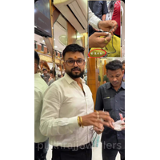
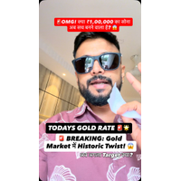
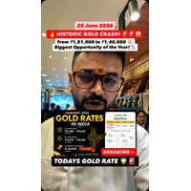
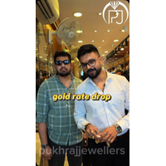
Social Report
20 Jun 2026 - 19 Jul 2026
Top posts • SILVANA
The most engaging posts
Date
Image
Text
Type
Engagement
Comments
Likes
Chandi hali ho jae… uska kala sach 😎✅ Sabko lagta hai silver sirf sasti hoti hai… Par asli game...
reel
reel
reel
reel
reel
105176
5894
5098
4967
3948
551
105
69
211
10
104625
5789
5029
4756
3938
02 Jul
30 Jun
25 Jun
26 Jun
16 Jul
🚨 BREAKING: Historic Gold Rate Update! 📉😱 आज Gold Rate में एक और बड़ा बदलाव देखने को मिला। मा...
🚨😱 HISTORIC DROP IN GOLD RATE! 💥💥 At the beginning of the year, gold was trading around ₹1,8...
Rolex Chain ✨🔥 Bold links. Premium finish. Royal look. 👑 Upgrade your style with the latest Ro...
🚩 Happy Jagannath Rath Yatra! 🙏 On this sacred occasion, Pukhraj Jewellers wishes you and your...

Slide 6
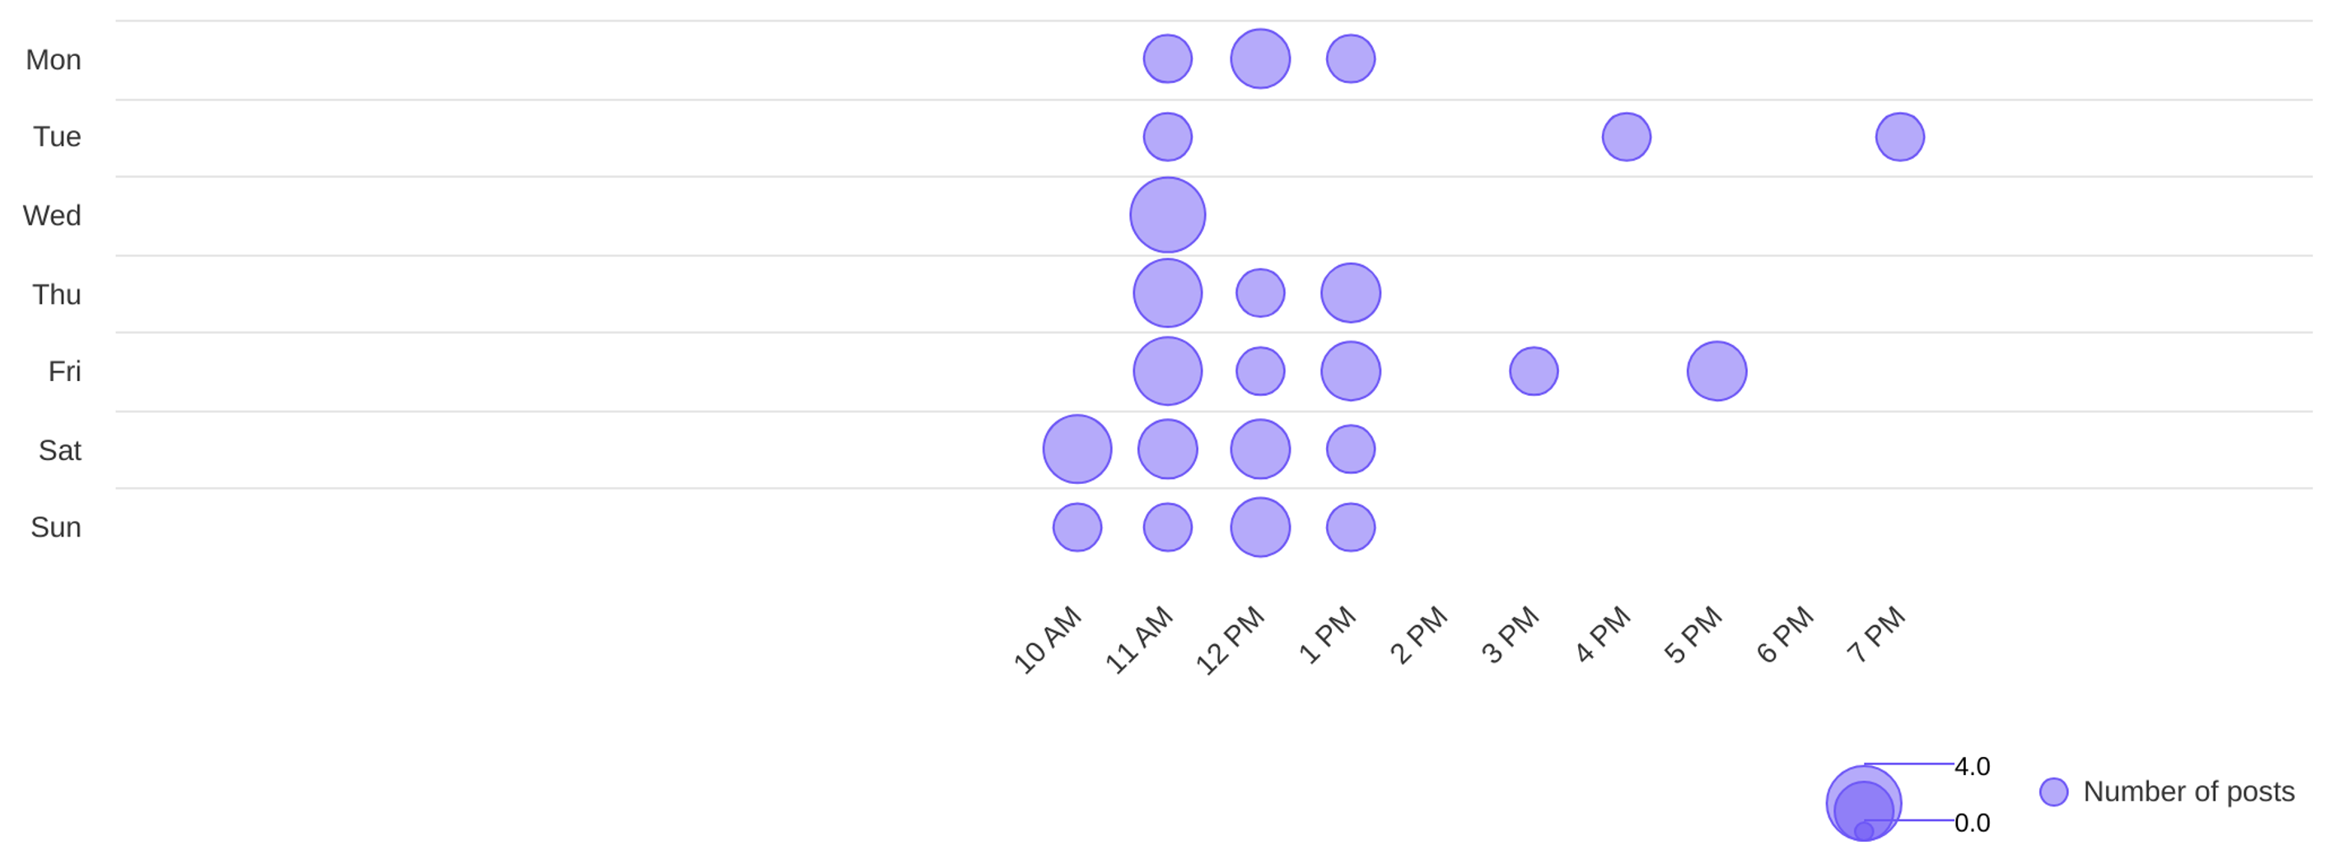
Social Report
20 Jun 2026 - 19 Jul 2026
Publishing behaviour • DIYAM HOUSE OF SILVER
See the posting patterns of the page
Posting times
11 AM
wed
Day with most posts
Hour with most posts

Slide 7
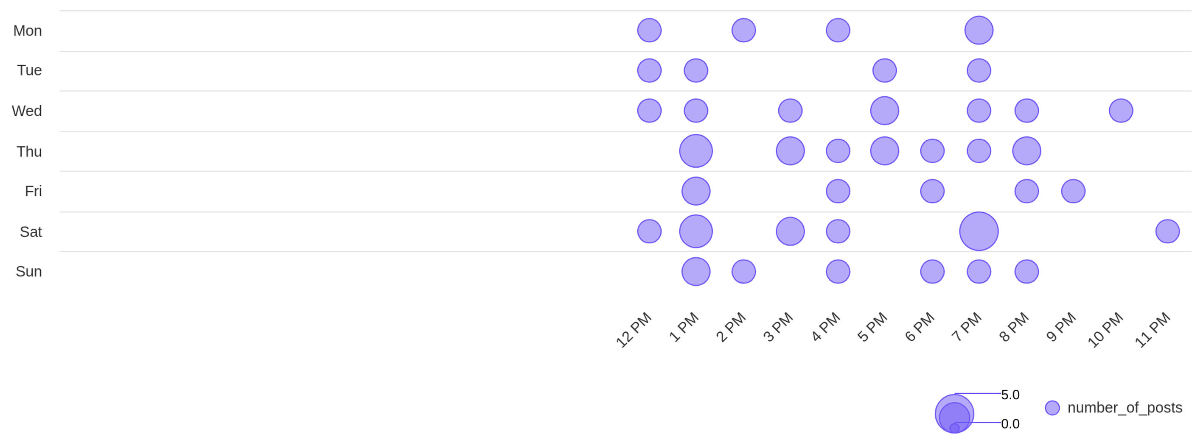
Social Report
20 Jun 2026 - 19 Jul 2026
Publishing behaviour • SILVANA
See the posting patterns of the page
Posting times
7 PM
sat
Day with most posts
Hour with most posts

Slide 8
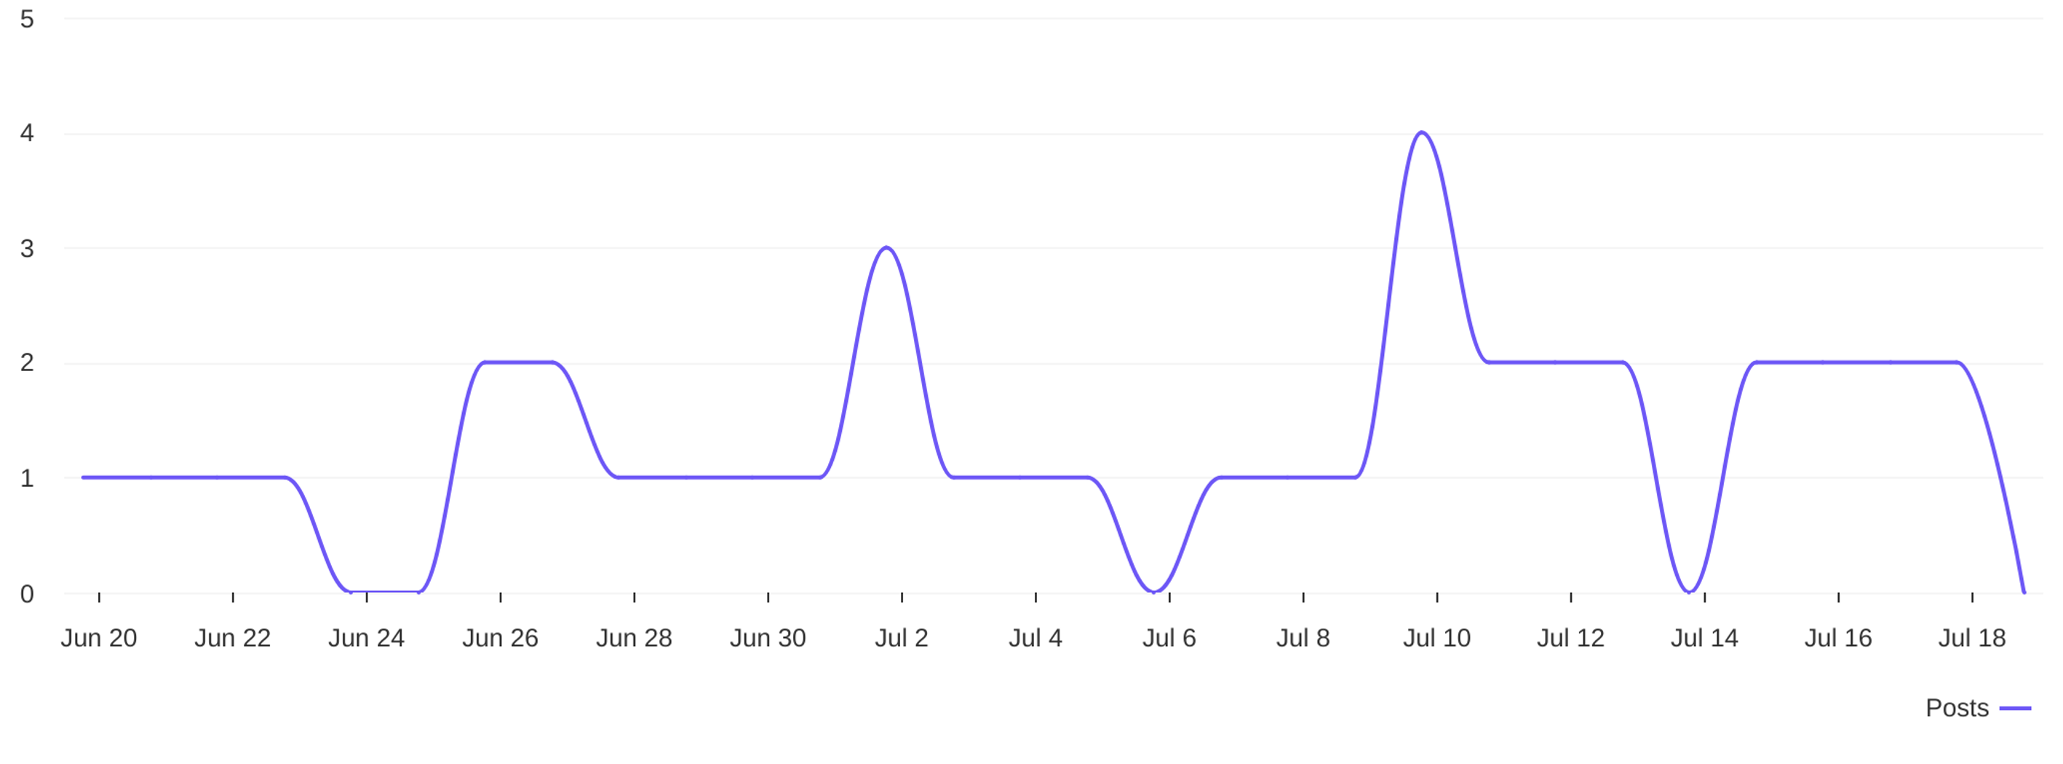
Social Report
20 Jun 2026 - 19 Jul 2026
Publishing behaviour • DIYAM HOUSE OF SILVER
See the posting patterns of the page
Distribution of posts
1.3
avg posts / day

Slide 9
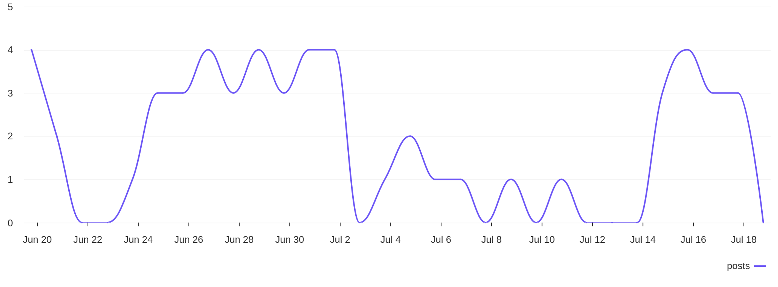
Social Report
20 Jun 2026 - 19 Jul 2026
Publishing behaviour • SILVANA
See the posting patterns of the page
Distribution of posts
1.8
avg posts / day

Slide 10
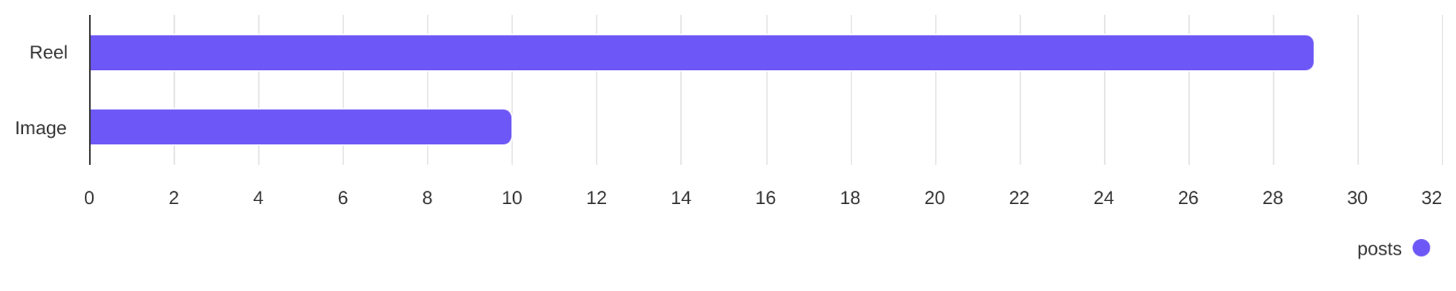
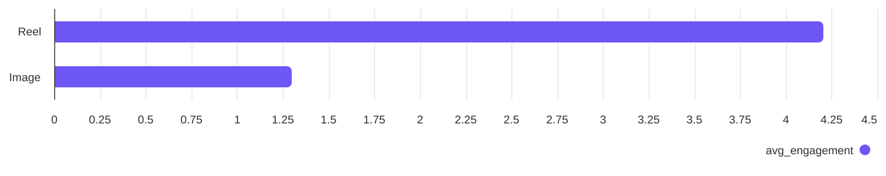
Social Report
20 Jun 2026 - 19 Jul 2026
Content performance • DIYAM HOUSE OF SILVER
See what types of post the profile published and understand the success of different post types
Post types
Reel count
Image count
29
10
Post types ranked by avg. engagement
Reel
Image
4.21
1.30

Slide 11
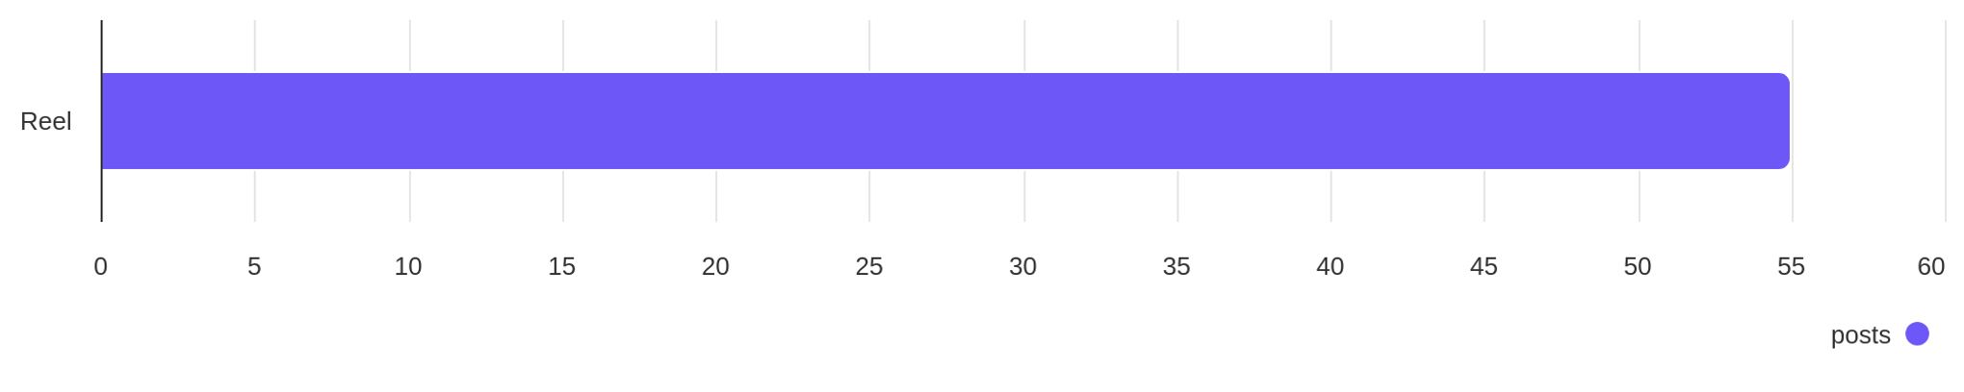
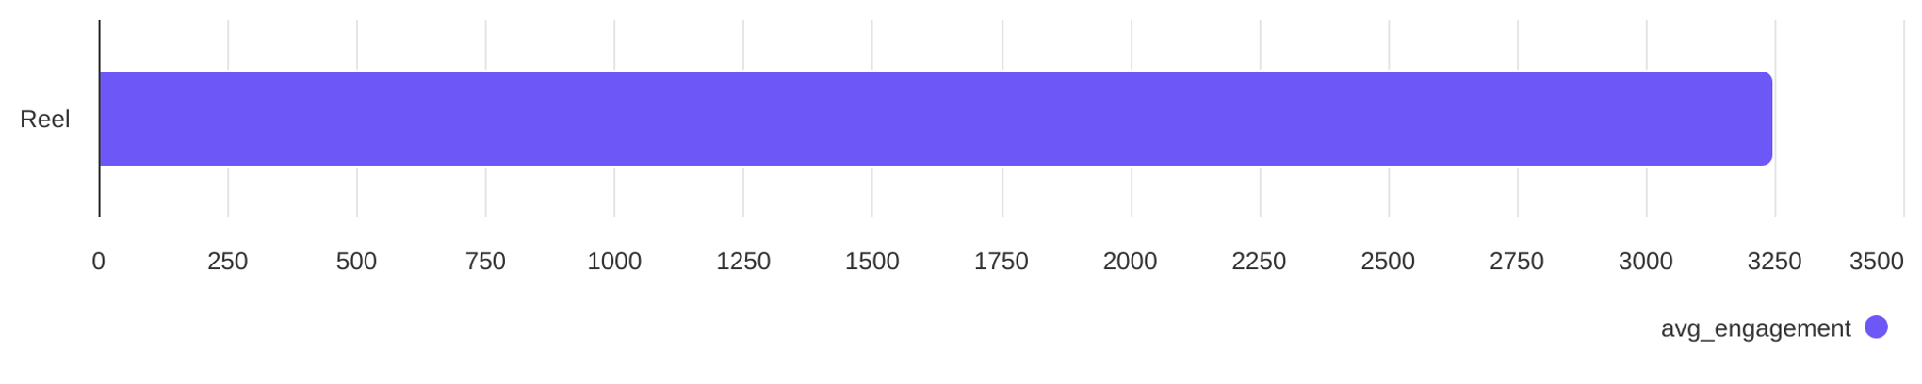
Social Report
20 Jun 2026 - 19 Jul 2026
Content performance • SILVANA
See what types of post the profile published and understand the success of different post types
Post types
Reel count
55
Post types ranked by avg. engagement
Reel
3249

Slide 12
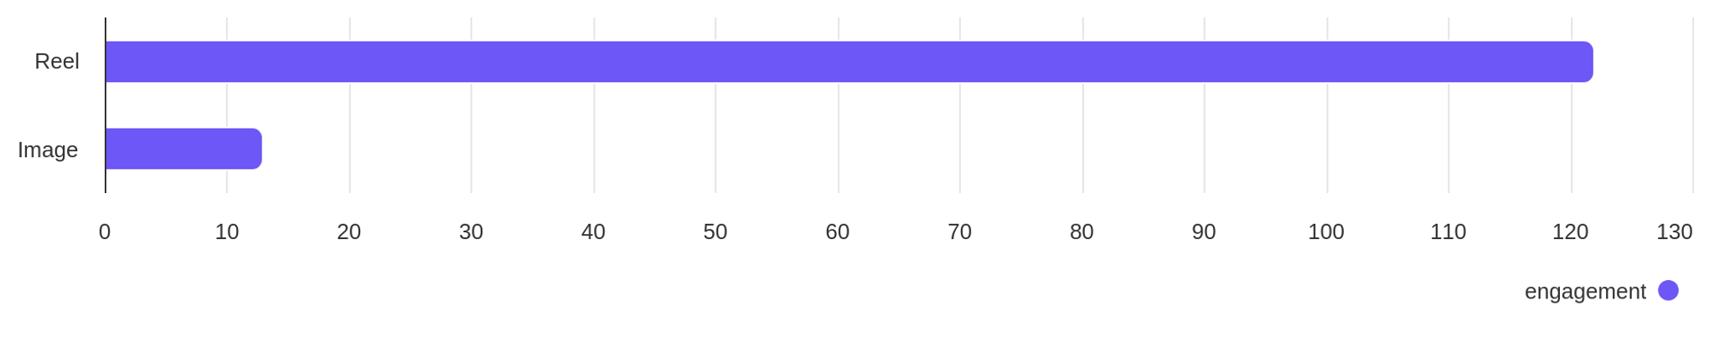
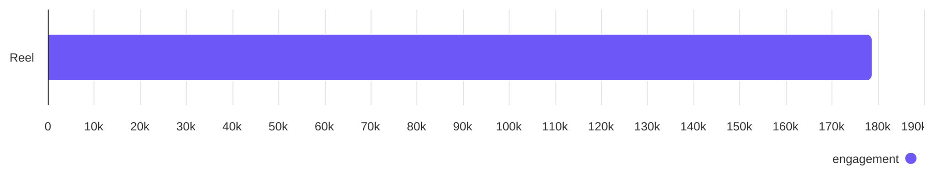
Social Report
20 Jun 2026 - 19 Jul 2026
Engagement overview
See the distribution of engagement (likes + comments)
Post types ranked by engagement - DIYAM HOUSE OF SILVER
Reel
Image
122
13
Post types ranked by engagement - SILVANA
Reel
178.71K

Slide 13
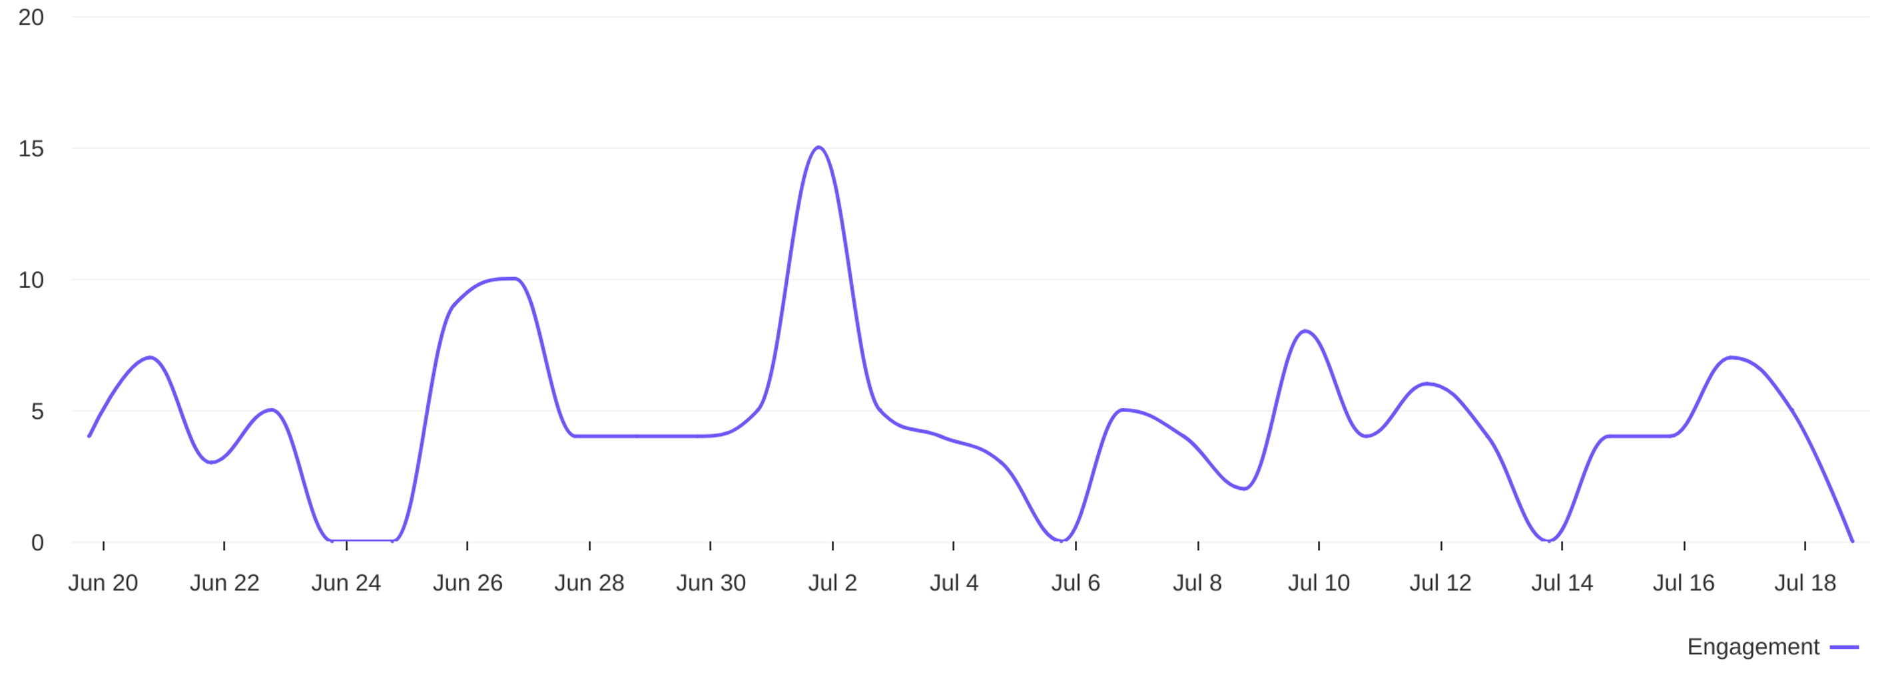
Social Report
20 Jun 2026 - 19 Jul 2026
Engagement overview • DIYAM HOUSE OF SILVER
See the distribution of engagement (likes + comments)
Engagement distribution / day
4.5
avg eng / day

Slide 14
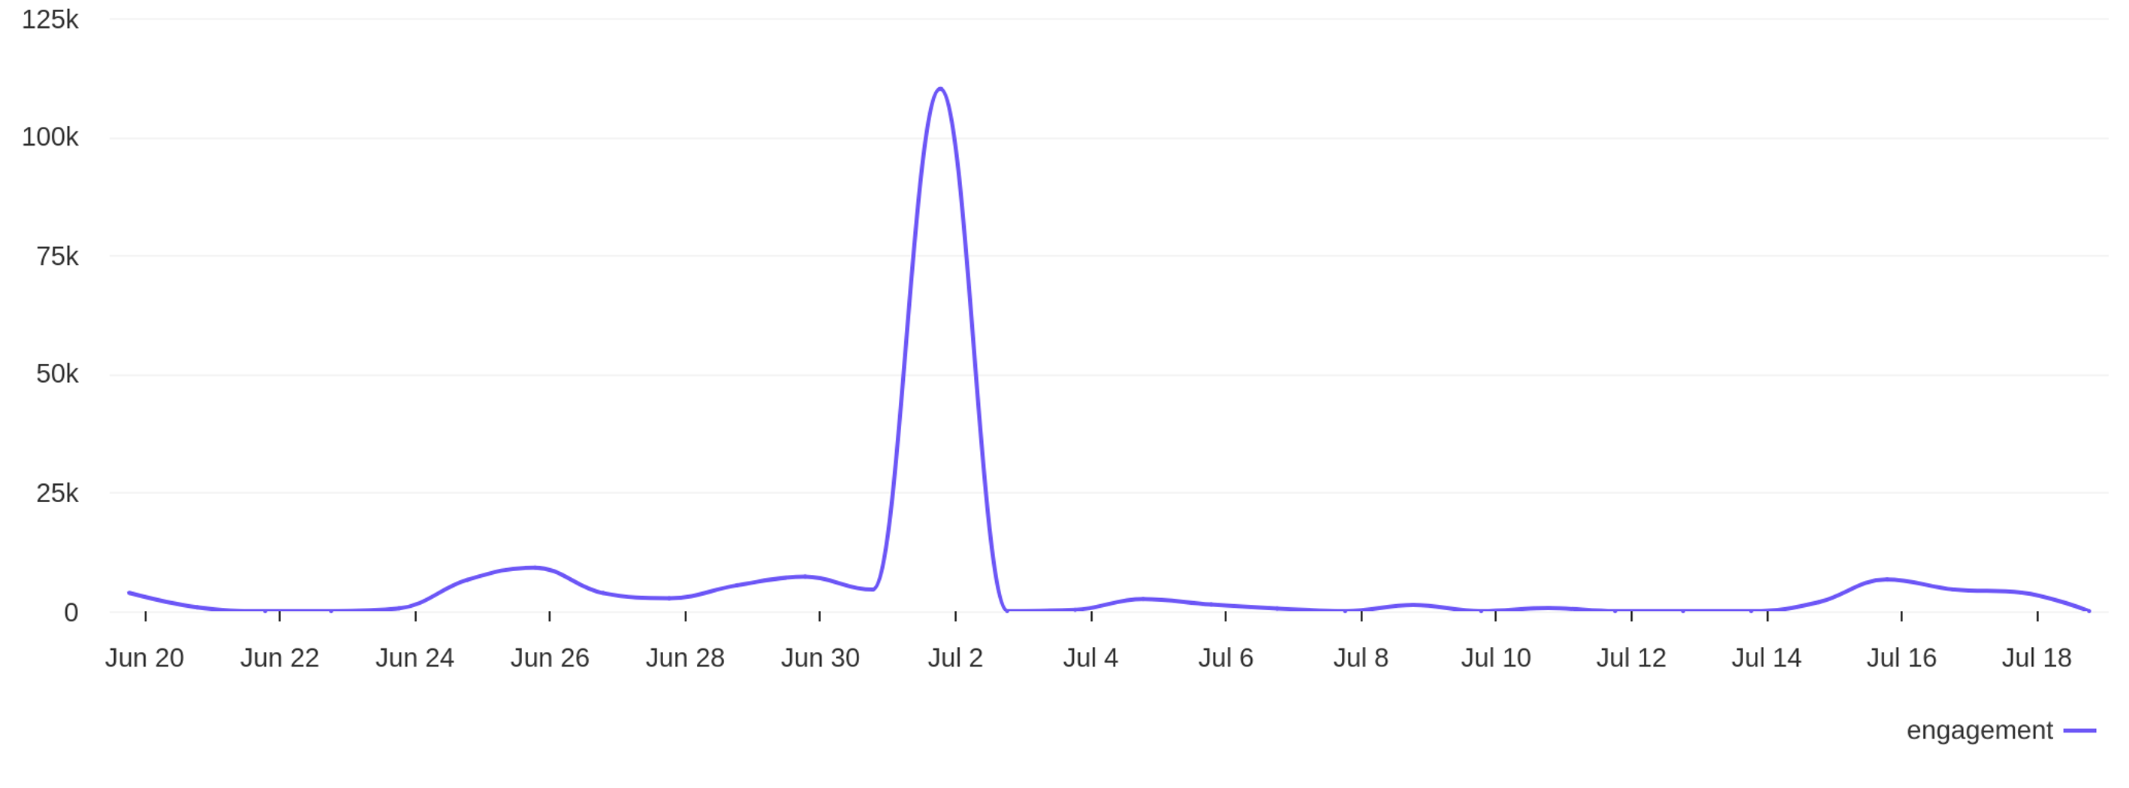
Social Report
20 Jun 2026 - 19 Jul 2026
Engagement overview • SILVANA
See the distribution of engagement (likes + comments)
Engagement distribution / day
5957
avg eng / day

Slide 15
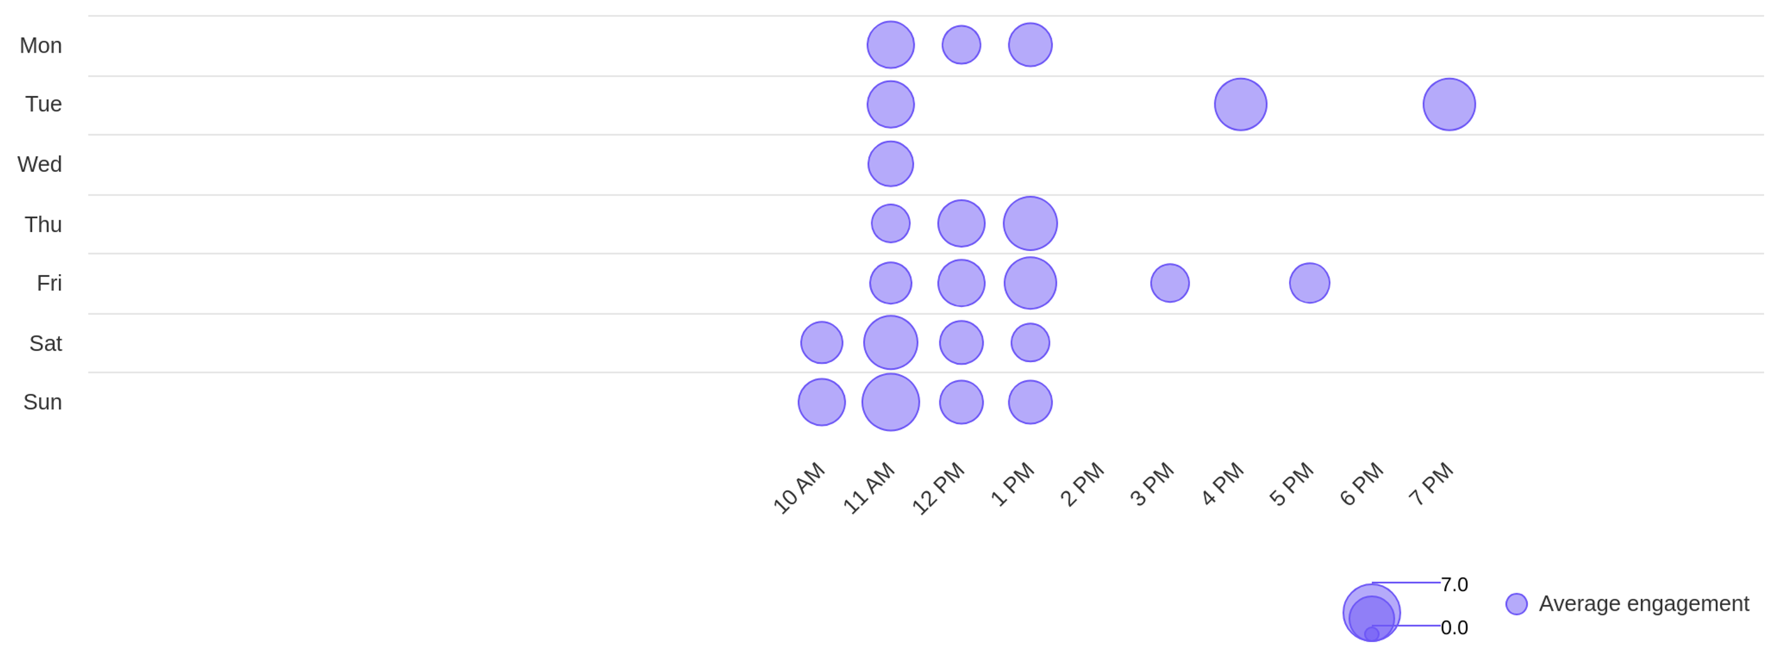
Social Report
20 Jun 2026 - 19 Jul 2026
Engagement overview • DIYAM HOUSE OF SILVER
See the distribution of engagement (likes + comments)
Best time to post by engagement
sun
11 AM
Day with most engagement
Hour with most engagement

Slide 16
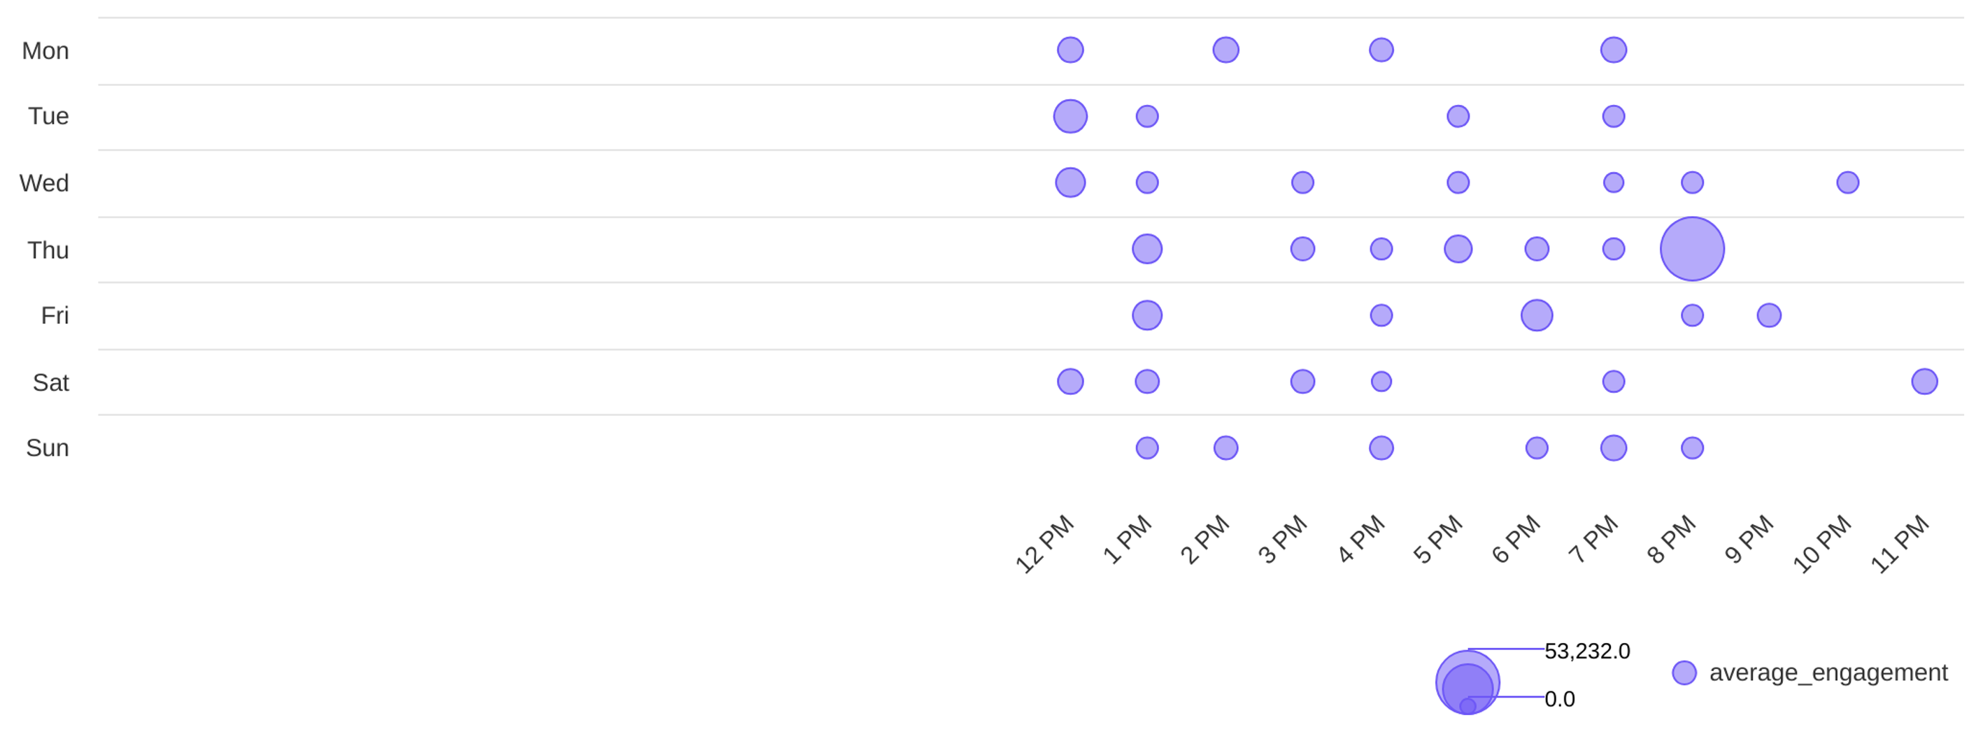
Social Report
20 Jun 2026 - 19 Jul 2026
Engagement overview • SILVANA
See the distribution of engagement (likes + comments)
Best time to post by engagement
thu
8 PM
Day with most engagement
Hour with most engagement

Slide 17
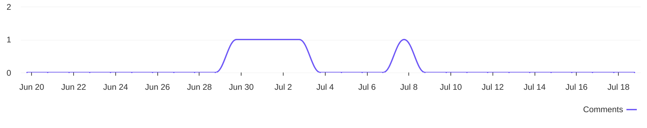
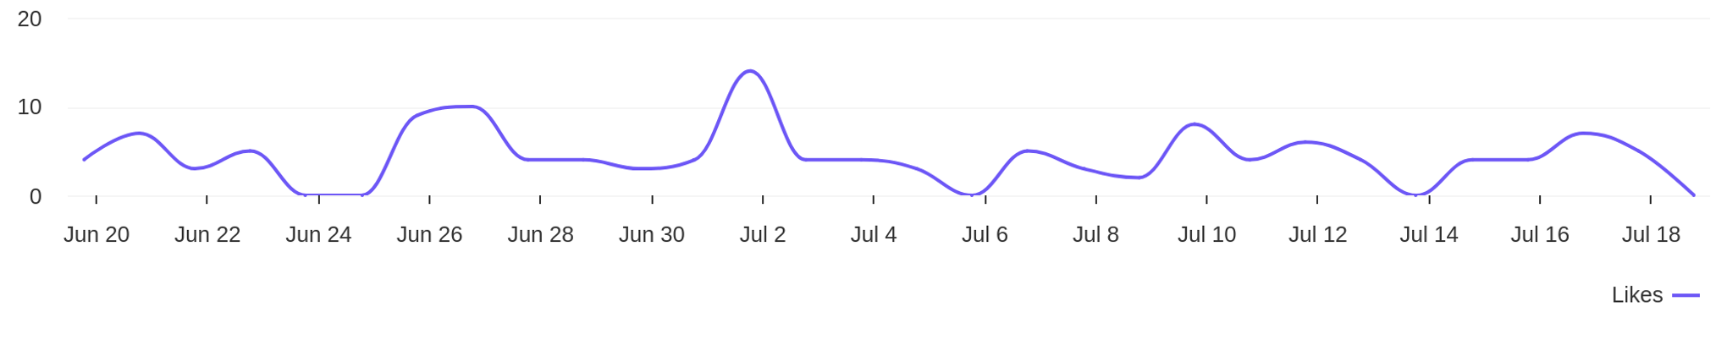
Social Report
20 Jun 2026 - 19 Jul 2026
Engagement metrics • DIYAM HOUSE OF SILVER
Breakdown of engagement for the profile
Distribution of comments / day
5
comments
Distribution of likes / day
130
likes

Slide 18
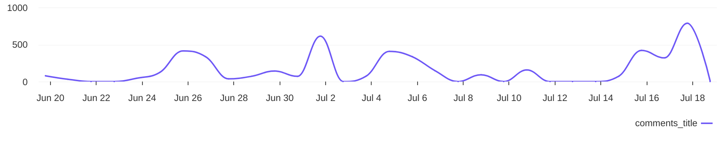
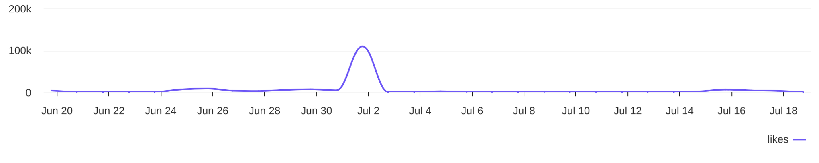
Social Report
20 Jun 2026 - 19 Jul 2026
Engagement metrics • SILVANA
Breakdown of engagement for the profile
Distribution of comments / day
4761
comments
Distribution of likes / day
173.9K
likes

Slide 19
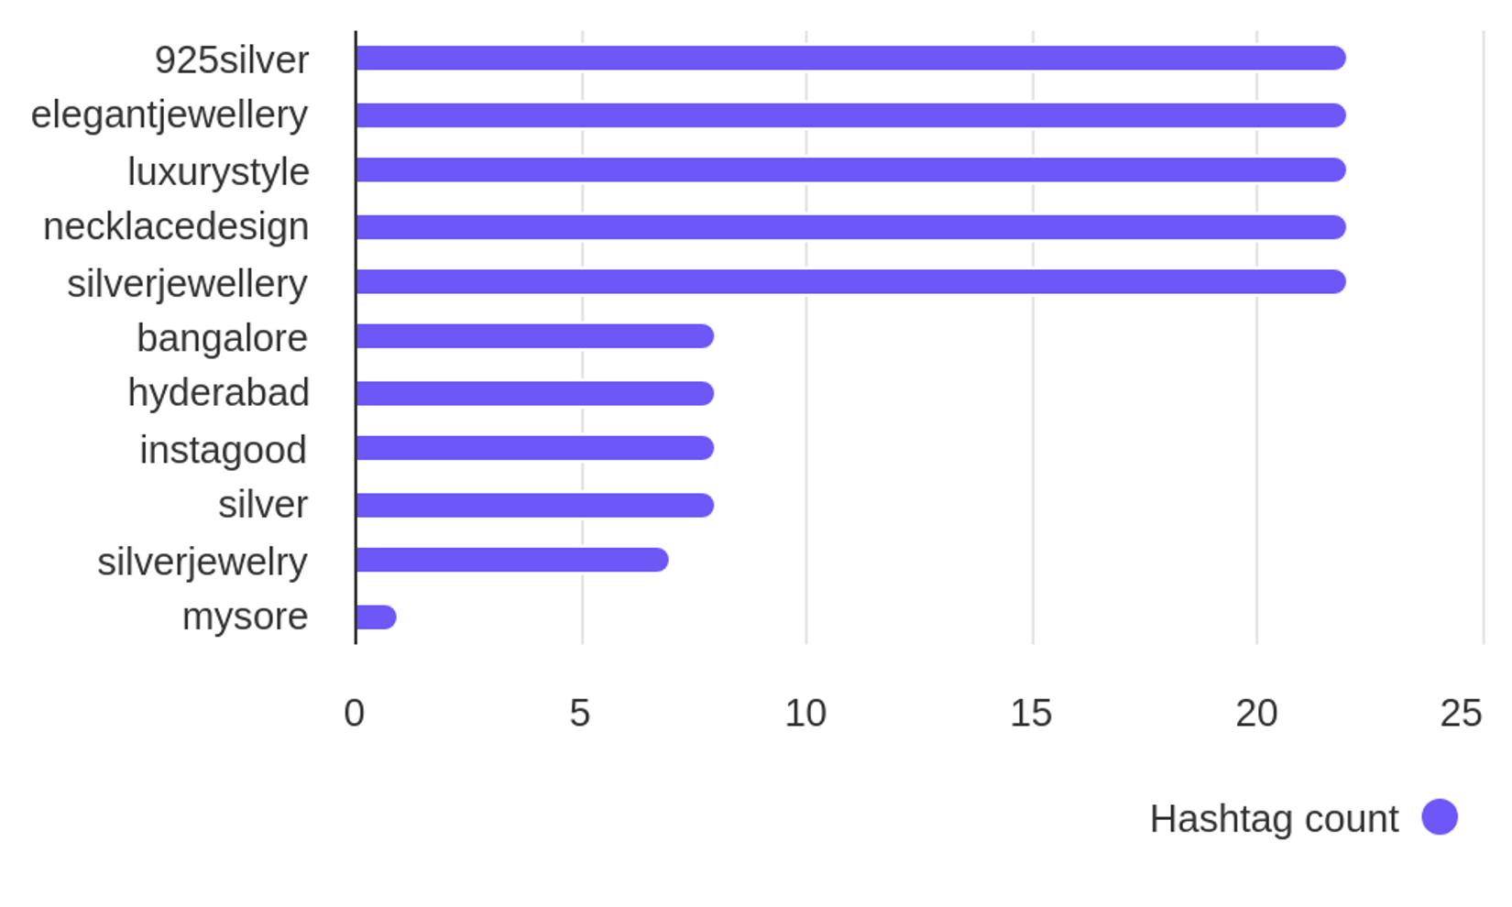

Social Report
20 Jun 2026 - 19 Jul 2026
Hashtag analysis • DIYAM HOUSE OF SILVER
See what hashtags are used the most
3.8
Most used hashtags
avg. hashtags
/ post
Hashtags
Occurrences
925silver
elegantjewellery
luxurystyle
necklacedesign
silverjewellery
bangalore
hyderabad
22
22
22
22
22
8
8

Slide 20
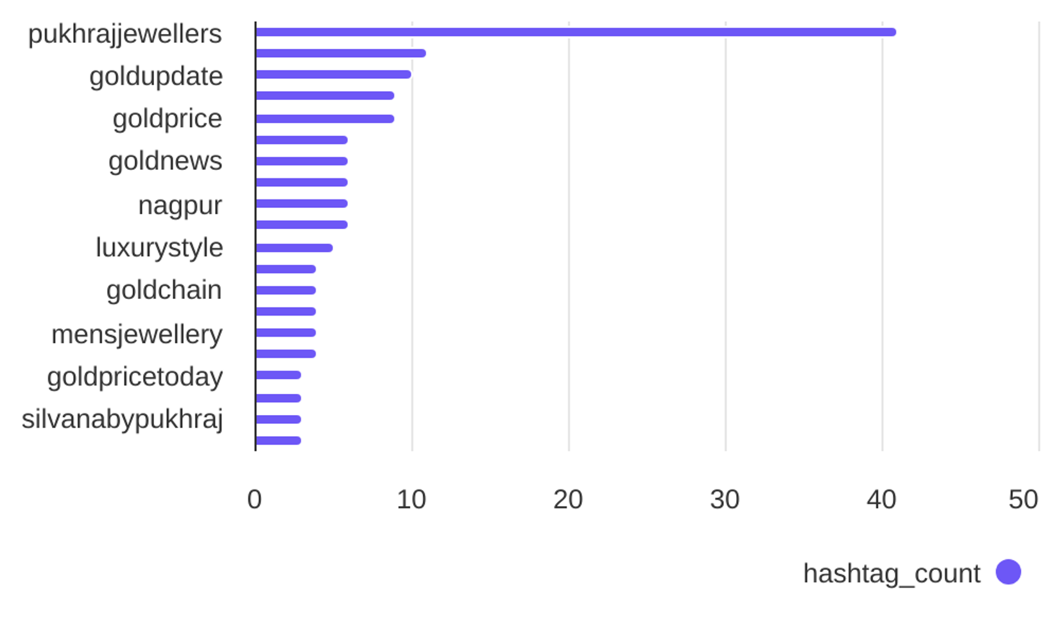
Social Report
20 Jun 2026 - 19 Jul 2026
Hashtag analysis • SILVANA
See what hashtags are used the most
4.5
Most used hashtags
avg. hashtags
/ post
Hashtags
Occurrences
pukhrajjewellers
goldrate
goldupdate
goldjewellery
goldprice
goldmarket
goldnews
41
11
10
9
9
6
6

