Slide 1



Instagram Social Report
DIYAM HOUSE OF SILVER vs Tiffany & Co.
20 Jun 2026 - 19 Jul 2026

Slide 2


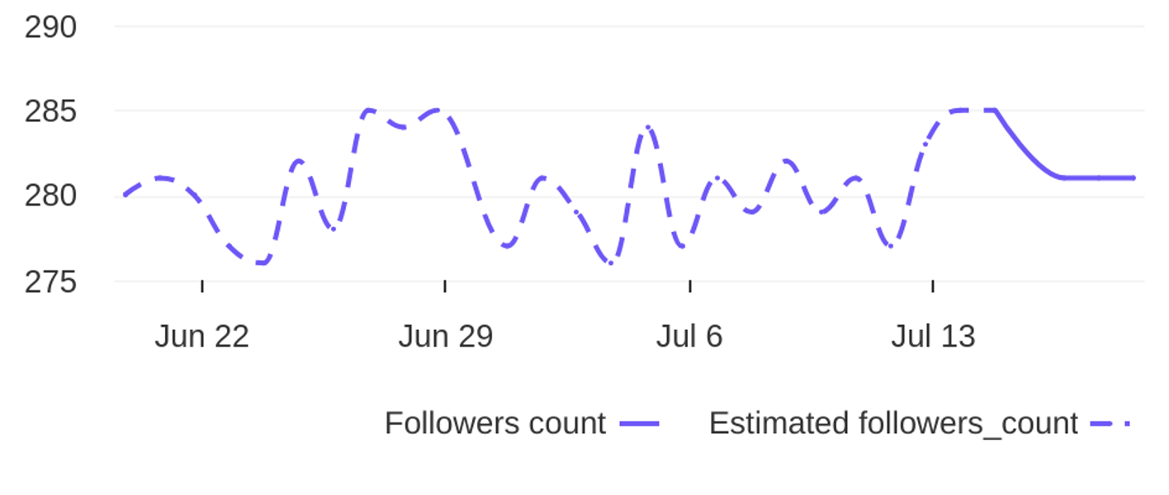
Social Report
20 Jun 2026 - 19 Jul 2026
Profile summary • DIYAM HOUSE OF SILVER
Key metrics of the profile
135
39
Followers' evolution
3.5
posts
engagement
1.2%
avg. engagement
avg. engagement
/ post
rate / post
1
Followers
0.4%
Avg. Eng. Rate/Post
281
engagement
Eng. Rate/Profile
profile growth
Followers
rate / profile

Slide 3

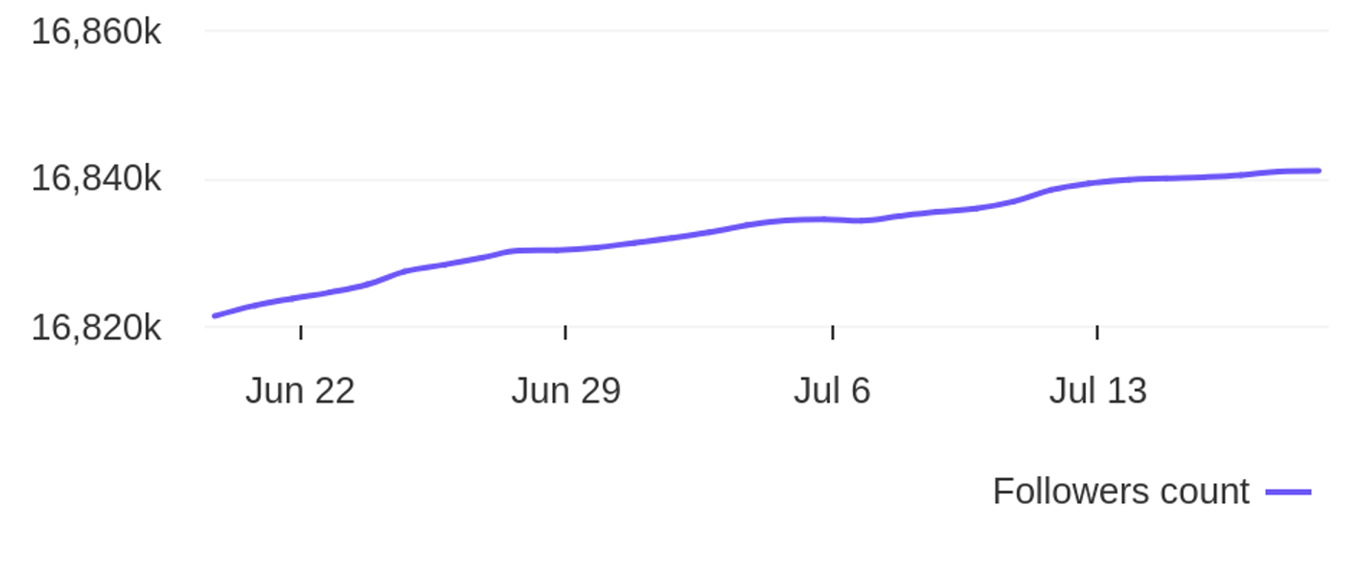
Social Report
20 Jun 2026 - 19 Jul 2026
Profile summary • Tiffany & Co.
Key metrics of the profile
327.7K
26
Followers' evolution
12.6K
posts
engagement
0.1%
avg. engagement
avg. engagement
/ post
rate / post
19.6K
Followers
0.1%
Avg. Eng. Rate/Post
16840861
engagement
Eng. Rate/Profile
profile growth
Followers
rate / profile

Slide 4




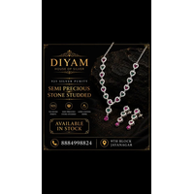
Social Report
20 Jun 2026 - 19 Jul 2026
Top posts • DIYAM HOUSE OF SILVER
The most engaging posts
Date
Image
Text
Type
Engagement
Comments
Likes
925 Silver Adjustable Rakhi. Available in stock. Get yours before its over. For more details Dm o...
reel
reel
reel
reel
reel
8
7
7
5
5
1
0
0
0
0
7
7
7
5
5
02 Jul
21 Jun
27 Jun
26 Jun
17 Jul
925 Silver Earings Oxidise Finish. Available in Stock. For more details DM or visit store. diyamh...
925 silver oxadise Necklace. Available in stock. For more details Dm or Visit store. diyamhouseof...
925 Silver Necklace. Available in Stock. For more details Dm or Visit Store. diyamhouseofsilver 9...
925 silver antique finish necklace. Available in stock. For more details Dm or visit store. diyam...

Slide 5

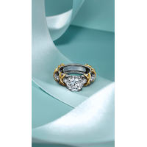

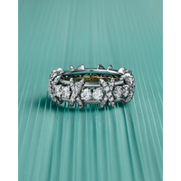
Social Report
20 Jun 2026 - 19 Jul 2026
Top posts • Tiffany & Co.
The most engaging posts
Date
Image
Text
Type
Engagement
Comments
Likes
House ambassadors Anne Curtis and Win Metawin celebrate the opening of the reimagined Tiffany & C...
reel
reel
reel
image
carousel_album
62686
29964
25269
21327
17022
632
366
251
163
74
62054
29598
25018
21164
16948
01 Jul
07 Jul
06 Jul
29 Jun
03 Jul
The House’s iconic Sixteen Stone by Tiffany ring has been reimagined with a striking center diamo...
Introducing the Sixteen Stone by Tiffany solitaire diamond ring. Since 1837, Tiffany & Co. has de...
A platinum and diamond evolution of the design introduced by Jean Schlumberger in 1959, this Sixt...
Introducing the reimagined Singapore Flagship at ION Orchard in the Garden City. Featuring the Ho...

Slide 6
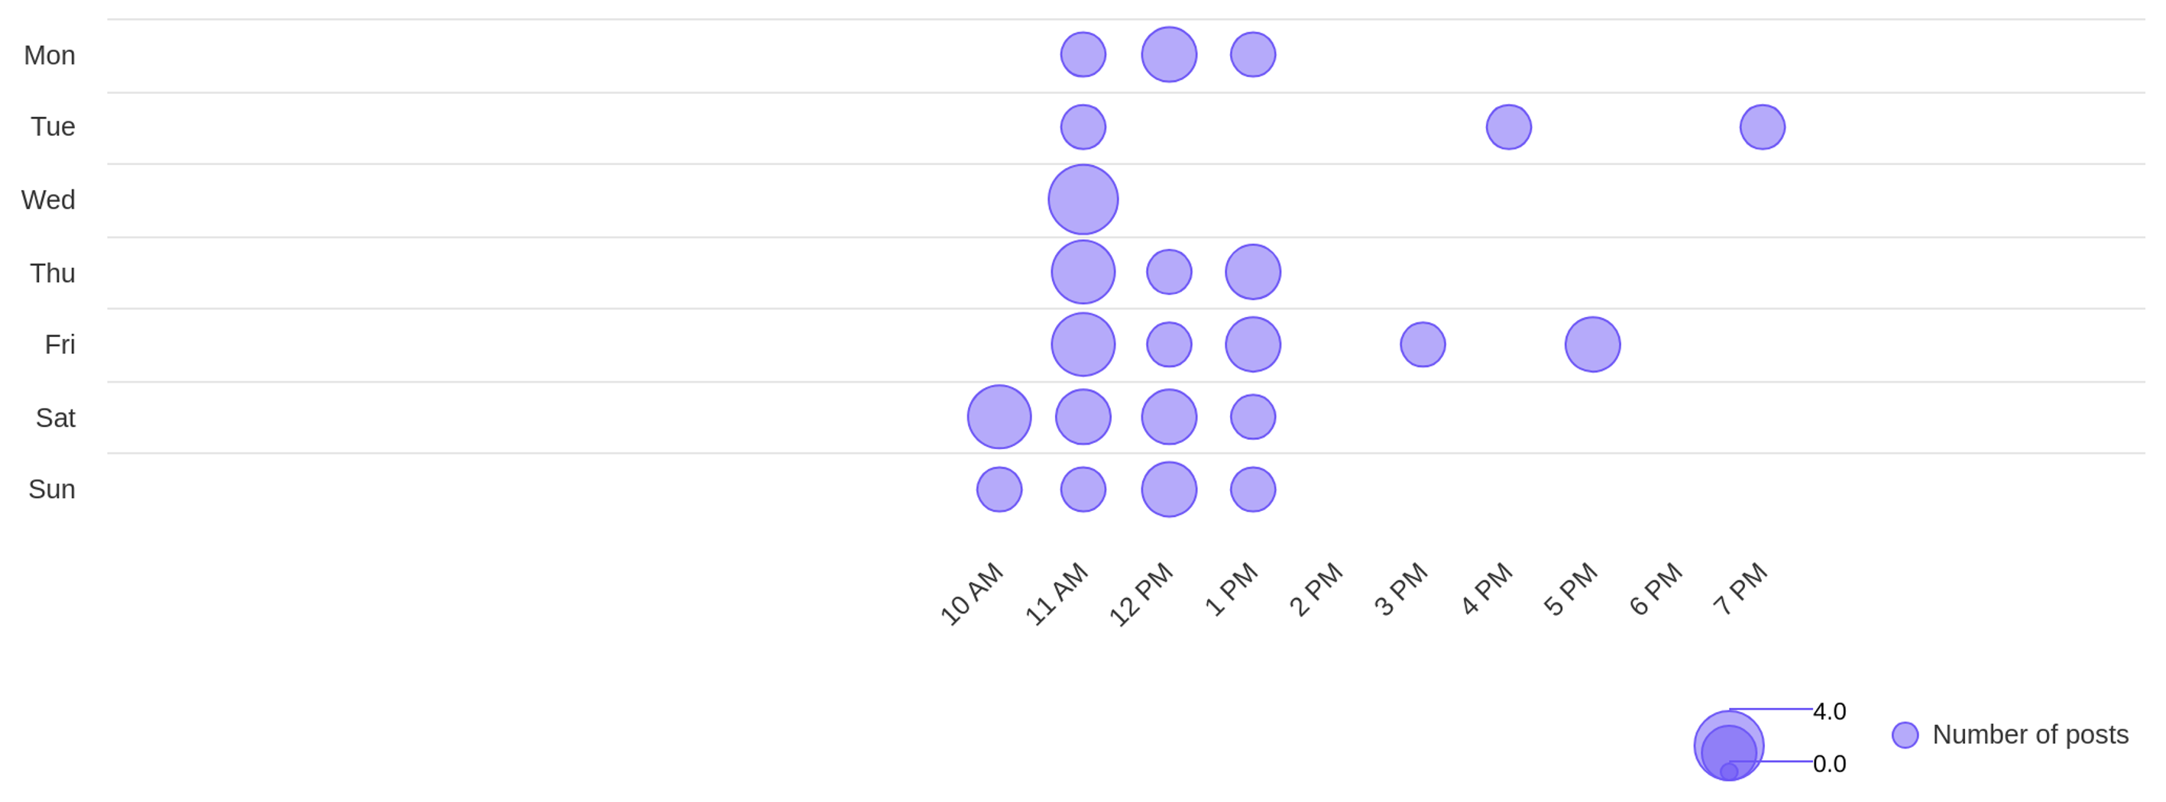
Social Report
20 Jun 2026 - 19 Jul 2026
Publishing behaviour • DIYAM HOUSE OF SILVER
See the posting patterns of the page
Posting times
11 AM
wed
Day with most posts
Hour with most posts

Slide 7
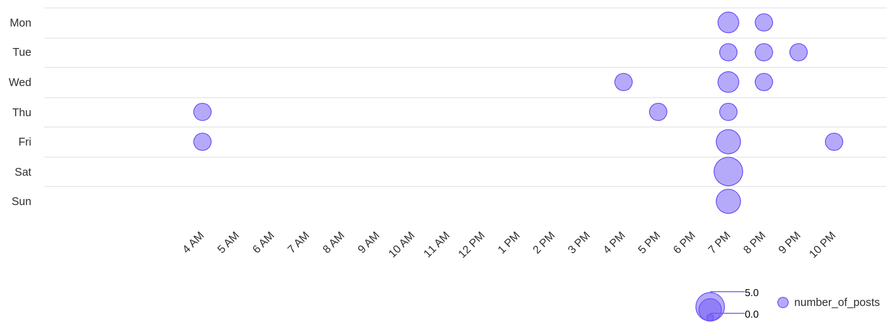
Social Report
20 Jun 2026 - 19 Jul 2026
Publishing behaviour • Tiffany & Co.
See the posting patterns of the page
Posting times
7 PM
sat
Day with most posts
Hour with most posts

Slide 8
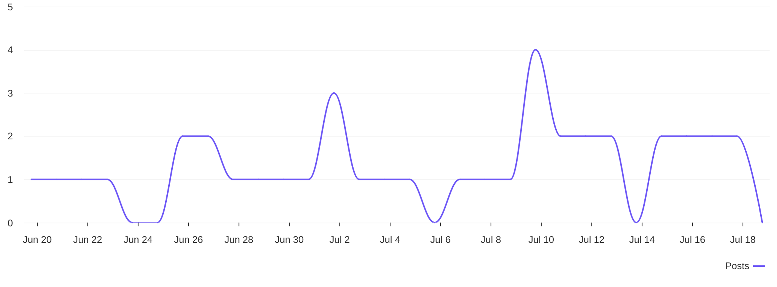
Social Report
20 Jun 2026 - 19 Jul 2026
Publishing behaviour • DIYAM HOUSE OF SILVER
See the posting patterns of the page
Distribution of posts
1.3
avg posts / day

Slide 9
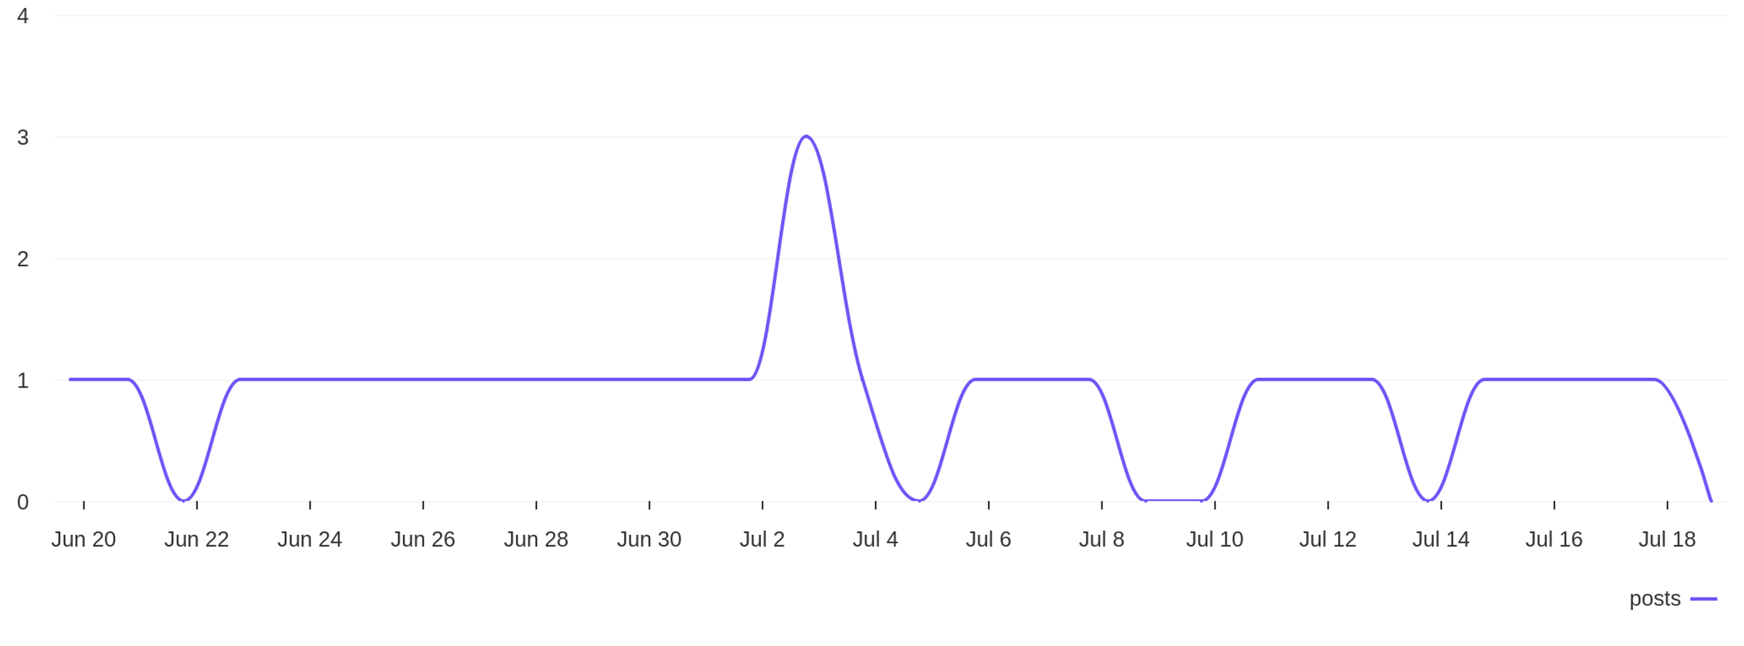
Social Report
20 Jun 2026 - 19 Jul 2026
Publishing behaviour • Tiffany & Co.
See the posting patterns of the page
Distribution of posts
0.9
avg posts / day

Slide 10
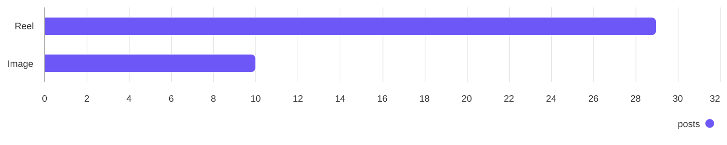
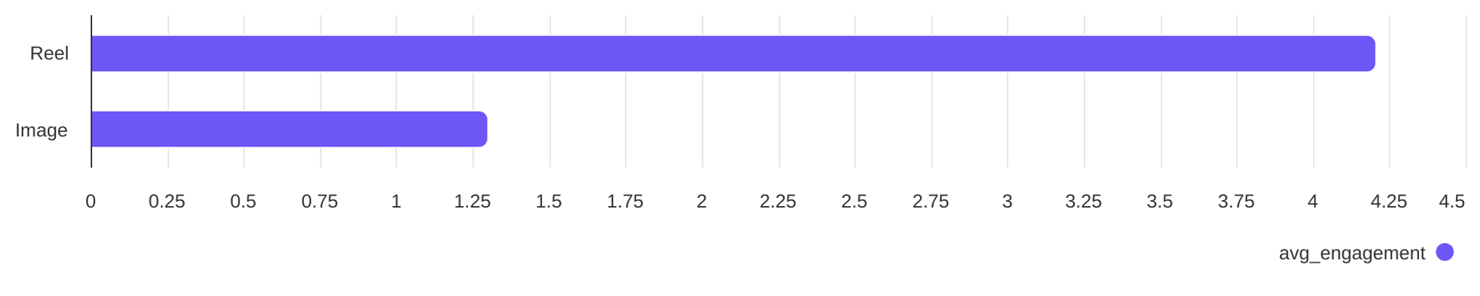
Social Report
20 Jun 2026 - 19 Jul 2026
Content performance • DIYAM HOUSE OF SILVER
See what types of post the profile published and understand the success of different post types
Post types
Reel count
Image count
29
10
Post types ranked by avg. engagement
Reel
Image
4.21
1.30

Slide 11
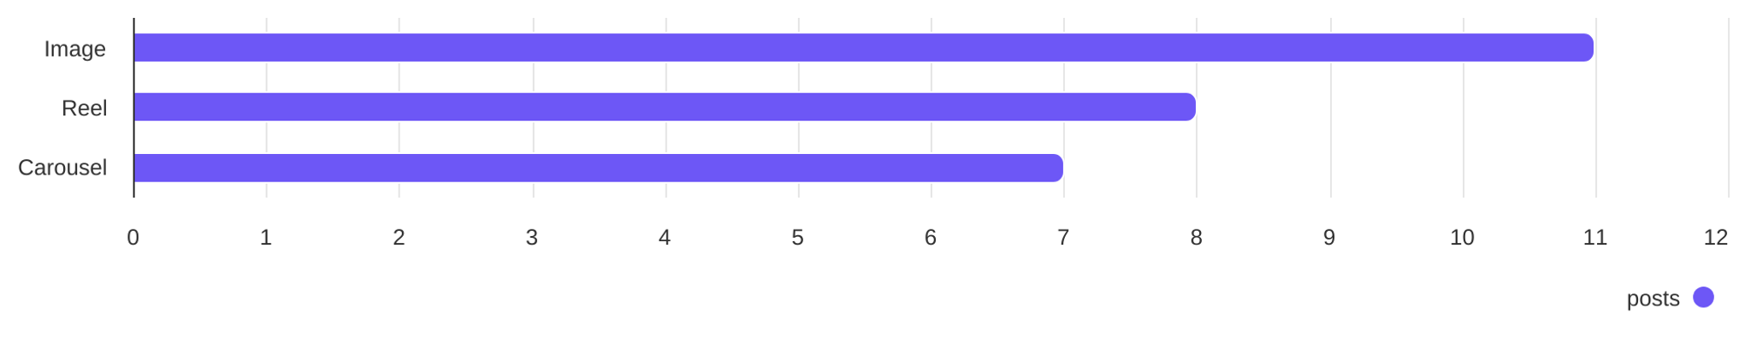
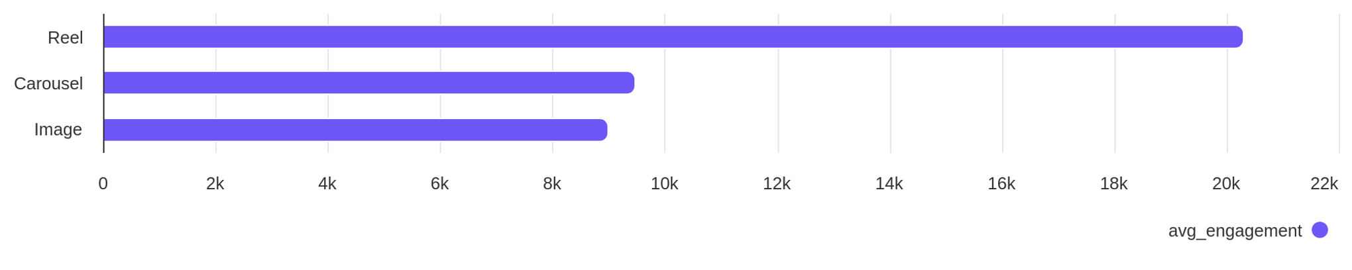
Social Report
20 Jun 2026 - 19 Jul 2026
Content performance • Tiffany & Co.
See what types of post the profile published and understand the success of different post types
Post types
Image count
Reel count
Carousel count
11
8
7
Post types ranked by avg. engagement
Image
Reel
Carousel
8995
20.30K
9472

Slide 12
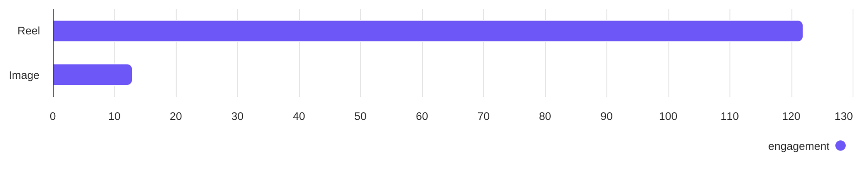
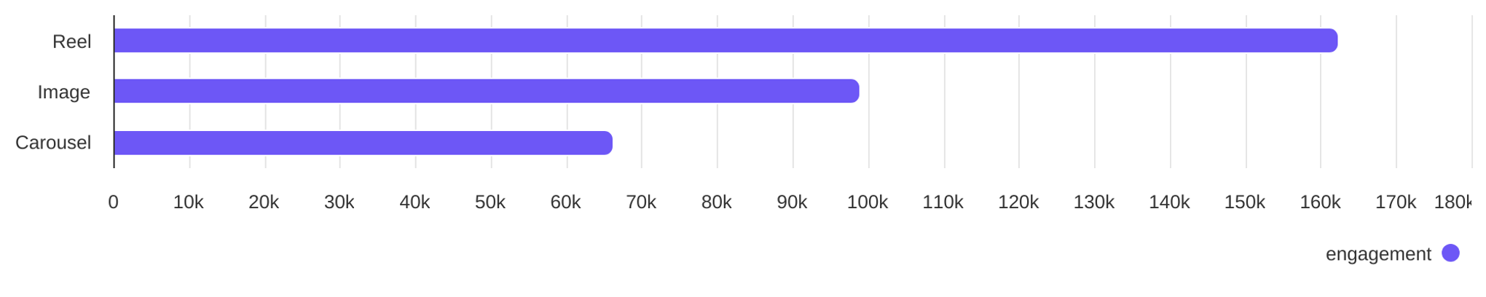
Social Report
20 Jun 2026 - 19 Jul 2026
Engagement overview
See the distribution of engagement (likes + comments)
Post types ranked by engagement - DIYAM HOUSE OF SILVER
Reel
Image
122
13
Post types ranked by engagement - Tiffany & Co.
Image
Reel
Carousel
98.94K
162.40K
66.31K

Slide 13
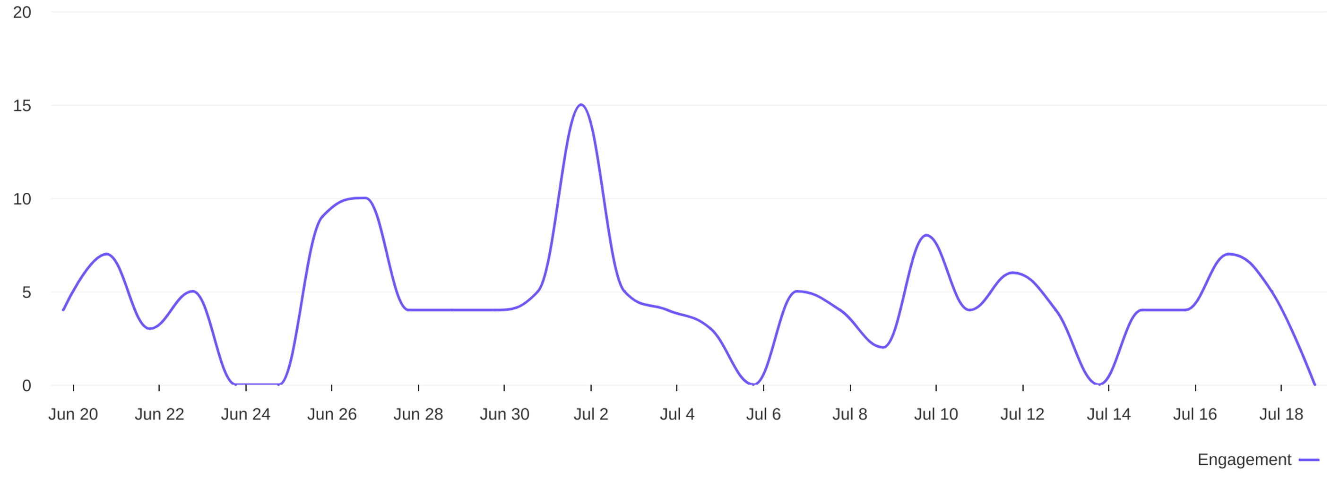
Social Report
20 Jun 2026 - 19 Jul 2026
Engagement overview • DIYAM HOUSE OF SILVER
See the distribution of engagement (likes + comments)
Engagement distribution / day
4.5
avg eng / day

Slide 14
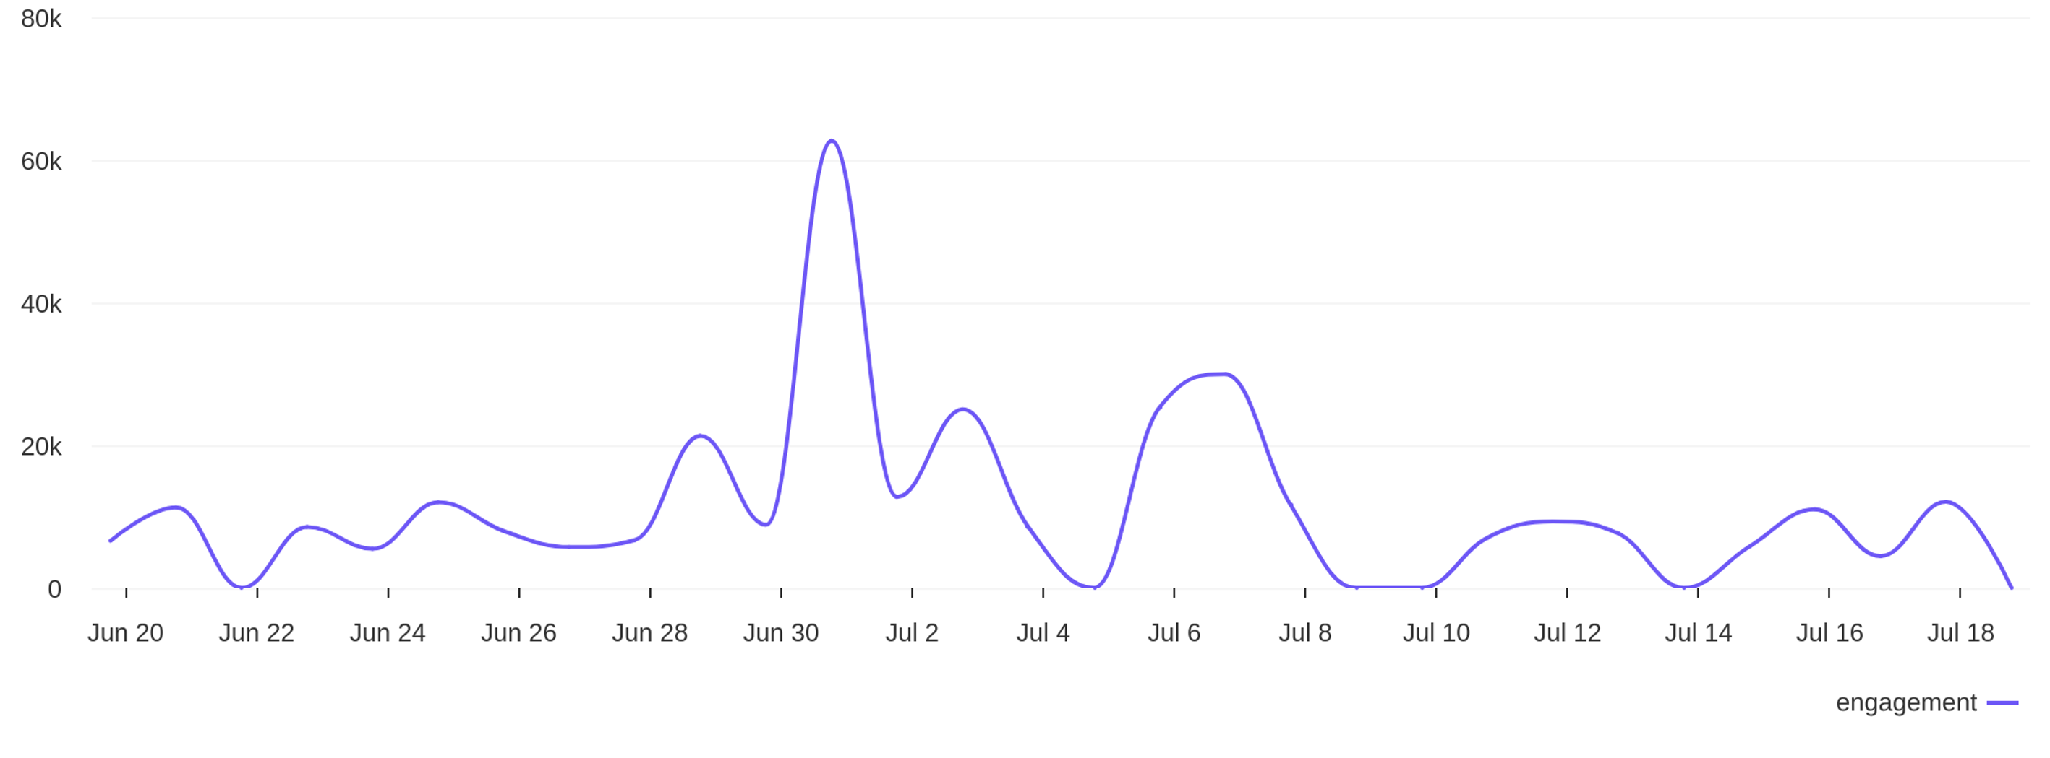
Social Report
20 Jun 2026 - 19 Jul 2026
Engagement overview • Tiffany & Co.
See the distribution of engagement (likes + comments)
Engagement distribution / day
10.9K
avg eng / day

Slide 15
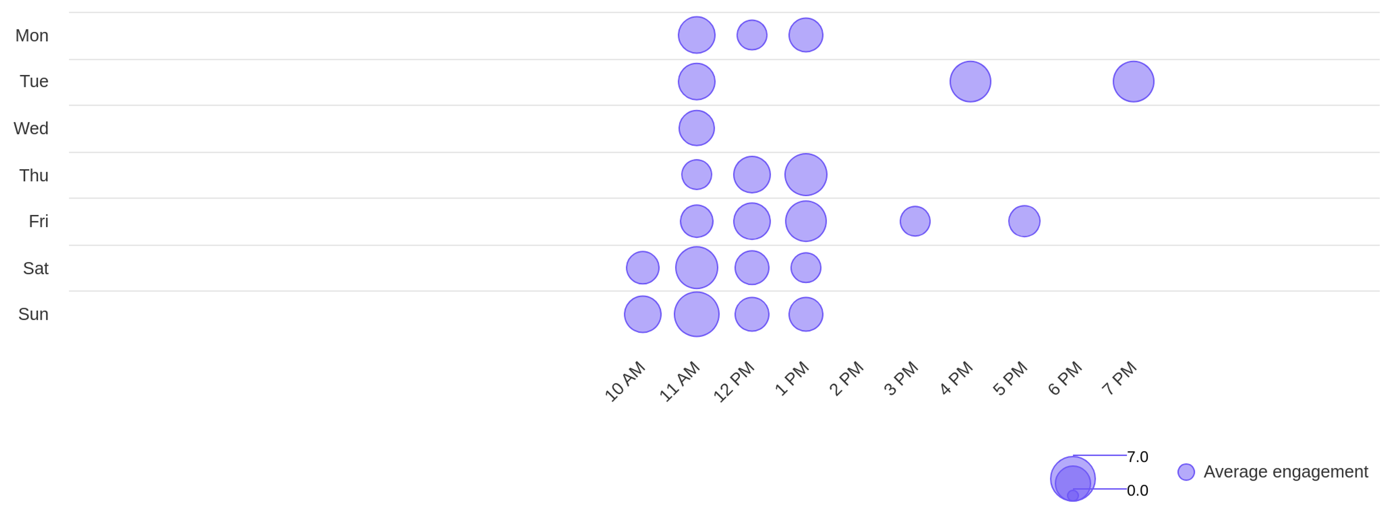
Social Report
20 Jun 2026 - 19 Jul 2026
Engagement overview • DIYAM HOUSE OF SILVER
See the distribution of engagement (likes + comments)
Best time to post by engagement
sun
11 AM
Day with most engagement
Hour with most engagement

Slide 16
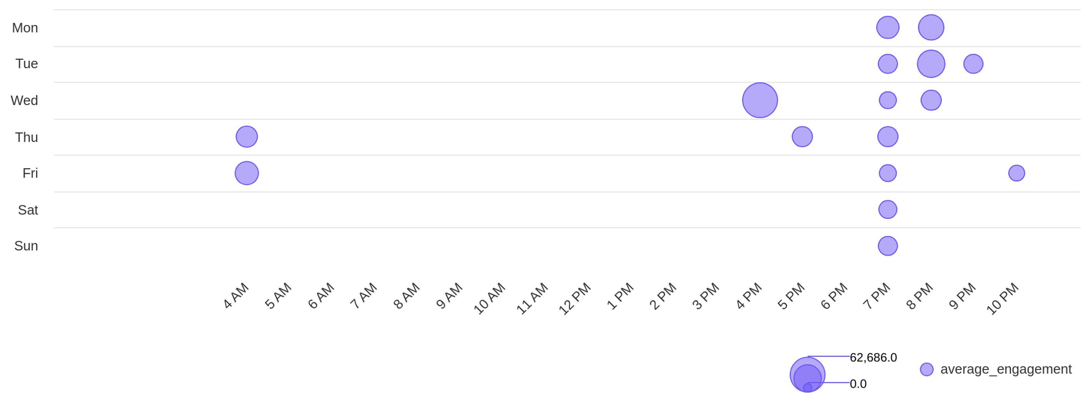
Social Report
20 Jun 2026 - 19 Jul 2026
Engagement overview • Tiffany & Co.
See the distribution of engagement (likes + comments)
Best time to post by engagement
wed
4 PM
Day with most engagement
Hour with most engagement

Slide 17
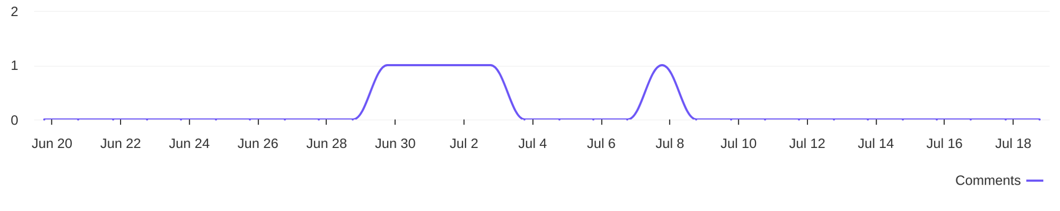
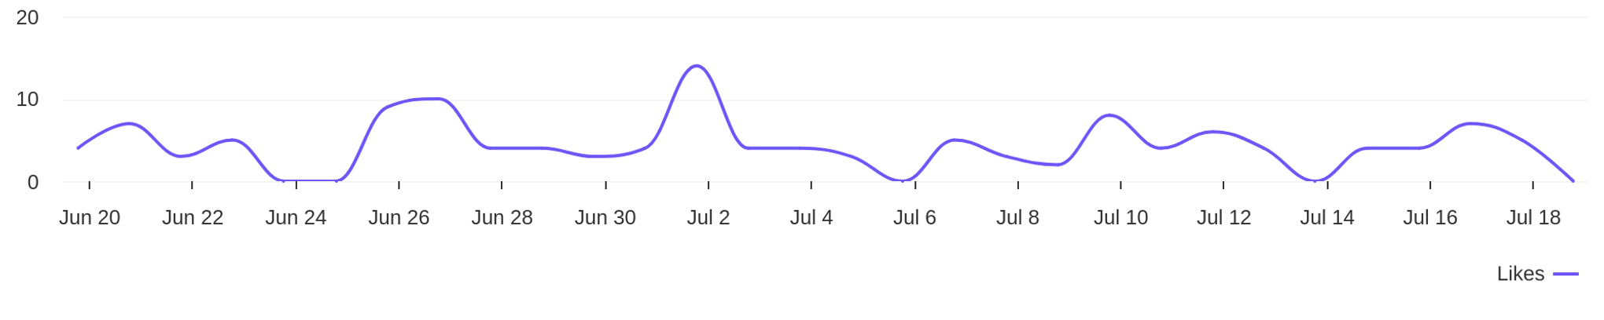
Social Report
20 Jun 2026 - 19 Jul 2026
Engagement metrics • DIYAM HOUSE OF SILVER
Breakdown of engagement for the profile
Distribution of comments / day
5
comments
Distribution of likes / day
130
likes

Slide 18
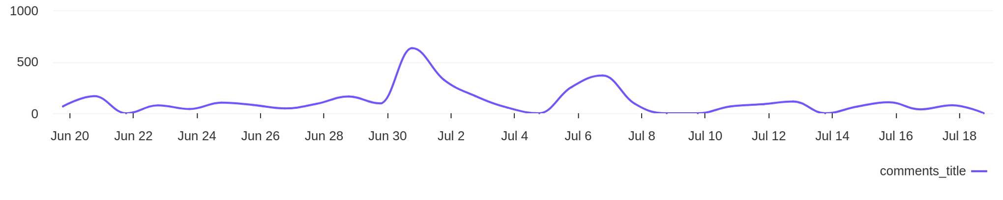
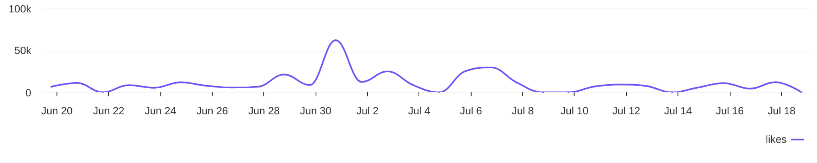
Social Report
20 Jun 2026 - 19 Jul 2026
Engagement metrics • Tiffany & Co.
Breakdown of engagement for the profile
Distribution of comments / day
3374
comments
Distribution of likes / day
324.3K
likes

Slide 19
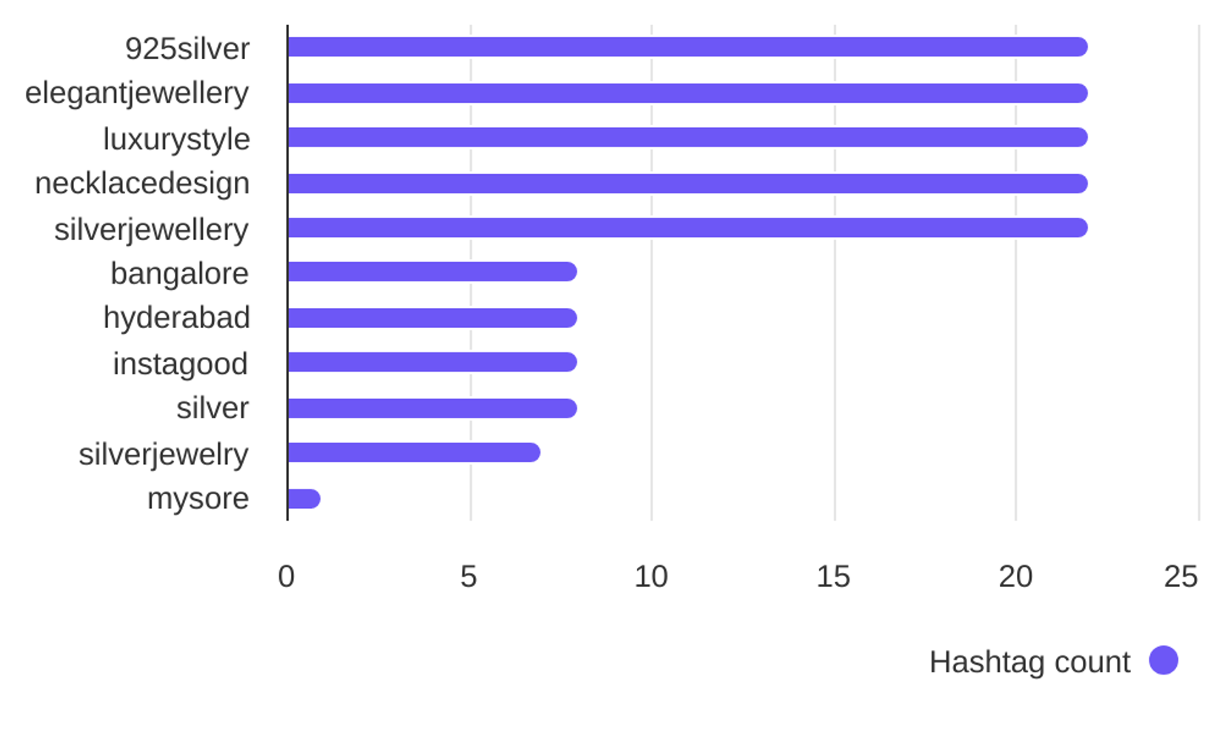

Social Report
20 Jun 2026 - 19 Jul 2026
Hashtag analysis • DIYAM HOUSE OF SILVER
See what hashtags are used the most
3.8
Most used hashtags
avg. hashtags
/ post
Hashtags
Occurrences
925silver
elegantjewellery
luxurystyle
necklacedesign
silverjewellery
bangalore
hyderabad
22
22
22
22
22
8
8

Slide 20
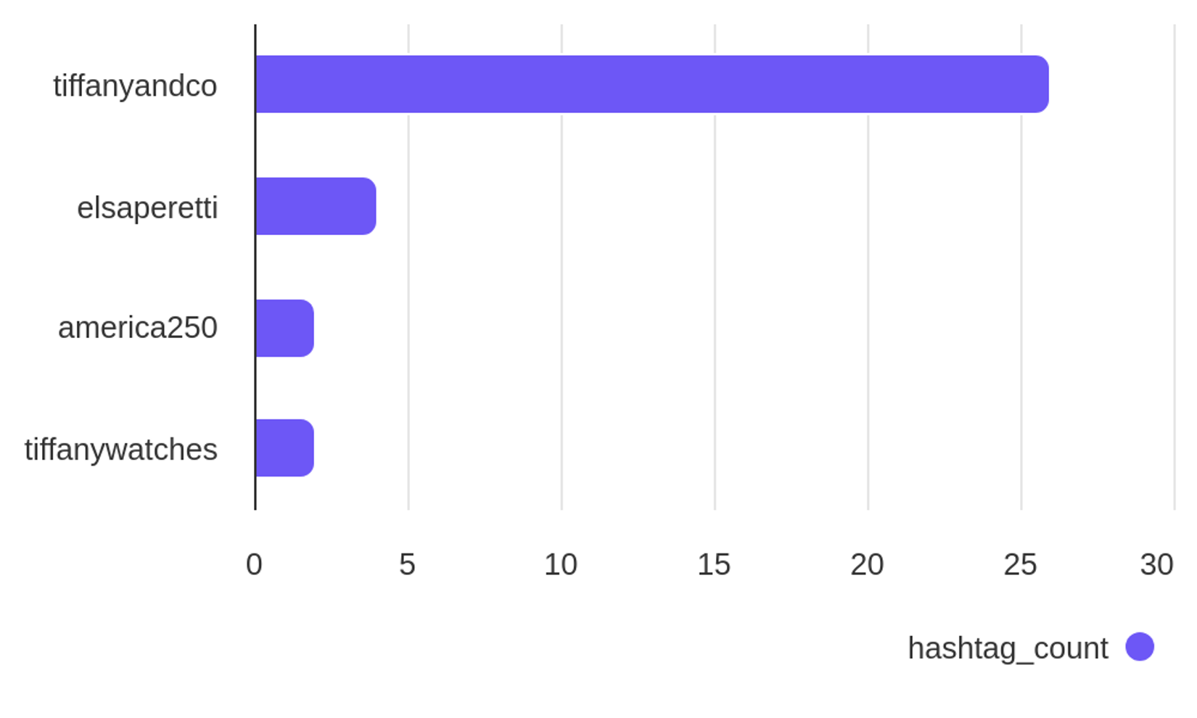
Social Report
20 Jun 2026 - 19 Jul 2026
Hashtag analysis • Tiffany & Co.
See what hashtags are used the most
1.3
Most used hashtags
avg. hashtags
/ post
Hashtags
Occurrences
tiffanyandco
elsaperetti
america250
tiffanywatches
26
4
2
2

