Slide 1
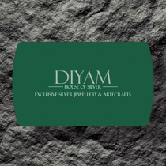

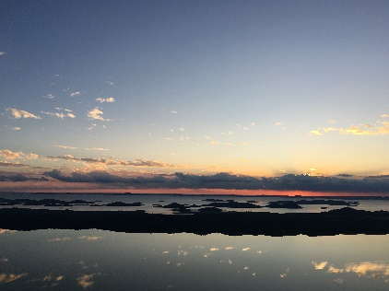
Instagram Social Report
DIYAM HOUSE OF SILVER vs OnnMe
18 Jun 2026 - 17 Jul 2026

Slide 2


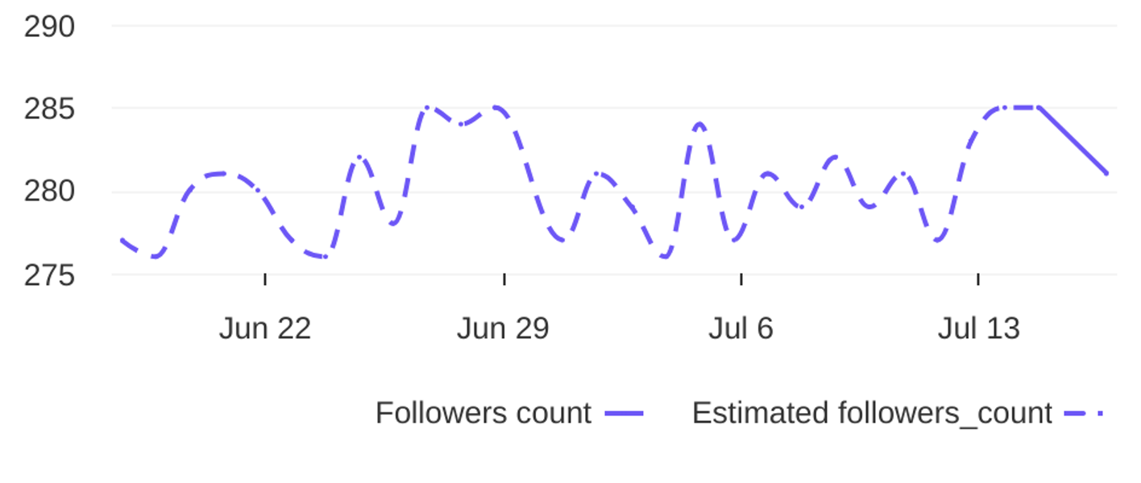
Social Report
18 Jun 2026 - 17 Jul 2026
Profile summary • DIYAM HOUSE OF SILVER
Key metrics of the profile
138
39
Followers' evolution
3.5
posts
engagement
1.3%
avg. engagement
avg. engagement
/ post
rate / post
4
Followers
1.4%
Avg. Eng. Rate/Post
281
engagement
Eng. Rate/Profile
profile growth
Followers
rate / profile

Slide 3

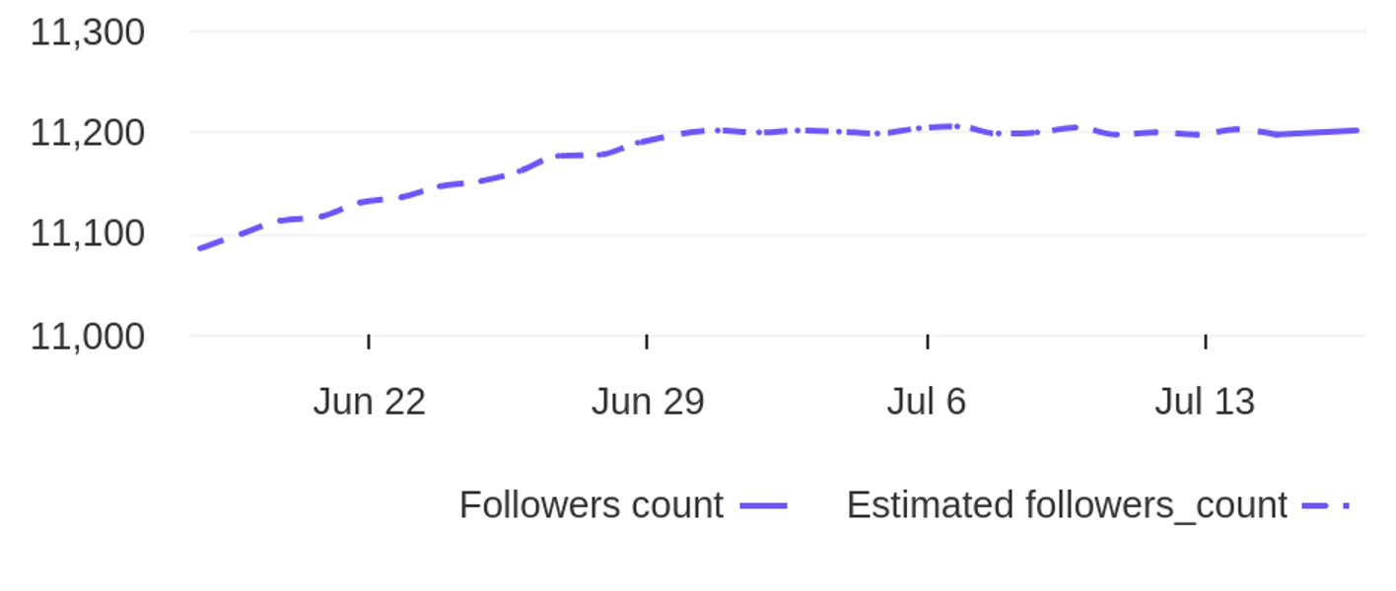
Social Report
18 Jun 2026 - 17 Jul 2026
Profile summary • OnnMe
Key metrics of the profile
20.1K
60
Followers' evolution
335.1
posts
engagement
3.0%
avg. engagement
avg. engagement
/ post
rate / post
116
Followers
1.0%
Avg. Eng. Rate/Post
11201
engagement
Eng. Rate/Profile
profile growth
Followers
rate / profile

Slide 4


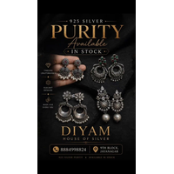
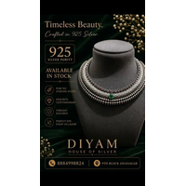
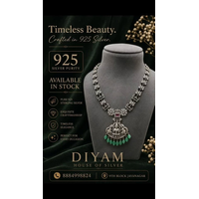
Social Report
18 Jun 2026 - 17 Jul 2026
Top posts • DIYAM HOUSE OF SILVER
The most engaging posts
Date
Image
Text
Type
Engagement
Comments
Likes
925 Silver Adjustable Rakhi. Available in stock. Get yours before its over. For more details Dm o...
reel
reel
reel
reel
reel
8
7
7
6
5
1
0
0
0
0
7
7
7
6
5
02 Jul
21 Jun
27 Jun
18 Jun
26 Jun
925 Silver Earings Oxidise Finish. Available in Stock. For more details DM or visit store. diyamh...
925 silver oxadise Necklace. Available in stock. For more details Dm or Visit store. diyamhouseof...
925 silver necklace in oxidese finish. Available in stock. For more detailes Dm or visit store. d...
925 Silver Necklace. Available in Stock. For more details Dm or Visit Store. diyamhouseofsilver 9...

Slide 5
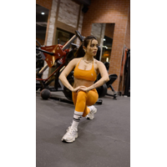
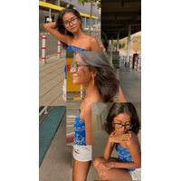
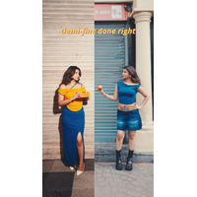
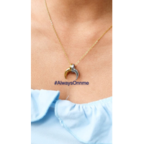
Social Report
18 Jun 2026 - 17 Jul 2026
Top posts • OnnMe
The most engaging posts
Date
Image
Text
Type
Engagement
Comments
Likes
Teekhi enough to turn heads. ONNME enough to keep them looking. ✨🌶️ To avail this offer use m...
reel
reel
reel
reel
reel
14745
1331
679
273
211
365
12
78
42
26
14380
1319
601
231
185
11 Jul
06 Jul
22 Jun
20 Jun
04 Jul
Mood swings, call for retail therapy! [Everyday jewellery, Demi-fine jewellery, Gold Plated, Bu...
mirror, mirror, who’s taking over tonight?🪞✨ Use code VAANI25 to avail the offer right now!! [...
proof that one piece can carry the whole look.✨ Use code FAHMA25 to avail this offer. [Everyday...
From catching the metro to catching everyone’s attention. 🚇✨ [Everyday jewellery, Demi-fine jew...

Slide 6
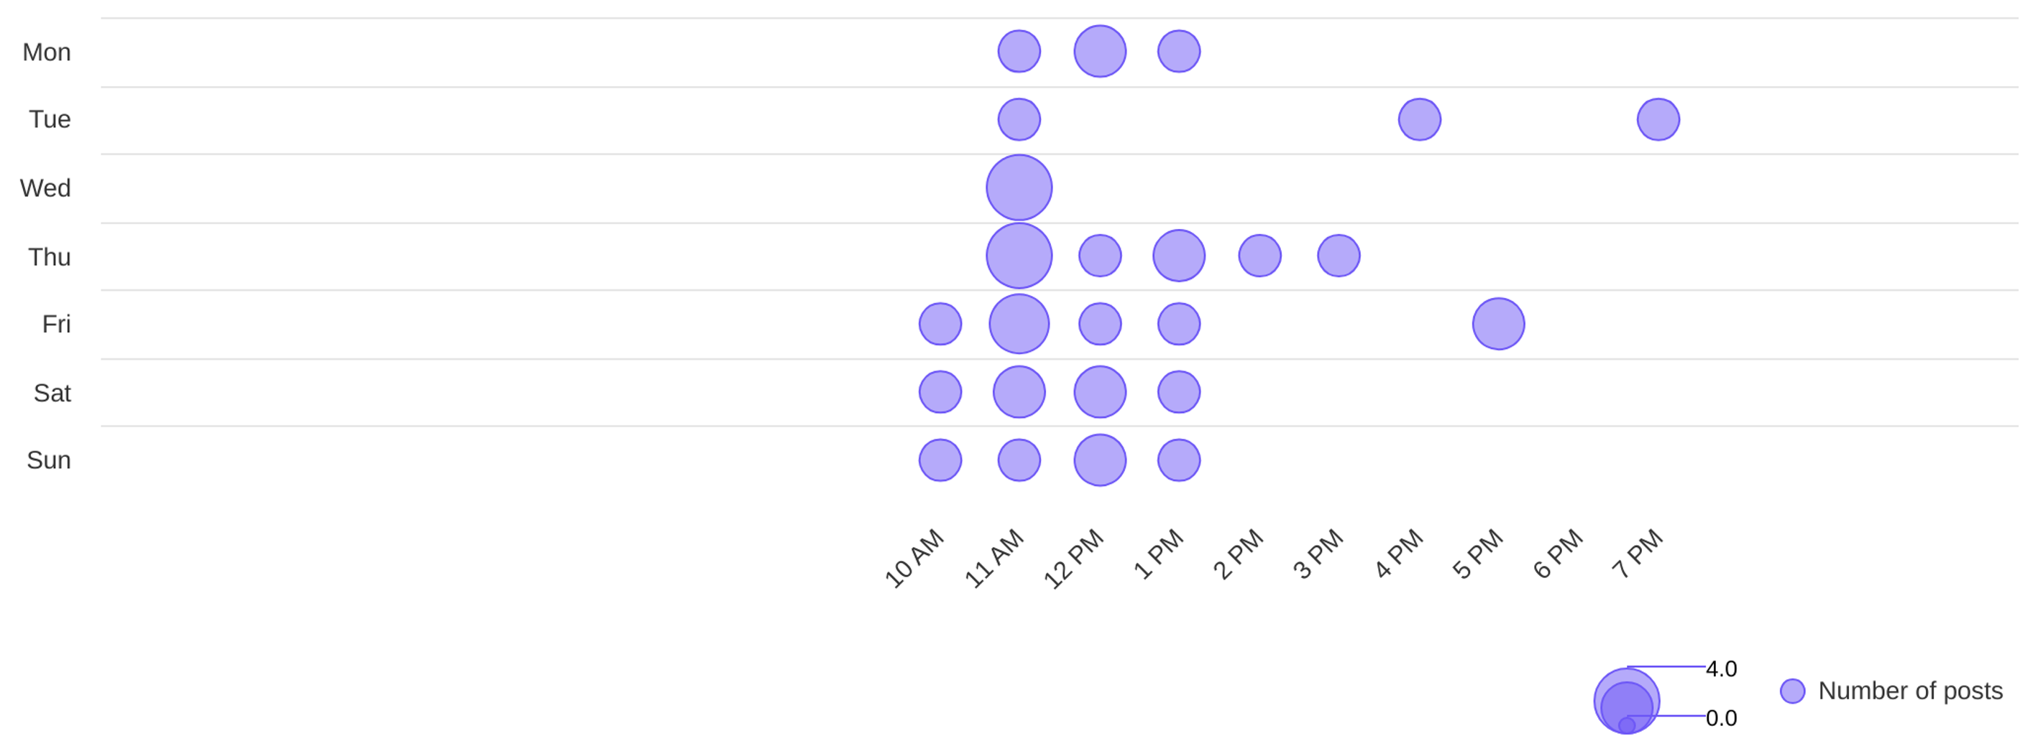
Social Report
18 Jun 2026 - 17 Jul 2026
Publishing behaviour • DIYAM HOUSE OF SILVER
See the posting patterns of the page
Posting times
11 AM
wed
Day with most posts
Hour with most posts

Slide 7
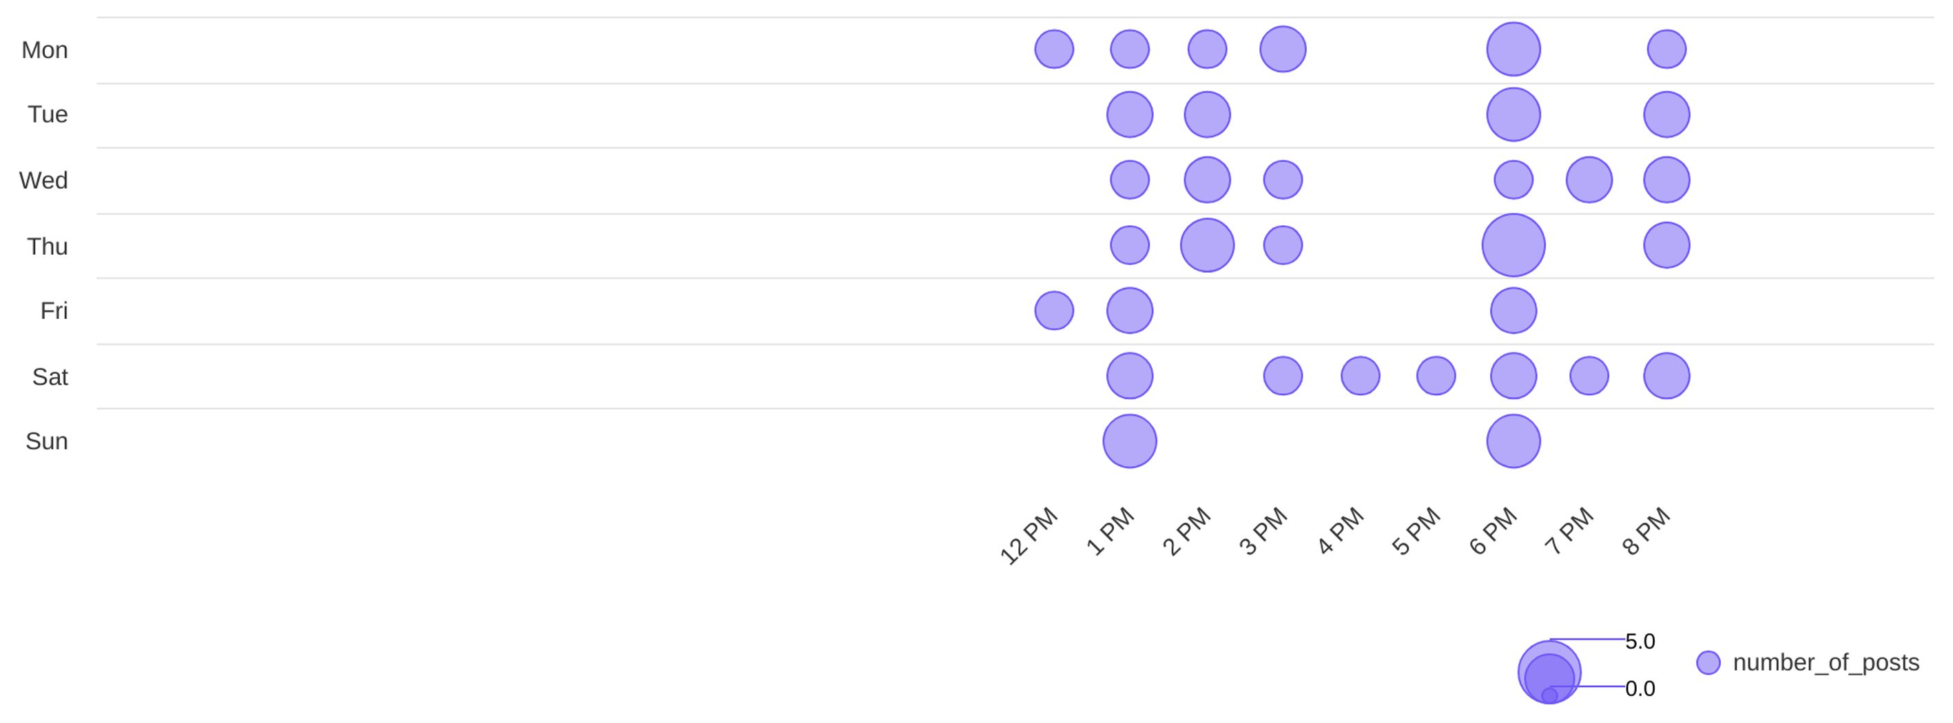
Social Report
18 Jun 2026 - 17 Jul 2026
Publishing behaviour • OnnMe
See the posting patterns of the page
Posting times
6 PM
thu
Day with most posts
Hour with most posts

Slide 8
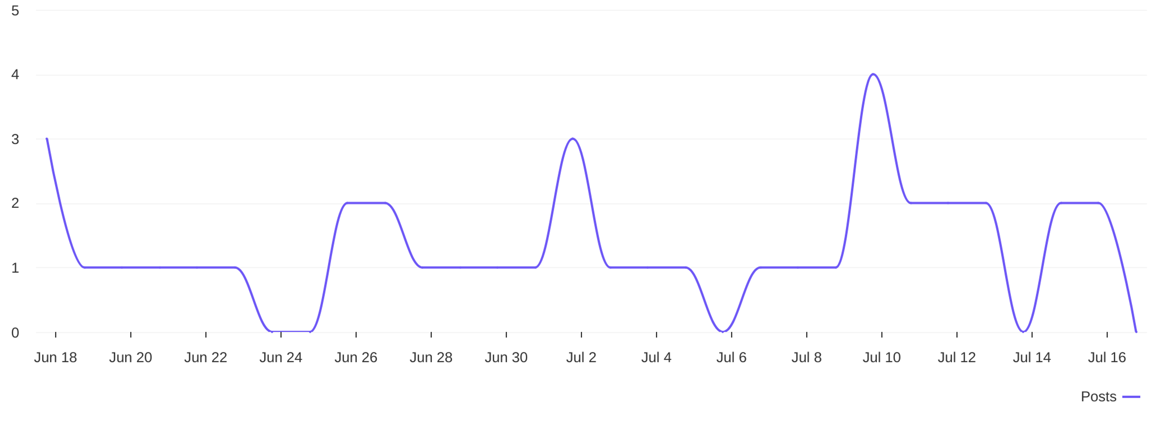
Social Report
18 Jun 2026 - 17 Jul 2026
Publishing behaviour • DIYAM HOUSE OF SILVER
See the posting patterns of the page
Distribution of posts
1.3
avg posts / day

Slide 9
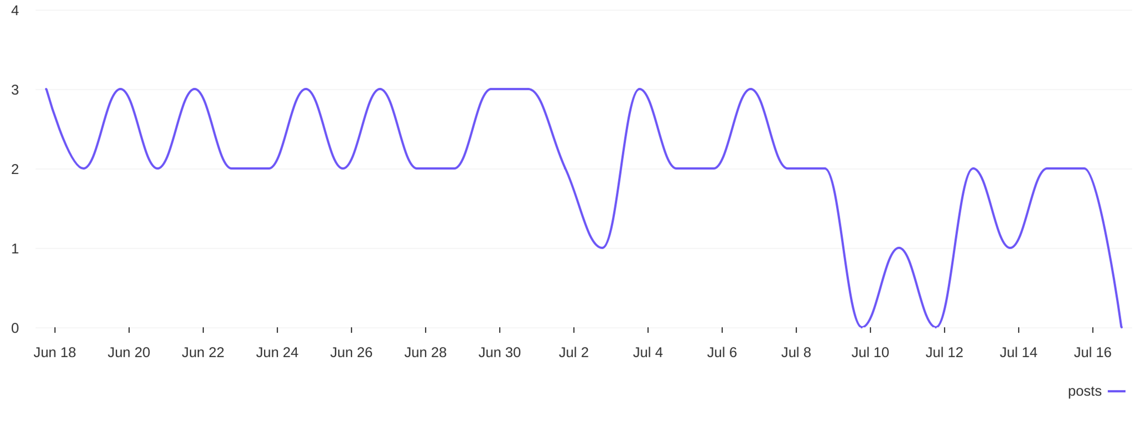
Social Report
18 Jun 2026 - 17 Jul 2026
Publishing behaviour • OnnMe
See the posting patterns of the page
Distribution of posts
2
avg posts / day

Slide 10
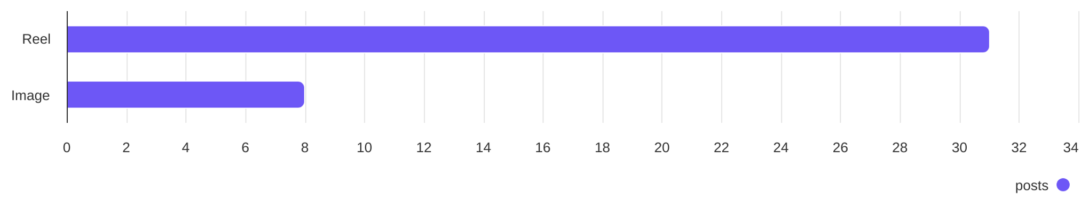
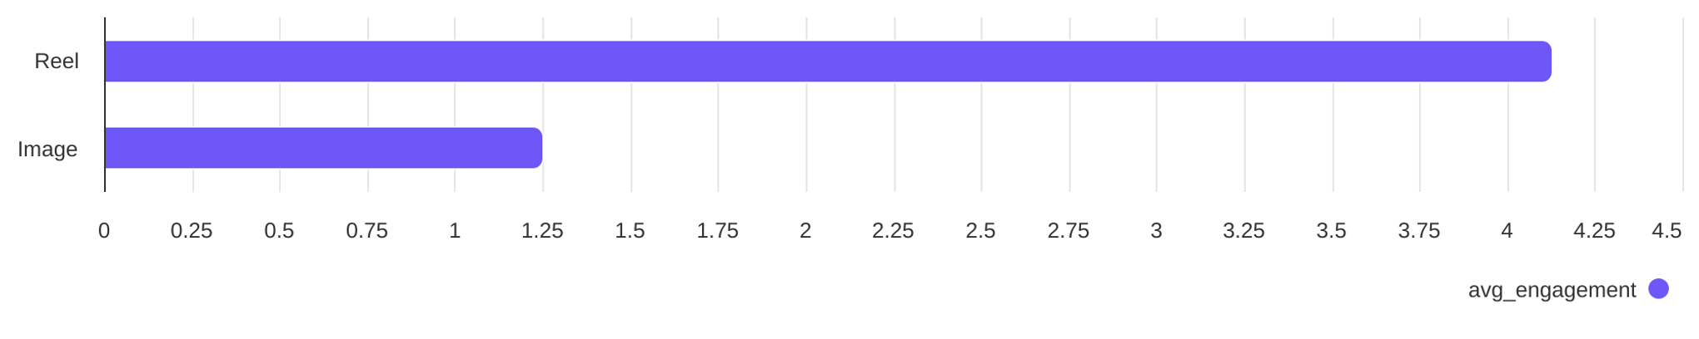
Social Report
18 Jun 2026 - 17 Jul 2026
Content performance • DIYAM HOUSE OF SILVER
See what types of post the profile published and understand the success of different post types
Post types
Reel count
Image count
31
8
Post types ranked by avg. engagement
Reel
Image
4.13
1.25

Slide 11
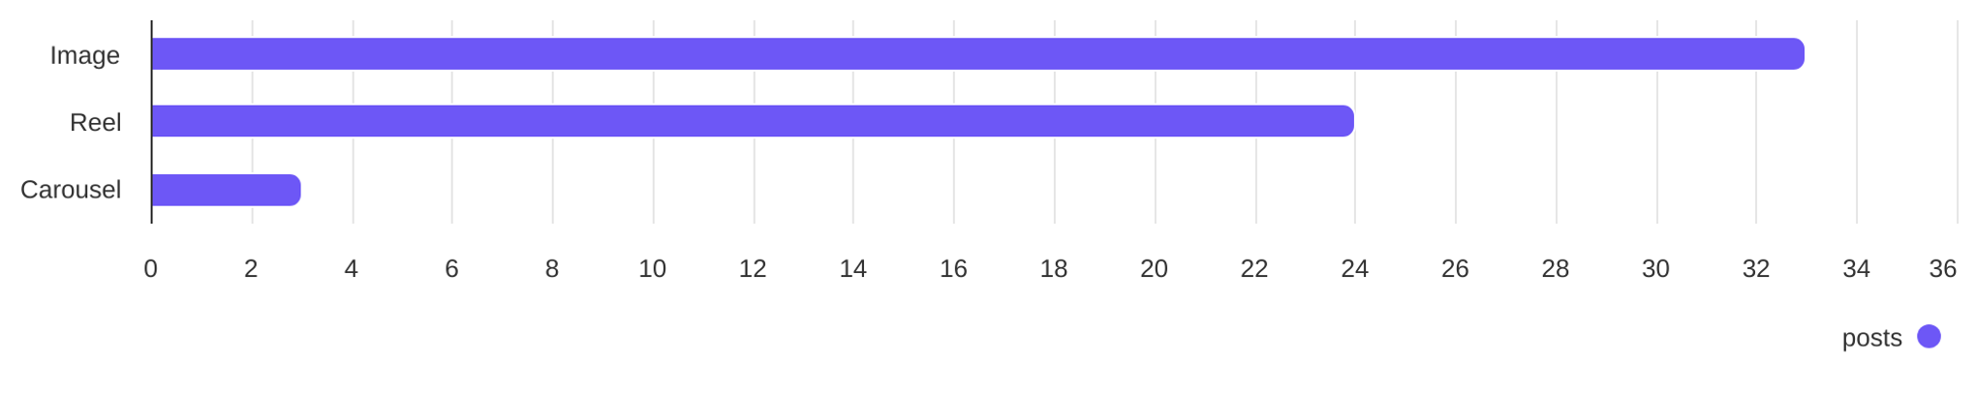
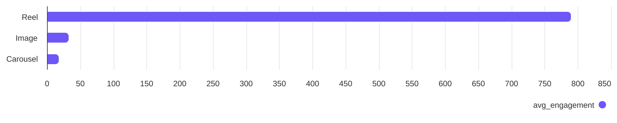
Social Report
18 Jun 2026 - 17 Jul 2026
Content performance • OnnMe
See what types of post the profile published and understand the success of different post types
Post types
Image count
Reel count
Carousel count
33
24
3
Post types ranked by avg. engagement
Image
Reel
Carousel
33.36
789.71
18.33

Slide 12
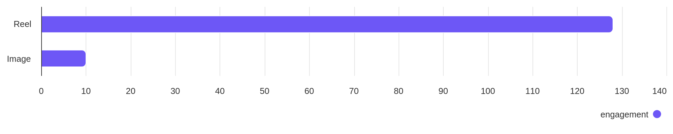
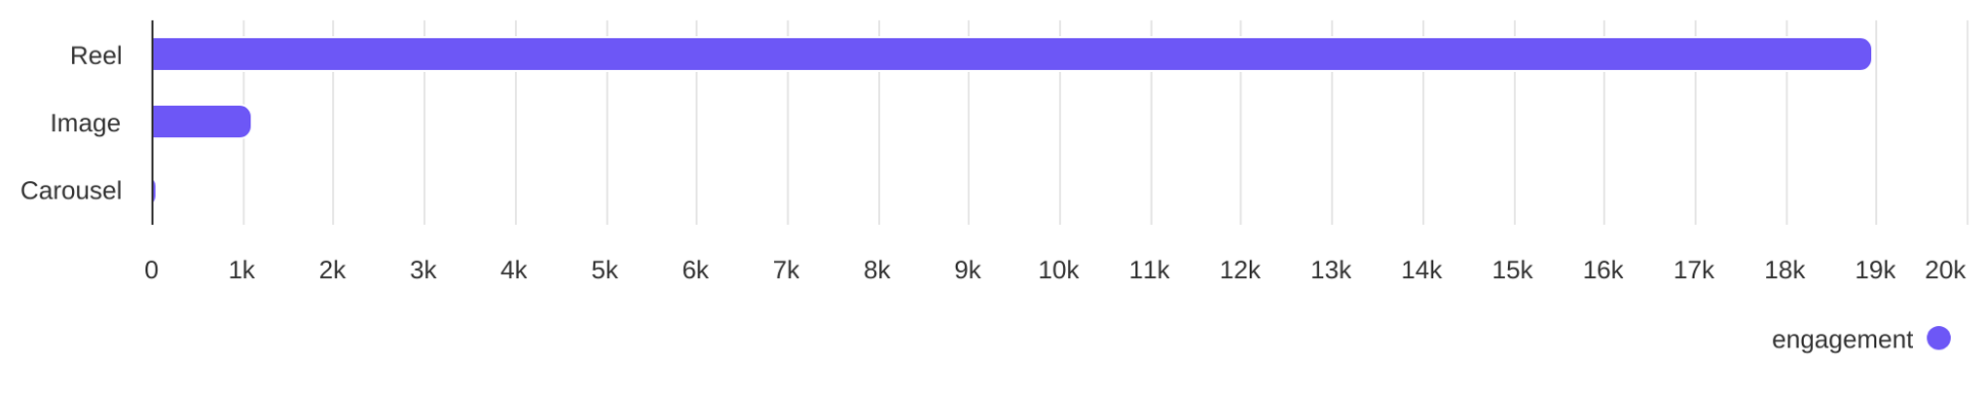
Social Report
18 Jun 2026 - 17 Jul 2026
Engagement overview
See the distribution of engagement (likes + comments)
Post types ranked by engagement - DIYAM HOUSE OF SILVER
Reel
Image
128
10
Post types ranked by engagement - OnnMe
Image
Reel
Carousel
1101
18.95K
55

Slide 13
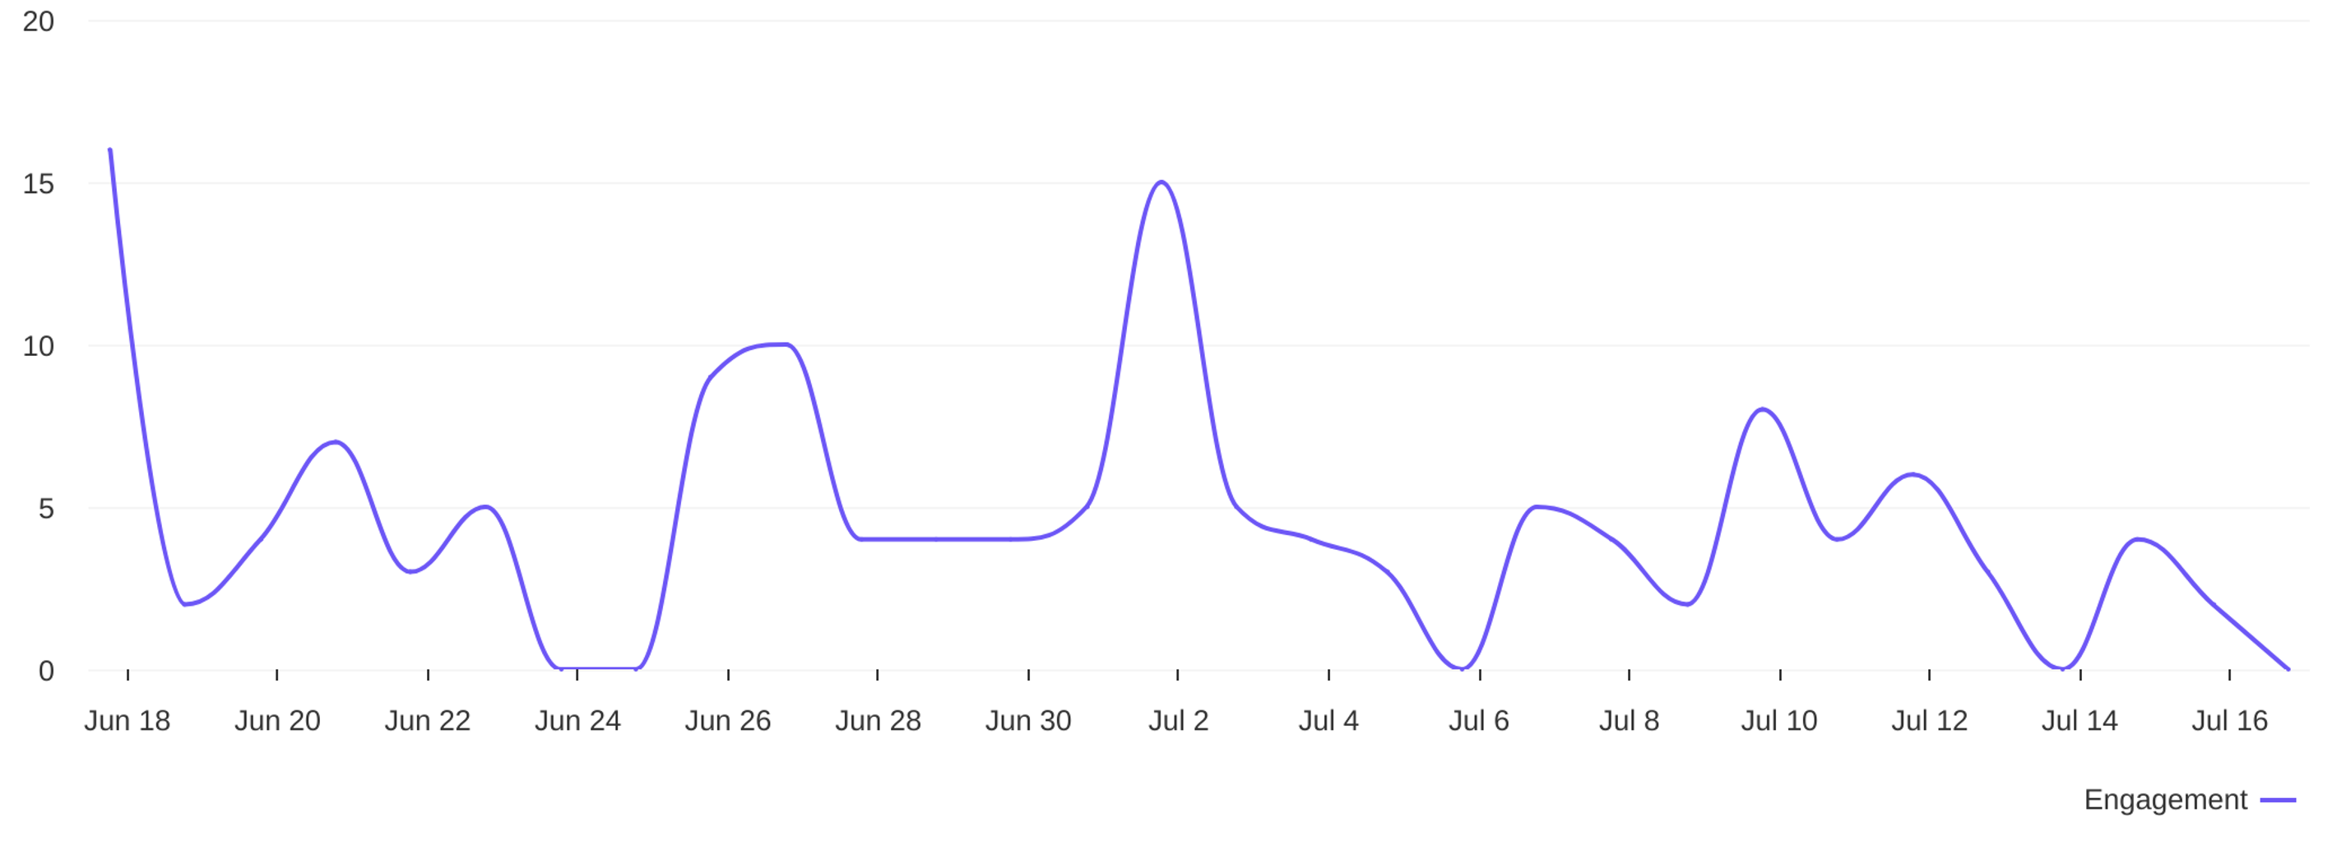
Social Report
18 Jun 2026 - 17 Jul 2026
Engagement overview • DIYAM HOUSE OF SILVER
See the distribution of engagement (likes + comments)
Engagement distribution / day
4.6
avg eng / day

Slide 14
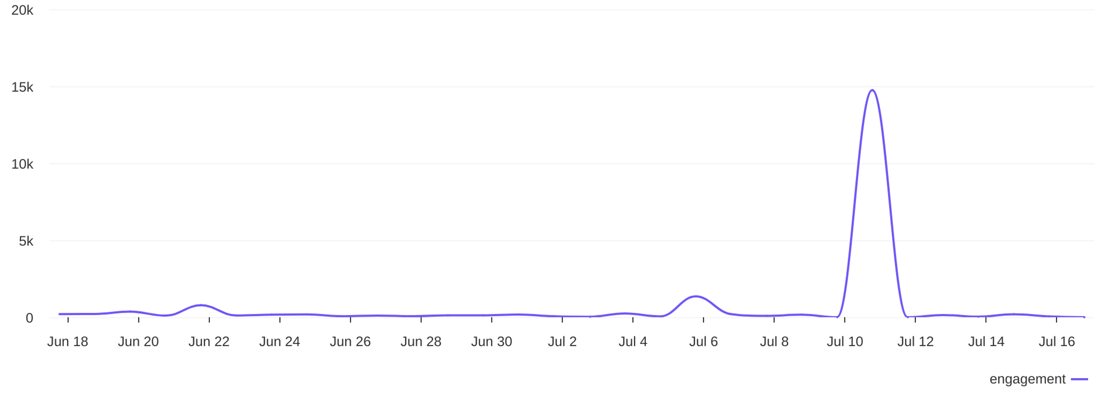
Social Report
18 Jun 2026 - 17 Jul 2026
Engagement overview • OnnMe
See the distribution of engagement (likes + comments)
Engagement distribution / day
670.3
avg eng / day

Slide 15
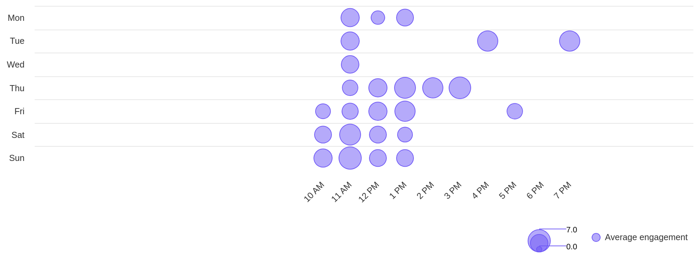
Social Report
18 Jun 2026 - 17 Jul 2026
Engagement overview • DIYAM HOUSE OF SILVER
See the distribution of engagement (likes + comments)
Best time to post by engagement
sun
11 AM
Day with most engagement
Hour with most engagement

Slide 16
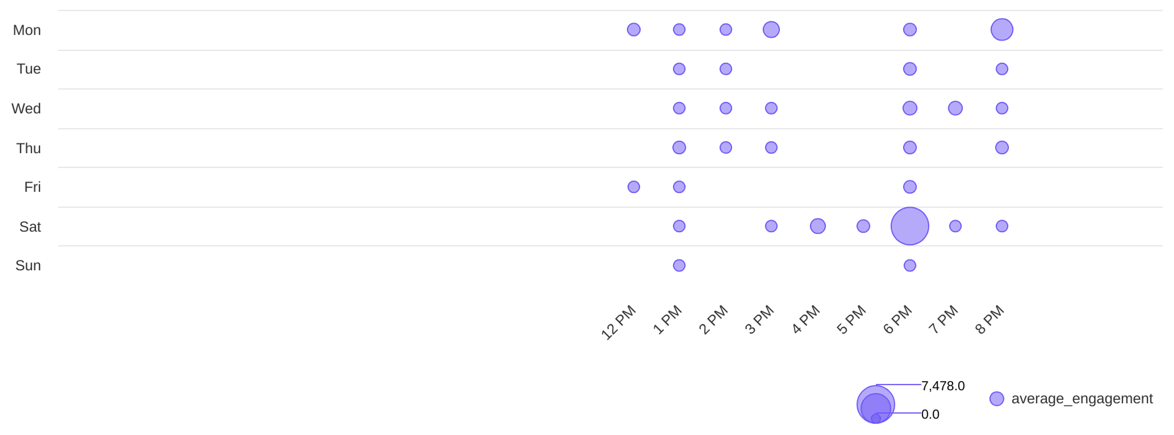
Social Report
18 Jun 2026 - 17 Jul 2026
Engagement overview • OnnMe
See the distribution of engagement (likes + comments)
Best time to post by engagement
sat
6 PM
Day with most engagement
Hour with most engagement

Slide 17
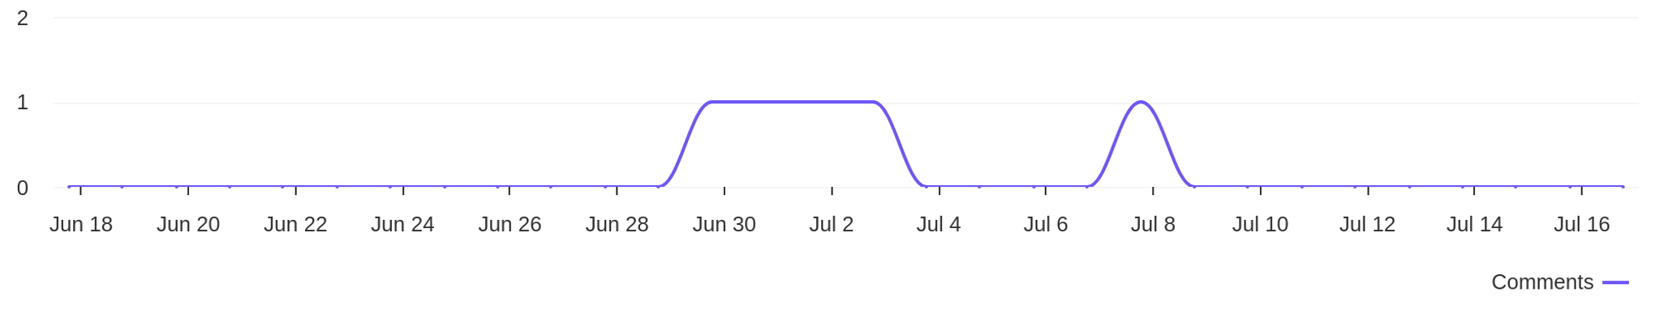
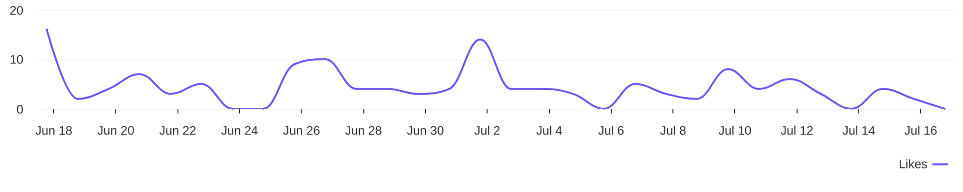
Social Report
18 Jun 2026 - 17 Jul 2026
Engagement metrics • DIYAM HOUSE OF SILVER
Breakdown of engagement for the profile
Distribution of comments / day
5
comments
Distribution of likes / day
133
likes

Slide 18
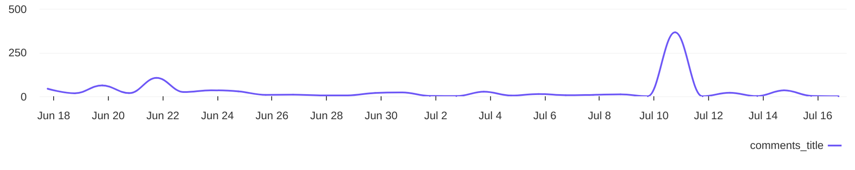
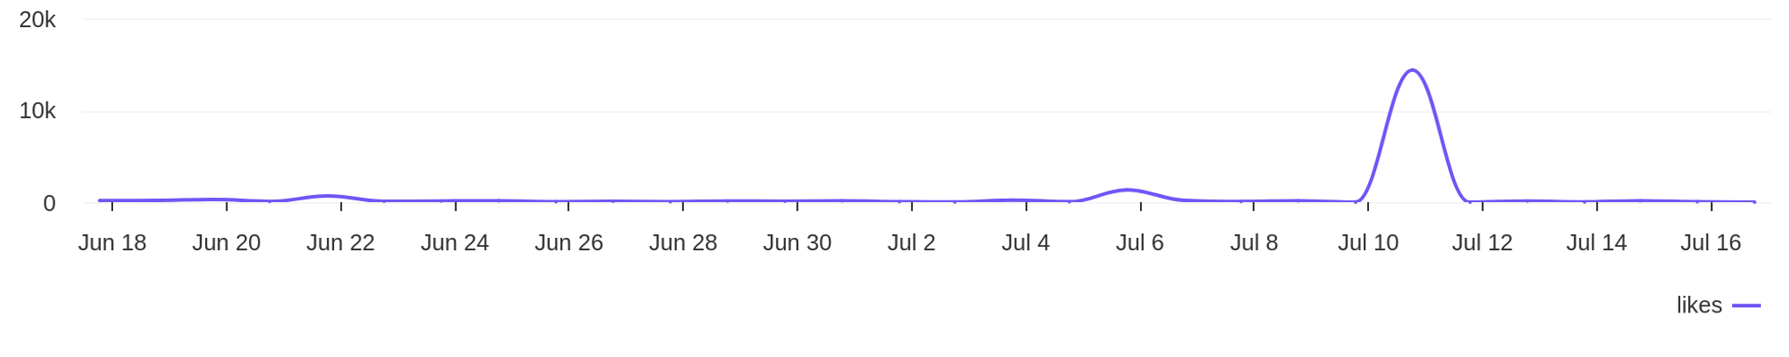
Social Report
18 Jun 2026 - 17 Jul 2026
Engagement metrics • OnnMe
Breakdown of engagement for the profile
Distribution of comments / day
892
comments
Distribution of likes / day
19.2K
likes

Slide 19
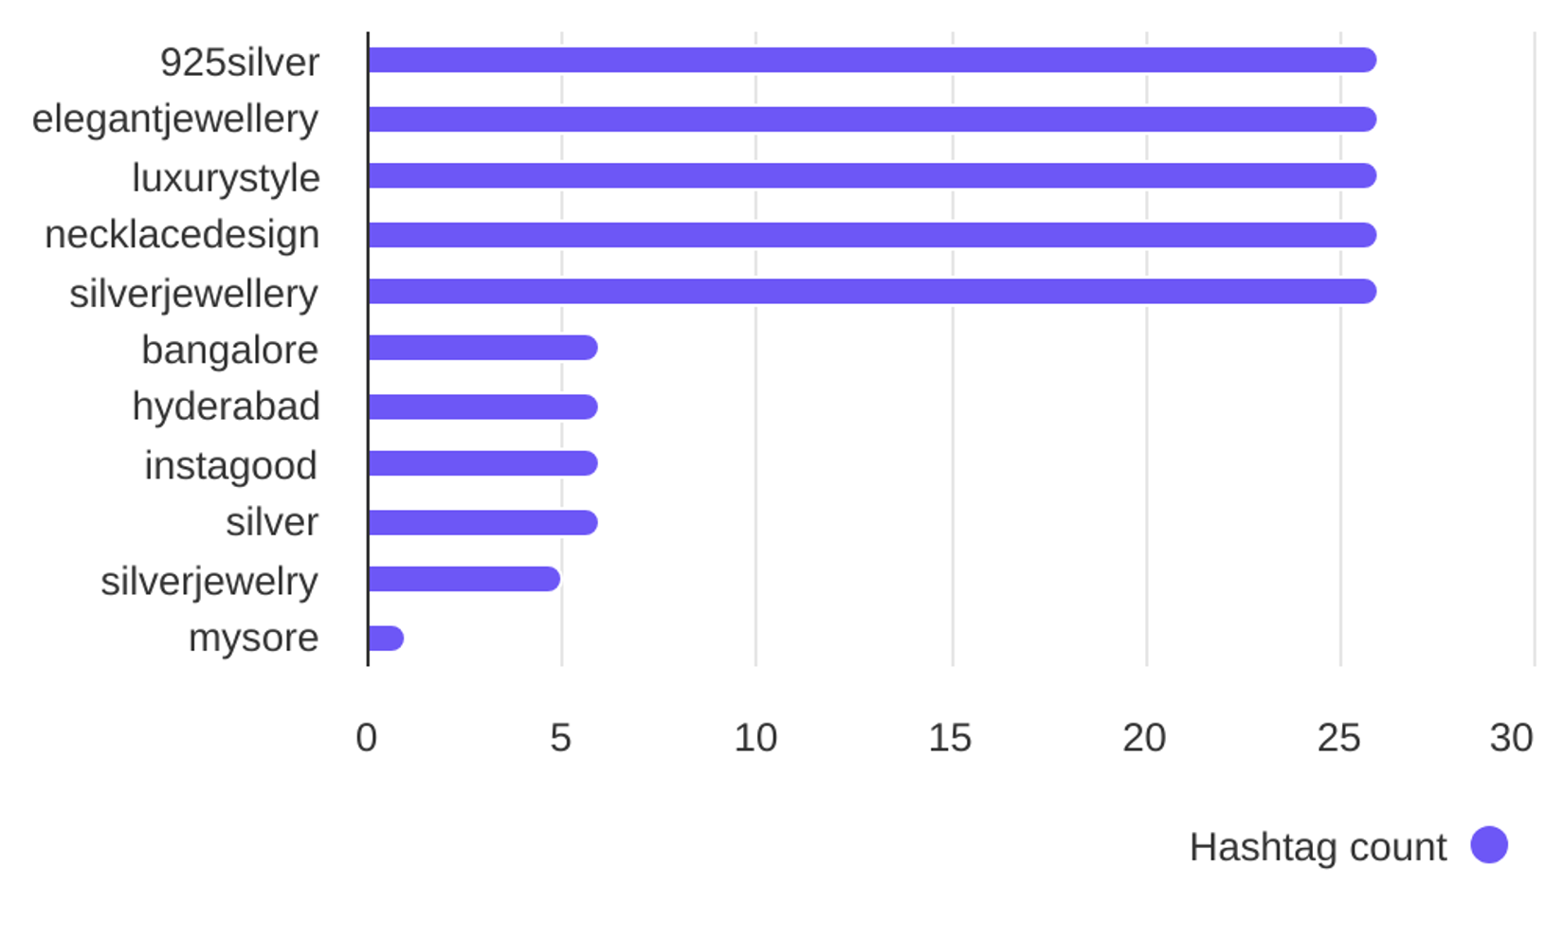

Social Report
18 Jun 2026 - 17 Jul 2026
Hashtag analysis • DIYAM HOUSE OF SILVER
See what hashtags are used the most
4.1
Most used hashtags
avg. hashtags
/ post
Hashtags
Occurrences
925silver
elegantjewellery
luxurystyle
necklacedesign
silverjewellery
bangalore
hyderabad
26
26
26
26
26
6
6

Slide 20
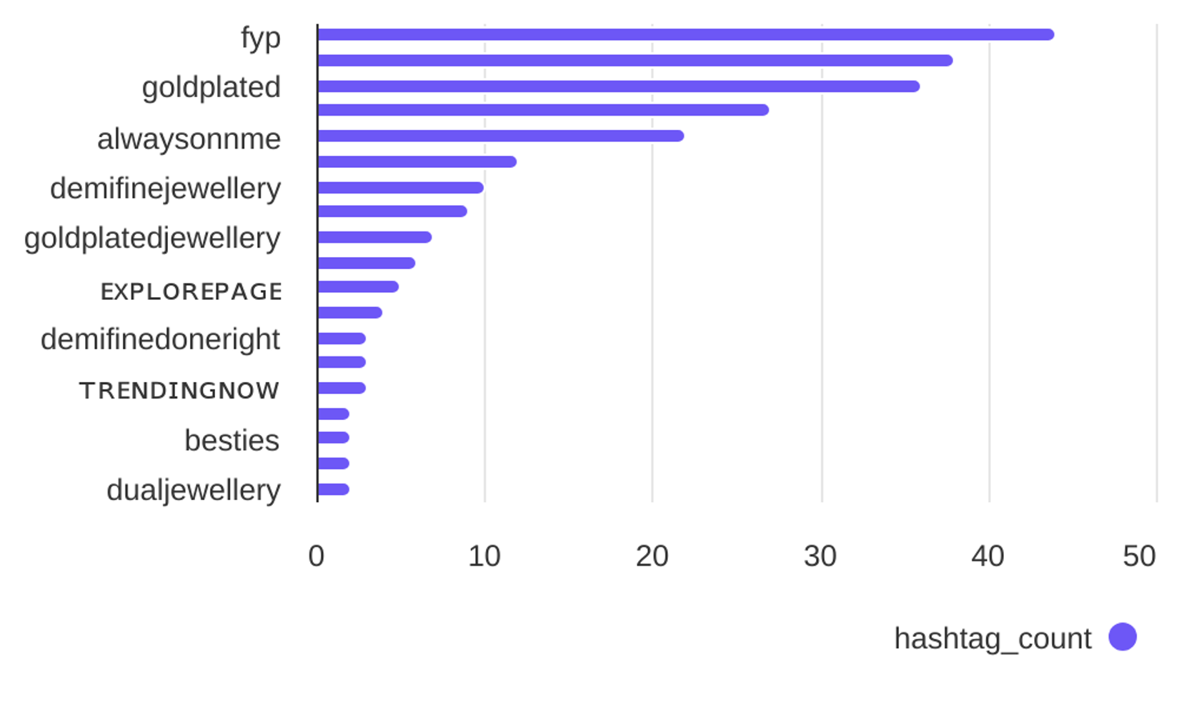
Social Report
18 Jun 2026 - 17 Jul 2026
Hashtag analysis • OnnMe
See what hashtags are used the most
5.0
Most used hashtags
avg. hashtags
/ post
Hashtags
Occurrences
fyp
onnme
goldplated
explorepage✨
alwaysonnme
dualtonejewellery
demifinejewellery
44
38
36
27
22
12
10

