Slide 1

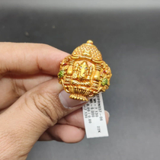

Instagram Social Report
DIYAM HOUSE OF SILVER vs Psg Gold
18 Jun 2026 - 17 Jul 2026

Slide 2


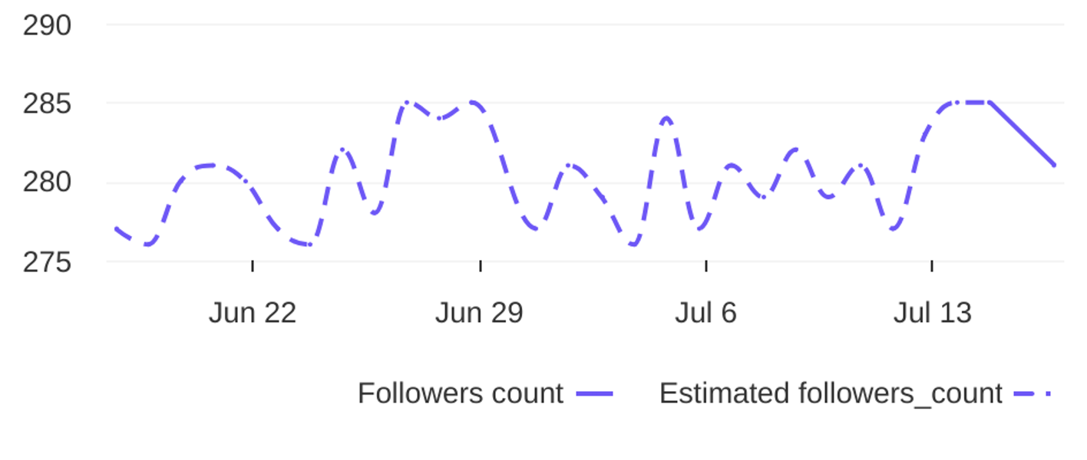
Social Report
18 Jun 2026 - 17 Jul 2026
Profile summary • DIYAM HOUSE OF SILVER
Key metrics of the profile
138
39
Followers' evolution
3.5
posts
engagement
1.3%
avg. engagement
avg. engagement
/ post
rate / post
4
Followers
1.4%
Avg. Eng. Rate/Post
281
engagement
Eng. Rate/Profile
profile growth
Followers
rate / profile

Slide 3

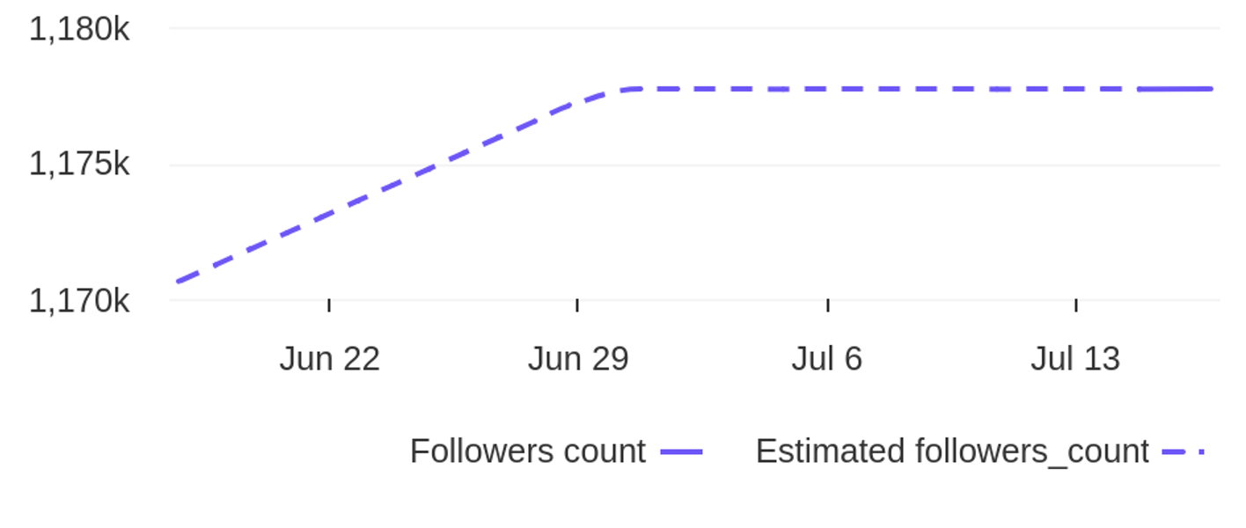
Social Report
18 Jun 2026 - 17 Jul 2026
Profile summary • Psg Gold
Key metrics of the profile
59.9K
190
Followers' evolution
315.3
posts
engagement
0.0%
avg. engagement
avg. engagement
/ post
rate / post
7066
Followers
0.6%
Avg. Eng. Rate/Post
1177713
engagement
Eng. Rate/Profile
profile growth
Followers
rate / profile

Slide 4



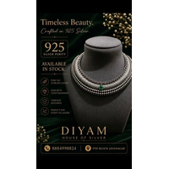

Social Report
18 Jun 2026 - 17 Jul 2026
Top posts • DIYAM HOUSE OF SILVER
The most engaging posts
Date
Image
Text
Type
Engagement
Comments
Likes
925 Silver Adjustable Rakhi. Available in stock. Get yours before its over. For more details Dm o...
reel
reel
reel
reel
reel
8
7
7
6
5
1
0
0
0
0
7
7
7
6
5
02 Jul
21 Jun
27 Jun
18 Jun
26 Jun
925 Silver Earings Oxidise Finish. Available in Stock. For more details DM or visit store. diyamh...
925 silver oxadise Necklace. Available in stock. For more details Dm or Visit store. diyamhouseof...
925 silver necklace in oxidese finish. Available in stock. For more detailes Dm or visit store. d...
925 Silver Necklace. Available in Stock. For more details Dm or Visit Store. diyamhouseofsilver 9...

Slide 5
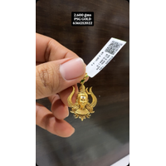
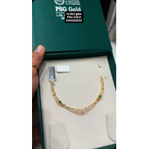
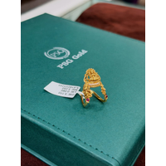
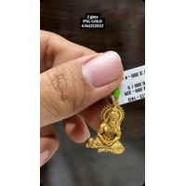
Social Report
18 Jun 2026 - 17 Jul 2026
Top posts • Psg Gold
The most engaging posts
Date
Image
Text
Type
Engagement
Comments
Likes
2.600 gms
reel
reel
carousel_album
reel
reel
5743
4269
2085
1625
1053
64
173
3
12
4
5679
4096
2082
1613
1049
18 Jun
03 Jul
06 Jul
18 Jun
10 Jul
22 CT gold / BIS 916 Hall mark Necklace 13.862 gms Contact No. For more details 6361212022 , 9...
22 CT gold / BIS 916 Hall mark Ring Contact No. For more details 6361212022 , 9113993129 psg.g...
2 gms
22 CT gold / BIS 916 Hall mark Chain 10.500 gms Contact No. For more details 6361212022 , 911...

Slide 6
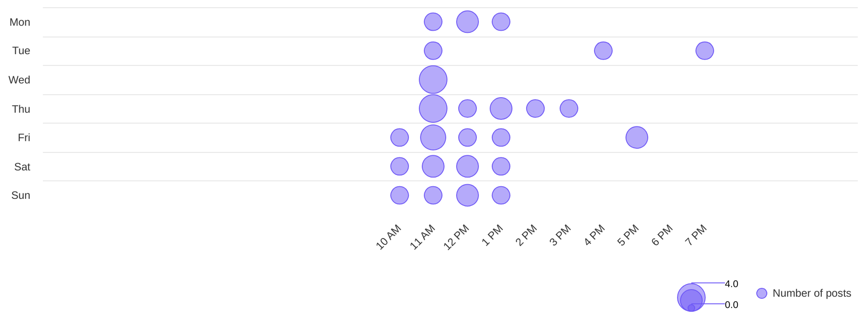
Social Report
18 Jun 2026 - 17 Jul 2026
Publishing behaviour • DIYAM HOUSE OF SILVER
See the posting patterns of the page
Posting times
11 AM
wed
Day with most posts
Hour with most posts

Slide 7
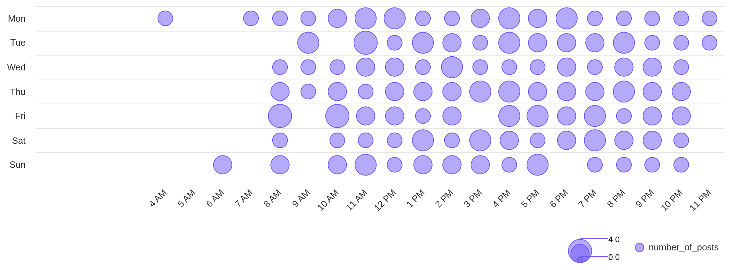
Social Report
18 Jun 2026 - 17 Jul 2026
Publishing behaviour • Psg Gold
See the posting patterns of the page
Posting times
11 AM
tue
Day with most posts
Hour with most posts

Slide 8
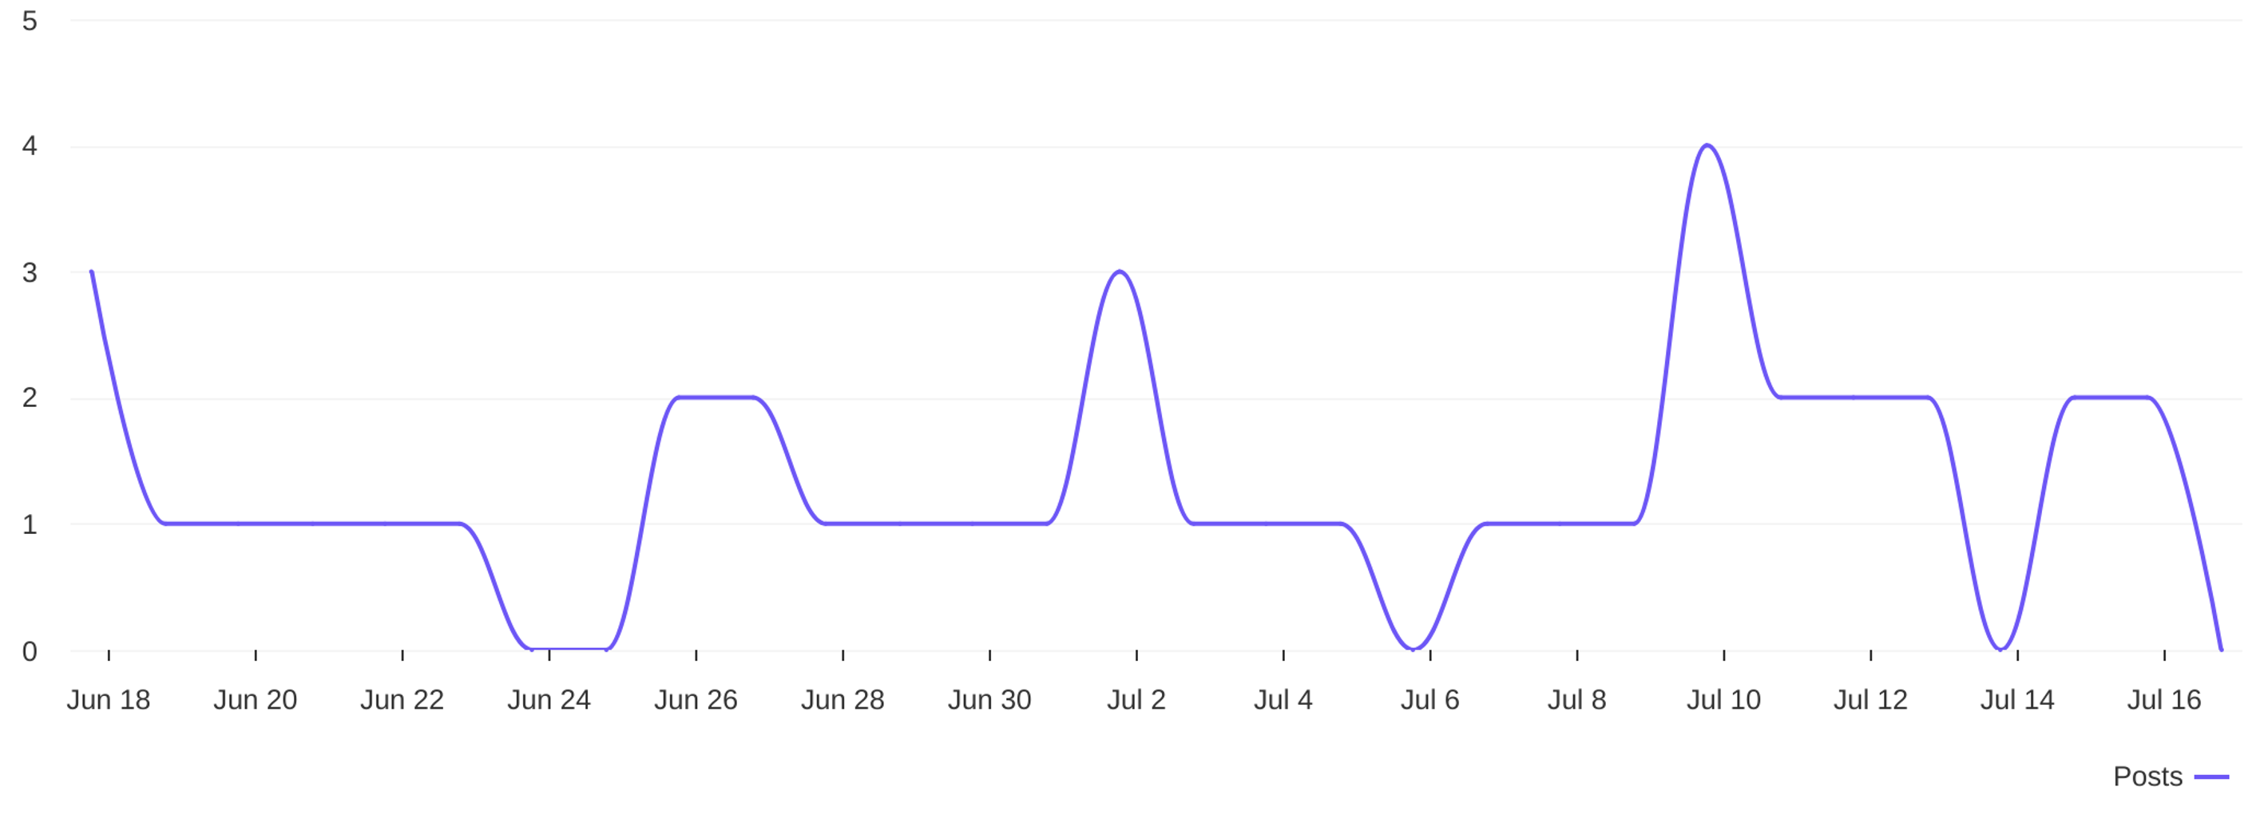
Social Report
18 Jun 2026 - 17 Jul 2026
Publishing behaviour • DIYAM HOUSE OF SILVER
See the posting patterns of the page
Distribution of posts
1.3
avg posts / day

Slide 9
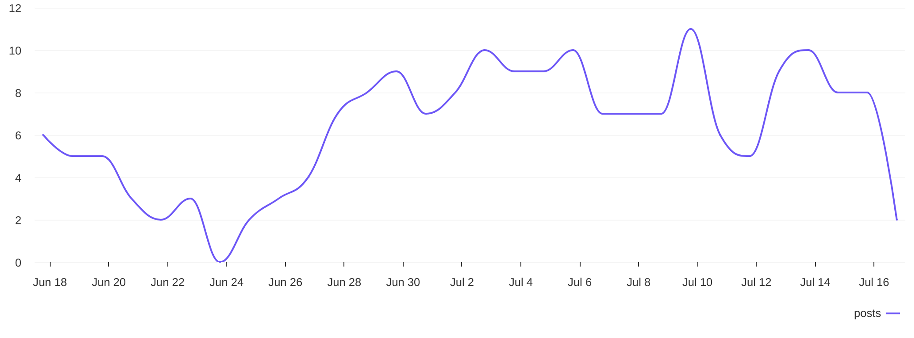
Social Report
18 Jun 2026 - 17 Jul 2026
Publishing behaviour • Psg Gold
See the posting patterns of the page
Distribution of posts
6.3
avg posts / day

Slide 10
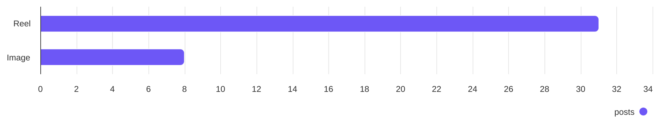
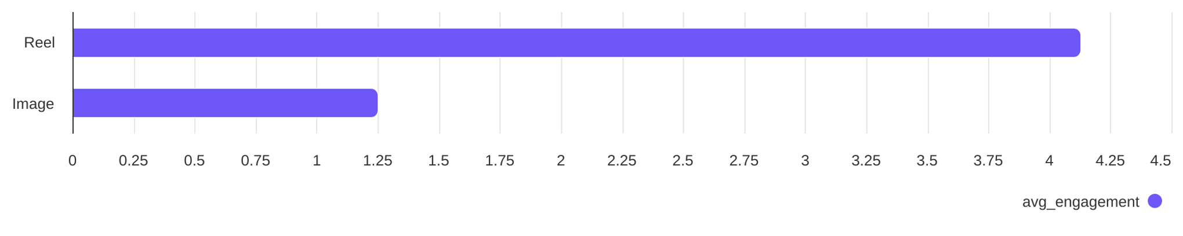
Social Report
18 Jun 2026 - 17 Jul 2026
Content performance • DIYAM HOUSE OF SILVER
See what types of post the profile published and understand the success of different post types
Post types
Reel count
Image count
31
8
Post types ranked by avg. engagement
Reel
Image
4.13
1.25

Slide 11
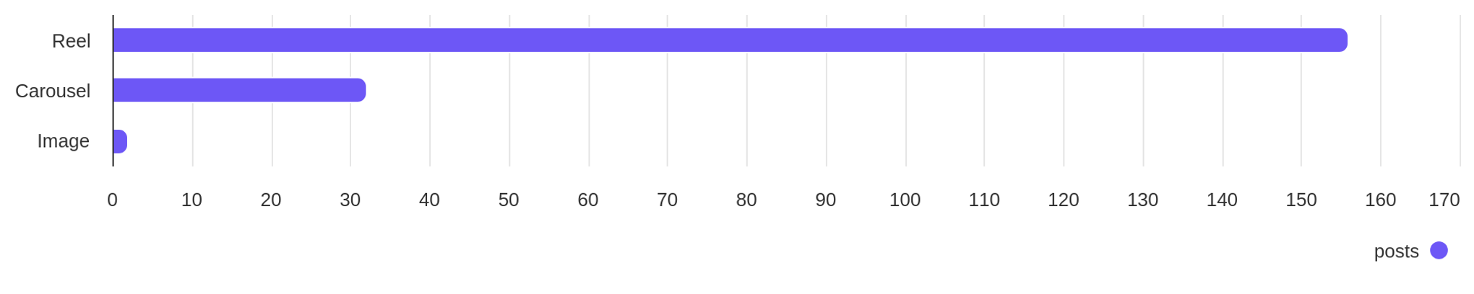
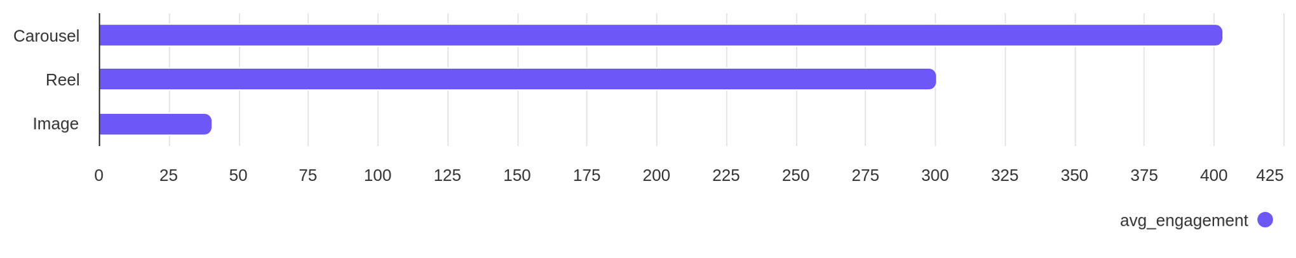
Social Report
18 Jun 2026 - 17 Jul 2026
Content performance • Psg Gold
See what types of post the profile published and understand the success of different post types
Post types
Reel count
Carousel count
Image count
156
32
2
Post types ranked by avg. engagement
Reel
Carousel
Image
300.75
403.34
40.50

Slide 12
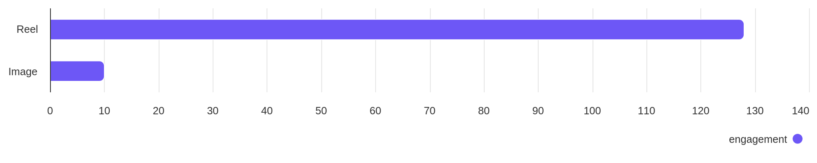
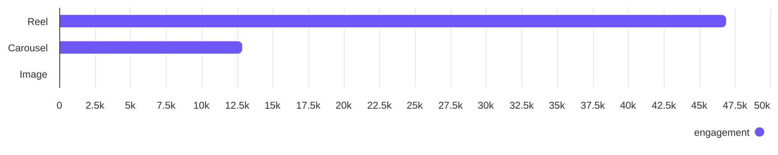
Social Report
18 Jun 2026 - 17 Jul 2026
Engagement overview
See the distribution of engagement (likes + comments)
Post types ranked by engagement - DIYAM HOUSE OF SILVER
Reel
Image
128
10
Post types ranked by engagement - Psg Gold
Reel
Carousel
Image
46.92K
12.91K
81

Slide 13
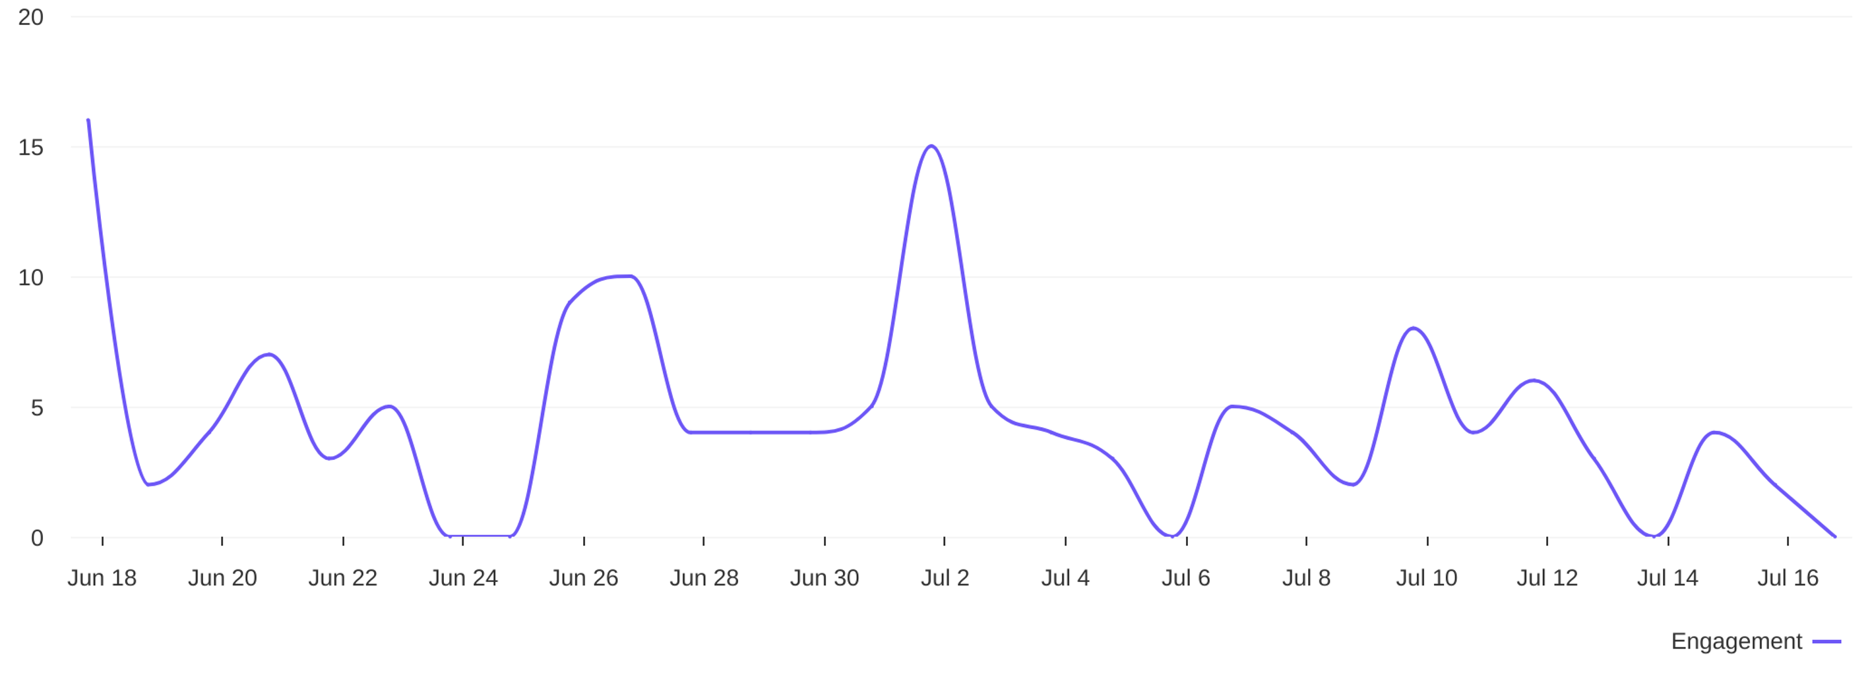
Social Report
18 Jun 2026 - 17 Jul 2026
Engagement overview • DIYAM HOUSE OF SILVER
See the distribution of engagement (likes + comments)
Engagement distribution / day
4.6
avg eng / day

Slide 14
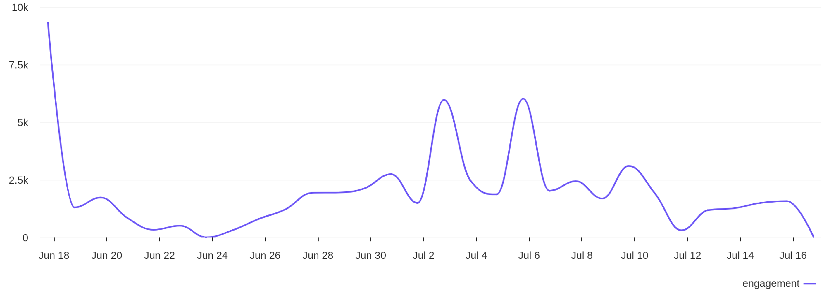
Social Report
18 Jun 2026 - 17 Jul 2026
Engagement overview • Psg Gold
See the distribution of engagement (likes + comments)
Engagement distribution / day
1997
avg eng / day

Slide 15
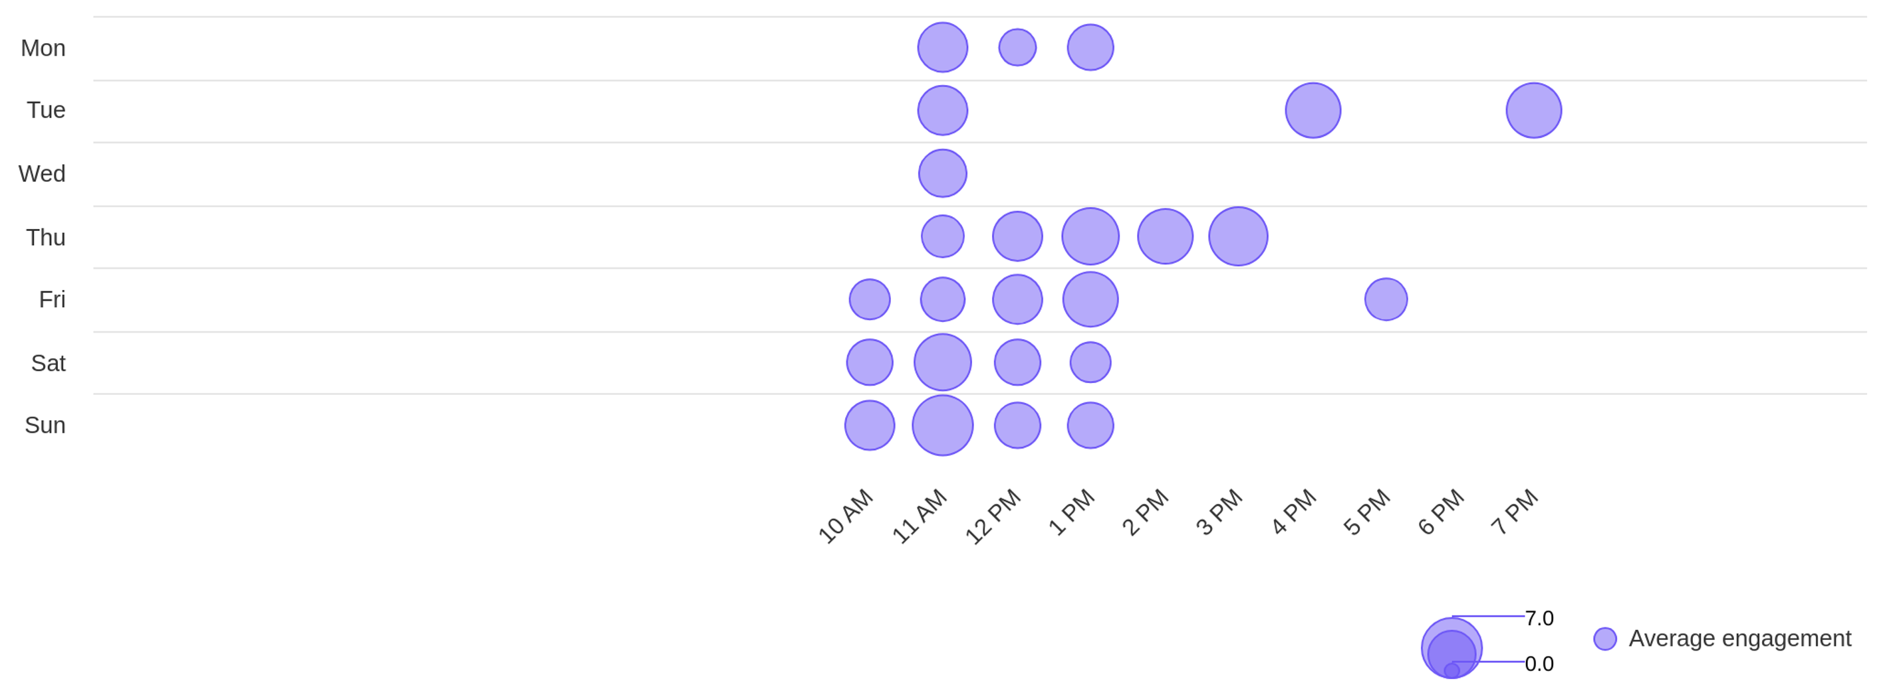
Social Report
18 Jun 2026 - 17 Jul 2026
Engagement overview • DIYAM HOUSE OF SILVER
See the distribution of engagement (likes + comments)
Best time to post by engagement
sun
11 AM
Day with most engagement
Hour with most engagement

Slide 16
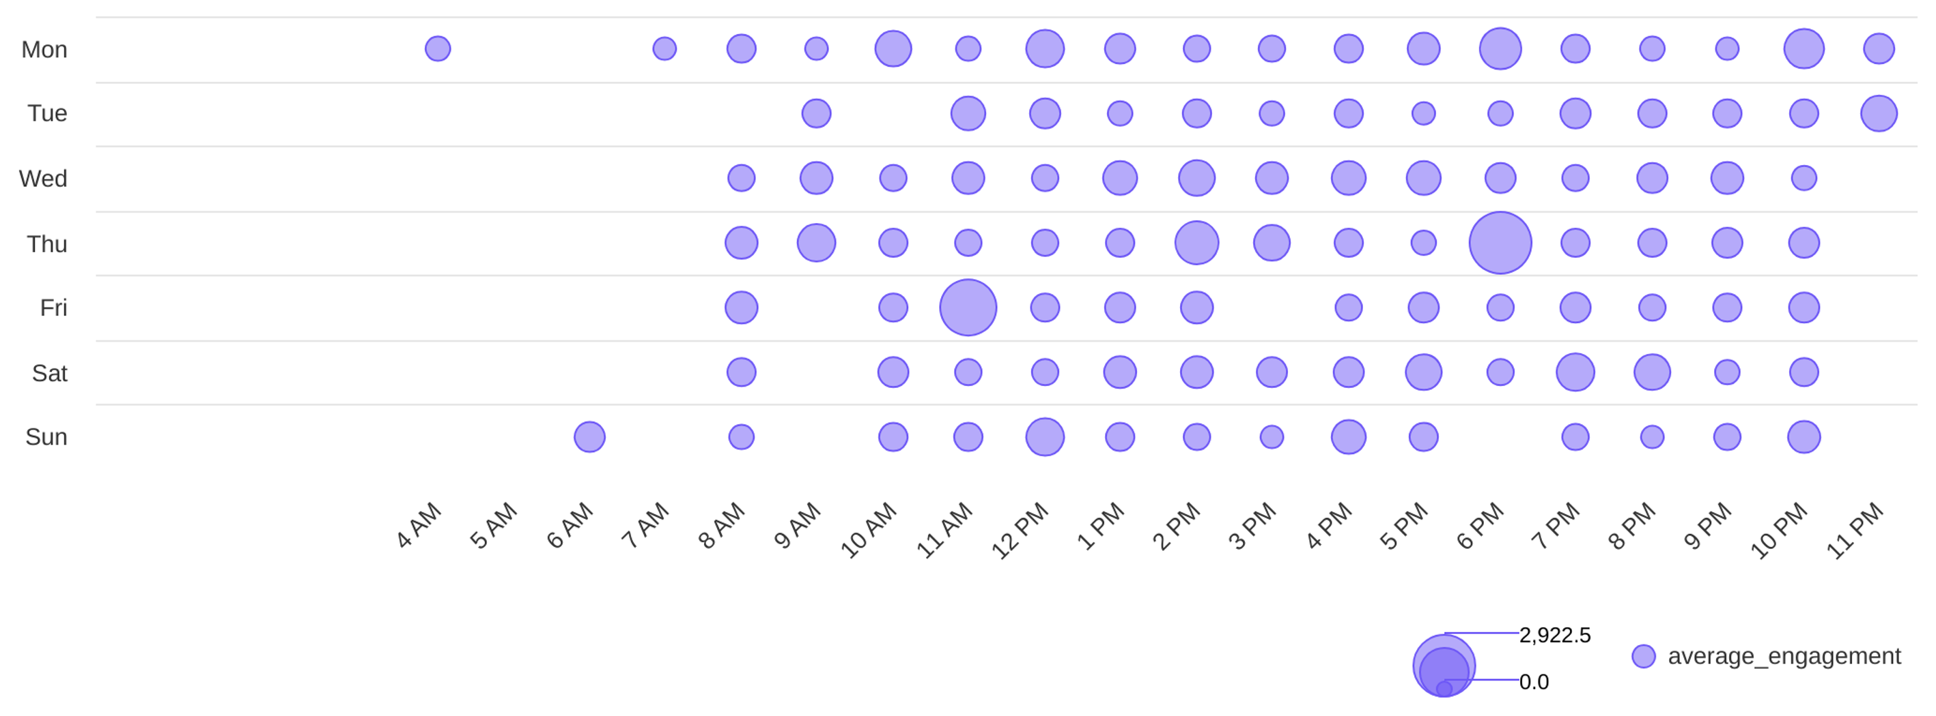
Social Report
18 Jun 2026 - 17 Jul 2026
Engagement overview • Psg Gold
See the distribution of engagement (likes + comments)
Best time to post by engagement
thu
6 PM
Day with most engagement
Hour with most engagement

Slide 17
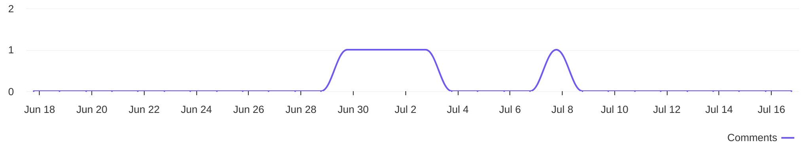
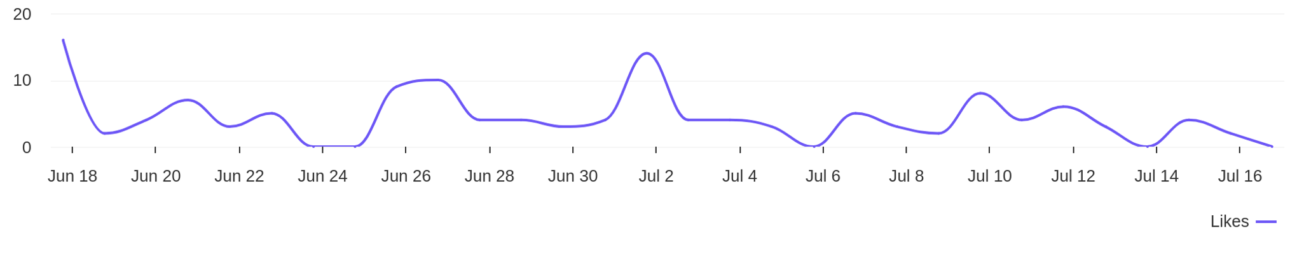
Social Report
18 Jun 2026 - 17 Jul 2026
Engagement metrics • DIYAM HOUSE OF SILVER
Breakdown of engagement for the profile
Distribution of comments / day
5
comments
Distribution of likes / day
133
likes

Slide 18
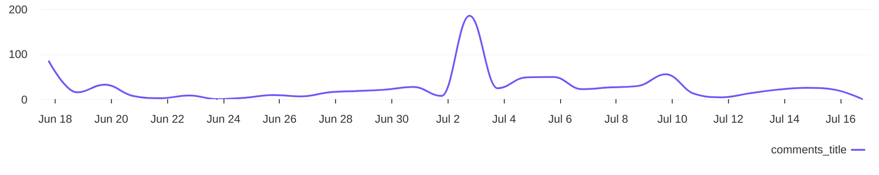
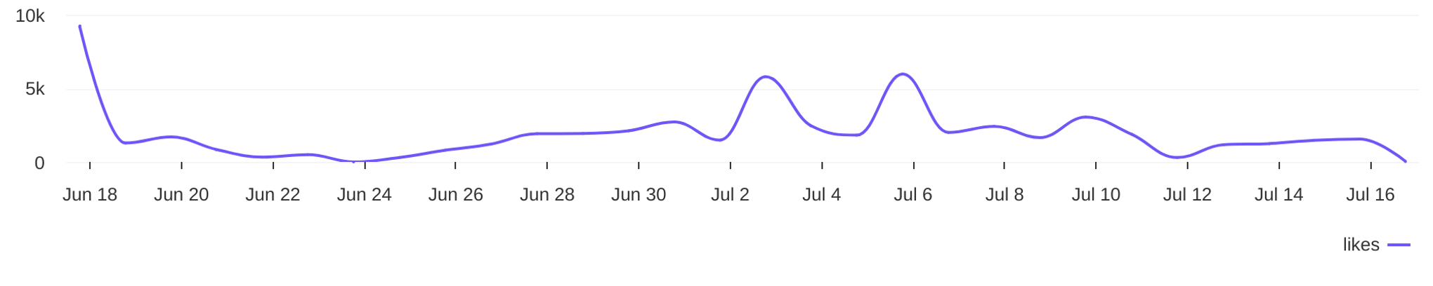
Social Report
18 Jun 2026 - 17 Jul 2026
Engagement metrics • Psg Gold
Breakdown of engagement for the profile
Distribution of comments / day
788
comments
Distribution of likes / day
59.1K
likes

Slide 19
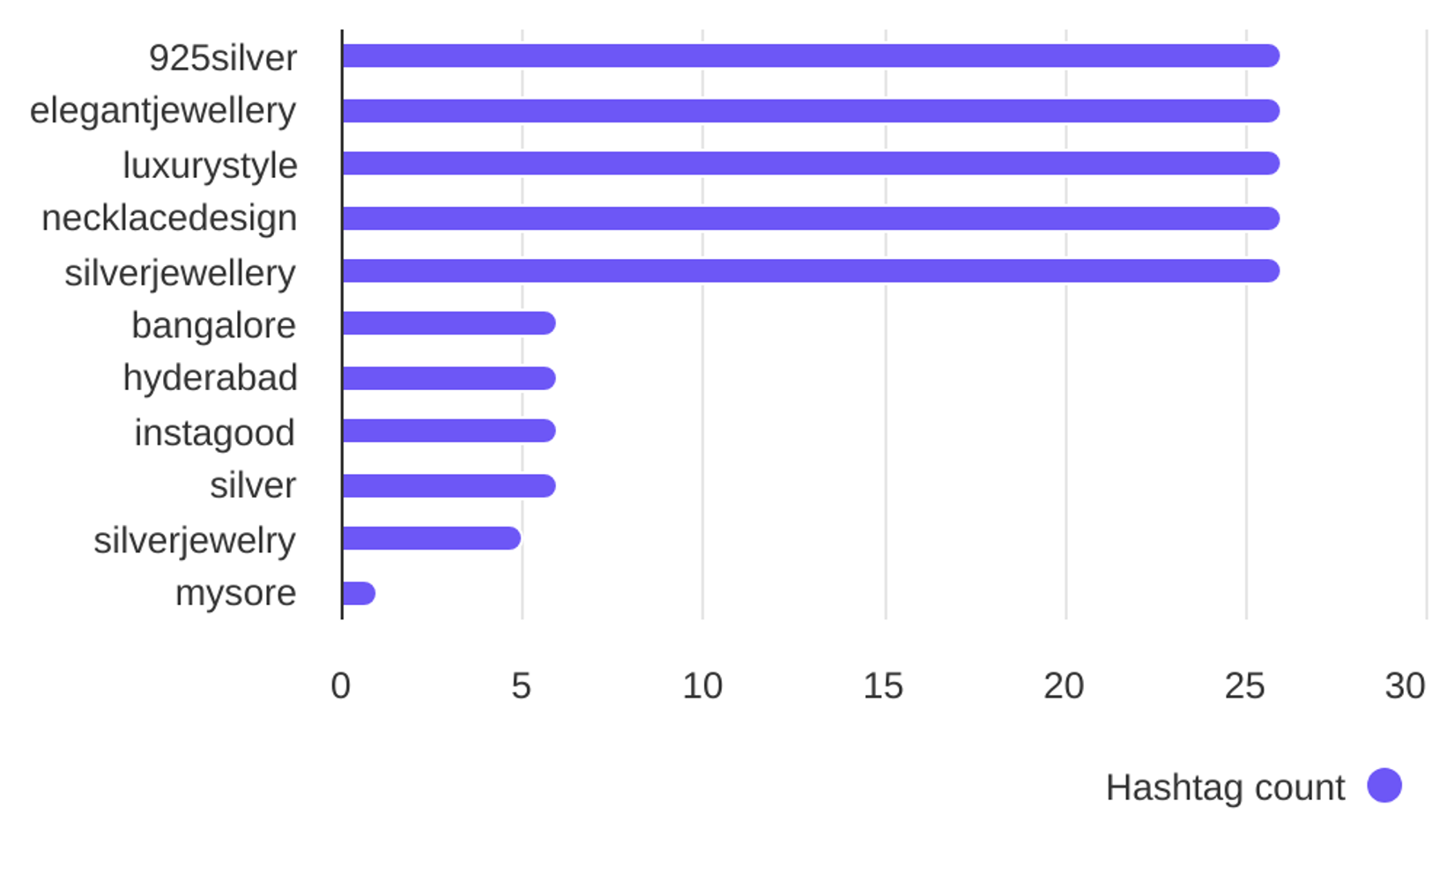

Social Report
18 Jun 2026 - 17 Jul 2026
Hashtag analysis • DIYAM HOUSE OF SILVER
See what hashtags are used the most
4.1
Most used hashtags
avg. hashtags
/ post
Hashtags
Occurrences
925silver
elegantjewellery
luxurystyle
necklacedesign
silverjewellery
bangalore
hyderabad
26
26
26
26
26
6
6

Slide 20
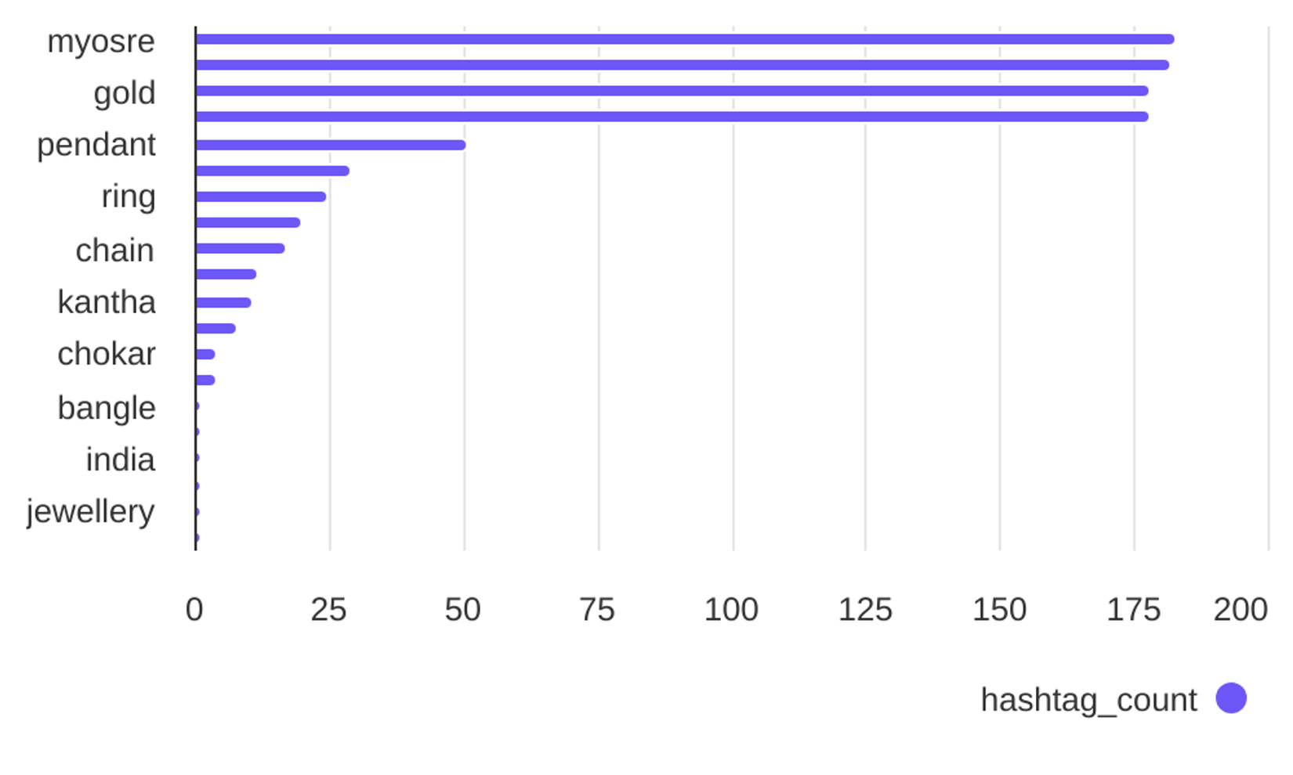
Social Report
18 Jun 2026 - 17 Jul 2026
Hashtag analysis • Psg Gold
See what hashtags are used the most
4.8
Most used hashtags
avg. hashtags
/ post
Hashtags
Occurrences
myosre
sumitjewels
gold
longharam
pendant
necklace
ring
183
182
178
178
51
29
25

