Slide 1


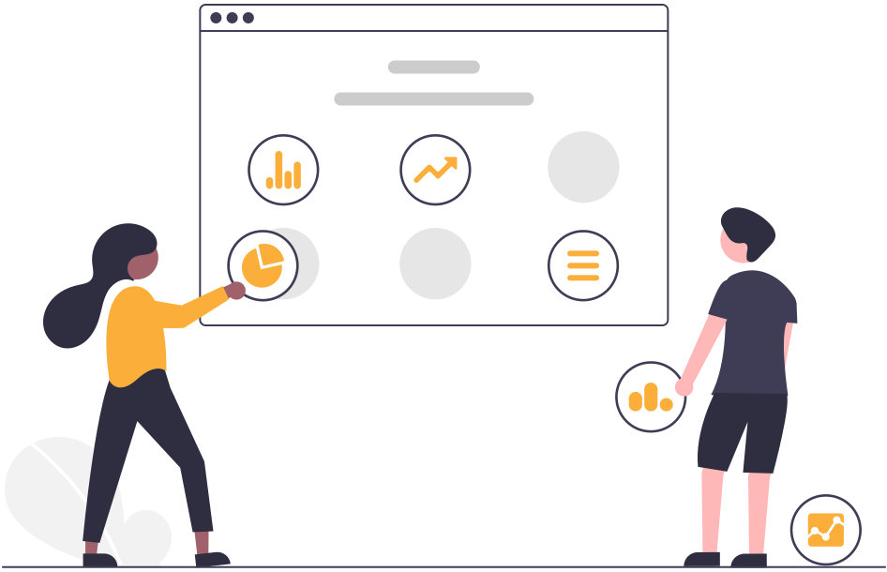
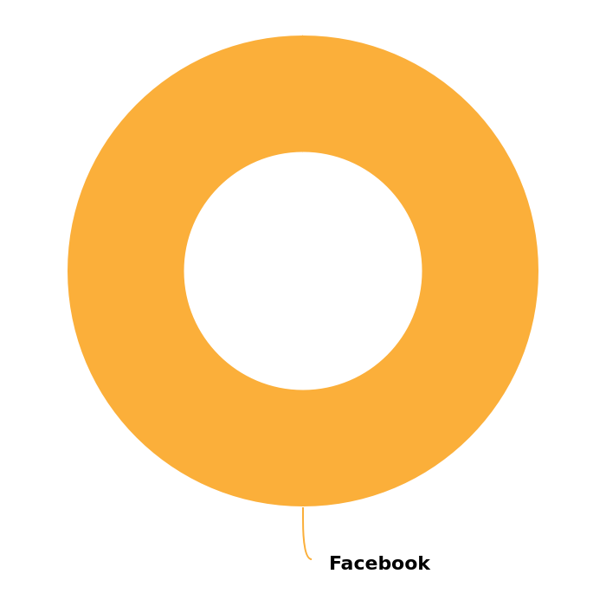
Instagram Social Report
18 Jun 2026 - 17 Jul 2026
DIYAM HOUSE OF SILVER

Slide 2






Content Summary
18 Jun 2026 - 17 Jul 2026
Key metrics for the selected period
39
Total Organic Posts
18.75% lower
138
Total Organic Engagement
26.60% lower
5383
Estimated Impressions
57.21% higher
3383
Estimated Reach
40.37% higher
These metrics are compared to the previous period of 18 May 2026 - 17 Jun 2026

Slide 3



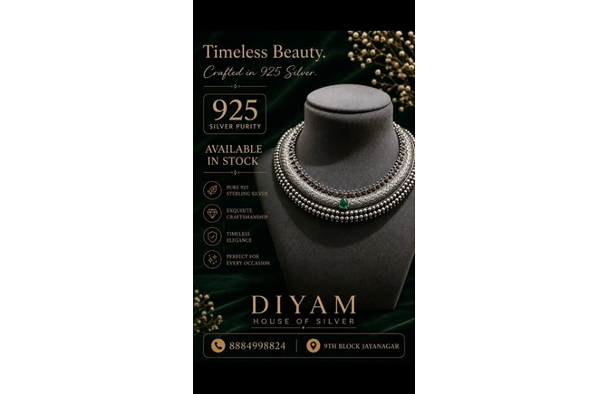
Top 3 Posts
18 Jun 2026 - 17 Jul 2026
See the top 3 posts published by this Instagram Profile
diyamhouseofsilver
02 Jul
diyamhouseofsilver
21 Jun
diyamhouseofsilver
27 Jun
925 Silver Adjustable Rakhi. Available in stock. Get yours before its over. For more details Dm or V...
925 Silver Earings Oxidise Finish. Available in Stock. For more details DM or visit store. diyamhous...
925 silver oxadise Necklace. Available in stock. For more details Dm or Visit store. diyamhouseofsil...
Likes
7
Comments
1
Likes
7
Comments
0
Likes
7
Comments
0
130 reach
8 engagement
208 impressions
2.847% eng. rate by followers
3.846% eng. rate by impressions
85 reach
7 engagement
136 impressions
2.491% eng. rate by followers
5.147% eng. rate by impressions
120 reach
7 engagement
192 impressions
2.491% eng. rate by followers
3.646% eng. rate by impressions

Slide 4
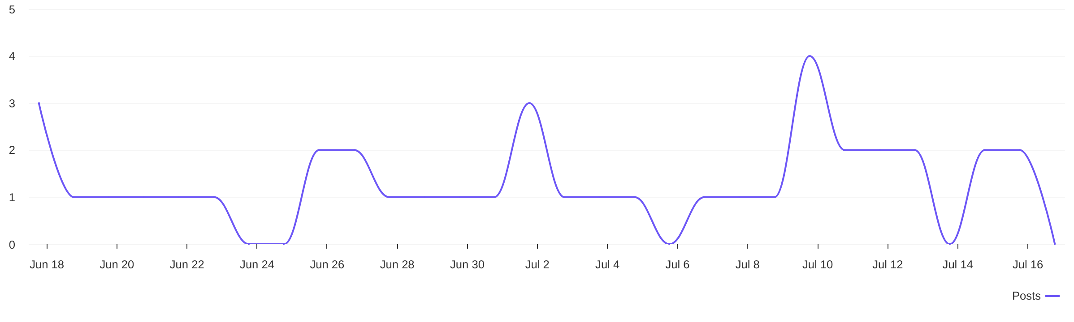
Organic Posts Distribution
18 Jun 2026 - 17 Jul 2026
See the posting patterns of this Instagram profile
The total number of posts is
39
which is 18.75% lower than the previous period

Slide 5
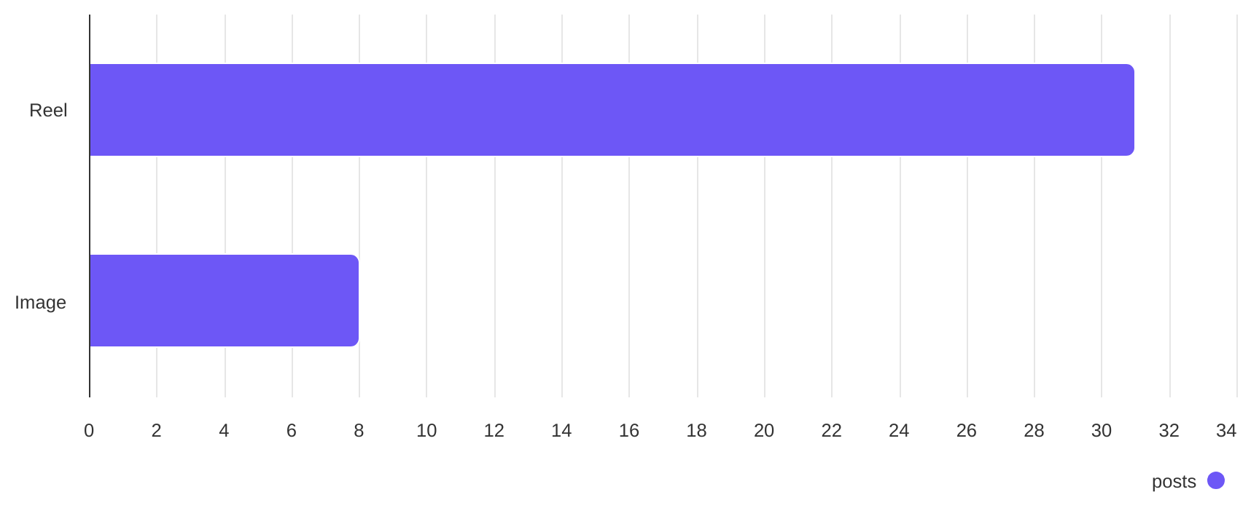


Post Types
18 Jun 2026 - 17 Jul 2026
See the publishing behaviour of this Instagram profile
Reel
Image
31
8
For better results, try and post more Reels since that's the type of content that brings the highest engagement

Slide 6
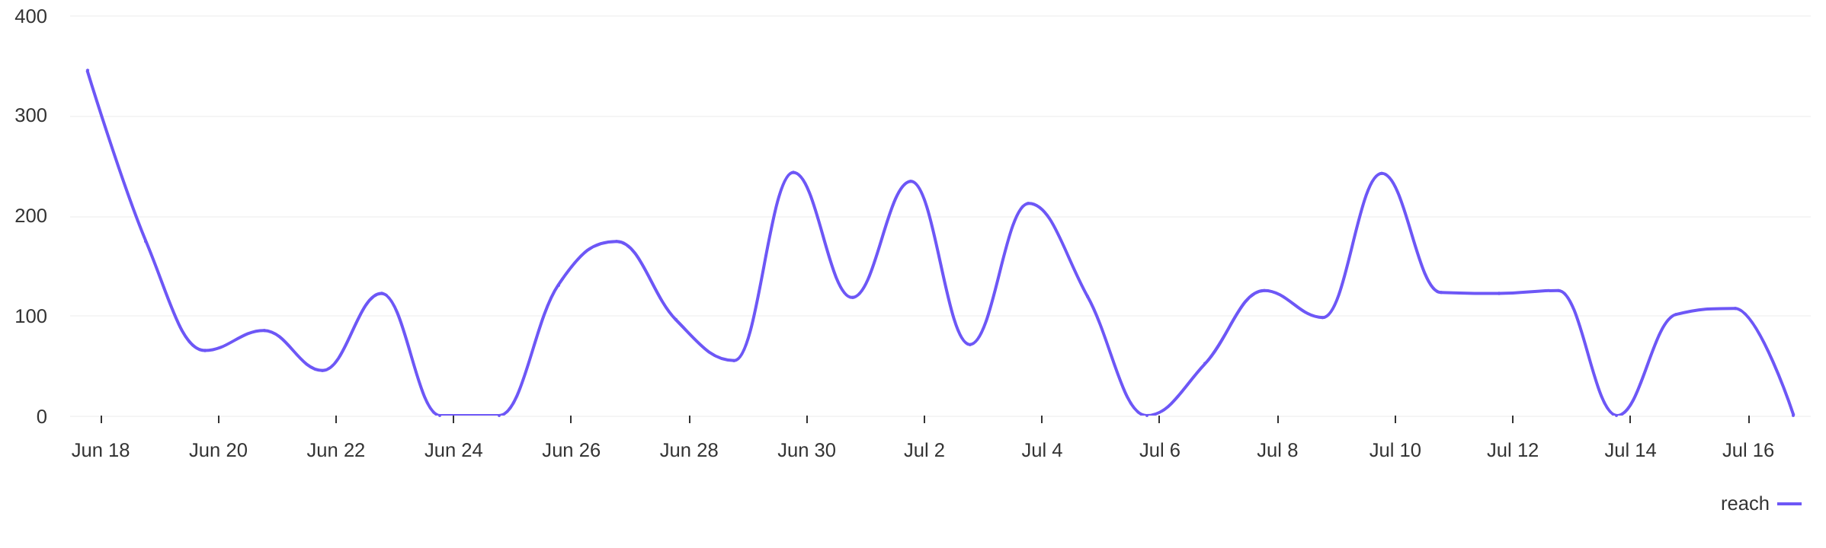
Organic Posts Reach Distribution
18 Jun 2026 - 17 Jul 2026
Unique people who have seen any post from this Instagram Profile
The estimated page reach is
3383
which is 40.37% higher than the previous period

Slide 7
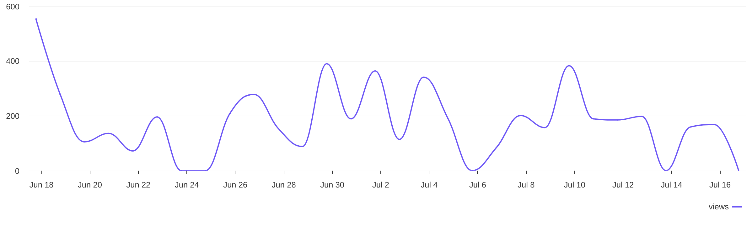
Organic Posts Impressions Distribution
18 Jun 2026 - 17 Jul 2026
The number of times the content has been seen
The estimated number of impressions is
5383
which is 57.21% higher than the previous period

Slide 8
When to post?
18 Jun 2026 - 17 Jul 2026
Based on data, this is the best time to post on Instagram to get a higher engagement
Day with the highest engagement
sun
Hour with the highest engagement
11 AM
Almost there! For better results, try to post on undefined. Seven days in a week, but this day might be the one that matters.
Day with most posts
wed
Hour with most posts
11 AM

Slide 9
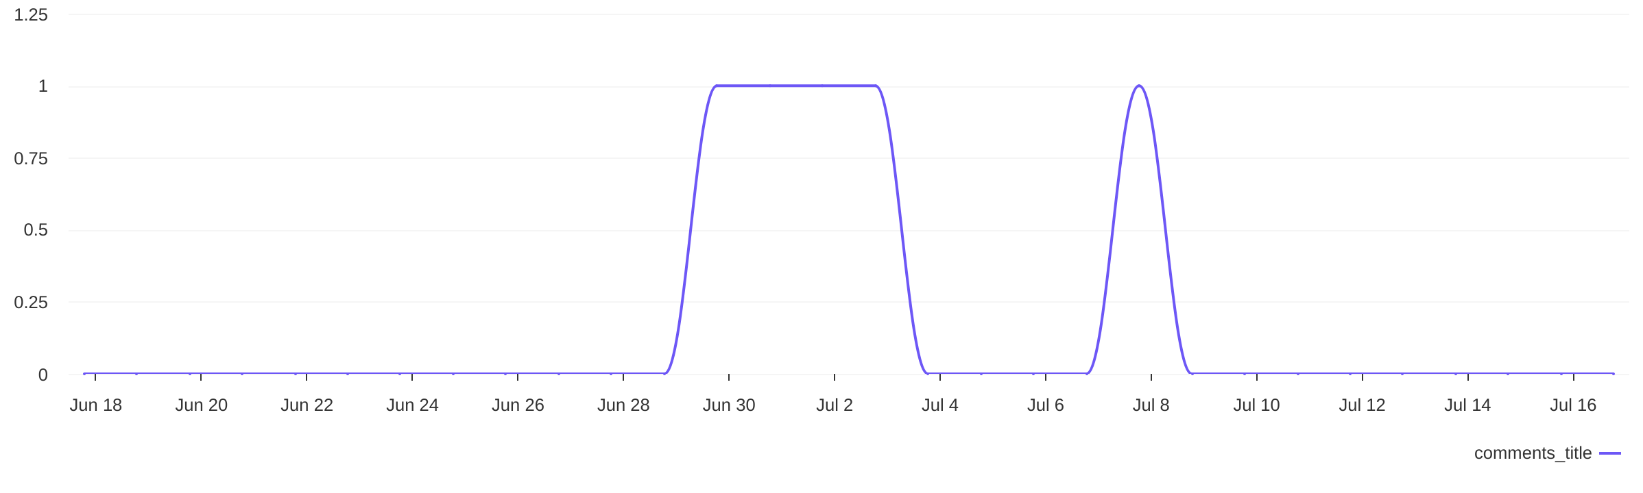

Organic Comments Distribution
18 Jun 2026 - 17 Jul 2026
Take a look at the variation of comments received
The total number of comments is
5
which is 400% higher than the previous period

Slide 10
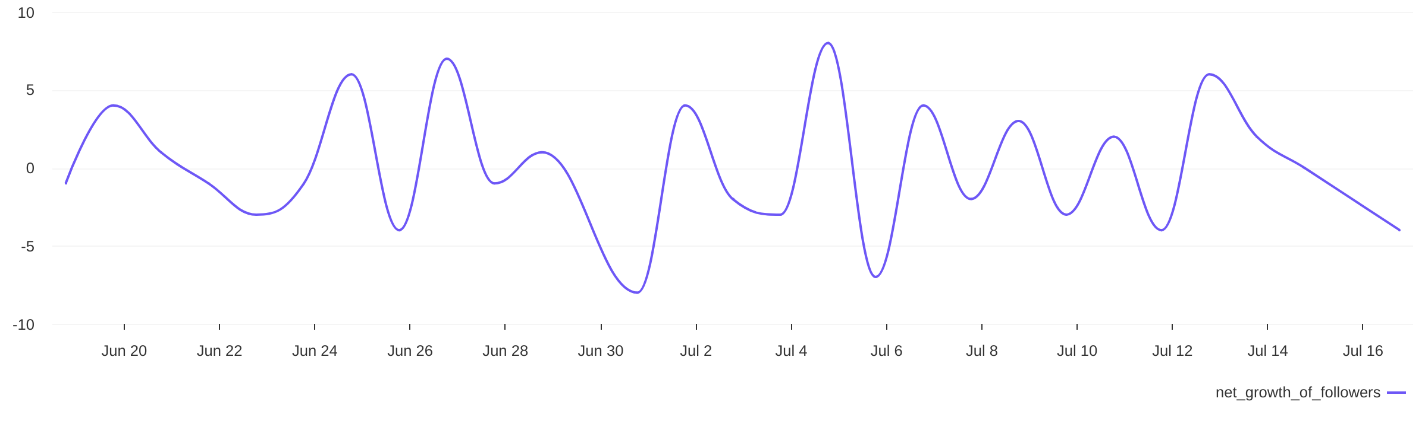

Followers Growth
18 Jun 2026 - 17 Jul 2026
Key metrics for the selected time period
The total number of followers is
The followers growth percent is
281
4
which is 2.18% higher than the previous period
which is 42.86% lower than the previous period

