Slide 1

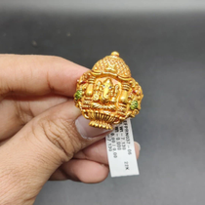

Instagram Social Report
Vardhman Jewels vs Psg Gold
18 Jun 2026 - 17 Jul 2026

Slide 2


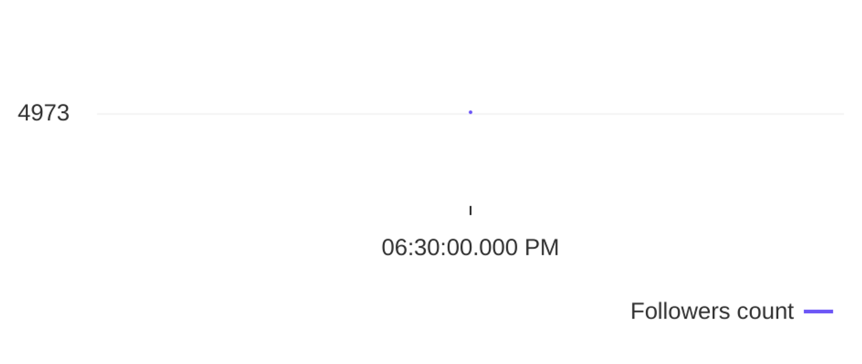
Social Report
18 Jun 2026 - 17 Jul 2026
Profile summary • Vardhman Jewels
Key metrics of the profile
105
12
Followers' evolution
8.8
posts
engagement
0.2%
avg. engagement
avg. engagement
/ post
rate / post
0
Followers
0%
Avg. Eng. Rate/Post
4973
engagement
Eng. Rate/Profile
profile growth
Followers
rate / profile

Slide 3

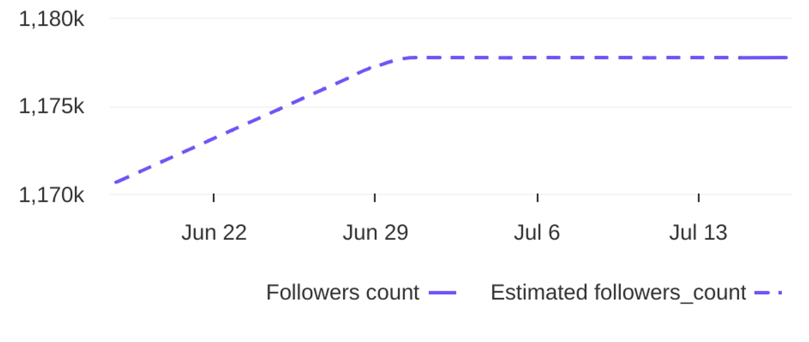
Social Report
18 Jun 2026 - 17 Jul 2026
Profile summary • Psg Gold
Key metrics of the profile
59.9K
190
Followers' evolution
315.3
posts
engagement
0.0%
avg. engagement
avg. engagement
/ post
rate / post
7066
Followers
0.6%
Avg. Eng. Rate/Post
1177713
engagement
Eng. Rate/Profile
profile growth
Followers
rate / profile

Slide 4


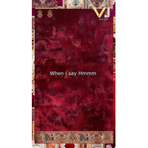
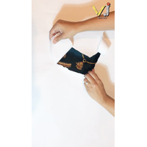

Social Report
18 Jun 2026 - 17 Jul 2026
Top posts • Vardhman Jewels
The most engaging posts
Date
Image
Text
Type
Engagement
Comments
Likes
✨ Real stories, pure trust! ✨ (Vardhaman Jewels customer review, best jewellery collection, pure...
reel
reel
reel
carousel_album
image
24
15
12
11
9
1
1
0
1
0
23
14
12
10
9
25 Jun
06 Jul
07 Jul
18 Jun
26 Jun
If you know , you know. That “hmm” isn’t just a sound ; it’s the sound of masterpiece in progress...
✨ The wait ends here. Unveiling our newest jewellery collection—crafted to sparkle, designed to c...
✨Discover 2026’s hottest jewellery trends, crafted to elevate every celebration at Vardhaman Jewe...
✨See timeless elegance reflected in every handcrafted Vardhaman jewel you wear with pride✨ (Vard...

Slide 5
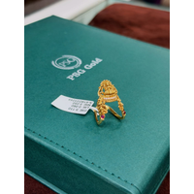
Social Report
18 Jun 2026 - 17 Jul 2026
Top posts • Psg Gold
The most engaging posts
Date
Image
Text
Type
Engagement
Comments
Likes
2.600 gms
reel
reel
carousel_album
reel
reel
5743
4269
2085
1625
1053
64
173
3
12
4
5679
4096
2082
1613
1049
18 Jun
03 Jul
06 Jul
18 Jun
10 Jul
22 CT gold / BIS 916 Hall mark Necklace 13.862 gms Contact No. For more details 6361212022 , 9...
22 CT gold / BIS 916 Hall mark Ring Contact No. For more details 6361212022 , 9113993129 psg.g...
2 gms
22 CT gold / BIS 916 Hall mark Chain 10.500 gms Contact No. For more details 6361212022 , 911...

Slide 6
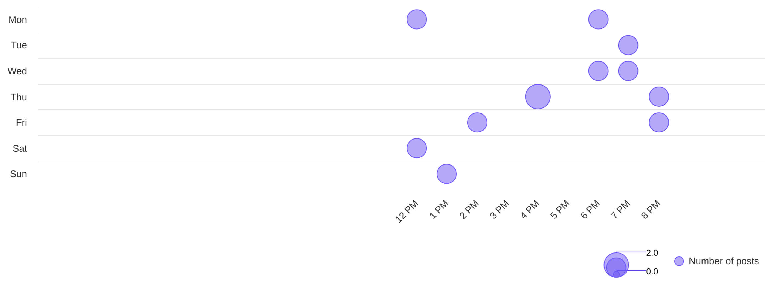
Social Report
18 Jun 2026 - 17 Jul 2026
Publishing behaviour • Vardhman Jewels
See the posting patterns of the page
Posting times
4 PM
thu
Day with most posts
Hour with most posts

Slide 7
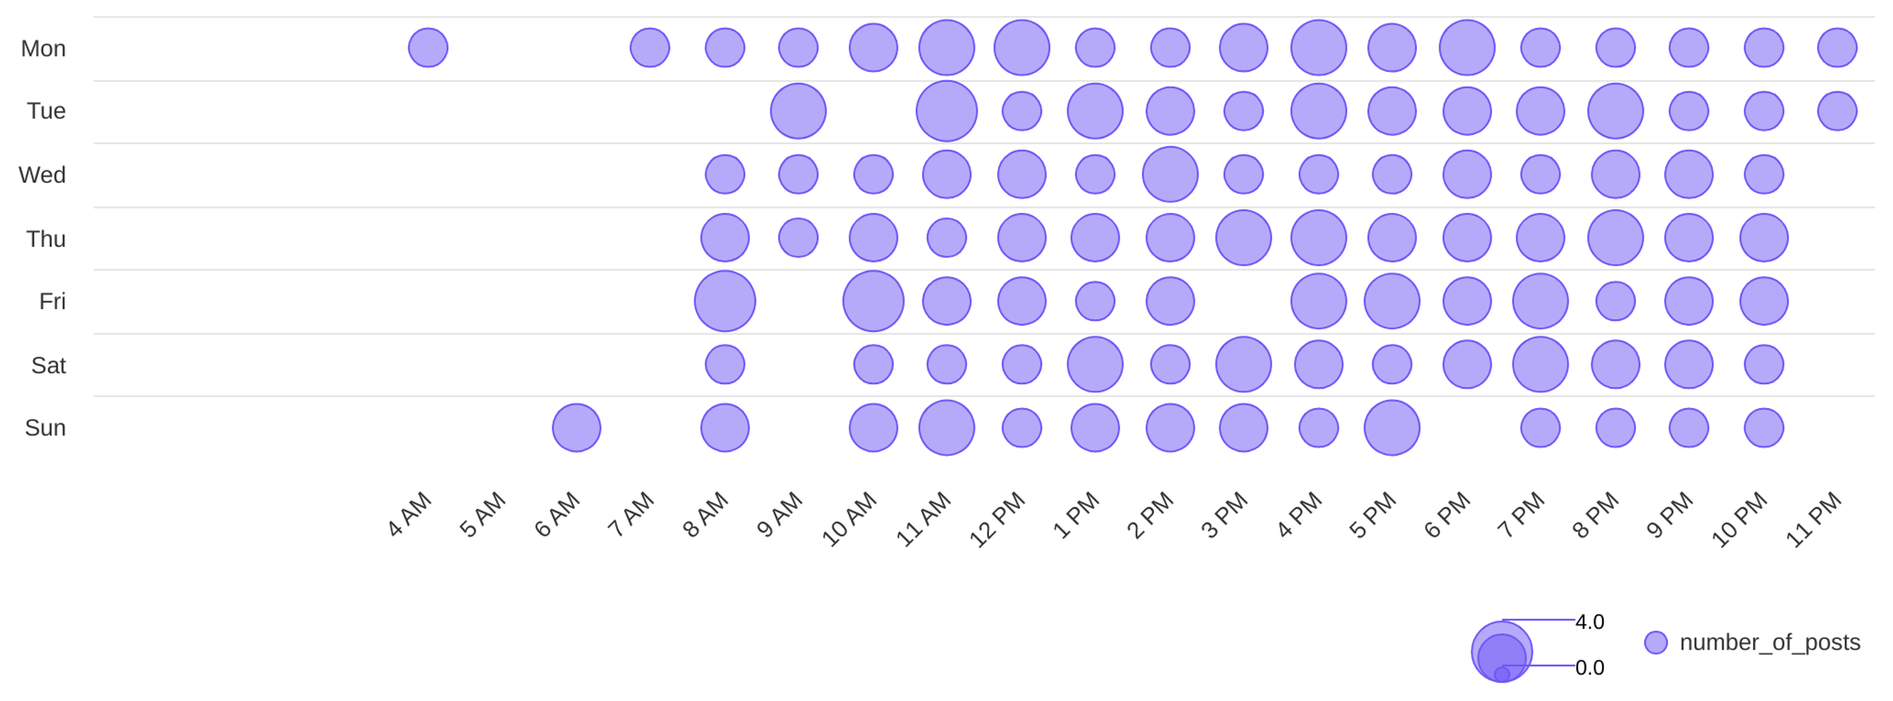
Social Report
18 Jun 2026 - 17 Jul 2026
Publishing behaviour • Psg Gold
See the posting patterns of the page
Posting times
11 AM
tue
Day with most posts
Hour with most posts

Slide 8
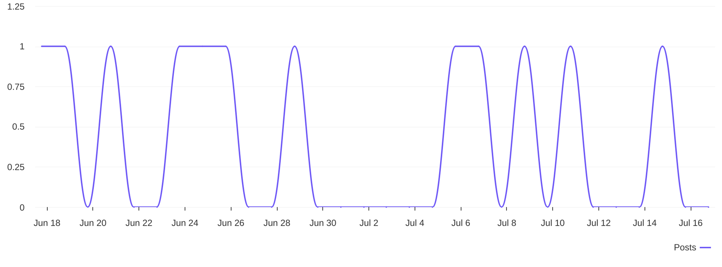
Social Report
18 Jun 2026 - 17 Jul 2026
Publishing behaviour • Vardhman Jewels
See the posting patterns of the page
Distribution of posts
0.4
avg posts / day

Slide 9
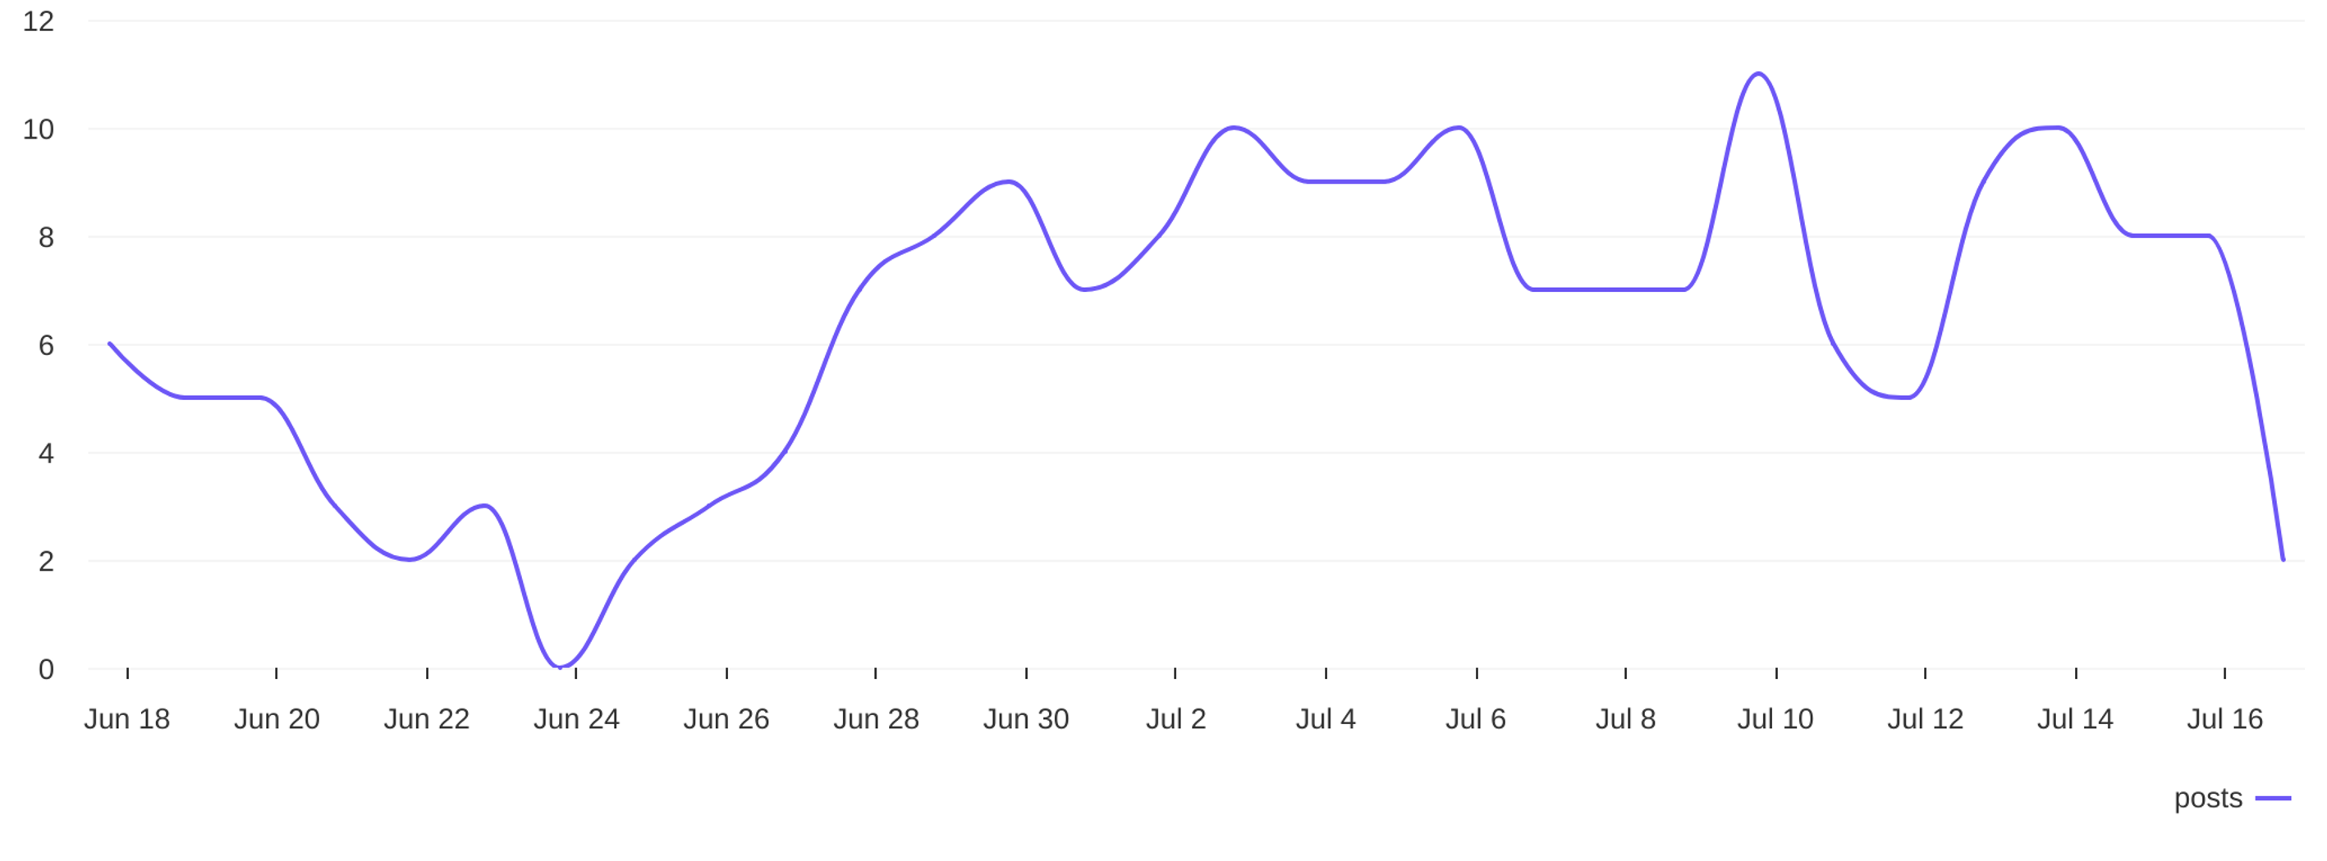
Social Report
18 Jun 2026 - 17 Jul 2026
Publishing behaviour • Psg Gold
See the posting patterns of the page
Distribution of posts
6.3
avg posts / day

Slide 10
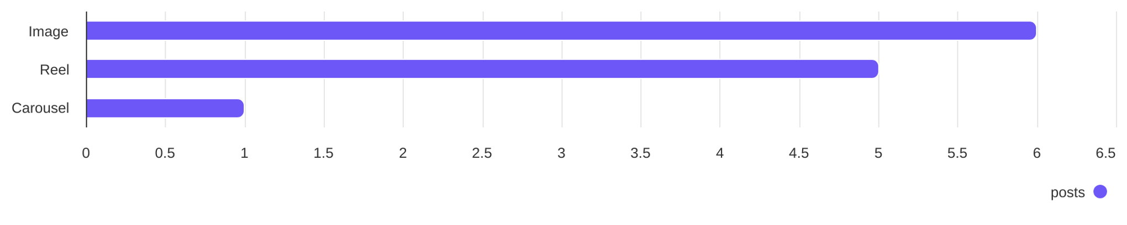
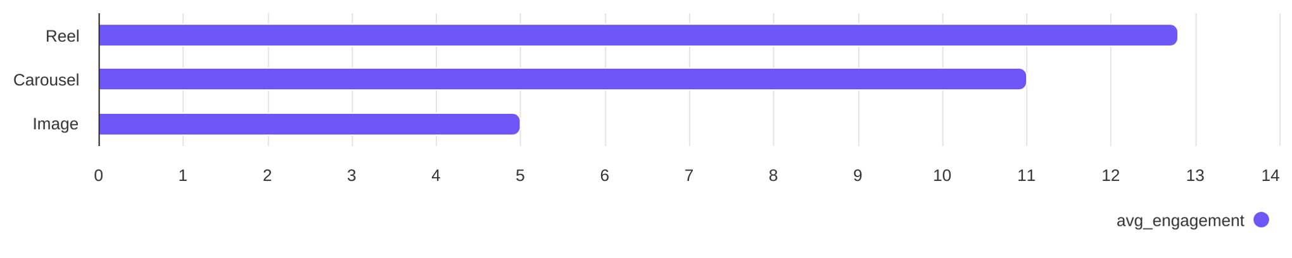
Social Report
18 Jun 2026 - 17 Jul 2026
Content performance • Vardhman Jewels
See what types of post the profile published and understand the success of different post types
Post types
Image count
Reel count
Carousel count
6
5
1
Post types ranked by avg. engagement
Image
Reel
Carousel
5
12.80
11

Slide 11
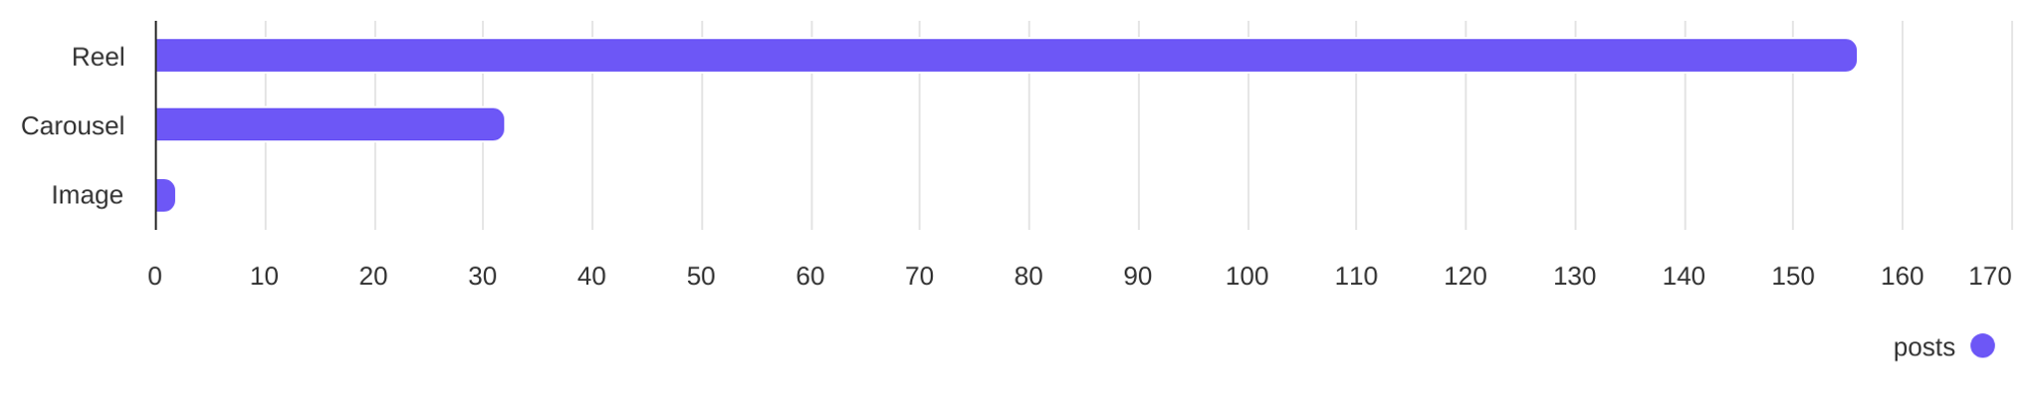
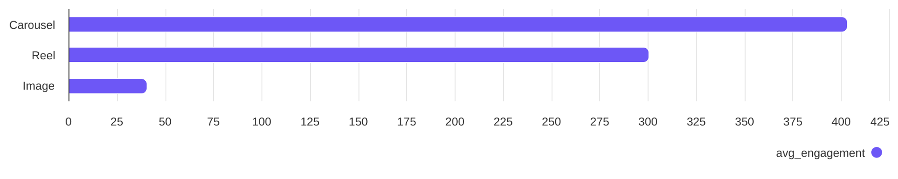
Social Report
18 Jun 2026 - 17 Jul 2026
Content performance • Psg Gold
See what types of post the profile published and understand the success of different post types
Post types
Reel count
Carousel count
Image count
156
32
2
Post types ranked by avg. engagement
Reel
Carousel
Image
300.75
403.34
40.50

Slide 12
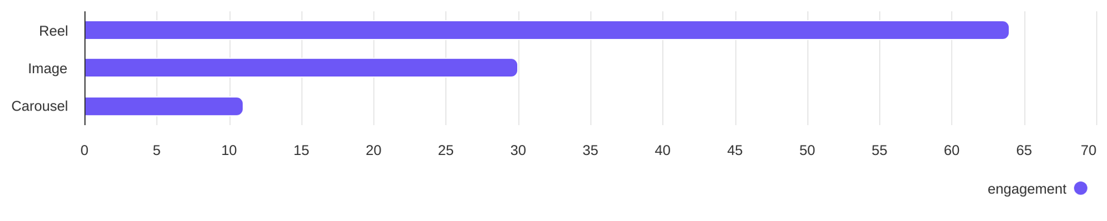
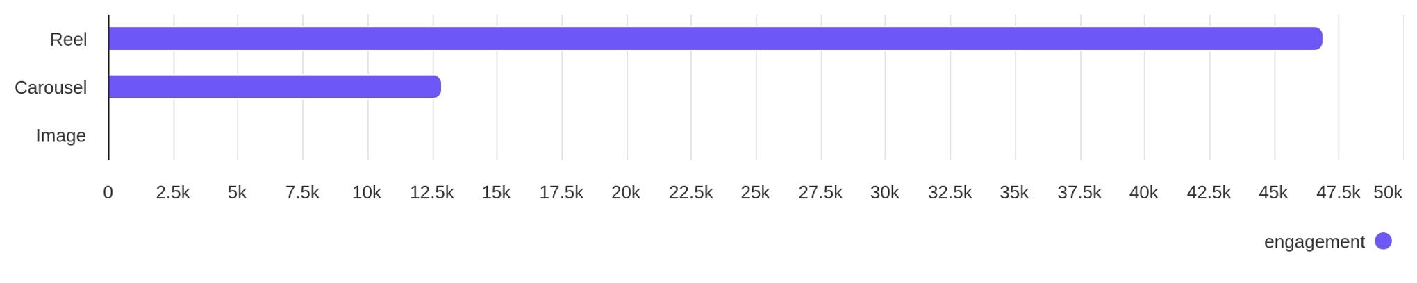
Social Report
18 Jun 2026 - 17 Jul 2026
Engagement overview
See the distribution of engagement (likes + comments)
Post types ranked by engagement - Vardhman Jewels
Image
Reel
Carousel
30
64
11
Post types ranked by engagement - Psg Gold
Reel
Carousel
Image
46.92K
12.91K
81

Slide 13
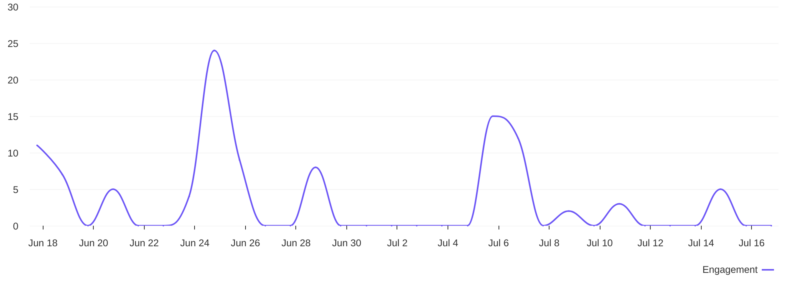
Social Report
18 Jun 2026 - 17 Jul 2026
Engagement overview • Vardhman Jewels
See the distribution of engagement (likes + comments)
Engagement distribution / day
3.5
avg eng / day

Slide 14
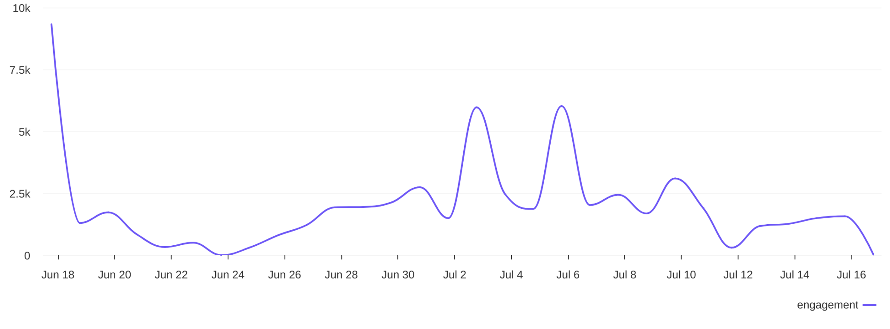
Social Report
18 Jun 2026 - 17 Jul 2026
Engagement overview • Psg Gold
See the distribution of engagement (likes + comments)
Engagement distribution / day
1997
avg eng / day

Slide 15
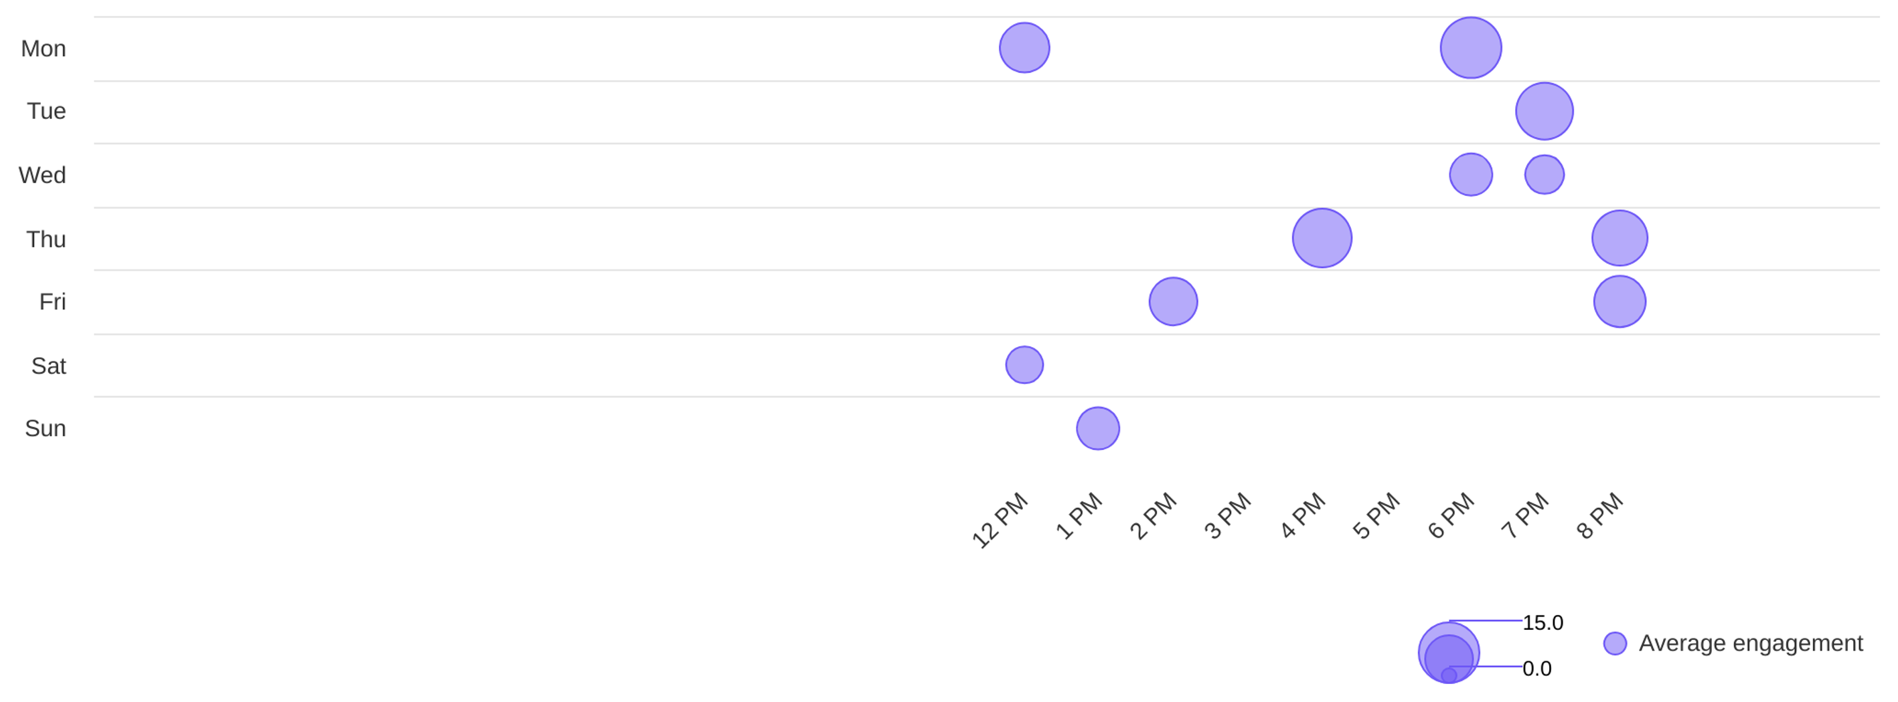
Social Report
18 Jun 2026 - 17 Jul 2026
Engagement overview • Vardhman Jewels
See the distribution of engagement (likes + comments)
Best time to post by engagement
mon
6 PM
Day with most engagement
Hour with most engagement

Slide 16
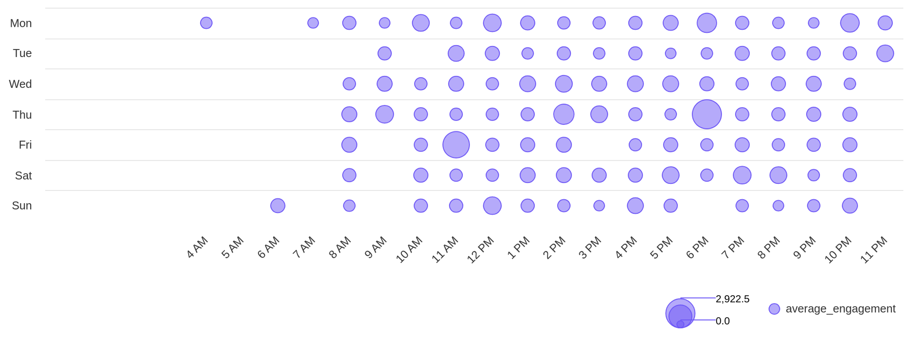
Social Report
18 Jun 2026 - 17 Jul 2026
Engagement overview • Psg Gold
See the distribution of engagement (likes + comments)
Best time to post by engagement
thu
6 PM
Day with most engagement
Hour with most engagement

Slide 17
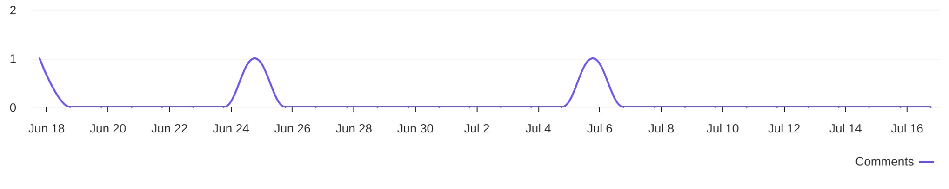
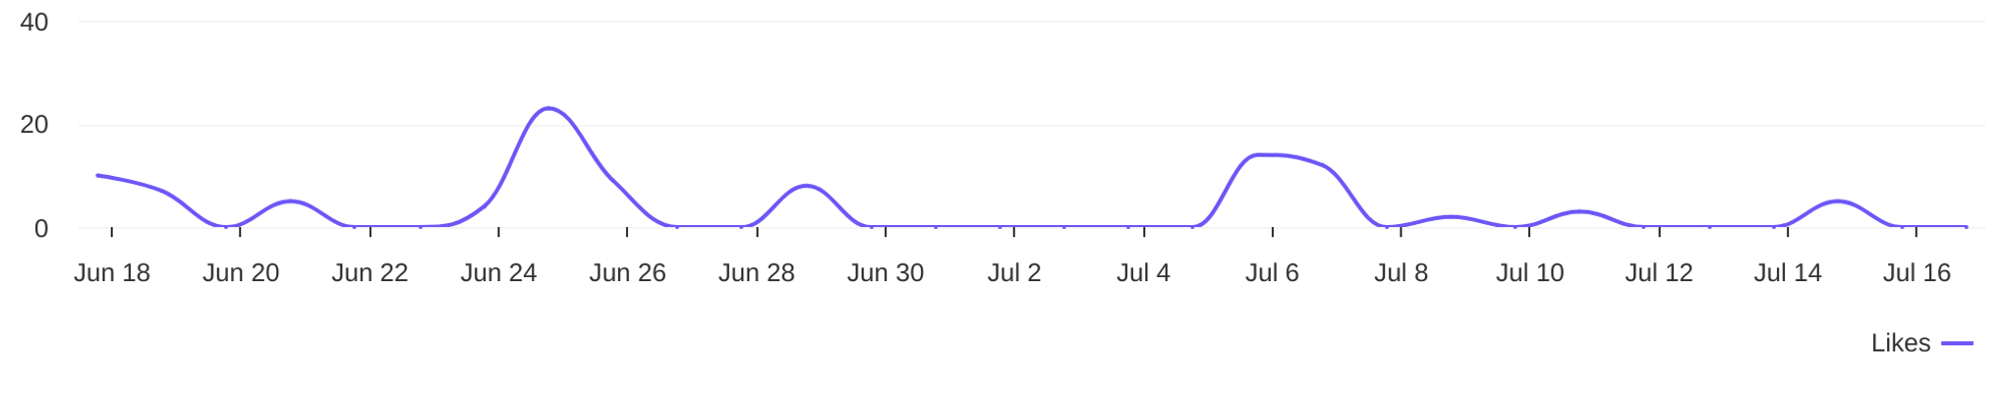
Social Report
18 Jun 2026 - 17 Jul 2026
Engagement metrics • Vardhman Jewels
Breakdown of engagement for the profile
Distribution of comments / day
3
comments
Distribution of likes / day
102
likes

Slide 18
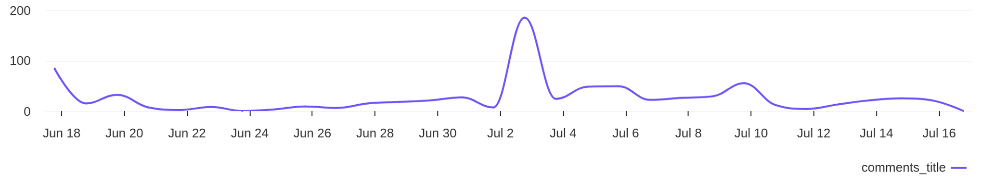
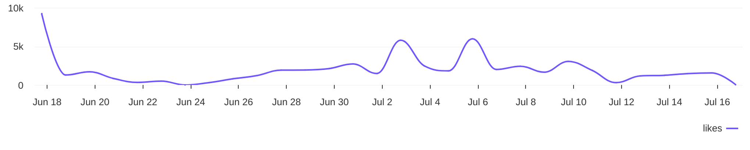
Social Report
18 Jun 2026 - 17 Jul 2026
Engagement metrics • Psg Gold
Breakdown of engagement for the profile
Distribution of comments / day
788
comments
Distribution of likes / day
59.1K
likes

Slide 19
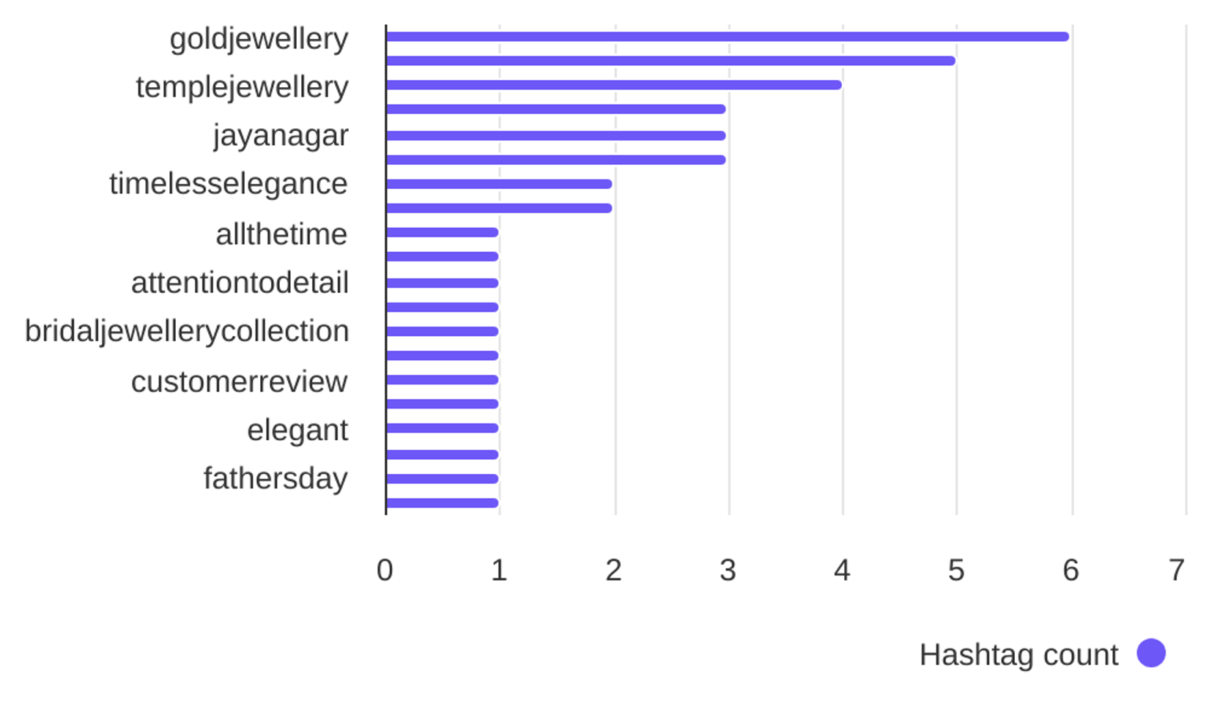

Social Report
18 Jun 2026 - 17 Jul 2026
Hashtag analysis • Vardhman Jewels
See what hashtags are used the most
5
Most used hashtags
avg. hashtags
/ post
Hashtags
Occurrences
goldjewellery
vardhamanjewellers
templejewellery
bridaljewellery
jayanagar
vardhamanjewels
timelesselegance
6
5
4
3
3
3
2

Slide 20
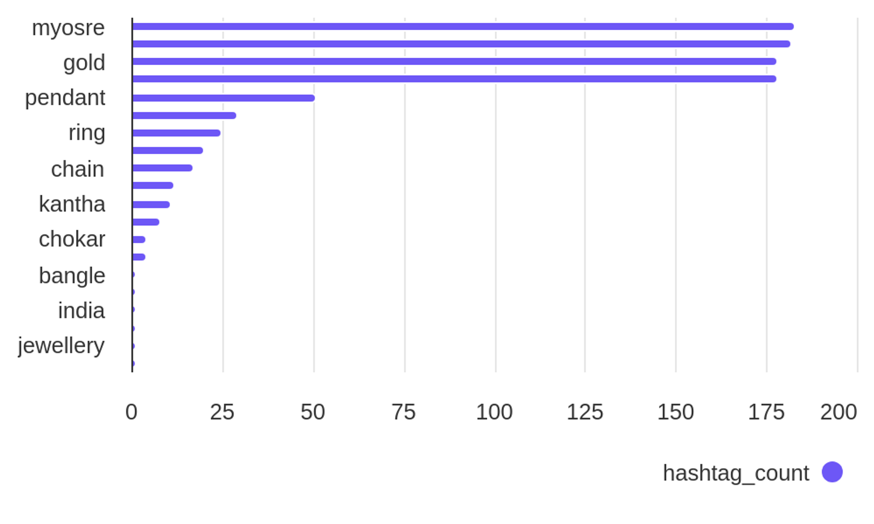
Social Report
18 Jun 2026 - 17 Jul 2026
Hashtag analysis • Psg Gold
See what hashtags are used the most
4.8
Most used hashtags
avg. hashtags
/ post
Hashtags
Occurrences
myosre
sumitjewels
gold
longharam
pendant
necklace
ring
183
182
178
178
51
29
25

