Slide 1
Resolution Lens
Market research with Panta
Geon Woo Kim
South Korea
Product presentation, September 2026
Prototype developed with AI coding assistance
Notes:
Product presentation for the Panta sidetrack and Colosseum. Entrant name and country come from the owner-created public profile: https://superteam.fun/earn/t/chocobar. No prior experience or founder credentials are asserted. Product source: https://github.com/harry-kim-droid/resolution-lens. This is a silent product presentation, not a recording of the entrant speaking.

Slide 2
Market review
A researcher comparing markets needs to understand the event behind each quote.
Which resolution wording is available?
Which sources does it link?
When did the viewer fetch this observation?
Problem hypothesis. External demand remains unvalidated.
Notes:
Problem hypothesis, not validated customer research. Derived from the prototype design and observed missing metadata. No user interviews or customer demand are claimed. Product source: https://github.com/harry-kim-droid/resolution-lens.

Slide 3
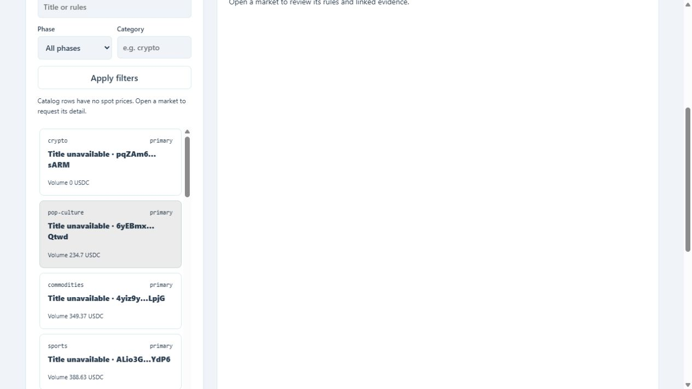
Panta API integration
Market catalog and filters
Cursor pagination
Market detail and quotes
Recent trade records
The API key stays on the local server. The viewer uses market reads only.
Dated API observations from September 30, 2026
Notes:
Authenticated GET endpoints: https://docs.panta.market/api-reference/markets/list.md, https://docs.panta.market/api-reference/markets/get.md, https://docs.panta.market/api-reference/markets/trades.md. Screenshot: https://github.com/harry-kim-droid/resolution-lens/blob/main/demo/screens/02-catalog.png. Dated authorized live-key capture, September 30, 2026.

Slide 4
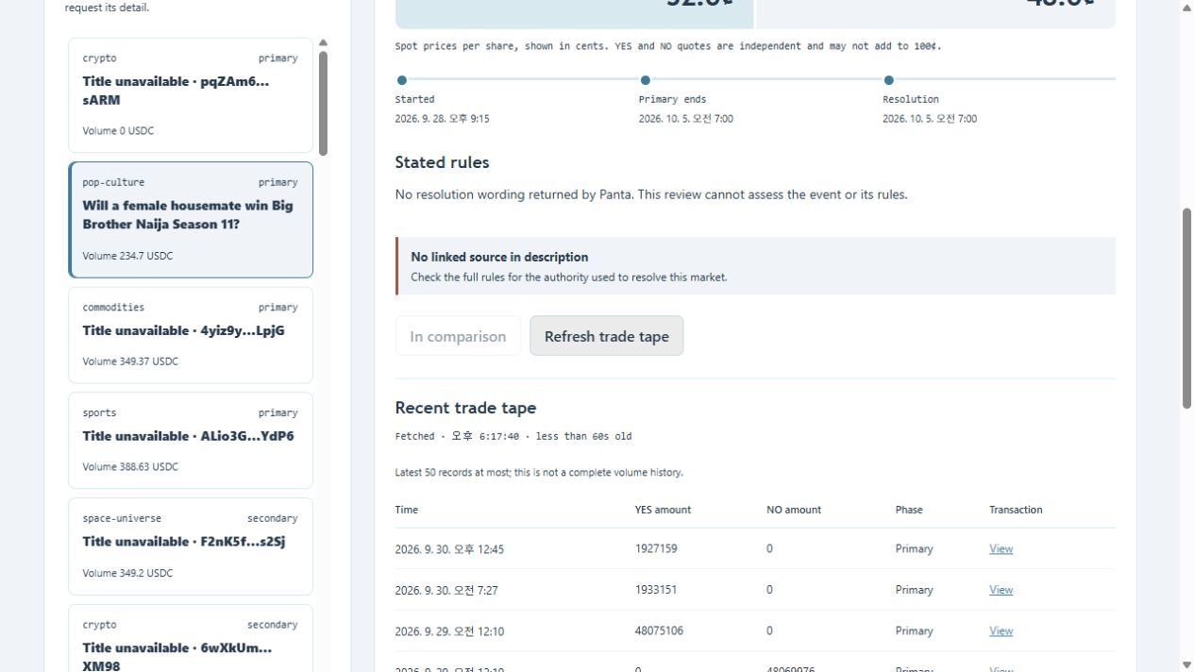
Verified prototype
40 markets across two pages
9 recent trade records
24 automated tests passed
Compare up to three markets.
Export a dated JSON review.
Captured results describe the tested prototype and observation time.
Notes:
Actual authorized live-key observations from September 30, 2026: 40 markets across two disjoint pages and nine returned trade records. Screenshot: https://github.com/harry-kim-droid/resolution-lens/blob/main/demo/screens/05-trades.png. All 24 tests passed in the public publication checkout on Windows, including an actual disposable DPAPI round trip. Test source: https://github.com/harry-kim-droid/resolution-lens/tree/main/test.

Slide 5
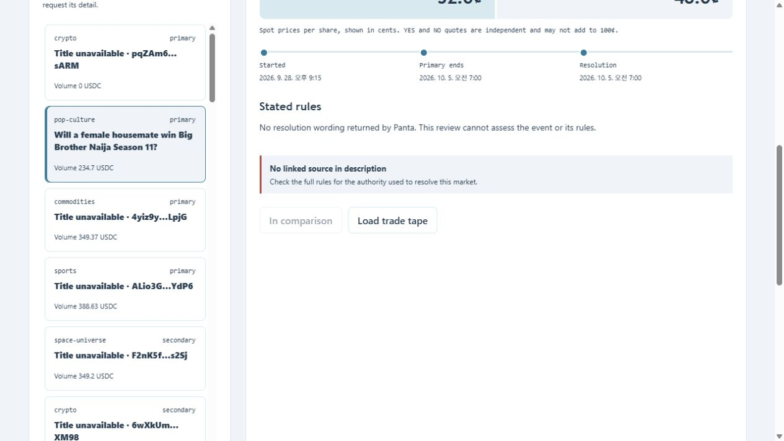
Missing resolution data
The reviewed market returned no resolution wording. Missing descriptions and null quotes remain visible.
The viewer cannot assess absent rules or independently verify market outcomes.
Notes:
The reviewed live-key market returned no resolution wording. Most titles in the initial catalog page were blank. Screenshot: https://github.com/harry-kim-droid/resolution-lens/blob/main/demo/screens/04-rules.png. These are dated observations, not a claim about every Panta market. Provider sources and outcomes are not independently verified.

Slide 6
Validation and distribution
Initial audience: researchers who repeatedly compare markets.
Next work: investigate missing metadata and test the review workflow with actual users.
Shared review histories and annotations are possible paid workflows. Demand, pricing and API costs still need validation.
No customers, commercial revenue or awarded contest funds.
github.com/harry-kim-droid/resolution-lens
Notes:
Distribution and paid-workflow ideas are hypotheses, not established demand, user commitments or a commercial forecast. API pricing remains unconfirmed: https://docs.panta.market/guides/terms-of-use.md, section 12. Current product source: https://github.com/harry-kim-droid/resolution-lens. No customers, commercial revenue or awarded contest funds have been established.

