Slide 1
3-D Geometry

Slide 2
Outline
Coordinate systems
3-D homogeneous transformations
  Translation, scaling, rotation
Changes of coordinates
  Rigid transformations

Slide 3

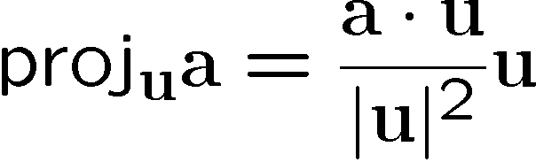

Vector Projection
The projection of vector a onto u is that component of a in the direction of u

Slide 4
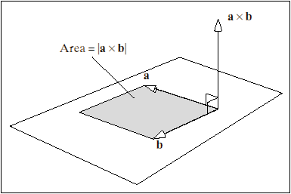
Vector Cross Product
Definition: If a = (x_{a}, y_{a}, z_{a})^{T} and b = (x_{b}, y_{b}, z_{b})^{T}, then:
c = a x b
  c is orthogonal to both
  a and b (direction given
  by right-hand rule),
  with magnitude
  |c| = |a||b| sin θ
from Hill

Slide 5



Coordinate System: Definitions
Let x = (x, y, z)^{T} be a point in 3-D space (R³). What do these values mean?
A coordinate system in R^{n} is defined by an origin o and n orthogonal basis vectors
  In R³, positive direction of each axis X, Y, Z is indicated by unit vector i, j, k, respectively, where k = i X j (in a right-handed system)
  Coordinate is length of projection of vector from origin to point onto axis basis vector.
o
x

Slide 6
3-D Camera Coordinates
Right-handed system
From point of view of camera looking out into scene:
  +X right, -X left
  +Y down, -Y up
  +Z in front of camera, -Z behind

Slide 7
Going from 2-D to 3-D
Points: Add z coordinate
Transformations: Become 4 x 4 matrices with extra row/column for z component—e.g., translation:

Slide 8
3-D Scaling

Slide 9
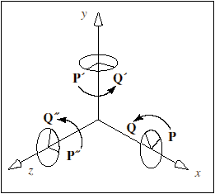
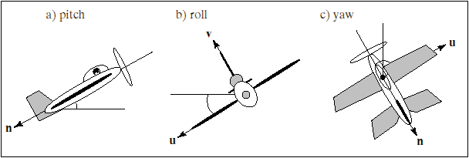
3-D Rotations
In 2-D, we are always rotating in the plane of the image, but in 3-D the axis of rotation itself is a variable
Three canonical rotation axes are the coordinate axes X, Y, Z
These are sometimes referred to in aviation terms: pitch, yaw or heading, and roll, respectively
from Hill
from Hill

Slide 10
3-D Euler Rotation Matrices
Similar to 2-D rotation matrices, but with coordinate corresponding to rotation axis held constant
E.g., a rotation about the X axis of θ radians:

Slide 11
3-D Rotation Matrices
General form is:
Properties
  R^{T} = R⁻¹
  Preserves vector lengths, angles between vectors
  Upper-left block R_{3x3} is orthogonal matrix
    Rows form orthonormal basis (as do columns): Length = 1, mutually orthogonal
    So R_{3x3} x projects point x onto unit vectors represented by rows of R_{3x3}

Slide 12


Coordinate System Conversion
Camera coordinates C: Origin at center of camera, Z axis pointed in viewing direction
World coordinates W: Arbitrary origin, axes
  Way to specify camera location, orientation (aka pose) in same frame as scene objects
^{C}x, ^{W}x,: Same point in different coordinates

Slide 13
Coordinate System Conversion
Camera coordinates C: Origin at center of camera, Z axis pointed in viewing direction
World coordinates W: Arbitrary origin, axes
  Way to specify camera location, orientation (aka pose) in same frame as scene objects
^{C}x, ^{W}x,: Same point in different coordinates

Slide 14
Coordinate System Conversion
Camera coordinates C: Origin at center of camera, Z axis pointed in viewing direction
World coordinates W: Arbitrary origin, axes
  Way to specify camera location, orientation (aka pose) in same frame as scene objects
^{C}x, ^{W}x,: Same point in different coordinates

Slide 15






Change of Coordinates: Special Case of Same Axes
Distinct origins, parallel basis vectors:

Slide 16
Change of Coordinates: Special Case of Same Origin
Just need to rotate basis vectors so that they are aligned
Rotation matrix is projection of basis vectors in new frame

Slide 17
Change of Coordinates: Special Case of Same Origin
Why is this?
A point p = (x, y, z) in R³ has coordinates ^{A}p = (^{A}x, ^{A}y, ^{A}z) in A (defined by axes i_{A}, j_{A}, and k_{A}) such that:

Slide 18
Change of Coordinates: Special Case of Same Origin
An equivalent way to write this is with matrix products:

Slide 19
Change of Coordinates: Special Case of Same Origin
This leads immediately to:
If we write this as , then we have
And we call

Slide 20
3-D Rigid Transformations
Combination of rotation followed by translation without scaling
“Moves” an object from one 3-D position and orientation (pose) to another
T
R
M

Slide 21






3-D Transformations:
Arbitrary Change of Coordinates
A rigid transformation can be used to represent a general change in the coordinate system that “expresses” a point’s location

Slide 22
Rigid Transformations: Homogeneous Coordinates
Points in one coordinate system are transformed to the other as follows:
takes the camera to the world origin, transforming world coordinates to camera coordinates
Notes:
T is the transformation taking the camera to the world origin, because this transforms points
expressed in world coordinates into the camera coordinate system

