Slide 1
Chapter 2
Digital Image Fundamentals

Slide 2
Outline
Elements of Visual Perception
Light and the Electromagnetic Spectrum
Image Sensing and Acquisition
Image Sampling and Quantization
Basic Relationships Between Pixels
Linear and Non-linear Operations

Slide 3
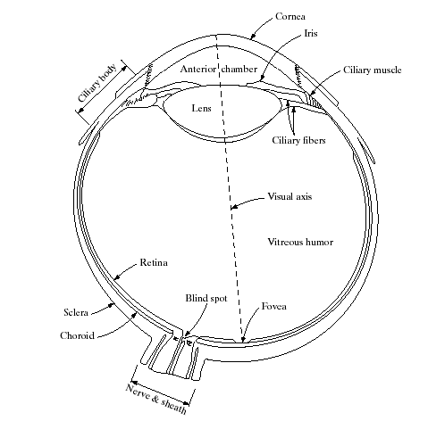
Structure of the Human Eye
眼球構造圖

Slide 4
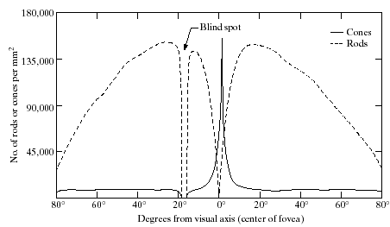
Distribution of Rods & Cones

Slide 5
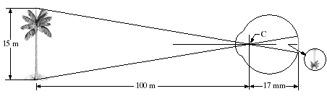
Image Formation in the Eye

Slide 6
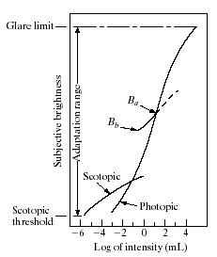
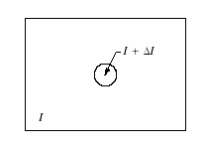
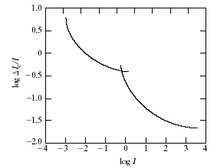
Brightness Adaptation and Discrimination
brightness discrimination is poor (the Weber ratio is large) at low levels of illumination

Slide 7
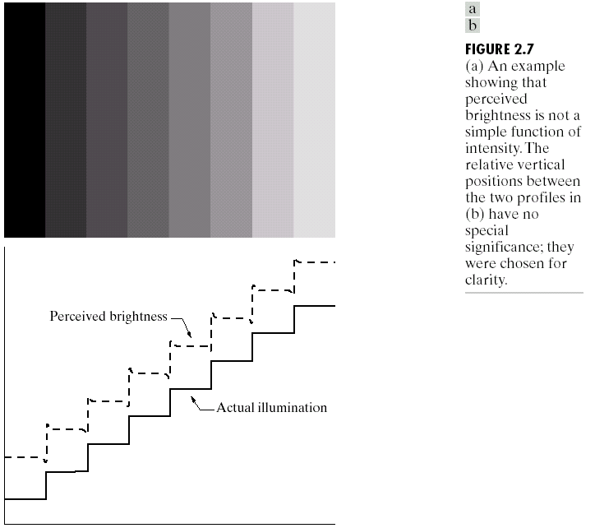
Perceived Brightness
Over shoot

Slide 8

Simultaneous Contrast

Slide 9

Optical Illuminations (I)

Slide 10
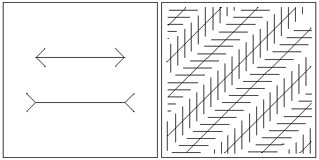
Optical Illuminations (II)

Slide 11
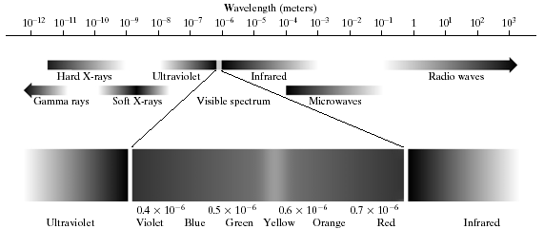
Light and the EM Spectrum

Slide 12
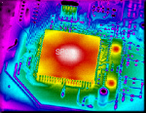
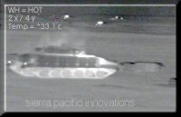
Thermal (Infrared) Imaging
Thermal cameras

Slide 13
Image Sensing & Acquisition
Using a single detector ex. thermo
Using sensor strips ex.掃描
Using sensor array

Slide 14
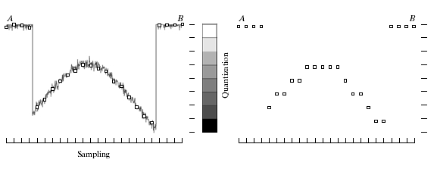
Sampling & Quantization

Slide 15
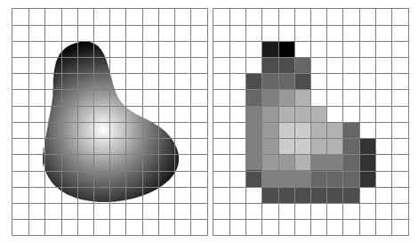
Illustration

Slide 16
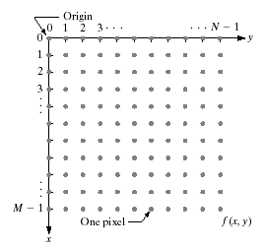


Representing Digital Images

Slide 17
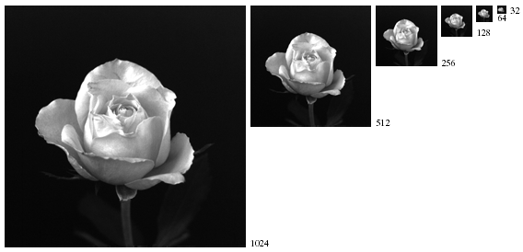
Spatial Resolution

Slide 18
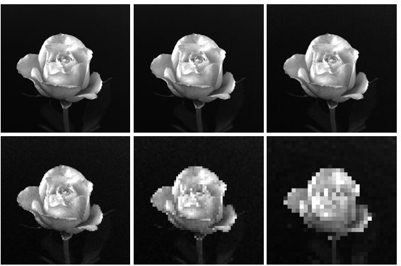
Subsample & Resample

Slide 19
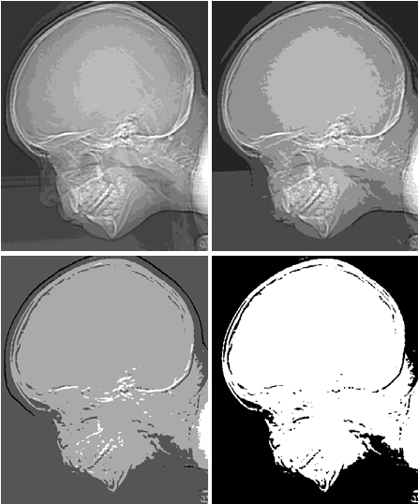
Gray-level Resolution
16
8
4
2

Slide 20
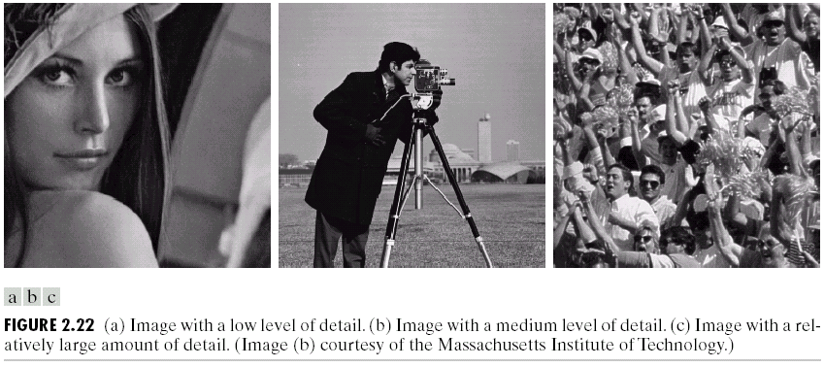
Images with Different Level of Details

Slide 21
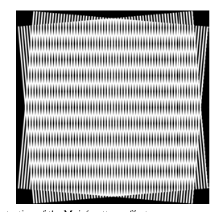
Aliasing and Moire Patterns
Occurs when sample rate is not high enough. (Shannon’s sampling theorem)

Slide 22
Zooming and Shrinking
Nearest neighbor interpolation
(receptive field)
Pixel replication (a special case of nearest neighbor interpolation)
Bilinear interpolation

Slide 23
Basic Relationships between Pixels
Neighbors
  Horizontal and vertical – 4 neighbors
  Diagonal neighbors
  8-neighbors
Adjacency, connectivity, regions and boundary

Slide 24
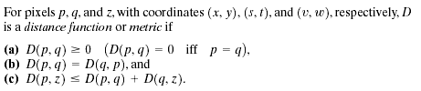
Distance Measure
Euclidean distance
D4 distance (city-block distance)
D8 distance (chessboard distance)

Slide 25
Linear and Nonlinear Operations
H is said to be a linear operator if: H(af+bg)=aH(f)+bH(g)

Slide 26
Graphics Format
Bitmap vs. vector graphics
Graphics File Formats FAQ
Graphic file formats at a glance
The programmer’s file format collection
Web graphics: JPEG vs. GIF vs. PNG.

