Slide 1
Chapter 4
Image Enhancement in the Frequency Domain

Slide 2
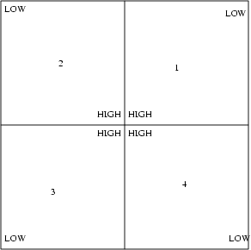
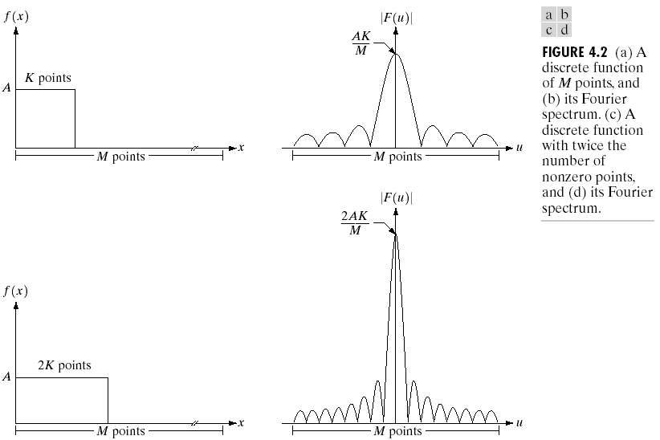
Fourier Transform
1-D Fourier Transform
1-D Discrete Fourier Transform (DFT)
Magnitude(實部加虛部開根號)
Phase(加arctan)
Power spectrum
Notes:
證 rectangular 轉換是 sinc 2k ( 證圖片上到下)
0 ~ M-1 個點從零開始所以 可以把圖片做側往右邊貼上因為是週期就比較看得懂
右上圖為2維高低頻分佈

Slide 3
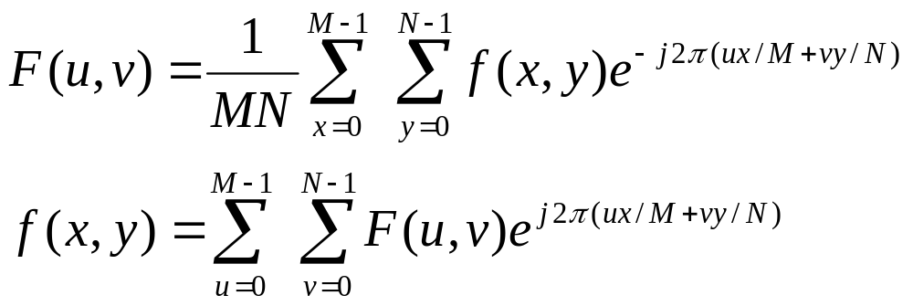
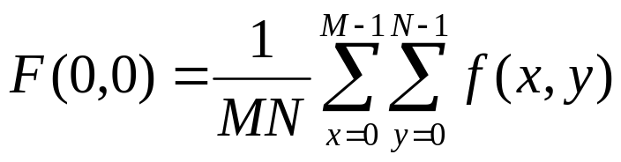
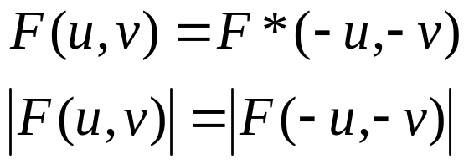

2D DFT
Definition:
if f(x,y) is real
Notes:
單純 DFT 計算量是每一個點 mn 有 mn 個點所以是 m^2n^2 計算量
所以實在做都是用 FDFT 快速傅立葉
F* = 找共軛
DFT 不管位移方向結果都會相同 ＝有週期（證明在照片裡）
要做 zero padding 不然會出問題因為有週期
| F(u,v) | = | F(M-u, N-v) |

Slide 4
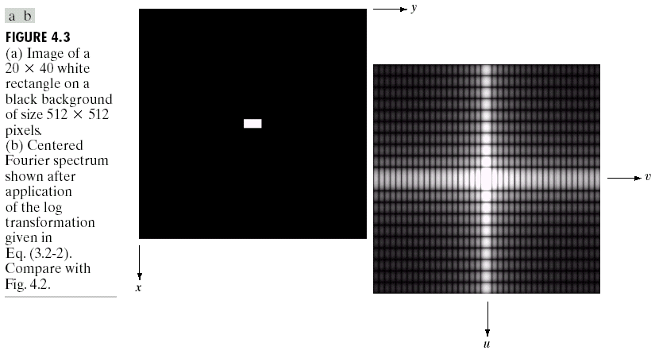
Centered Fourier Spectrum
It can be shown that:

Slide 5
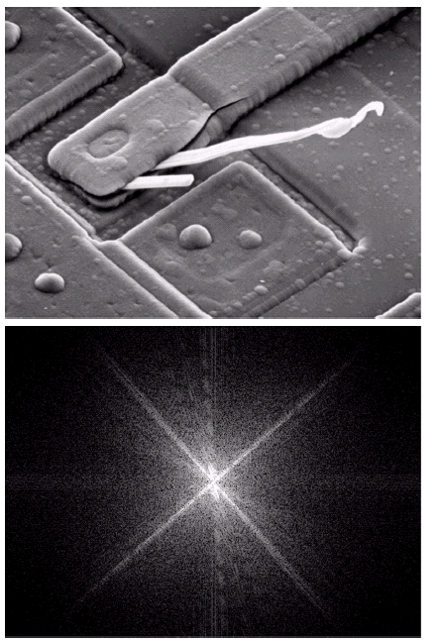
Example
SEM Image

Slide 6
Filtering in the Frequency Domain
Multiply the input image by (-1)^x+y to center the transform
Compute F(u,v), the DFT of input
Multiply F(u,v) by a filter H(u,v)
Computer the inverse DFT of 3
Obtain the real part of 4
Multiply the result in 5 by (-1)^(x+y)

Slide 7
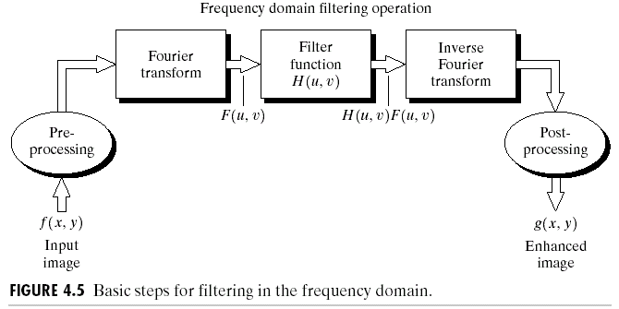
Fourier Domain Filtering

Slide 8
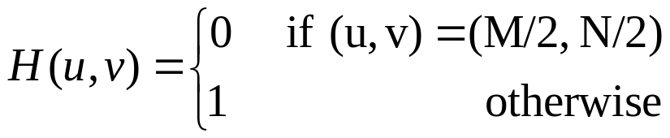
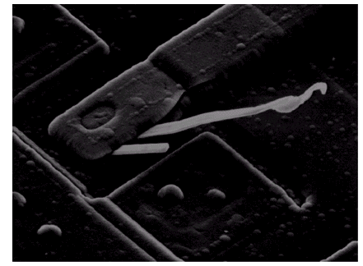
Some Basic Filters
Notch filter:

Slide 9
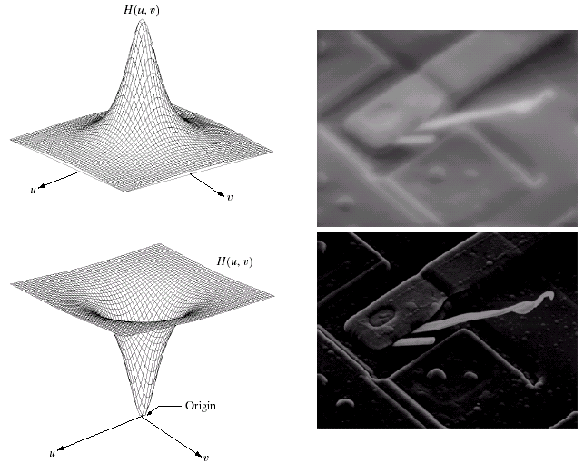
Lowpass and Highpass Filters

Slide 10
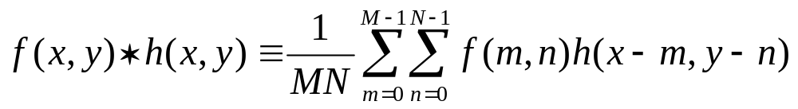
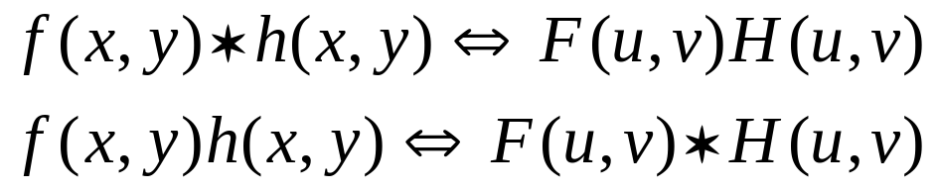
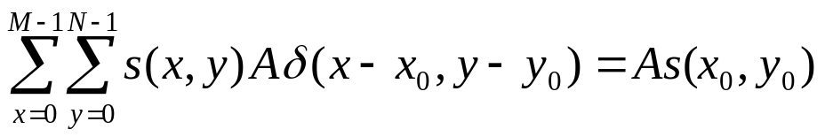
Convolution Theorem
Definition
Theorem
Need to define the discrete version of impulse function to prove these results.

Slide 11
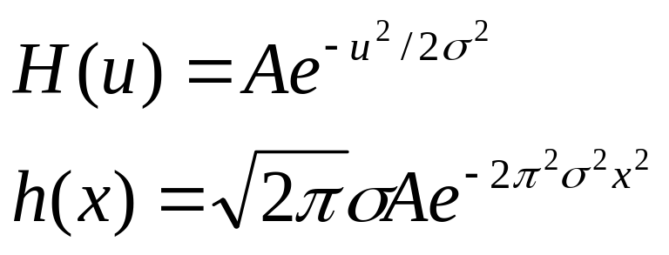
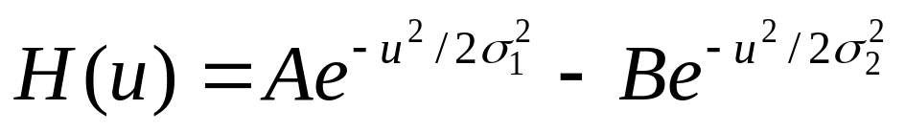
Gaussian Filters
Difference of Gaussians (DoG)

Slide 12
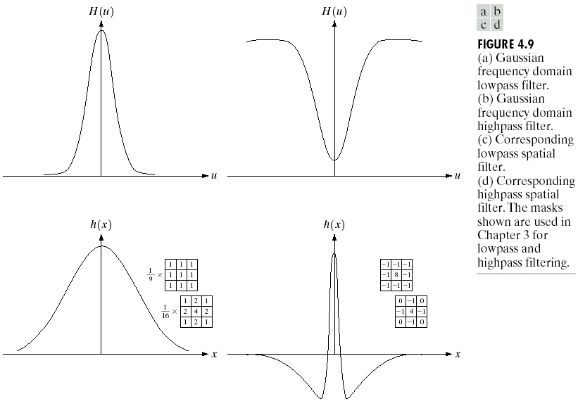
Illustration

Slide 13
Smoothing Filters
Ideal lowpass filters
Butterworth lowpass filters
Gaussian lowpass filters

Slide 14
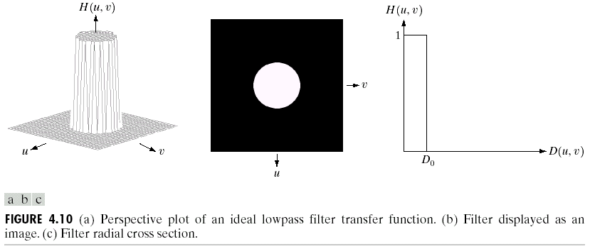
Ideal Lowpass Filters

Slide 15
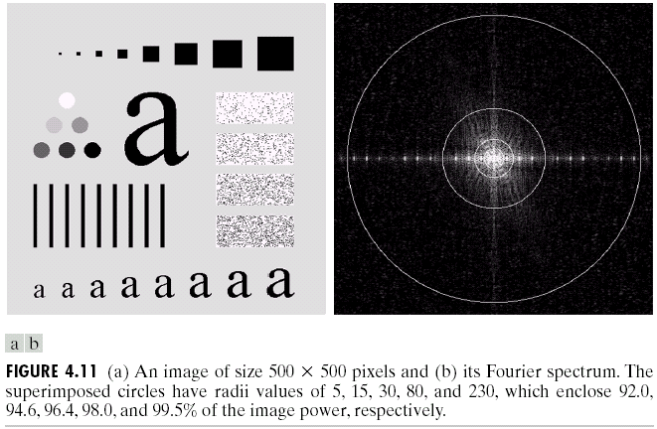
Example

Slide 16
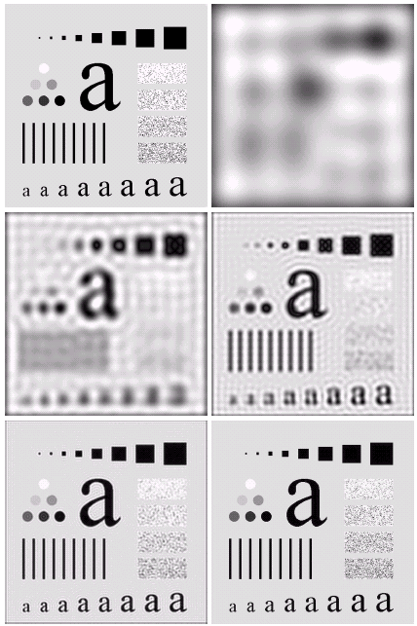
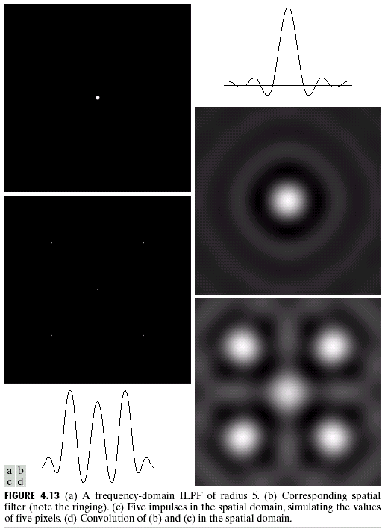
Ringing Effect

Slide 17
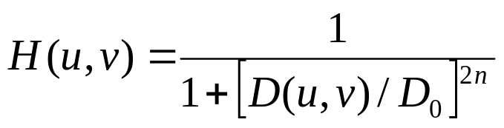
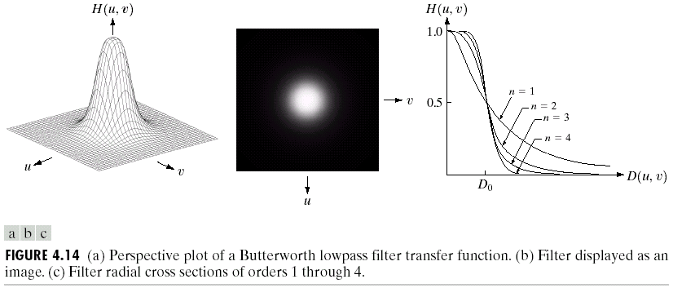
Butterworth Lowpass Filters
Definition:

Slide 18
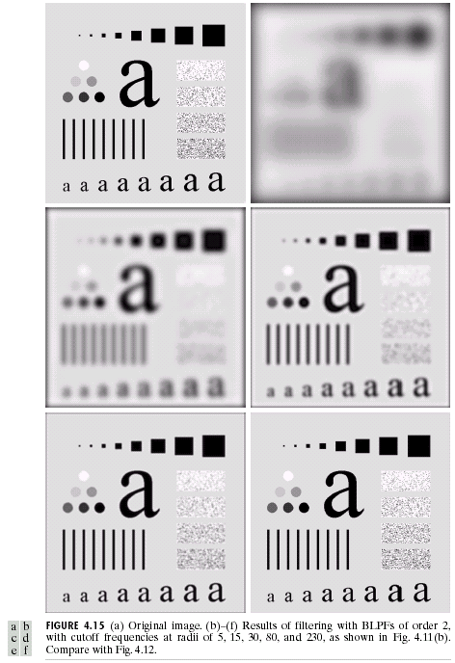
Example

Slide 19
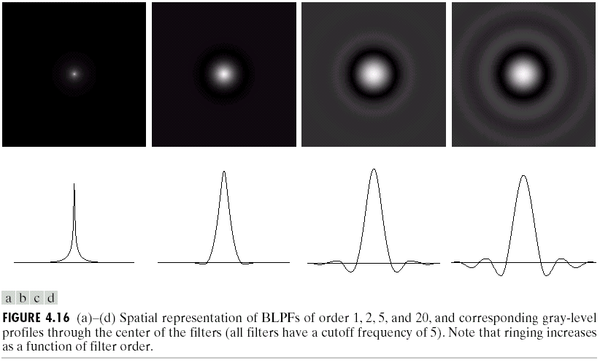
Ringing Effect

Slide 20
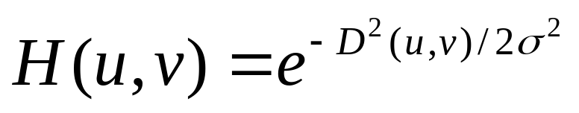
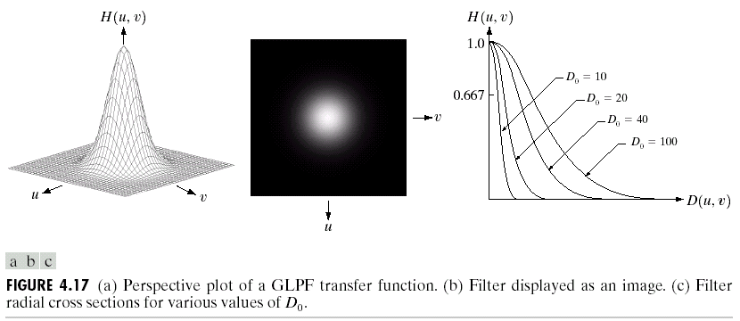
Gaussian Lowpass Filters
Definition:

Slide 21
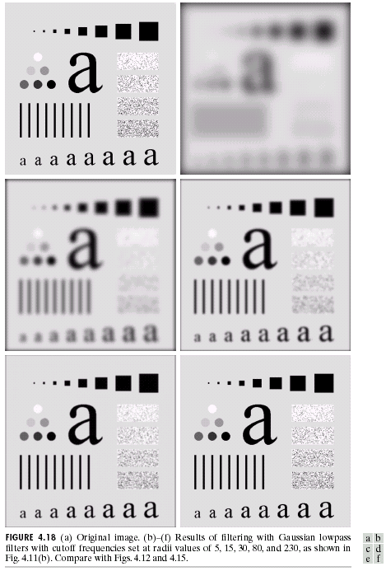
Example

Slide 22
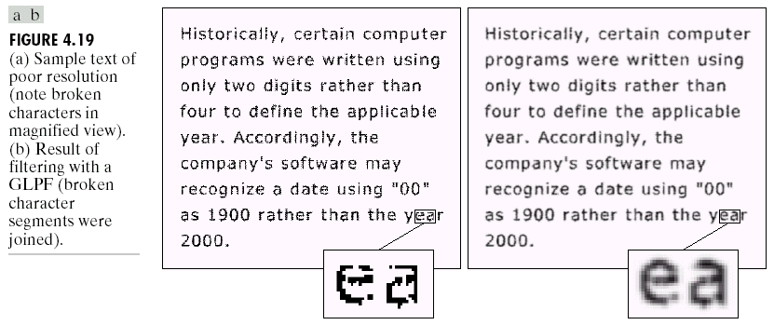
More example

Slide 23
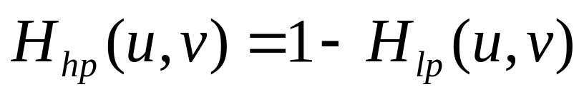
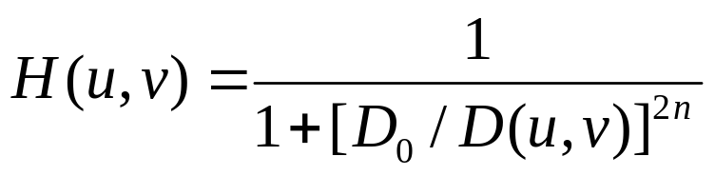
Sharpening Filters
High-pass filters
In general,
Ideal highpass filter
Butterworth highpass filter:
Gaussian highpass filters

Slide 24
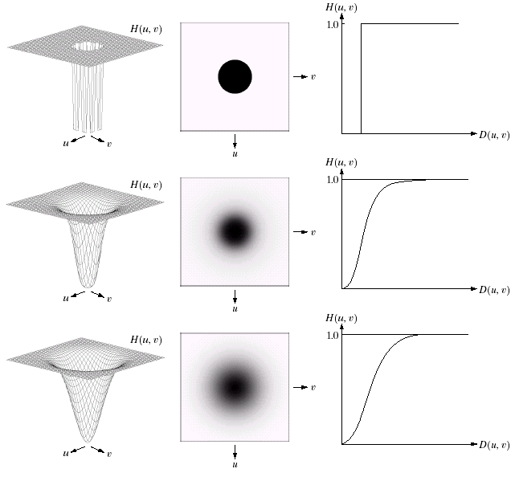
Relationship between Lowpass and Highpass Filters

Slide 25
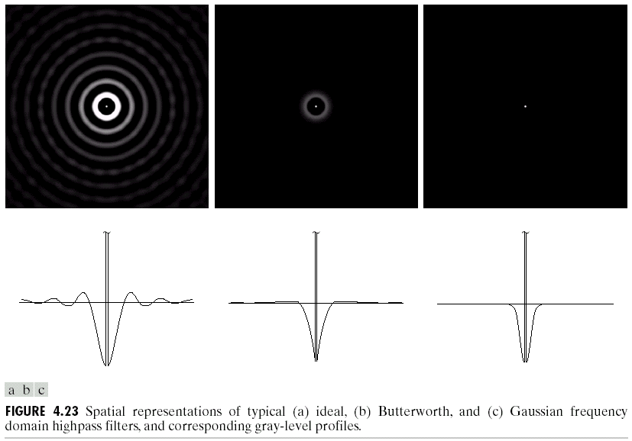
Spatial Domain Representation

Slide 26
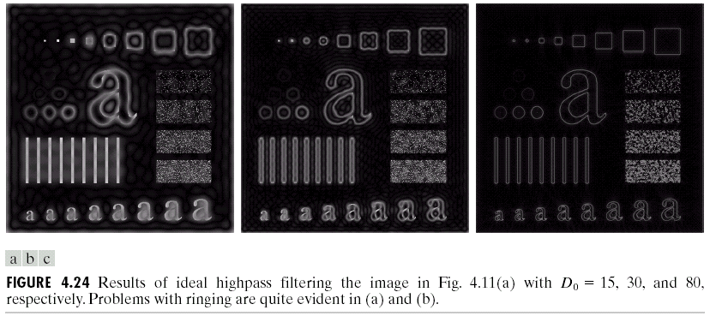
Ideal Highpass Example

Slide 27
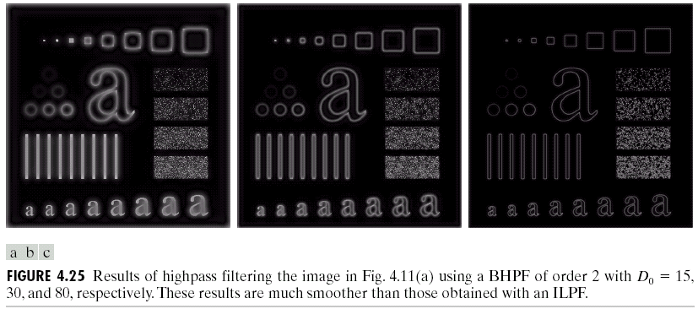
Butterworth Highpass Example

Slide 28
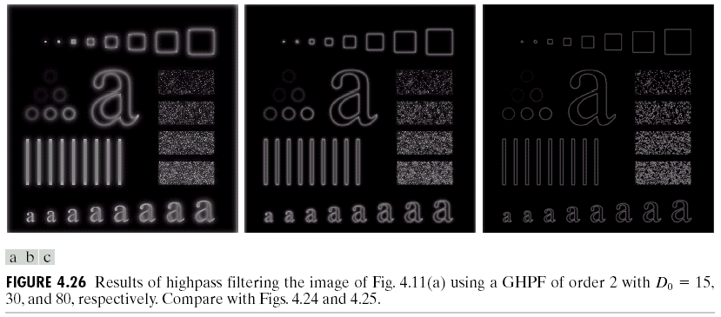
Gaussian Highpass Example

Slide 29
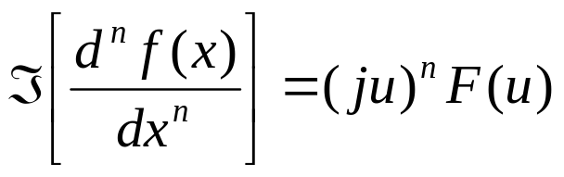
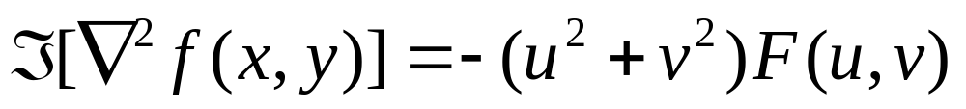
Laplacian in the Frequency Domain
It can be shown that:
Therefore,

Slide 30
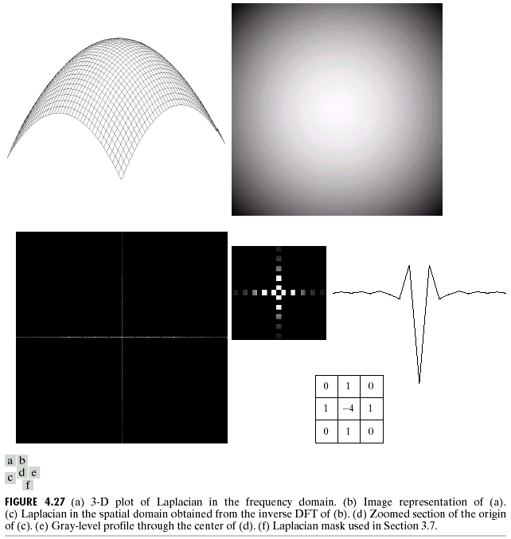
Illustration

Slide 31


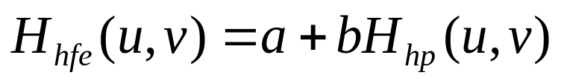
Other Filters
Unsharp masking:
High-boost filtering:
High-frequency emphasis filtering:

Slide 32
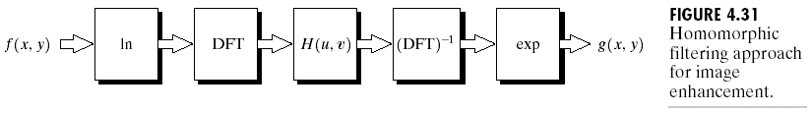
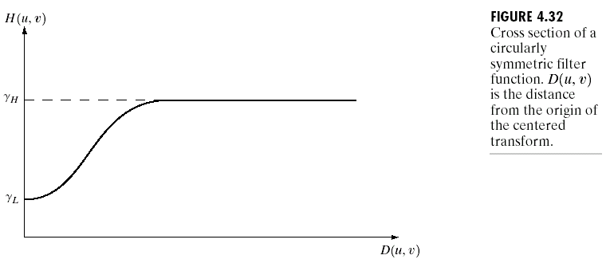
Homomorphic Filtering

Slide 33
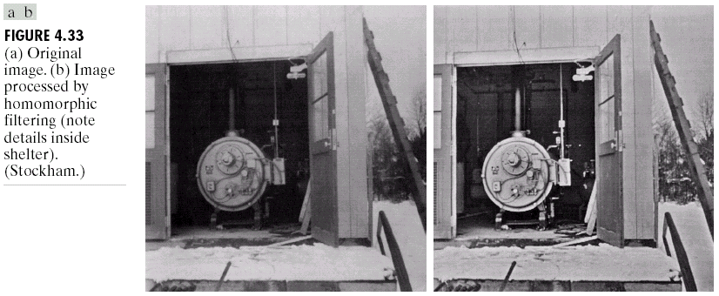
Example

Slide 34
DFT: Implementation Issues
Rotation
Periodicity and conjugate symmetry
Separability
Need for padding
Circular convolution
FFT
Notes:
Padding problems : if the img has bright spots on the edges adding a dark frame will show some non-existing sihloet

Slide 35
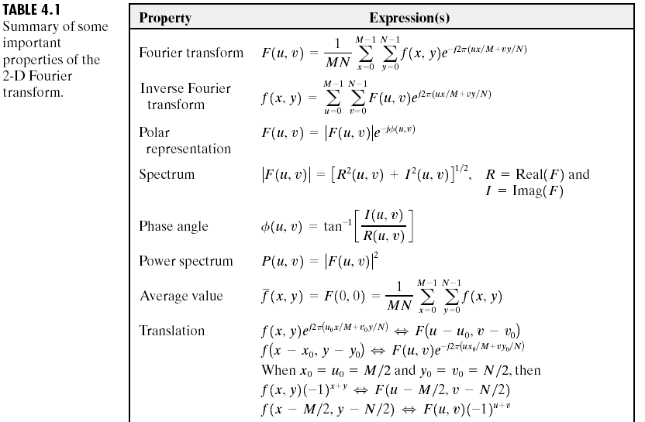
Properties of 2D FT (1)
Notes:
Translation 必考 考6個不是零
傅立葉shift and phase in domains
會以 sin cos 表達

Slide 36
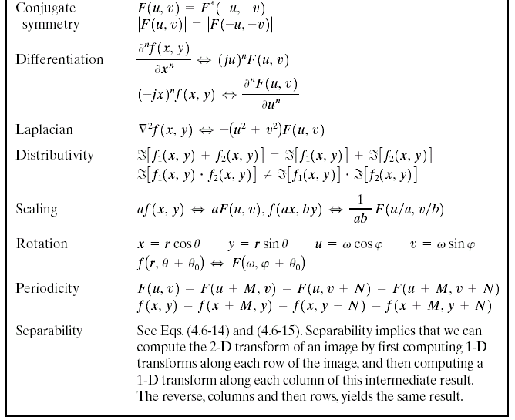
Properties of 2D FT (2)

Slide 37
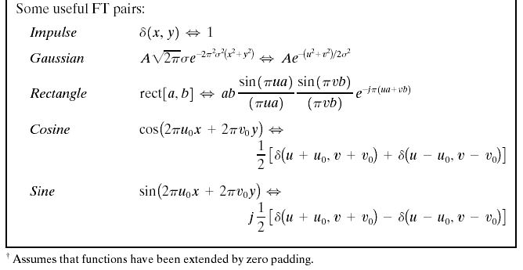
FT Pairs

