Slide 1
Camera Calibration

Slide 2
Camera Calibration
Issues:
  what are intrinsic parameters of the camera?
  what is the camera matrix? (intrinsic+extrinsic)
General strategy:
  view calibration object
  identify image points
  obtain camera matrix by minimizing error
  obtain intrinsic parameters from camera matrix

Slide 3
Error Minimization
  Linear least squares
    easy problem numerically
    solution can be rather bad
  Minimize image distance
    more difficult numerical problem
    solution usually rather good,
    start with linear least squares

Slide 4
Camera Parameters
Intrinsic parameters: relate the camera’s coordinate to the idealized coordinate system used in Chapter 1.
Extrinsic parameters: related the camera’s coordinate to a fixed world coordinate system and specify its position and orientation in space.

Slide 5
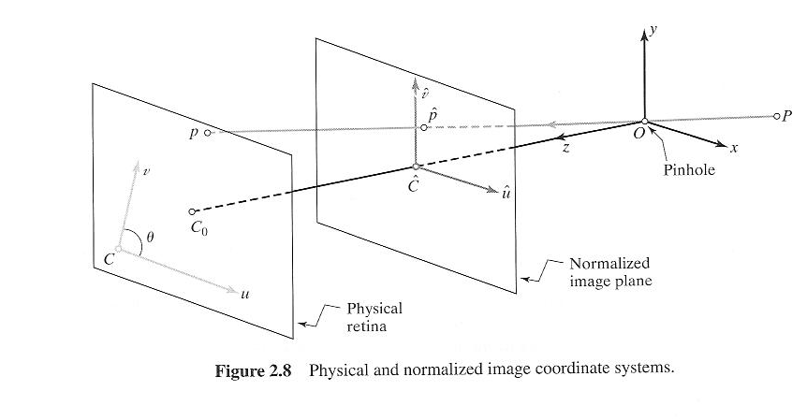
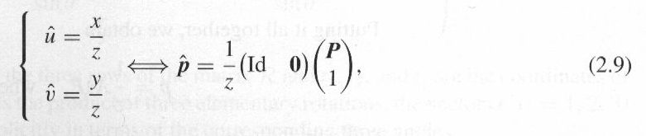
Intrinsic Parameters

Slide 6
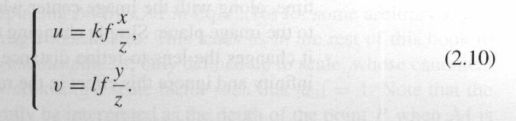
Intrinsic Parameters (cont’d)
The physical retina of the camera is located at a distance f!= 1 from the pin hole.
The image coordinates (u,v) of the image point p are usually expressed in pixels units (instead of, say, meters)
Pixels are normally rectangular instead of square
Thus:

Slide 7
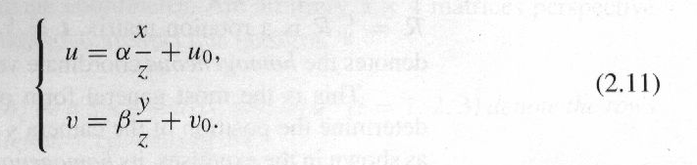
Intrinsic Parameters (cont’d)
The origin of the camera coordinate system is at a corner C of the retina (not at the center).
The center of the CCD matrix usually does not coincide with the principal point C₀.
Two parameters u₀, v₀ to define the position of C₀ in the retinal coordinate system.
Thus:
Notes:
Origin isn’t inline therefore add u0 and v0

Slide 8
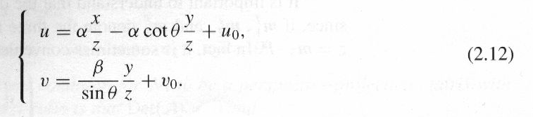
Intrinsic Parameters (cont’d)
Finally, the camera coordinate system may be skewed due to manufacturing error, so that angle θ between two image axes is not equal to 90º.

Slide 9
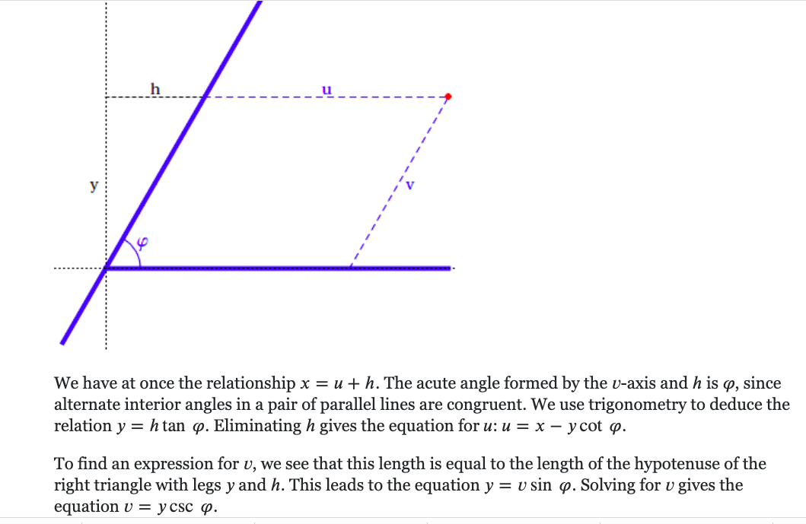

Slide 10
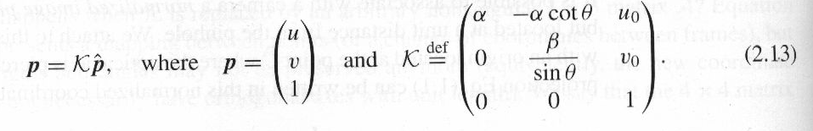
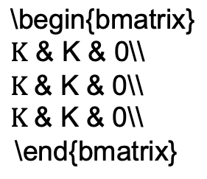

Intrinsic Parameters (cont’d)
Combining (2.9) and (2.12) results in:
P=(x,y,z,1)^{T} denotes the homogeneous coordinate vector of P in the camera coordinate system.
Five intrinsic parameters: u₀, v₀ , α, β, θ

Slide 11


Extrinsic Parameters
Camera frame (C), world frame (W)
Substituting in (2.14) yields:
P=(^{W}x, ^{W}y, ^{W}z,1)^{T} denotes the homogeneous coordinate vector of P in the frame W.

Slide 12
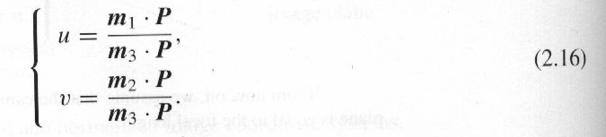
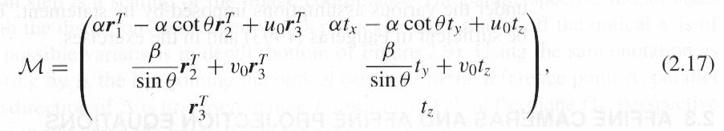
Camera Parameters
Let m₁^{T}, m₂^{T}, m₃^{T} denote the three rows of M, then z= m₃ ·P.
In addition,
5 intrinsic, 6 extrinsic parameters:

Slide 13
Characterization of the Perspective Projection Matrices
Write M=(A b)
A: 3x3 matrix, b in R³
Let a₃^{T} denote the 3rd row of A, then a₃^{T} must be a unit vector.
In (2.16), replace M by λM does not change the corresponding image coordinates ➔ homogeneous objects (define up to scale).
Notes:
M -> aM will not change the result of u and v => v = am1p/am3p = m1p/m3p

Slide 14
Perspective Projection Matrices
General perspective projection matrix:
Zero-skew: θ=90º.
Zero-skew and unit aspect ratio: θ=90º, α=β.
A camera with known non-zero skew and nonunit aspect ratio can be transformed into a camera with zero skew and unit aspect ratio.

Slide 15


Arbitrary 3x4 Matrix
Let M= (A b) be a 3x4 matrix, a_{i}^{T} (i=1,2,3) denote the rows of A.
A necessary and sufficient for M to be a perspective projection matrix is that Det(A)≠0.
A necessary and sufficient for M to be a zero-skew perspective projection matrix is that Det(A)≠0 and
A necessary and sufficient for M to be a perspective projection matrix with zero-skew and unit aspect ratio is that:

Slide 16
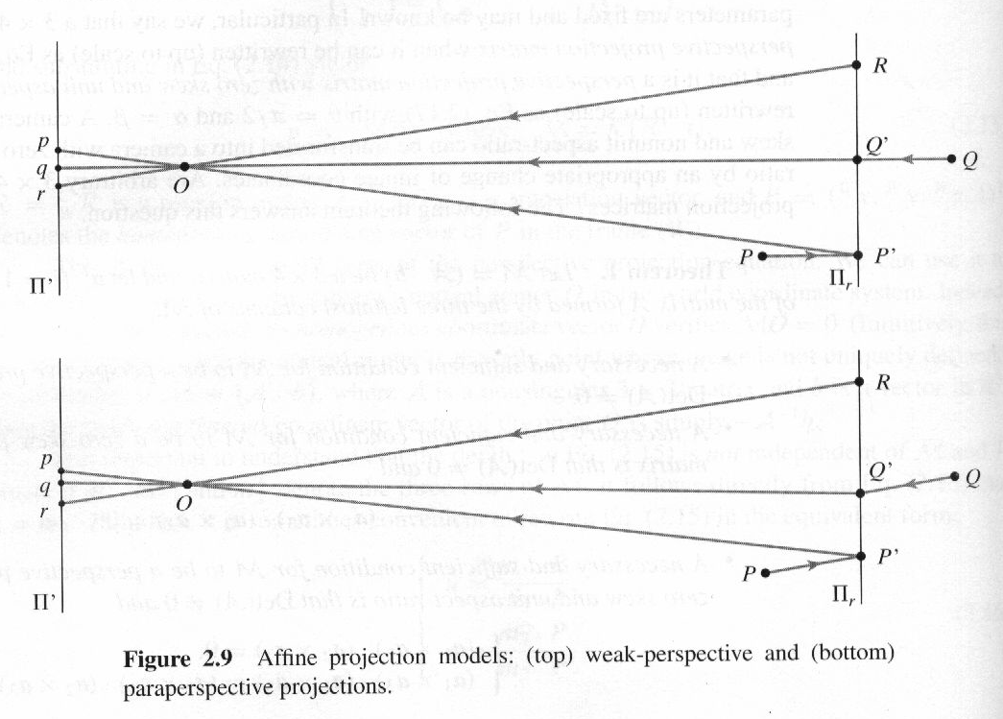
Affine Cameras
Weak prospective and orthographic projection.

Slide 17
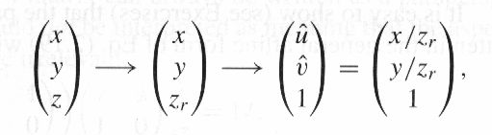
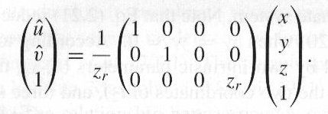
Affine Projection Equations
z_{r}: the depth of the reference point R.
or
Notes:
因爲 z 在固定距離所以去除 z 的 dependency => 不是 identity

Slide 18
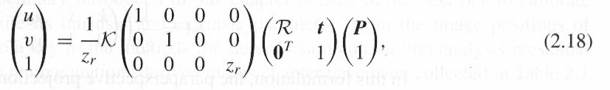
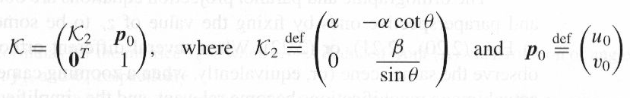

Affine Projection Equations (cont’d)
Introducing K, R and t gives:
Note that z_{r} is constant and
(2.18) becomes:

Slide 19
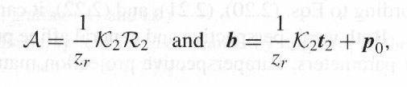

Affine Projection Equations (cont’d)
In weak perspective projection, we can take u₀=v₀=0
In addition, z_{r} is know a priori,
2 intrinsic parameters (k, s), five extrinsic parameters and one scene-dependent structure parameter z_{r}.

Slide 20
Geometric Camera Calibration
Least-squares parameter estimation
  Linear
  Non-linear

Slide 21

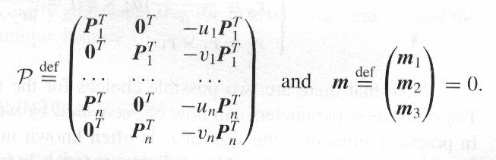
Camera Calibration
Estimation of the projection matrix
Or Pm =0 where
n>= 6 → at least 12 homogeneous equations

Slide 22
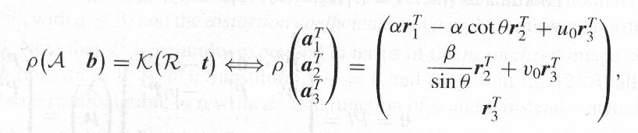
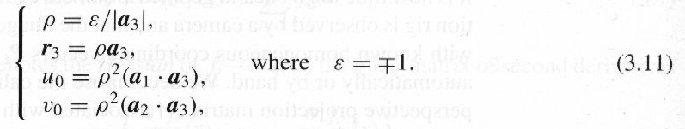
Camera Calibration (cont’d)
Estimation of the intrinsic and extrinsic parameters:
Notes:
r1, r2, r3 are orthogonal to each other

Slide 23
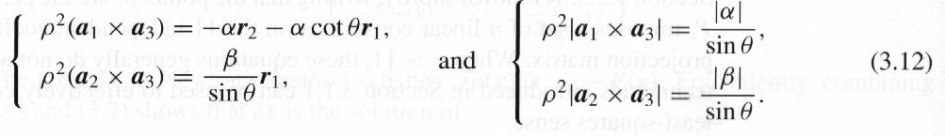
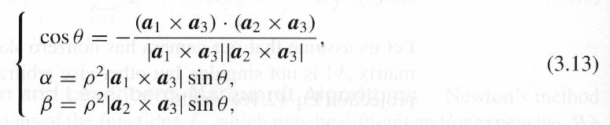
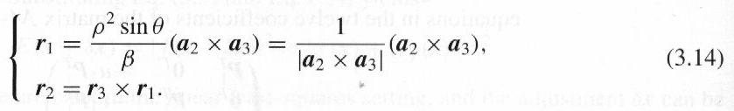
Camera Calibration (cont’d)

Slide 24
Complications
Taking radial distortion into account
Analytical photogrammetry

