Slide 1
Computer Science 101
Functions and Programs

Slide 2
Python Functions
A function is a piece of code that performs a task of some kind.
  A function has a name that is used when we need for the task to be executed. Asking that the task be executed is referred to as “calling” the function.
  Some functions need one or more pieces of input when they are called. Others do not.
  Some functions give back a value; others do not. If a function gives back a value, this is referred to as “returning” the value.

Slide 3
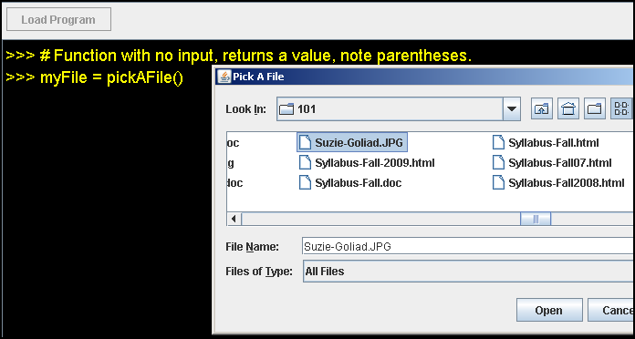
Python Session

Slide 4
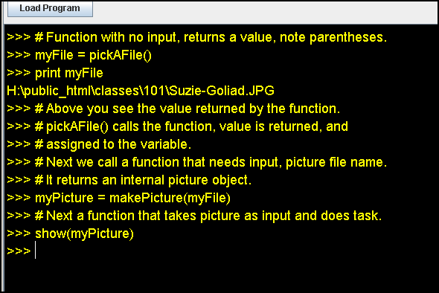
Python Session (cont.)

Slide 5
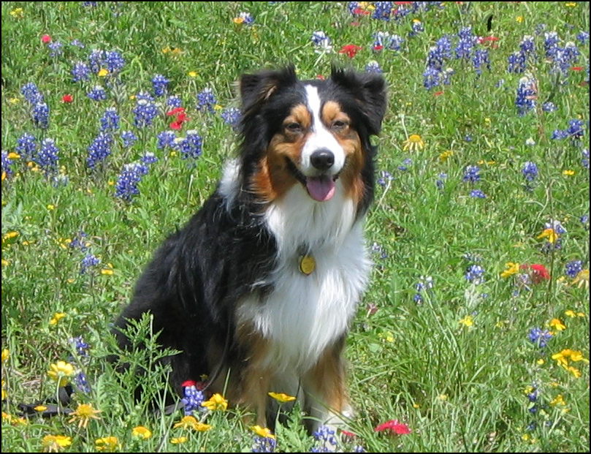
Good Ole Suzie

Slide 6
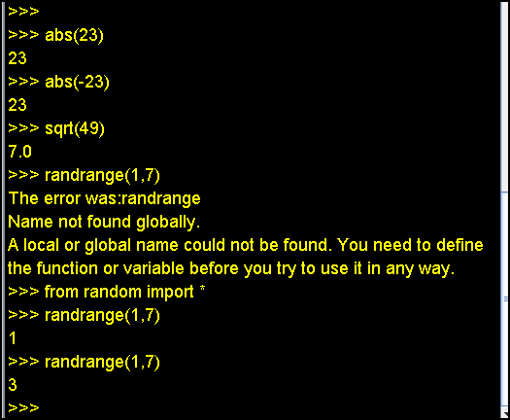
Python Session (cont.)

Slide 7
Defining Our Own Functions
No inputs, no values returned
def <function name> ():
<code to execute (indented)>
Note: <function name> would be replaced with the name of the function we’re defining.
Parentheses are required as is the colon.

Slide 8
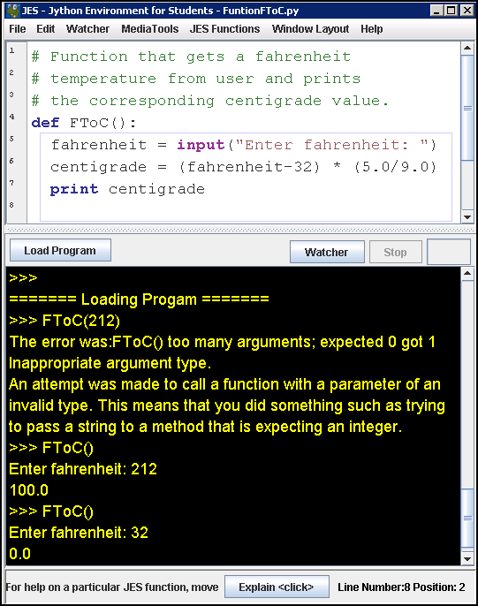

Slide 9
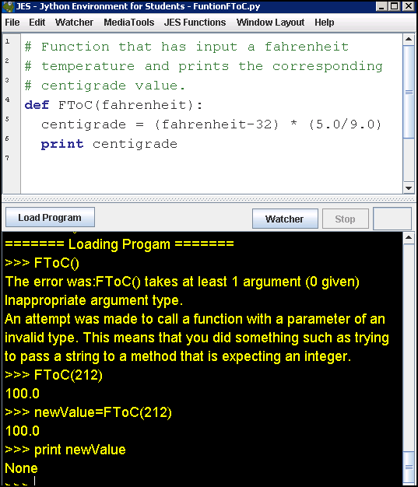

Slide 10
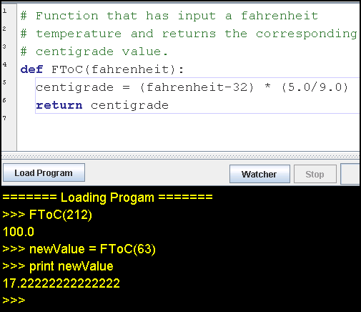

Slide 11
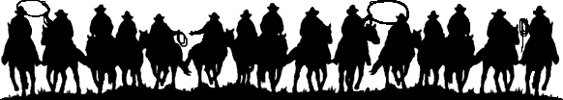
If a bullfrog had wings ...

