Slide 1
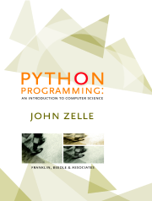
Python Programming:
An Introduction to
Computer Science
Chapter 6
Defining Functions

Slide 2
Objectives
To understand why programmers divide programs up into sets of cooperating functions.
To be able to define new functions in Python.
To understand the details of function calls and parameter passing in Python.

Slide 3
Objectives (cont.)
To write programs that use functions to reduce code duplication and increase program modularity.

Slide 4
The Function of Functions
So far, we’ve seen four different types of functions:
  Our programs comprise a single function called main().
  Built-in Python functions (abs)
  Functions from the standard libraries (math.sqrt)
  Functions from the graphics module (p.getX())

Slide 5
The Function of Functions
In the code on page 166, the code for drawing the bars occurs in two different places.
  The first bar is drawn immediately before the loop.
  The remaining bars are drawn within the loop.

Slide 6
The Function of Functions
Having similar or identical code in more than one place has some drawbacks.
  Issue one: writing the same code twice or more.
  Issue two: This same code must be maintained in two separate places.
Functions can be used to reduce code duplication and make programs more easily understood and maintained.

Slide 7
Functions, Informally
A function is like a subprogram, a small program inside of a program.
The basic idea – we write a sequence of statements and then give that sequence a name. We can then execute this sequence at any time by referring to the name.

Slide 8
Functions, Informally
The part of the program that creates a function is called a function definition.
When the function is used in a program, we say the definition is called or invoked.

Slide 9
Functions, Informally
Happy Birthday lyrics…
def main():
print "Happy birthday to you!"
print "Happy birthday to you!"
print "Happy birthday, dear Fred..."
print "Happy birthday to you!"
Gives us this…
>>> main()
Happy birthday to you!
Happy birthday to you!
Happy birthday, dear Fred...
Happy birthday to you!

Slide 10
Functions, Informally
There’s some duplicated code in the program! (print "Happy birthday to you!")
We can define a function to print out this line:
def happy():
print "Happy birthday to you!“
With this function, we can rewrite our program.

Slide 11
Functions, Informally
The new program –
def singFred():
happy()
happy()
print "Happy birthday, dear Fred...“
happy()
Gives us this output –
>>> singFred()
Happy birthday to you!
Happy birthday to you!
Happy birthday, dear Fred...
Happy birthday to you!

Slide 12
Functions, Informally
Creating this function saved us a lot of typing!
What if it’s Lucy’s birthday? We could write a new singLucy function!
def singLucy():
happy()
happy()
print "Happy birthday, dear Lucy...“
happy()

Slide 13
Functions, Informally
We could write a main program to sing to both Lucy and Fred
def main():
singFred()
print
singLucy()
This gives us this new output
>>> main()
Happy birthday to you!
Happy birthday to you!
Happy birthday, dear Fred..
Happy birthday to you!
Happy birthday to you!
Happy birthday to you!
Happy birthday, dear Lucy...
Happy birthday to you!

Slide 14
Functions, Informally
This is working great! But… there’s still a lot of code duplication.
The only difference between singFred and singLucy is the name in the third print statement.
These two routines could be collapsed together by using a parameter.

Slide 15
Functions, Informally
The generic function sing
def sing(person):
happy()
happy()
print "Happy birthday, dear", person + ".“
happy()
This function uses a parameter named person. A paramater is a variable that is initialized when the function is called.

Slide 16
Functions, Informally
Our new output –
>>> sing("Fred")
Happy birthday to you!
Happy birthday to you!
Happy birthday, dear Fred.
Happy birthday to you!
We can put together a new main program!

Slide 17
Functions, Informally
Our new main program:
def main():
sing("Fred")
print
sing("Lucy")
Gives us this output:
>>> main()
Happy birthday to you!
Happy birthday to you!
Happy birthday, dear Fred.
Happy birthday to you!
Happy birthday to you!
Happy birthday to you!
Happy birthday, dear Lucy.
Happy birthday to you!

Slide 18
Future Value with a Function
In the future value graphing program, we see similar code twice:
# Draw bar for initial principal
bar = Rectangle(Point(0, 0), Point(1, principal))
bar.setFill("green")
bar.setWidth(2)
bar.draw(win)
bar = Rectangle(Point(year, 0), Point(year+1, principal))
bar.setFill("green")
bar.setWidth(2)
bar.draw(win)

Slide 19
Future Value with a Function
To properly draw the bars, we need three pieces of information.
  The year the bar is for
  How tall the bar should be
  The window the bar will be drawn in
These three values can be supplied as parameters to the function.

Slide 20
Future Value with a Function
The resulting function looks like this:
def drawBar(window, year, height):
# Draw a bar in window starting at year with given height
bar = Rectangle(Point(year, 0), Point(year+1, height))
bar.setFill("green")
bar.setWidth(2)
bar.draw(window)
To use this function, we supply the three values. If win is a Graphwin, we can draw a bar for year 0 and principal of $2000 using this call:
drawBar(win, 0, 2000)

Slide 21
Functions and Parameters: The Details
It makes sense to include the year and the principal in the drawBar function, but why send the window variable?
The scope of a variable refers to the places in a program a given variable can be referenced.

Slide 22
Functions and Parameters: The Details
Each function is its own little subprogram. The variables used inside of one function are local to that function, even if they happen to have the same name as variables that appear inside of another function.
The only way for a function to see a variable from another function is for that variable to be passed as a parameter.

Slide 23
Functions and Parameters: The Details
Since the GraphWin in the variable win is created inside of main, it is not directly accessible in drawBar.
The window parameter in drawBar gets assigned the value of win from main when drawBar is called.

Slide 24
Functions and Parameters: The Details
A function definition looks like this:
def <name>(<formal-parameters>):
<body>
The name of the function must be an identifier
Formal-parameters is a possibly empty list of variable names

Slide 25
Functions and Parameters: The Details
Formal parameters, like all variables used in the function, are only accessible in the body of the function. Variables with identical names elsewhere in the program are distinct from the formal parameters and variables inside of the function body.

Slide 26
Functions and Parameters: The Details
A function is called by using its name followed by a list of actual parameters or arguments.
<name>(<actual-parameters>)
When Python comes to a function call, it initiates a four-step process.

Slide 27
Functions and Parameters: The Details
  The calling program suspends execution at the point of the call.
  The formal parameters of the function get assigned the values supplied by the actual parameters in the call.
  The body of the function is executed.
  Control returns to the point just after where the function was called.

Slide 28
Functions and Parameters: The Details
Let’s trace through the following code:
sing(“Fred”)
print
sing(“Lucy”)
When Python gets to sing(“Fred”), execution of main is temporarily suspended.
Python looks up the definition of sing and sees that it has one formal parameter, person.

Slide 29
Functions and Parameters: The Detail
The formal parameter is assigned the value of the actual parameter. It’s as if the following statement had been executed:
person = “Fred”

Slide 30
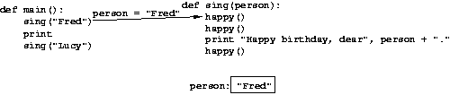
Functions and Parameters: The Details
Note that the variable person has just
been initialized.

Slide 31
Functions and Parameters: The Details
At this point, Python begins executing the body of sing.
The first statement is another function call, to happy. What happens next?
Python suspends the execution of sing and transfers control to happy.
happy consists of a single print, which is executed and control returns to where it left off in sing.

Slide 32
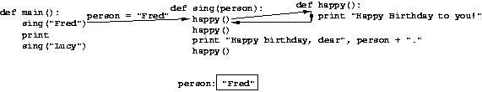
Functions and Parameters: The Details
Execution continues in this way with two more trips to happy.
When Python gets to the end of sing, control returns to main and continues immediately following the function call.

Slide 33

Functions and Parameters: The Details
Notice that the person variable in sing has disappeared!
The memory occupied by local function variables is reclaimed when the function exits.
Local variables do not retain any values from one function execution to the next.

Slide 34
Functions and Parameters: The Details
The next statement is the bare print, which produces a blank line.
Python encounters another call to sing, and control transfers to the sing function, with the formal parameter “Lucy”.

Slide 35
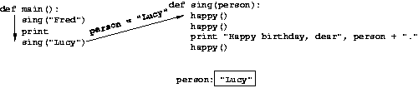
Functions and Parameters: The Details
The body of sing is executed for Lucy with its three side trips to happy and control returns to main.

Slide 36

Functions and Parameters: The Details

Slide 37
Functions and Paramters: The Details
One thing not addressed in this example was multiple parameters. In this case the formal and actual parameters are matched up based on position, e.g. the first actual parameter is assigned to the first formal parameter, the second actual parameter is assigned to the second formal parameter, etc.

Slide 38
Functions and Parameters: The Details
As an example, consider the call to drawBar:
drawBar(win, 0, principal)
When control is passed to drawBar, these parameters are matched up to the formal parameters in the function heading:
def drawBar(window, year, height):

Slide 39
Functions and Parameters: The Details
The net effect is as if the function body had been prefaced with three assignment statements:
window = win
year = 0
height = principal

Slide 40
Getting Results from a Function
Passing parameters provides a mechanism for initializing the variables in a function.
Parameters act as inputs to a function.
We can call a function many times and get different results by changing its parameters.

Slide 41
Functions That Return Values
We’ve already seen numerous examples of functions that return values to the caller.
discRt = math.sqrt(b*b – 4*a*c)
The value b*b – 4*a*c is the actual parameter of math.sqrt.
We say sqrt returns the square root of its argument.

Slide 42
Functions That Return Values
This function returns the square of a number:
def square(x):
return x*x
When Python encounters return, it exits the function and returns control to the point where the function was called.
In addition, the value(s) provided in the return statement are sent back to the caller as an expression result.

Slide 43
Functions That Return Values
>>> square(3)
9
>>> print square(4)
16
>>> x = 5
>>> y = square(x)
>>> print y
25
>>> print square(x) + square(3)
34

Slide 44
Functions That Return Values
We can use the square function to write a routine to calculate the distance between (x₁,y₁) and (x₂,y₂).
def distance(p1, p2):
dist = math.sqrt(square(p2.getX() - p1.getX()) + square(p2.getY() - p1.getY()))
return dist

Slide 45
Functions That Return Values
Sometimes a function needs to return more than one value.
To do this, simply list more than one expression in the return statement.
def sumDiff(x, y):
sum = x + y
diff = x – y
return sum, diff

Slide 46
Functions That Return Values
When calling this function, use simultaneous assignment.
num1, num2 = input("Please enter two numbers (num1, num2) ")
s, d = sumDiff(num1, num2)
print "The sum is", s, "and the difference is", d
As before, the values are assigned based on position, so s gets the first value returned (the sum), and d gets the second (the difference).

Slide 47
Functions That Return Values
One “gotcha” – all Python functions return a value, whether they contain a return statement or not. Functions without a return hand back a special object, denoted None.
A common problem is writing a value-returning function and omitting the return!

Slide 48
Functions That Return Values
If your value-returning functions produce strange messages, check to make sure you remembered to include the return!

Slide 49
Functions that Modify Parameters
Return values are the main way to send information from a function back to the caller.
Sometimes, we can communicate back to the caller by making changes to the function parameters.
Understanding when and how this is possible requires the mastery of some subtle details about how assignment works and the relationship between actual and formal parameters.

Slide 50
Functions that Modify Parameters
Suppose you are writing a program that manages bank accounts. One function we would need to do is to accumulate interest on the account. Let’s look at a first-cut at the function.
def addInterest(balance, rate):
newBalance = balance * (1 + rate)
balance = newBalance

Slide 51
Functions that Modify Parameters
The intent is to set the balance of the account to a new value that includes the interest amount.
Let’s write a main program to test this:
def test():
amount = 1000
rate = 0.05
addInterest(amount, rate)
print amount

Slide 52
Functions that Modify Parameters
We hope that that the 5% will be added to the amount, returning 1050.
>>> test()
1000
What went wrong? Nothing!

Slide 53
Functions that Modify Parameters
The first two lines of the test function create two local variables called amount and rate which are given the initial values of 1000 and 0.05, respectively.
def addInterest(balance, rate):
newBalance = balance * (1 + rate)
balance = newBalance
def test():
amount = 1000
rate = 0.05
addInterest(amount, rate)
print amount

Slide 54
Functions that Modify Parameters
Control then transfers to the addInterest function.
The formal parameters balance and rate are assigned the values of the actual parameters amount and rate.
Even though rate appears in both, they are separate variables (because of scope rules).
def addInterest(balance, rate):
newBalance = balance * (1 + rate)
balance = newBalance
def test():
amount = 1000
rate = 0.05
addInterest(amount, rate)
print amount

Slide 55
Functions that Modify Parameters
The assignment of the parameters causes the variables balance and rate in addInterest to refer to the values of the actual parameters!
def addInterest(balance, rate):
newBalance = balance * (1 + rate)
balance = newBalance
def test():
amount = 1000
rate = 0.05
addInterest(amount, rate)
print amount

Slide 56
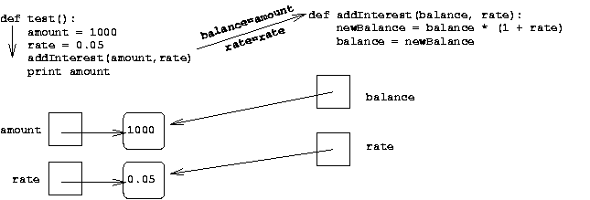
Functions that Modify Parameters

Slide 57
Functions that Modify Parameters
Executing the first line of addInterest creates a new variable, newBalance.
balance is then assigned the value of newBalance.
def addInterest(balance, rate):
newBalance = balance * (1 + rate)
balance = newBalance
def test():
amount = 1000
rate = 0.05
addInterest(amount, rate)
print amount

Slide 58
Functions that Modify Parameters
balance now refers to the same value as newBalance, but this had no effect on amount in the test function.
def addInterest(balance, rate):
newBalance = balance * (1 + rate)
balance = newBalance
def test():
amount = 1000
rate = 0.05
addInterest(amount, rate)
print amount

Slide 59
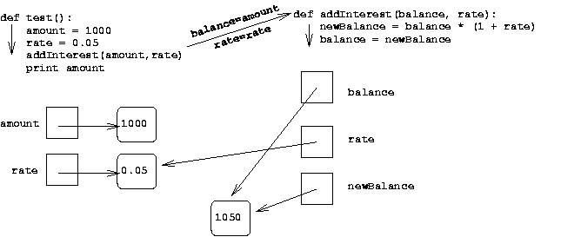
Functions that Modify Parameters

Slide 60
Functions that Modify Parameters
Execution of addInterest has completed and control returns to test.
The local variables, including the parameters, in addInterest go away, but amount and rate in the test function still refer to their initial values!
def addInterest(balance, rate):
newBalance = balance * (1 + rate)
balance = newBalance
def test():
amount = 1000
rate = 0.05
addInterest(amount, rate)
print amount

Slide 61
Functions that Modify Parameters
To summarize: the formal parameters of a function only receive the values of the actual parameters. The function does not have access to the variable that holds the actual parameter.
Python is said to pass all parameters by value.

Slide 62
Functions that Modify Parameters
Some programming languages (C++, Ada, and many more) do allow variables themselves to be sent as parameters to a function. This mechanism is said to pass parameters by reference.
When a new value is assigned to the formal parameter, the value of the variable in the calling program actually changes.

Slide 63
Functions that Modify Parameters
Since Python doesn’t have this capability, one alternative would be to change the addInterest function so that it returns the newBalance.

Slide 64
Functions that Modify Parameters
def addInterest(balance, rate):
newBalance = balance * (1 + rate)
return newBalance
def test():
amount = 1000
rate = 0.05
amount = addInterest(amount, rate)
print amount
test()

Slide 65
Functions that Modify Parameters
Instead of looking at a single account, say we are writing a program for a bank that deals with many accounts. We could store the account balances in a list, then add the accrued interest to each of the balances in the list.
We could update the first balance in the list with code like:
balances[0] = balances[0] * (1 + rate)

Slide 66
Functions that Modify Parameters
This code says, “multiply the value in the 0th position of the list by (1 + rate) and store the result back into the 0th position of the list.”
A more general way to do this would be with a loop that goes through positions 0, 1, …, length – 1.

Slide 67
Functions that Modify Parameters
# addinterest3.py
# Illustrates modification of a mutable parameter (a list).
def addInterest(balances, rate):
for i in range(len(balances)):
balances[i] = balances[i] * (1+rate)
def test():
amounts = [1000, 2200, 800, 360]
rate = 0.05
addInterest(amounts, 0.05)
print amounts
test()

Slide 68
Functions that Modify Parameters
Remember, our original code had these values:
[1000, 2200, 800, 360]
The program returns:
[1050.0, 2310.0, 840.0, 378.0]
What happened? Python passes parameters by value, but it looks like amounts has been changed!

Slide 69
Functions that Modify Parameters
The first two lines of test create the variables amounts and rate.
The value of the variable amounts is a list object that contains four int values.
def addInterest(balances, rate):
for i in range(len(balances)):
balances[i] = balances[i] * (1+rate)
def test():
amounts = [1000, 2200, 800, 360]
rate = 0.05
addInterest(amounts, 0.05)
print amounts

Slide 70
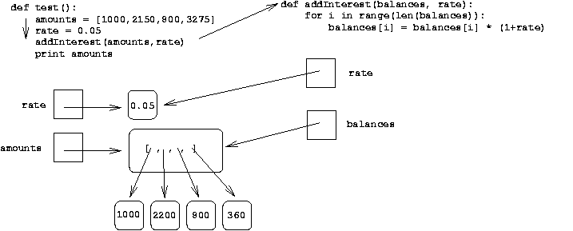
Functions that Modify Parameters

Slide 71
Functions that Modify Parameters
Next, addInterest executes. The loop goes through each index in the range 0, 1, …, length –1 and updates that value in balances.
def addInterest(balances, rate):
for i in range(len(balances)):
balances[i] = balances[i] * (1+rate)
def test():
amounts = [1000, 2200, 800, 360]
rate = 0.05
addInterest(amounts, 0.05)
print amounts

Slide 72
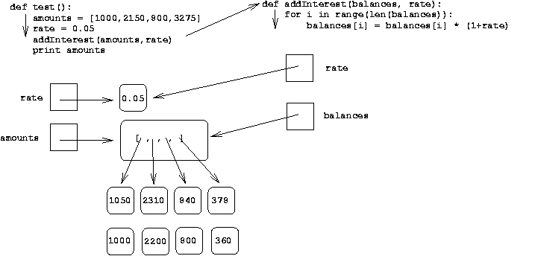
Functions that Modify Parameters

Slide 73
Functions that Modify Parameters
In the diagram the old values are left hanging around to emphasize that the numbers in the boxes have not changed, but the new values were created and assigned into the list.
The old values will be destroyed during garbage collection.
def addInterest(balances, rate):
for i in range(len(balances)):
balances[i] = balances[i] * (1+rate)
def test():
amounts = [1000, 2200, 800, 360]
rate = 0.05
addInterest(amounts, 0.05)
print amounts

Slide 74
Functions that Modify Parameters
When addInterest terminates, the list stored in amounts now contains the new values.
The variable amounts wasn’t changed (it’s still a list), but the state of that list has changed, and this change is visible to the calling program.

Slide 75
Functions that Modify Parameters
Parameters are always passed by value. However, if the value of the variable is a mutable object (like a list of graphics object), then changes to the state of the object will be visible to the calling program.
This situation is another example of the aliasing issue discussed in Chapter 5!

Slide 76
Functions and Program Structure
So far, functions have been used as a mechanism for reducing code duplication.
Another reason to use functions is to make your programs more modular.
As the algorithms you design get increasingly complex, it gets more and more difficult to make sense out of the programs.

Slide 77
Functions and Program Structure
One way to deal with this complexity is to break an algorithm down into smaller subprograms, each of which makes sense on its own.
This topic will be discussed in more detail in Chapter 9.

Slide 78
Functions and Program Structure
def main():
# Introduction
print "This program plots the growth of a 10 year investment."
# Get principal and interest rate
principal = input("Enter the initial principal: ")
apr = input("Enter the annualized interest rate: ")
# Create a graphics window with labels on left edge
win = GraphWin("Investment Growth Chart", 320, 240)
win.setBackground("white")
win.setCoords(-1.75,-200, 11.5, 10400)
Text(Point(-1, 0), ' 0.0K').draw(win)
Text(Point(-1, 2500), ' 2.5K').draw(win)
Text(Point(-1, 5000), ' 5.0K').draw(win)
Text(Point(-1, 7500), ' 7.5k').draw(win)
Text(Point(-1, 10000), '10.0K').draw(win)
# Draw bar for initial principal
drawBar(win, 0, principal)
# Draw a bar for each subsequent year
for year in range(1, 11):
principal = principal * (1 + apr)
drawBar(win, year, principal)
raw_input("Press <Enter> to quit.")
win.close()

Slide 79
Functions and Program Structure
We can make this program more readable by moving the middle eight lines that create the window where the chart will be drawn into a value returning function.

Slide 80
Functions and Program Structure
def createLabeledWindow():
window = GraphWin("Investment Growth Chart", 320, 240)
window.setBackground("white")
window.setCoords(-1.75,-200, 11.5, 10400)
Text(Point(-1, 0), ' 0.0K').draw(window)
Text(Point(-1, 2500), ' 2.5K').draw(window)
Text(Point(-1, 5000), ' 5.0K').draw(window)
Text(Point(-1, 7500), ' 7.5k').draw(window)
Text(Point(-1, 10000), '10.0K').draw(window)
return window
def main():
print "This program plots the growth of a 10 year investment."
principal = input("Enter the initial principal: ")
apr = input("Enter the annualized interest rate: ")
win = createLabeledWindow()
drawBar(win, 0, principal)
for year in range(1, 11):
principal = principal * (1 + apr)
drawBar(win, year, principal)
raw_input("Press <Enter> to quit.")
win.close()

