Slide 1
Demo Scripts
app_spis_tool.py

Slide 2
Introduce
Implemented by Python
Platform
Windows PC with FT4222H
For receiving data from WiseEye devices
JPG: the captured image
Metadata: the detection result

Slide 3
app_spis_tool.py
Receiving data through SPI interface
WiseEye: SPI Master
Windows PC: SPI Slave

Slide 4
app_spis_tool.py
Architecture
Application Layer
app_spis_tool.py
The major scripts for WiseEye demostration
Middle Layer
hmx_meta_data_format.py
hmx_spi_slave_commands.py
Providing GetJpeg, GetMetaData commands for application layer
logger.py
hmx_utils.py
hmx_spi_slave_packet_handlers.py
Collect and Parsing data from SPI Slave Interface
spi.py
Hardware Abstraction Layer
FT4222H

Slide 5
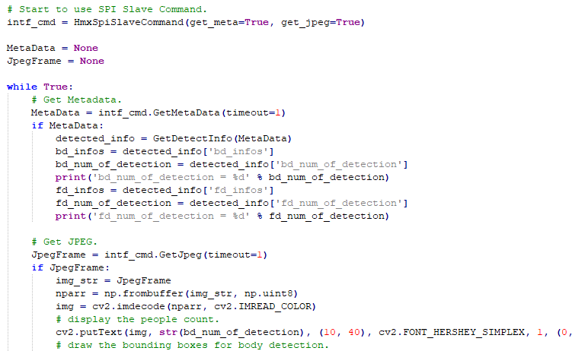
app_spis_tool.py
Specify SPI Slave to be the interface for receiving data from WiseEye.
Receiving Data Types: Metadata, JPEG
A loop for keeping to get Metadata and JPEG from WiseEye
Get Metadata
Parsing binary Metadata to python dictionary
Get JPEG
Decode JPEG to image buffer
Draw the BD number to the image buffer

Slide 6
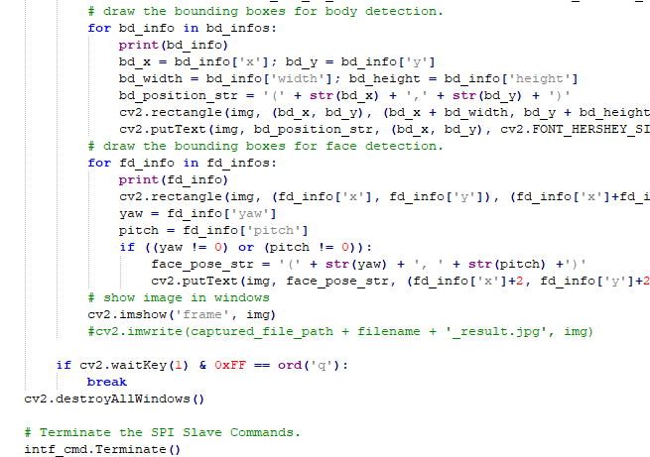
app_spis_tool.py
Drawing all the bounding boxes for body detection
The bounding box(x, y, w, h) of a detected human body
Draw the bounding box to the image buffer
Draw the position of the detected human body to the image buffer
Drawing all the bounding boxes for face detection
Draw the bounding box to the image buffer
Draw the yaw and pitch information for the face
Display the image buffer to display Window
If press the ‘q’ key, leave the loop and terminate the tool.

Slide 7
detected_info
{'human_presence':human_presence, 'bd_num_of_detection':bd_num_of_detection, 'bd_infos':bd_infos, 'fd_num_of_detection':fd_num_of_detection, 'fd_infos':fd_infos}
human_presence
Indicates if human presence or not.
bd_num_of_detection
The number of detected human body.
fd_num_of_detection
The number of detected human body.
bd_infos
The list of bd_info
{'x':x, 'y':y, 'width':width, 'height':height, 'score':score}
fd_infos
The list of fd_info
{'x':x, 'y':y, 'width':width, 'height':height, 'score':score, 'yaw':face_yaw, 'pitch':face_pitch}

Slide 8
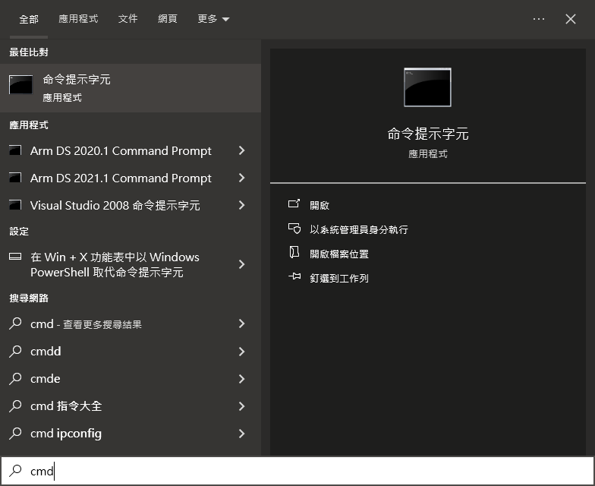
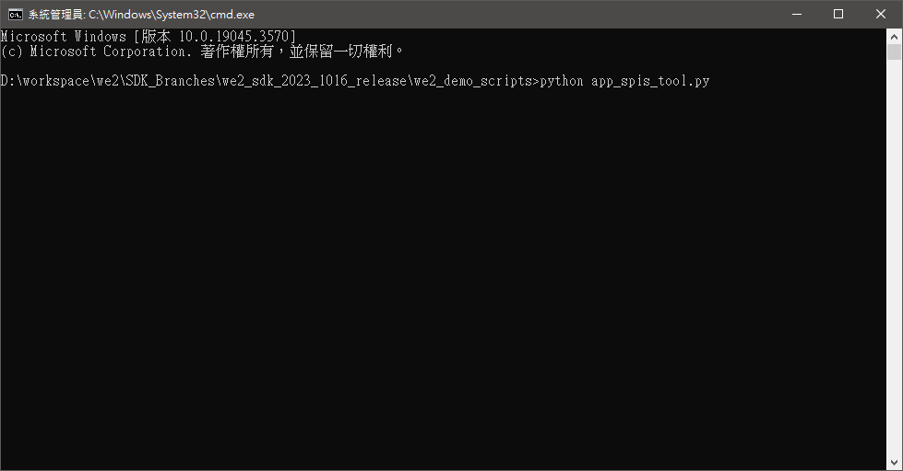
Usage 1. cmd.exe
Execute cmd
Change to the demo scripts folder
Enter the following command
python app_spis_tool.py

Slide 9
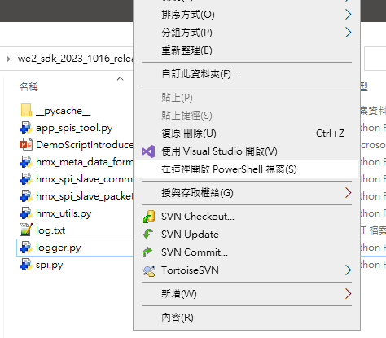
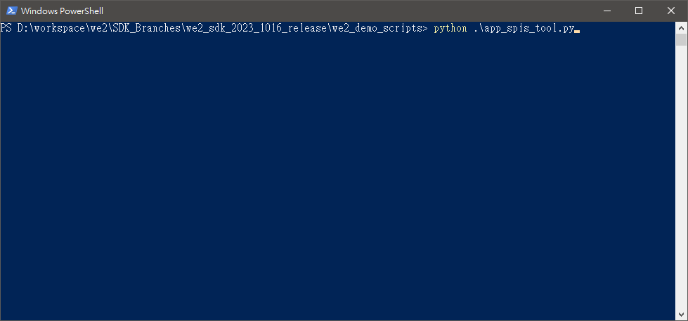
Usage 2. Windows Power Shell
Press ‘shift’ key and click the left button of mouse to pop up the menu window.
Click ‘Execute PowerShell Window’
Execute the following command in the Windows PowerShell
python .\app_spis_tool.py

Slide 10
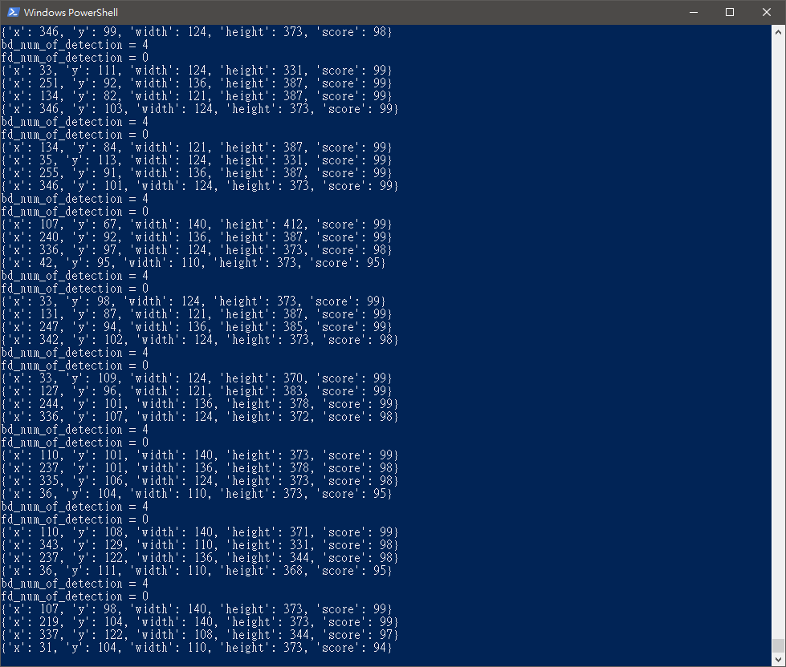
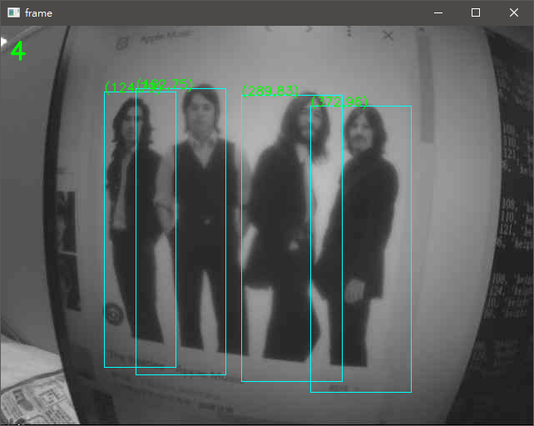
Example
WE2 SDK
YoloFastest BD

Slide 11
Q&A

